Slide 1

KIRA BLACKWELL, DAVE ISRAEL, VIR THANVI
March 4, 2021
Notes:
ANIMATED

Slide 2
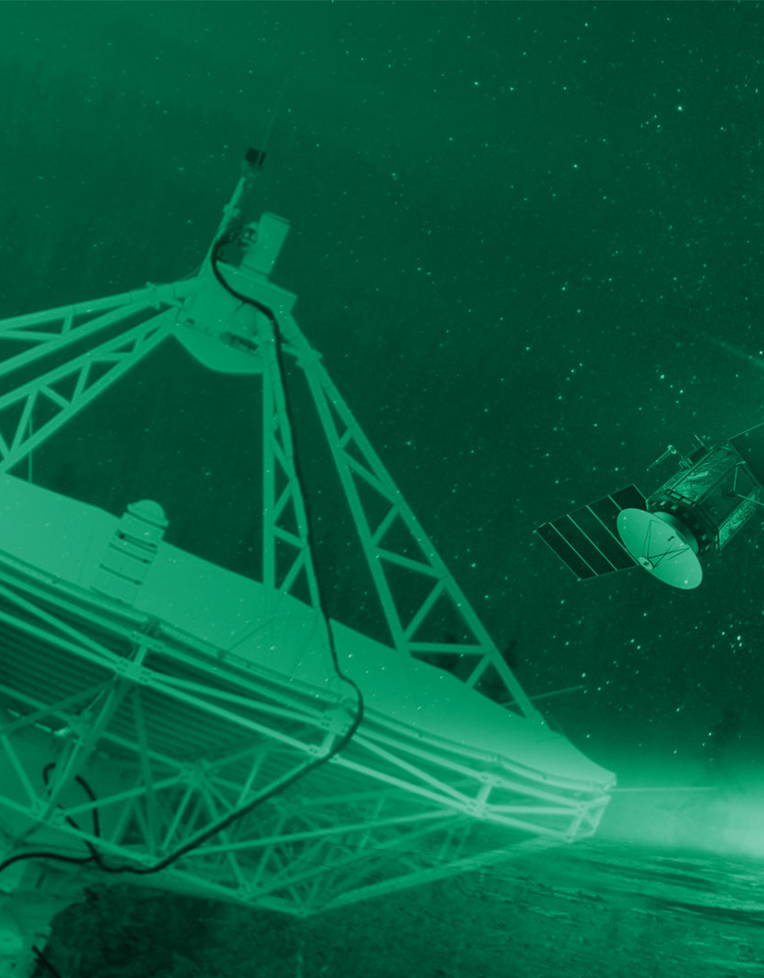

Today’s Agenda
1:00 - 1:05 pm
CIS Introduction
Kira Blackwell
DTE Capabilities Overview
Vir Thanvi
NASA’s DTE & LUNAR Architecture
Dave Israel
Q & A
1:05 - 1:20 pm
1:20 - 1:35 pm
1:35 - 2:00 pm

Slide 3
Kira Blackwell
Industry Engagement Manager

Slide 4

Thank you for attending NASA’s first-ever OneLink Session. During the event you will learn about the Near Space Network, the changes NASA has made to network architecture, the Commercialization, Innovation, and Synergies (CIS) office, and our goals for fostering industry partnerships.
By attending today’s OneLink Session, companies will be invited to UpLink Sessions from March 8-12, 2021. These sessions are deeper, one-on-one meetings with the CIS office and NASA leadership to learn more about each company’s capabilities.

Slide 5
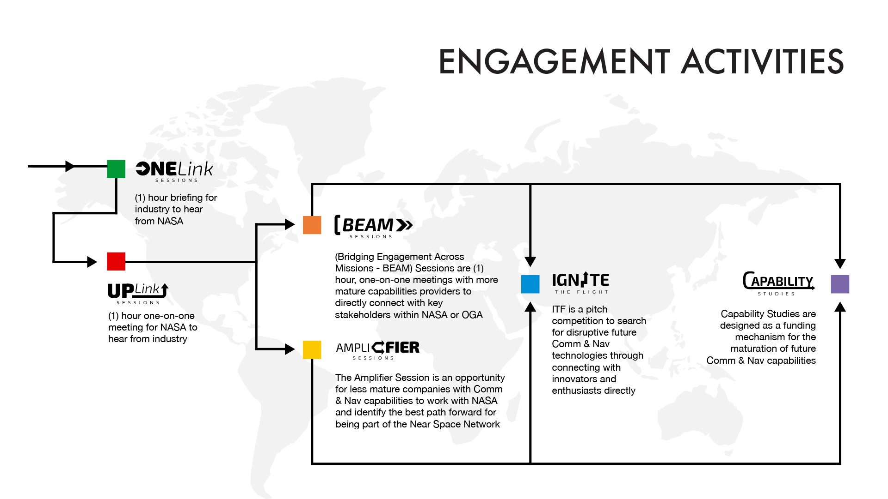
Industry Engagement Activities

Slide 6
Vir Thanvi
Near Space Network (NSN) Project Manager

Slide 7



Our Domain
Near Space: the volume of space from the Earth’s surface to 2,000,000 kilometers
Earth Proximity Region: a subset of near space; the volume from Earth’s surface to GEO (36,000 km) and the initial focus of service commercialization
Deep Space: volume of space starting at 2,000,000 km from Earth’s surface and proceeding out into the solar system and beyond and supported by the Deep Space Network
 | FY20 | FY25 Projections
Number of Earth Proximity Missions | 43 missions | 62 missions
Number of HEO Missions | 5 missions | 4 missions
Number of Lunar Missions | 3 missions | 5 missions
Number of SEL1/2 Missions | 2 missions | 3 missions
Frequency Bands | S, X, Ku, Ka | S, X, Ku, Ka, Optical (Infrared)
Data Rates (DTE) | Up to 3.5 Gbps | Up to 3.5 Gbps
Data Rates (Earth Relay) | Up to 1.2 Gbps | Up to 1.2 Gbps
Data Rates (Lunar Relay) | N/A | Up to 100 Mbps
Space Internetworking Services | N/A | Delay/Disruption Tolerant Networking (DTN)
SEL1
HEO
Lunar
SEL2
L1
L2
Earth Proximity: GEO and Below
7
Not Drawn to Scale

Slide 8
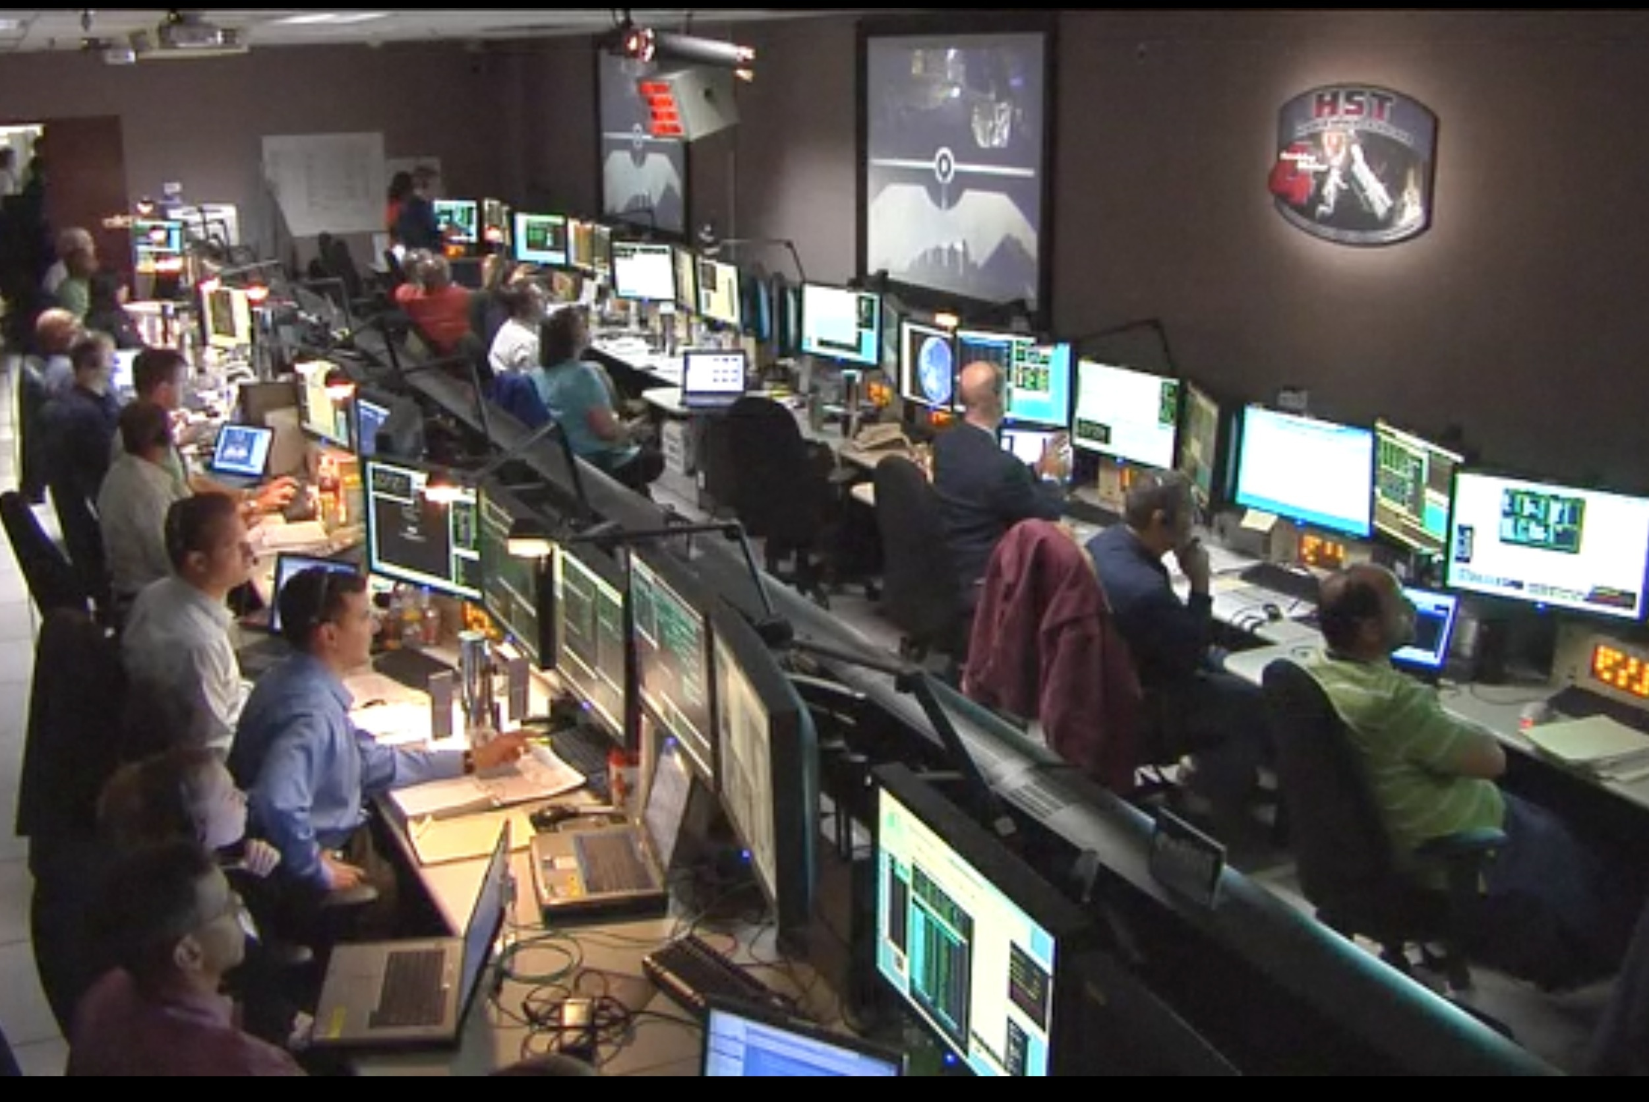

What We Do
The Near Space Network empowers diverse missions up to two million kilometers away with communications and navigation services.
We connect customer missions to essential communications and navigation services.
We alleviate the need for users to do in-depth background research on which services or service providers best fit their mission.
We provide trusted and time-tested expertise to missions as they formulate, design, launch, and operate their missions.
We utilize government and commercial assets to achieve user goals through the entire mission lifecycle.
Near Space Network
NASA Network Assets
Commercial 1 Network Assets
Commercial N Network Assets

Slide 9

2020 Snapshot
Commercial Crew Program
SpaceX DM-2
Commercial Crew Program
SpaceX DM-2
SpaceX DM-2 Mission
2
Million Direct-to-Earth
Service Minutes
10
Million Space Relay
Service Minutes
16
Launches
Supported
9

Slide 10
Architecture Overview
The Near Space Network synthesizes both government and commercial service providers into a comprehensive network of services for missions. These include space link providers (SLPs) and terrestrial link providers (TLPs).
SLPs fulfill their service through direct-to-Earth (DTE) connections via a robust arrangement of ground stations worldwide and space relay services through multiple generations of relay satellites.
Terrestrial link providers (TLP) transmit data from ground stations to users and mission operations centers across the U.S. and globally.
Near Space Network
NASA Network Assets
Commercial 1 Network Assets
Commercial N Network Assets

Slide 11
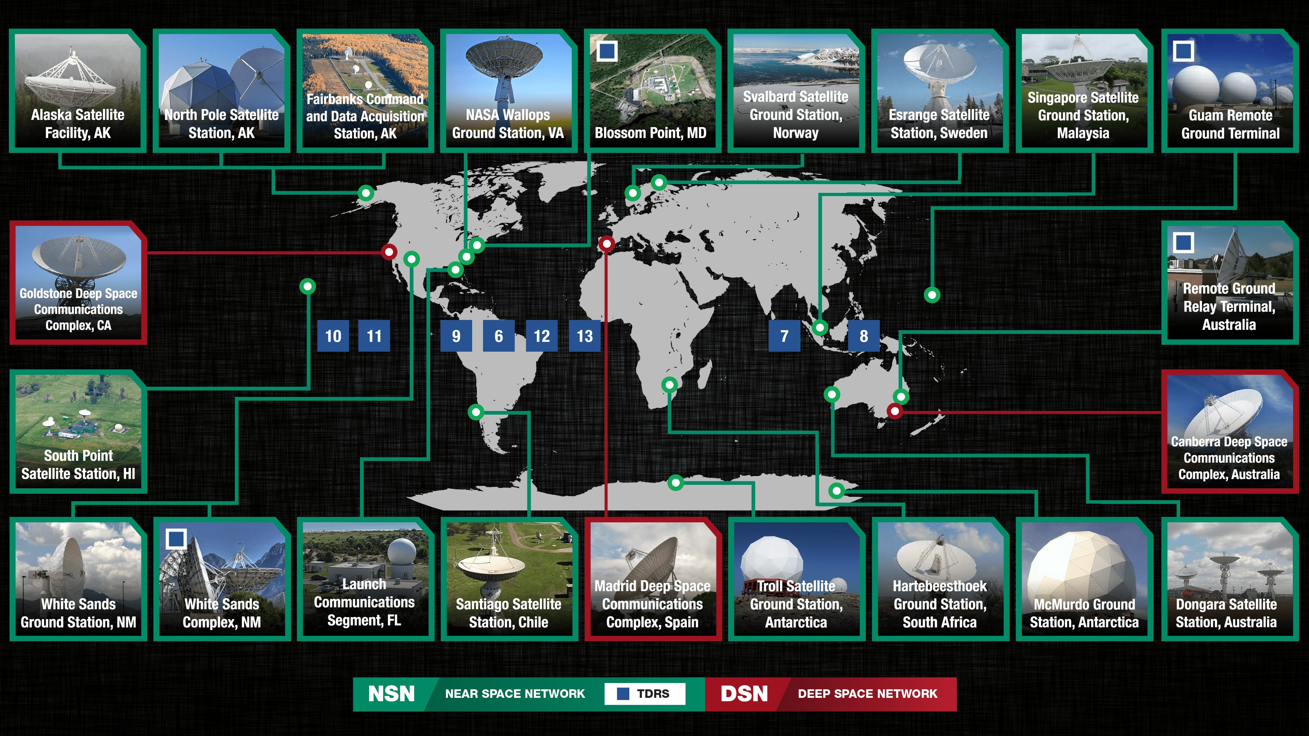
Current Network Infrastructure

Slide 12
Services Provided
Communications Analysis
Spectrum Management
Mission Design and Planning
Service Agreements
Launch
Operations
Post-Mission Support Activities
Requirements Analysis
Mission/
Provider
Engagement
Viability Assessment
Ongoing Engagement
Studies/Pre-Phase A
Phase B: Prelim Design
& Tech Completion
Phase C:
Final Design & Fab
Phase D:
Sys I&T Checkout
Phase E:
O&M
Phase F:
Closeout
Assessment
Assessment
Assessment
Assessment
Assessment
Comm & Nav Support for the Entire Mission Lifecycle

Slide 13
Dave Israel
Exploration & Space Communications Architect

Slide 14
New NASA Network Architectural View: Introducing the Near Space Network
Space Communications and Navigation (SCaN) Program Office
Deep Space Network
(JPL Managed)
Near Space Network
(GSFC Managed)
DSN / Deep Space Operations Control Center
NSN / Near Space Operations Control Center
Goldstone, California
Canberra, Australia
Government Space Link Provider (SLP)
Commercial Space Link Provider (SLP)
Government Space Link Provider (SLP)
Government Space Link Provider (SLP)
Commercial e Link Provider (SLP)
Commercial Link Provider (SLP)
Madrid, Spain

Slide 15
The Near Space Network (NSN)
The Near Space Network provides missions with communications and navigation services.
Before
After
User Mission
SN
User Mission
ACCESS
DTE and Relay Govt. Assets
User Mission
NEN
Government
DTE
User Mission
NSN
User Mission
Other Govt. SLP
User Mission
Other Govt. SLP
User Mission
Commercial DTE
User Mission
Commercial DTE
Commercialization, Innovation, and Synergies (CIS) Office
New Commercial Providers
Notes:
Services will be supplied through a blend of commercial and government providers.
The transition to the Near Space Network will seamlessly integrate new capabilities and providers without interruption to any mission services.
NSN covers the near-space region, from Earth to 2 million kilometers.

Slide 16
Near Space Network Functions and Interfaces
User MOC
NSN
Virtual Network Manager
Service Provider
Service Request
Service Planning and Scheduling Management
Network Unused Time
Service Orchestration
Service Response
Service Request
FWD/RTN Data
Service Response
User Demarc
Service Execution Management
Provider Demarc
FWD/RTN Data
Dynamic Routing
Data Transport Orchestration
Dynamic Routing
FWD/RTN Data
NSN PoP
NSN PoP
FWD/RTN Data

Slide 17
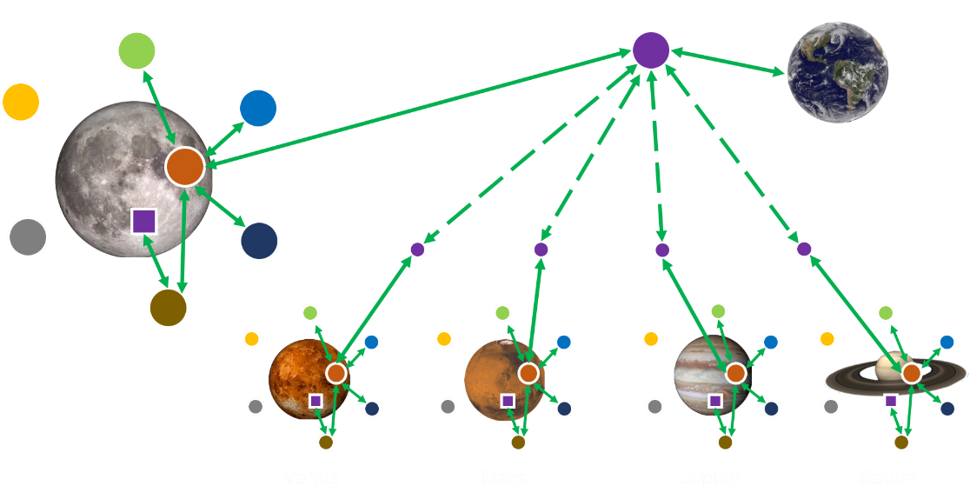
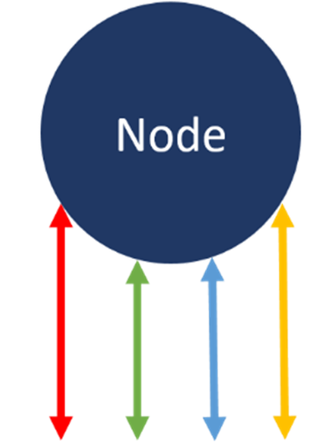
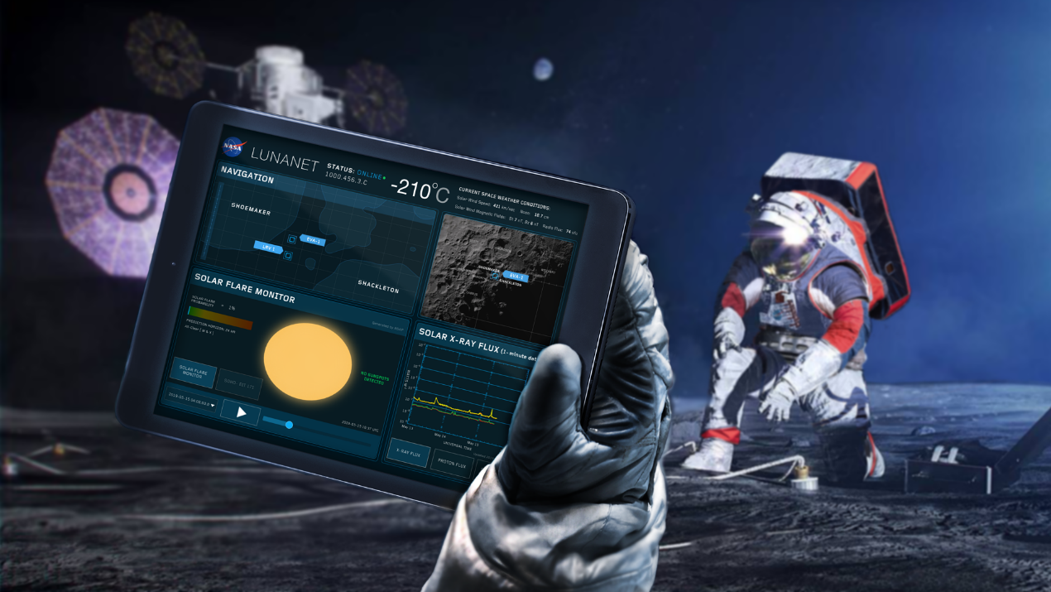
LunaNet
LunaNet Service Types
Communications Services (Com)
Position, Navigation, and Timing Services (PNT)
Detection and Information Services (Det)
Science (Sci)
Just as the internet and GPS have transformed our lives on Earth, LunaNet will transform lunar science and exploration.
Com
PNT
Det
Sci
Service Interfaces
Notes:
A flexible scalable architecture for providing communications and navigation services to all lunar missions
Disaggregated approach allows for phased implementation of infrastructure as driven by user needs and technology developments
Architecture implementation comprised of NASA, International, and Commercial interoperable lunar surface, lunar orbiting, and earth-based elements
Incorporates in-situ capabilities to detect events and distribute situational alerts
Is fully compatible with future deployments at Mars or any other destination

Slide 18
Upcoming Events
March 8-12
Uplink Sessions
BEAM Sessions
Amplifier Session
Ignite the Flight
April 12-13
April 21
June 10-17

Slide 19
Q & A
https://www.menti.com/1gcngp54k8

