Slide 1
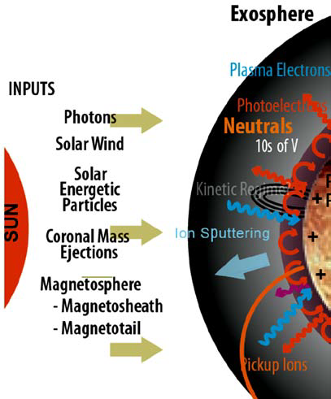
Negative Ion Sputtering from Lunar Samples by Solar Wind Ions
J. W. Keller, J. L. McLain, D. J. Chornay
Why this work?
Solar Wind Sputtering is one of several physical processes altering the lunar surface
  Others include impacts and solar photons
The Solar Wind’s composition drives chemical alteration of the surface
  Hydrogen is a reducing element leading to the formation of nano-phase iron and allows formation of water. (proton irradiation alone does not seem to form water by reaction with oxygen in the lunar soil)
Sputtered particles contributes to the lunar exosphere
  The low energy tail of the distributions and heavier elements are gravitationally bound.
Notes:
We appreciate the opportunity to present these results virtually although we do miss face to face interactions and look forward to when we can return to that format.
Solar Wind at the Moon
The solar wind is composed electrons and ions, 95% protons, 4% alpha, and trace elements such has oxygen, carbon, and iron. These ratios will vary depending on the conditions at the sun
At the Moon, the average velocity of SW ions is around 400 km/s around one kV for the protons and since other SW ions travel close to the same velocity their energy is proportional to their mass.
Action of the SW on the lunar surface
First the SW modifies the surface by bond breaking and forming processes and by implantation. Since the SW is primarily hydrogen, the lunar surface is driven to a chemically reduced state as seen by the formation of nano-phase iron
And this process is further accelerated by micrometeorite impacts

Slide 2
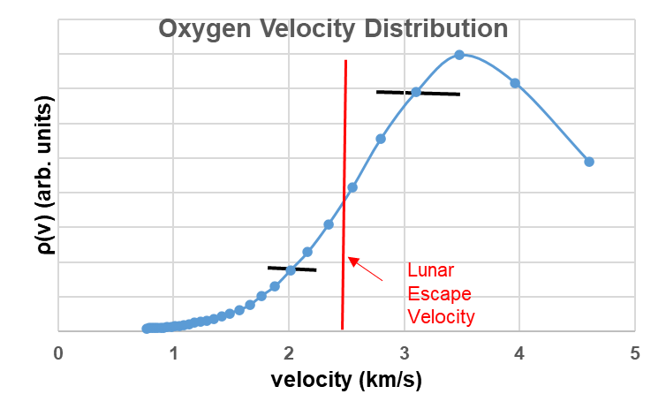
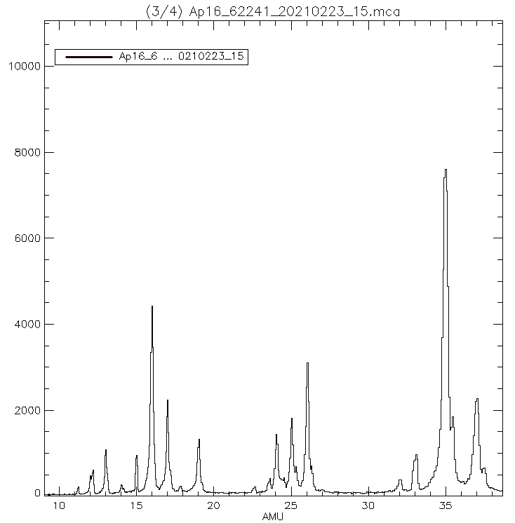
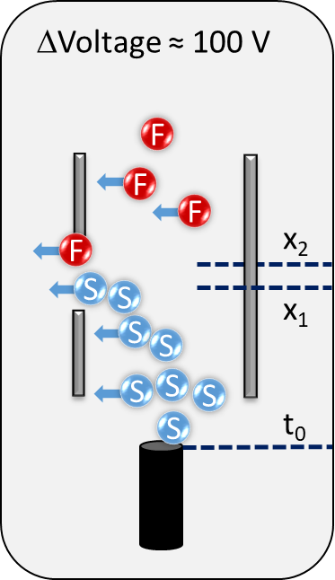
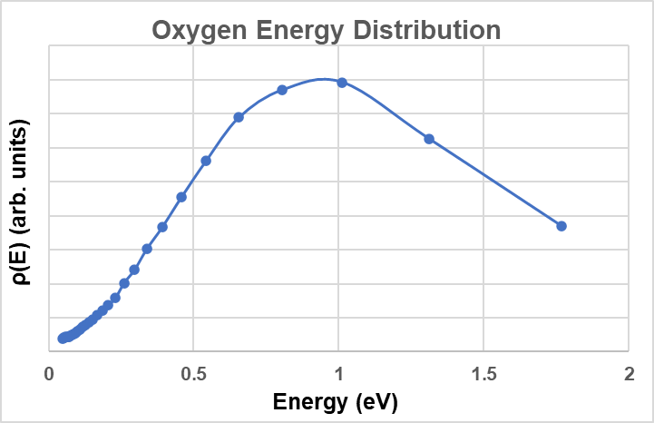
Negative Ion Sputtering by 2 keV H₂⁺ from Apollo 16 Sample 62241
We detect a low energy population of sputtered particles possibly arising after initial impact as the sputterer loses energy and random walks through the material
Ion TOF Spectra taking after baking sample for 1 hr at 400 C and irradiating with 4 keV Argon ions for 2 hr.s
Cl⁻
C₂⁻ HC₂⁻ ,
C₂H_{2,} ⁻
O⁻
OH⁻
Cl⁻
Extract sputtered ions at different time delays to map out distribution.
F⁻
Notes:
Comment that the OH to O ratio changes considerably depending on whether or not the sample is heated, with OH signal more intense that O prior to heating.

Slide 3


Conclusions
Very preliminary results
We have identified a low energy population of particles sputtered by solar wind energy ions
  May arise after initial impact as particles lose energy while random walking in the matrix
Some evidence of chemically driven process seen in negative ions sputtering
  More work is needed to confirm
Notes:
Supported by internal funds

