Slide 1

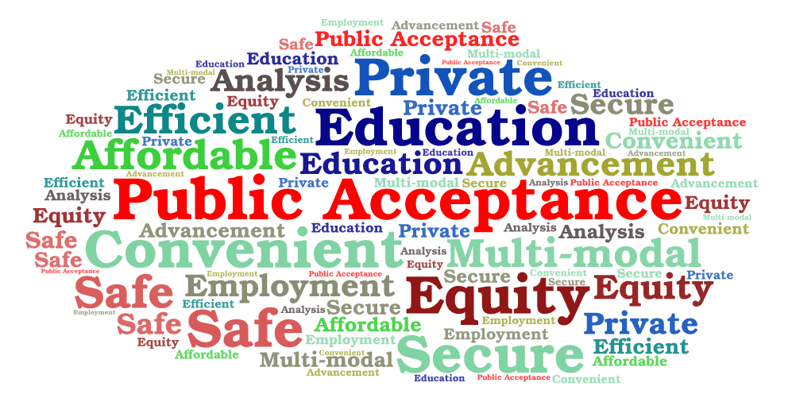


Public Acceptance
Education
CIWG Meeting
Pull together stakeholder POCs and identify “pieces of the puzzle”
Socialize “pieces of the puzzle” with the community
Next steps-
Framework

Slide 2

Puzzle Pieces (In no particular order)
Education
  Public
  Decision Makers
  Planners
Outreach
Privacy
Noise
  Aural
  Visual
Liability
  Flying public
  Non-user risk exposure/safety of the non-flying public
  Insurance
Local Department of Transportations
  Planner(s) – process and analysis
  Investment timelines
  Near and long-range planning and policies
Effects of increasing autonomy
Public consensus/inputs on plans
Security
Workforce development and job creation
Local vs Federal Roles
  When and how to engage
Multi-modal transportation integration
Risks
Equitable
  Access to benefits including ADA
  Pricing
  Displacement
Affordability
National Commonality
Locality Tailoring
Flight paths & Location of Vertiports
Land Use
  Zoning
Mode Choice
  Factors
Environment
Congestion
Electrification
Consumer Protections
Paths to public acceptance (e.g., actually flying in a UAM vehicle for a trip)
References
  List of studies looking at public acceptance
  List of case studies on AAM public acceptance

Slide 3
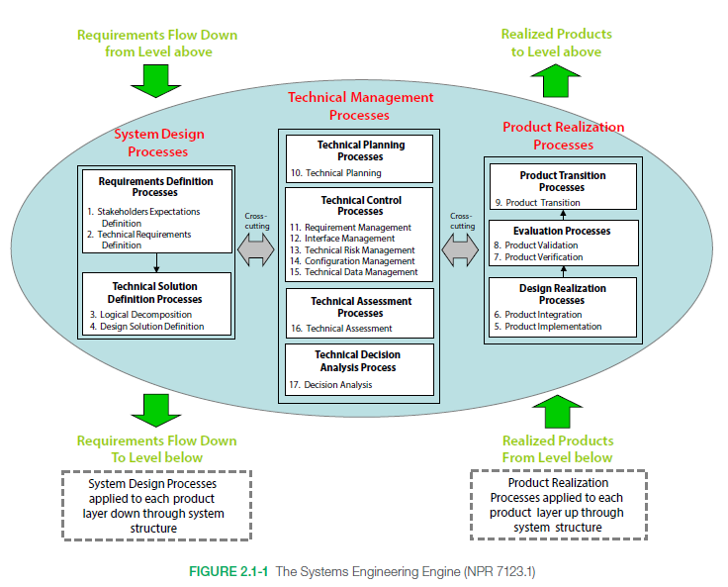
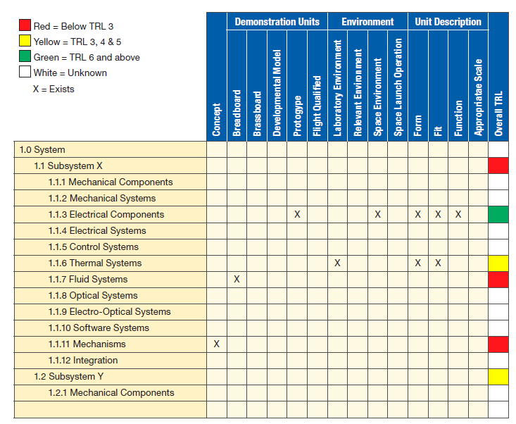
Public Acceptance- Frameworks
How to consider public acceptance
Consider from a role’s perspective:
  Public Intuitions – Boards of Supervisors, Departments of Transportations…..
  “Community” Public – people who live where AAM/UAM operations occur
  “Flying Public” – AAM/UAM Customers
  Cross-cutting areas
Identify areas of commonality and areas where localities can tailor to their requirements
From a process perspective
  Early adopter locations
  Design vs Operations
From an authority perspective (RACI)
  Identify knowns
  Identify unknowns
  Identify areas in between
Systems Engineering perspective
The “Community” Public
The “Flying” Public
Public Institutions

