Slide 1
Lander Technologies (SBU data removed)
October 16, 2019
Debra Terrell
Lunar CATALYST Astrobotic Partner Manager

Slide 2
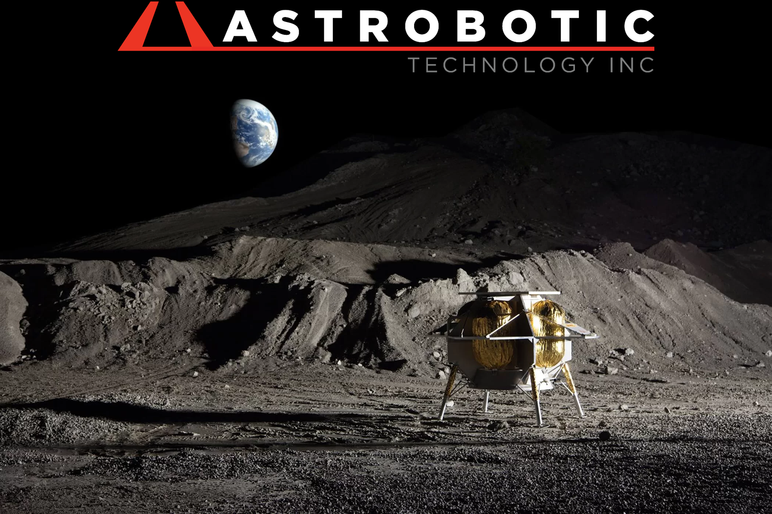
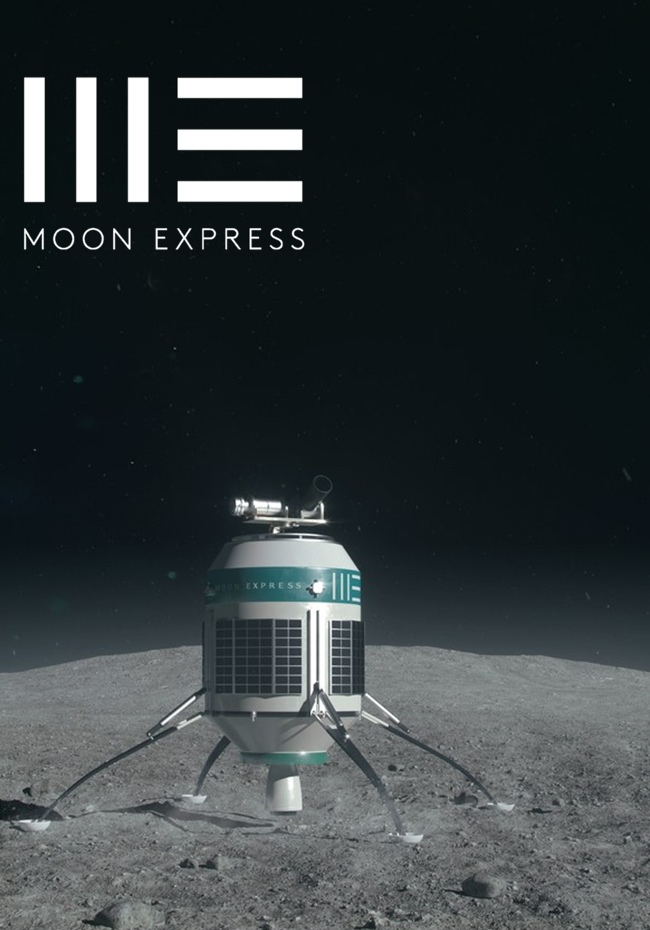
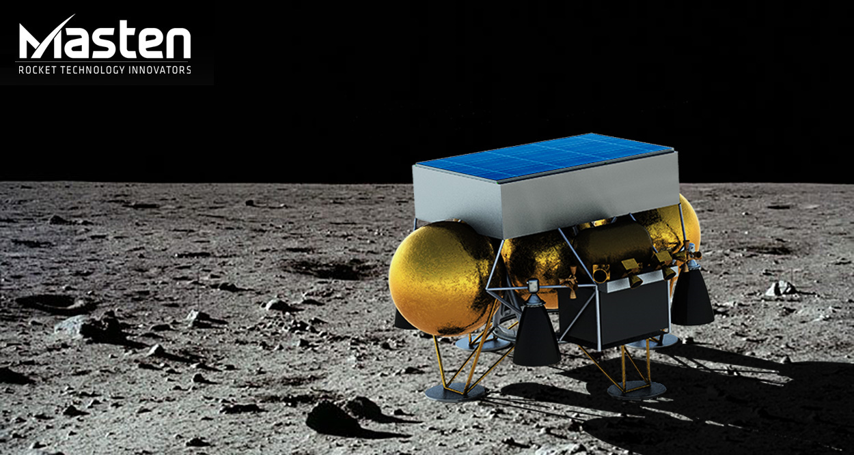
Lander Technologies
Project Overview
Why is this project important?
Government and commercial interest in exploration of cis-lunar space and the lunar surface is growing.
Lander capabilities, completed designs, and overall access (especially low cost) to the lunar surface are still relatively limited.
Objectives
Lunar CATALYST
This project targets improving access to the lunar surface by supporting commercial efforts to build landers, reducing risk on key lander technologies & developing a lander-smart work force and identifying key technologies thru lander design activities.
CryoFILL
Demonstrate propellant liquefaction capabilities for ISRU at a relevant scale and in a relevant environment. This includes Brassboard testing, transient system modeling, insulation system risk reduction, and the assembly/demo of a prototype liquefaction system.
FY19 activities
Lunar CATALYST:
  Astrobotic Technology, Inc.
  Masten Space Systems
  Moon Express
CryoFILL

Slide 3
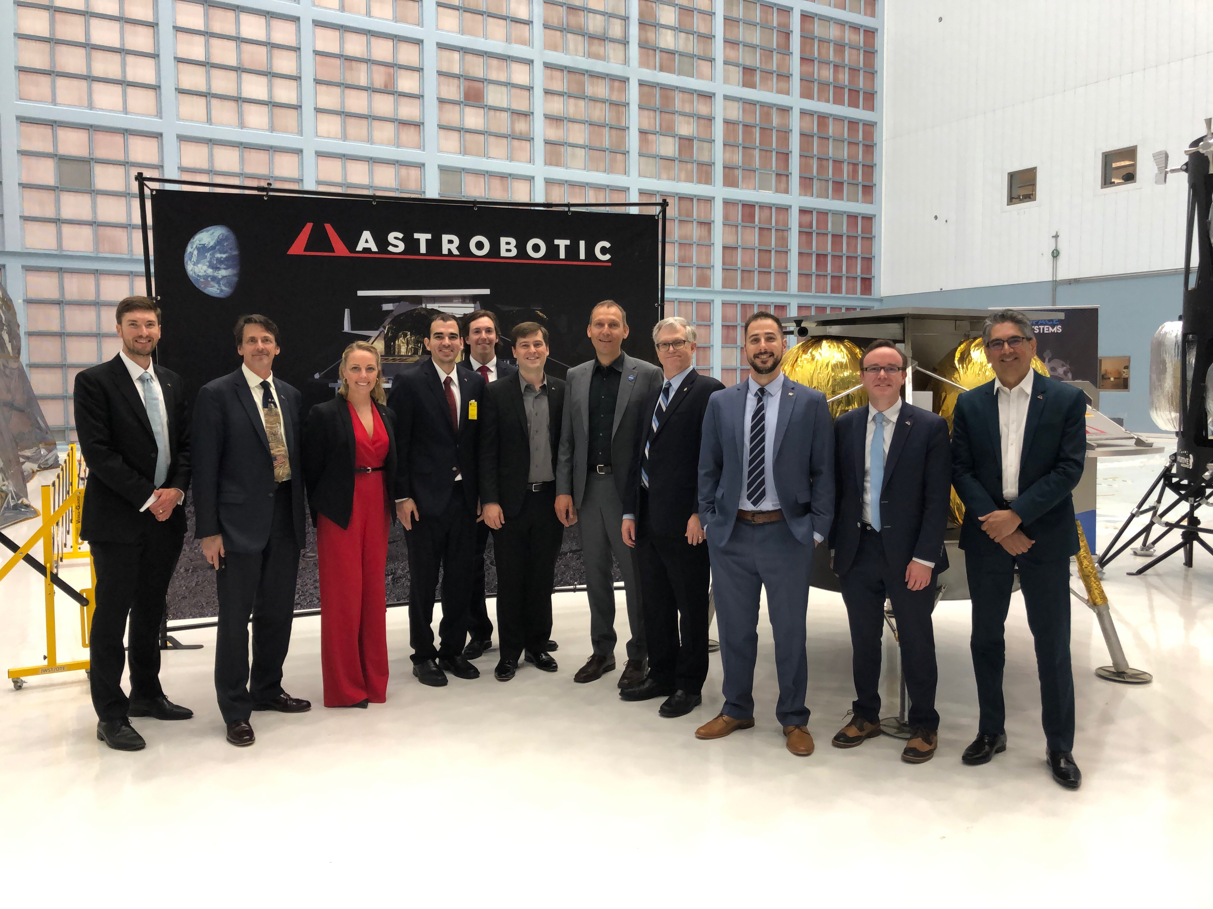
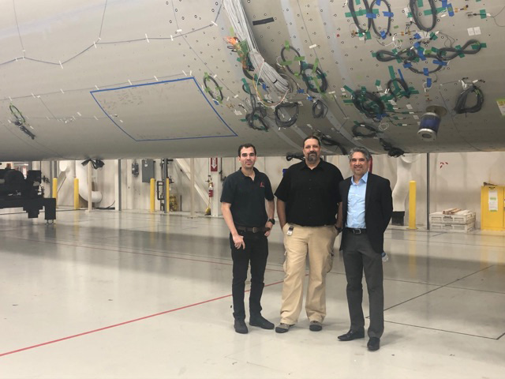
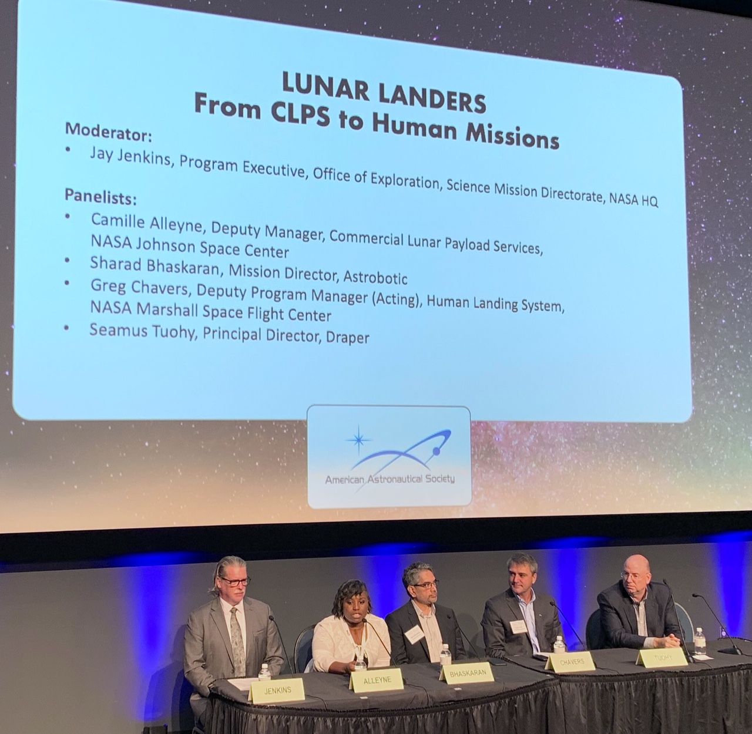
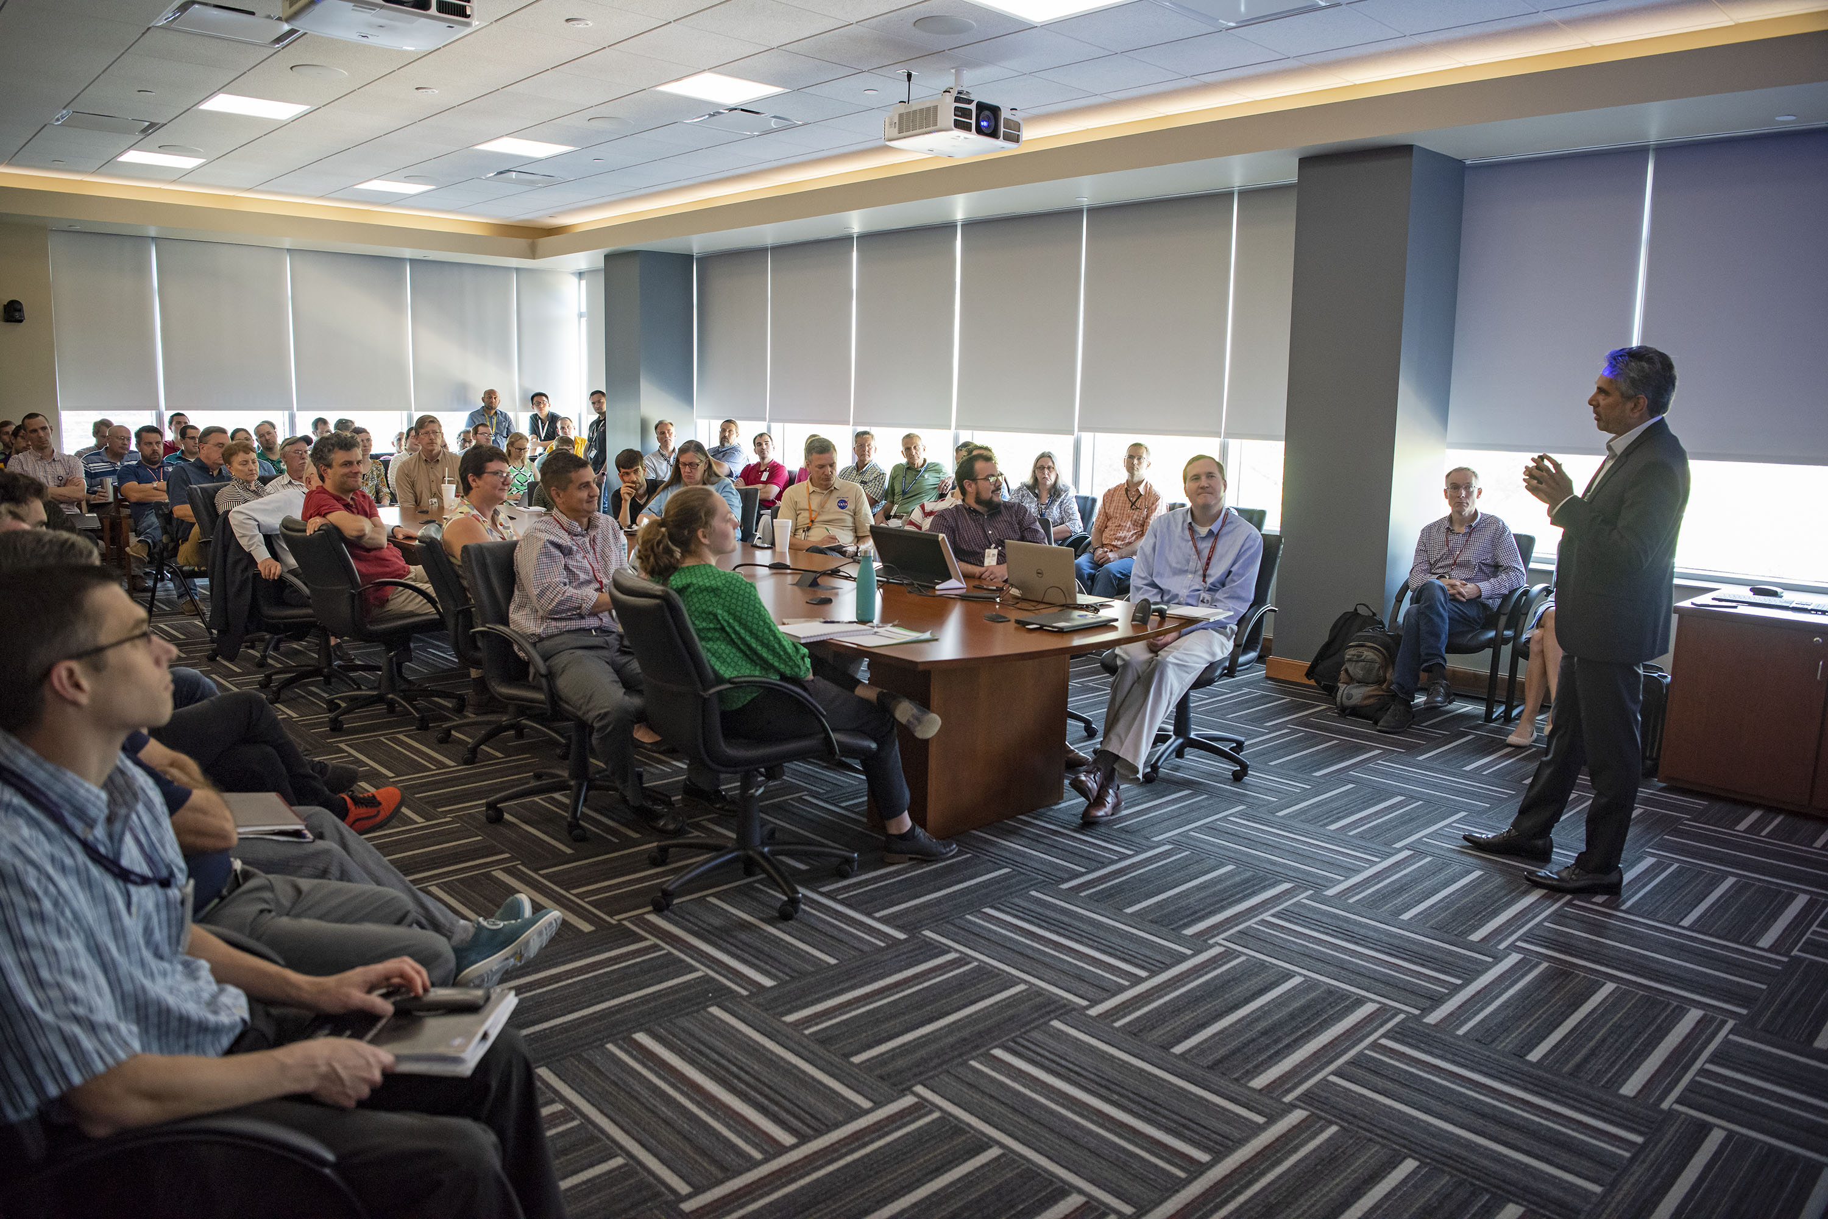
Lander Technologies
Astrobotic Technology, Inc. Accomplishments & Activities FY19
Accomplishments:
Astrobotic signed a launch contract with ULA for the first Vulcan mission
All Peregrine Long Lead Procurements have been initiated
NASA IV&V of GNC simulation validated model and assumptions with 99.6% successful landing
Component/payload steady-state and dynamic loads and thermal environment derived
Power System Architecture matured and refined
Communications architecture updated to reflect data rate capability spacecraft-to-ground increase to 3.0 Mbps
Mission Ops Plan was developed and refined
Astrobotic Quality Management System (QMS) and AS9100 procedures/forms aligned to Peregrine risk posture
Produced multiple trajectory options and analyses, lunar dust obscuration and plume lunar surface interaction analyses.
FY20 Look Ahead
Build and test STM and multiple in-house subsystem designs
Mature design to enable Peregrine System Critical Design Review (CDR)
Astrobotic tours ULA facility
Astrobotic and CLPS Team
Sharad Bhaskaran, Peregrine Mission Manager
addresses capacity crowd at MSFC Tech Talk
Sharad Bhaskaran, Peregrine Mission Manager
on Von Braun Symposium Lunar Lander Panel

Slide 4
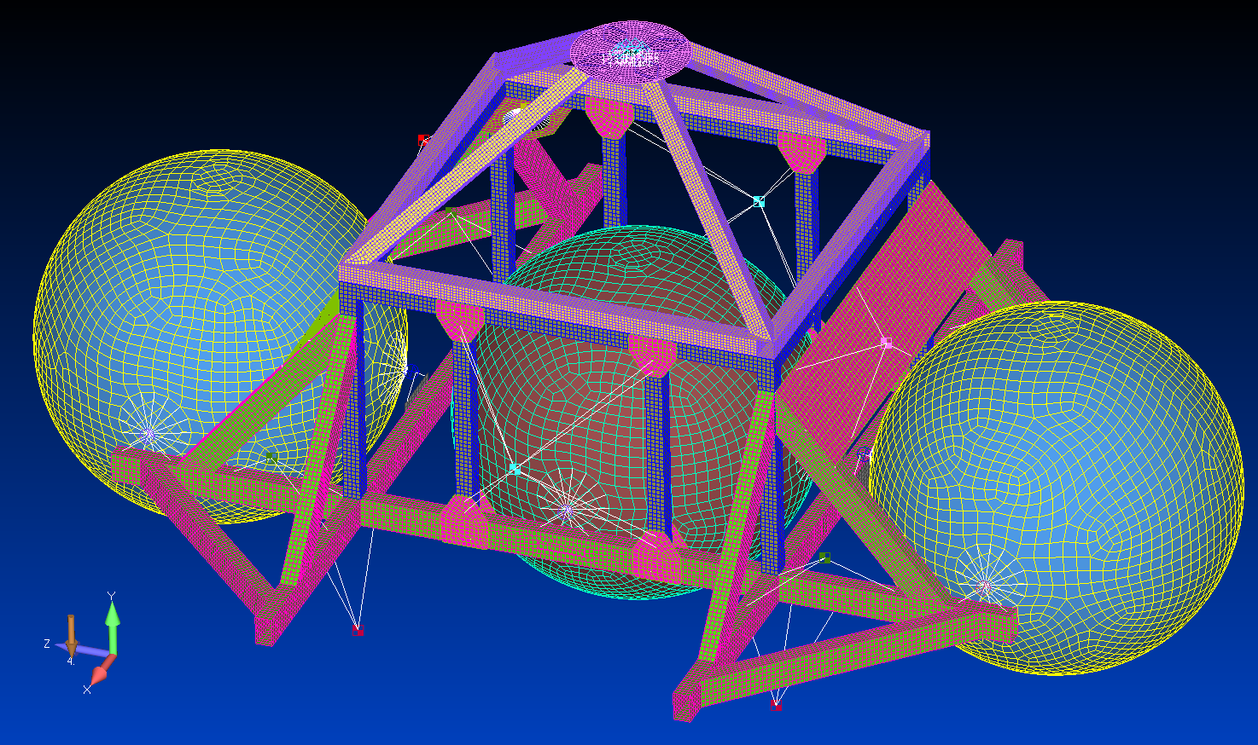
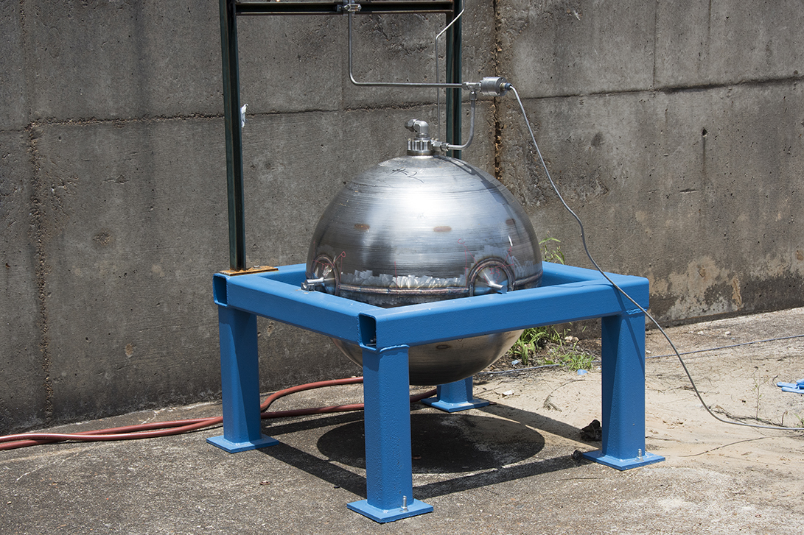
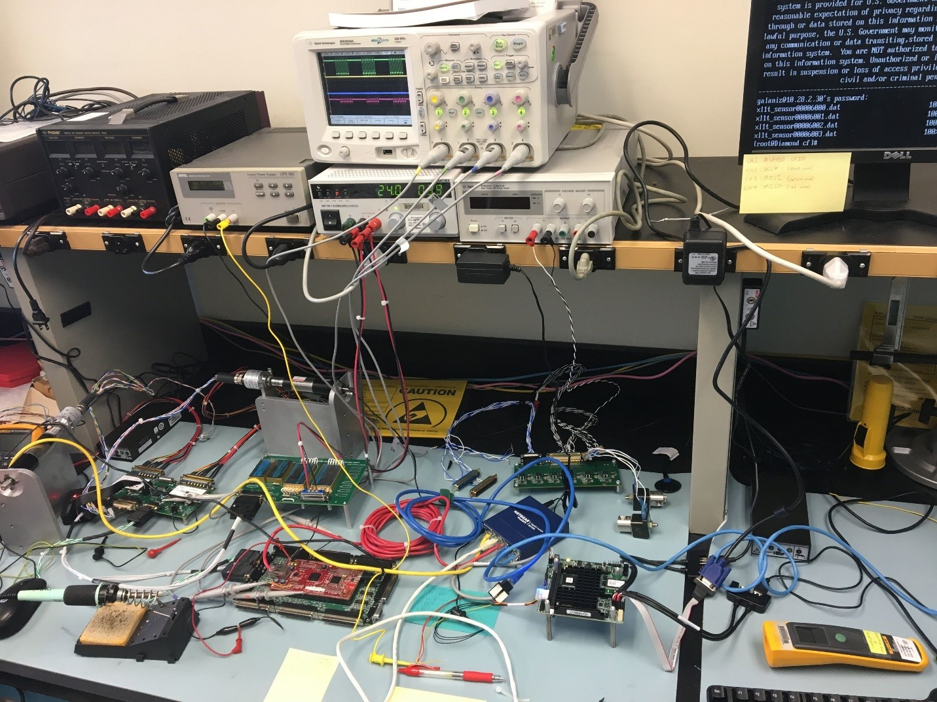
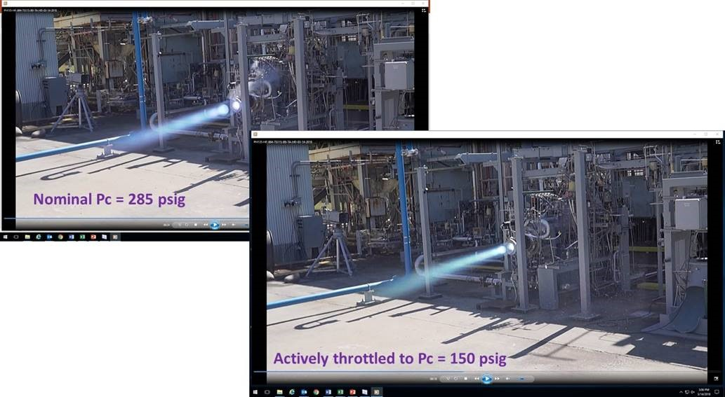
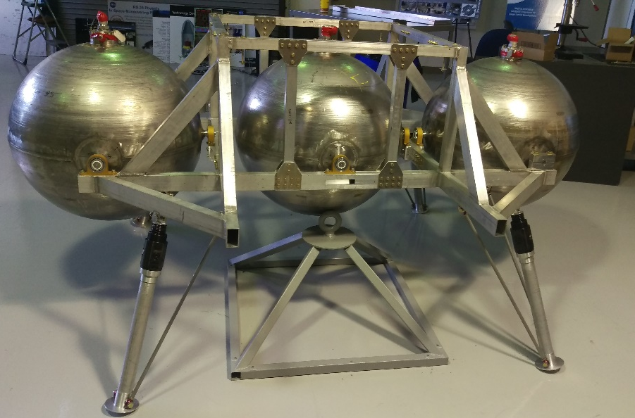
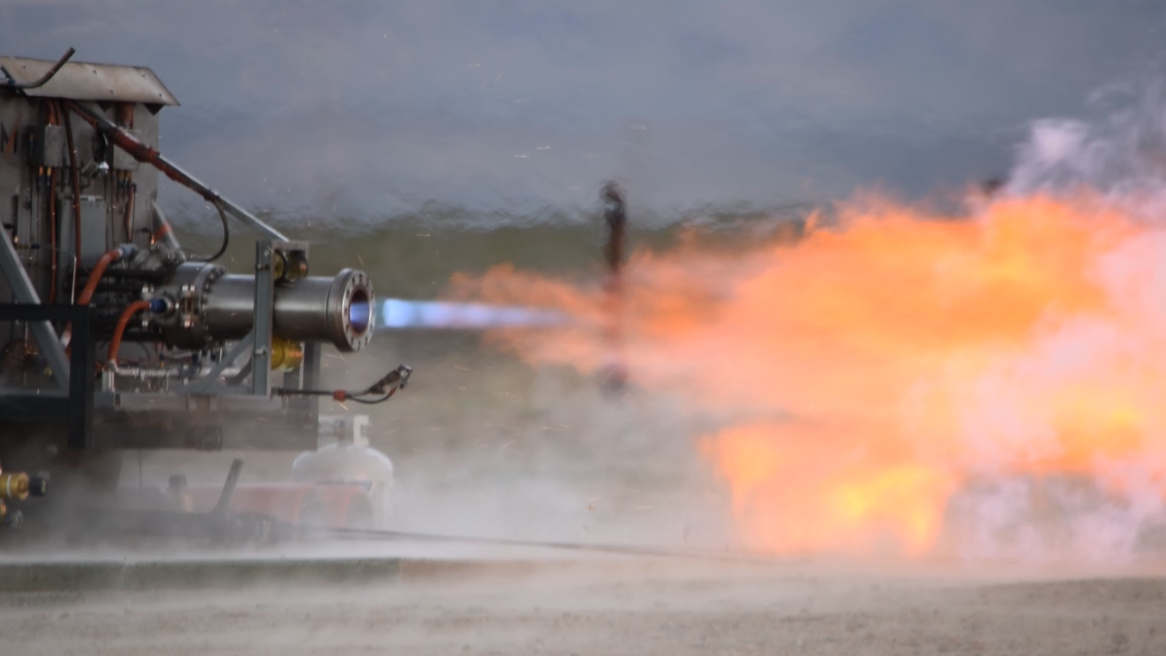
Lander Technologies
Masten Space Systems Accomplishments & Activities FY19
Accomplishments
Shipped the XL-1T to Masten Space Systems!
  Included primary structure with tanks (some secondary structures)
  Integrated avionics, FSW, and GN&C designs
Completed the Integrated Avionics, FSW, and GN&C Hardware-in-the-loop testing
Finished new landing feet design and plume interaction thermal model analysis
Completed GNC GLASS simulation code
Completed hot-fire test campaign for META4 #4
Completed preliminary Easy-5 analysis for propulsion system flow
Completed 5k ablative engine testing in Mojave, CA
Down-selected battery for the XL-1T
Engine controller and several other avionics components ready for box builds
System-Level Structural Model
Tank Burst Testing
Hardware-in-the-loop Test Setup
META-4 Hot-Fire Testing (MSFC)
AS-Built XL-1T Structure with Tanks
5k Engine Hot-Fire Testing (Mojave, CA)

Slide 5
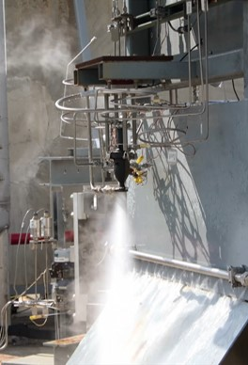
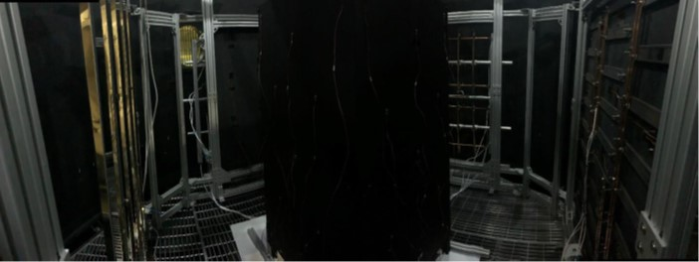
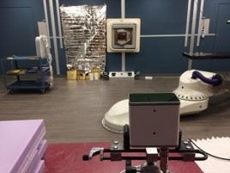
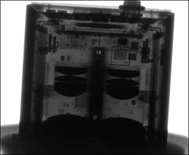
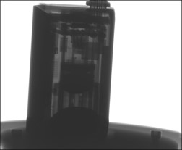
Lander Technologies
Moon Express Accomplishments & Activities FY19
Accomplishments
Engine Build & Test activity for Moon Express PECO Engine, CT scans, stress relief/removal from build plate, machining
Monoprop engine testing (HTP only) performed at MSFC in September including two 300 second runs
GMAT task delivered a new drop of SW with upgraded capabilities
Work on GMAT task supports other NASA missions
cFS development with GSFC continued to refine MATLAB SIL interfaces and streamline Moon Express workflows.
Performed two re-tests of the NASA-designed thermal shroud for TVAC testing
Performed radiation testing on sensors
FY20 Period
Deliver monoprop test data including design comments to Moon Express
Complete monoprop test report after receive final set of test data
Ship hardware to appropriate final destination
Monoprop test during startup pulsing sequence
NASA Heat cage redesign with four concepts
NASA Radiation testing setup and X-ray results

Slide 6
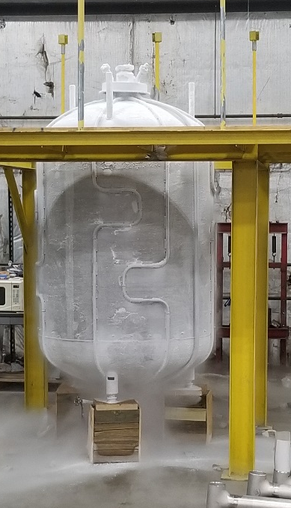
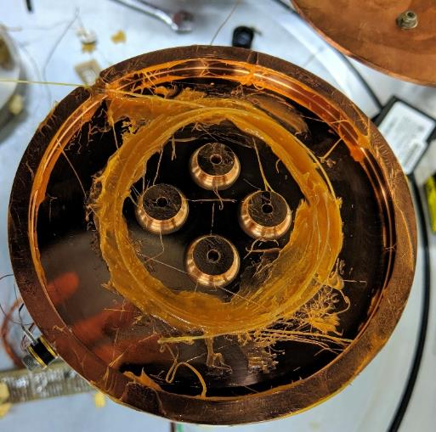
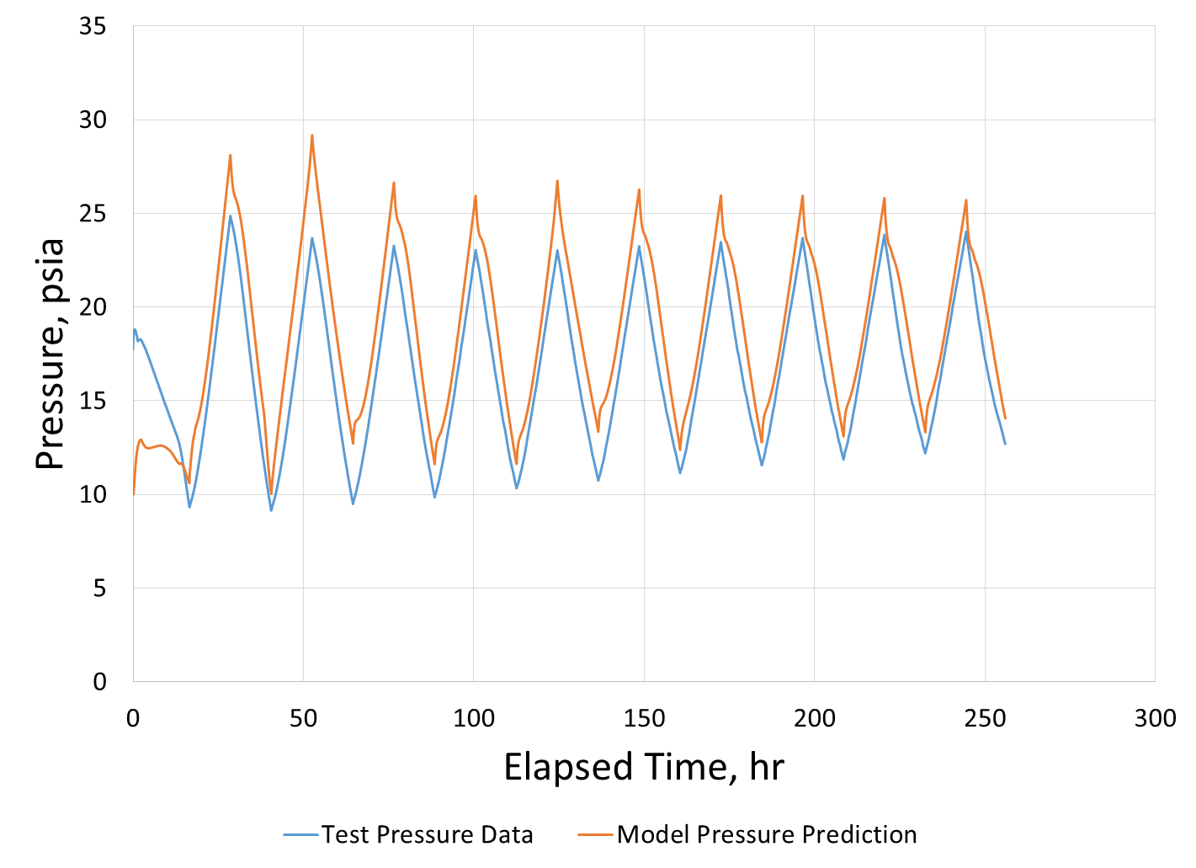
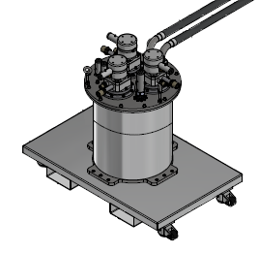
CryoFILL Accomplishments & Activities FY19
Perform “Brassboard” testing
  Completed constant flow liquefaction testing (~1 lbm/hr) with nitrogen at 5 different fill levels
  Completed transient testing with inlet gas flow (12 hr on, 12 hr off) at 3 fill levels
  Completed testing using dip tube to simulate bubbling gas up through main fill/drain line.
  Added thermocouple probe to try to help determine vapor stratification and repeated 5 tests.
  Consulting with Prototype team
  Presented initial results at Space Cryogenics Workshop
Transient system modeling
  Performing validation modeling against brassboard nitrogen testing.
  Performed initial CFD approaches to help improve modeling of the condensation and stratification during condensation processes.
  Presented initial results at Cryogenic Engineering Conference
Soft Vacuum Insulation system risk reduction
  Performed room temperature and low temperatures testing on samples provided by Quest Thermal Systems under an SBIR Phase II contract
  Awarded MarVACS procurement to Lockheed Martin
Fiber Optic Sensing System (FOSS)
  Developed new coated sensor to double sensitivity in cryogenic regime
  Tested and calibrating (in process) new coated sensor in nitrogen at a variety of pressures and using cryocooler system as a function of temperature.
Prototype system
  Completed Design Analysis Cycle-2
  Procured tank, industrial cryocooler, instrumentation, multilayer insulation,
  Fabricated tank internals and tank handling fixtures
  Instrumented tank and starting MLI installation
  Prepared test facility for liquid oxygen service
  Conflict in test facility usage with HLS App E Partner
Prototype tank being coldshocked
FOSS encased in grease
during testing
Transient flow test pressure and model predictions for Brassboard test, 50% full, 12 hours double flow, 12 hours no flow
Prototype Industrial Cryocooler

Slide 7
Lander Technologies
Plans
Plans for FY20
Complete Risk Reduction and Technology Development activities relevant to lunar exploration needs to include large lander needs
  CryoFILL will resume work on the Prototype system buildup
  Execute MarVACS contract and oversee Quest Phase II SBIR
Support SMD’s Commercial Lunar Payload Services (CLPS) activities, as needed
Support SMD’s Thruster Advancement for Low-temperature Operation in Space (TALOS) activities, as needed
Position NASA workforce and processes plus strengthen commercial capabilities for increased, sustained Lunar exploration and development

Slide 8
Lander Technologies
Partnerships
Lunar CATALYST
  Astrobotic Technology – broad spectrum engineering support and low-cost thruster development
    RSAA in signature loop for FY20-21 activities
  Masten Space Systems – broad spectrum engineering support, fabrication of test bed, support of cryogenic engine development
  Moon Express – broad spectrum engineering support and wide variety of testing
Other external companies:
  United Launch Alliance (ULA) – HEO/CCSC XEUS/ACES landing kit (GNC, trajectory, landing gear)
  ULA – Launch provider for Astrobotic Peregrine Mission 1
AES
  Moon Trek for Astrobotic landing site
  Moon Trek for Mexican Space Agency/Astrobotic payload
STMD:
  NDL – baselined as Astrobotic landing sensor
  TALOS – working Frontier Aerospace Corp. under Game Changing Development to qualify this engine
  GCD Fluid Technologies project on 150 W/90 K Cryocoolers
  Multiple Tipping Point Selections:
    CFM integrated propulsion testing for robust lander services (Blue Origin)
    Flight Qualification of the TALOS, Mon25/MMH Thruster (Frontier)
    Stand-Alone Sensor for High Precision Planetary Landing (Astrobotic)
    Advancing Sensor Suites to Enable Landing Anywhere on the lunar surface (Blue Origin)

Slide 9
Lander Technologies
Partnerships
SMD:
  Commercial Lunar Payload Services – All three Lunar CATALYST Partners selected
    Astrobotic Peregrine awarded one of the first CLPS missions (2021)
CryoFILL:
  GCD Cryogenic Fluid Technologies (Cryocoolers)
  Launch Service Program (LSP) on FOSS
  Evolvable Cryogenics – modeling resources (CPUs and licenses)
MSC/Mars Lander and Ascent Vehicle
Human Lander System (HLS)
NASA Centers:
  Distributed Lander Team; increased involvement of additional NASA centers beyond original team
  Center IRAD (MSFC and LaRC)
Cooperative Agreement Notice (CAN)
  With AU: investigate automotive sensors for landers (Astrobotic)
  With MSS: ePump development
  With Agile Space Propulsion Company (formerly Advanced Mobile Propulsion Test): Additively Manufactured Advanced Space Engines
  With Frontier Aerospace Corporation: Development of a Low Cost, Low Pressure, Light Weight, MON/MMH Bi-prop 100lb Thruster with 300 Isp.
CoECI:
  YET2 on Automotive Sensors for autonomous lunar landing

Slide 10
Lander Technologies
Partnerships (continued)
SBIR:
  TALOS (SBIR Phase III)
  Cryogenic fluid management sub-topic to begin technology development on long lead items for liquefaction sub-system
  Working multiple Phase II’s on High Turndown ratio heat rejection for lunar lander applications; advanced thermal switch with JPL; Phase IIX for the Variable Conductance Heat Pipe (VCHP) for potential flight demo
  STTR/SBIR Phase I subtopic Lander Systems Technologies T9.01 (STTR 2018) and Z7.04 (SBIR 2019)
    T9.01-8762 Regeneratively Cooled Ceramic Matrix Composite Nozzle Assembly for Reduced Weight - Physical Sciences, Inc.
    T1.01-3842 Refractory Additively Manufactured Affordable Launch Vehicle RCS - Valley Tech Systems, Inc.
    T9.01-5313 Properties Investigation of High-MON Oxidizers for Use in Deep Space Exploration - Frontier Aerospace Corp
    T9.01-6232 Prediction of Plume Induced Rock Fracture for Landers - CFD Research Corporation
    Z7.04-2725 Plume-Surface Interaction in Rarefied Environments - CFD Research Corporation
    Z7.04-2726 Measurement and Modeling of High Speed Polydisperse Granular Flow Under Plume/Surface Interaction Conditions - CFD Research Corporation
    Z7.04-3492 High Temperature Nozzle Seals for Dissimilar Materials - Physical Science, Inc.
    Z7.04-3871 Testing Deep Cratering Physics to Inform Plume Effects Modeling for Masten Space Systems - Masten Space Systems, Inc.
Notes:
Expect to award some STTR Phase IIs, soon.

Slide 11
Back-up

Slide 12
CATALYST Partner Press Releases/Papers/Presentations
Lunar CATALYST Team
Challenges of Designing a Passive Thermal Control System for the Astrobotic Peregrine Lunar Lander, Stephanie Mauro/ES22/MSFC, Thermal and Fluids Analysis Workshop.
Thermal Environment Modeling Practices for the Descent Trajectory of Lunar Landers, Alex Szerszen/ES22-ESSCA/MSFC, Thermal and Fluids Analysis Workshop.
Challenges of Designing a Passive Thermal Control System for the Astrobotic Peregrine Lunar Lander, Stephanie Mauro/ES22/MSFC, International Conference on Environmental Systems (ICES).

Slide 13
CATALYST Partner Press Releases/Papers/Presentations
Masten
JANNAF paper on Plume Integration Thermal Model Analysis – will be presented in Dayton, Ohio for the JANNAF/37th Exhaust Plume and Signature meeting in early June
Astrobotic
Astrobotic’s CubeRover Program Awarded $2 Million Contract by NASA https://www.astrobotic.com/2019/10/2/astrobotic-s-cuberover-program-awarded-2-million-contract-by-nasa
Astrobotic Commends Senate NASA Funding Bill’s Strong Resources for Lunar Science, Exploration https://www.astrobotic.com/2019/9/30/astrobotic-commends-senate-nasa-funding-bill-s-strong-resources-for-lunar-science-exploration
Astrobotic’s John Thornton Named ‘CEO of the Year’ at the Pittsburgh Tech50 Awards https://www.astrobotic.com/2019/9/27/astrobotic-s-john-thornton-named-ceo-of-the-year-at-the-pittsburgh-tech50-awards
Astrobotic and Spacebit Announce Agreement to Bring the First UK Commercial Payload to the Moon https://www.astrobotic.com/2019/9/24/astrobotic-and-spacebit-announce-agreement-to-bring-the-first-uk-commercial-payload-to-the-moon
Astrobotic Selects United Launch Alliance Vulcan Centaur Rocket to Launch its First Mission to the Moon https://www.astrobotic.com/2019/8/19/astrobotic-selects-united-launch-alliance-vulcan-centaur-rocket-to-launch-its-first-mission-to-the-moon
Astrobotic Awarded $5.6 Million NASA Contract to Deliver Autonomous Moon Rover https://www.astrobotic.com/2019/7/1/astrobotic-awarded-5-6-million-nasa-contract-to-deliver-autonomous-moon-rover
Astrobotic Awarded NASA Study Contract for Polar Mission to the Moon https://www.astrobotic.com/2019/6/18/astrobotic-awarded-nasa-study-contract-for-polar-mission-to-the-moon
Astrobotic Awarded $79.5 Million Contract to Deliver 14 NASA Payloads to the Moon https://www.astrobotic.com/2019/5/31/astrobotic-awarded-79-5-million-contract-to-deliver-14-nasa-payloads-to-the-moon
Astrobotic Signs Lunar Payload Agreement with Canadensys Aerospace https://www.astrobotic.com/2019/5/20/astrobotic-signs-lunar-payload-agreement-with-canadensys-aerospace
Drone Maps Icy Lava Tube in Iceland in Preparation for Cave Exploration on the Moon and Mars https://www.astrobotic.com/2019/3/19/drone-maps-icy-lava-tube-in-iceland-in-preparation-for-cave-exploration-on-the-moon-and-mars
Astrobotic Commends Strong Support for Lunar Exploration in NASA’s FY2020 Budget Request https://www.astrobotic.com/2019/3/18/astrobotic-commends-strong-support-for-lunar-exploration-in-nasa-s-fy2020-budget-request

Slide 14
Conferences FY19
Astrobotic Technology presentations:
March 18 - RoboBurgh as part of the “Tech of Pittsburgh” panel. Event held at CMU’s Osher Lifelong Learning Institute. Hosted by the Pittsburgh Business Times.
March 18 - 22 – LPI Lunar and Planetary Science Conference in The Woodlands, TX.
April 5-7 – ASME E-Fest North in Detroit, MI.
April 8 – Fusion Forum during the Space Symposium held in Colorado Springs, CO.
May 6 - 2019 Fulbright “From Lab to Market” Enrichment Seminar hosted at the Omni William Penn Hotel in Pittsburgh.
June 15 – TEDxPittsburgh
June 26 – Space Enterprise Summit in Washington D.C.
September 12 – Von Braun Symposium and MSFC Tech Talk held at NASA Marshall Space Flight Center

