Slide 1
Safety and Public Acceptance
Dr. Natasha Neogi
NASA Langley Research Center
SAE AeroTech Digital Summit
AAM Use Cases and Public Acceptance Panel
March 10th, 2021

Slide 2
Why is safety important?
DeHavilland Comet Crashes: January 10, 1954; April 8, 1954
Grand Canyon Midair Collision: June 30, 1956
New York Airways Helicopter Crash (PanAm Rooftop): June 16, 1977
Drone crashes near White House: October 9, 2015
Drone hits army helicopter flying over Staten Island: September 22, 2017
Missing Army Drone found 600 miles away in Colorado: February 10, 2017
Missing Drone shuts down Latvian Airspace: May 4, 2020
Better safe than sorry. -Nineteenth-century proverb.
Notes:
The Register reports that things went haywire on Saturday after a drone company, SIA UAVFactory, lost contact with its 26kg (57-pound) drone during a testing run. Making matters worse: this drone was fueled for up to 90 hours of flight, the better part of a week.

Slide 3
What is safety, really?
Safety: Freedom from accidents or loss events.
Accident: An undesired and unplanned event that results in a loss (including loss of human life or injury, property damage, environmental pollution, etc.).
Hazard: A system state or set of conditions that, together with a particular set of worst-case environmental conditions, will lead to an accident (loss event).
Hazard Level: A function of the hazard severity (worst case damage that could result from the hazard given the environment is in its most unfavorable state) and the likelihood (qualitative or quantitative) of its occurrence.
Risk: A function of the hazard level combined with (1) the likelihood of the hazard leading to an accident and (2) hazard exposure or duration.
Risk
Hazard Level
Hazard Severity
Hazard Likelihood
Hazard Exposure
Likelihood Hazard Leads to Accident
Nancy G. Leveson. 1995. Safeware: system safety and computers. Association for Computing Machinery, New York, NY, USA.
Notes:
System Safety Engineering: The system engineering process used to prevent accidents by identifying and eliminating or controlling hazards. Note that hazards are not the same as failures; dealing with failures is usually the province of reliability engineering.

Slide 4
Factors that affect risk based on Use Case
Passenger carrying vs non-passenger carrying
Piloting Paradigm
  Remote pilot vs Onboard pilot
  GCS to UA ratio (m:N)
Overflown Area
  Rural vs. Urban
Airspace Class (e.g, A, B, G, etc.)
  Air Traffic Density
Environmental Conditions
  VMC vs. IMC
VLOS vs. BVLOS...
Design Factors | Representative Range | Reason this Factor Matters
# People Onboard | 0, 1-2, 3-4, 5-8, 9-19 | Harm to people
Mass | Micro (<4.4 lb), Small (<55 lb), Medium (<7000 lb), Large (>7000 lb) | Harm to people
Operational Speed | Low Speed, Medium Speed, Subsonic, Supersonic | Harm to people
Remote Control Authority | Inner Loop, Outer Loop, Autonomous | Interference with crew safety role
GCS to UA Ratio | 0:1, 1:1, 1:n, m:1, m:n | Interference with crew safety role
Operational Factors
Population Density | None, Sparse, Medium, Dense | Harm to people
Operational Altitude | <500 ft, <18000 ft, <60000 ft, >60000 ft | Degradation of safety margin
Air Traffic Density | None, Light, Moderate, Heavy | Degradation of safety margin
Mission Duration/ Range | Minutes, Hours, Days, Weeks | Degradation of safety margin
Visual Conditions | Day VMC, Night VMC, IMC | Interference with crew safety role
Operational Volume | Contained, Uncontained | Degradation of safety margin
Access to Overflown Area | Controlled, Uncontrolled | Harm to people
Pilot locality | VLOS-RLOS, BVLOS-RLOS, VLOS-BRLOS, BVLOS-BRLOS | Interference with crew safety role
Hayhurst, K. J., Maddalon, J. M., Neogi, N. A., and Verstynen, H. A., Design Requirements for Unmanned Rotorcraft Used in Low-Risk Concepts of Operations, NASA/TM-2016-219345, November 2016
Notes:
Pax vs non-pax: Hull loss may not be a hazard depending on your operation
Remote vs Onboard pilot: 91.11 3 (b) …When a rule of this section gives another aircraft the right-of-way, the pilot shall give way to that aircraft and may not pass over, under, or ahead of it unless well clear.
(m:N): 91.3 (a) The pilot in command of an aircraft is directly responsible for, and is the final authority as to, the operation of that aircraft. (for 1:1)
Right-size the vehicle to the business case
Right-size operational environment to business case
Understand regulatory details (weight, speed, altitude, overflown area) that induce more assurance evidence
Complex avionics for safety critical functions are a key driver
Allow for informed tradeoffs regarding mitigations

Slide 5
Safety, Risk, and Public Acceptance
Public acceptance of risk related to (aviation) industry often predicted by four factors
  the public’s perception of their own personal knowledge about the (aviation) industry,
  the perceived effect of accidents related to the (aviation) industry,
  the perceived benefit obtained from the (aviation) industry, and
  the trust in the government’s risk management abilities.
Dominant factor: Trust in the government’s risk management abilities!
Role of Regulation: Regulatory Continuum
Delegation to Agency + Negotiation
Enforced Self-Regulation
Voluntary Self Regulation
Government Ownership
Command and Control
Delegation to Agency
Free Market
Air Traffic Control
Aircraft Certification
Health Insurance
Notes:
(1) Command & Control Regulation: Prosecution if regulation not followed. (2)Delegation to Agency: Audit with or without penalty (3) Delegation to Agency + Negotiation: Audit with or without penalty, (4) Enforced Self-Regulation: Realtime business examinations/record keeping reviews, (5) Voluntary Self-Regulation: Education, record keeping, service delivery (convenience, access, choice, control)
Government Ownership→(Mandatory government guidance -->Legal penalties)→Mandatory code of practice-->Voluntary code of practice/guidance with government backing-->Voluntary code of practice/guidance without government backing-->Corporate Social Responsibility policy—>Market led actions
Market:
Non-excludable goods: Non-paying consumers cannot be prevented from accessing a good. Air is an example of a non-excludable good.
Non-rivalrous goods: A good whose consumption by one consumer does not prevent simultaneous consumption by other consumers.
Broadcast television is an example of a non-rival good. (Note: Spectrum is a rival good)
Rivalrous and fully excludable: your car. Rivalrous and non-excludable: water, fish etc. (common pool resources)
Non-rivalrous and excludable: Television signal, private parks; non-rivalrous and non-excludable: street lighting, lighthouses, defense, air…

Slide 6


Safety, Risk, and Public Acceptance
Public acceptance of risk related to (aviation) industry often predicted by four factors
  the public’s perception of their own personal knowledge about the (aviation) industry,
  the perceived effect of accidents related to the (aviation) industry,
  the perceived benefit obtained from the (aviation) industry, and
  the trust in the government’s risk management abilities.
Dominant factor: Trust in the government’s risk management abilities!
Role of Regulation: Regulatory Continuum
Delegation to Agency + Negotiation
Enforced Self-Regulation
Voluntary Self Regulation
Government Ownership
Command and Control
Delegation to Agency
Free Market
Health Insurance
Aircraft Certification
Air Traffic Control
Public Acceptance will depend on the risk tolerance and (cultural) characteristics of the general public.
Notes:
(1) Command & Control Regulation: Prosecution if regulation not followed. (most environmental regulation) (2)Delegation to Agency: Audit with or without penalty (FDA) (3) Delegation to Agency + Negotiation: Audit with or without penalty, (4) Enforced Self-Regulation: Realtime business examinations/record keeping reviews, (American Bar Association, American Medical Association) (5) Voluntary Self-Regulation: Education, record keeping, service delivery (convenience, access, choice, control) (The internet…)
Government Ownership→(Mandatory government guidance -->Legal penalties)→Mandatory code of practice-->Voluntary code of practice/guidance with government backing-->Voluntary code of practice/guidance without government backing-->Corporate Social Responsibility policy—>Market led actions
Market:
Non-excludable goods: Non-paying consumers cannot be prevented from accessing a good. Air is an example of a non-excludable good.
Non-rivalrous goods: A good whose consumption by one consumer does not prevent simultaneous consumption by other consumers.
Broadcast television is an example of a non-rival good. (Note: Spectrum is a rival good)
Rivalrous and fully excludable: your car. Rivalrous and non-excludable: water, fish etc. (common pool resources)
Non-rivalrous and excludable: Television signal, private parks; non-rivalrous and non-excludable: street lighting, lighthouses, defense, air…

Slide 7
Backups

Slide 8
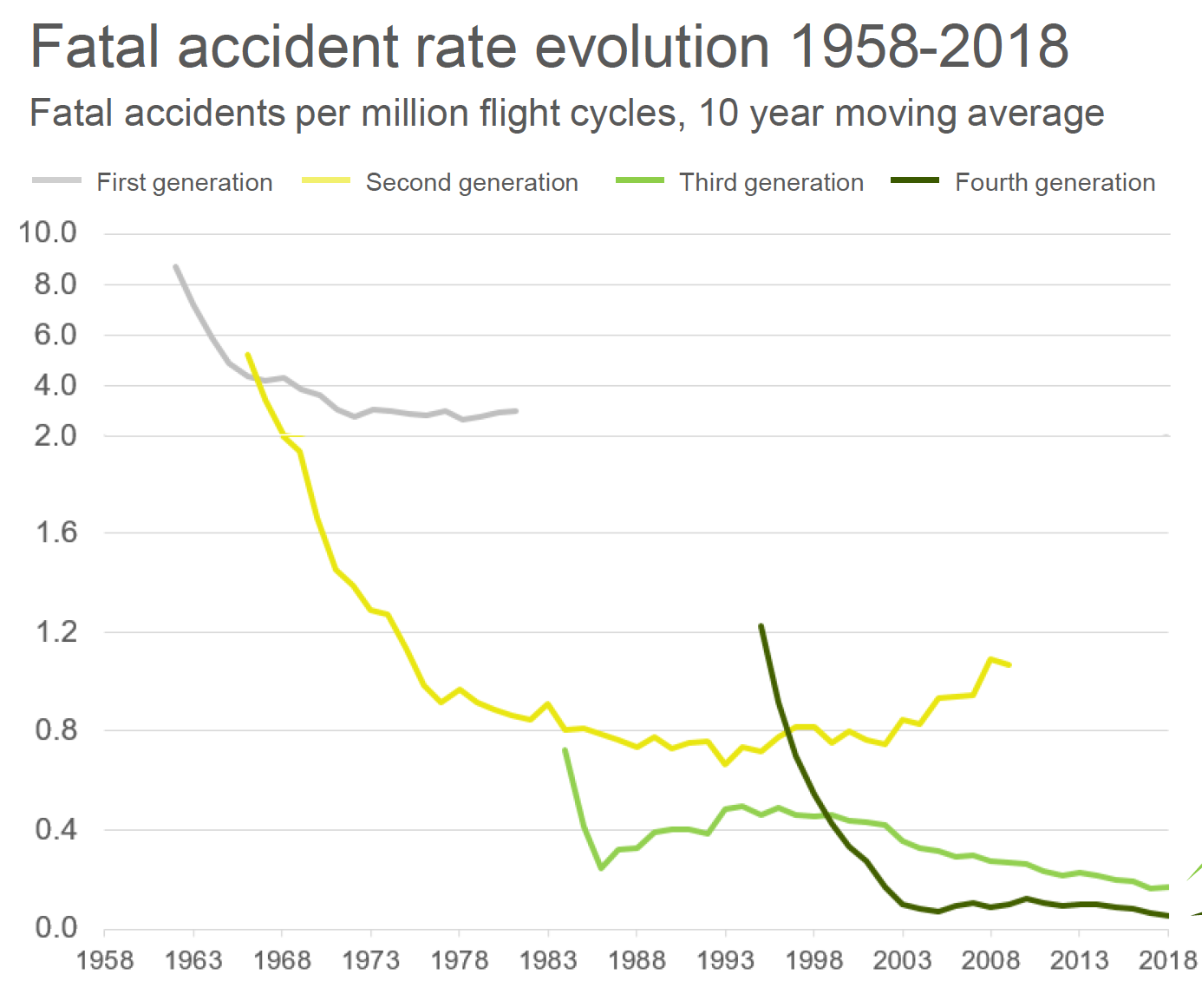
What is safety, really?
How the FAA sees it…
How industry sees it…
NASA SVO Study, https://www.atca.org/Uploads/symposium/2019/WhitePapers/A%20Roadmap%20to%20Certify%20Flying%20Cars.pdf
IATA Safety and Flight Ops Conference, April 2, 2019
https://www.iata.org/contentassets/0772118eec2e40bbba472b862e4f45ec/sfo2019-day1-aircraft-automation.pdf

Slide 9
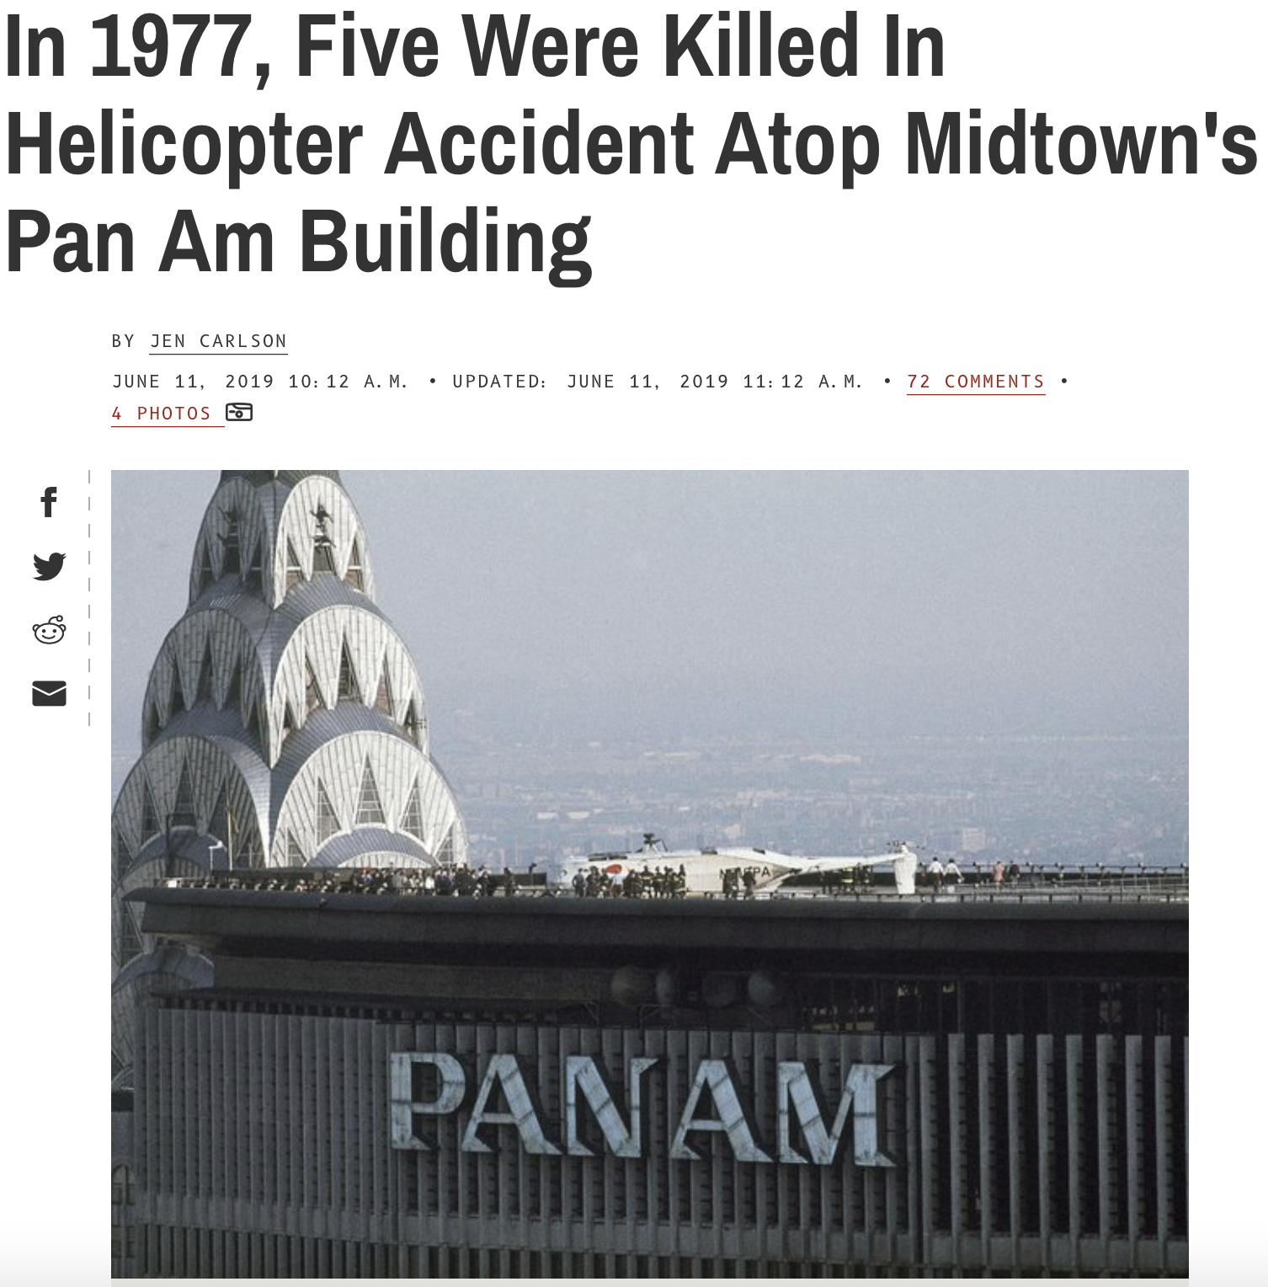
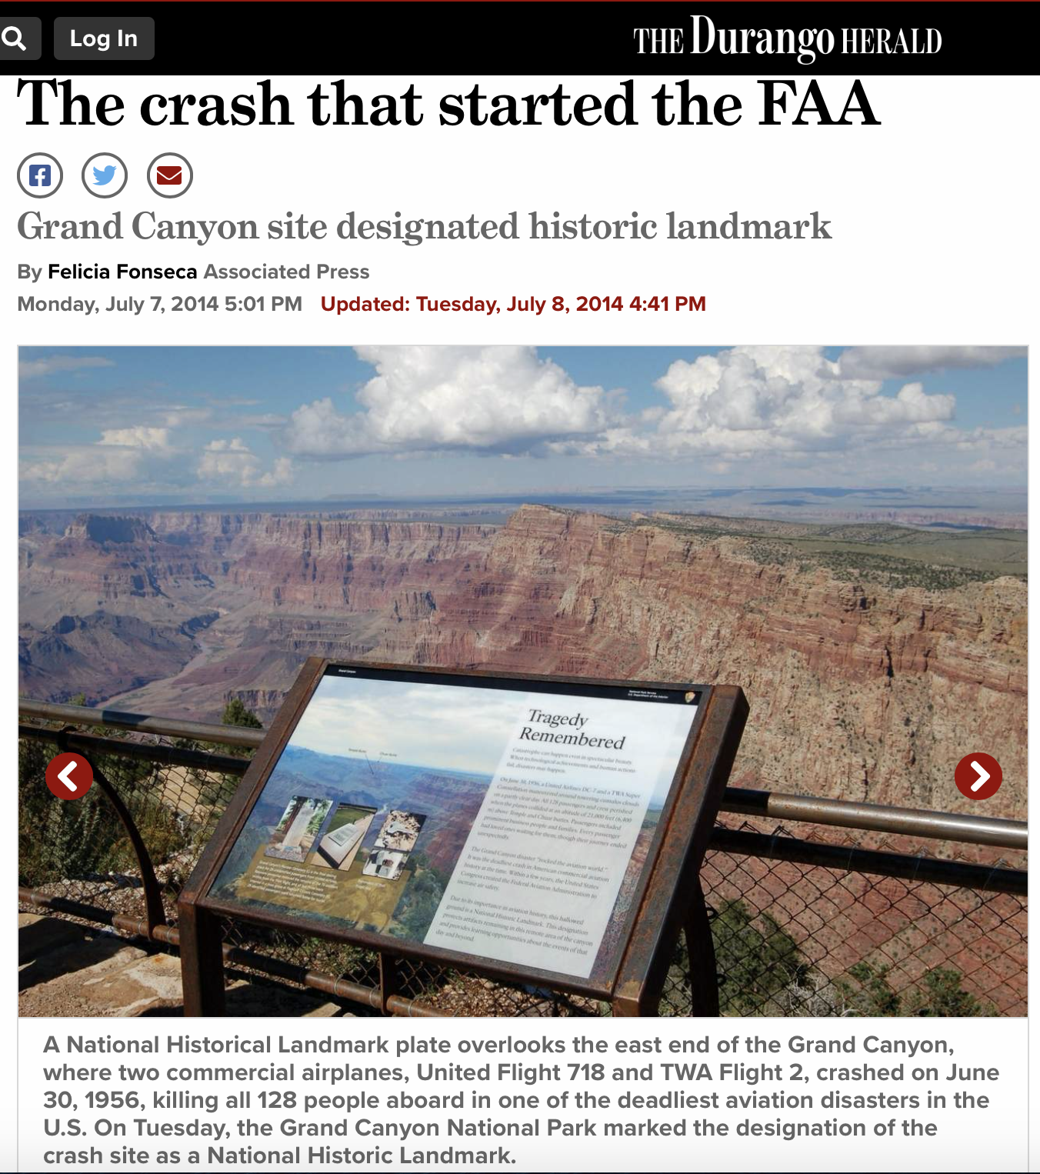
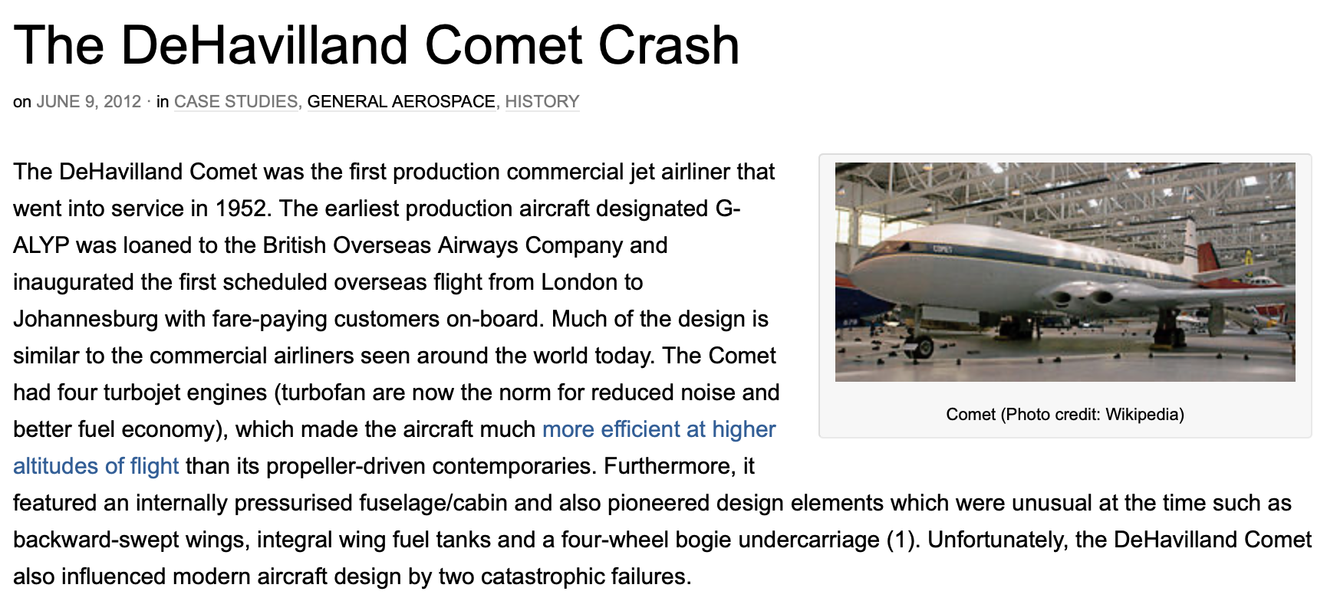
Why is safety important?
Grand Canyon Midair Collision, 1956
~ Durango Herald, July 8, 2014
De Havilland Comet Crashes, 1953-4
~ Aerospace Engineering, June 9, 2012
US Airways accident on Pan Am Building, 1977
~ Gothamist, June 11, 2019
Notes:
Within two years of entering service two of the Comet fleet fell apart during ascent to cruise altitude with a total loss of the aircrafts and the death of 56 passengers. The first production aircraft G-ALYP, scheduled on BOAC Flight 781 from Rome Ciampino to London Heathrow, was lost on January 10, 1954 by the fuselage breaking up in mid-air 20 minutes after taking off. BOAC voluntarily grounded its fleet and engineers suggested 60 immediate modifications to the design to rectify some of the design flaws that were believed to have caused the accident (2). Comet flights resumed on March 23, 1954 but only two weeks later on April 8, 1954 Comet G-ALYY, on the chartered South African Airways Flight 201 from Rome Ciampino to Cairo, again crashed into the Mediterranean sea within 30 minutes of take-off. The entire Comet 1 fleet was then grounded, its Certificate of Airworthiness revoked and the line production at DeHavilland in Hatfield suspended.
https://aerospaceengineeringblog.com/dehavilland-comet-crash/
The Grand Canyon mid-air collision occurred on June 30, 1956, when a United Airlines Douglas DC-7struck a Trans World Airlines Lockheed L-1049 Super Constellation over the Grand Canyon National Park. All 128 on board both flights perished, making it the first commercial airline crash to result in more than 100 deaths. The collision took place in uncontrolled airspace, where it was the pilots' own responsibility to maintain separation ("See and avoid"). This highlighted the antiquated state of air traffic control, which became the focus of major aviation reforms.
https://durangoherald.com/articles/75580
On May 16th, 1977, a New York Airways helicopter killed five people in Manhattan. While it did not crash, it did tip over as it sat idling on the heliport atop the Pan Am Building (now the MetLife Building, at 200 Park Ave) in Midtown. This caused the aircraft to come apart—as it tipped over a large rotor blade snapped off and, as the NY Times described it the next day, "slashed people to death before coming to rest 59 stories below and a block away on Madison Avenue." The first four victims were on the roof, the fifth was on the street below. Others suffered non-fatal injuries.
https://gothamist.com/news/in-1977-five-were-killed-in-helicopter-accident-atop-midtowns-pan-am-building

Slide 10
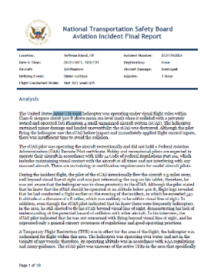
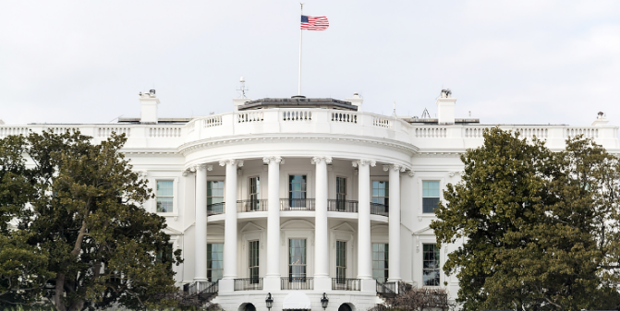
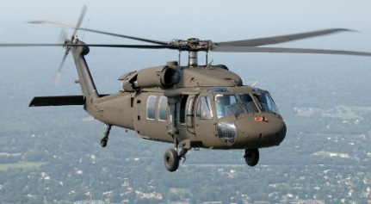
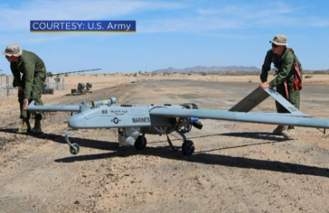
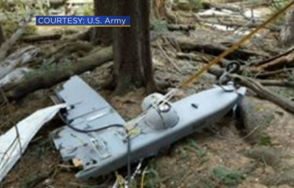
Why is safety important?
“Small Drone Crashes Near White House Despite Ban Against Flights in D.C.”
~ USA Today, Oct. 9, 2015
“Drone Hits Army Helicopter Flying Over Staten Island ”
~ CBS News, Sep. 22, 2017
Aviation in itself is not inherently dangerous. But…it is terribly unforgiving of any carelessness, incapacity or neglect.
Captain Alfred Gilmer 'Lamps' Lamplugh, British Aviation Insurance Group, London. circa early 1930’s.
Better safe than sorry. -Nineteenth-century proverb.
“Missing Army Drone From Arizona Found about 600 miles away in Colorado”
~ Denver Post, Feb. 10, 2017
Notes:
Aviation in itself is not inherently dangerous. But to an even greater degree than the sea, it is terribly unforgiving of any carelessness, incapacity or neglect.
Captain Alfred Gilmer 'Lamps' Lamplugh, British Aviation Insurance Group, London. circa early 1930’s.
The road must be run safe first, and fast afterward.
Rulebook of the New York & Erie Railroad, 1854.
Usually [the cause of aviation accidents] is because someone does too much too soon, followed very quickly by too little too late.
Steve Wilson, NTSB investigator, Oshkosh, WI, August 1996.
Mishaps are like knives that either serve us or cut us as we grasp them by the blade or the handle.
James Russell Lowell, Cambridge Thirty Years Ago, Literary Essays, volume I, 1864-1890.
Of the major incentives to improve safety, by far the most compelling is that of economics. The moral incentive, which is most evident following an accident, is more intense but is relatively short lived.
Jerome Lederer, director of the Flight Safety Foundation for 20 years and NASA's first director of Manned Flight Safety, quoted in Memorial Tributes: National Academy of Engineering, Volume 11, 2007.
Better safe than sorry.
Nineteenth-century proverb.

Slide 11
Factors that affect risk based on Use Case—Takeaways
Right-size the vehicle to the business case
Right-size operational environment to business case
Understand regulatory details (weight, speed, altitude, overflown area) that induce more assurance evidence
Complex avionics for safety critical functions are a key driver
Allow for informed tradeoffs regarding mitigations
Design Factors | Representative Range | Reason this Factor Matters
# People Onboard | 0, 1-2, 3-4, 5-8, 9-19 | Harm to people
Mass | Micro (<4.4 lb), Small (<55 lb), Medium (<7000 lb), Large (>7000 lb) | Harm to people
Operational Speed | Low Speed, Medium Speed, Subsonic, Supersonic | Harm to people
Remote Control Authority | Inner Loop, Outer Loop, Autonomous | Interference with crew safety role
GCS to UA Ratio | 0:1, 1:1, 1:n, m:1, m:n | Interference with crew safety role
Operational Factors
Population Density | None, Sparse, Medium, Dense | Harm to people
Operational Altitude | <500 ft, <18000 ft, <60000 ft, >60000 ft | Degradation of safety margin
Air Traffic Density | None, Light, Moderate, Heavy | Degradation of safety margin
Mission Duration/ Range | Minutes, Hours, Days, Weeks | Degradation of safety margin
Visual Conditions | Day VMC, Night VMC, IMC | Interference with crew safety role
Operational Volume | Contained, Uncontained | Degradation of safety margin
Access to Overflown Area | Controlled, Uncontrolled | Harm to people
Pilot locality | VLOS-RLOS, BVLOS-RLOS, VLOS-BRLOS, BVLOS-BRLOS | Interference with crew safety role
Maddalon, J. M., Swieringa, K.A., Greenfeld, I., Brandt, S. L., Robinson, P. I., Wu., M. G., Lee, S., Volk, P., and J. Del Frate, Best Practices Identified through the Completion of UAS Flight Demonstrations, NASA/TM-2020-5011606, January 2021

