Slide 1
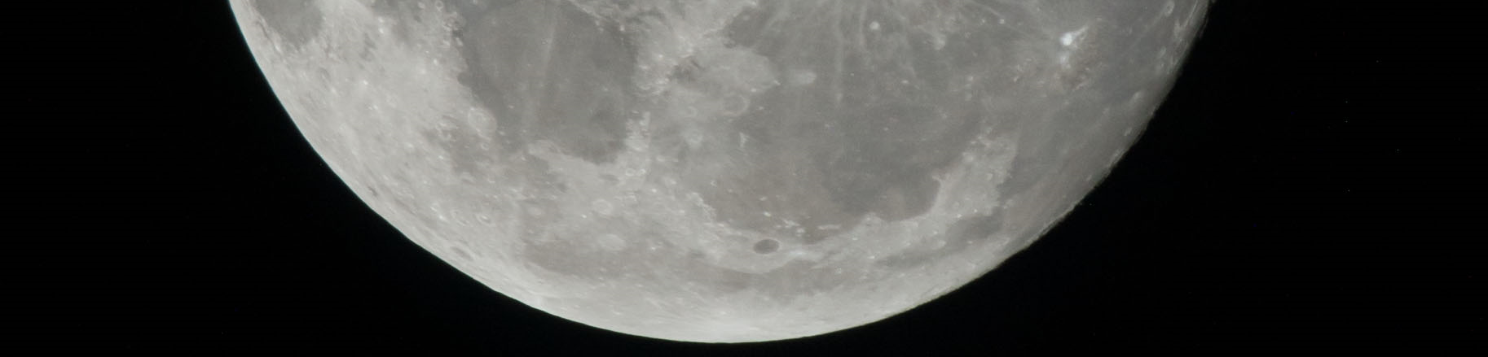

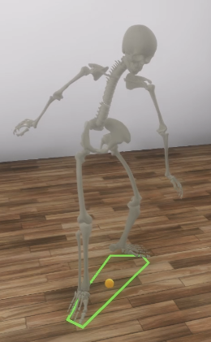
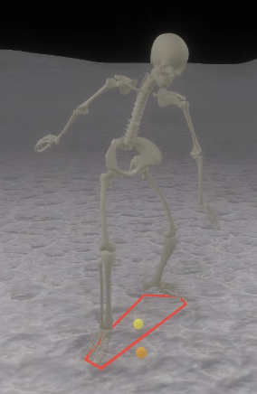
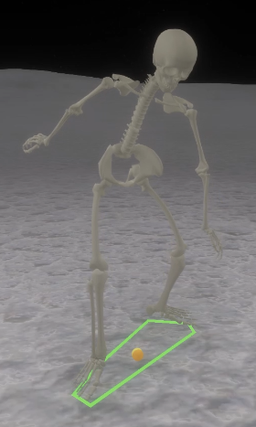
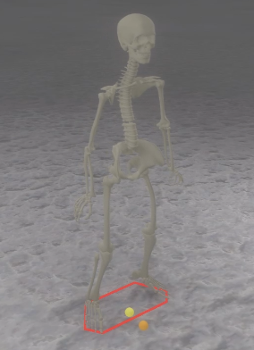
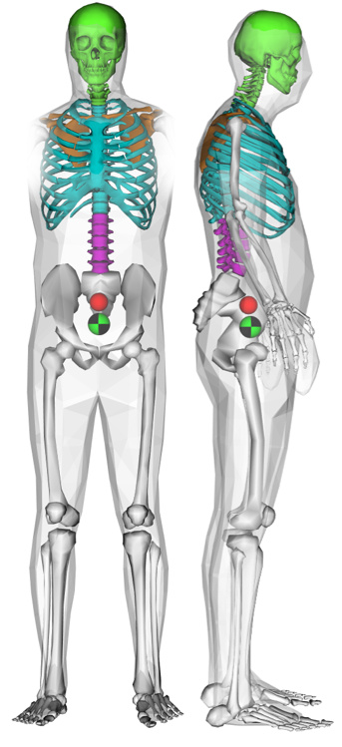
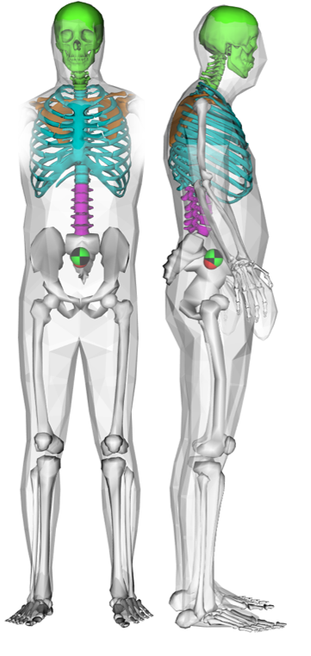
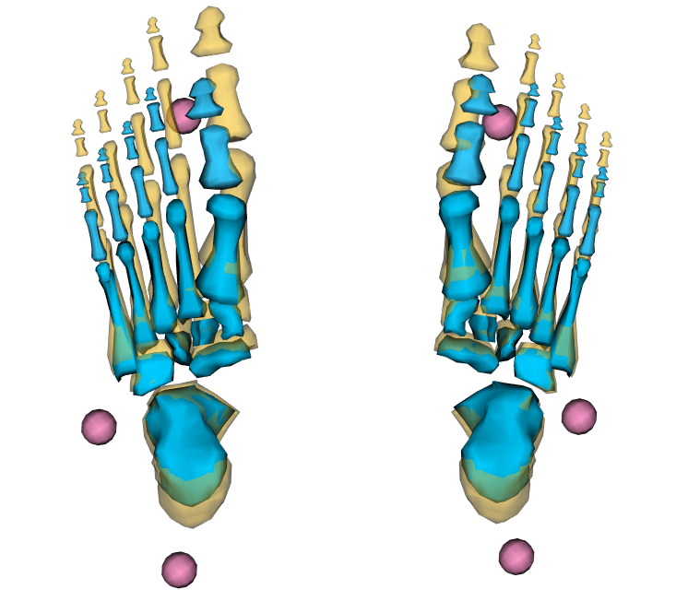
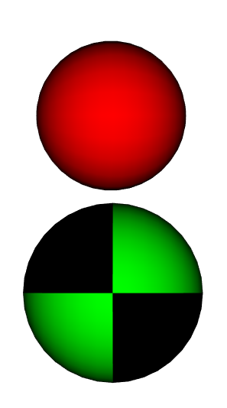

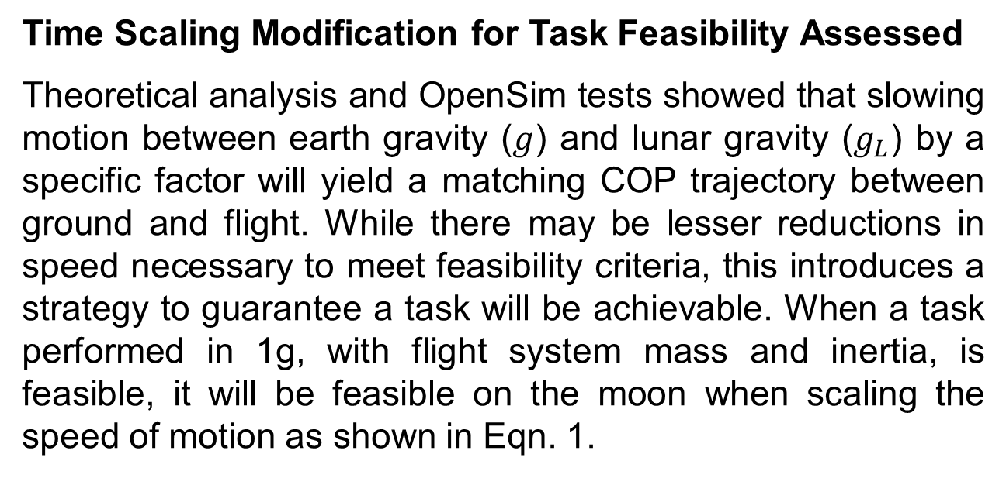
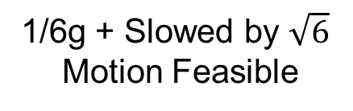
Lunar Surface Operations Modeling Using Digital Astronaut Simulation
National Aeronautics and Space Administration
Johnson Space Center (JSC) 2020 JSC Technology Showcase: FY20 CIF IRAD
Kaitlin H. Lostroscio/ kaitlin.h.lostroscio@nasa.gov, Leslie J. Quiocho, Ken Huffman, David Frenkel, Charlotte Bell, Fouad Matari
Technology Area (TA): 6.3.2 – Long Duration Health; 6.3.3 – Behavioral Health; 6.3.4 – Human Factors; 11.2.3 – Human-System Performance Modeling; EA TIP 4.2.3.2 – Digital Astronaut (DAS)
TRL: start 4 / current 6
FY20 IRAD PROJECT Overview
During Apollo, crew members experienced a number of falls while engaging in extravehicular activity. The Digital Astronaut Simulation (DAS) expanded human biomechanics modeling tools to begin investigating this prospective mission safety and success challenge for the Artemis program.
INNOVATION
A core capability was developed to detect if a motion is dynamically feasible in a given gravitational environment. Fed by motion capture and mass properties data, this technology enables observation of whether tasks performed in 1G can be performed the same way in lunar gravity or if they require modifications.
Outcomes
Time Scaling Modification for Task Feasibility Assessed
Theoretical analysis and OpenSim tests showed that slowing motion between earth gravity ($g$) and lunar gravity ($g_{L}$) by a specific factor will yield a matching COP trajectory between ground and flight. While there may be lesser reductions in speed necessary to meet feasibility criteria, this introduces a strategy to guarantee a task will be achievable. When a task performed in 1g, with flight system mass and inertia, is feasible, it will be feasible on the moon when scaling the speed of motion as shown in Eqn. 1.
1g to 1/6g
Feasibility
Scale Factor
$$\sqrt{\frac{g_{L}}{g}}≅\sqrt{\frac{1}{6}}$$
(Eqn. 1)
When scaling time by Eqn. 1 is performed, ground reaction forces and moments as well as joint forces and torques are theoretically scaled by the same amount.
Feasibility Criteria Established
If the projection of the Center of Mass (CM) on ground goes outside the human Base of Support (BOS), without a correcting step, the motion is not dynamically feasible.
If the ground force Center of Pressure (COP) goes outside the BOS, the motion is not dynamically feasible.
Model Scaling Investigated
Accurate size and mass distribution of each subject-specific OpenSim model [1-3] is important in producing reliable calculated terms for checking motion feasibility. Manual scaling techniques were investigated for ensuring accurate foot geometry is used in defining the BOS. OpenSim model CM locations and mass distribution results were compared with those obtained via 3D body scans. Improvements to the accuracy of OpenSim model mass distribution and CM location did not significantly improve calculated ground reaction force and moment results. Additional study of COP results and segment CM locations may lead to actionable improvements to consider.
1g
Motion Feasible
1/6g
Motion Not Feasible
1/6g + Slowed by $\sqrt{6}$
Motion Feasible
BOS
CM projection
INFUSION SPACE / EARTH
This technology is applicable toward preparations for Artemis and missions in alternate gravity environments. With infusion in ground-based training and testing, this tool can prospectively assess representativeness of analog environments/systems and inform conceptual operations.
PARTNERSHIPS / collaborations
The Anthropometry & Biomechanics Facility (ABF/SK3) team provided 3D scan and anthropometric data to compare with our human models for the scaling investigation. ABF also provided insights and consultation based on their experience with suited and lunar operations, which motivated our joint hosting of a TCC Wearable Technologies Challenge for Human-Suit Interaction Measurement. Our partnership with the University of South Florida’s CARRT provided initial data to compare our motion-based method of calculating COP with force plate measurements. The project team also thanks John DeWitt (KBRwyle) and Beth LeWandowski (GRC) for their consultation in the formulation of the work as well as ER facilities for test support.
Future Work
This work will continue as a Year-2 Center Innovation Fund award involving verification activities in the Prototype Immersive Technology (PIT) lab and application for the Active Response Gravity Offload System (ARGOS), and/or incorporation of additional xEVA aspects.
COP
Visualizer displaying case where ground-based motion is not feasible in lunar gravity. Lateral accelerations and angular momentum were too large; hence adjustments are needed.
Representative foot geometry is critical for defining the BOS during stand-in-place type tasks. A method was developed to augment foot scaling with manual measurements instead of motion capture data which used few markers to define. The image (above) depicts the foot scaled based on marker position in yellow and the manually scaled foot in blue.
Scan CM
OpenSim CM
Overlays of scan on OpenSim model before (left) and after (right) mass redistribution demonstrate the resulting shift in OpenSim CM position. It was confirmed that the remaining offset in CM positions was not attributed to model alignment, but rather could be indicative of differences in individual body segment partitioning, grouping, and CM locations.
[1] S. L. Delp, F. C. Anderson, A. S. Arnold, P. Loan, A. Habib, C. T. John, E. Guendelman, and D. G. Thelen, “OpenSim: open-source software to create and analyze dynamic simulations of movement,” IEEE Trans Biomed Eng, vol. 54, no. 11, pp. 1940–1950, 2007 (2007)
[2] Rajagopal, Apoorva, et al. "Full-Body Musculoskeletal Model for Muscle-Driven Simulation of Human Gait." IEEE Transactions on Biomedical Engineering 63.10 (2016): 2068-2079. (2016) https://simtk.org/home/full_body/
[3] R. K. Huffman, W. K. Thompson, C. A. Gallo, L. J. Quiocho, “Improvement Of Scaling And Inverse Kinematic Results with Additional Upper Body Joints Added to Opensim Rajagopal Model”, NASA Human Research Program Investigator’s Workshop, (2019).
27021-1

