Slide 1
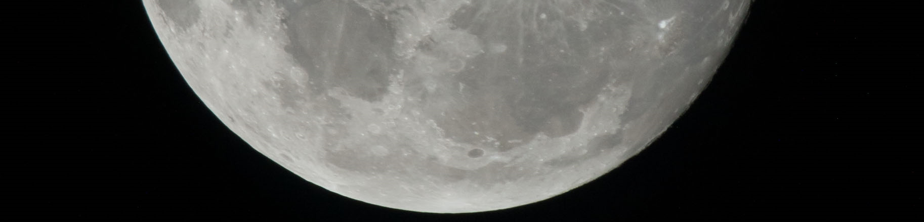
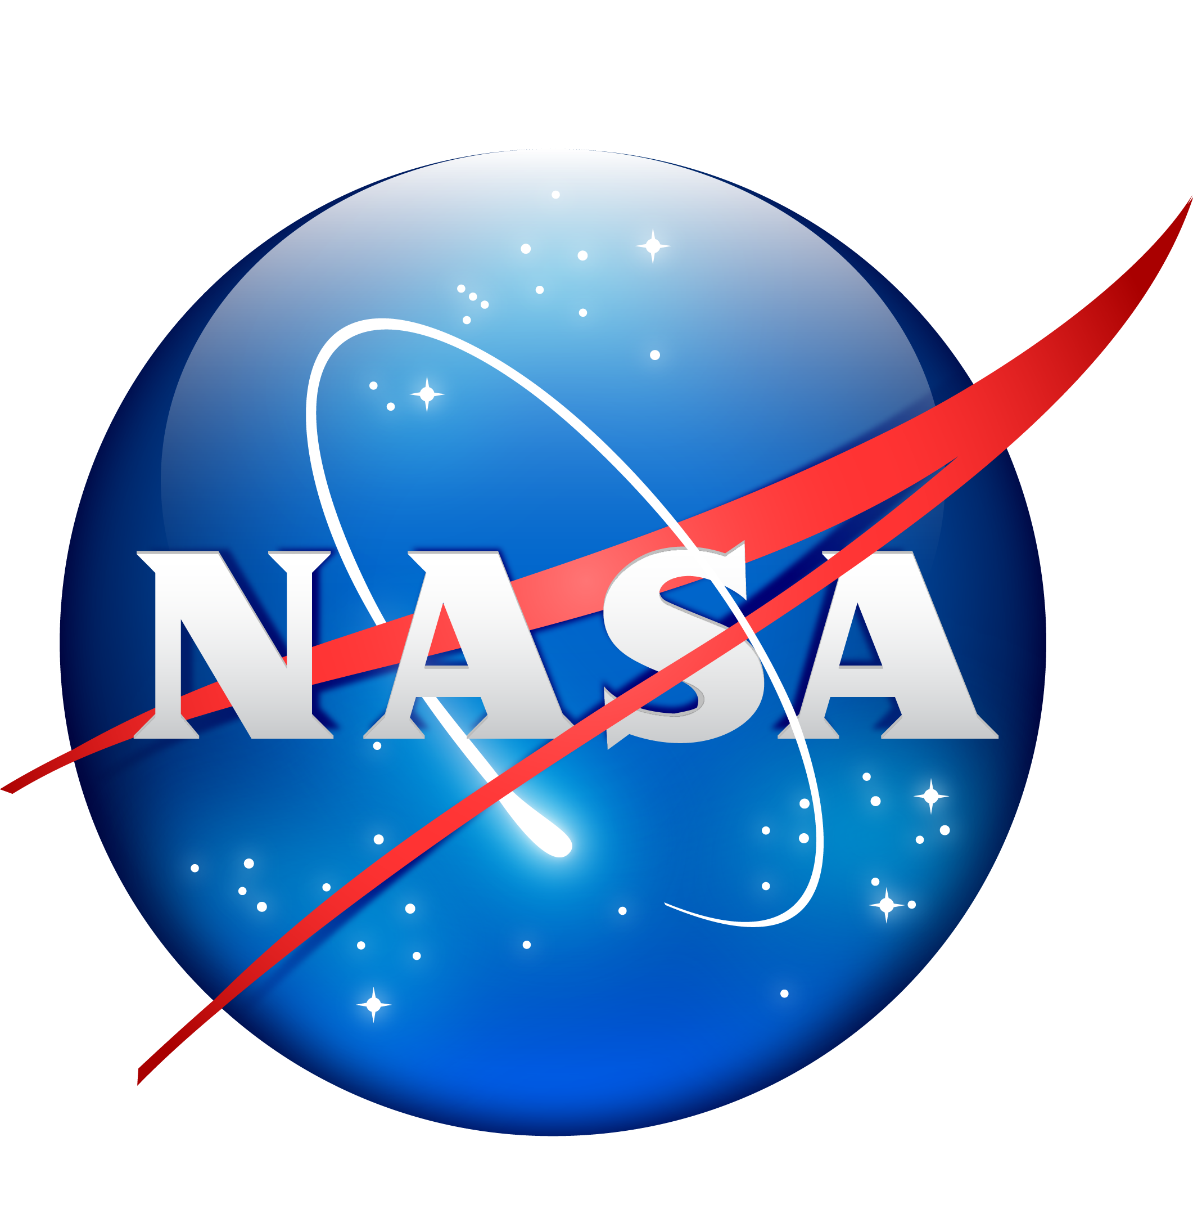
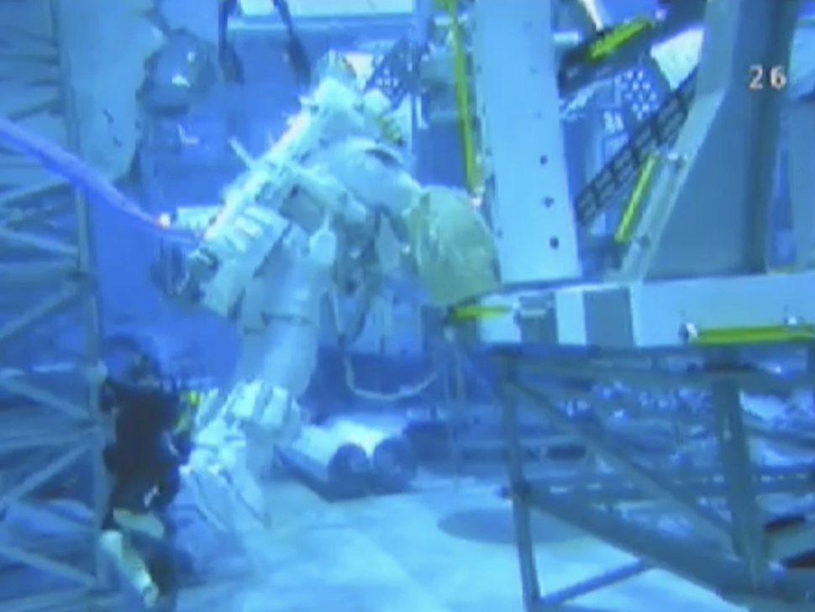
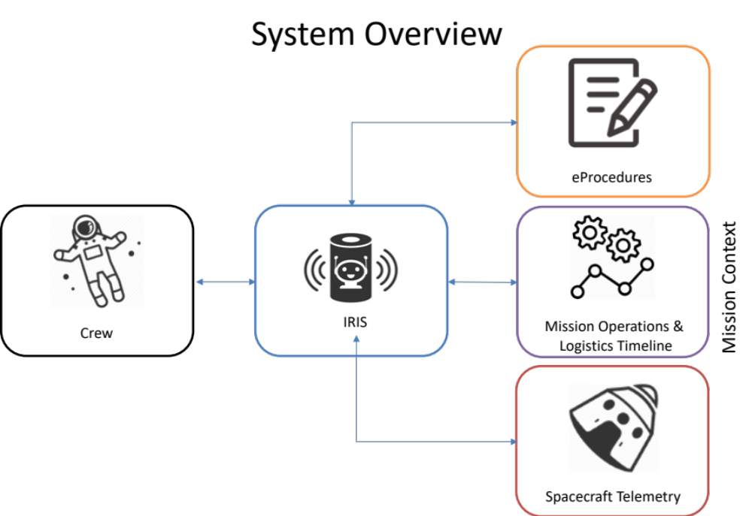
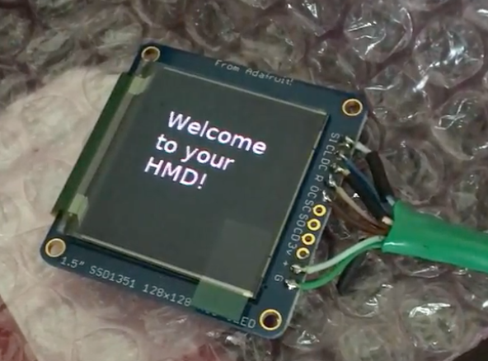
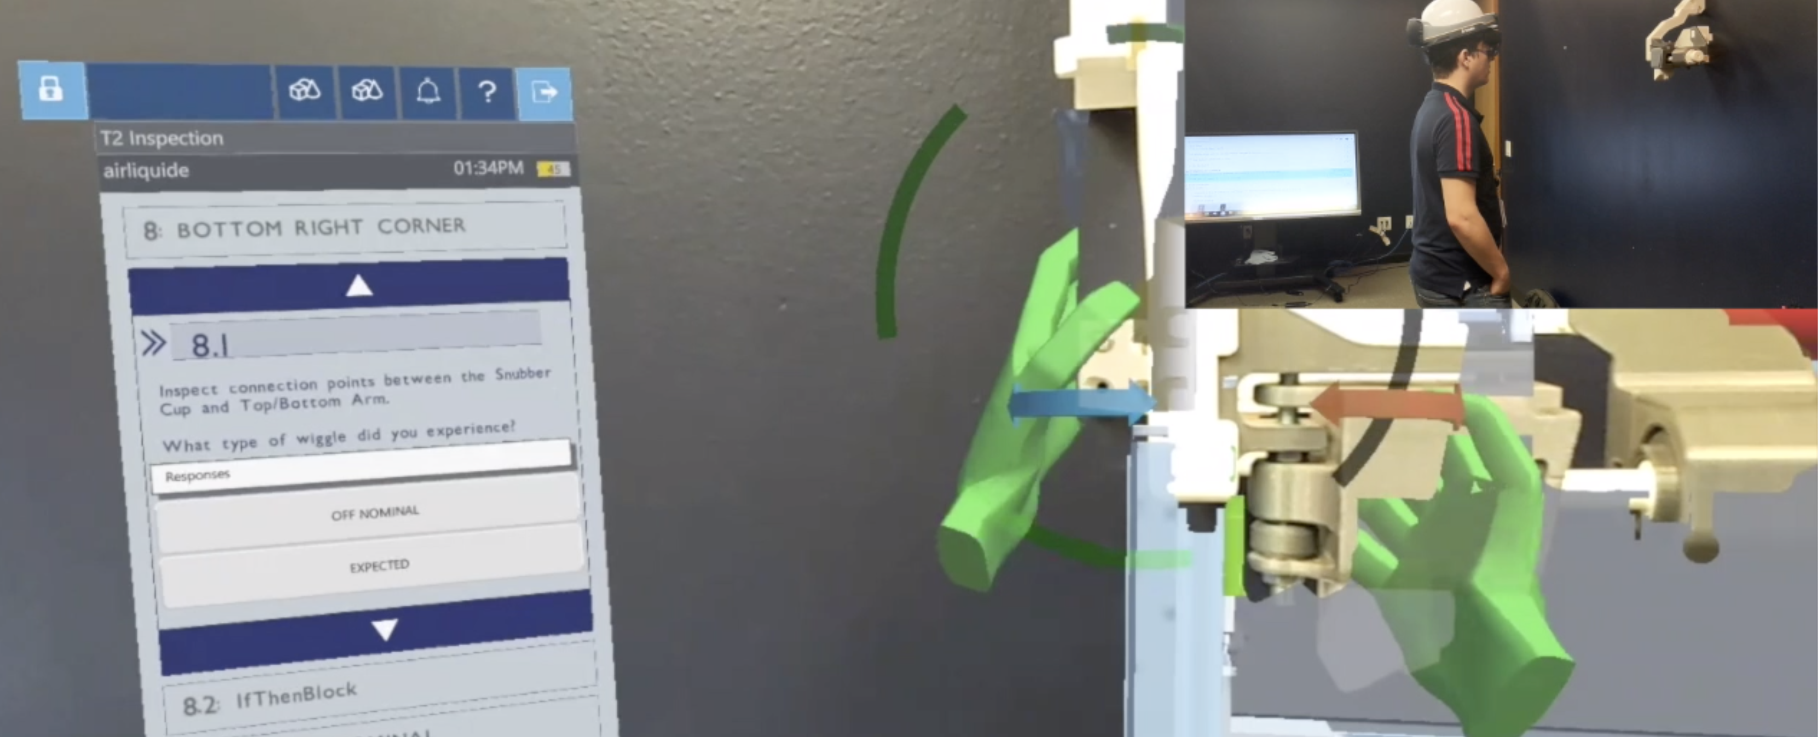
Intelligent Response and Interaction System (IRIS)
National Aeronautics and Space Administration
Johnson Space Center (JSC) / White Sands Test Facility (WSTF) 2020 JSC Technology Showcase: FY20 CIF IRAD
Aly Shehata / aly.shehata@nasa.gov, Lui Wang, William Baker
Technology Taxonomy Area (TX): EA Domain Plan Gap Number (DPN) – 4.4.2 (Intelligent Advisor Product Line). HAT Needs Numbers - 4.7.a.E (Crew Autonomy beyond LEO) and 7.5.a.E (Mission Control Automation beyond LEO). Related TABS Numbers – Crew Automated Planning & Execution, Adjustable Automation, JIT training and integrated flight operation system 4.5.2.4, 4.5.5.0, 7.5.1.0, 7.5.3.1 and 7.5.3.2
TRL: Start 3 / Current 4
FY20 IRAD PROJECT Overview
Crew Assistance technologies will be an essential element to the upcoming Lunar exploration missions. Operations and training burdens must be minimized, in order to meet Lunar & Mars challenges and compressed schedule. To achieve crew autonomy and independence from the ground support, an intuitive dialogue-based voice assistant must be developed to assist human operator and to be the communication hub between the crew and ground. This project aims to accelerate human exploration and support crew autonomy developing an intuitive, dialogue-based, voice crew assistant.
INNOVATION
Historically, voice systems at NASA have been developed in an offline and proprietary environment. These technologies were typically rule-based systems that produced a very rigid voice system compared to the average smartphone in 2020. Today, industry utilizes heavy cloud-based machine learning technologies to achieve state-of-the-art conversational systems (such as Google Assistant and Siri). These machine-learning based systems tend to produce a much more generalized and robust voice solution that can generalize to different variants of dialogue and noise environments. Typically, these technologies would not be available in an offline space environment with minimal resources. However, on-the-edge machine learning solutions are also quickly maturing, allowing industry to begin deploying these conversational agents “on-prem”, with a minimal hardware footprint.
Our approach is to use the on-prem machine learning computing paradigms to establish the needed voice infrastructure to support crew deep space missions. This approach is building upon recent breakthroughs in voice and conversational processing technology. Our objective is to build a highly dialogue-based voice assistant can be built to support a wide variety of space-flight use-cases.
Outcome
The IRIS project developed the components needed to rapidly train highly conversational voice agents using Google Cloud technologies within the IRIS framework. We have also developed the necessary architecture to support the end-to-end use-case for procedures, command-and-control, and knowledge-based questions. This allows users of the IRIS framework to rapidly prototype and wireframe conversations around already existing procedures or auxiliary systems
Figure 2: IRIS HMD Command & Control Evaluation at the NBL
Figure 3: System Overview
INFUSION SPACE / EARTH
As machine learning applications become more widely adopted throughout the NASA software and hardware community, certification and integration of these new computing platforms, within flight systems, will be necessary.
The IRIS Voice Assistant will be unique capability to all Human Spaceflight Programs, AES, STMD, Orion and Commercial Crew.
Seeking ground demonstrations opportunities including Gateway iPAS, NEEMO and HERA analog testing facilities (FY 20)
Based on feedback from evaluation and testing, the proposed system will be productized and deployed for flight demonstration during Artemis or on ISS. (FY 22)
PARTNERSHIPS / collaborations
JSC - Engineering: ER, EV, MCC: CD, SD, Support: IO, CTO, APPDAT, Digital Transformation
Google – Google Cloud & Applied AI, Engineering Support
Future Work
Machine learning paradigms can be applied to solve a new class of problems that can be applied to multiple domains. Inherently, state-of-the-art voice recognition, machine-vision, and fault-detection solutions are gravitating towards these machine learning paradigms and are enabling a whole new suite of applications to support autonomy, such as self-driving vehicles.
These technologies are readily becoming available to be applied within the NASA use-case to support crew autonomy on deep-space missions. Through this work, we have also identified that “on-prem” capabilities are required to support machine-learning application in an offline space-environment.
Figure 1: Procedure assistant demo using IRIS, ProX, and HoloLens

