Slide 1
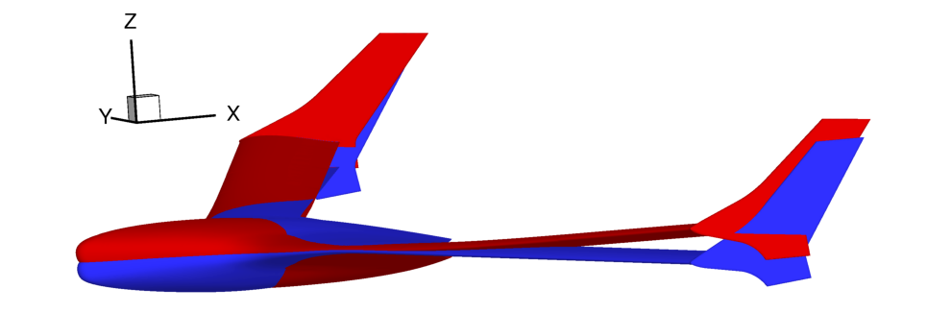
Computational Fluid Dynamics Reduced-Order Modeling
for Aircraft Stability & Control Prediction
Dr. Brett Hiller
NASA Langley Research Center, USA
NATO STO Early Career Scientist Event, Virtual Symposium, March 15, 2021

Slide 2

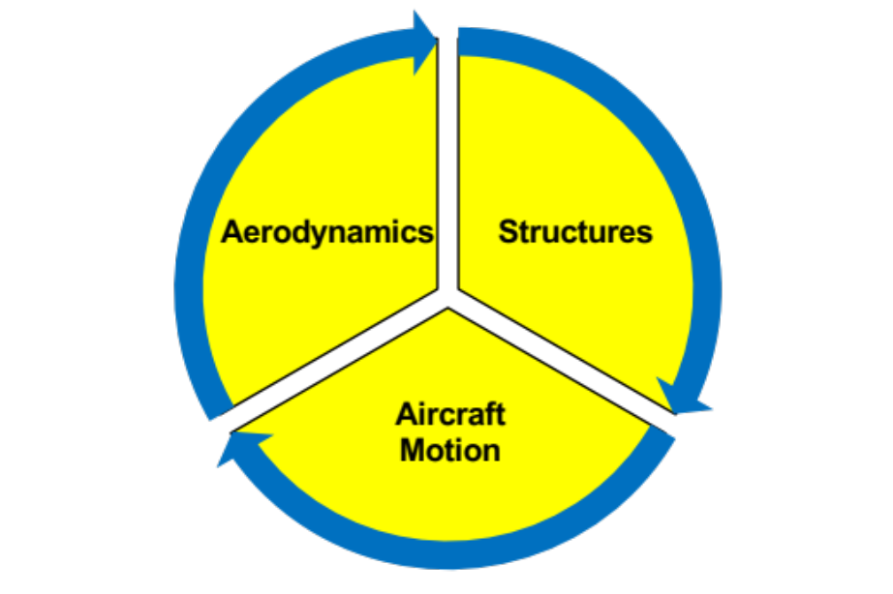


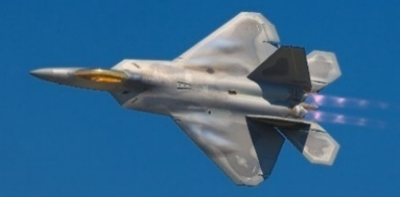
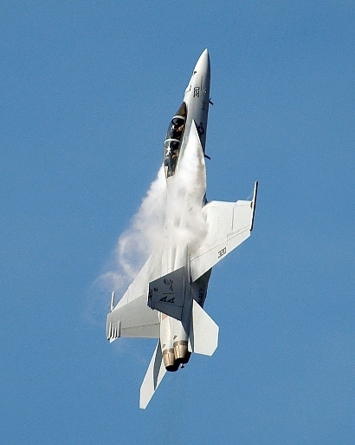
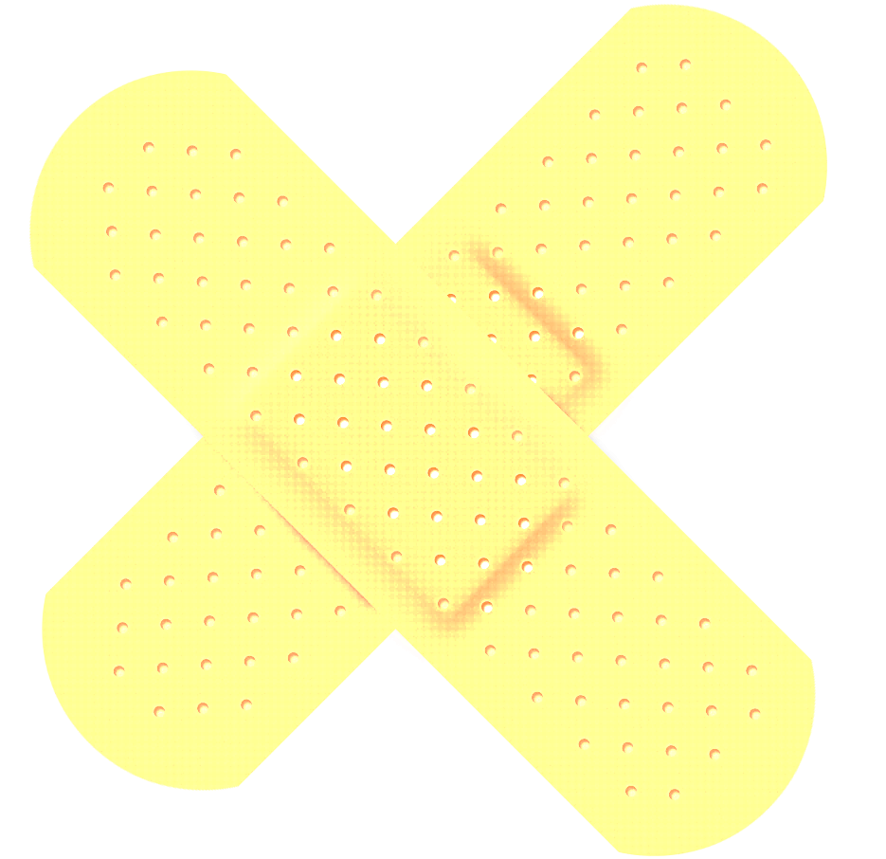
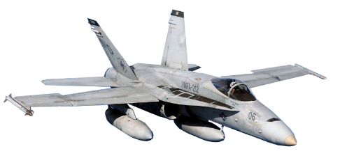
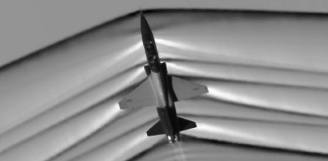
Aerodynamic Prediction Challenges
      Aeroelasticity
Complex Interactions
      Control Surface Deflections
      Gusts
      Fast Motion Rates
Fly & Fix Approach
      Separated Flow
25+ Flight Programs
since the 1940s have encountered stability and control (S&C) issues in flight testing [1]
      Shock Waves
Notes:
[1] Chambers, J. R., & Hall, R. M. (2004). Historical review of uncommanded lateral-directional motions at transonic conditions. Journal of aircraft, 41(3), 436-447.

Slide 3
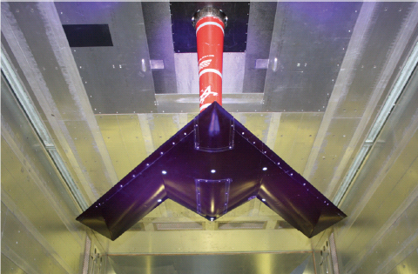
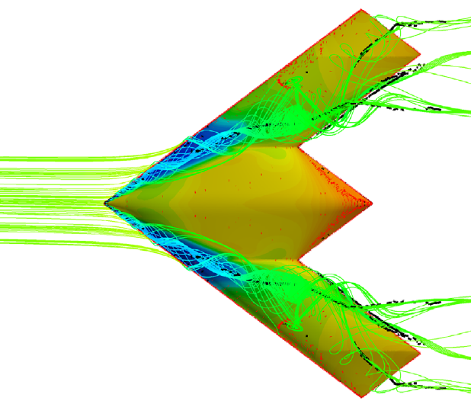
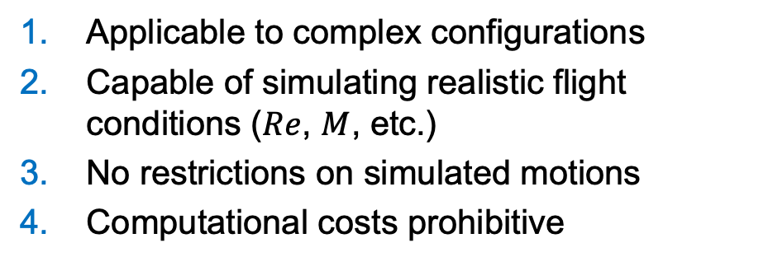
Toward Virtual Flight Simulation
Physical Testing
Computational Fluid Dynamics Simulation
SACCON Wind Tunnel Test [2]
SACCON Flight Simulation [3]
Significant costs in building and testing
S&C measurements limited to low speeds
Test rig kinematic constraints
Calibration for interference & wall effects
Applicable to complex configurations
Capable of simulating realistic flight conditions ($Re$, $M$, etc.)
No restrictions on simulated motions
Computational costs prohibitive
Notes:
[2] Cummings, R., & Schuette, A. (2010). An integrated computational/experimental approach to UCAV stability & control estimation: overview of NATO RTO AVT-161. In 28th AIAA Applied Aerodynamics Conference (p. 4392).
[3] Frink, N. (2010, June). Strategy for dynamic CFD simulations on SACCON configuration. In 28th AIAA Applied Aerodynamics Conference (p. 4559).

Slide 4
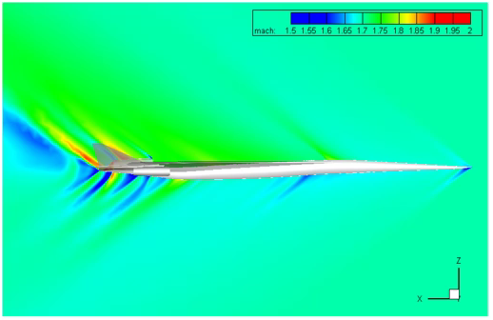

The Need for Reduced-Order Modeling
Traditional Flight Dynamics Predictions
  Approach: CFD leveraged for quasi-steady S&C derivatives
  Benefit: Resolves nonlinear aerodynamic flow features
  Limitations: Incapable of resolving unsteady flow phenomena
Unsteady Aerodynamic Reduced-Order Modeling
  Method: CFD snapshots of flow features due to unit changes
  in maneuver inputs, recombined for trajectory predictions
  Benefits:
    Resolves nonlinear and unsteady flow phenomena
    Coupled simulations predict aerostructural interactions
    Once created, CFD-based trajectory predictions in seconds
  Limitations:
    Requires intelligent snapshot sampling of flight space
    Predictions only as good as CFD state of the art
    Requires change to flight simulator infrastructure
N+2 Forced Oscillation Simulation [4]
X-56 Simulation: Rigid vs. Aeroelastic [5]
Notes:
[4] Bozeman, M. D., Tai, J. C., Robertson, B. E., & Mavris, D. N. (2018). Prediction of Dynamic Stability Derivatives for Flexible Aircraft using FUN3D. In 2018 AIAA Aerospace Sciences Meeting (p. 2063).
[5] Hiller, B. R., Frink, N. T., Silva, W. A., & Mavris, D. N. (2020). Aeroelastic Indicial Response Reduced-Order Modeling for Flexible Flight Vehicles. Journal of Aircraft, 57(3), 469-490.

Slide 5
Latest Publication
Hiller, B. R., Frink, N. T., Silva, W. A., & Mavris, D. N. (2020). Aeroelastic Indicial Response Reduced-Order Modeling for Flexible Flight Vehicles. Journal of Aircraft, 57(3), 469-490.
Thank You!
Contact: Brett Hiller <brett.hiller@nasa.gov>

