Slide 1


ISE Energy Efficiency Webinar:
Innovations: Driving Prosperity, Slashing Emissions
Energy and Aviation
Gaudy M. Bezos-O’Connor
Project Manager
NASA Electrified Powertrain Flight Demonstration Project
Notes:
How important is aviation to the U.S. economy?
NASA Aeronautics directly benefits an aviation sector that annually generates more than one-and-a-half trillion dollars in total U.S. economic activity*, and an aerospace positive trade balance of nearly $78 billion.**
NOTE that these are pre-COVID numbers. COVID-19 has impacted us all but has dealt a particularly damaging blow to the global aviation industry. NASA Aeronautics is leaning in to these times, working with industry and government partners to regain public confidence in our aviation system, accelerate new technology development through a stable commitment to research and development, and find opportunities for rapid adoption of new technologies to help us adjust to this new environment.
Another impressive way to look at numbers:
The number of passengers flown in 2019 is enough to fill every NFL stadium in the United States 440 times. (NFL stadiums in the US hold about 2.1 million people.)
The weight of cargo carried in 2019 is about the same as the weight of 3,672 Great Walls of China. (The Great Wall weighs about 116 billion pounds and is considered the heaviest manmade object on Earth.)
Passengers and cargo carried numbers come from the U.S. Bureau of Transportation Statistics. Numbers shown are for previous full year.
•Source: “The Economic Impact of Civil Aviation on the U.S. Economy,” Federal Aviation Administration, January 2020
** Source: “Leading Indicators for the U.S. Aerospace Industry,” International Trade Administration, 2019

Slide 2







Sustainability – a Global View
“Sustainable development is development that meets the needs of the present without compromising the ability of future generations to meet their own needs.” - UN World Commission on Environment and Development
Meet the Mission
Value to People
Mobility
Freedom
Health
Meet the Mission
Protect the Planet
Protect Local Areas
Protect Ecosystems/wildlife, ….
….
Meet the Mission
Value to Business
Profit to Shareholders
Jobs

Slide 3
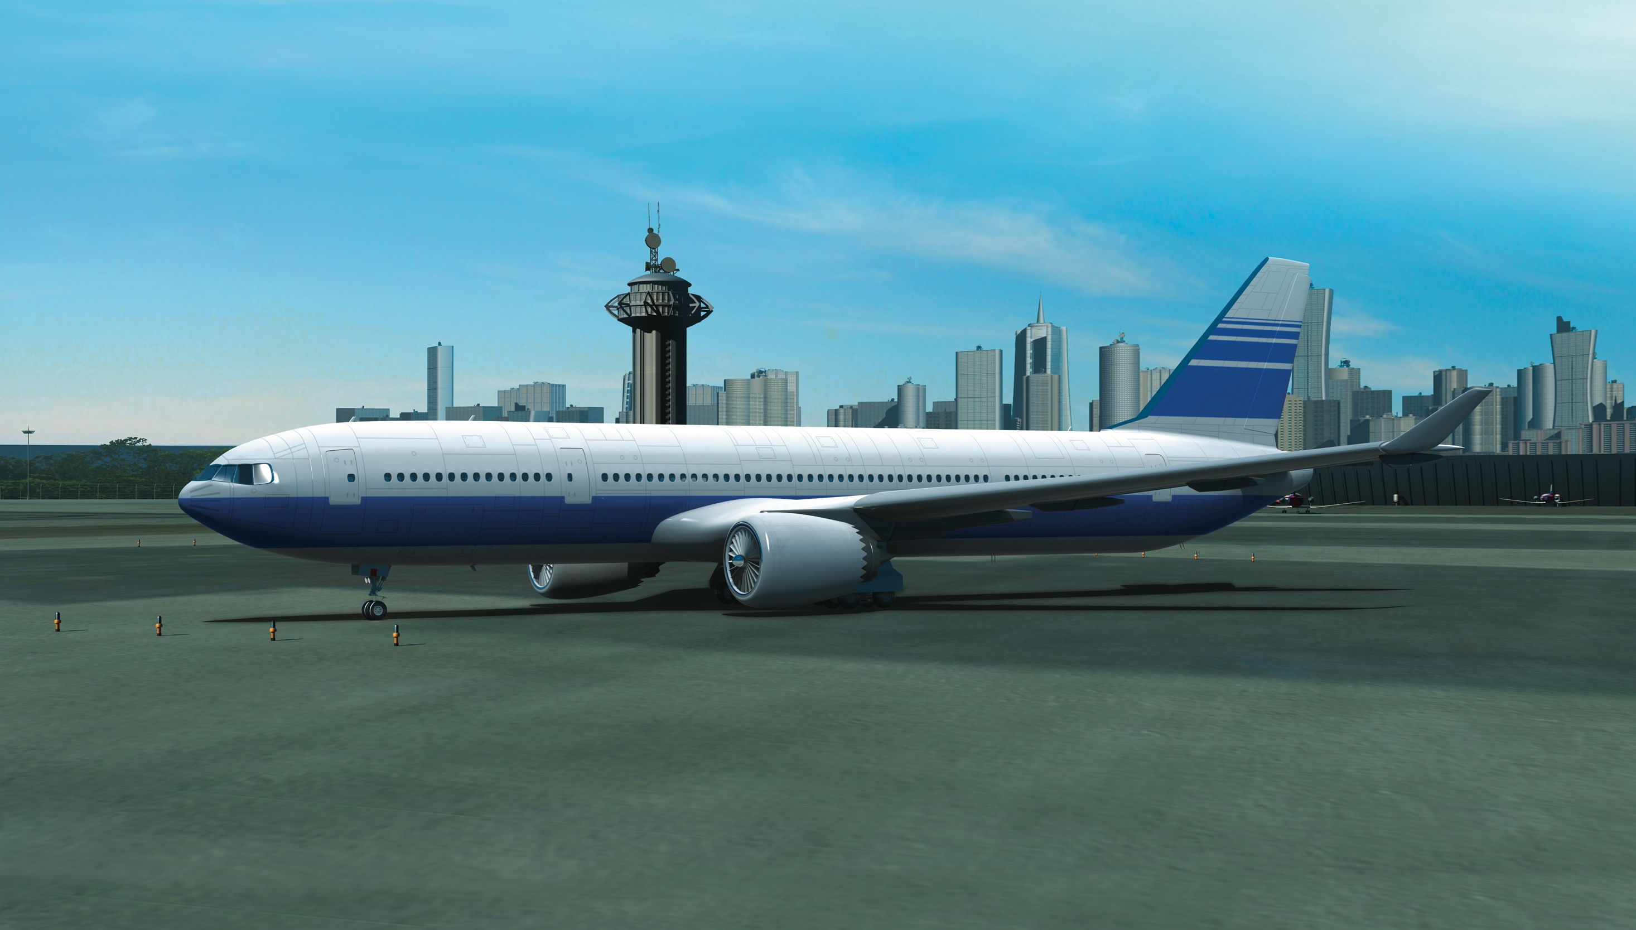
Aviation: Vital to our economy and culture
Pre-COVID
$78 billion positive trade balance; only U.S. industry with positive trade balance
• $1.8 trillion total U.S. economic activity
• 10.9 million direct/indirect jobs
• 21.3 billion tons of freight transported by U.S. airlines in 2019
COVID Impacts Delay Projected Growth
U.S. passenger airlines incurred pre-tax losses of $46B in 2020 ($35B net losses). But, air cargo demand reached an all-time high in 3Q 2020.
  (Airlines for America, “Impact of COVID-19 Data Updates)
Global reduction of 2,699 million passengers (-60%)
  (ICAO, “Uniting Aviation”)
Major disruption in new commercial aircraft production and deliveries
  Boeing Commercial Market Outlook 2020-2039
Post-COVID: Aviation Resilience Supports Recovery
Recovery slowly begins in 2021
Passenger numbers back to 2019 levels by 2024 at earliest, starting with domestic
  (https://www.iata.org/en/pressroom/pr/2020-11-24-01/)
20 years from now, world fleet will be 87% larger; needed to serve Asian markets
Disruption also calls for new strategies for new fleets that further improve efficiency and sustainability
  (Boeing Commercial Market Outlook 2020-2039)
Notes:
NASA Aeronautics has made decades of contributions to aviation. Our research heritage goes back more than 100 years to the days of the National Advisory Committee for Aeronautics, the organization from which NASA was created in 1958.
Every U.S. commercial aircraft and U.S. air traffic control tower has NASA-developed technology on board.
That’s why we say, “NASA’s with you when you fly.”
The technologies and knowledge shown here are woven into the DNA of aviation as we know it today.
(For details of tech items, visit: https://www.nasa.gov/sites/default/files/files/c_litho_12_07_09_v2_high.pdf. Similar charts for general aviation, military aircraft, civil rotorcraft and tilt rotor are available at https://www.nasa.gov/aero/nasa-aero-lithographs.html)

Slide 4
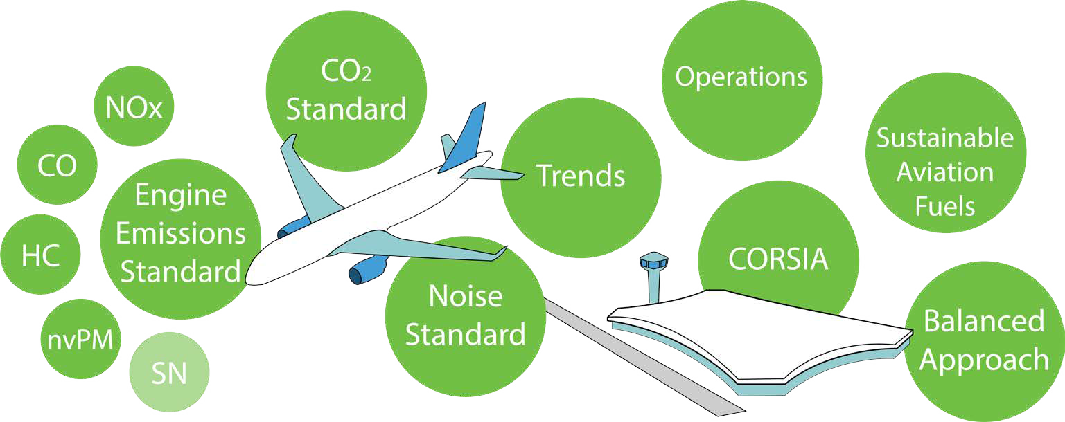
International Civil Aviation Organization (ICAO) Committee
on Aviation Environmental Protection (CAEP)
At the end of each 3-year work cycle, ICAO’s CAEP conducts an assessment of future environmental trends in aviation:
Aircraft engine Greenhouse Gas (GHG) emissions that affect the global climate
Aircraft noise
Aircraft engine emissions that affect Local Air Quality (LAQ)
Ref. Environmental Trends in Aviation to 2050 CHAPTER ONE Aviation and Environmental Outlook

Slide 5
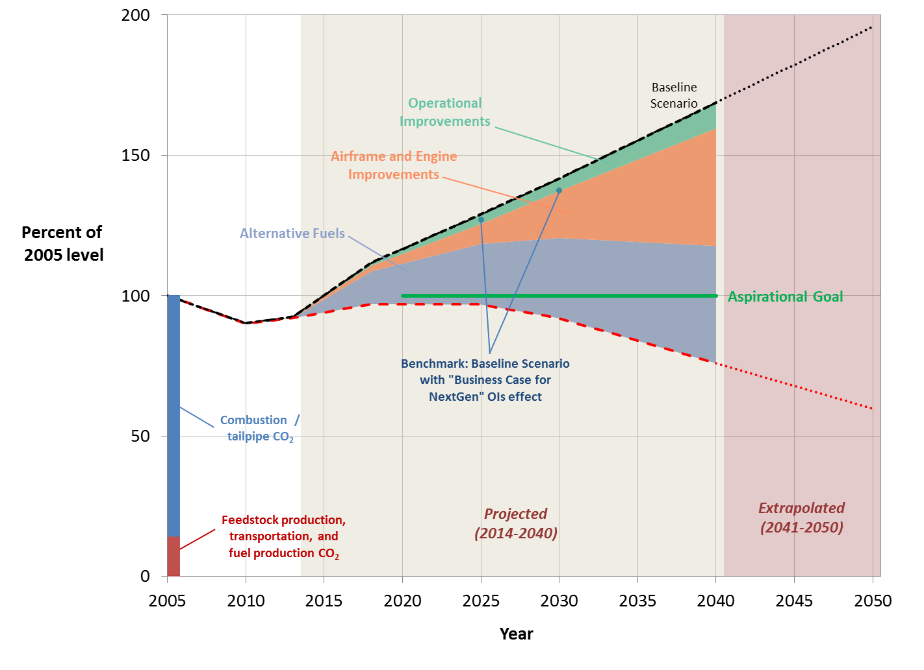
Projected life-cycle CO₂ emissions impacts
– aggressive system improvement scenario
Life-Cycle CO₂ Emissions
(as percent of 2005 level)
Reference: ICAO 2015

