Slide 1
Optimization of sensor materials using physical vapor transport growth method
Christopher Cooper, Sonali Saraf, Dan Kazal, Brian Cullum, Fow-Sen Choa, Bradley Arnold, Lisa Kelly and N. B. Singh
University of Maryland, Baltimore County, Baltimore, MD
and
Ching Hua Su
NASA Marshall Space Flight Center, Huntsville, AL
We thank NASA Headquarters and Marshall Space Flight Center for financial support

Slide 2
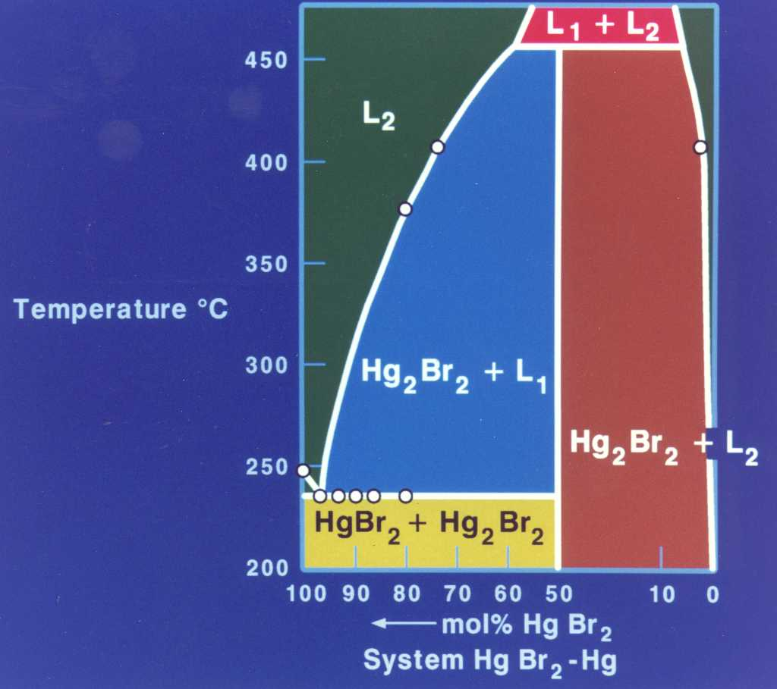
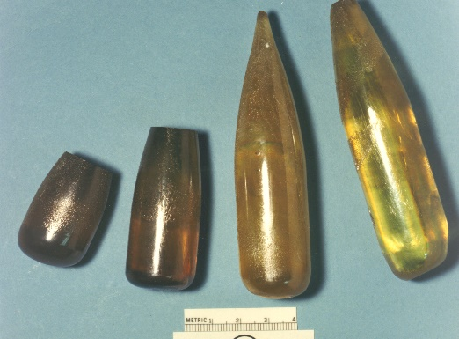
Optimization of sensor materials using physical vapor transport growth method
Outlines
  Objectives
  Background
    Effect of growth parameters
    Effect of fluid flow
  Experimental design, methods
    Horizontal vs vertical configuration
  Experimental method
  Results
  Conclusion
Decomposing melt and high vapor pressure prohibits melt growth and PVT is good method
PVT grown crystals
PVT is an excellent method when there is decomposition during growth

Slide 3
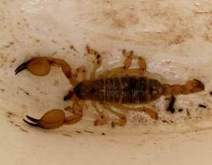
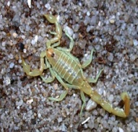
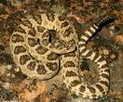
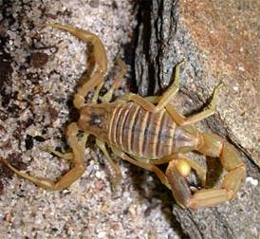
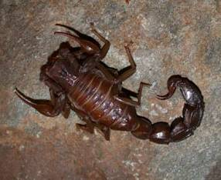
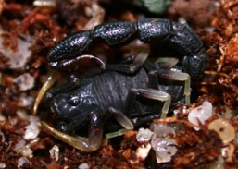

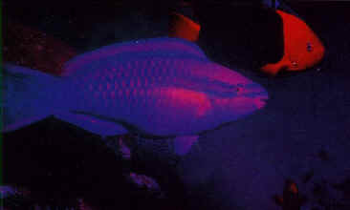
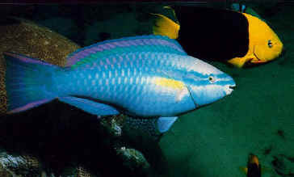

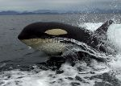
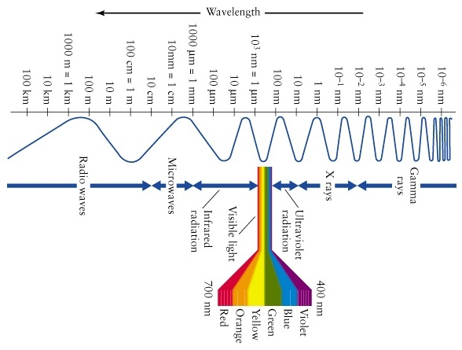
Thrust on bioinspired sensors
There is a great need for a sensor with potential ultraviolet vision of birds, IR heat sensing of snakes, photoreceptors of scorpions sensing from deep UV to LWIR, and aquatic life in the UV through the red.

Slide 4
Concept for bioinspired sensing
  biosensor designs are based on:
  Animals have great sensing ability before storms, tsunami, earthquake etc. (Piezo sensing, dog nose, skin changes)
  Large fishes do not get hit with boats, ships etc. (Piezo )
  Imaging capability (changing color of sensor e.g. eyes)
  Changing skin for sensing as change of weather (dyes)
  Contact sensors (contact potential, thermal, mechanical and chemical)
Bio sensors and bio inspired sensors can be designed based on novel materials

Slide 5
Optimization of sensor materials using physical vapor transport growth method
  Background on materials growth methods
  Bridgman method (BM)
    Vertical BM
    Horizontal MB
  Czochralski method(CZ)
    Moving crucible
    Moving seed
  Vapor transport method
    Physical vapor transport
    Molecular beam assisted
    Laser assisted (PLD etc.)
    Chemical vapor transport (CVD)
    Molecular organic CVD
  Solution growth method
  Travelling solvent/heater method (TS/TM)
In decomposing materials with incongruent systems and high vapor pressure systems:
Melt growth methods such as BM, CZ can not be used since melt decomposes
Solution growth can not be used due to insolubility
TS/TM can not be used due to miscibility or solubility
Method depends on the material and size

Slide 6
Growth of bio sensor materials using physical vapor transport growth method
  Objectives
  The objectives are to evaluate feasibility of physical vapor transport method for the growth of sensor materials and to determine effect of parameters on the quality of grown materials.
Process used by Su et al will be used; Opt. Eng. 56(7), 077106 (2017),J. Crystal Research and Technology, 180023, 1-10 (2019)., Optical Materials 60, 474-480 (2016), J. Materials Today 4, 4 5478-5487 (2017).
Method depends on the material and size

Slide 7
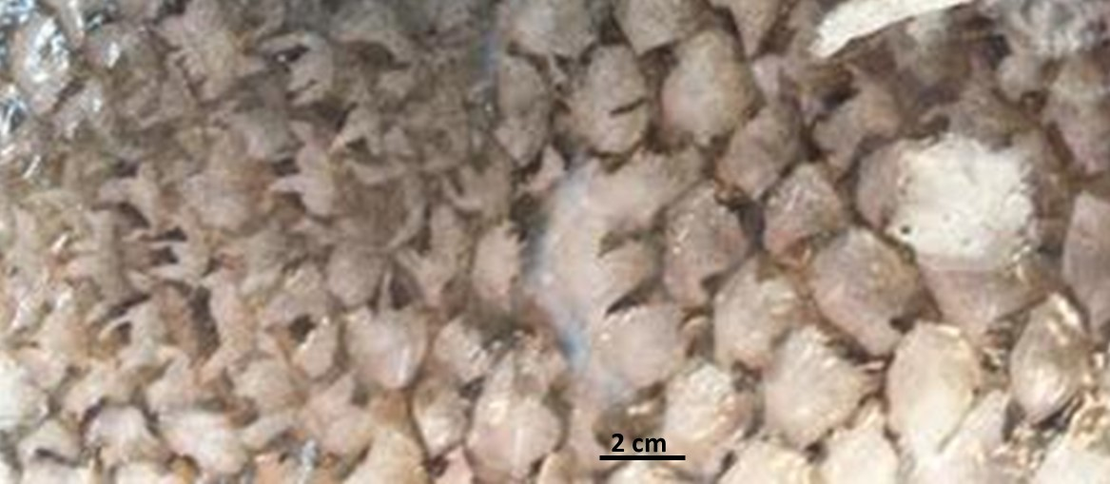
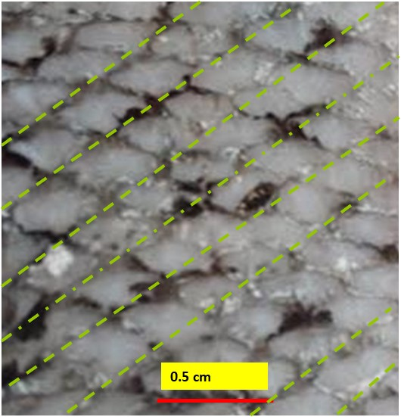
Optimization of sensor materials using physical vapor transport (PVT) growth method
  During the growth of nano-, micro-, thin film and bulk crystals, in addition to growth parameters, fluid flow is most important factor.
  Fluid flow affects the morphology and hence performance
(b)
(a)
Irregular pattern on the skin of a typical pond salmon fish and (b) regular patterns on the skin of a typical salmon fish. Both were almost identical in size.
Method depends on the material and size

Slide 8
Previous research using PVT on IR detector materials in our lab
Growth studies: PbSe pure and Sn doped
Studies are performed with physical vapor deposition on silicon substrates
  Effect of growth temperature
  Morphologies
  Resistivity
  Effect of annealing
  Transition of morphologies
There is limited data for Sn-doped materials on various substrates for MWIR detectors
Papers published in Optical Eng. And SPIE proceedings

Slide 9
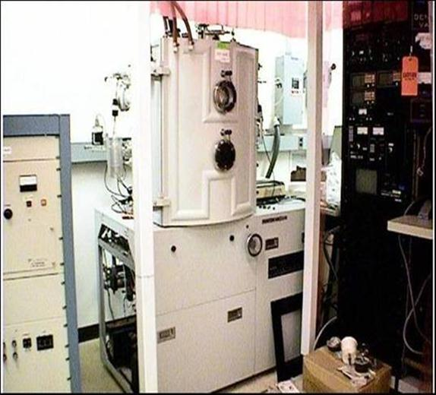
Commercial PVT DENTON system used by us
Materials System
  PbSe and PbS, 99.9999% purity used as source material
  Tantalum boat
  Resistively heated
Substrate
  Si (111)
  Dilute HF etch to remove native oxide
Process
  Base vacuum in 10⁻⁷ Torr range
  Stationary, resistively heated 2’ substrate mount
  Temperature of substrate varied
  PVD process
  PbSe sublimation
  1 K/sec Deposition Rate
Characterization
  SEM, X-ray, 4-point probe
  D* (sensitivity) TBD
PVD Growth of material

Slide 10
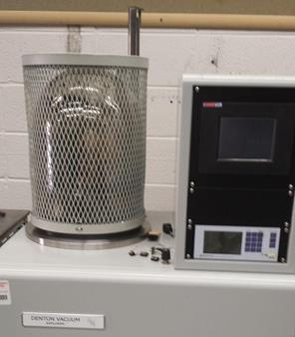
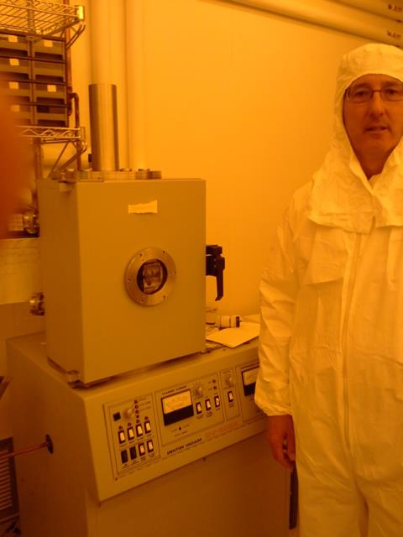
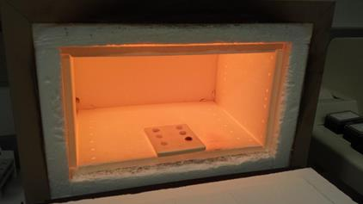
We are using several systems for the growth of materials for PVT
DENTON Evaporator
We have several growth chambers available at UMBC

Slide 11
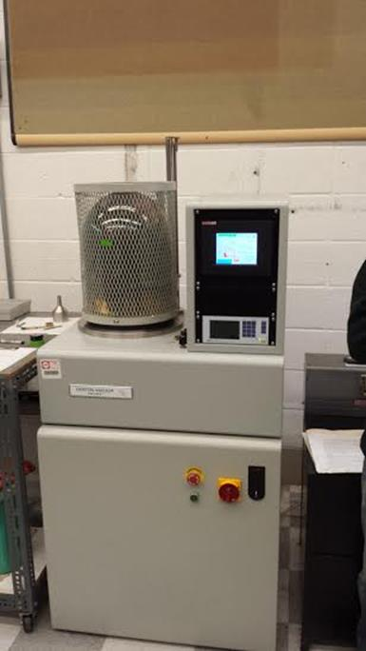
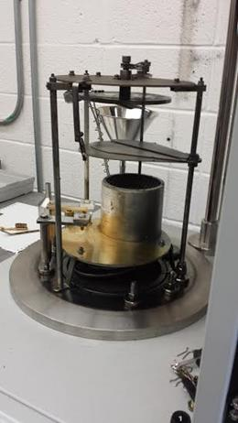
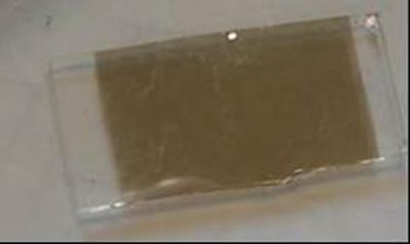
PVD Furnace used for deposition in present study
Example of Lead tin selenide sample grown by PVD on a glass substrate
DENTON Furnace
Crucible and holder
Temperature and transport path can be controlled during deposition

Slide 12
PVD Furnace used for deposition of PbSe, ZnSe, and several other materials
Example of Lead tin selenide sample grown by PVD on a glass substrate
DENTON Furnace
Crucuble and holder
Temperature and transport path can be controlled during deposition

Slide 13
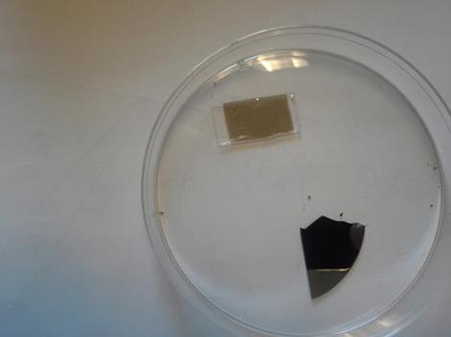
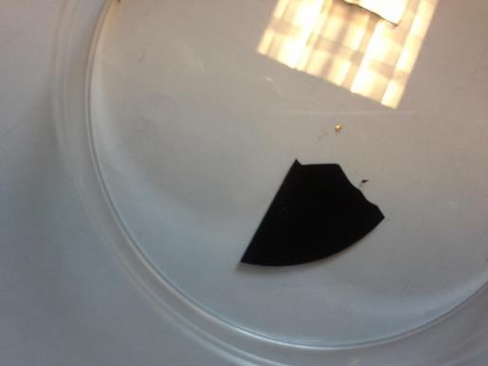
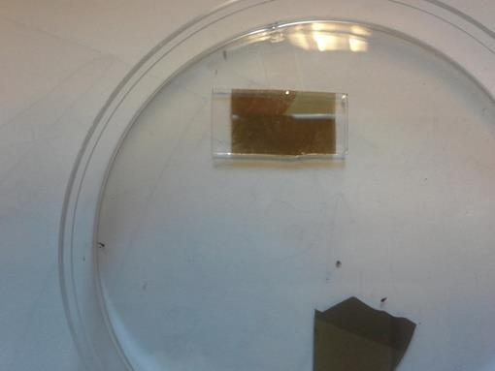
We used high resistivity Silicon and glass as substrates
We cut the Si wafers in 4 pieces
Several deposition runs were performed using PbSe and tin doped PbSe source materials
Time of deposition was 5-10 minutes
Present attempt was to study effect of tin on PbSe

Slide 14
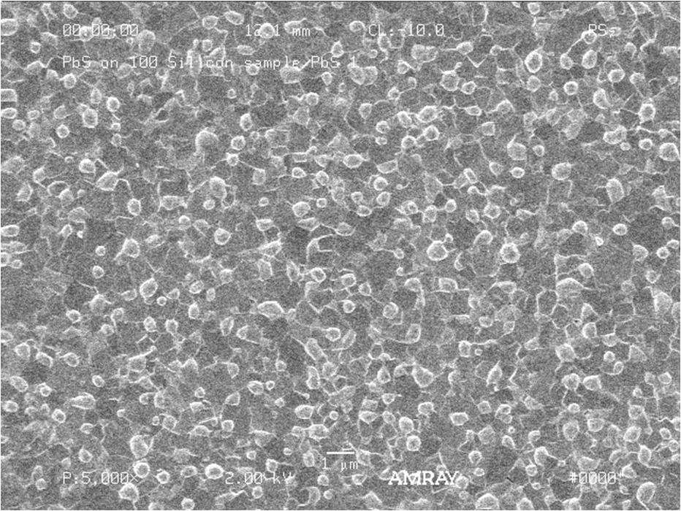
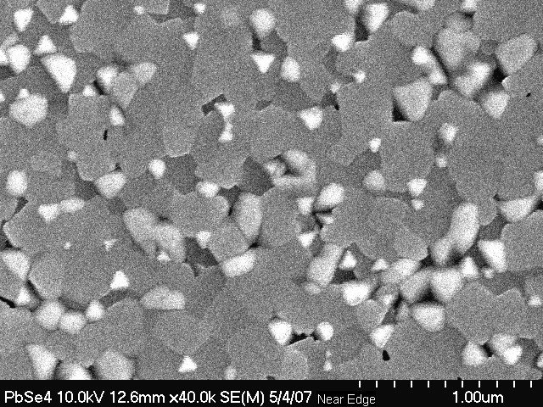
Growth of PbSe, an IR sensing material in two different conditions
a
b
c
film grown on Silicon substrate
morphology at low ΔT showing uniform morphology
large ΔT showing different shaped grains and nonuniformity
Morphology is different and varies with growth condition

Slide 15
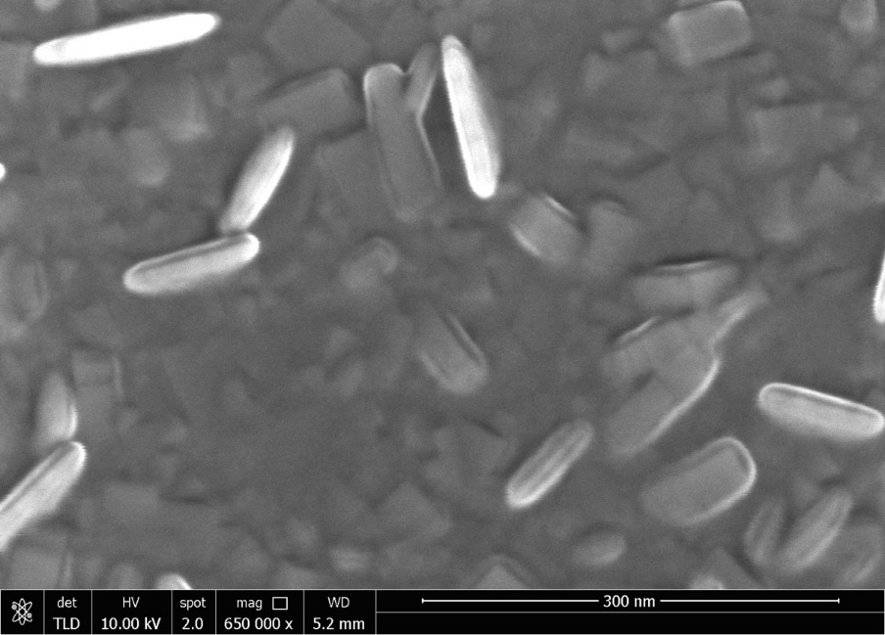
Examples of nanomorphology of pure PbSe material on silicon substrate
Purity had significant effect on the morphology:,
Elongated morphology on the nanocubes were observed

Slide 16
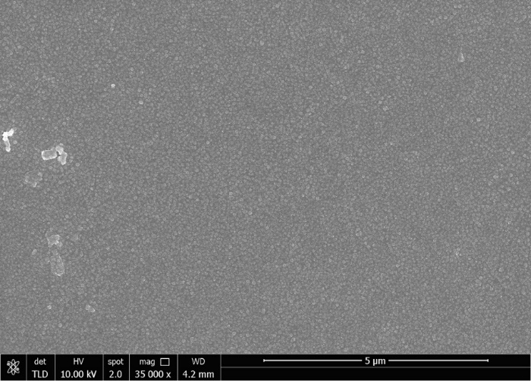
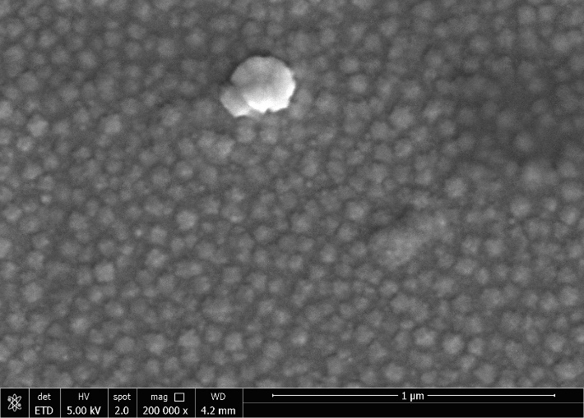
Morphology of PbSe material on silicon substrate: Slight variation in growth condition
Shiny tin rich phases were observed
Change in growth parameters did not change morphology

Slide 17
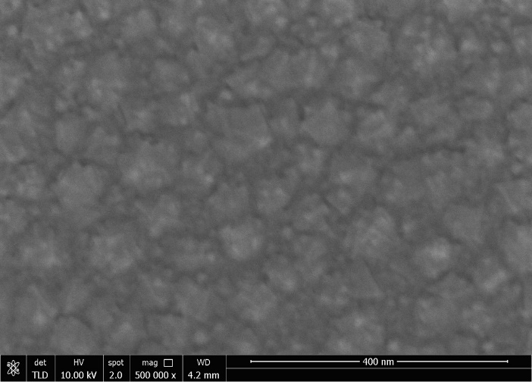
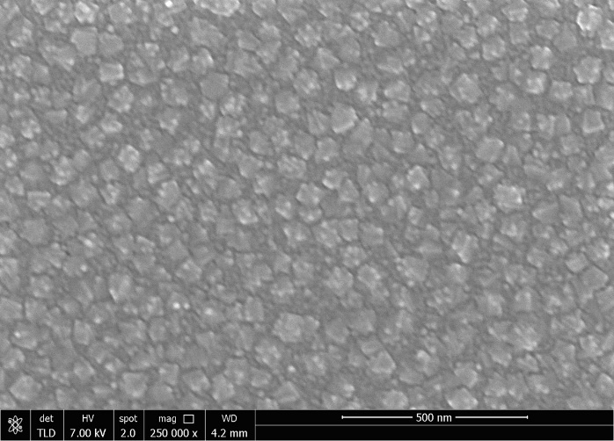
Doping of PbSe changed nanomorphology
Morphology at two portion of the substrate
There was no sign of cubes or spheres
Annealing also changed the morphology

Slide 18
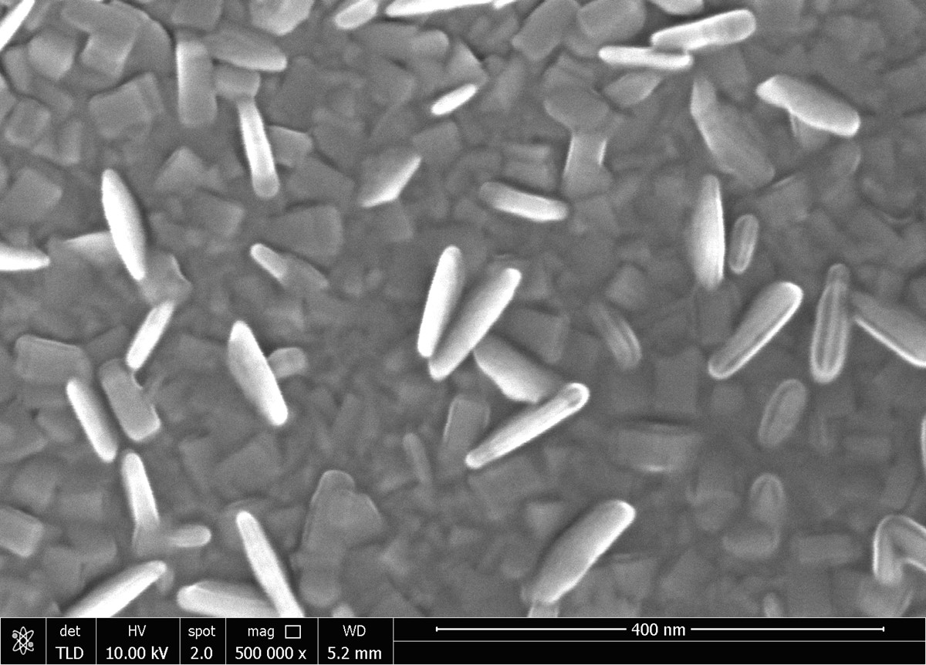
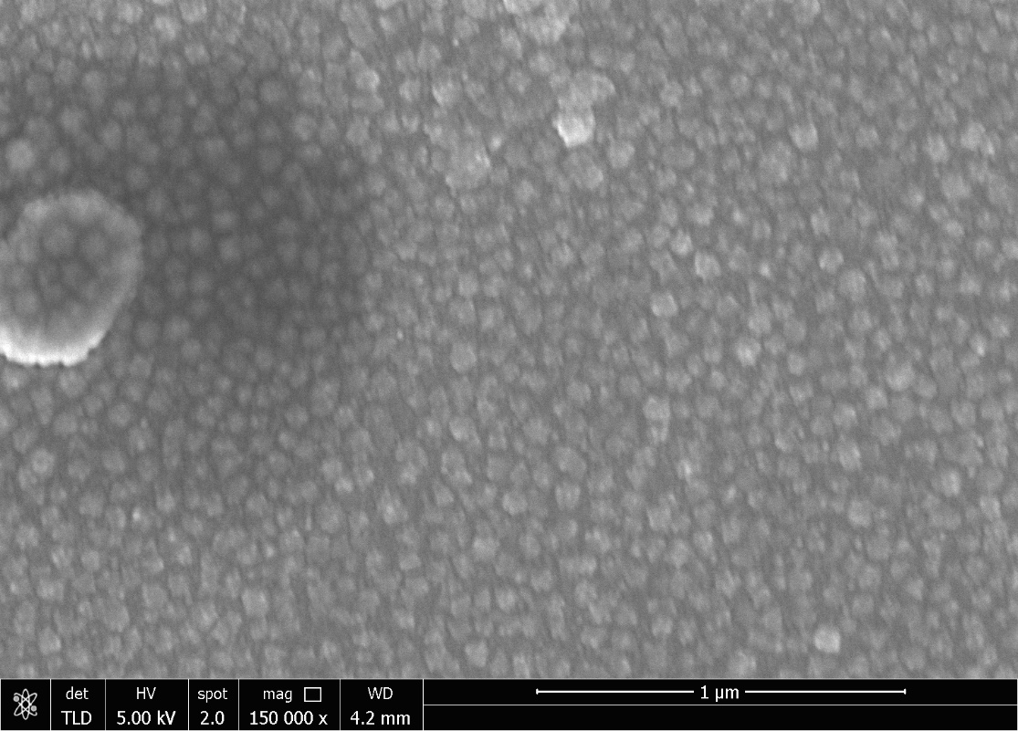
Nanomorphology of pure and doped PbSe
In CdSe doped grains grew on the top of thin films of grains, but morphology did not change
Morphology was different; but did not change

Slide 19
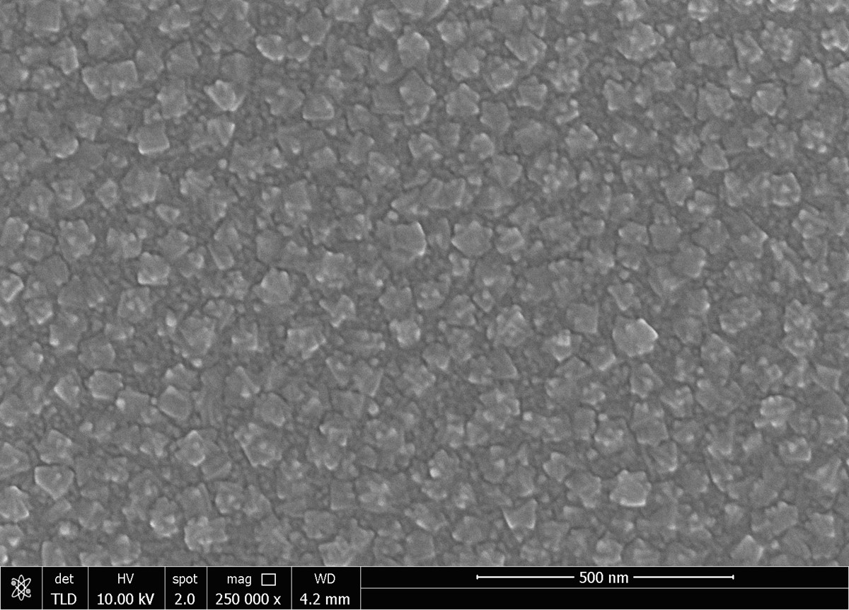
Grains had small instability and anisotropy at interface ; Size up to 50nm nm
Tin doping had octahedral morphology

Slide 20
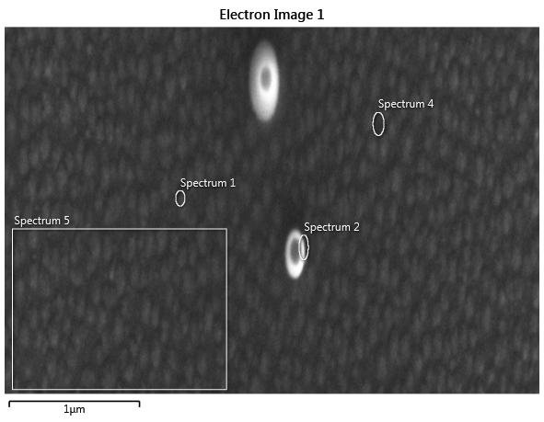
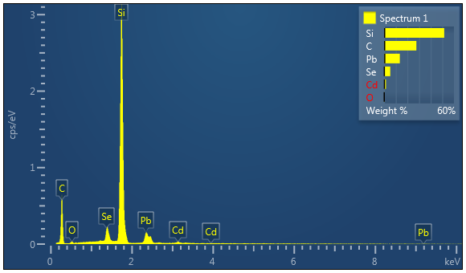
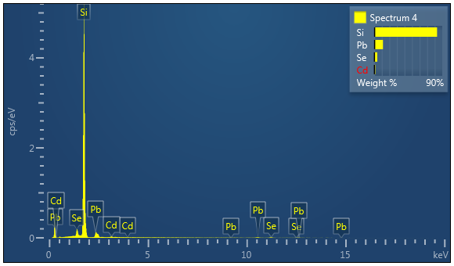
Materials spots selected to evaluate for the composition
Composition of each components for the selected spots 1 and 4 shown in Figure.
We did not find CdSe rich phases in the matrix

Slide 21
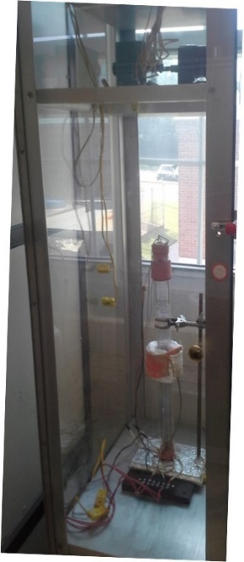
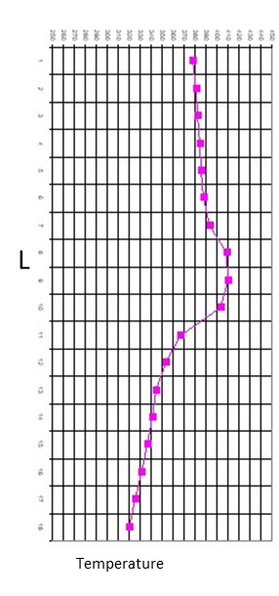
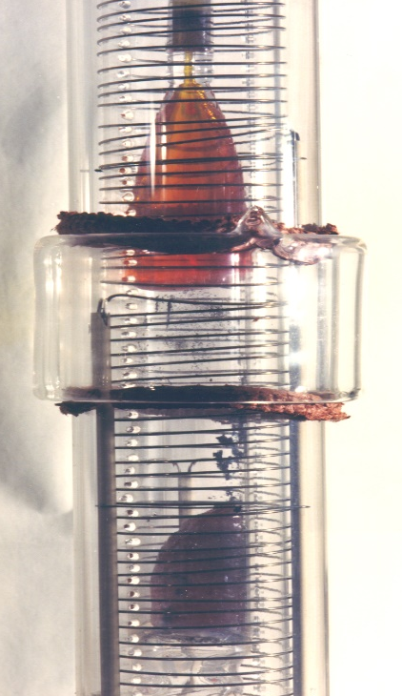
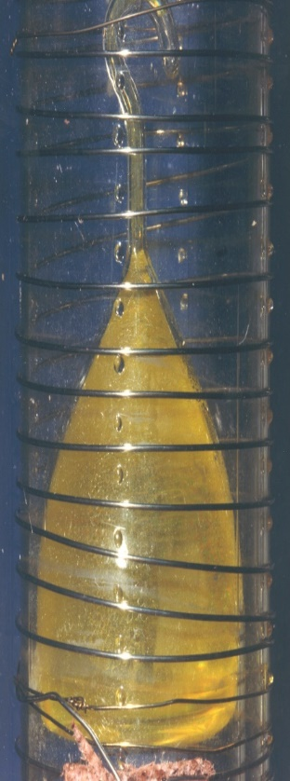
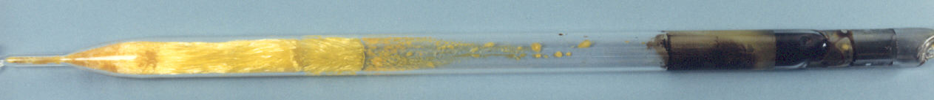
We have furnaces in our laboratory for controlled PVT growth
PVT vertical furnace, a typical thermal profile and a grown crystal
Vertical PVT is commonly used for the growth of bio, organic and inorganic material
Nano-, micro-, thin film and bulk crystals can be grown by PVT
Singh et al (>30 papers)

Slide 22
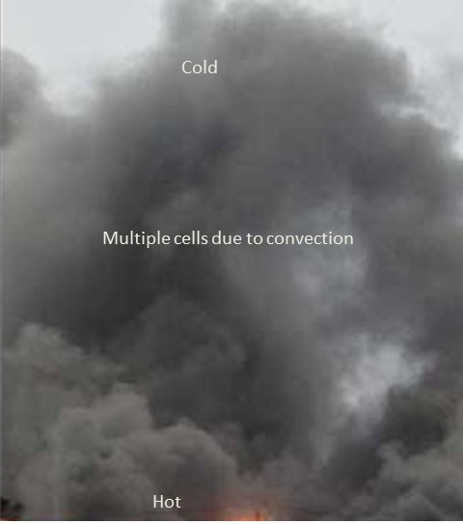
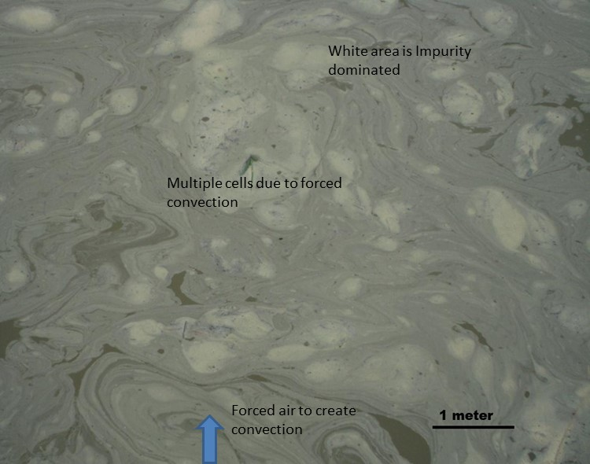
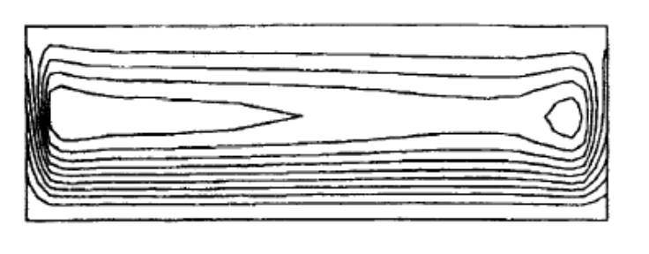
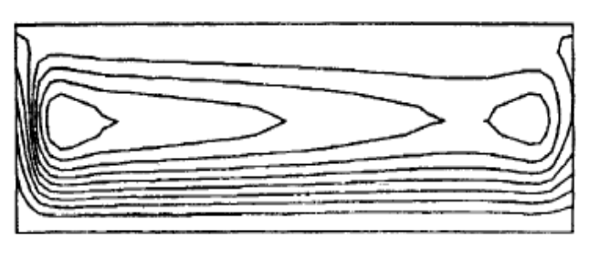
Optimization of PVT: Fluid flow is very important parameter in PVT process
Effect of fluid flow and pattern formation in (a) fire (Bottom hot top cold) and (b) a 15x 20-meter size (1.5-meter-deep) pond created by steady dynamic flow air blowing from bottom
a
b
. Streamline flow for gravity level of (a)10⁻¹g and (b)10⁻²g in horizontal configuration (Singh et al)
Instabilities can be controlled by modelling fluid flow during PVT

Slide 23
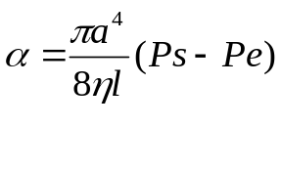
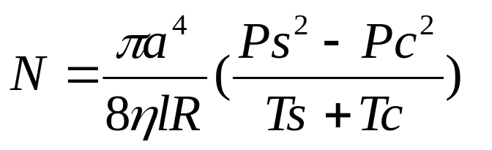
PVT method in controlled condition has shown good quality materials
  The velocity profile across the circular duct is derived by substituting the general expression for shear stress into Newton’s law of viscosity and integrating by applying the no-slip condition at the wall. The average velocity is defined as:
Tc Pc
α = Volume Flow Rate
η = Viscosity
Number of Moles per second
through cross section
2a
l
  where ΔP = P_{S} – P_{c}, P_{S} and P_{c} are the vapor pressure at the source and crystal interfaces, η is the viscosity, 8η L a result which is Hagen-Poiseuille equation. In spite of the fact that this equation is only applicable to incompressible fluids, one can derive the number of moles, N, flowing each second through the cross sectional area, which is given as:
Ts Ps
The model shows that pressure, temperature, path and diameter
affects the number of molecules travels from hot to cold end

Slide 24
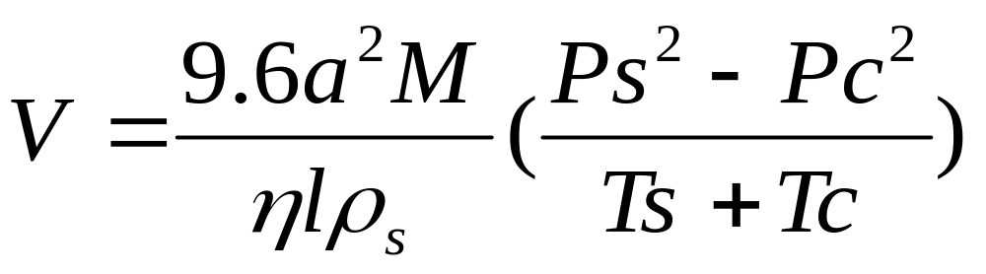
PVT growth optimization
Velocity Equation
a and l in cm
M in g/mole
η in Poise
ρ_{s} in g/cm³
Pc and Ps in Torr
Tc and Ts in K
A growth rate higher than 5 cm/day was predicted.
Growth velocity can be predicted from parameters

Slide 25
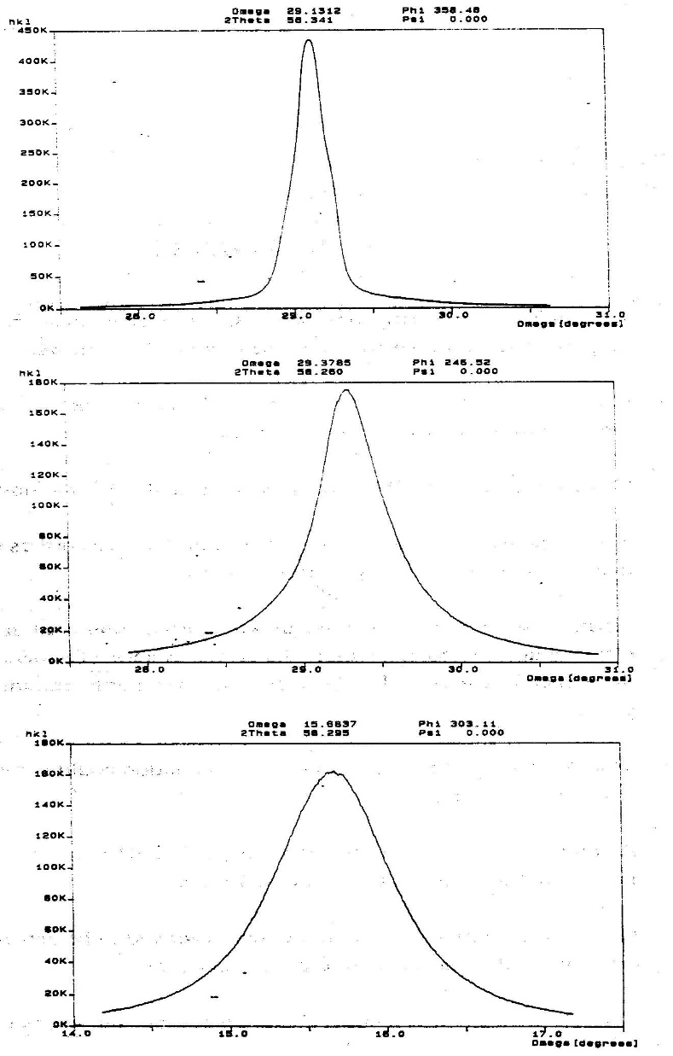

Fluid flow controls quality: X-Ray demonstrates that materials quality decreases if flow increases
Good material grown in very low flow
Flow affects the quality , proven by X-ray FWHM

Slide 26

Gravity controls diffusion: Transport Region as the Function of Gravity Level
For achieving good quality, pure diffusive
growth can be achieved in <10⁻⁴ g level

Slide 27
Summary
Controlled PVT method is an excellent method for growth of biosensor materials
Bulk, thin films and nanocrystals can be grown by PVT method
Fluid flow has significant effect on the materials and hence sensors performance
Variety of materials including oxides, selenides, sulfides (major sensor components) can be grown by PVT
Further study to optimization is based on materials for the growth
We have established variety of growth methods and characterization methods for the sensors, lasers, rad detectors and microelectronic materials
Morphology of material controls the performance of sensors

Slide 28
Thank You Very Much

