Slide 1


AA – School of Architecture
Mars Symposium
Los Angeles, California
March 19, 2021
Robert P. Mueller
NASA Kennedy Space Center
Swamp Works

Slide 2
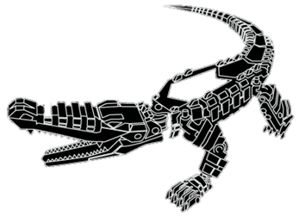
Introduction
Rob Mueller
Senior Technologist
NASA Kennedy Space Center (KSC)
Cape Canaveral, Florida, USA
Co-Founder of the KSC Swamp Works – an innovation environment for technology
Co-Founder of the Granular Mechanics & Regolith Operations (GMRO) lab
Chairman of the ASCE Aerospace Division / 2016 Earth & Space conference
BSME Bachelor of Science in Mechanical Engineering – University of Miami
MSSE Master of Space Systems Engineering – TU Delft, Netherlands
MBA Master of Business Administration – Florida Institute of Technology
32 years of NASA experience – from dust to thrust

Slide 3
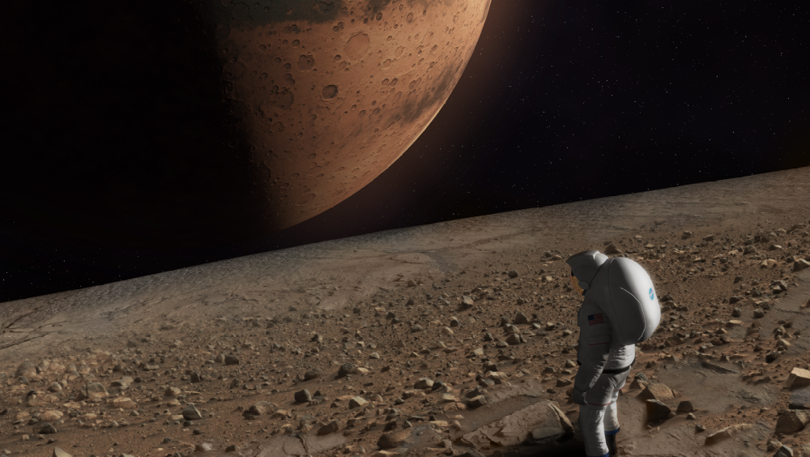
NASA Strategic Plan Objective 1.1
Expand human presence into
the solar system and to the
surface of Mars to advance
exploration, science,
innovation, benefits to
humanity, and international
collaboration.
Sending humans to Mars is a top NASA priority and the Agency believes that such missions will significantly expand the amount of science which can be accomplished on the planet. If carefully planned and executed, the Agency sees a natural and symbiotic interdependency between robotic and human missions to Mars.

Slide 4
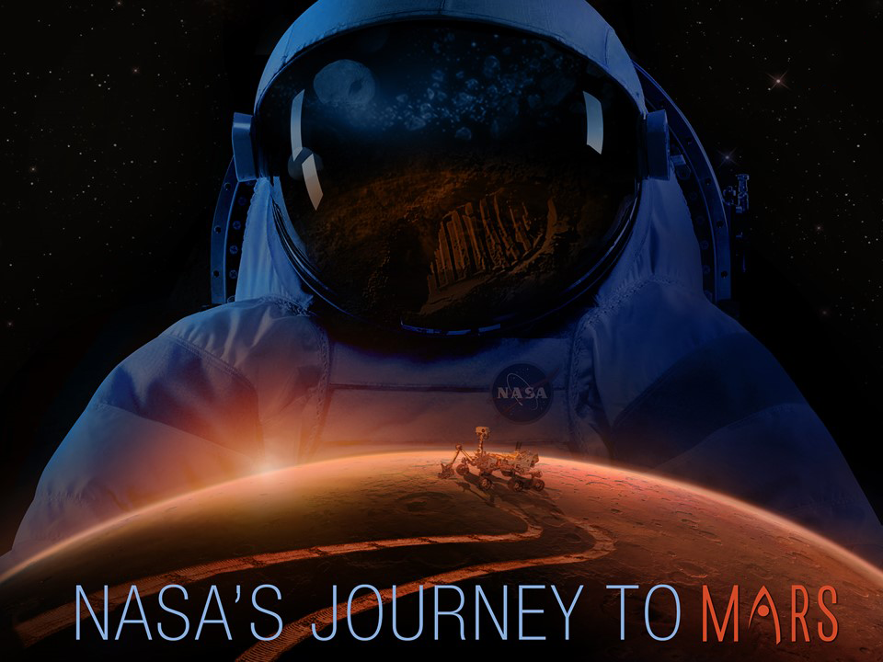
HOW DO
WE DO IT?

Slide 5
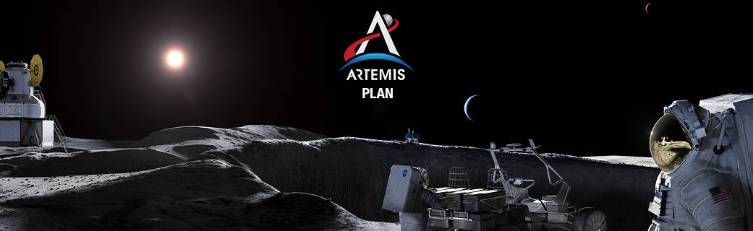
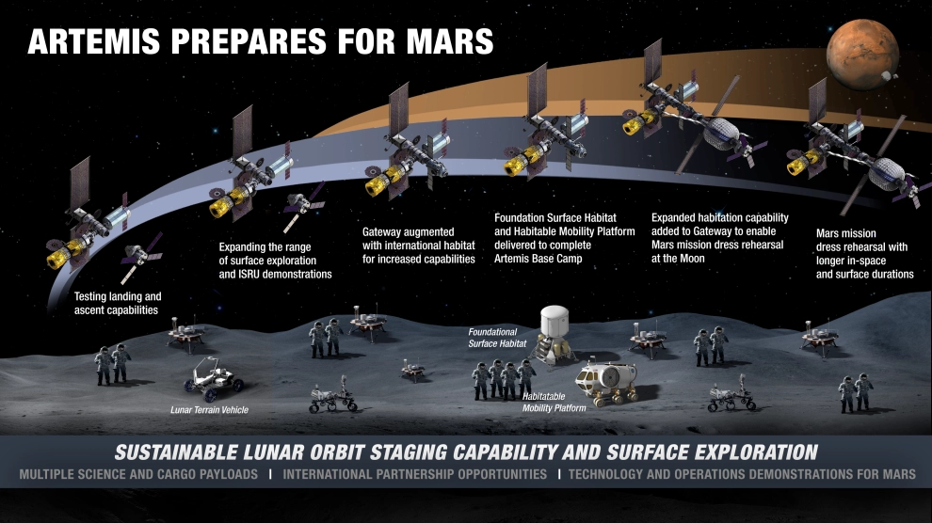
NASA Artemis Program – Lunar Proving Ground for Mars

Slide 6
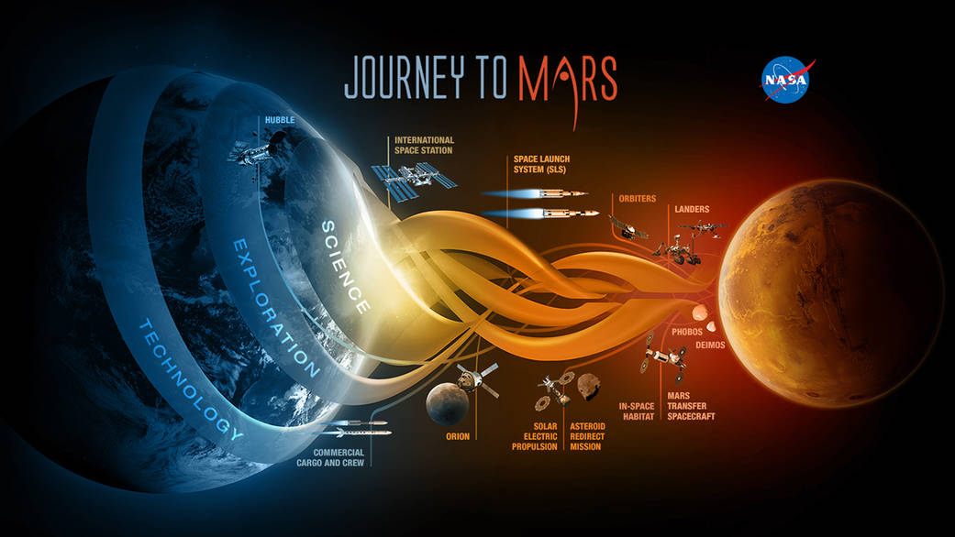
NASA Evolvable Mars Campaign

Slide 7

Why Mars? Overview of the Solar System
Zones from Planet Formation:
  Terrestrial Planets – materials accreting close to sun
  Main Asteroid Belt
  Gas Giants– volatiles that could accrete farther from the sun
  Moons of Gas Giants – icy bodies, some capture KBO’s
  Kuiper Belt Objects (KBO’s) – icy bodies
  Oort Cloud – icy bodies, the origin of comets
The “Snow Line”
7

Slide 8
Environmental Considerations
Gravity
Atmosphere or Vacuum
Dust
Rotation Period (day/night cycles)
Seasons
Temperature Extremes
Particle Radiation
Electrostatics and charging
Solar Flux
Magnetic Field
Soil Characteristics
Ice Characteristics
Subsurface Geology
Planetary Protection
8

Slide 9
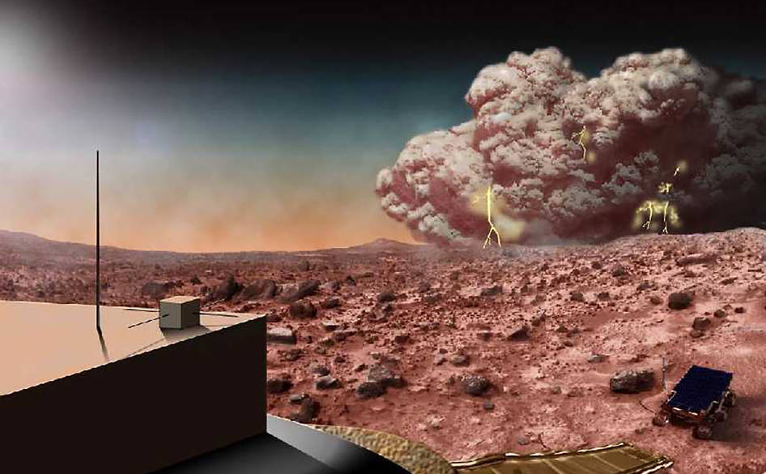
Atmosphere and Weather
https://mars.nasa.gov/multimedia/images/?ImageID=7483

Slide 10
Mars Summary
Gravity ~3/8 of Earth
Atmospheric pressure ~1% of Earth’s, but varies seasonally by 30% as it freezes and unfreezes from the polar caps
Wind only has 1% of force as Earth’s wind
Mars has CO2 frost & snow
Sand & Dust carried by wind still abrades like on Earth
Atmosphere mostly carbon dioxide
Very dusty atmosphere; dust storms, dust devils
10

Slide 11
Mars, continued
Radiation environment on the surface is harsh for humans & electronics
Soil is weathered, behaves like terrestrial soil
Soil is diverse
Geology is complex
Little is known about subsurface geology
  Mixture of CO2 and water ice and clathrates
  Varying mechanical strength
  Ice is on the surface at high latitudes
  Ice is near the surface at moderate latitudes
  Ice is deep beneath the surface at low latitudes
11

Slide 12
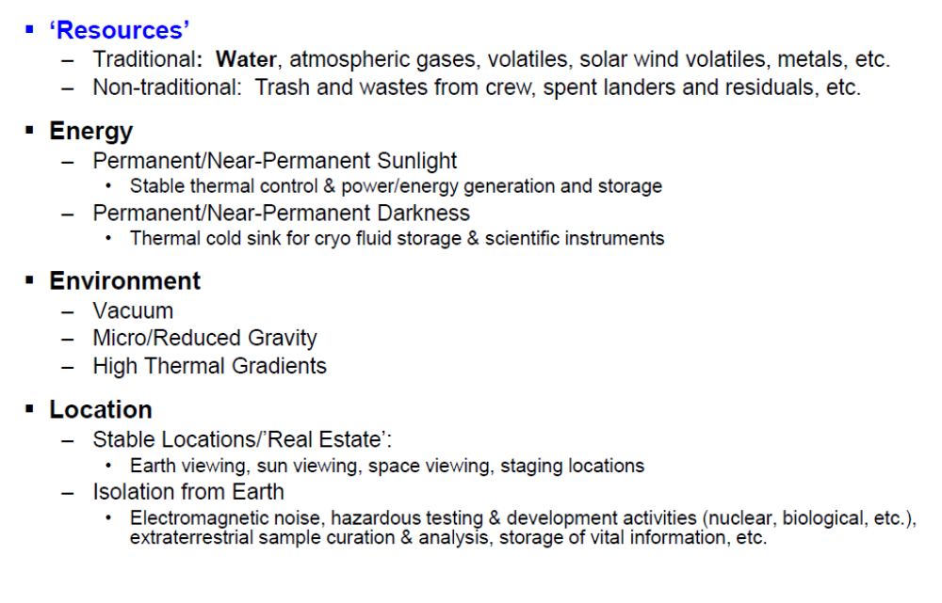
What are Space Resources?

Slide 13
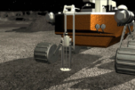

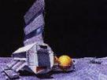
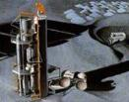
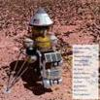
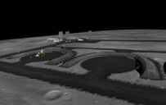
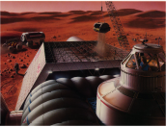
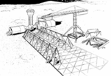
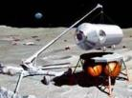
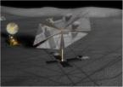
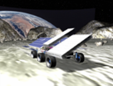
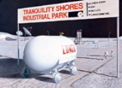

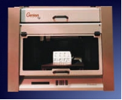
What is In Situ Resource Utilization (ISRU)?
ISRU involves any hardware or operation that harnesses and utilizes “in-situ resources” to create products and services for robotic and human exploration
Five Major Areas of ISRU
Resource Characterization and Mapping
Physical, mineral/chemical, and volatile/water
Mission Consumable Production
Propellants, life support gases, fuel cell reactants, etc.
Civil Engineering & Surface Construction
Radiation shields, landing pads, roads, habitats, etc.
In-Situ Energy Generation, Storage & Transfer
Solar, electrical, thermal, chemical
In-Situ Manufacturing & Repair
Spare parts, wires, trusses, integrated structures, etc.
‘ISRU’ is a capability involving multiple technical discipline elements (mobility, regolith manipulation, regolith processing, reagent processing, product storage & delivery, power, manufacturing, etc.)
‘ISRU’ does not exist on its own. By definition it must connect and tie to multiple uses and systems to produce the desired capabilities and products.
Notes:
So now that I’ve outlined what I consider to be Space resources, let’s define the ISRU project in that context. Read the definition. Discuss the five major areas we intend to address over the life of the ISRU project. Mention that the Mission Consumable Production is again the one that gets the most attention because it offers the most mass & cost savings. But the other 4 categories can’t be ignored if the agency wants to insure mission success.

Slide 14
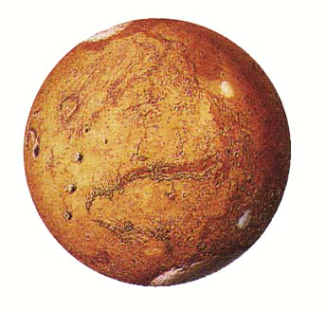
Lunar and Mars Resources
Regolith *
Silicon Dioxide (43.5%)
Iron Oxide (18.2%)
Sulfur Trioxide (7.3%)
Aluminum Oxide (7.3%)
Magnesium Oxide (6.0%)
Calcium Oxide (5.8%)
Other (11.9%)
Water (2 to >50%)^{XX}
* Based on Viking Data
^{XX} Mars Odyssey Data
Mars Resources
Atmosphere
Carbon Dioxide (95..5%)
Nitrogen (2.7%)
Argon (1.6%)
Oxygen (0.1%)
Water (210 ppm)
Atm. CO₂
Water
Soil
Energy
Solar Power
Geothermal?
Mars Resources
Atmospheric gases, and in particular carbon dioxide (95.5 %) , are available everywhere at 6 to 10 torr (0.1 psi)
Viking and Mars Odyssey data shows that water is wide spread but spatial distribution and form of water/ice is not well understood (hydrated clays and salts, permafrost, liquid aquifers, and/or dirty ice)

Slide 15
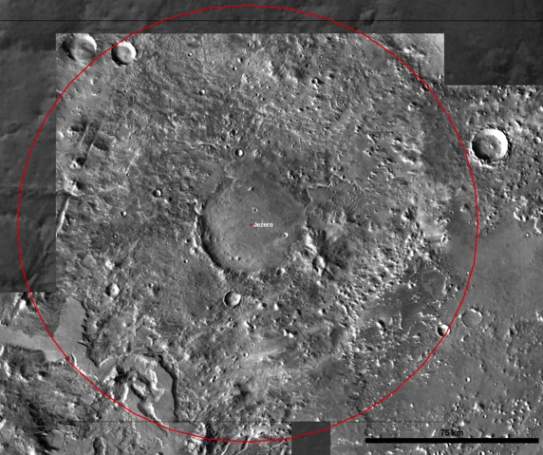
Exploration Zone Layout
Habitation Zone
Science ROI’s
Resource ROI
Science ROI
Science ROI’s
Resource ROI
ROI = Regions of Interest

Slide 16
Goals of the Human Landing Sites Study
Identify landing sites for human surface exploration of Mars.
  These landing sites provide access to Exploration Zones (EZs) which are regions on Mars that contain multiple sites of scientific interest as well as satisfying engineering and human constraints for human exploration
  Leverage Mars Reconnaissance Orbiter (MRO) data collection capabilities to acquire data of potential prioritized human Mars landing sites within the exploration zones
  Exploration Zones will be chosen to maximize science return as well as support human operations
  This work will result in a database of high science interest sites, which can easily be updated as we learn more about Mars and what is needed to support humans on the planet
This effort is a joint Human Exploration and Operations Mission Directorate (HEOMD) / Science Mission Directorate (SMD) study
Notes:
Emc is not anorganization. It’s HAT

Slide 17
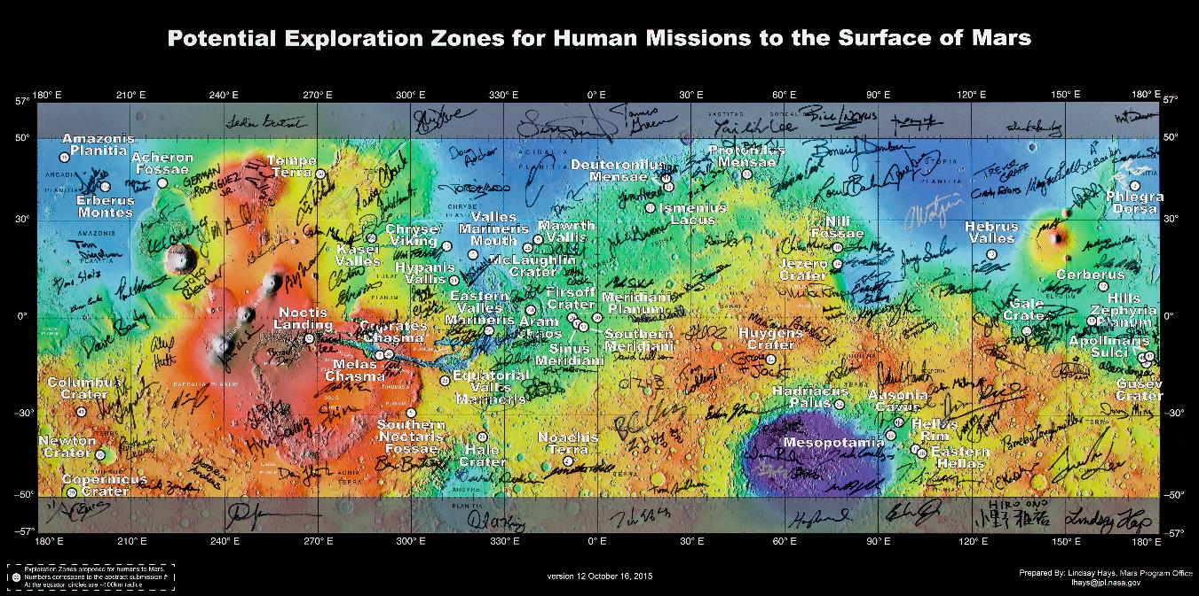
45 EZ Proposals covering highly diverse regions of Mars
Key Requirements for Exploration Zones:
Permanent Research Outpost Diverse Science and ISRU ROIs Access to Water | Pinpoint Landings are assumed and required +/- 50 degrees latitude +2 miles MOLA altitude

Slide 18
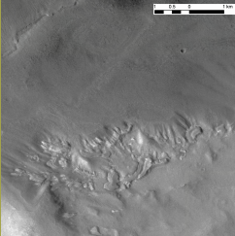
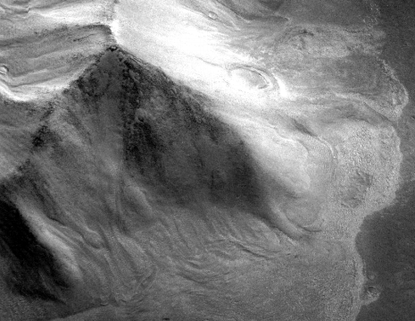
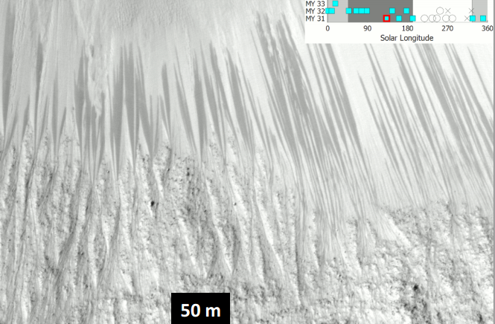
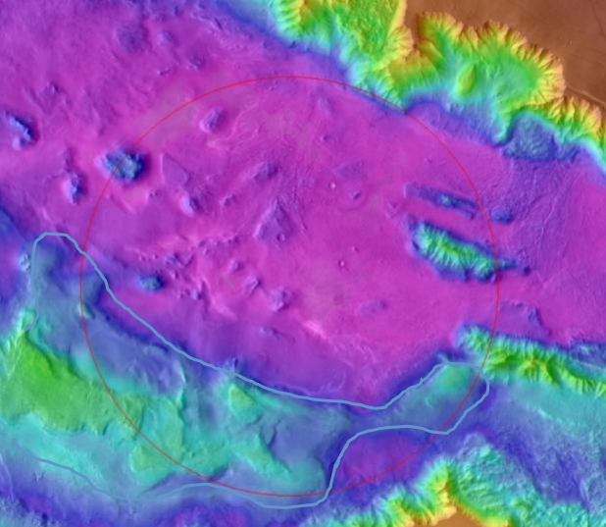
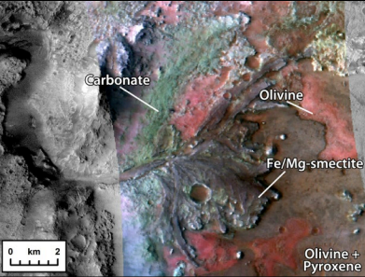
Mars has Several Water Feedstock Options:
“Sheet” Ice
Debris-Covered Glaciers
Recurring Slope Lineae
Other Options:
- Hydrated Dunes
- Atmospheric H2O
Poly-hydrated Sulfates
Other Hydrated Minerals
  Many EZs had multiple water feedstock types

Slide 19
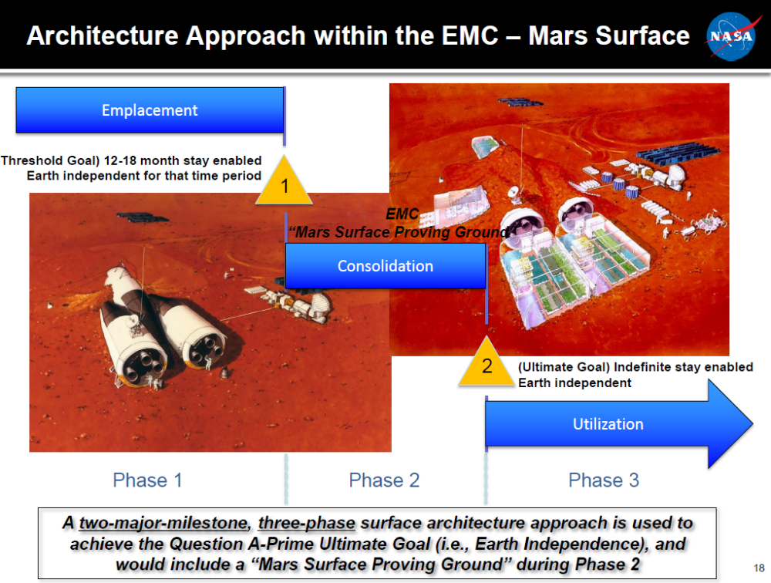
Mars Campaign

Slide 20
Horizontal & Vertical Construction
Foundations / Leveling
Launch/Landing Pads
Perimeter Pad Access & Utility Roads
Dust free zones
Radiation, Thermal & Micro Meteorite Shielding
Regolith Shielding on Roof over Trenches
Thermal Wadi’s for night time
Blast Protection Berms
Electrical Cable/ Utilities Trenches
Trenches for Habitat & Element Burial
Regolith Mining for O2 Production
H2O Ice/Regolith Mining from Shadowed Craters
Equipment Shelters
Maintenance Hangars
Lighting
Communication infrastructure
Thermal radiators
Power infrastructure
Base modules
ISRU processing plants

Slide 21
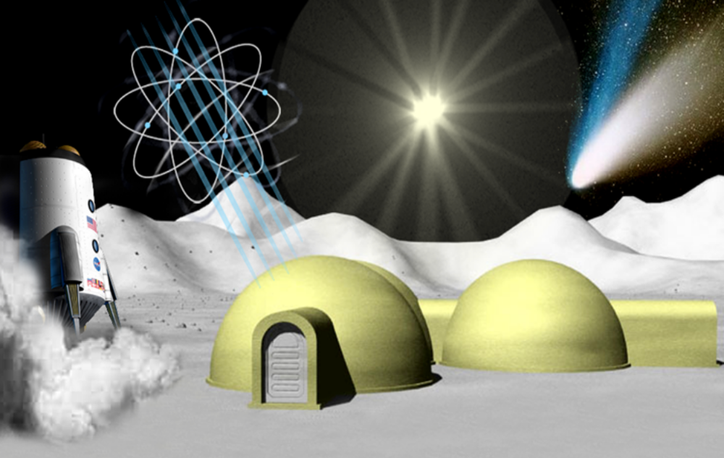

Multiple Sheltering Aspects Needed
Thermal Protection
Micro-meteoroid Protection
Exhaust Plume Protection
Radiation Protection
Radiation Protection
Micro-meteoroid Protection
Exhaust Plume Protection
Thermal Protection
Notes:
NIAC KSC Phase I Regolith Derived Heat Shield
NIAC USC Phase II ISRU-Based Robotic Construction Technologies
SBIR Phase II Tethers Unlimited in-­space additive manufacture of high-­performance truss structures
Pacific International Space Center for Exploration Systems - Binding Material Research & In-Situ Hawaiian Regolith Simulants

Slide 22
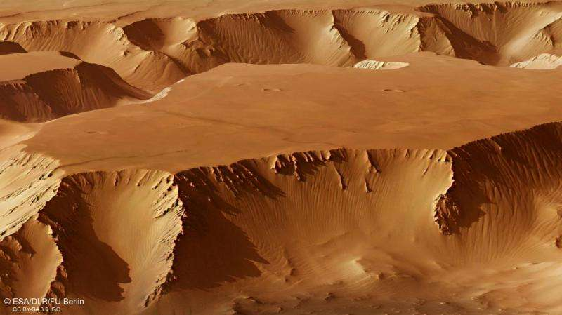
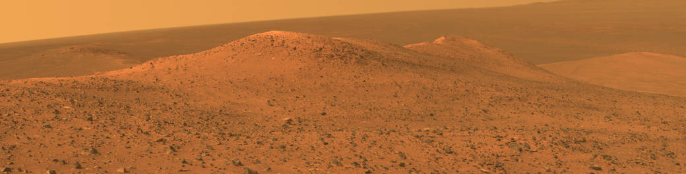
Mars is full of Regolith Fines
Regolith: Surficial layer covering the entire surface ranging in thickness from meters to tens of meters formed by geologicald and weathering processes – physical desegregation of larger fragments into smaller ones over time

Slide 23
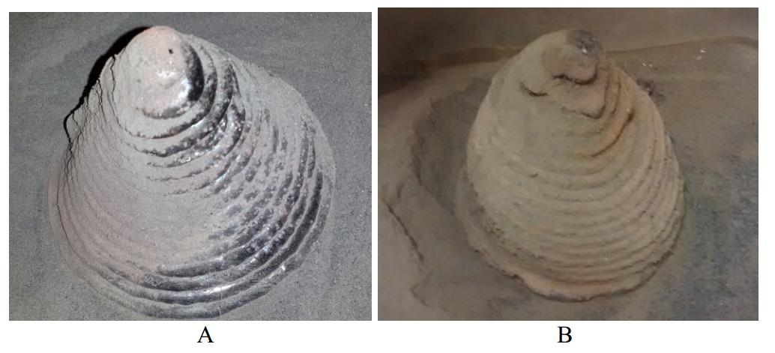
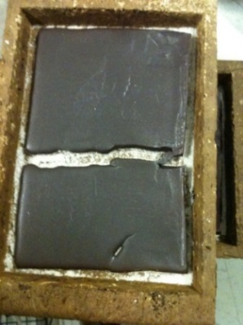
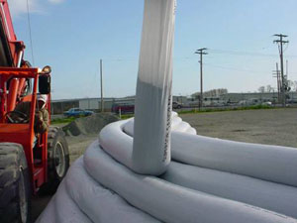
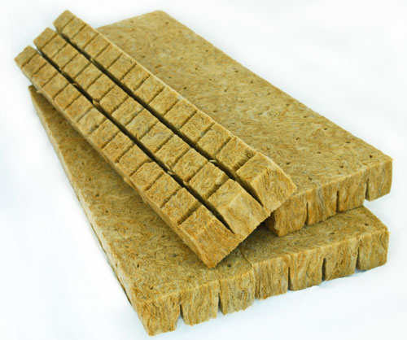
How to use Regolith as a Construction Material
Melting
Sintering
Concrete (waterless)
Rockwool / glass fiber
As-is, granular & rocks
Rammed
Extract materials from it
3D printing (additive manufacturing)

Slide 24


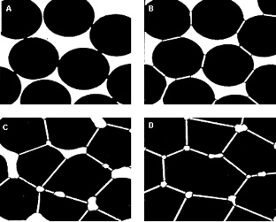
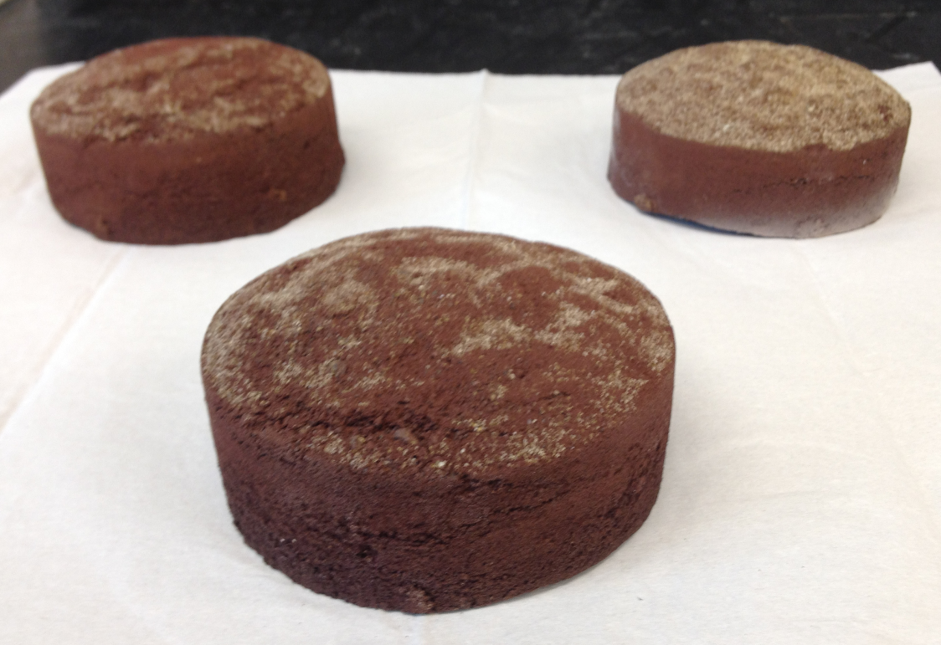
Regolith Sintering Process
Temperature and heating time are crucial factors in the resulting structure and density.
JSC-1AC
Regolith simulant sintered test pucks

Slide 25
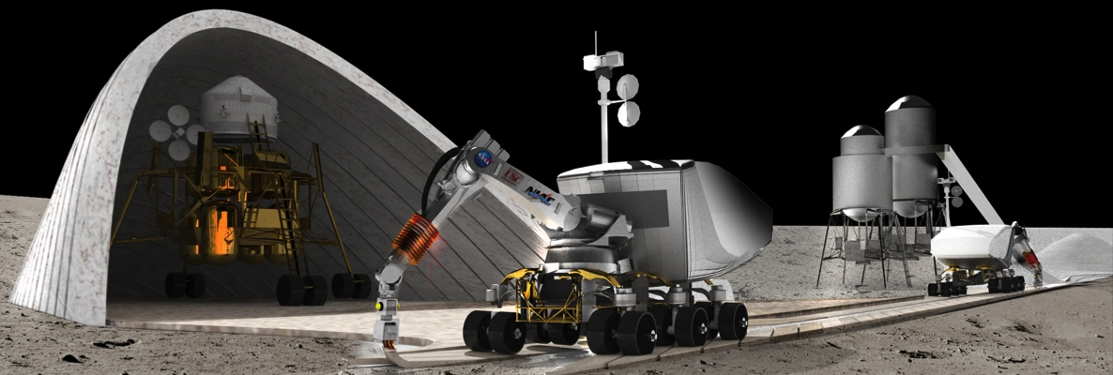
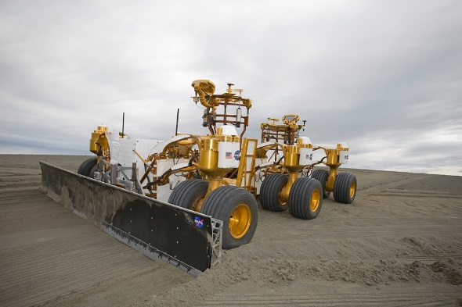
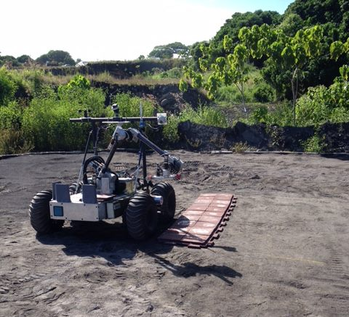
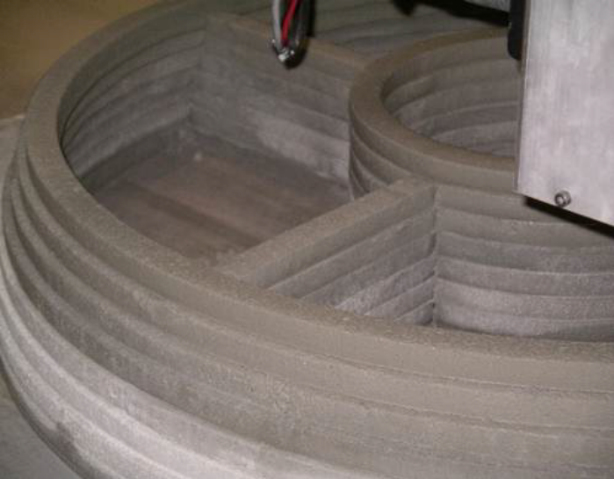
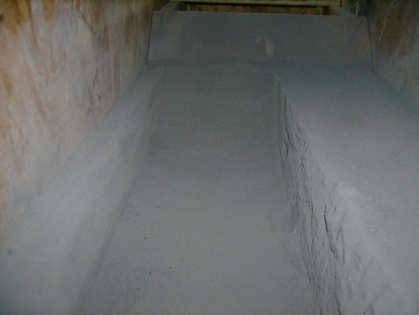
Image Courtesy
of NASA
Image Courtesy
of Dr. B. Khoshnevis,
Contour Crafting, LLC
Image Courtesy
of PISCES

Slide 26
Functions of a Building
Protection from outside environment
  Shelter
    Environment
    Space weather
    Other people’s actions
Provide comfortable work / living area
Storage area
Privacy
Sectioning within building between functions
Provide right living conditions
  Air, light, water, food, temperature, humidity
Mechanical, structural, monitoring and control systems
Safety mechanisms (e.g. sprinklers, fire-doors etc.)

Slide 27
Using Local Topography
Lava Tubes
Craters
Permanent illuminated
Permanent shadow
Caves (natural or excavated)
Ravines
Rilles
Canyons
Caves
Cliffs

Slide 28
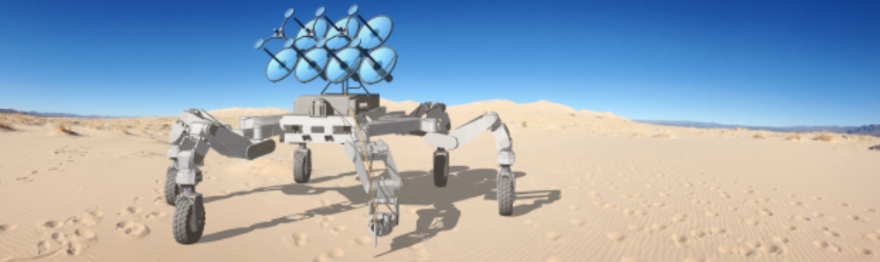
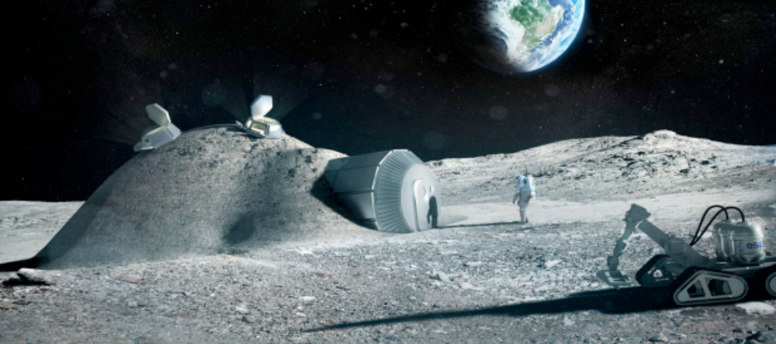
Advanced Construction Technologies
NASA JPL
ESA

Slide 29
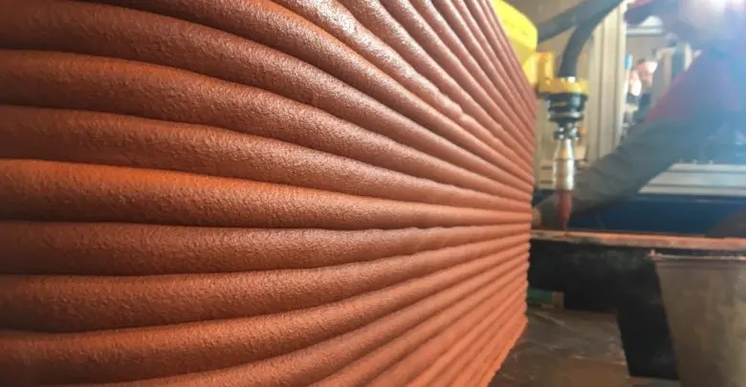
3D ADDITIVE CONSTRUCTION IMPLICATIONS FOR ARCHITECTURAL DESIGN: CRITERIA
1) Architectural concept and design approach
2) Architectural implementation
3) Documentation
4) Habitability
5) 3D-Print Constructability
6) Innovation
7) Functionality
8) Energy Efficiency
9) Mars Site Selection
10) Public Appeal

Slide 30
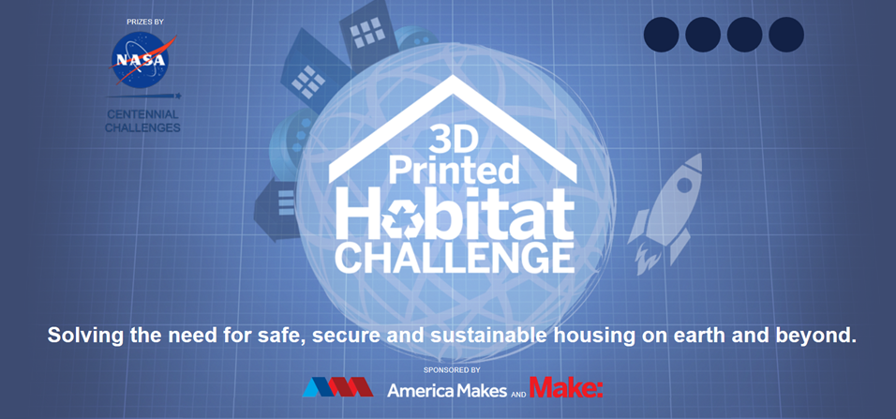


NASA Centennial Challenge: 3D Print a Mars Habitat
$3.1 Million Total Prize Purse (3 Phases)
Slide show of CC concepts

Slide 31
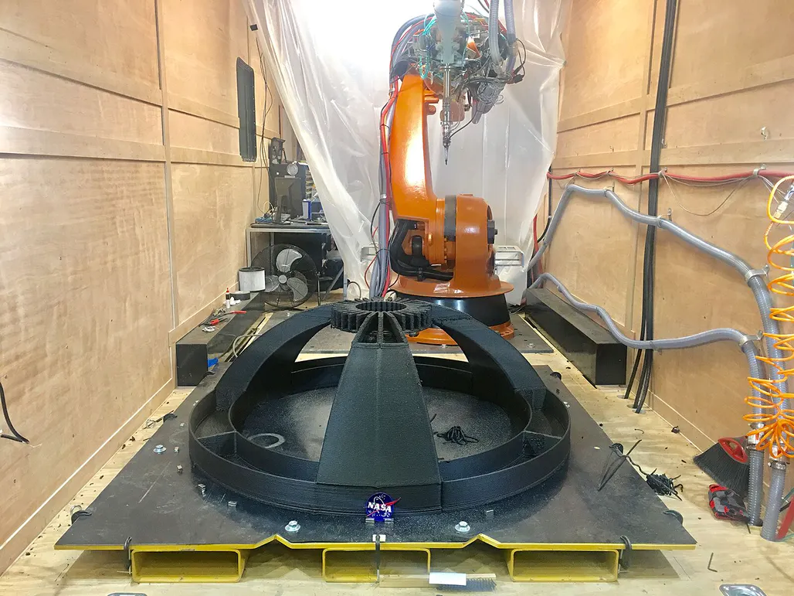
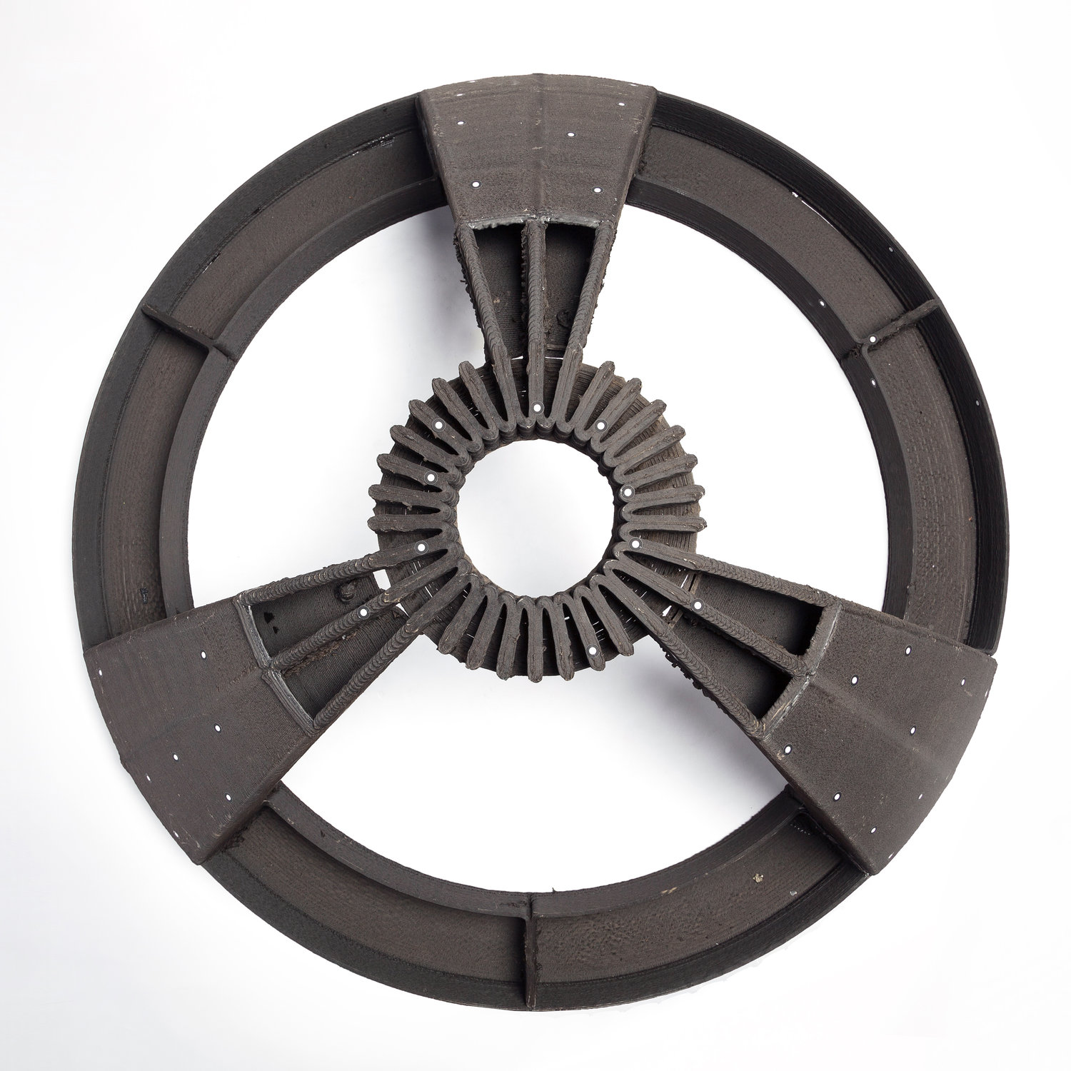
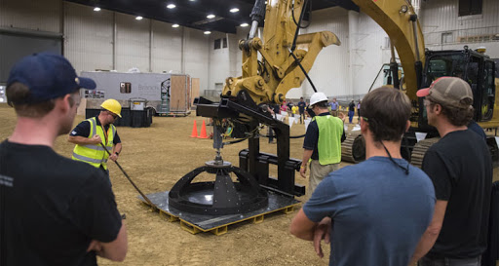
Phase 2: 3D Printed Dome Construction
Phase 2 Winner: Branch Technology
1 m diameter dome structure
Polymer Basalt Glass Material

Slide 32

Phase 3: On Site Construction Competition

Slide 33

One Future Mars Community Vision - What is Yours?
Centennial Challenge Winner: AI Space Factory

