Slide 1
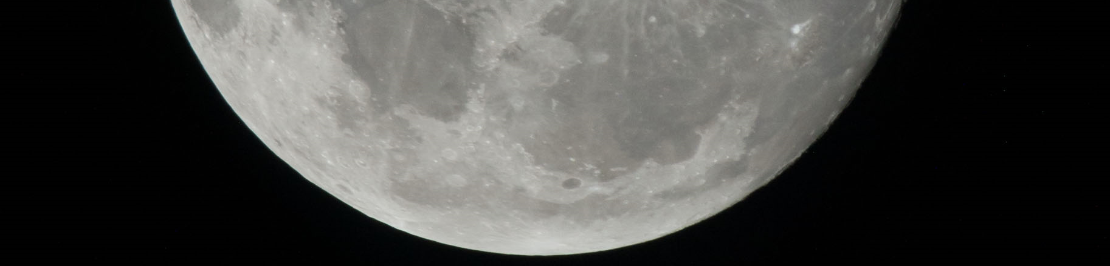

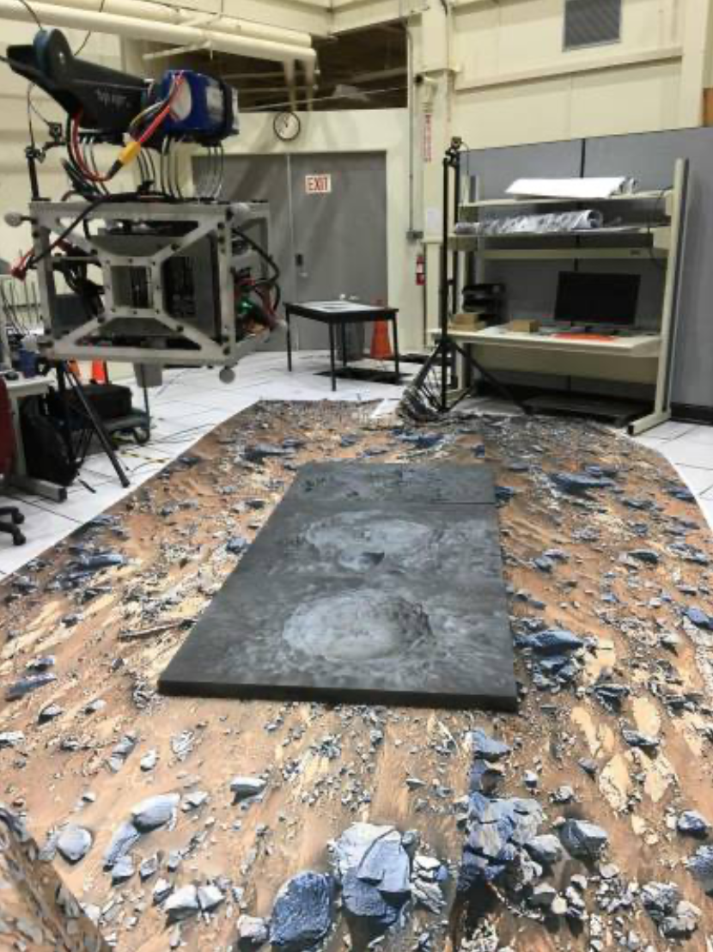
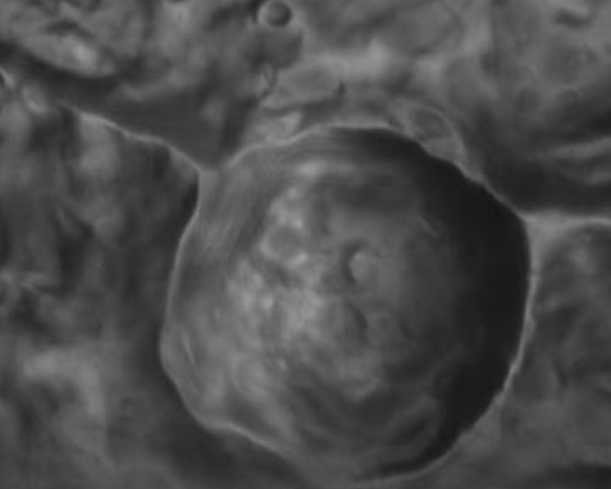
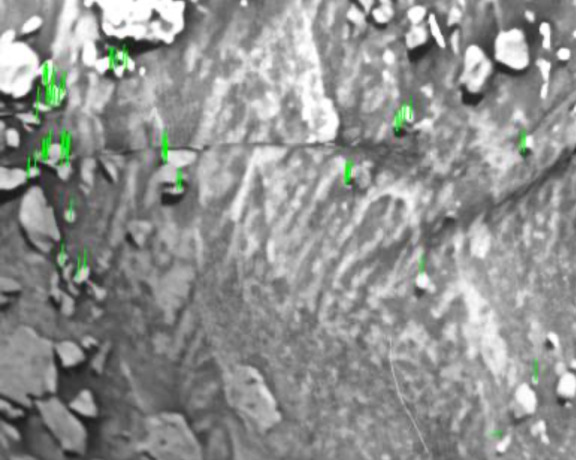
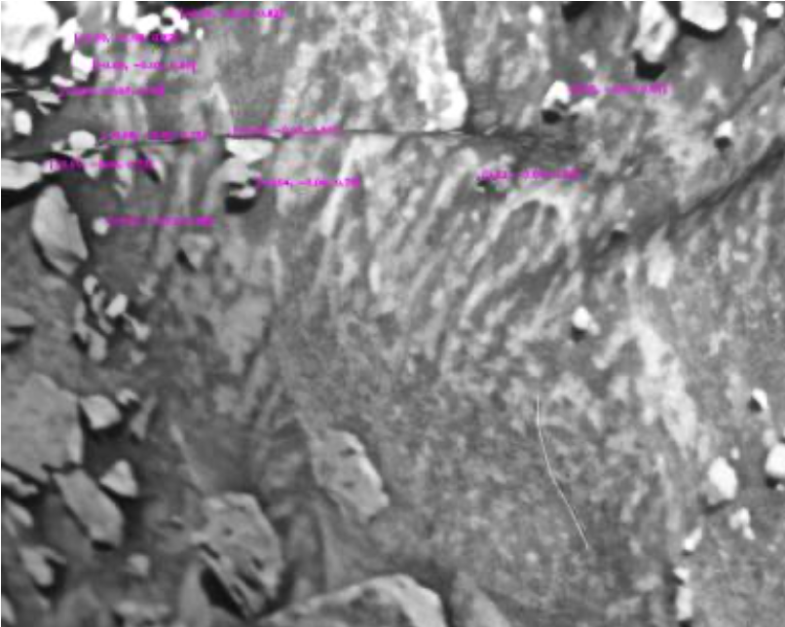
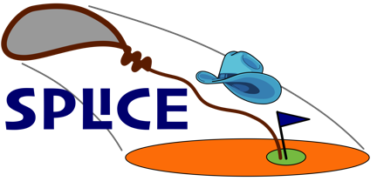

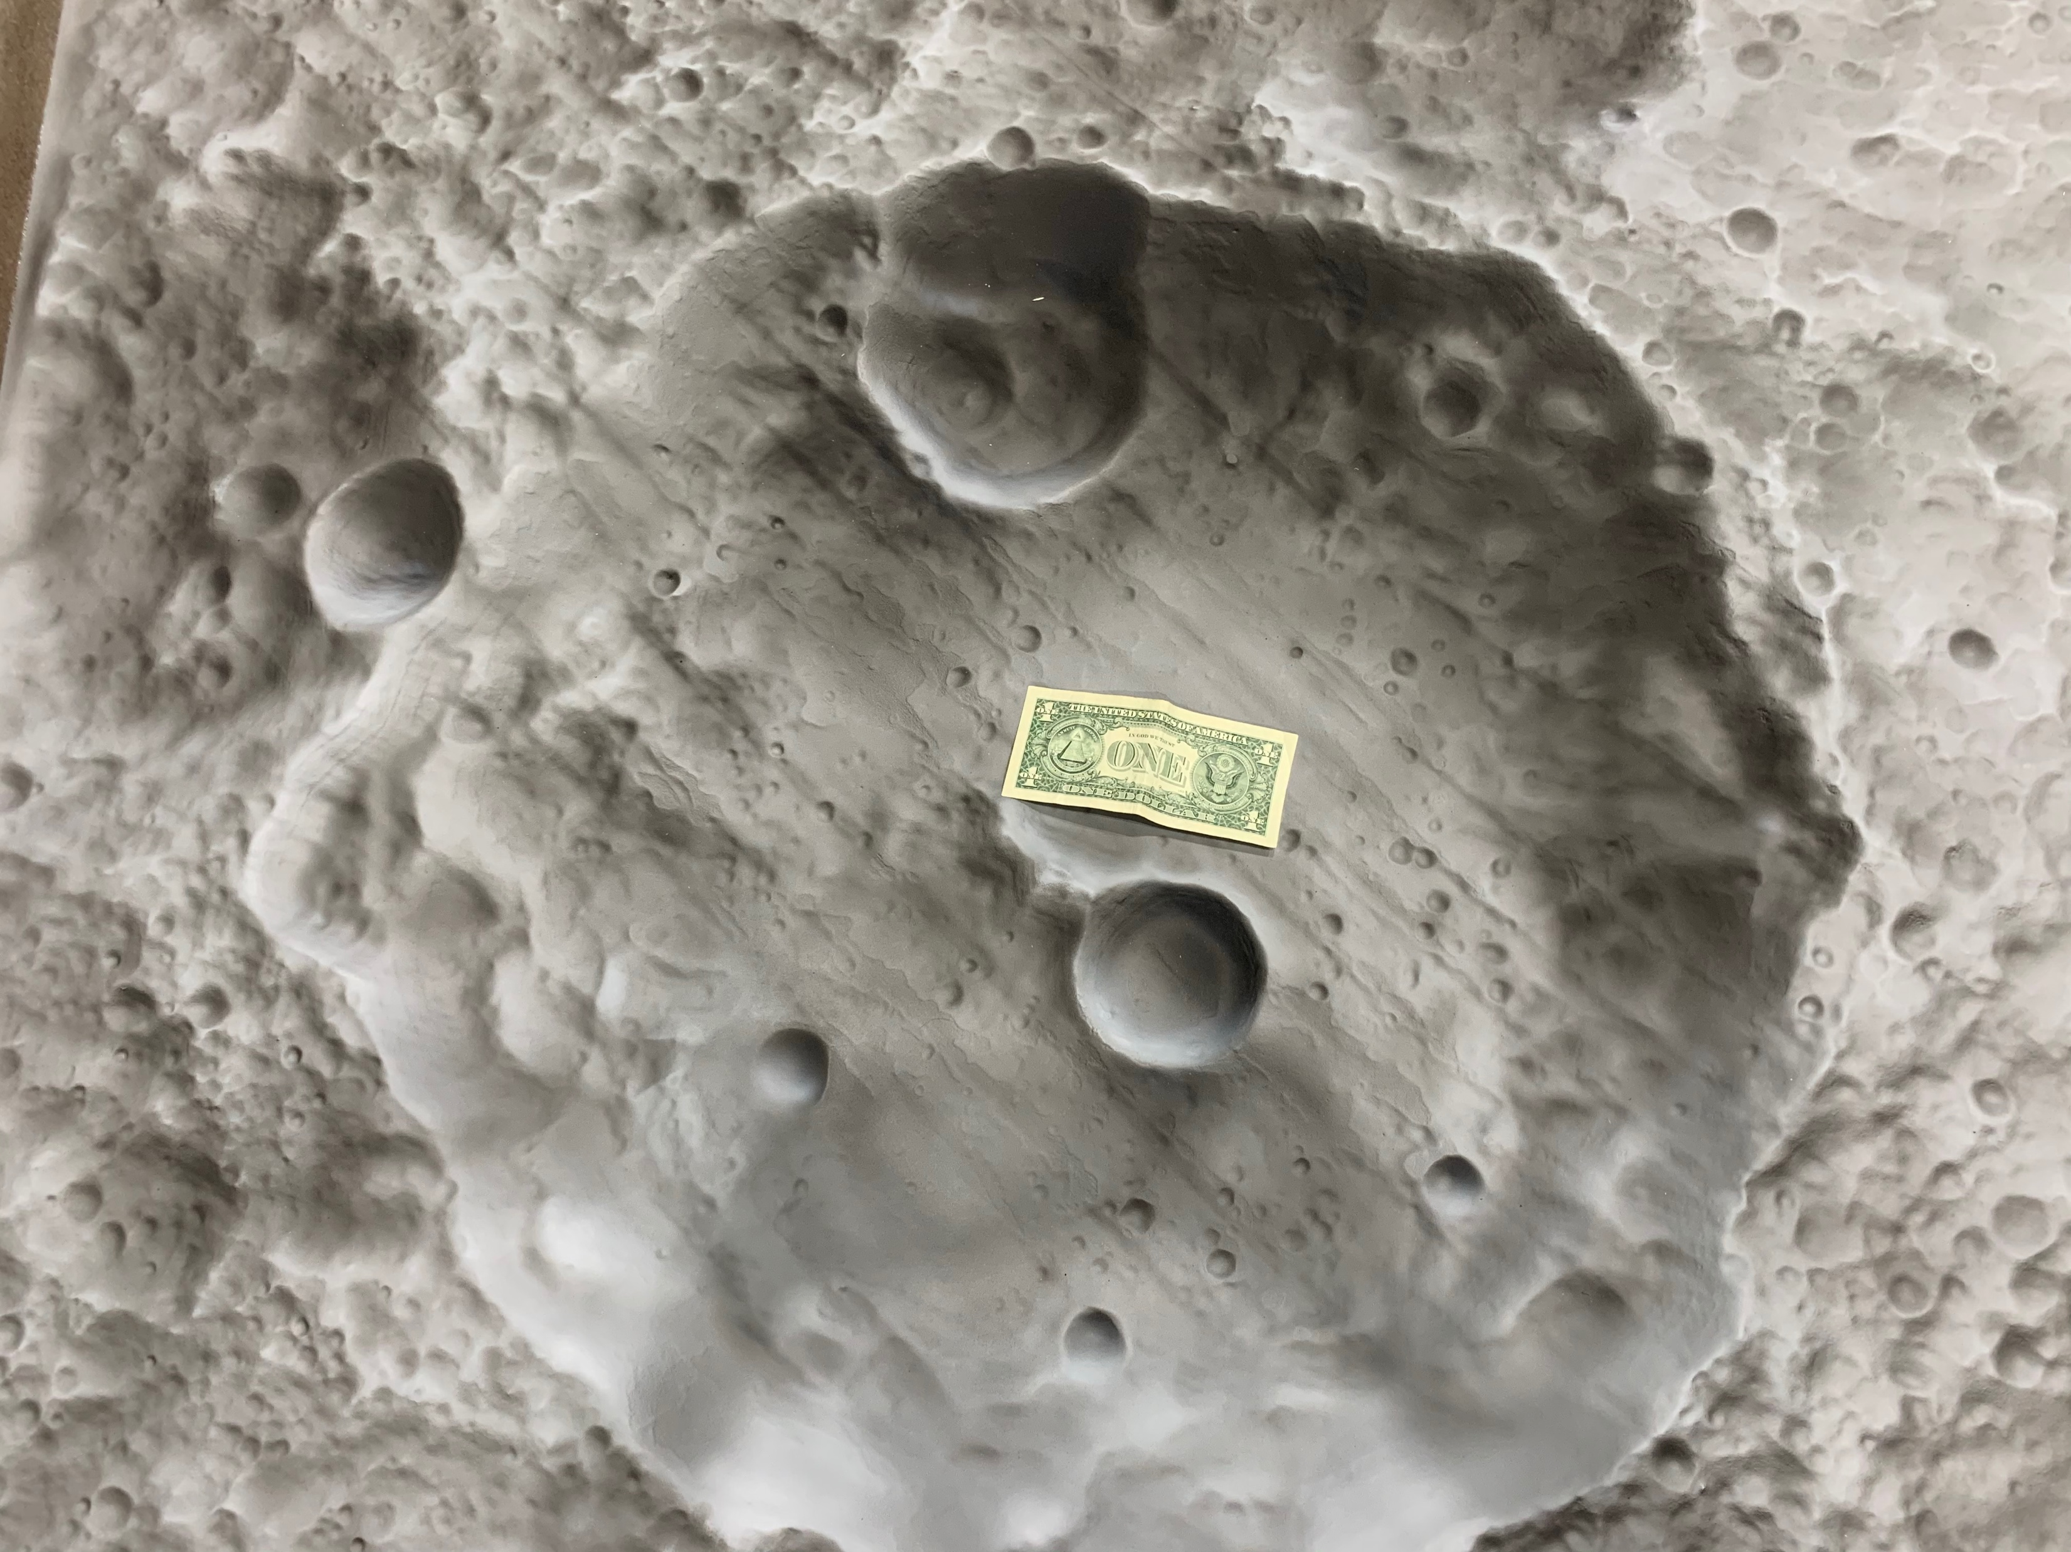
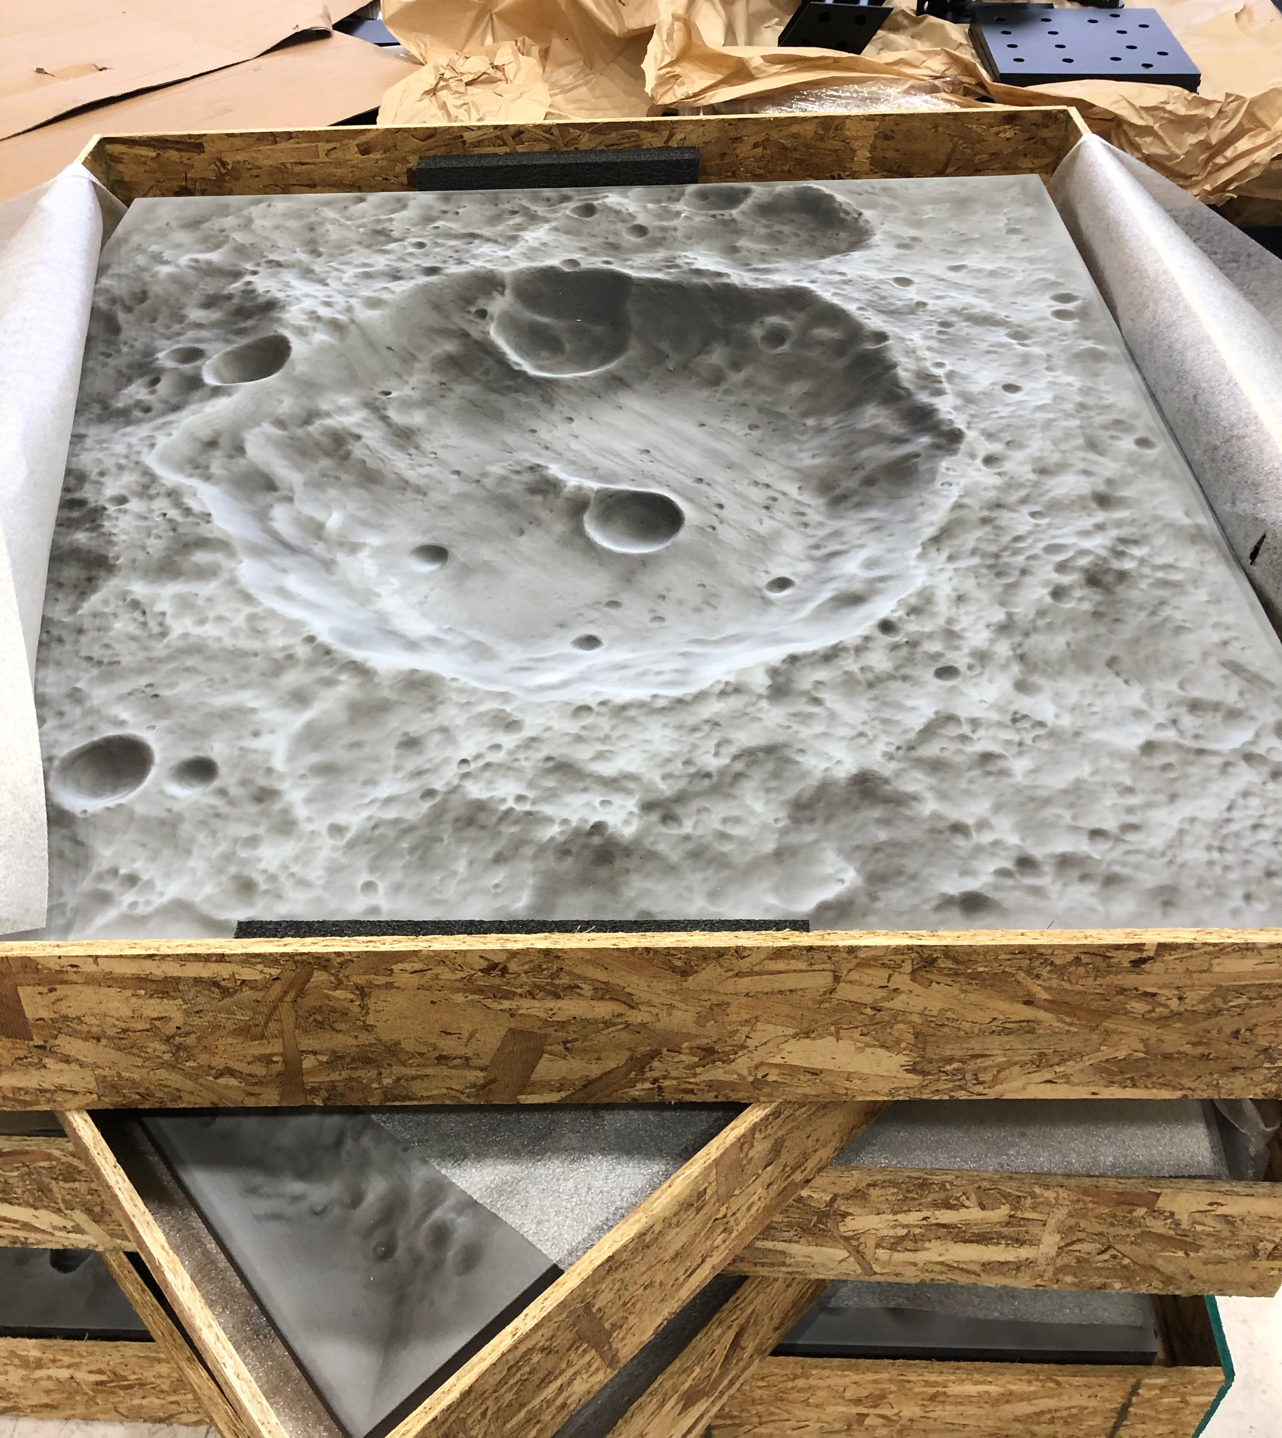
OASSIS: Onboard Adaptive Safe-site Identification System Y3
National Aeronautics and Space Administration
Johnson Space Center (JSC) / White Sands Test Facility (WSTF) 2020 JSC Technology Showcase: FY20 CIF IRAD
James S. McCabe, Ph.D. / james.s.mccabe@nasa.gov, Carolina Restrepo, Ronney Lovelace
Texas A&M University’s Land, Air, and Space Robotics Laboratory
Technology Area (TA): 9 Entry, Descent, and Landing TRL: start 3 / current 4
FY20 IRAD PROJECT Overview
The OASSIS Year 3 project continues to innovate with three goals: 1) transition to a generic configuration compatible with GNC flight software, 2) implement a new, computationally-efficient TRN algorithm for lunar landing, and 3) integrate with the a HWIL testbed to validate lunar landing GNC systems.
This project enables lunar lander GNC flight software to be tested dynamically without the need of a costly flight campaign and without the risk of catastrophic hardware loss. Additionally, the TRN algorithm development and testing enhances the state-of-the-art in pinpoint landing navigation, ultimately improving the overall landing accuracy, safety, and reliability of a crewed lunar landing mission.
INNOVATION
OASSIS enhances precision landing technologies in a two-pronged approach. First, the development of the Navigation, Estimation, and Sensing Testbed (NEST) payload enhances navigation software ground-testing capabilities in a low-cost environment with hardware in the loop. Second, the maturation and testing of a NASA JSC-developed, novel technique for terrain relative navigation (TRN) known as anonymous feature processing (AFP) suggests capable TRN performance at lower cost and risk than the current state-of-the-art. This project enables the testing, via NEST, of flight algorithms without the need of a costly flight campaign, and maturation of AFP proves out a new technology that greatly enhances precision landing capabilities while reducing system cost and risk.
Outcome
The NEST payload has continuously evolved toward becoming a capable sensor-laden test platform for navigation algorithm evaluation, and its readiness for integration into a dynamic testbed (such as a robotic arm or STAR cable gantry robot) has substantially improved due to the OASSIS CIF efforts. The AFP algorithm has transformed from first-concept to near flight-readiness, with numerical stability, computational efficiency, and overall navigation performance being understood and improved.
Lunar Terrain simulation
A substantial enhancement to the NEST testing capabilities was the acquisition of simulated terrain panels emulating the texture and color of the lunar surface. These panels are used to generate synthetic “in-flight” imagery with NEST cameras, and the surface texture can be used to stimulate onboard lidars as well.
Experimental results include NEST dynamically traversing simulated terrain panels, extracting feature tracks from sequences of images, and estimating the positions of those features in subsequent images (thereby estimating the pose of the NEST payload). The data output, when paired with AFP, provides a robust and accurate navigation solution to feed GNC.
Experimental Test Setup with Terrain Panels
Sample Image Collected by NEST Camera
Feature Tracks Found Within Sequential Images
Feature Positions Estimated by NEST
INFUSION SPACE / EARTH
PARTNERSHIPS / collaborations
Dr. Manoranjan Majji, Andrew Simon
Andrew Verras
Papers/Presentations
This project, and its collaboration with partners at Texas A&M University, has produced 6 conference presentations, 4 conference papers, and a peer-reviewed journal publication.
Future Work
Future efforts for OASSIS will focus on integrating the payload into new testbed environments, such as the SPLICE STAR robotic gantry testbed, to validate proposed and emerging navigation algorithms.
The NEST payload, as well as the lessons learned during lab testing, will be infused into the SPLICE project’s high-fidelity simulation environments where relevant algorithms could be matured into future lander flight software.
26666-1

