Slide 1



NASA R&M Efficiency through Findable, Accessible, Interoperable, and Reusable (FAIR) Digital Assets
Nancy J. Lindsey, Reliability& Maintainability Deputy Technical Fellow NASA HQ/GSFC
For the R&M Enterprise Data Sharing team: Laurel Dye (GRC), Timothy Adams (KSC), Roger Boyer (JSC), Richard Stutts (MSFC), Warren Grant (JSC), Bruce Reistle (JSC), Matthew Williamson (GRC), Steven Cornford (JPL), Christine Kilmer (GRC), Edward Zampino (GRC), Teri Hamlin (JSC), Todd Paulos (JPL), Irene Wirkus (GRC), Warren Grant (JSC), NASA R&M Technical Fellow (Anthony Diventi), Deputy Technical Fellow (Nancy Lindsey), and NASA Safety Center (NSC)
NASA/ESA/JAXA TRISMAC 2021
Nagoya, Japan (Virtual) May 17-20, 2021

Slide 2
Outline
National Aeronautics and Space Administration
www.nasa.gov
  Motivation
  R&M Digital Transformation Plan
  Data Survey Process
  Survey Results
  Survey Conclusions & Recommendations
  R&M Digital Transformation Next Steps
Mission Assurance Standards and Capabilities Division
OSMA HQ-GD000

Slide 3
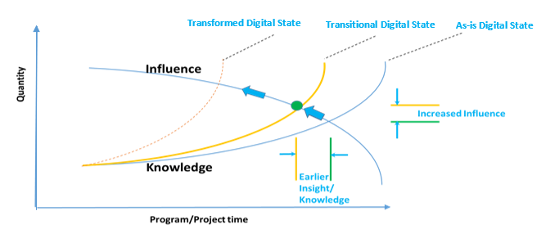
National Aeronautics and Space Administration
www.nasa.gov
Motivation
Digital Transformation:
Streamline the engineering processes and data acquisition/manipulation
Share data created or collected from other missions and early design phase seamlessly
Leverage tools and technology throughout NASA.
Ensure Mission Success though knowledge and influence
Mission Assurance Standards and Capabilities Division
OSMA HQ-GD000
Notes:
Digital Transformation is “employing digitization/digital technologies (e.g., Artificial Intelligence (AI), mobile, cloud, data) to change a process, product, or capability so dramatically (e.g., real-time, intelligent, personalized, anywhere, anytime)
More Timely Knowledge → More Influence → More Impact

Slide 4
  R&M Digital Transformation Plan
National Aeronautics and Space Administration
www.nasa.gov
  Phase1: Discover our Resources and Barriers
    Conduct Data Survey
    Communicate Findings
    Solicit Recommendations
  Phase 2: Enable Transitional Digital State
    Identify Findable, Accessible, Interoperable, and Reusable (FAIR) Strategies to fill data gaps
    Identify Strategies to mitigate implementation barriers
    Identify Strategies to enable greater R&M Efficiency
  Phase 3: Achieve Digital Transformation
Mission Assurance Standards and Capabilities Division
OSMA HQ-GD000
Notes:
Data available and data needed was necessary to determined before R&M could digitally transform or create Findable, Accessible, Interoperable, and Reusable (FAIR) data systems/capablities.

Slide 5

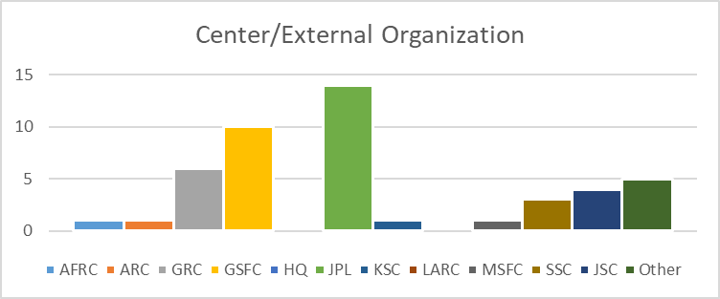
National Aeronautics and Space Administration
www.nasa.gov
Data Survey Process
Develop a Survey to Identify Data Existence and Needs
Conduct Survey and Interviews of R&M Practitioners
Review and Correlate Survey Inputs
Conduct Interviews of R&M Practitioners
Enhance Survey with R&M Application Inquiries
Review and Interpret Survey and Interview Data and Aggregation
Publish Findings and Share with TDT and Beyond
  Interviews were conducted to elicit clarity on data/application responses
  Findings are being used to enable transitional digital state planning
  Survey Report has data source listing include to enable community findability now.
Mission Assurance Standards and Capabilities Division
OSMA HQ-GD000
Notes:
Web enabled (and excel backup) survey of multiple choice and fill0-in questions.

Slide 6
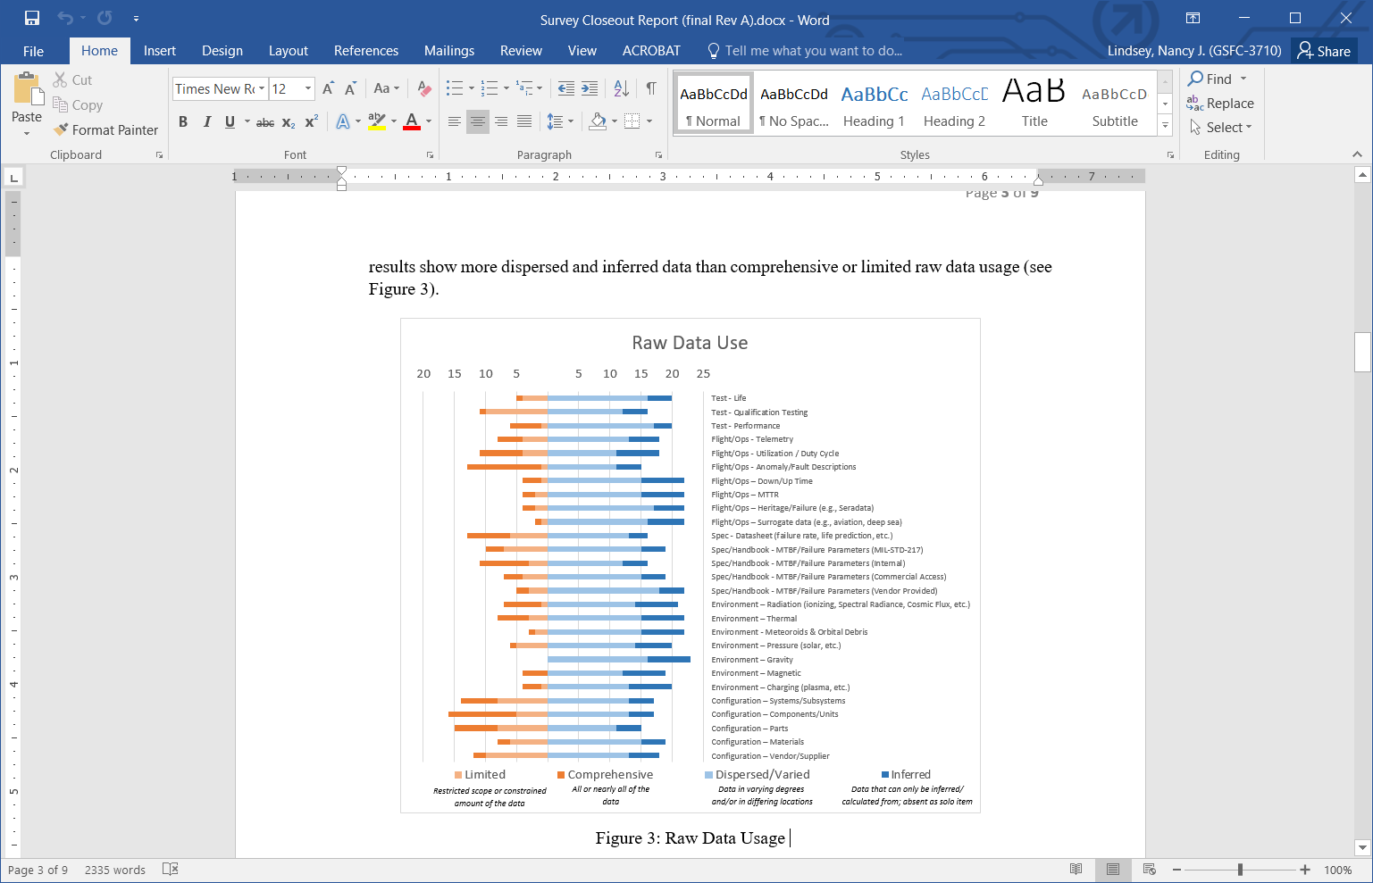
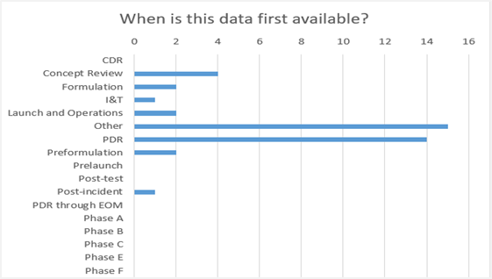
National Aeronautics and Space Administration
www.nasa.gov
Survey Results
Efficient R&M mission support depends on a wide variety of data.
R&M practitioners either have limited access to data and/or difficulty accessing/correlating disperse data
Data that is available to the R&M practitioner is available early and may wane later in development.
Mission Assurance Standards and Capabilities Division
OSMA HQ-GD000
Notes:
R&M survey results indicated that RMA efforts across NASA are dependent on a variety of raw data but generally start early in the mission life cycle and tend to wane prematurely in later lifecycle phases. Further, it was seen that the breadth of data types used by RMA practitioners is extensive, while the depth of data may be limited since the survey results show more dispersed and inferred data than comprehensive or limited raw data usage.
It is important that R&M practitioners have up-to-date data to efficiently assess risks for projects/missions. If data is disperse or varied or inferred it can lead to inaccurate assessments or repeated analysis efforts.

Slide 7
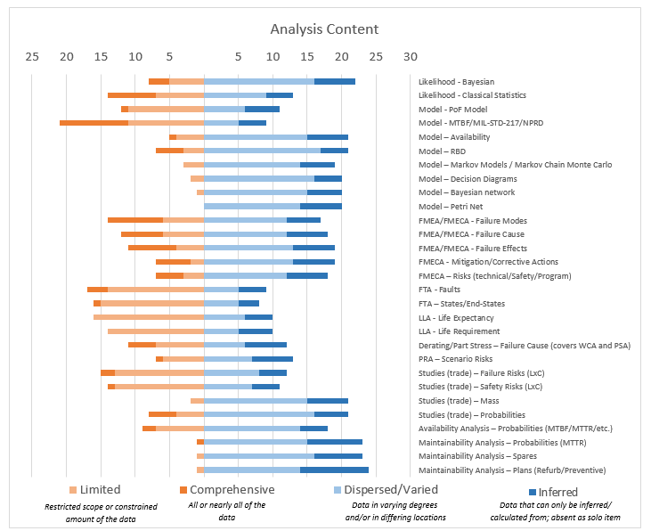
National Aeronautics and Space Administration
www.nasa.gov
Survey Results
R&M practitioners are routinely performing deterministic life, stress, and trade studies.
R&M practitioners are not often performing maintainability and availability analyses performed in a formal or deterministic sense.
R&M practitioners are not consistent across the agency in performing that traditional RMA analysis techniques (Failure Modes and Effects Analysis (FMEA/FMECA), Fault Tree Analysis (FTA), Probabilistic Risk Assessment (PRA)).
Handbook data is still dominating RMA models/ analyses.
Mission Assurance Standards and Capabilities Division
OSMA HQ-GD000
Notes:
R&M survey results (see Figure 4) also indicate that RMA teams create data in the form of analyses. It is assumed that the variation in analysis content across the respondents is based on mission needs. In particular, the survey results seems to indicate that maintainability and availability analyses are not being performed in a formal or deterministic sense, but more in a collateral manner as recommendation from other analyses. Conversely, responses seem show that life, stress, and trade studies are predominantly being performed deterministically, whereas the amount of inferred content in analyses indicated in the survey (dark blue lines on Figure 4) seems to show that traditional RMA analysis techniques (Failure Modes and Effects Analysis (FMEA/FMECA), Fault Tree Analysis (FTA), Probabilistic Risk Assessment (PRA)) are not being uniformly applied. For example, the survey shows that some respondents’ analyses are only inferring failure modes, effects, and causes. That likely implies that traditional Failure Modes and Effects techniques are not necessarily being applied. However, all of the technique indications will need further investigation to identify the true limitation to employing traditional RMA techniques.
Taking a deeper look, failure probability and failure rate derivation survey results (See Bayesian, Statistics, and modeling line items of Figure 4) are showing abundant use of modeling and statistical analysis, but the use of handbook data is still dominating RMA models/analyses. In deriving the probability of any cause (e.g., stress, physics, radiation) of a failure incident, models and statistical methods are normally used. Therefore it is assumed that RMA teams are only relying on handbook data out of necessity due to lack of data, guidance, direction, or support. This assumption will need to be confirmed with further investigation in order to reduce barriers to failure probability and failure rate derivation and sharing.

Slide 8
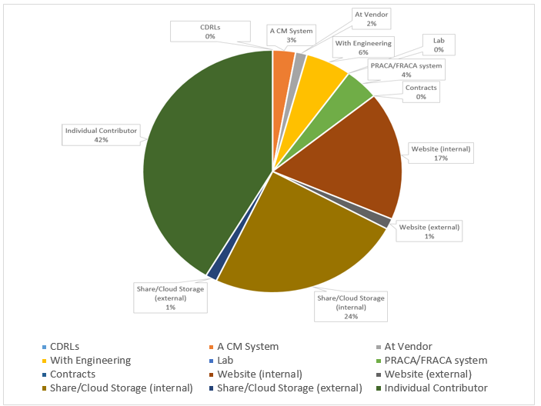
National Aeronautics and Space Administration
www.nasa.gov
Survey Results
As-Is Digital/Data State:
The majority raw/analysis data is either with individuals or within center/program internal systems and repositories.
Knowledge is not being passed easily from one engineer or effort to the next or across NASA.
FAIR Score:
Findable – Low
Accessible – Low
Interoperable – Moderate
Reusable – High Potential
Mission Assurance Standards and Capabilities Division
OSMA HQ-GD000
Notes:
Collaborative use of RMA data (raw and analysis artifacts) is dependent on if the data is FAIR - Findable, Accessible, Interoperable, and Reusable. Findable data (created or used) must be discoverable through inherent knowledge of its existence or through standard searching processes. The results of this survey show that the majority of the data is either with individuals or within center/ program internal systems and repositories.

Slide 9
National Aeronautics and Space Administration
www.nasa.gov
Survey Conclusions & Recommendations
R&M practitioners are serving the needs of the missions they support but can be assisted:
  Variations exist in analysis content and performance across the respondents.
    It is recommended that maintainability, availability, de-orbit/extended mission, life expectancy, readiness, testing, and cyber risk analyses
    barriers be researched to identify customer expectation/need gaps along with providing increased understanding of the value.
  Variations in analysis tool usage and tool availability to practitioners may cause analysis barriers.
    It is recommended that enterprise licensing of tools (not a limited set of tools but a repository of shared tool/seats) be assessed to avoid each
    enterprise procuring/renewing each tool they use separately.
  It is assumed that RMA teams are only relying on handbook data out of necessity due to lack of data, guidance, direction, or support.
    It is recommended that this assumption be confirmed with further investigation in order to reduce barriers to failure probability and failure rate
    derivation and sharing.
    It is recommended that failure rate improvement guidance be shared across R&M practitioners.
    It is recommended that derived failure rates be shared across R&M practitioners.
Improvements in Data Sharing (or Continued Digital Transformation) are needed to improve efficiency and impact value:
  Data Sharing across disciplines and within the R&M community is limited.
    It is recommended that follow-up questionnaires be sent to the points-of-contact for the newly discovered data sets within NASA.
    It is recommended that the value of data sharing be shared with other disciplines and R&M practitioners.
  Data Accessibility is limited due to storage manners (program/project –level).
    It is recommended approval for sharing inside or outside of the source program/ project be improved/facilitated.
    It is recommended that data sharing concepts that transcends ownership issues and foster interoperability/reuse be explored (e.g., mined data sharing).
    It is recommended that further research is needed into Non-NASA R&M raw and analysis data existence be pursued.
Development of a comprehensive strategy to maximize R&M digital transformation (DT) and project/program engagement
should involve the R&M community and DT teams across the space industry.
Mission Assurance Standards and Capabilities Division
OSMA HQ-GD000
Notes:
Since it appears that maintainability, availability, de-orbit/extended mission, life expectancy, readiness, testing, and cyber risk analyses are not being conducted commonly across NASA due to a lack of perceived value/need and/or funding, it is recommended that additional research into barriers be pursued to identify customer expectation/need gaps along with providing increased understanding of the value (e.g., failure risk assessment, anomaly triage/resolution, test planning/analysis, operations/maintenance planning, life limits, and sparing/redundancy/sensor optimization) of these analyses (and others) throughout project lifecycles, through customer discussion, training, and the planned R&M knowledge sharing portal.
In addition, while the survey did not specifically gather analysis tool information or usage, it became apparent in interviews and survey responses that there is a definite commonality in tool usage and that tool availability may cause analysis barriers as well. Currently each center must face the challenges of procuring/renewing each tool they use separately, which can create a resistance to tool acquisition and potentially create a barrier to analysis performance due to tool unavailability. Therefore, it is recommended that enterprise licensing of tools be assessed for feasibility. Note: additional data on each center’s tool usage will need to be gathered/used to develop a final enterprise licensing plan.
The implementation of the above recommendations and continued R&M data/process innovation and improvement efforts, in close coordination with NASA's/SMA's data governance activities, will support NASA’s digital transformation imperative and enable full utilization of RMA data and expertise across NASA.
Therefore, R&M is partnering with SMA’s DT outreach team (i.e., Sean, Steve) and SMA’s Data Governance folks (Laurel Dye, Bob Conway) to help capture inventories and highlight corresponding challenges associated with Data and Data-Process connectivity for not only R&M, but all of the SMA disciplines. We can certainly have representatives representing SMA on the Agency’s Data Governance board (Bob), Data Standards working group (Laurel), or SMA DT outreach participate in future (working) TDT meetings.
Solicit TDT help
Solicit ESA/JAXA help

Slide 10
National Aeronautics and Space Administration
www.nasa.gov
  R&M Digital Transformation Next Steps
  Phase1: Discover our Resources and Barriers
    Conduct Data Survey
    Communicate Findings
    Solicit Recommendations and Additional Data Sources
  Phase 2: Enable and Advance Transitional Digital State
    Identify Strategies to fill data gaps via FAIR approaches
      Data Mining for Data Sharing and Modeling Support within R&M
      Develop and Share practice data on the R&M Knowledge Portal
      Increase understanding of data needs and sharing with other disciplines
    Identify Strategies to mitigate implementation barriers
      Data Mining for Data Sharing and Modeling Support
      Develop and Share the value that can be anticipated from R&M Processes on the R&M Knowledge Portal
      Increase outreach to engineering disciplines across NASA and beyond
    Identify Strategies to enable greater R&M Efficiency
      Best Practice and product sharing
      Model-Based R&M (reference models, libraries, etc.)
      Physics of Failure
  Phase 3: Achieve Digital Transformation
Mission Assurance Standards and Capabilities Division
OSMA HQ-GD000
Notes:
Solicit TDT help
AFRC Project and Centralized CM systems
AMES Electrical Power Reliability Office dbase - https://dev qspress.ndc.nasa.gov:8443/EPRO/ Frontpage.cfm
AMES Pressure System dbase https://dev-qspress.ndc.nasa.gov:8443/General.cfm
ORION/ISS Cross Program FMEA-CIL System - https://cxfmea-cil.nasa.gov/
ORION/ISS Cross Program Hazard System - https://cxhazard.nasa.gov/home
Code QS Document Management System (QSDMS) - https://qsdms.arc.nasa.gov/document/documents
JSC Sharepoint - https://eisd.sp.jsc.nasa.gov/
MARS - Mission Assurance Reporting System (KSC)
MSFC Product/Project Data Management (Windchill) - https://nasa-ice.nasa.gov/windchill/
KDDMS - Kennedy Design and Data Management System (Windchill) - https://kddms.ndc.nasa.gov/Windchill/app/
KSC TIPS portal - https://adf-tosc.ksc.nasa.gov/TIPS/faces/home
NASA Integrated Collaborative Environment (ICE/Windchill) - https://nasa-ice.nasa.gov/portal/
NASA SMA Toolbox knowledge collection - https://nsc.nasa.gov/SMAToolbox/ui/search/default.aspx
Solicit ESA/JAXA help
Consistency – Efficiency – Accuracy – Relevance/Value/Impact

Slide 11
National Aeronautics and Space Administration
www.nasa.gov
Questions
Mission Assurance Standards and Capabilities Division
OSMA HQ-GD000

