Slide 1

IT Advanced Concepts
3D Printing Lab
Who we are, Where we have been, and Where we are going.
Pathways Showcase - Bryce Frase, IT-C1
Notes:
An overview of the disruptive technologies and abilities of the Kennedy Space Center ITACL lab

Slide 2
Introduction
Bryce Frase, IT-C1
UCF, Fall 2021
Aerospace Engineering
Accelerated BS/MS

Slide 3

IT-C Division
“Expertise, Leadership, and Guidance…
…Design, Development, and Sustaining…
…Engineering for the Entire Life Cycle”
Notes:
The Application Services Division is responsible for providing expertise, leadership, and guidance in the design, development, and sustaining of engineering for the entire life cycle (Concept Studies to Decommissioning) of new and existing applications, services, and processes.

Slide 4
ITACL 3D Printing Lab
Who We Are
Notes:
What does ITACL 3D Printing Lab do?
We are a disruptive technology group focused on additive manufacturing, rapid prototyping, software development, materials engineering to support the engineering process.

Slide 5
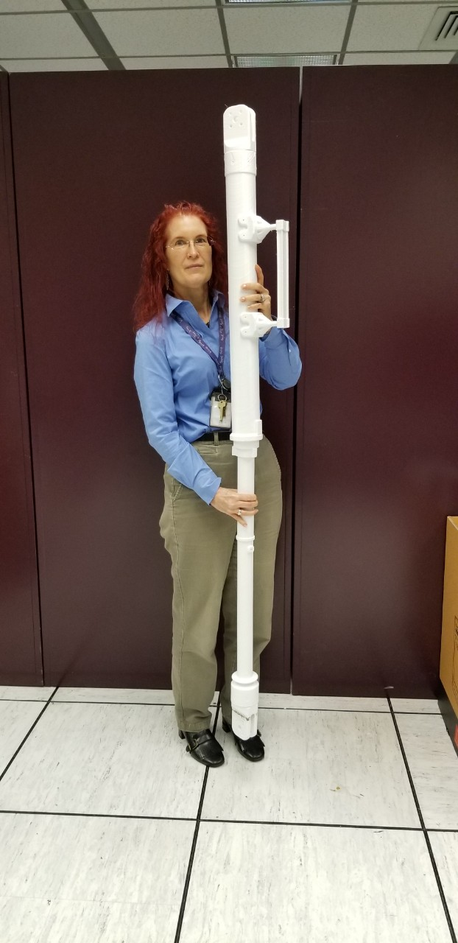
Large-Format Prints
Incredible Resolutions
3D Printing
Notes:
Technically infinite build volume
Resolutions smaller than half the size of a human hair (about 50 microns). That’s about one white blood cell!

Slide 6
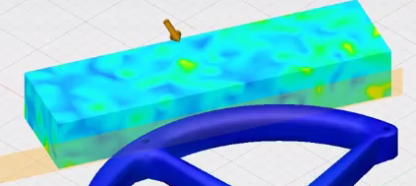
3D Modeling and Simulation
Simulation of an External Force on an Additive Manufactured Part
Notes:
What we do:
Design and run simulation on additive manufactured part physical properties. Light-weighting parts using topology, design for additive manufacturing.

Slide 7
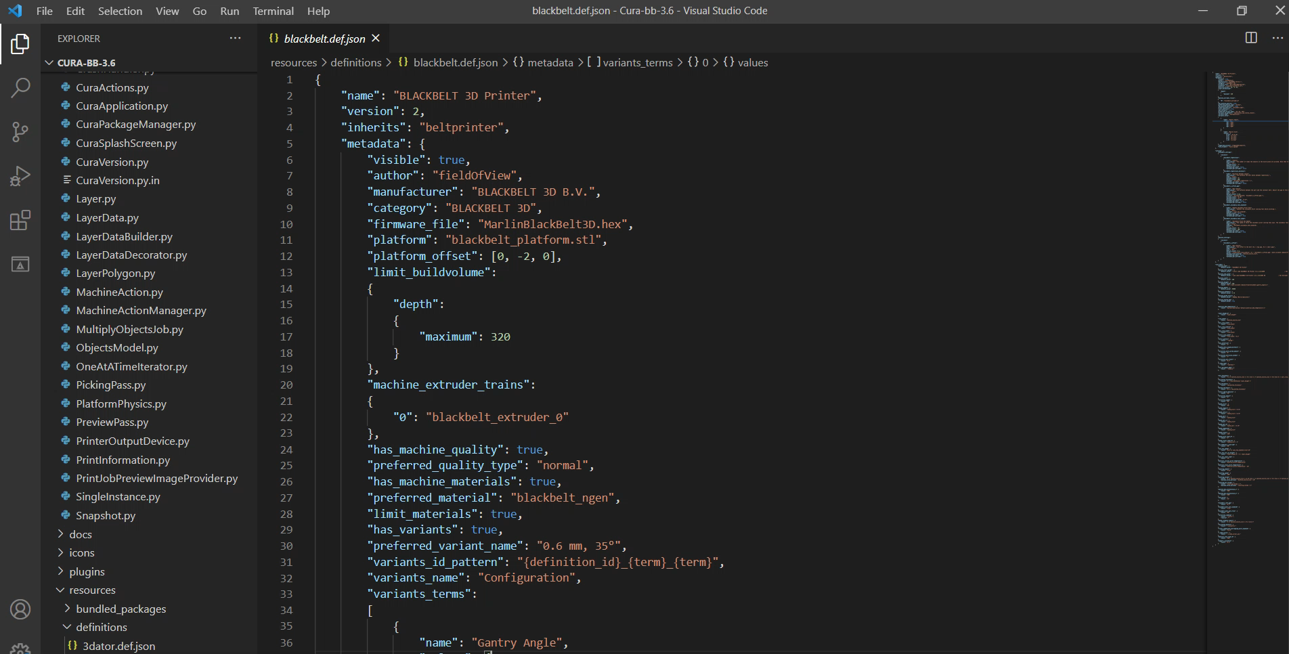
3D Printing Software Development
Notes:
What we do:
Design and run simulation on additive manufactured part physical properties. Light-weighting parts using topology, design for additive manufacturing.

Slide 8
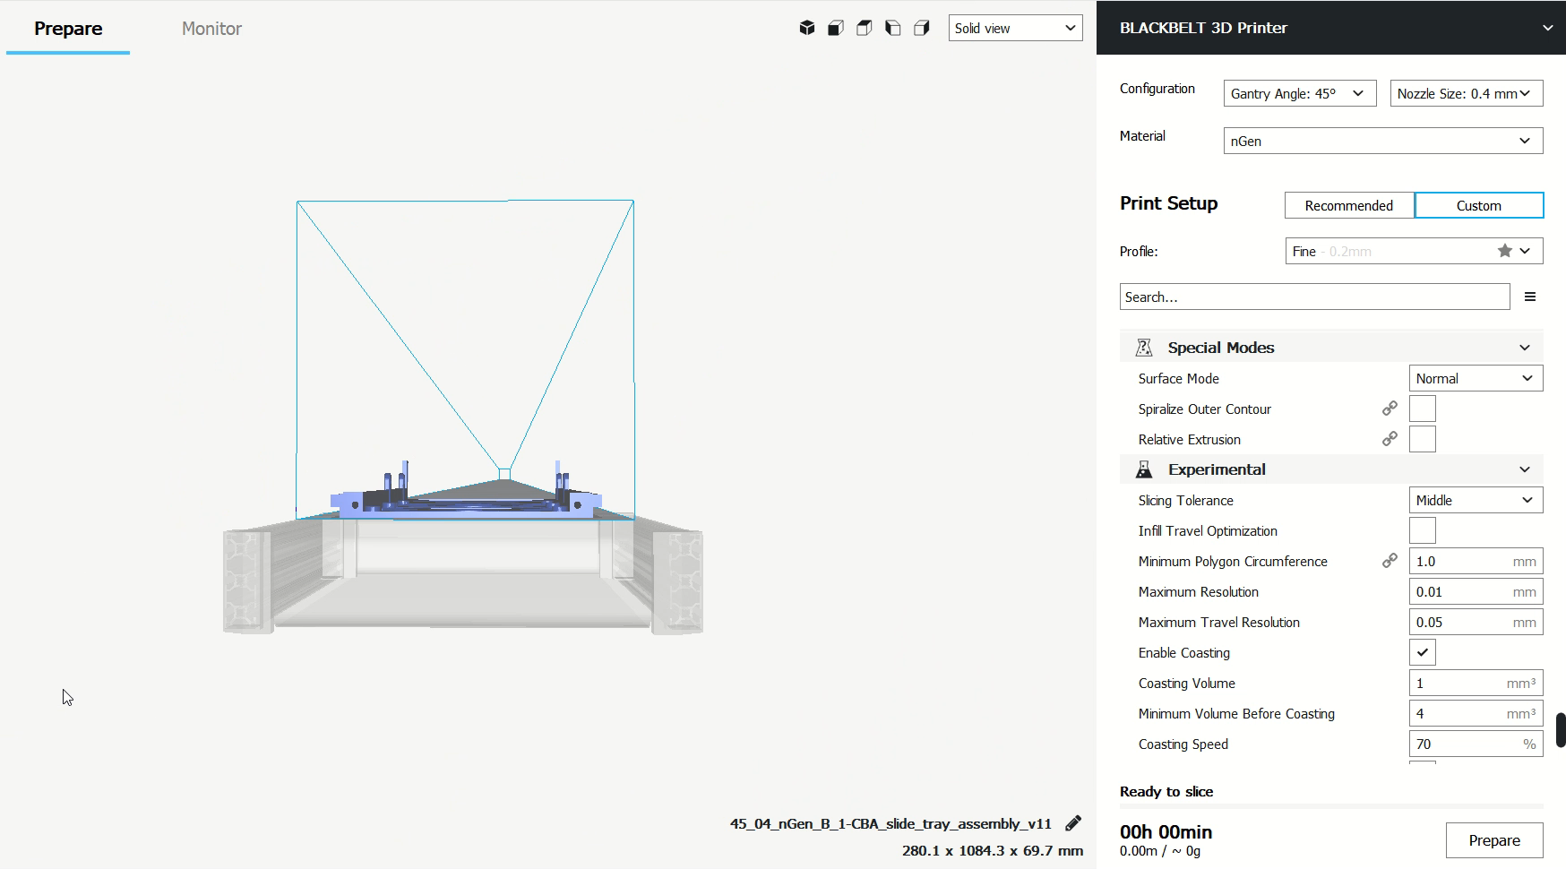
Slicing Software Developed for Belt-Style 3D Printers

Slide 9
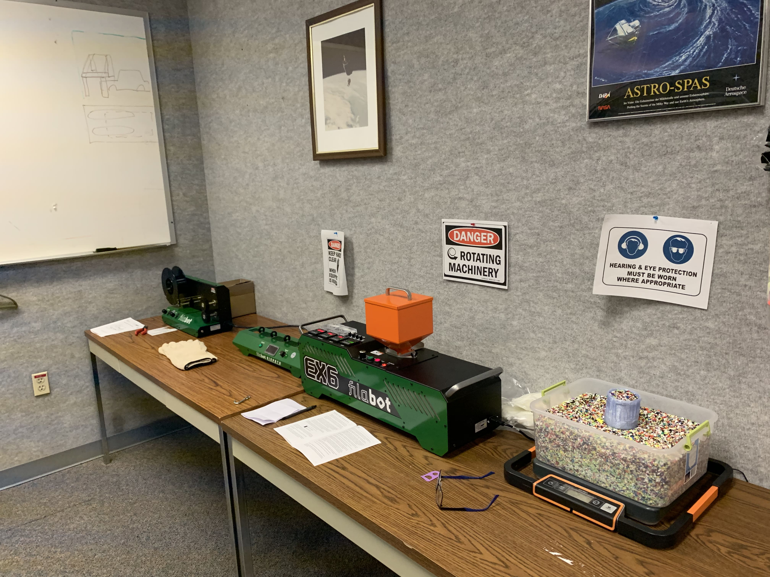
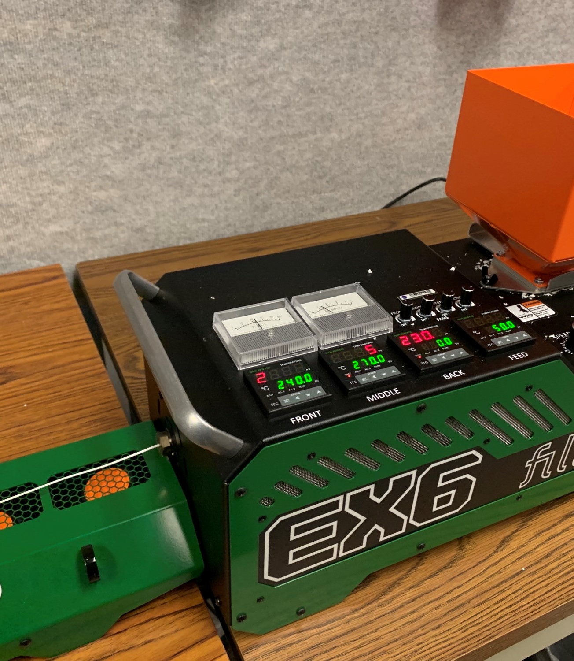
3D Print Recycling
Recycling Prints
In-house Filaments
Notes:
What we do:
-We can reuse old filament with minimal decay of physical properties
-Can create filaments with various additive properties – electrochemical
Engineers need materials with properties that match the physical requirements for the parts being produced

Slide 10
Engineering Design Process
Research
Design Requirements
Concept Generation
Preliminary Design
Redesign
Detailed Design
Production Planning
Where We
Reside
Notes:
Where we fit in the process

Slide 11
ITACL 3D Printing Lab
Where We Have Been

Slide 12
Series Production

Slide 13
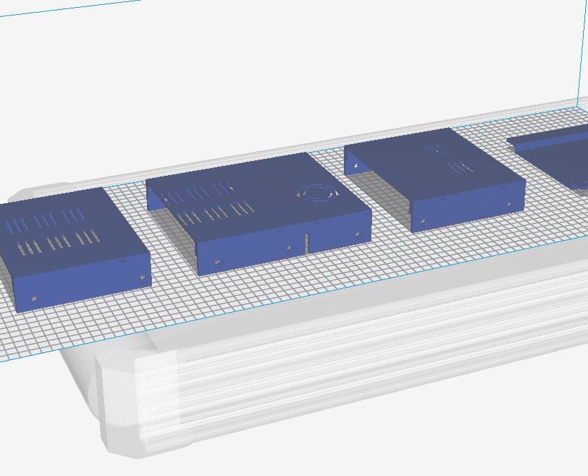
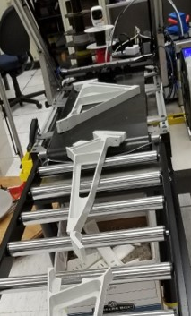

Slide 14
Autonomous & Continuous Printing

Slide 15
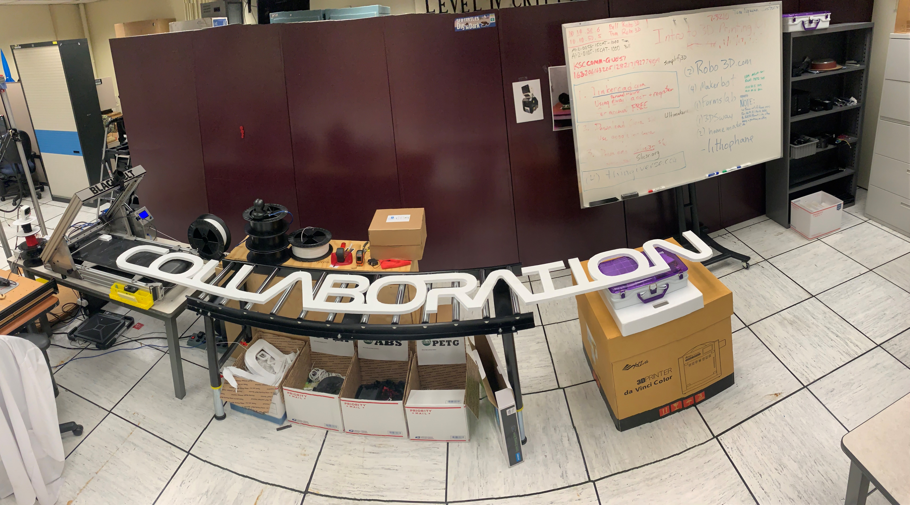
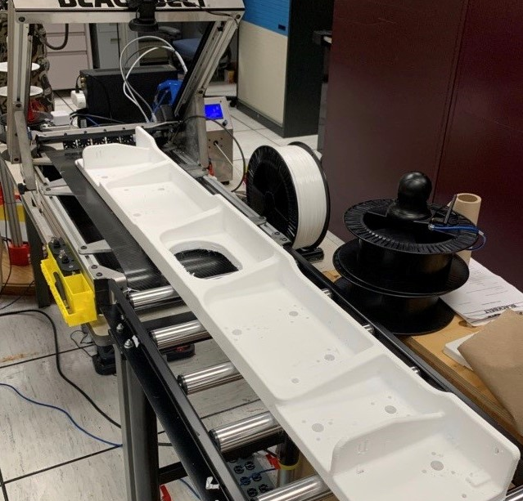
Over 10 Kg of Filament
Over 6 Days of Continuous Printing

Slide 16
Installation-Ready Quality

Slide 17
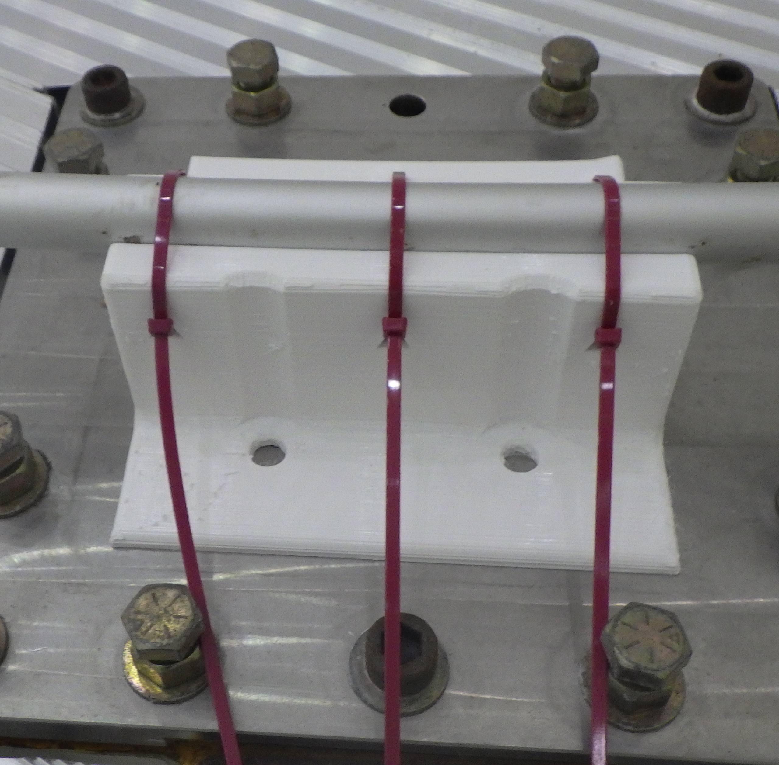
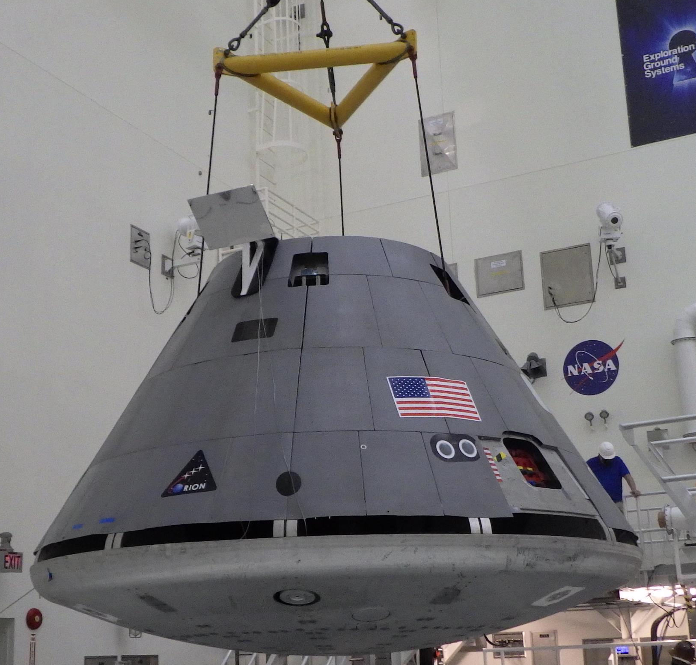
Specific Physical Properties

Slide 18
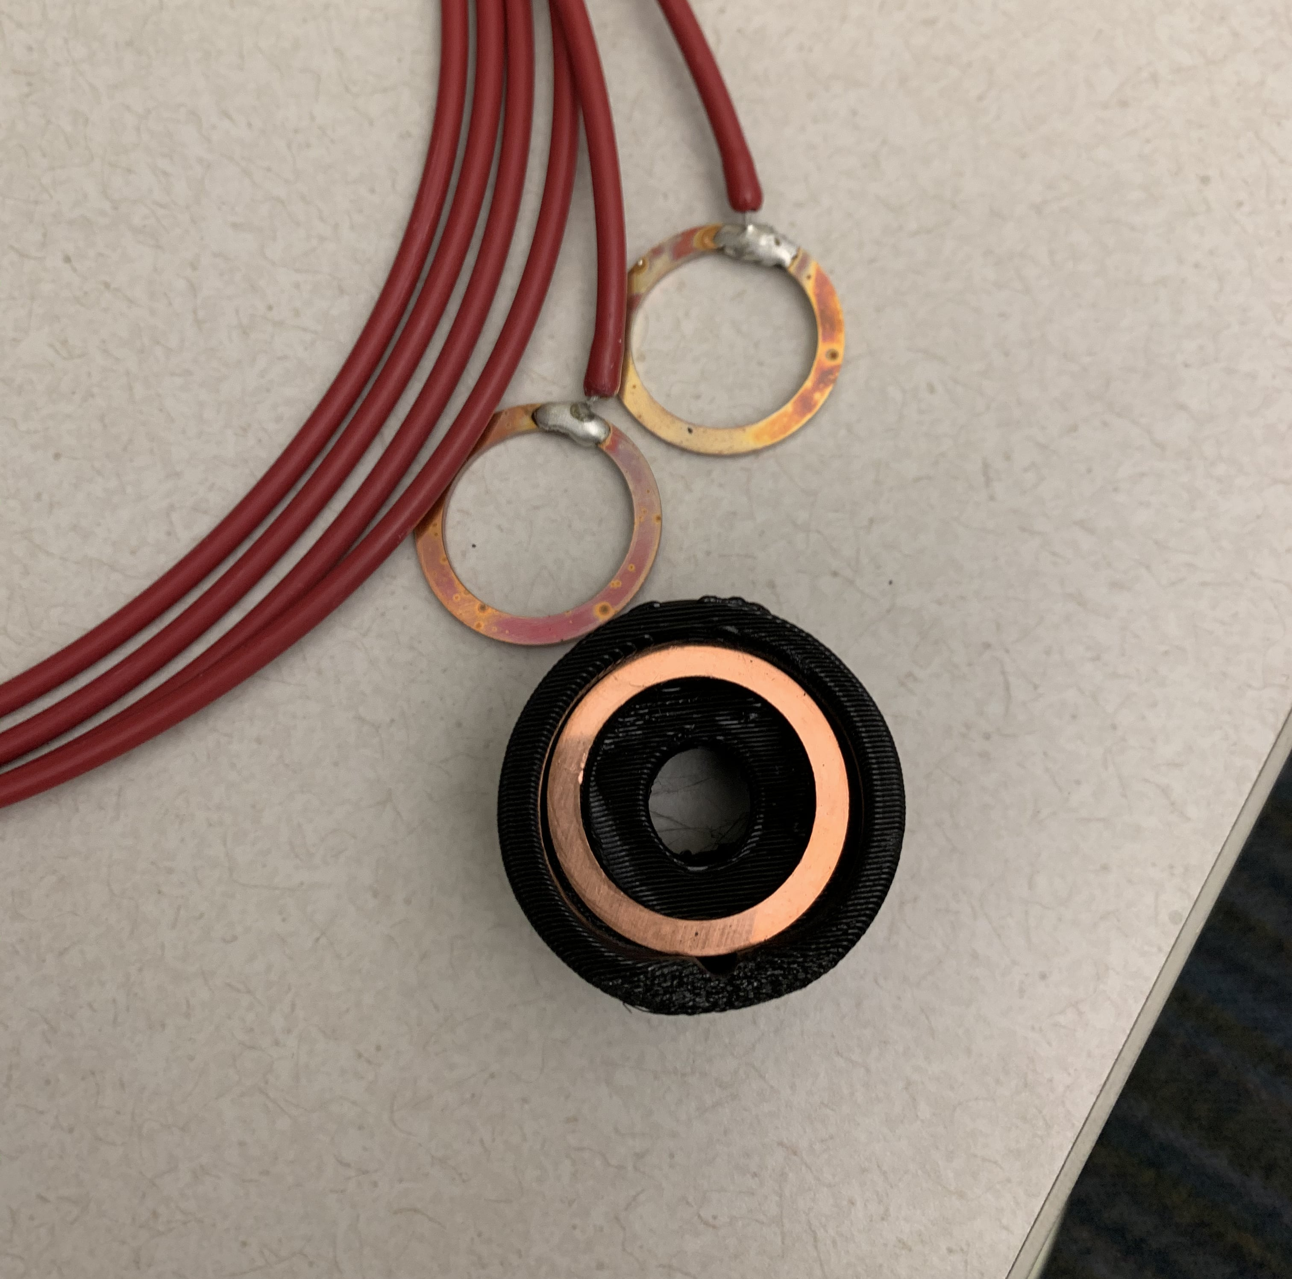
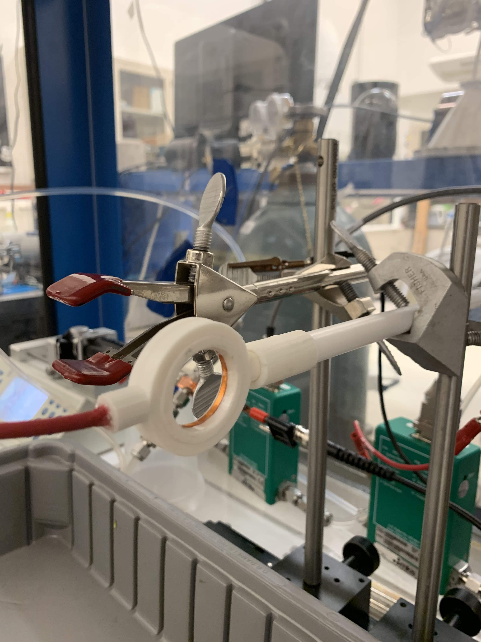
Specific Electrochemical Properties
Notes:
Electrochemical Properties, Material properties
Electrostatic Dissipative Filament: modified surface resistance by addition of certain forms of carbon. Allows for partially resistive to current flow and can safely usher static electricity to an attached ground and prevent sparking.

Slide 19
Self-Sustaining

Slide 20
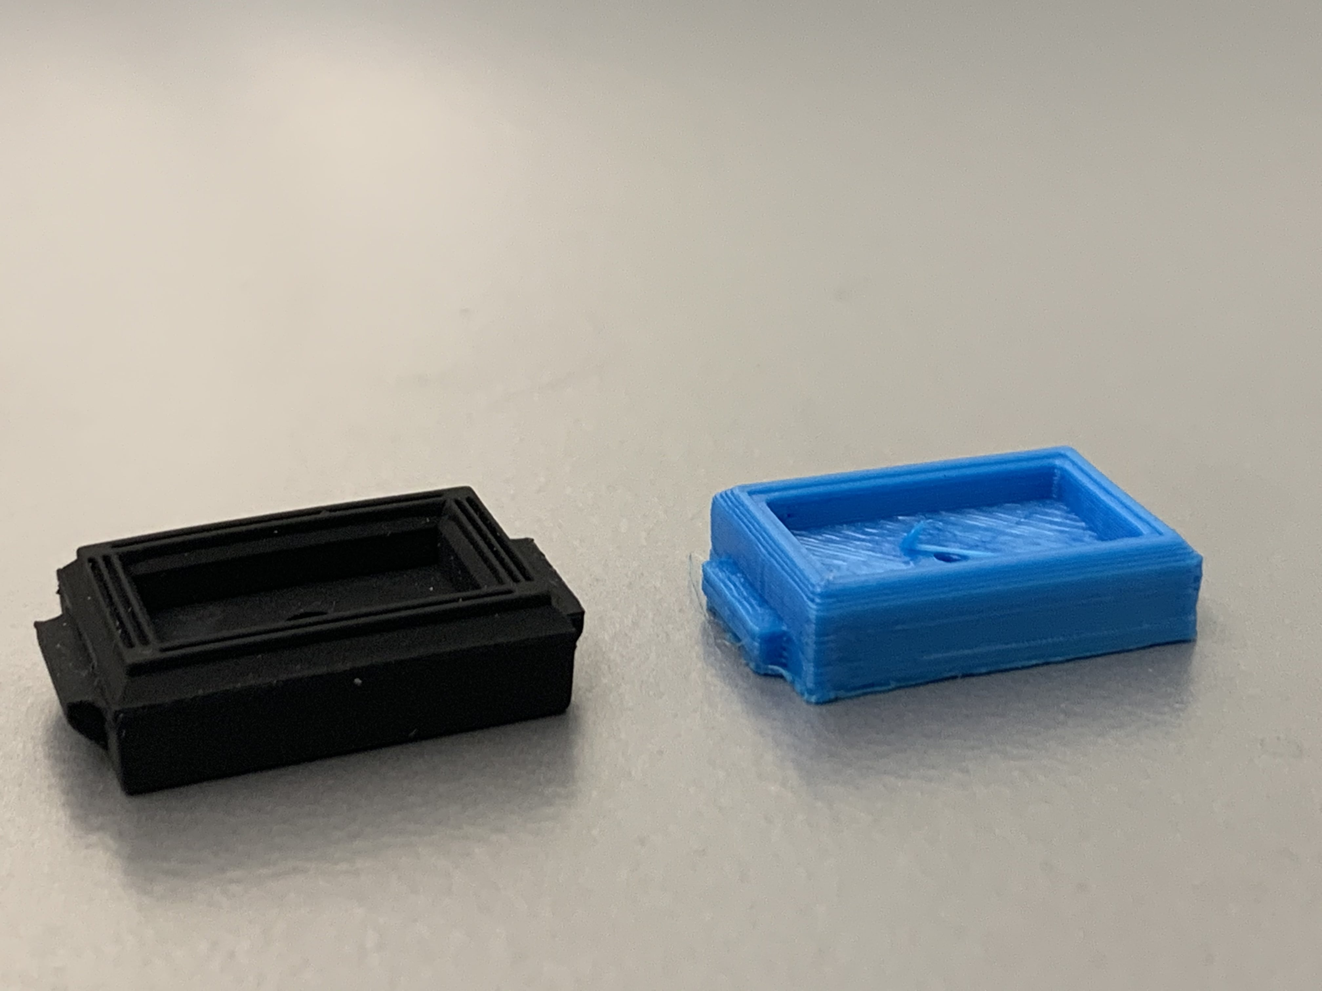
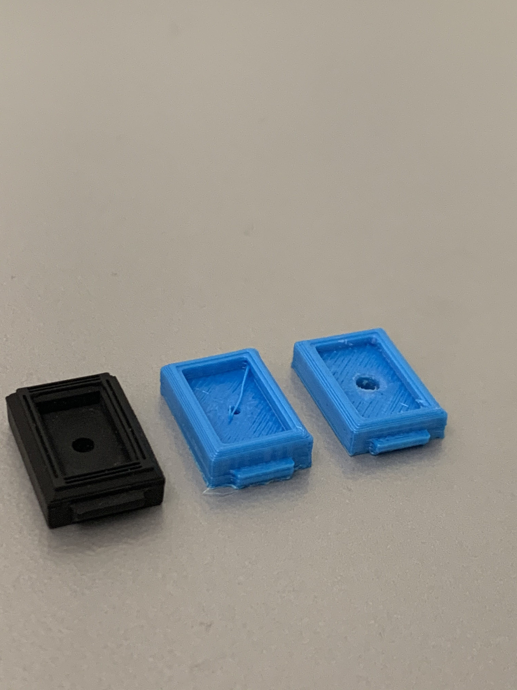
Replacement of Worn Parts

Slide 21
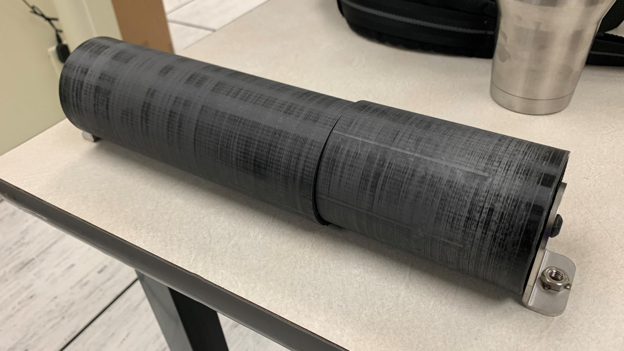
Full-Scale Replacement of Failed Parts

Slide 22
Self-Improving

Slide 23
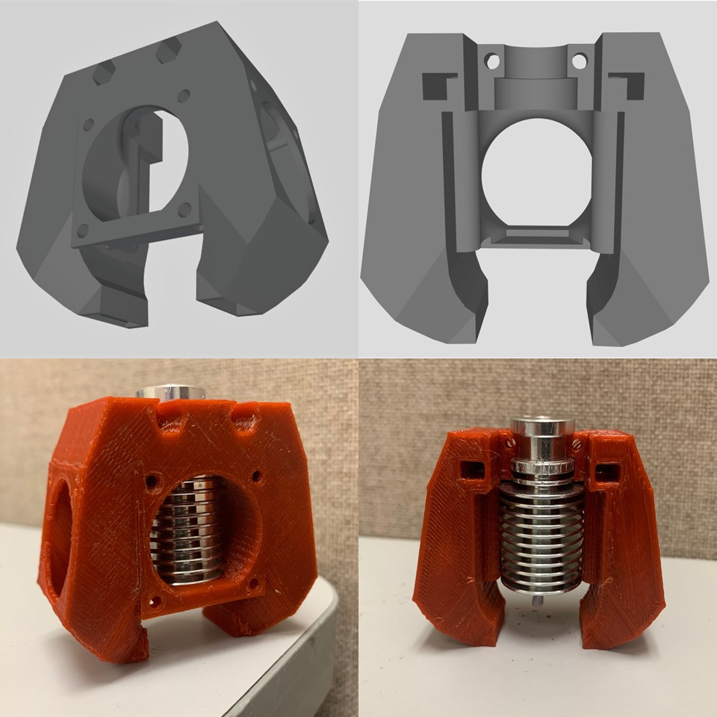
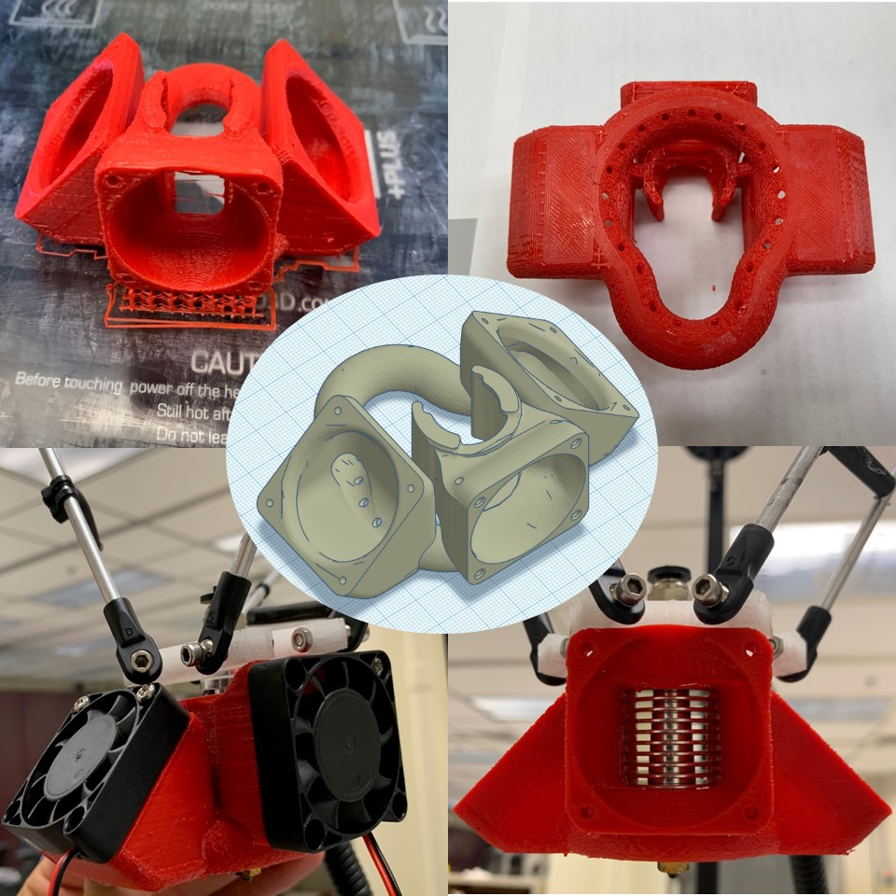
Designs of Improved Cooling for Printheads

Slide 24
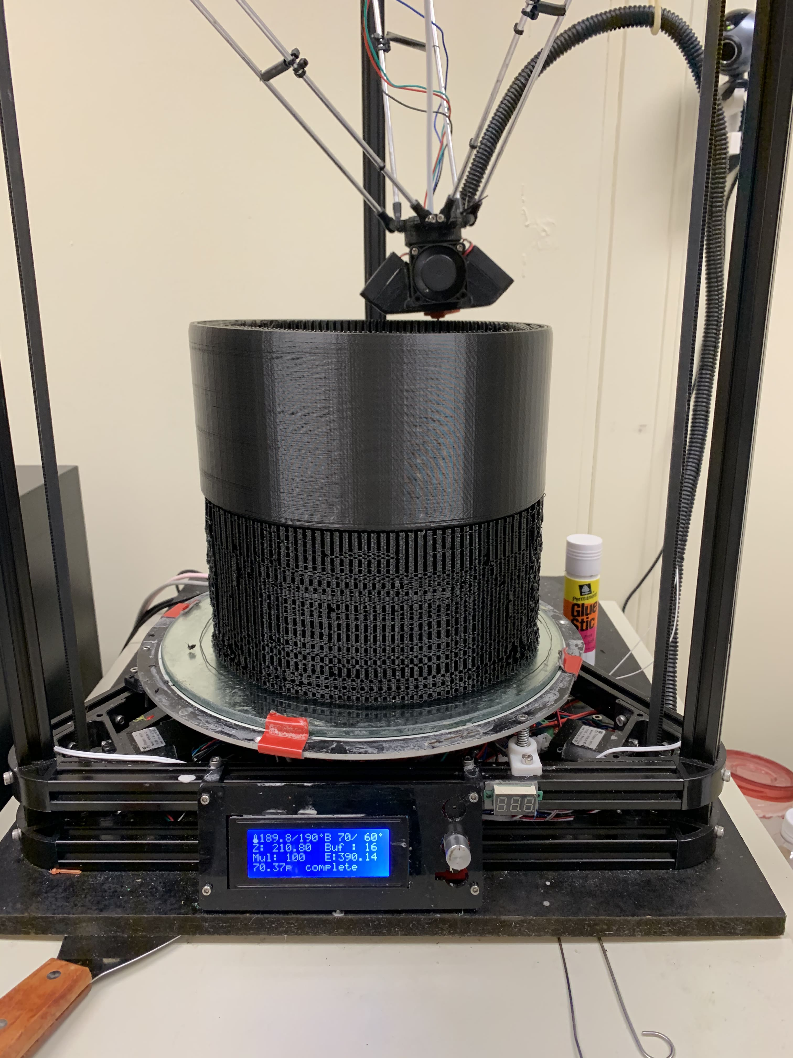
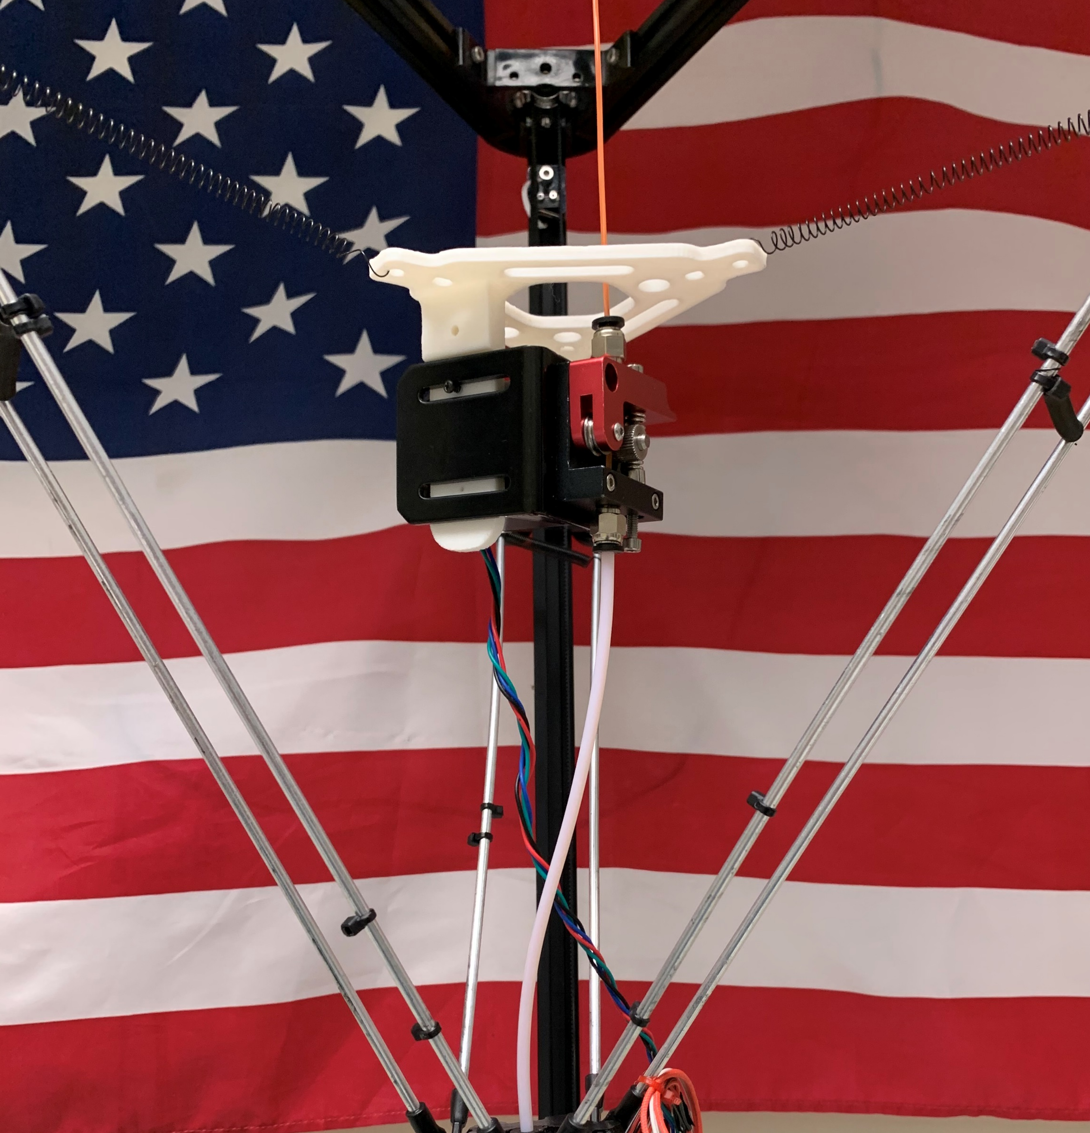
Direct Feed Design
New Designs in Action

Slide 25
Multi-Material Printing

Slide 26
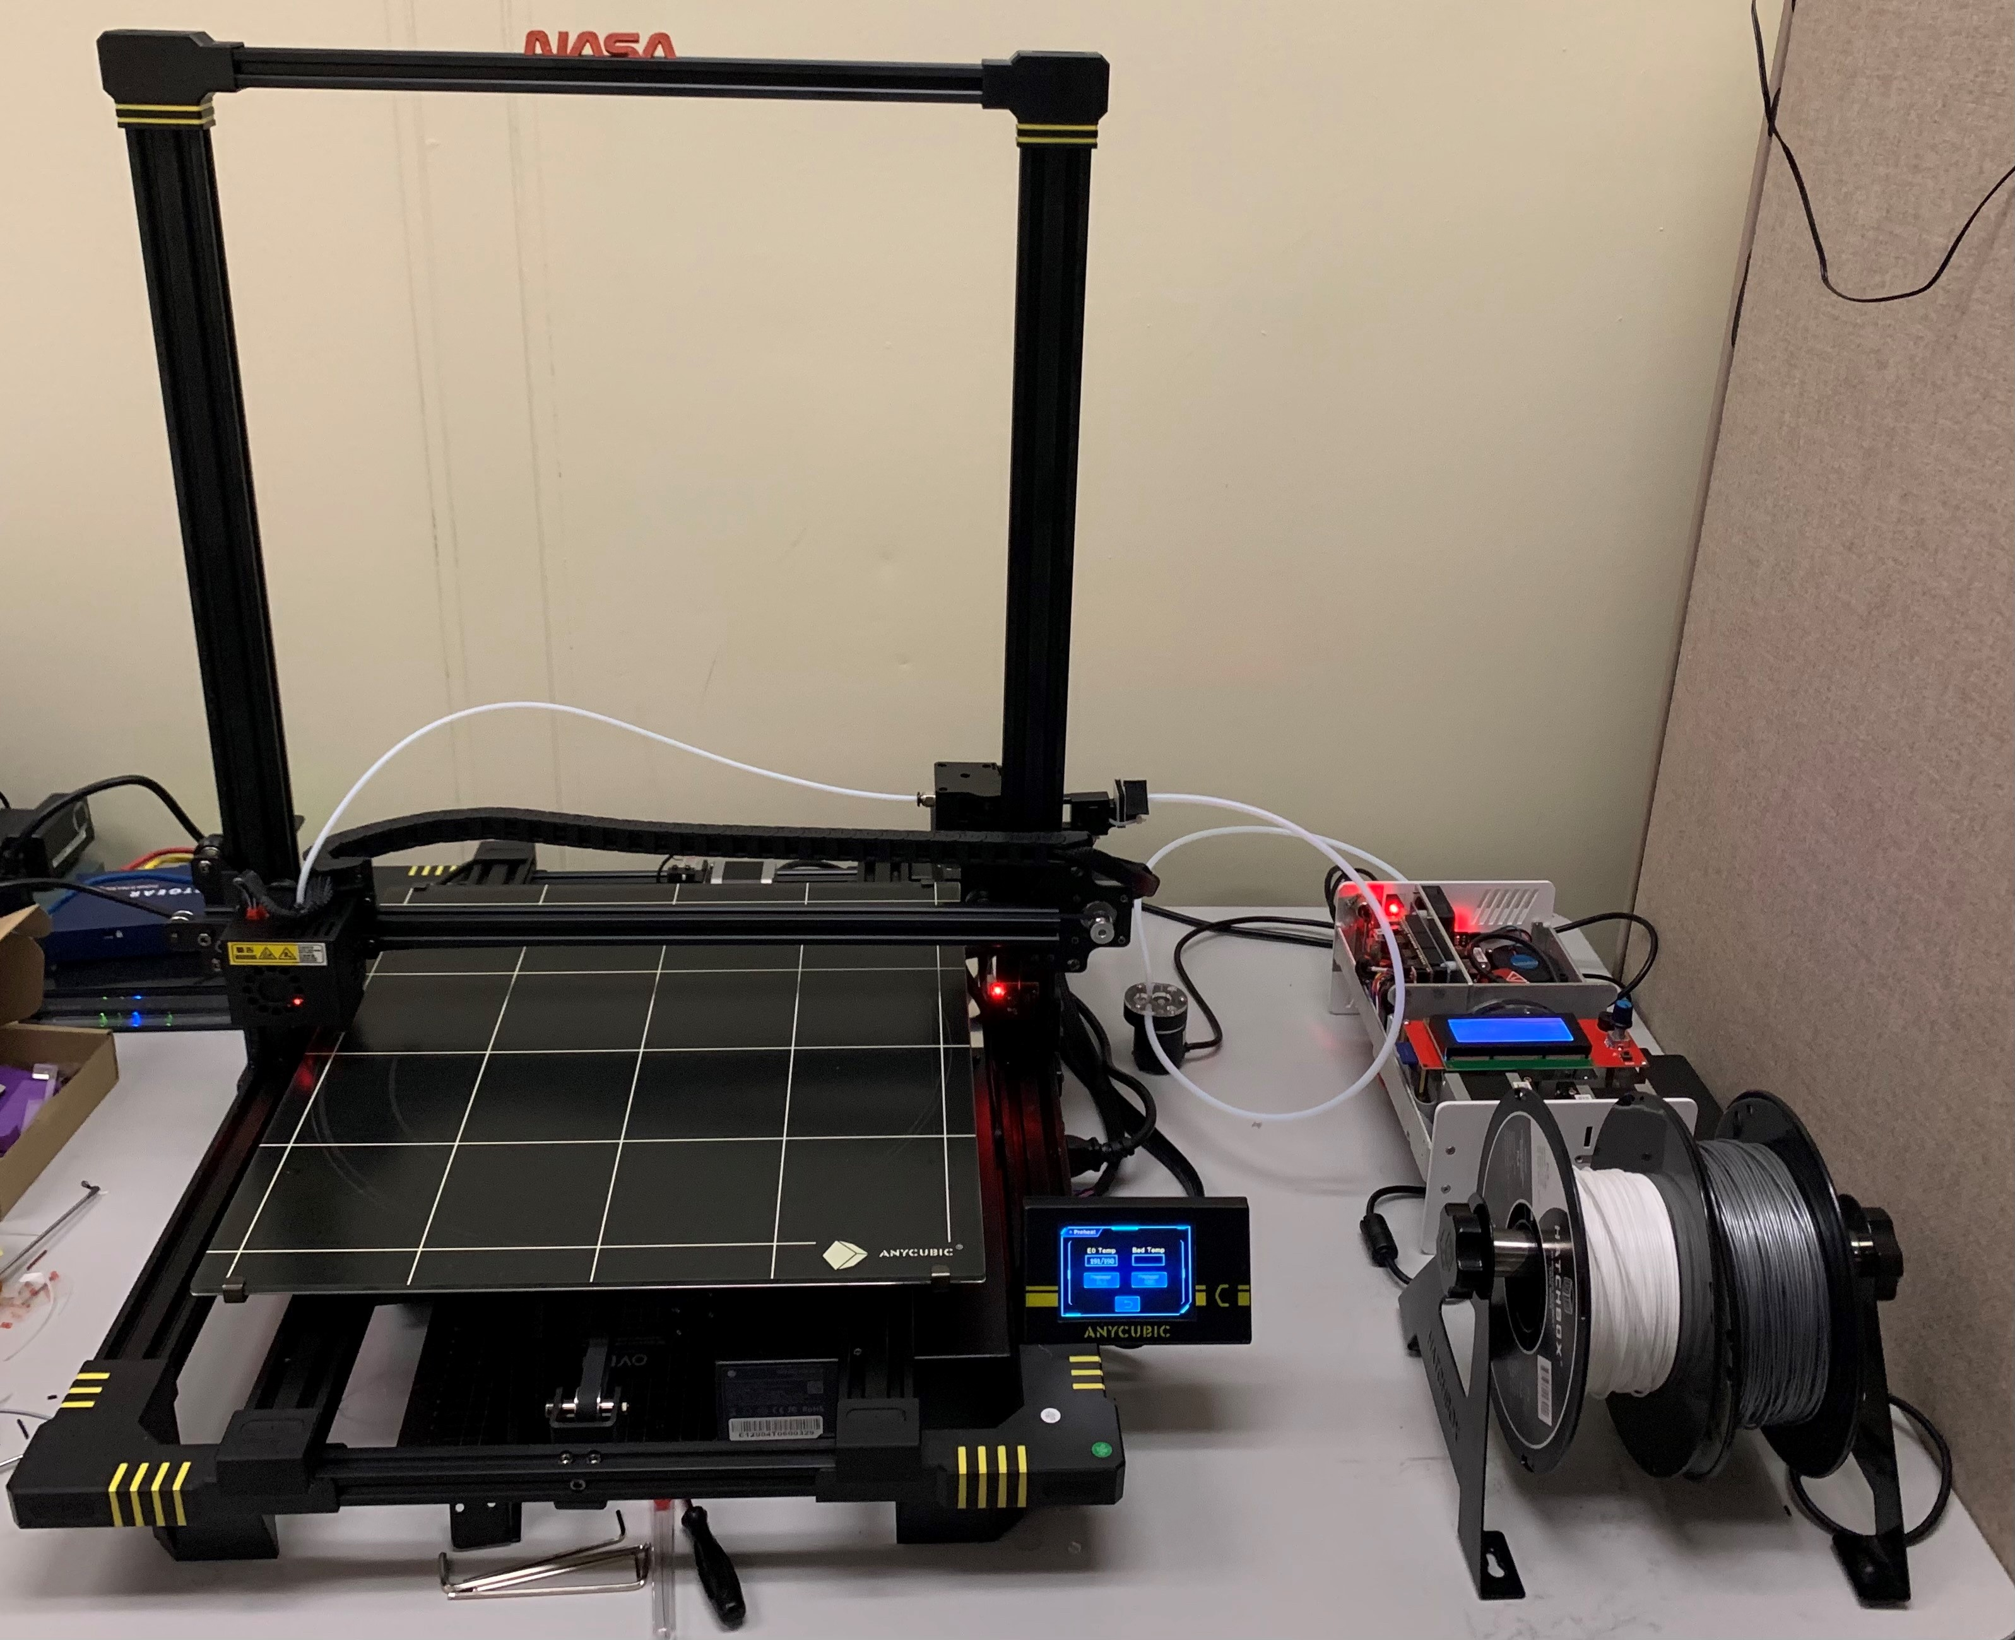
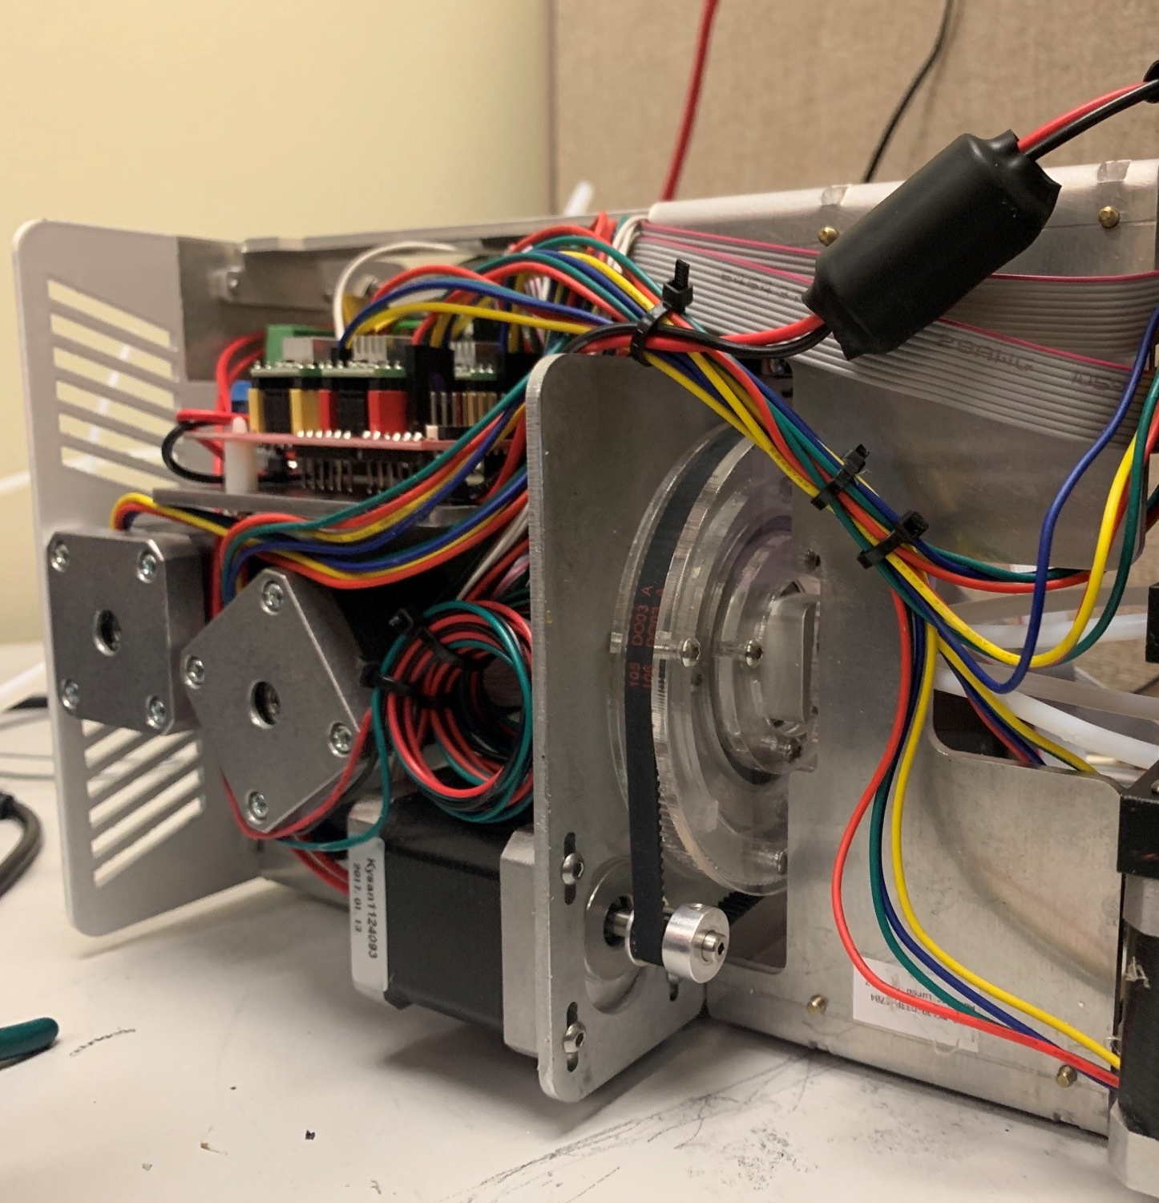
Multi-Material System
Re-Design of Controller Boards

Slide 27

4 Color Print Design

Slide 28
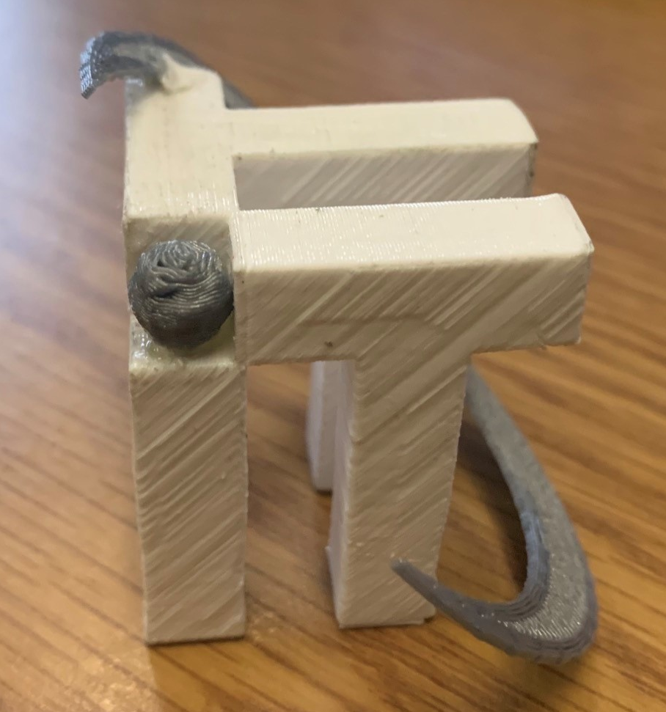
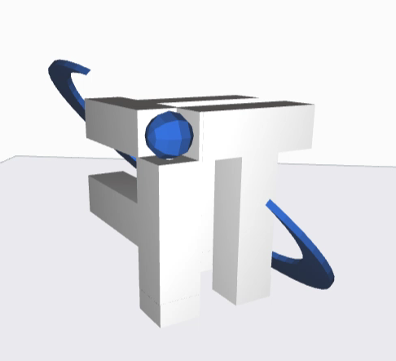
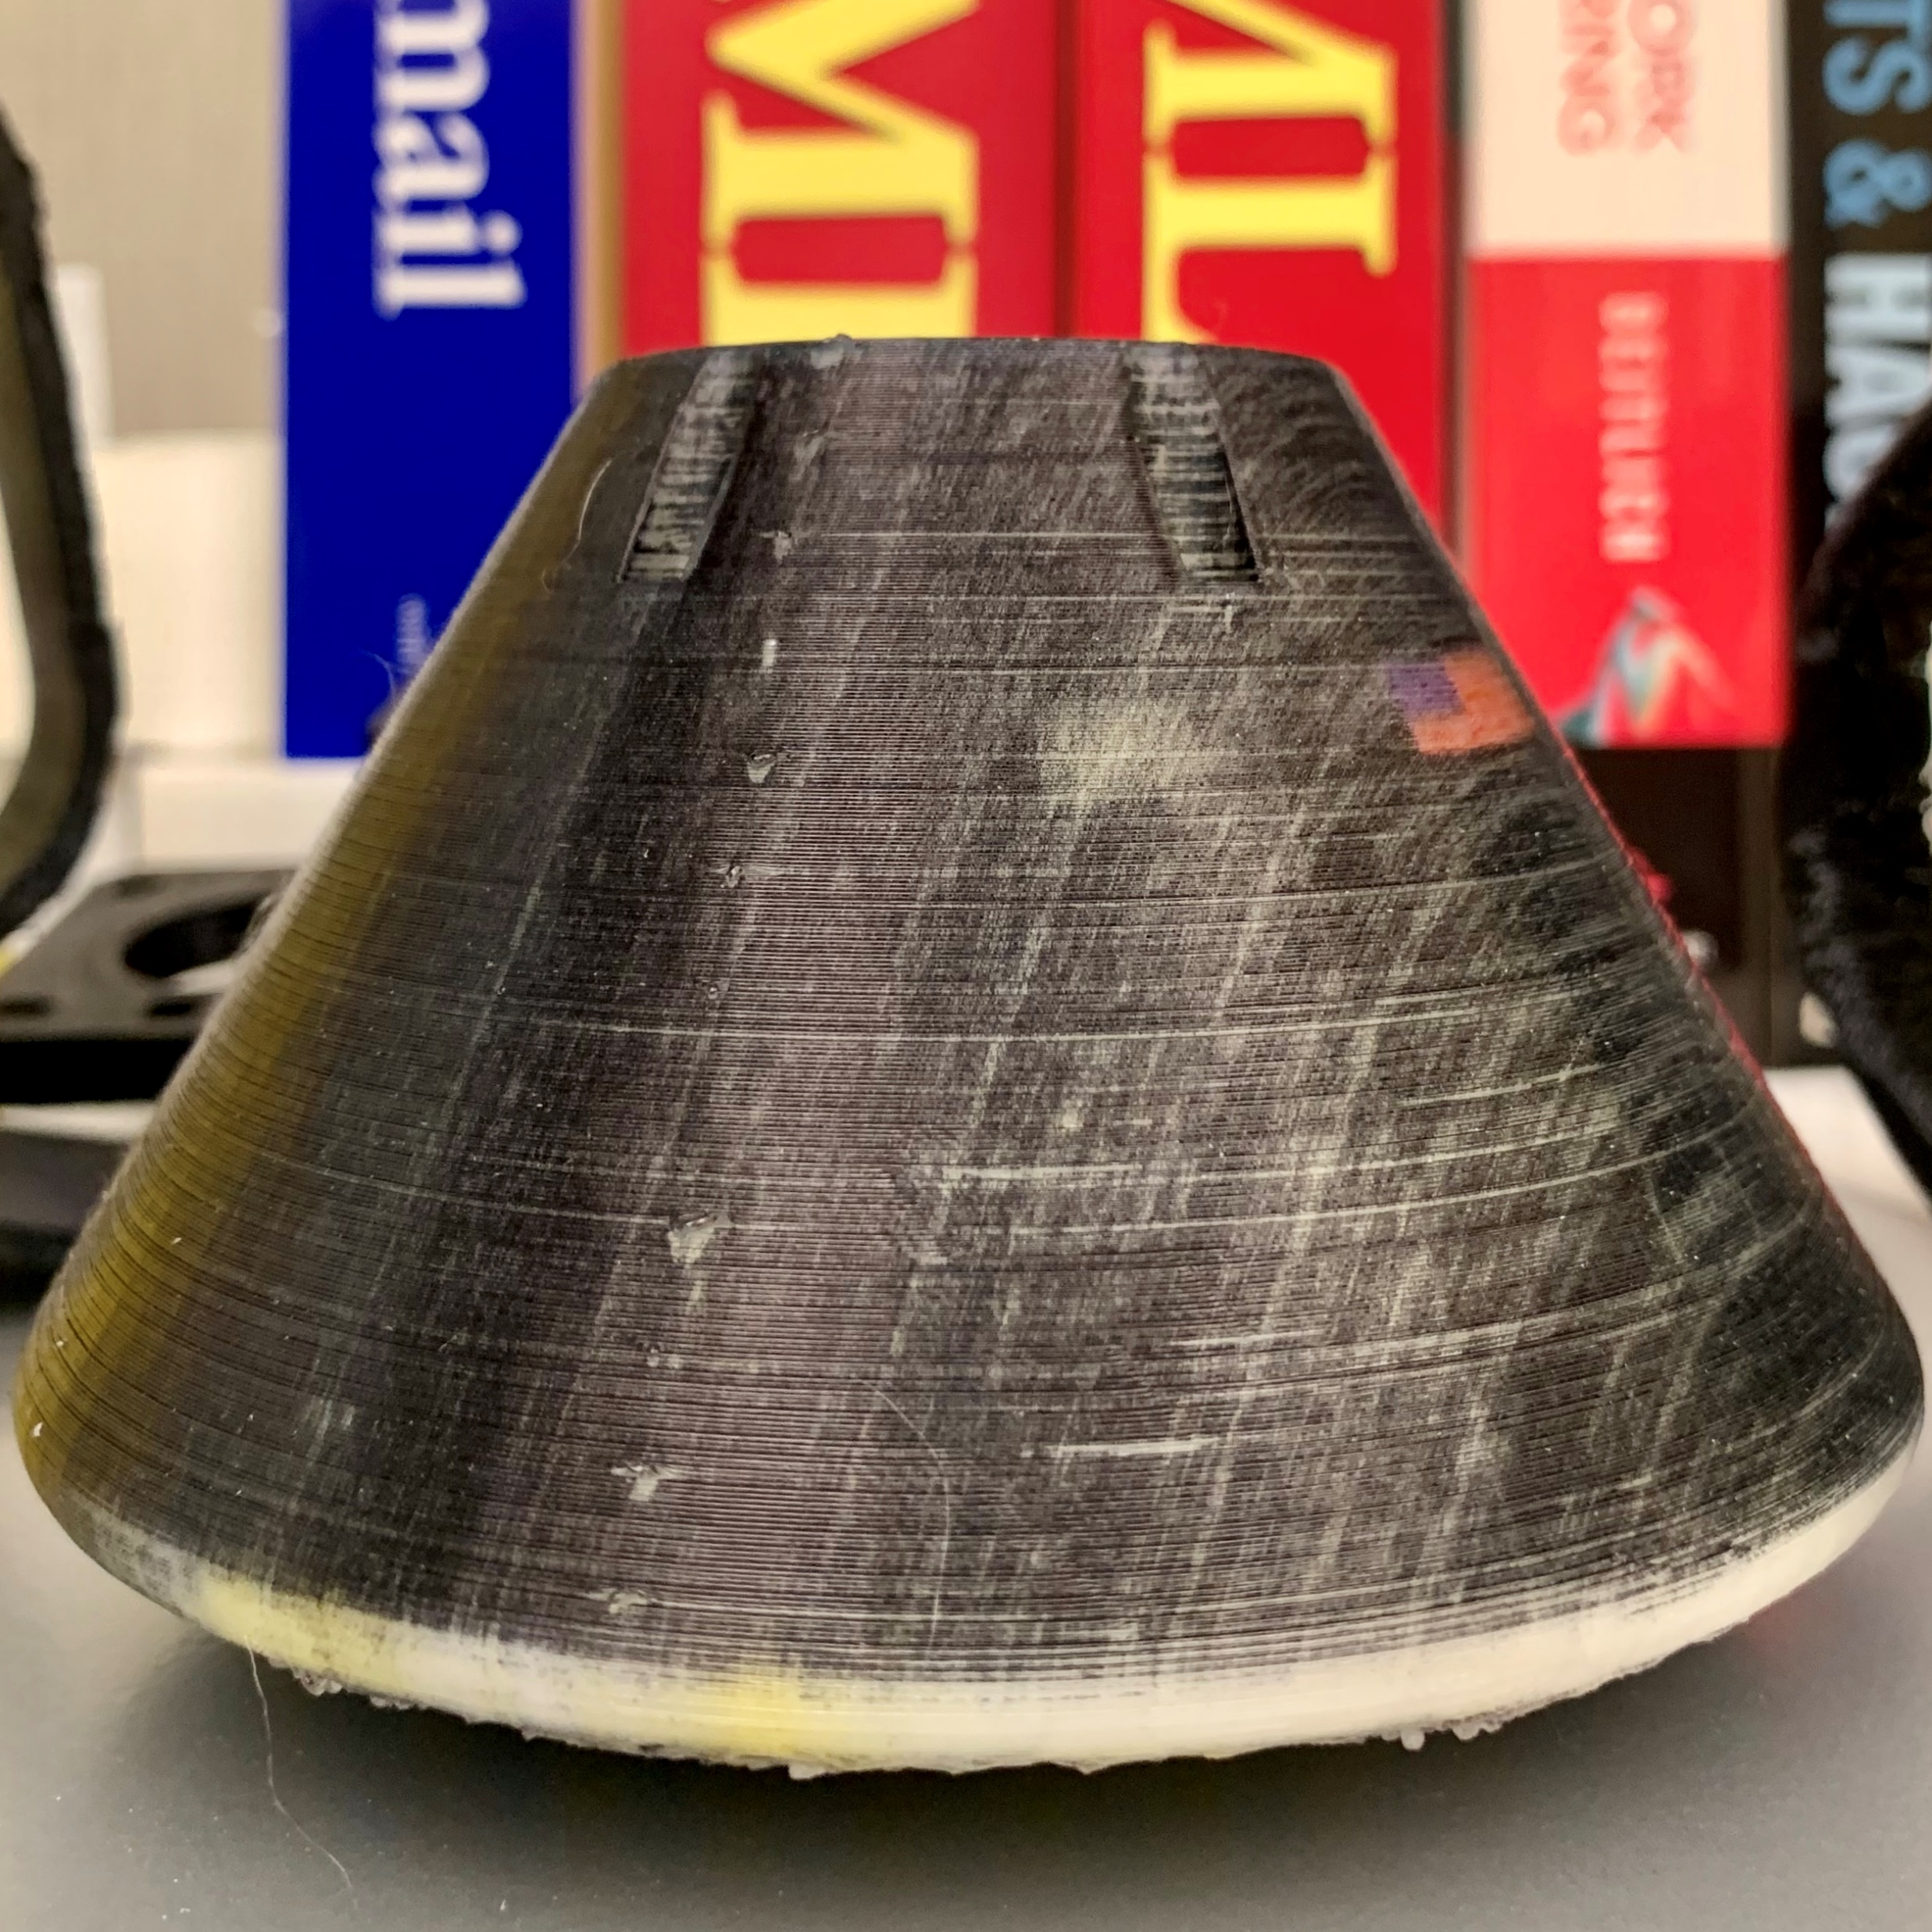
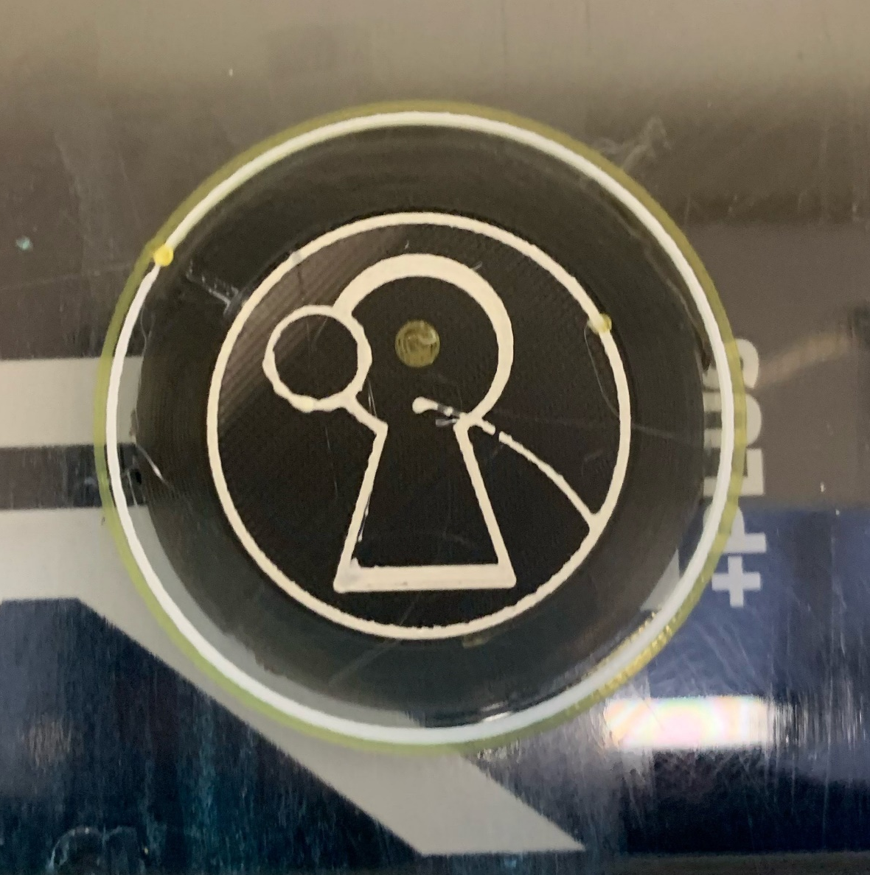

Slide 29
ITACL 3D Printing Lab
Where We Are Going
Notes:
The ITACL 3D Printing Lab’s next projects for new emerging technologies

Slide 30

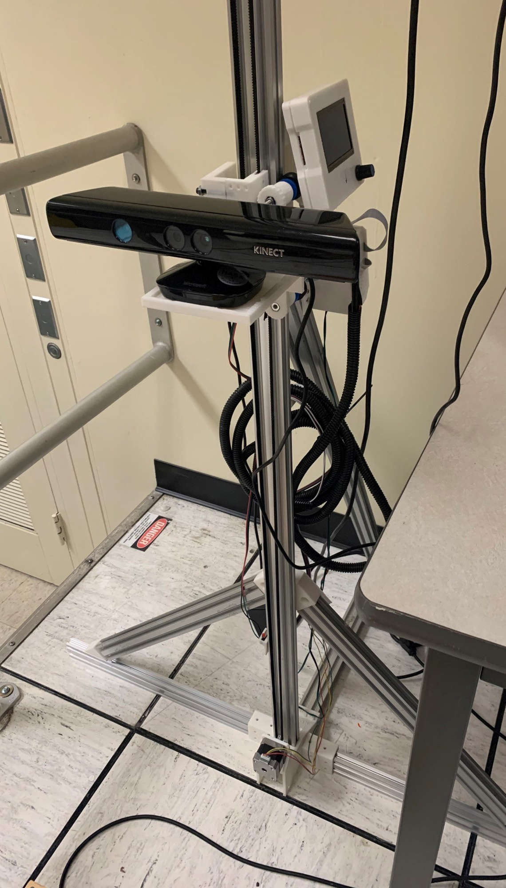
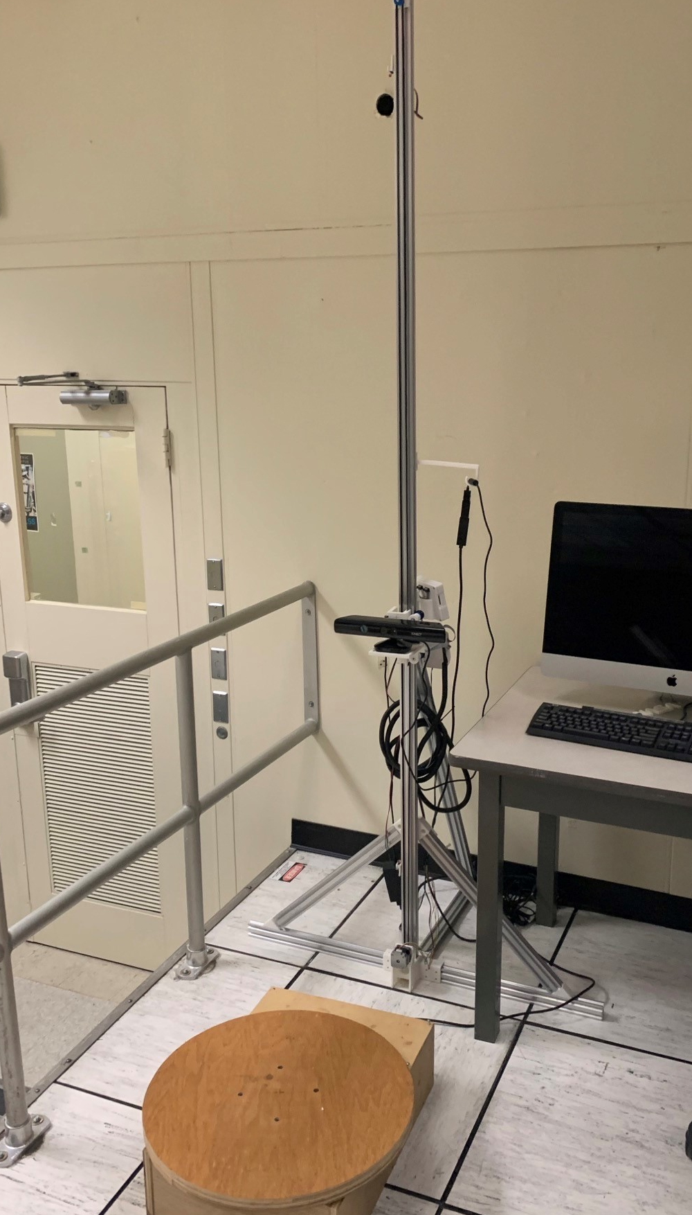
3D Scanning
Printing for Specific Objects
Replacing Weathered Parts
AI to Monitor Print Quality

Slide 31
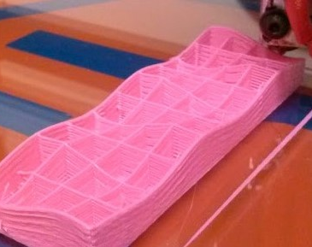
Non-Planar Printing
Printing Into Objects
Embedding Devices

Slide 32
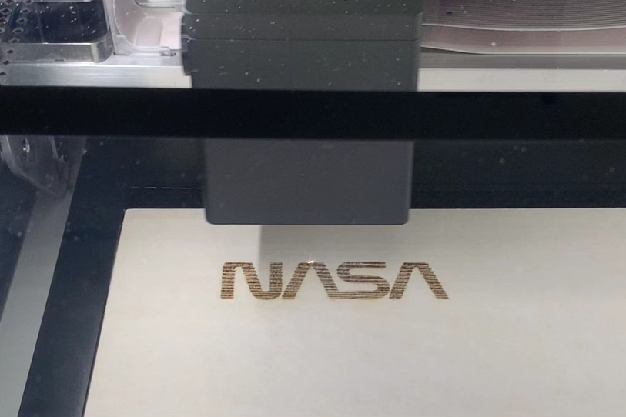
3D Laser Printers
Printed Circuit Boards
Metal Etching/Cutting
Resin Casings

Slide 33
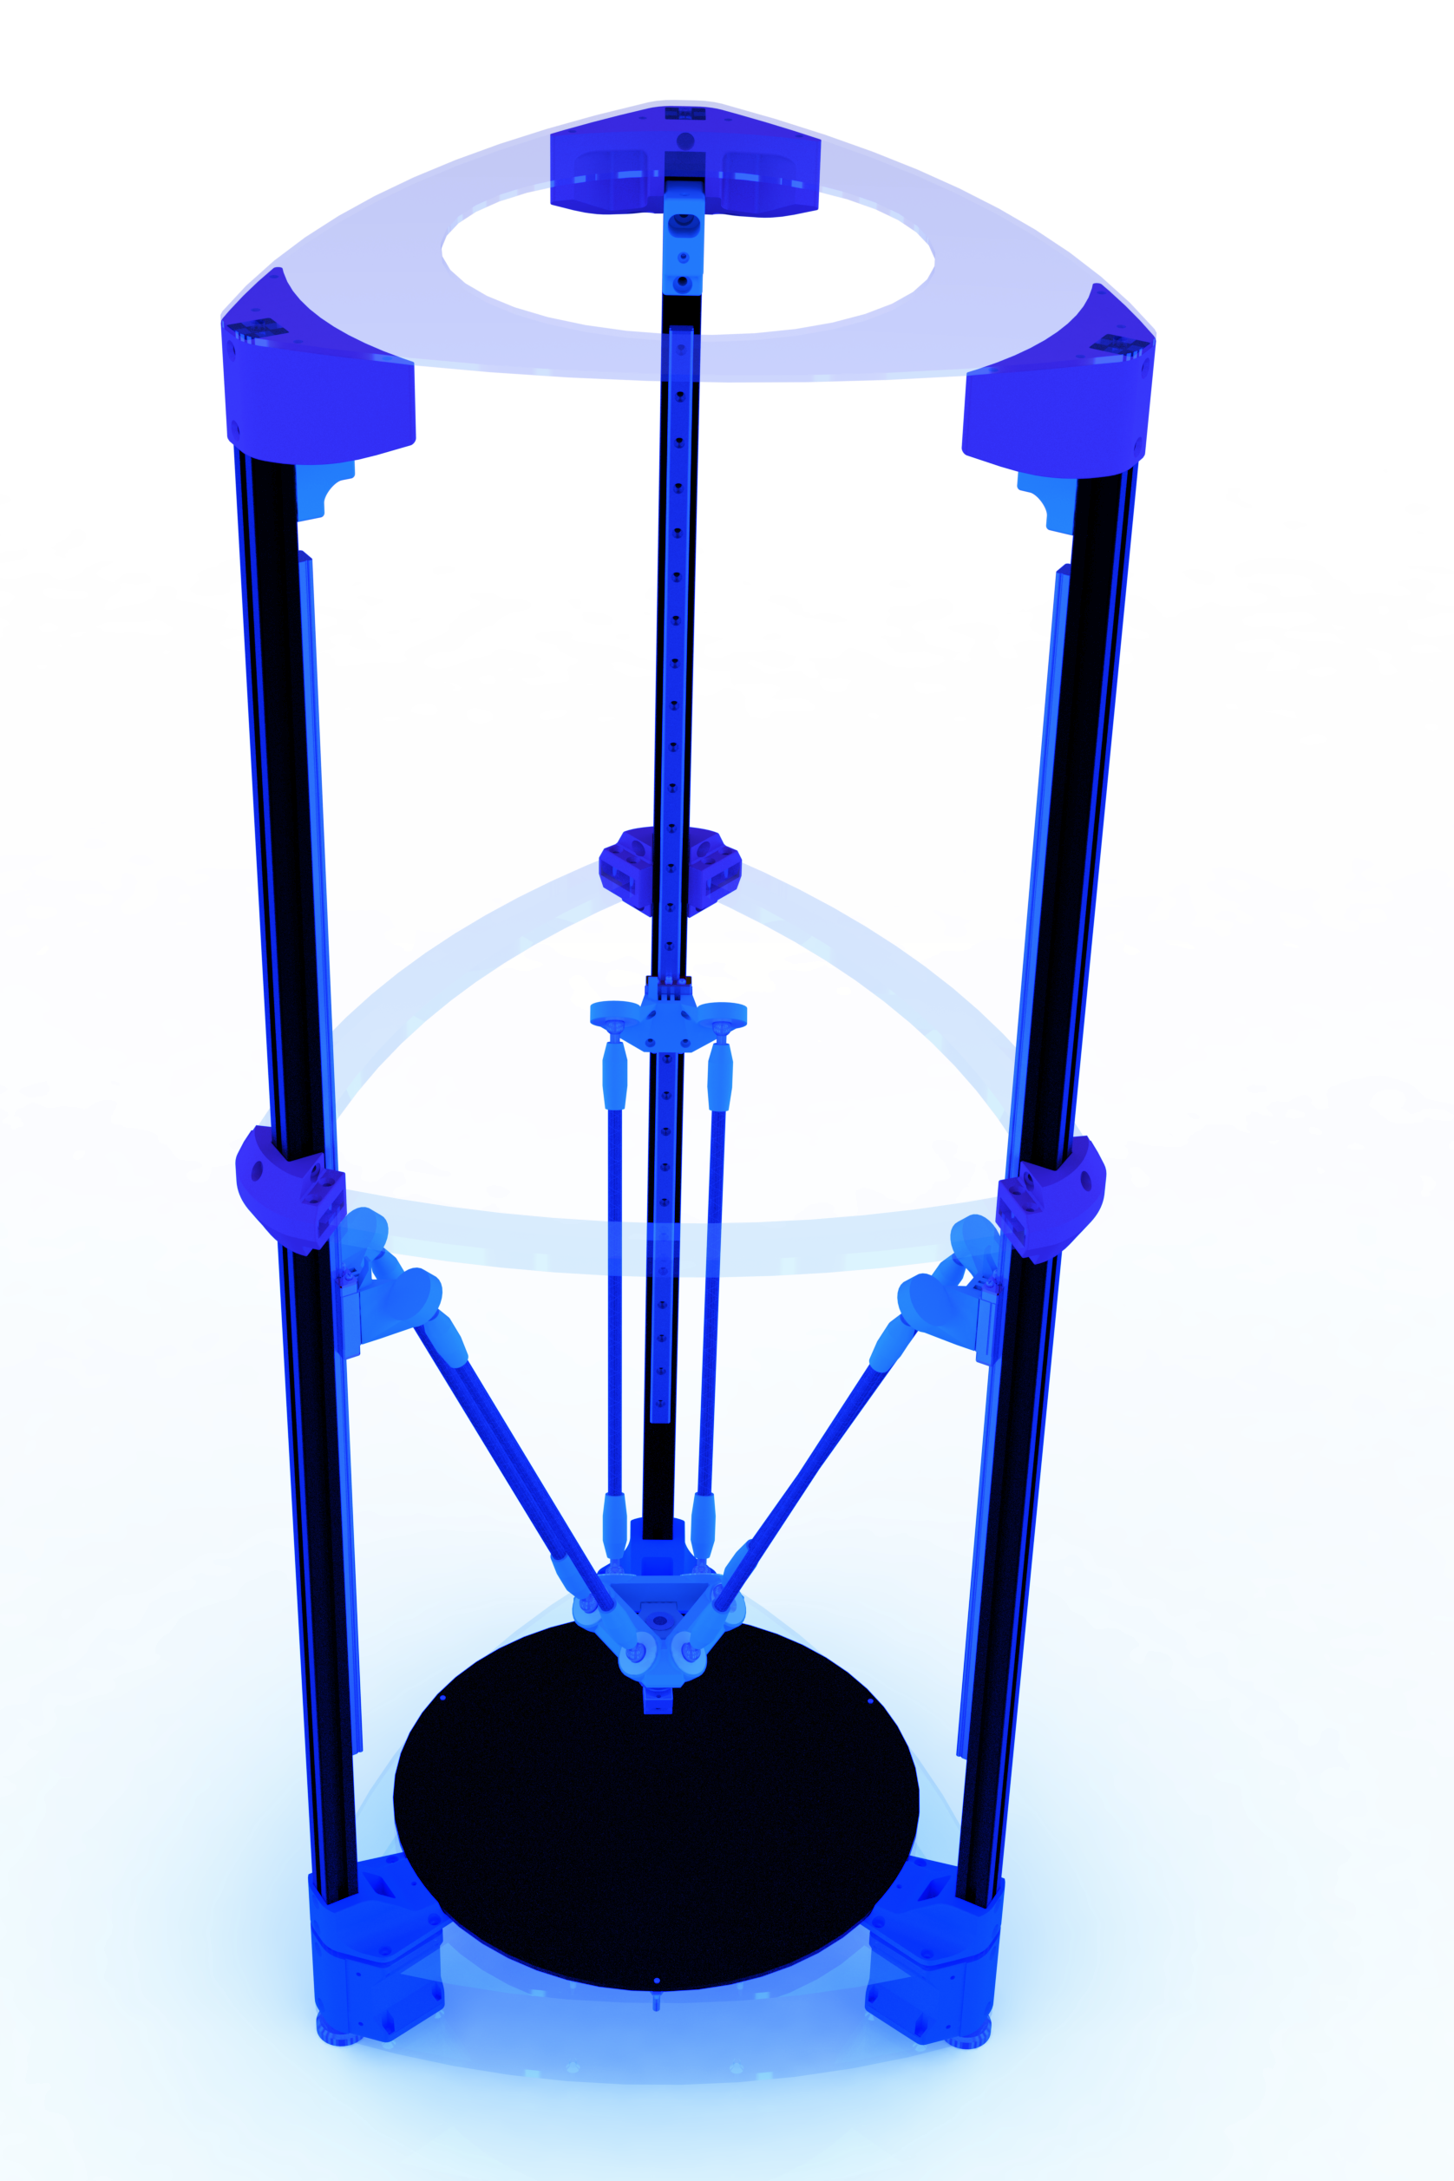
Low-Cost Metal Printing
Gas Metal Arc Welding
Under $1000
Open Source

Slide 34
All that we build, all that we study,
all that we do,
prepares us to go.

