Slide 1
Requirements Development Framework for Lunar In-Situ Surface Construction of Infrastructure
Session: Innovative Construction Techniques for Lunar and Martian Environments
ASCE Earth & Space Conference 2021
Robert W. Moses, Aerospace Technologist, Principal Investigator, NASA Langley Research Center
&
Robert P. Mueller, Sr. Technologist, NASA Kennedy Space Center, Swamp Works

Slide 2
Introduction
“Infrastructure to Stay” on the Lunar Surface has never been attempted
Major gaps exist between the functional capabilities versus the technologies necessary for Lunar Surface Construction
Requirements are needed for proceeding with gap closure
Conceptual mission architectures and current understanding about the Moon allow a starting point for deriving requirements

Slide 3
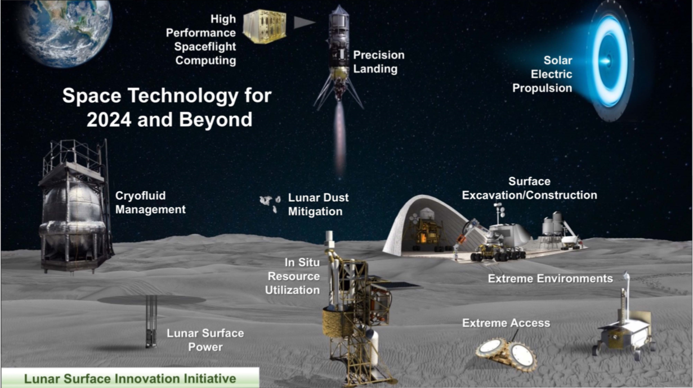
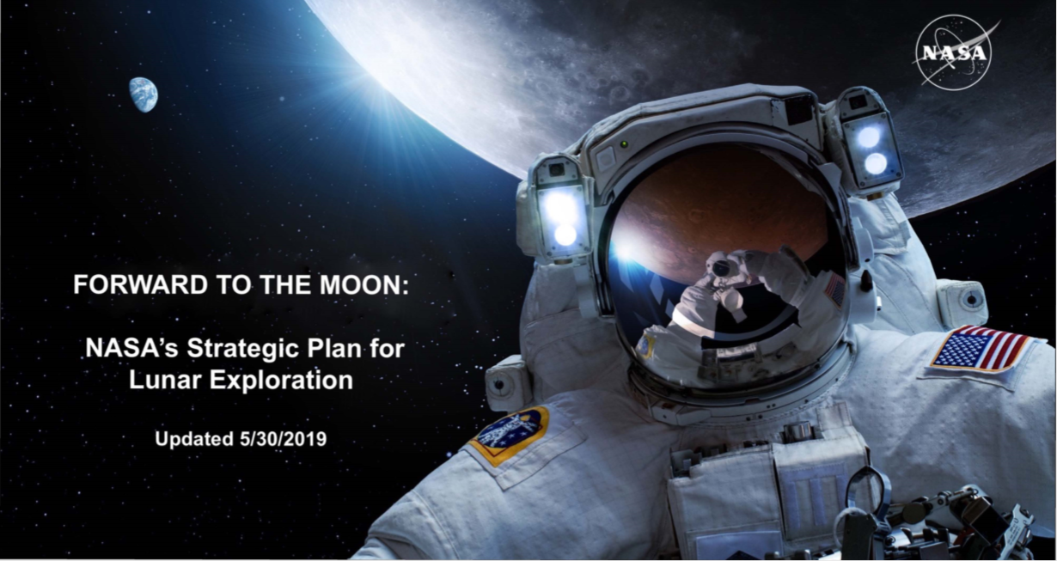
Establishing Priorities
Artemis Program:
https://www.nasa.gov/sites/default/files/atoms/files/america_to_the_moon_2024_artemis_20190523.pdf
3

Slide 4
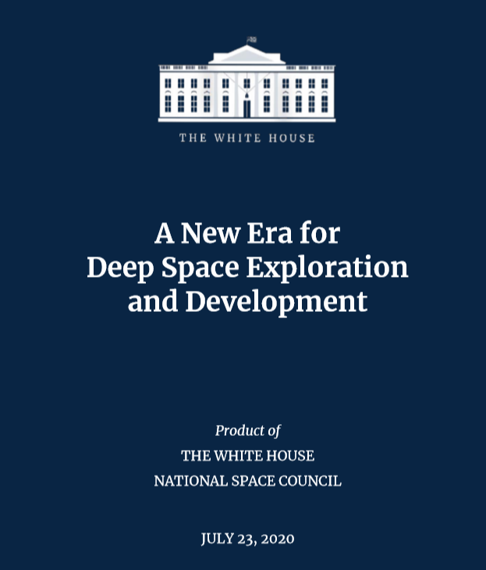
https://www.whitehouse.gov/wp-content/uploads/2020/07/A-New-Era-for-Space-Exploration-and-Development-07-23-2020.pdf
This focus on further extending an extraterrestrial human and robotic presence and on the development of commercial space industries makes the Artemis Program much more than a repeat of the Apollo Program. A serious, determined approach to lunar development requires a series of pre-positioned logistics packages. A combination of 3-D printing, telerobotics, and artificial intelligence could enable pre-positioning the equivalent of a small Antarctic scientific station. Newly arrived astronauts should have a substantial amount of resources already available and be able to spend their initial weeks building out the initial infrastructure for larger, future development teams

Slide 5
Methodology
Define an approach that allows a quick win aligned with long-term goal
Identify what’s needed vs. what’s there
Start with what we know
Obtain data over time to mature the concepts and achieve the final end goal

Slide 6
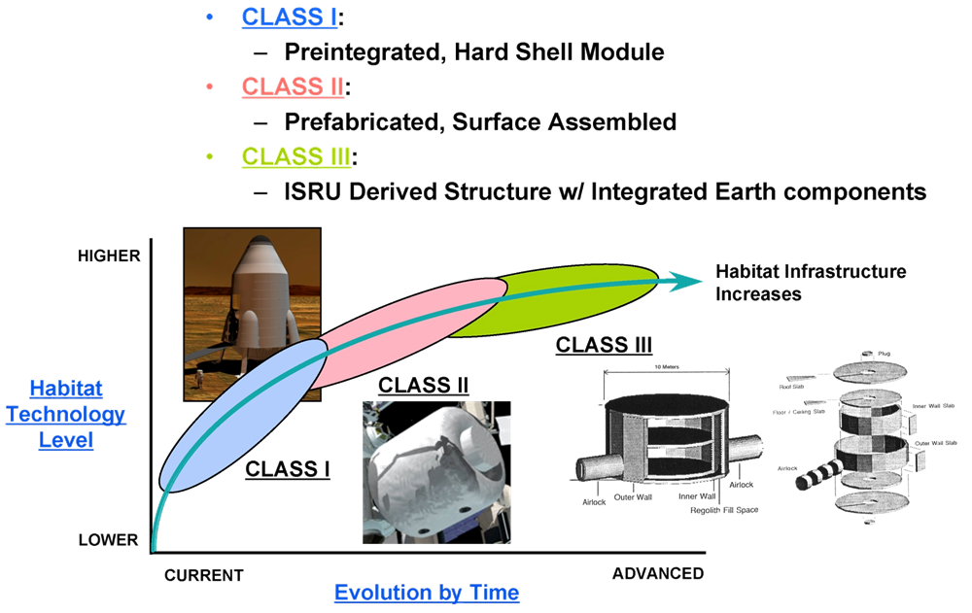
Classification of Lunar Construction
Ref: Kriss Kennedy et al

Slide 7
Getting Started On Requirements:
RESOURCES: WHAT’S THERE?
(ENERGY, GEOLOGICAL MATERIALS & GEOTECHNICAL CHARACTERISTICS)
INFRASTRUCTURE: WHAT’S NEEDED?
(DEFINED BY ARCHITECTURE)
Natural Resources
  Abundant Solar Energy
  Water & other volatiles
  Regolith
    Bulk material for construction
    Extracted metals from minerals
    Basalt glass fiber for composites
  Thermal Deltas, Vacuum, Location etc
Capabilities, Tools & Processes
  Regolith Simulants
  Cone penetrometer/ shear vane
  Seismic
  Ground Penetrating Radar
  Borings
  Sample Assays
  Mining & Size sorting, beneficiation
  Production & Storage
  Other capabilities & tools being developed
Landing & Launch Pads
Berms for Fission Power / Blast
Radiation Shielding for crew and equipment
Road and route ways
Other infrastructure such as trenches and compacted foundations
Pressurized Structures (e.g. Habitats)
Non-pressurized structures such as garages, hangars, and refueling depots
Dust-free zones for parking and operations
Access to Energy / Power

Slide 8
Functional Capabilities Needed
Long-distance communication, monitoring, and control
Increased autonomy/automation of operations
Improved user experience/ease of operation (i.e. reduced training load)
Multi-material printing & related control systems
Increased transportability / mass reduction
Expanded environmental range
Design for field reparability
Software Design Platform
Dust mitigation
Shielding / Ballistic Protection
Jobsite Mobility
Off-foundation construction / foundation delivery

Slide 9
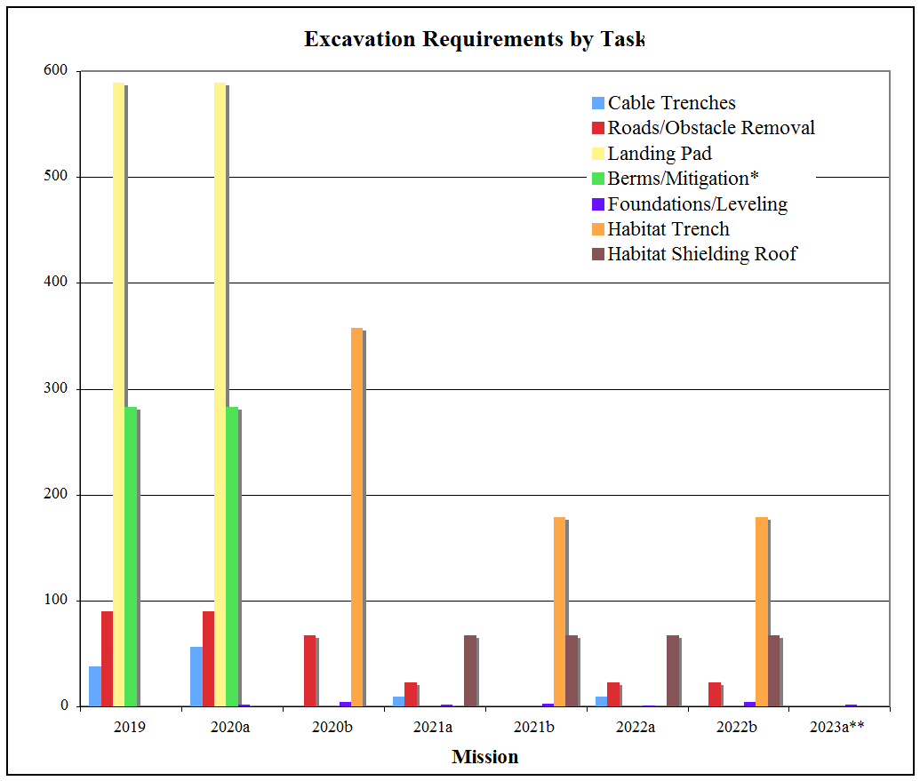
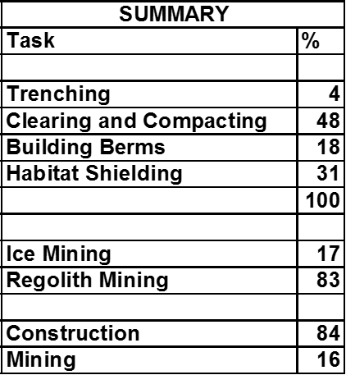
Scale of Lunar Surface Construction Tasks: Moving Regolith
Criteria for Lunar Outpost Excavation, R. P. Mueller and R. H. King
Space Resources Roundtable –SRR IX, October 26, 2007 Golden, Colorado

Slide 10
Proposed New Functional Capabilities WBS
4.0 In-Situ Construction
4.1 Site Planning and Design
4.2 In-Situ Construction Materials
4.3 Site Prep
4.4 Horizontal Construction (2D) & Pads
4.5 Vertical Construction (3D) & Shielding
4.6 Maintenance & Life-cycle
Site Survey & Characterization
Raw Material
Terrain Shaping, Grading, & Rock Clearing
Road Construction
Underground structures
Inspection & Compliance
Architecture Layout & Master Planning
By-product Material
Soil Stabilization
Foundation Construction
Above Ground Structures
Integrity & Preventative Maintenance
Civil Engineering Design
Processed Material
Below Grade Operations
Utilidor Construction
Shielding
Lifecycle Operations
GIS Configuration Control
Re-purposed Material
Landing / Launch Pad
Landing / Launch Pad Infrastructure
Facility Management
Construction Techniques and Methods
Stockpiling & Material Logistics
Waste Management
Access & Handling Equipment
Decommission and Re-planning / Salvage
Robotic/Human Construction Equipment
Uses Construction industry terminology

Slide 11
None of these capabilities exist today for Lunar Surface Construction
NASA’s Space Technology Mission Directorate is wrapping up a Gap Assessment Study of many mission capabilities that include Surface Construction
Roadmaps for gap closure are being created that identify systems development projects and lunar surface demonstration missions
Concepts of Operations are drawn for each Functional WBS to illustrate the systems concepts performing the tasks and their relationships with other mission assets

Slide 12
Results
A Game Changing Development Study is underway at NASA that illustrates the process of defining requirements and trading off alternative concepts and technologies

Slide 13
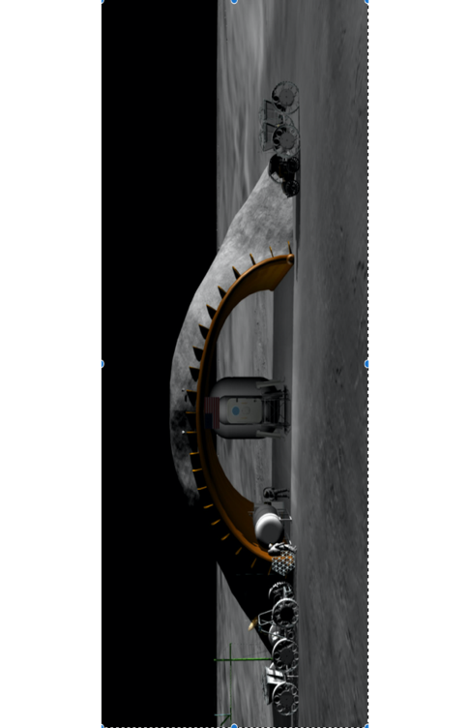
Lunar Safe Haven “shelter” Study Illustrates the Process
A Lunar Safe Haven “shelter” Study is underway at NASA that illustrates the process of defining requirements and trading off alternative concepts and technologies
Level Zero Requirements
  are being developed based on
    the Artemis Plan
    NASA Human Exploration and Operations Mission Directorate (HEOMD) ground rules and assumptions for future lunar exploration
    known lunar surface hazards
    an emphasis on in situ resource utilization (ISRU).
  guide the definition of the LSH Ground Rules and Assumptions and bound the trade space.
Lunar Safe Haven
Concept
Class I or II?

Slide 14
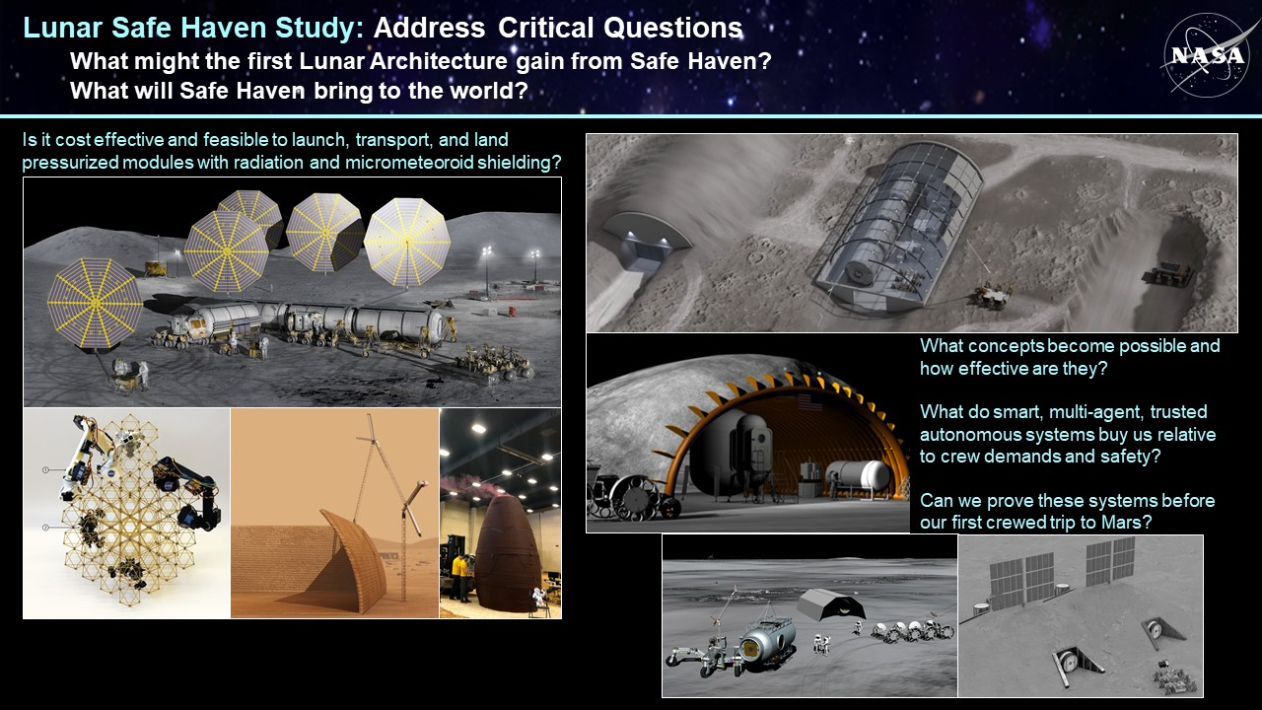

Slide 15
Conclusions
“Infrastructure to Stay” on the Moon pose new challenges for lunar Surface Construction which has never been attempted
Many gaps exist between functional capabilities versus technologies
Requirements are a vital element for closing those gaps
A framework for requirements development was presented
An ongoing study for a lunar surface shelter concept illustrates the process of defining requirements as well as evaluating alternative mission concepts
More results are planned for presentation at the upcoming SRR

Slide 16
Acknowledgements
NASA’s Systems Capabilities Leadership Team for In Situ Resource Utilization for recognizing the need for requirements
Lunar Surface Innovation Initiative (LSII) for ongoing support to develop Surface Construction capabilities and technologies

