Slide 1
Electromagnetic Thermocouple (TC) Anomaly Mechanisms During Atmospheric Entry
Magnus Haw
Sensors and Instrumentation Webcast
April 13, 2021

Slide 2
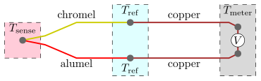
What is a Thermocouple?
In metals, electron mobility changes as a function of temperature
Therefore, thermal gradients produce voltage gradients in metals
uV/K
Q: So why is a junction needed?
A: Metrology reasons: voltage meters require closed circuits & physical contacts.
Consequently, TCs use two different material wires & measure the tiny temperature-dependent voltage difference between them

Slide 3
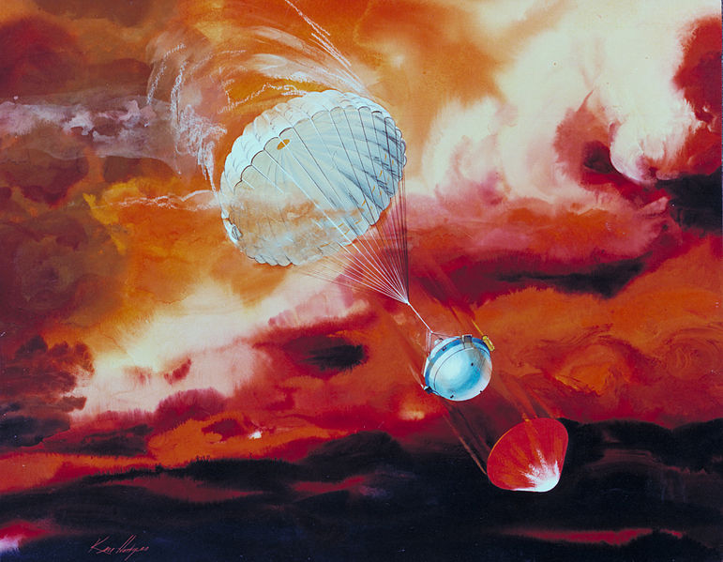

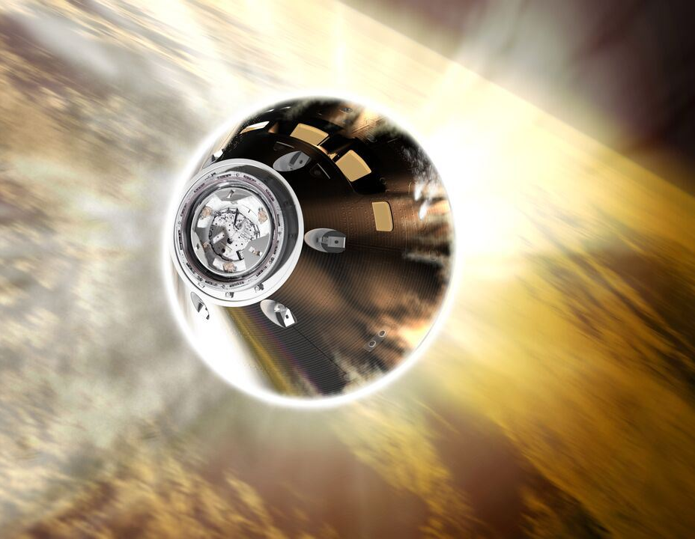
Why are TC anomalies important to understand?
We rely on TCs for nearly all high temperature measurements
TC high temperature measurements form the basis for many forms of simulation validation (material, aerothermal, radiative)
Important to know if in-flight safety thresholds are being exceeded
Galileo, Shuttle, Orion

Slide 4
Three Mechanisms
Surface voltage coupling
Hall effect current
RF rectification

Slide 5
#1. Surface voltage coupling
Short story: surface charge/voltages couple to near-surface bare TCs
Long story:
  Turbulence and pyrolysis gases enhance boundary layer electron density
  Non-parallel electron temperature and pressure gradients generate electric fields and currents in boundary layer & charge heatshield surface
  Non-uniform surface charge creates non-uniform voltages across heatshield
  Surface voltage couples to embedded bare TCs

Slide 6
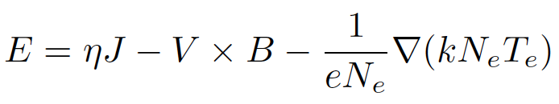
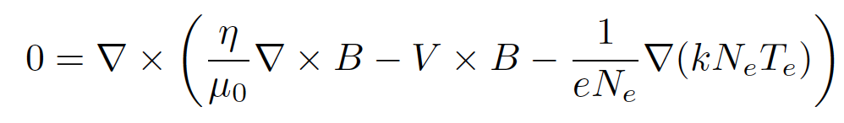
#1. Surface voltage coupling: Equations
B-field from generalized Ohm’s Law:
Assume EM fields are quasi-static, i.e., dB/dt = 0, dE/dt = 0
Solve for B, then calculate E

Slide 7
#1. Surface voltage coupling: Surface charge
take divergence of Ohms Law:

Slide 8
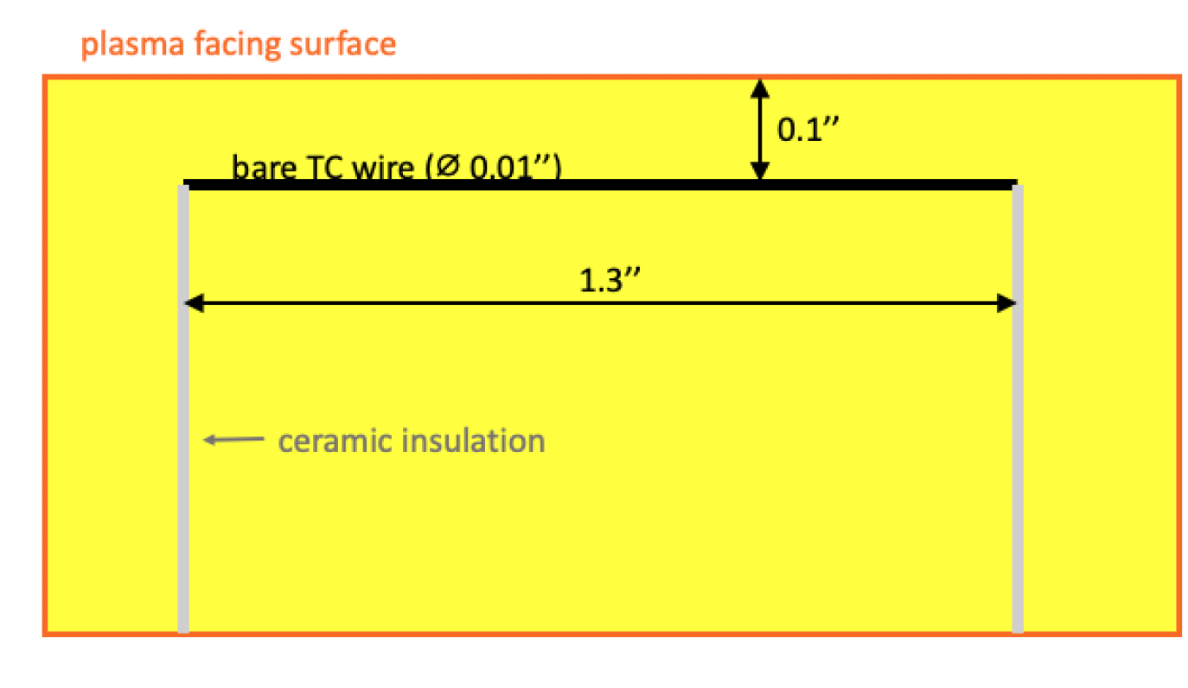
#1. Surface voltage coupling: TC placement

Slide 9
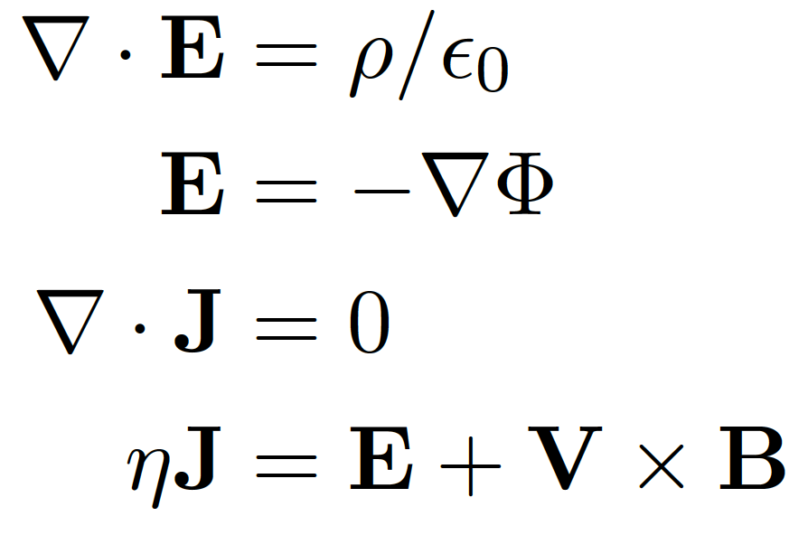

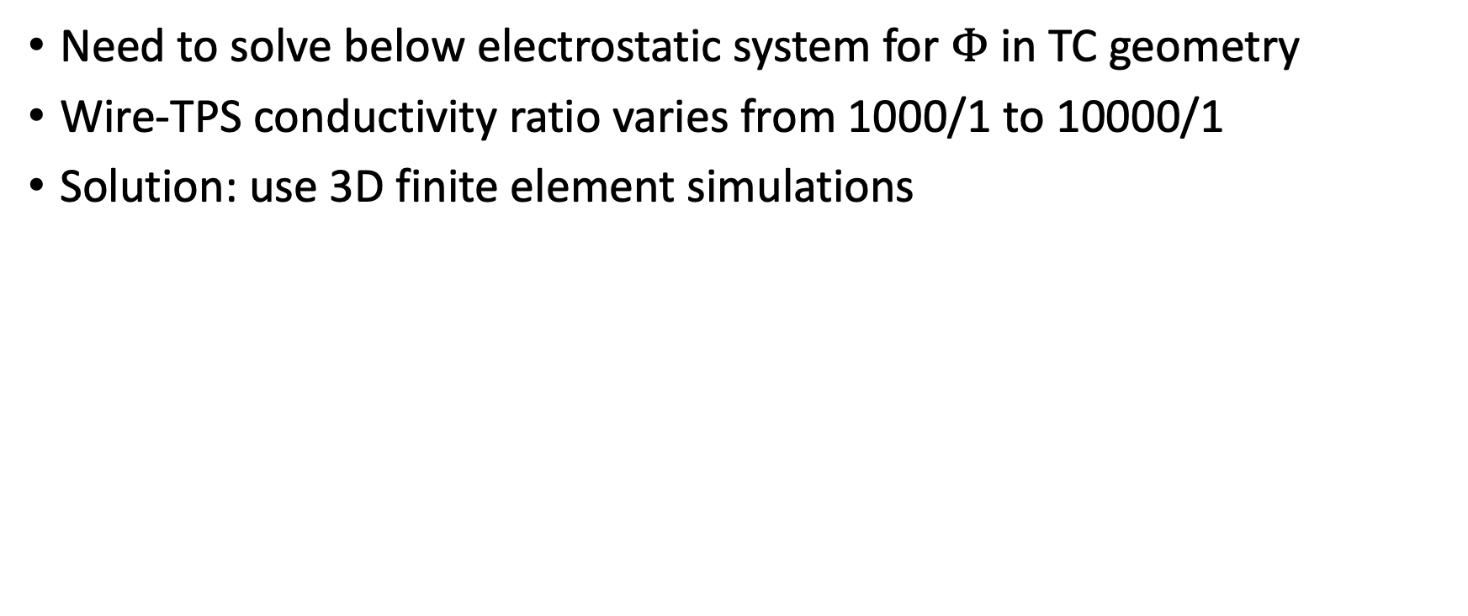
#1. Surface voltage coupling: Modeling
Need to solve below electrostatic system for $Φ$ in TC geometry
Wire-TPS conductivity ratio varies from 1000/1 to 10000/1
Solution: use 3D finite element simulations

Slide 10
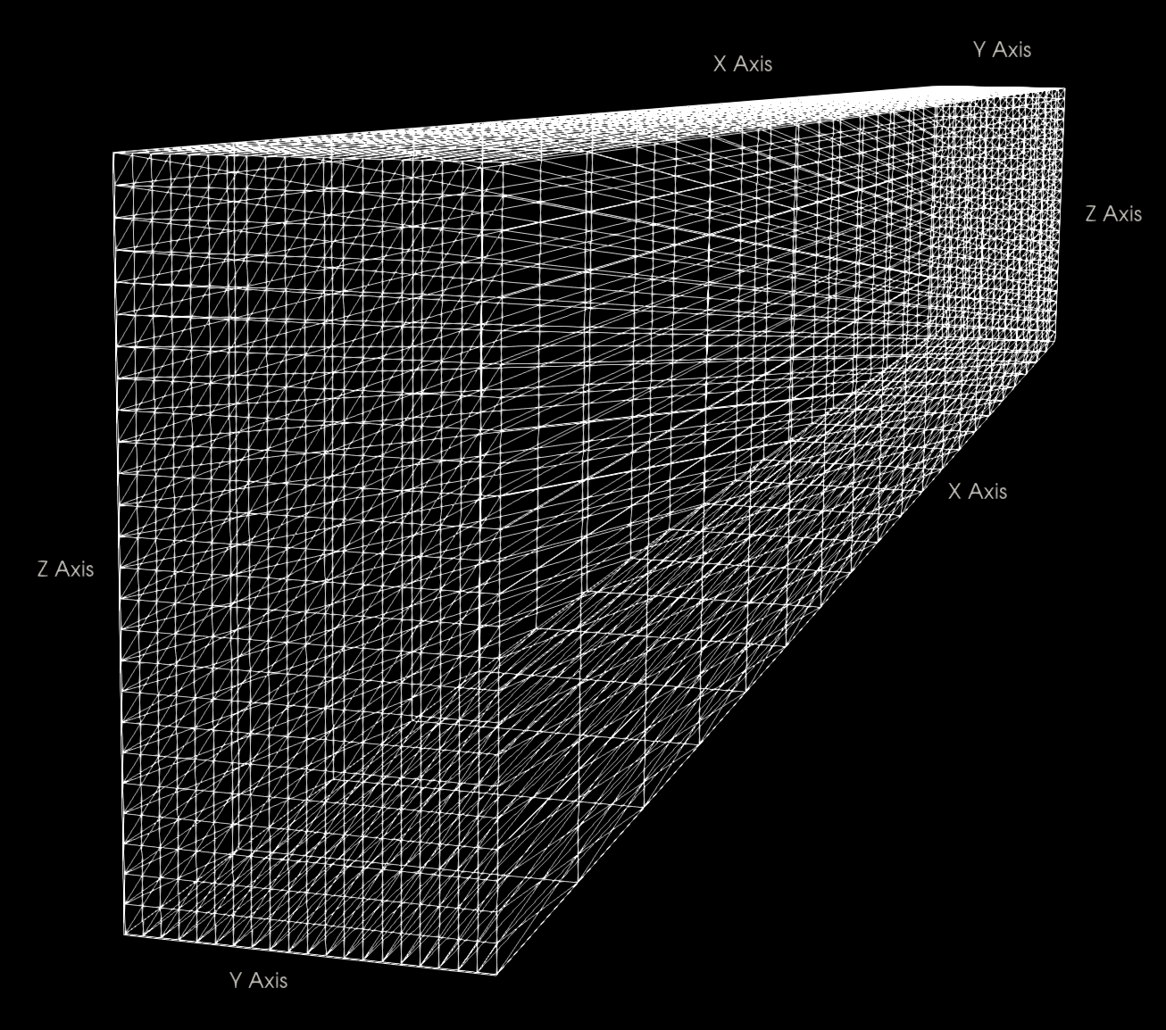
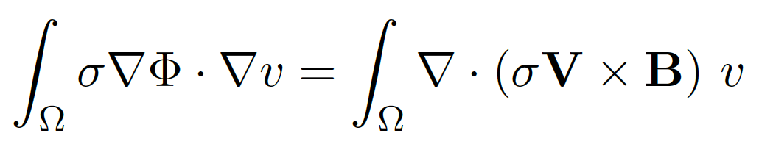
Numerical Methods
Used Python API for FEniCS platform
Finite element solver (2nd order): Rayleigh-Ritz (variational calculus method)
Variational (weak) formulation of potential equation
Numerical convergence
System run on full-domain and half domain.
The half domain mesh contained higher resolution in the yz-plane to better resolve the small wire radius.
All tests gave equivalent results for the wire voltage within 1%.

Slide 11
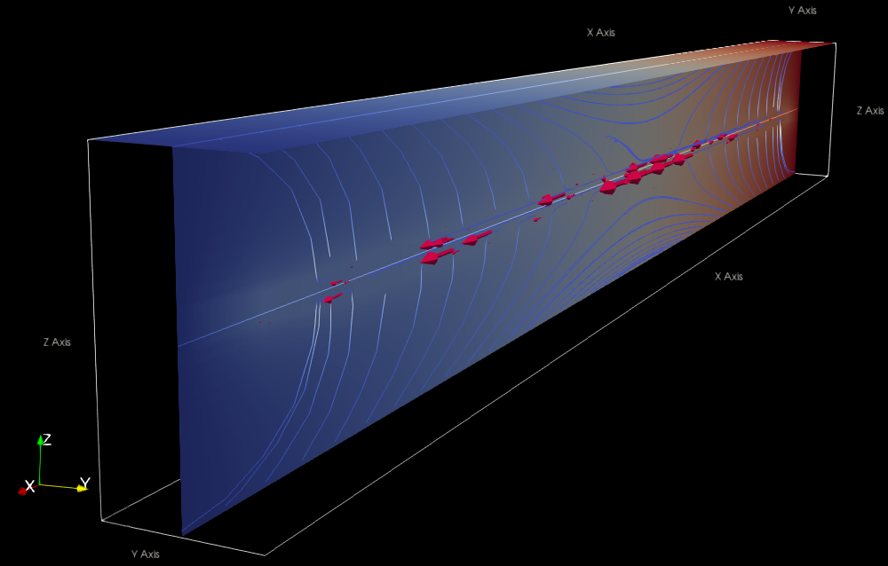
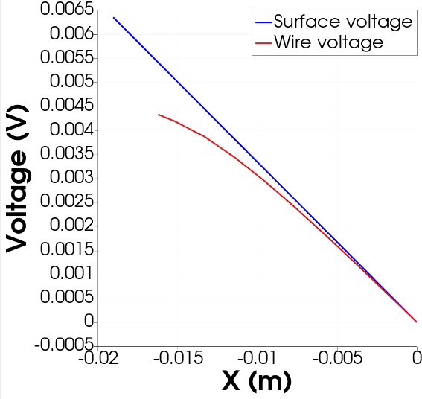
Assuming linear surface potential: 34-75% coupling

Slide 12
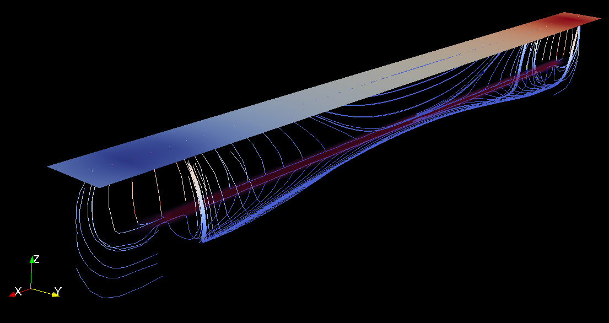
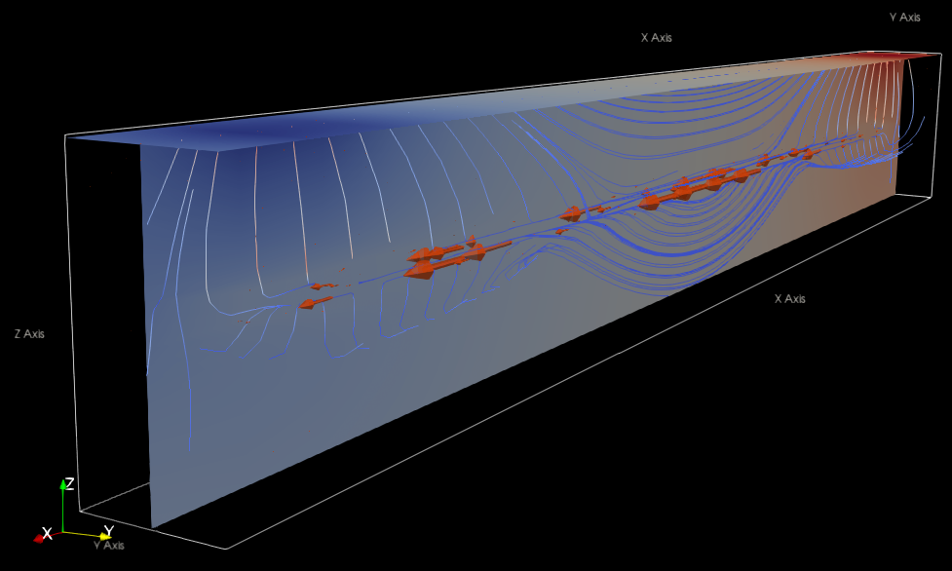
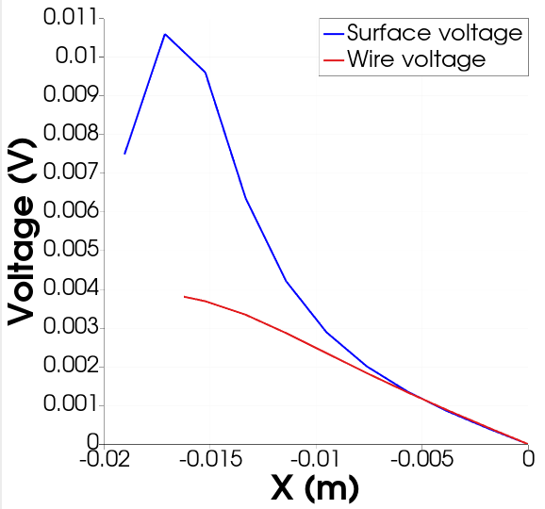
Assuming dipole surface potential: 17-36% coupling

Slide 13
#1. Surface voltage coupling: Conductivity ratio
The conductivity ratio between the TC wire and the sample is strongly dependent on temperature.
  metal conductivity drops at higher temperatures (5x)
  char conductivity increases at higher temperatures (>2x)
  contribution of pyrolysis gases to conductivity is unknown (??)
Estimate: > 10000/1 at low temperatures (300 K)
Estimate: < 1000/1 at high temperatures (1500 K)

Slide 14
#1. Surface voltage coupling: Relevance
Atmospheric entry conditions where boundary layer electron density is >> 10¹⁷ m³ (~T_{gas} > 5000 K)
TCs are embedded near the surface (< 0.25’’)
Anomaly is enhanced by turbulence and TPS materials containing elements with low ionization potentials (e.g., Si).
Anomaly is enhanced at higher material temperatures (char conductivity rises, metal conductivity falls)

Slide 15
#1. Surface voltage coupling: Mitigation
Electrically insulate near-surface TC wires
Reduce conductivity of TPS material/pyrolysis products (remove Si)
Get surface voltage distribution by measuring single-ended voltages of each TC contact, then model & correct for perturbations.

Slide 16
#2. Hall effect currents
Short story: Hall effect current driven through TC
Long story:
  Hall effect from Earth’s magnetic field creates an orientation dependent voltage drop across spacecraft frame
  A low impedance or grounded TC terminal allows current to flow through measurement circuit
  Ionized pyrolysis gases short TC to external plasma
  Circuit is closed via current path through external layer of plasma

Slide 17
B-field
Velocity
Metal frame
VxB electric field

Slide 18
B-field
Velocity
Current flows in metal frame due to
VxB field & begins to build up on edges
+
-
-
VxB field
+
-
+

Slide 19
B-field
Velocity
+
-
-
VxB field
+
-
+
Edge plasma is stationary relative to
Earth (VxB=0) & sufficiently conductive
to carry return current

Slide 20
B-field
Velocity
VxB field
Return current eliminates shielding effects
(i.e. no charge buildup on frame)
Return current flows through edge plasma

Slide 21
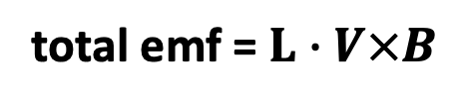
B-field
Velocity
TC experiences VxB emf
and draws anomalous
current
VxB field
TC wire
L
total emf = $L∙V×B$
current anomaly = emf/R
Return current flows through edge plasma

Slide 22
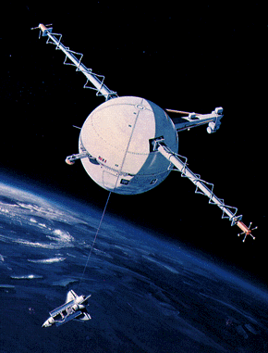
#2. Hall effect currents: Tether Experiment
Experiment with long wire (20 km) deployed from Shuttle with sensors at terminal ball
Produced kilovolts of EMF & melted tether
Same effect is present for all spacecraft but is orders of magnitude smaller since spacecraft size, L << 20 km

Slide 23
#2. Hall effect currents: TC Sensitivity
Very sensitive!
100 degC / 1.3 mV
Shuttle anomaly current threshold, @80 Ohms: 34 uA
These anomalous currents are typically too small to affect other diagnostics

Slide 24
#2. Hall effect currents: Relevance
Spacecraft with metal frame
TCs are embedded near the exterior surface (< 0.25’’)
Magnetic field is present (VxB≠0)
External plasma is electrically connected to TC and metal frame
TCs must have at least one low impedance terminal
Anomaly is enhanced by length of metal frame, spacecraft speed, and magnetic field magnitude/orientation.

Slide 25
#2. Hall effect currents: Mitigation
Make both TC terminals high impedance (easy)
Fully insulate TCs/internal metal frame from external plasma (hard)
Use smaller entry vehicles or lower entry speeds

Slide 26
#3. RF Rectification
Short story: RF interference can cause DC offsets in TC measurements
Long story:
  The low voltage produced by TCs (uV level) typically passes through an instrumentation amplifier (inamp) before digitization
  Inamps are slow and cannot reject common mode signals above ~20 kHz
  Radio frequency interference (RFI) gets rectified in TC inamp circuits leading to DC offsets
  Asymmetric rectification can occur from any unbalanced circuit elements

Slide 27
#3. RF Rectification: Relevance
Entry environment with significant incident RF power (>> mW)

Slide 28
#3. RF Rectification: Mitigation
Filtering
  RC low pass filter
  Common mode choke
  X2Y capacitor filter
Minimize RF pickup
  reduce circuit area
  use coaxial or twisted pair wire
Shielding

Slide 29
TC Anomaly Summary
Surface voltages can couple into near-surface bare TC wires
Low-impedance TC terminals are susceptible to Hall currents
RFI can generate DC offsets in TC digitization
Questions?

