Slide 1
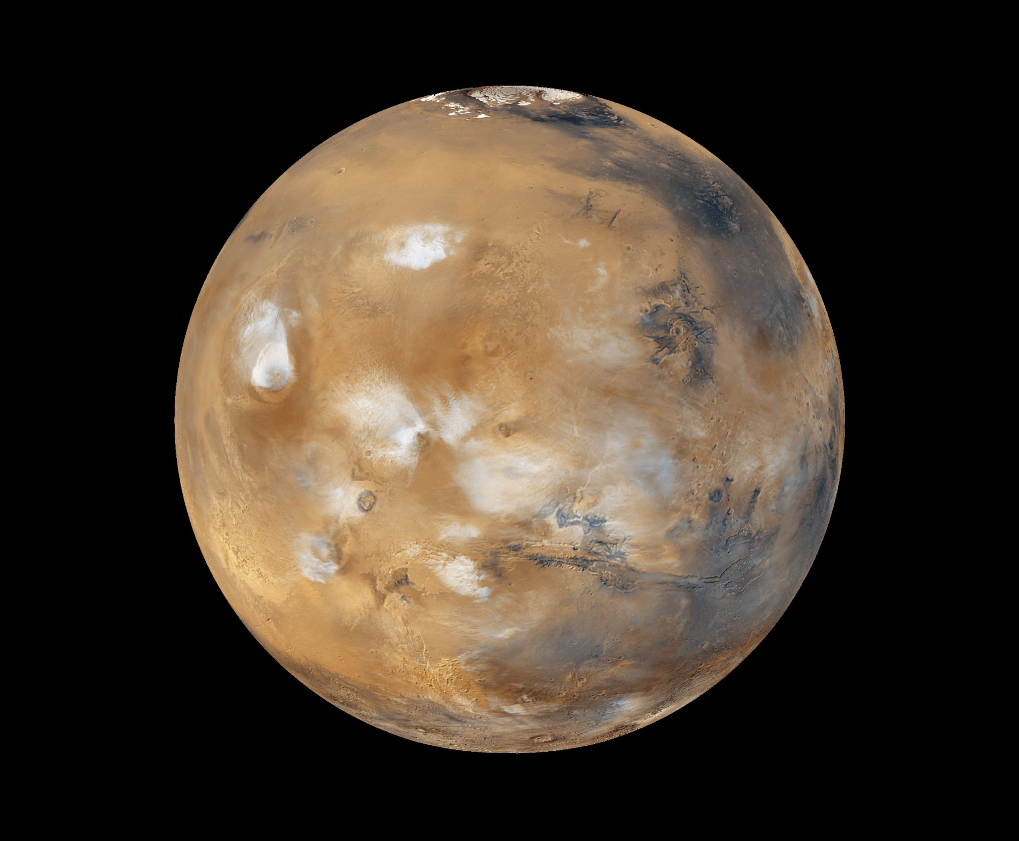

Missions to
Mars!
National Aeronautics and Space Administration
Presented to:
Kennesaw State University
Marietta, GA
Felix A. Soto Toro, Ph.D., PMP
Felix.A.Soto-Toro@NASA.gov
Kennedy Space Center, FL
03/19/2021
www.NASA.gov
www.nasa.gov
Notes:
Mars is the fourth planet from the sun and is named after the Roman god of war.

Slide 2
Agenda
Speaker’s Profile
NASA’s Mission, Vision and Themes and Strategic Goals
Why couldn’t the Space Shuttle be used to land on Mars
Why Mars ?
Unmanned Space Missions
Rovers Comparison
Perseverance Rover’s Descent and Touchdown on Mars
Launch Vehicles
Preparing for Manned Space Missions
Skills Required
Learning from Lunar Missions
Using Lunar Resources
References
Educational Opportunities

Slide 3

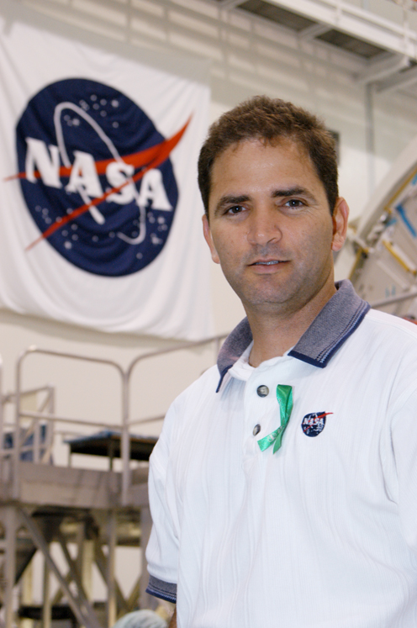

Academic Preparation
Place of Birth: Rio Piedras, Puerto Rico (PR)
K – 12: Luis M. Rivera (Elementary),
          Colegio San Vicente de Ferrer (Middle School),
          Colegio Madre Cabrini (High School)
BSEE: Florida Institute of Technology Melbourne, FL
MS Engineering Management:
            Florida Institute of Technology
            Melbourne, FL
MS Electrical Engineering:
            University of Central Florida
            Orlando, FL
Ph.D. Electrical Engineering:
            University of Central Florida
            Orlando, FL
Felix.A.Soto-Toro@NASA.gov

Slide 4
Professional Profile
Student Intern: NASA, Kennedy Space Center (KSC)
Electrical Engineer: NASA, KSC
Audit Liaison Representative: NASA, KSC
NASA Fellowship: Universidad Interamericana de Puerto Rico
          Bayamón, PR
NASA Fellowship: NASA, Johnson Space Center (JSC)
          Houston, TX
Adjunct Faculty: Universidad Politécnica de Puerto Rico
            Orlando, FL
Adjunct Faculty: University of Central Florida
            Orlando, FL

Slide 5
NASA Vision
To discover and expand knowledge for the benefit of humanity.

Slide 6
NASA Mission
Lead an innovative and sustainable program of exploration with commercial and international partners to enable human expansion across the solar system and bring new knowledge and opportunities back to Earth.
Support growth of the Nation’s economy in space and aeronautics, increase understanding of the universe and our place in it, work with industry to improve America’s aerospace technologies, and advance American leadership.

Slide 7
NASA Themes and Strategic Goals
DISCOVER - Expand human knowledge through new scientific discoveries
EXPLORE - Extend human presence deeper into space and to the Moon for sustainable long-term exploration and utilization
DEVELOP - Address national challenges and catalyze economic growth.
ENABLE - Optimize capabilities and operations.

Slide 8
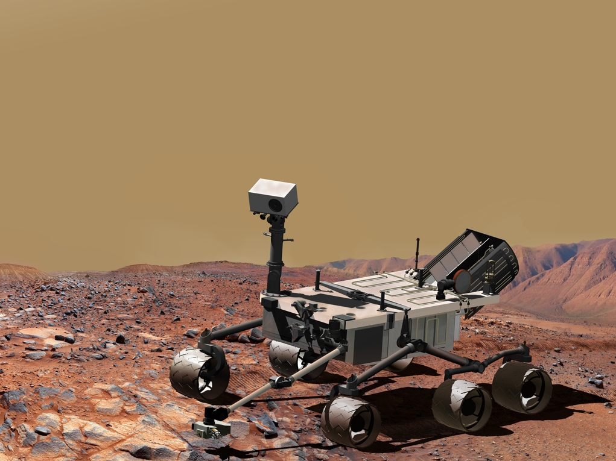
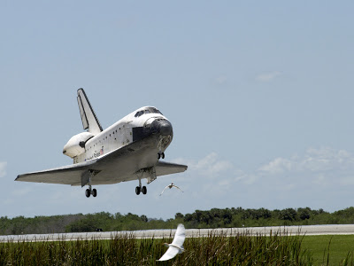
Why couldn’t the Space Shuttle be used
to land on Mars ?
Notes:
No hay Pista de aterrizaje
Terreno es montañozo
Mucho polvo
No hay torre de lanzamientos
No puede despegar por si solo. Necesita tanques externos
Sistema de Propulsion fue diseñado para llegar hasta la orbita cerca de la tierra.

Slide 9
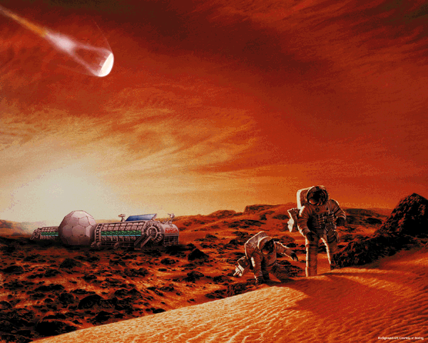
Why Go to Mars ?
Notes:
Y despues…. Asteroides……..

Slide 10
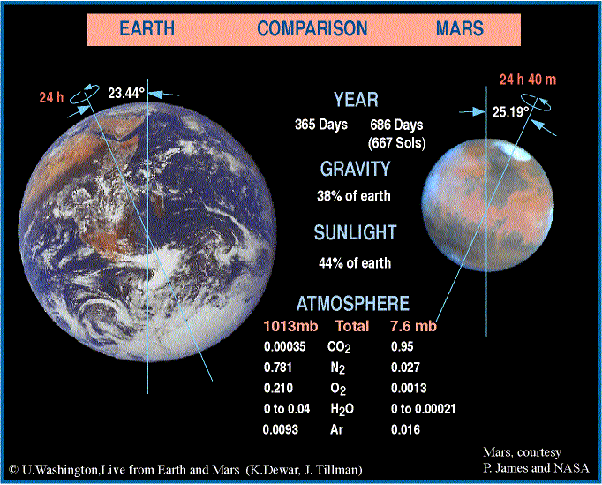
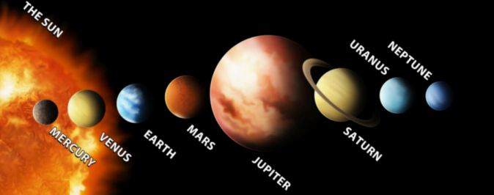
Characteristics of the planets
Mars, courtesy of:
P. James and NASA
Notes:
Gravity: 3/8 of earth
Farther than Earth from the Sun. Sunlight is 44% of Earth
Orbita de Marter alrededor del sol son alrededor de 2 años.

Slide 11
Planets Characteristics
Place | Size | Planet | Min Temp | Max Temp | Comments
1 | 0.383 | Mercury | 363º F | 869º F | No atmosphere.
2 | 0.949 | Venus | 430º F | 900º F | Highest average, thick atmosphere.
3 | 1 | Earth | -129º F | 159º F | Supports life !
4 | 0.532 | Mars | -220º F | 68º F | No atmosphere.
5 | 11.21 | Jupiter | -229º F | 1,337º F | Gas clouds.
6 | 9.45 | Saturn | -283º F | Core is 21,092º F | Tilted, seasons.
7 | 4.01 | Uranus | -371º F | 8,548º F | Coldest planet.
8 | 3.88 | Neptune | -360º F | Core is 12,632º F | Winds 2,100 km/hr
Note: Temperatures are approximated.
Temperature of Sun at the Core is 5,600º Celsius.
…Temperatures !
Conversion:
[°F] = [°C] × ⁹⁄₅ + 32
[°C] = ([°F] − 32) × ⁵⁄₉
Mars, courtesy of:
P. James and NASA, http://www.space.com/ and
http://nssdc.gsfc.nasa.gov/planetary/factsheet/planet_table_ratio.html
Notes:
Gravity: 3/8 of earth
Farther than Earth from the Sun. Sunlight is 44% of Earth

Slide 12
Unmmaned Missions
Mariner
Viking
Global Surveyor
Pathfinder
Odyssey
Exploration Rovers (Spirit and Opportunity)
Reconnaissance Orbiter
Phoenix Lander
Science Laboratory (Curiosity)
Mars 2020 (Perseverance & Ingenuity)
Notes:
Mars is called the red planet because of the iron oxide (rust) prevalent on the surface. It has a very thin atmosphere that is 95% carbon dioxide. Mars is about half the size of earth but a similar tilt of its axis giving it similar seasons as earth, though they are longer because of the two year trip around the sun. Landforms discovered and visible on Mars strongly suggest that liquid water has at least at times existed on the planet’s surface. This leads us to the driving research strategy:
Mars Overall Science Strategy
Determine whether life ever arose on Mars
Characterize the climate of Mars
Characterize the geology of Mars
Prepare for human exploration
The Mariner program, developed and managed by JPL in the 1960’s and early 70’s, was designed to explore the inner solar system planets – Venus, Mars and Mercury. Mariner 4, shown, launched Nov 28, 1964 and eight months later during its flyby, July 14, 1965, collected the first images of Mars. In 1969, Mariner 6 and 7 completed the first dual mission to Mars, flying over the equator and south polar regions. Mariner 9, in 1971, observed a great dust storm. It also provided the first close-up pictures of the planets two small moons, Phobos and Deimos.

Slide 13
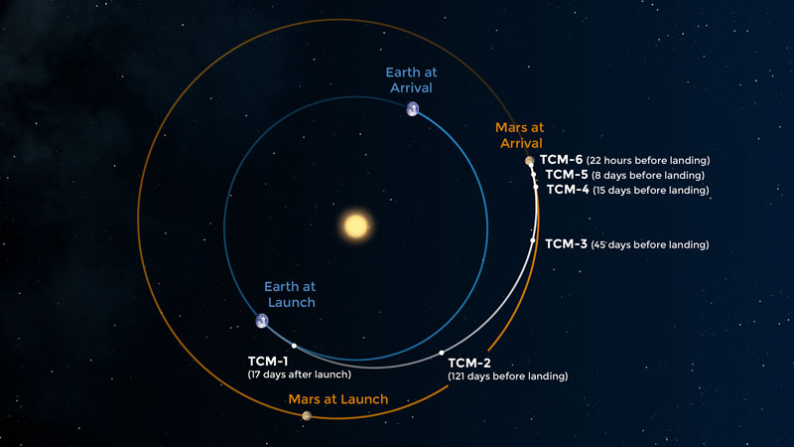
Route to Mars
(about a 7 months’ trip)
TCMs = Trajectory Correction Maneuvers
Notes:
https://www.jpl.nasa.gov/edu/learn/video/mars-in-a-minute-how-do-you-get-to-mars/
https://mars.nasa.gov/resources/21905/insights-route-to-mars/?site=insight
https://www.mars-one.com/faq/mission-to-mars/how-long-does-it-take-to-travel-to-mars
The precise duration of each journey depends on when it is taken. Because both Mars and Earth's orbits are not perfectly circular, the time it takes to travel between them varies from six to eight months.

Slide 14
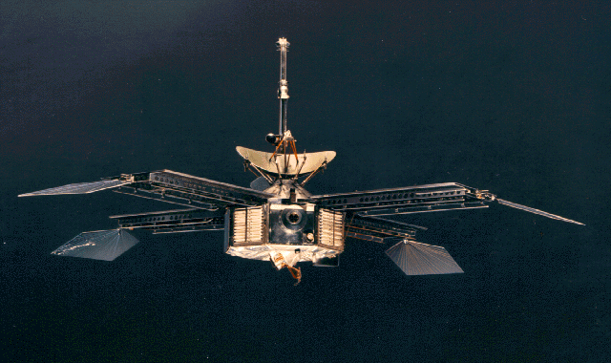
Mariner 4 (1964)
Designed to explore planets close to the Sun:
- Venus
Mars and
Mercury
Notes:
Mars is called the red planet because of the iron oxide (rust) prevalent on the surface. It has a very thin atmosphere that is 95% carbon dioxide. Mars is about half the size of earth but a similar tilt of its axis giving it similar seasons as earth, though they are longer because of the two year trip around the sun. Landforms discovered and visible on Mars strongly suggest that liquid water has at least at times existed on the planet’s surface. This leads us to the driving research strategy:
Mars Overall Science Strategy
Determine whether life ever arose on Mars
Characterize the climate of Mars
Characterize the geology of Mars
Prepare for human exploration
The Mariner program, developed and managed by JPL in the 1960’s and early 70’s, was designed to explore the inner solar system planets – Venus, Mars and Mercury. Mariner 4, shown, launched Nov 28, 1964 and eight months later during its flyby, July 14, 1965, collected the first images of Mars. In 1969, Mariner 6 and 7 completed the first dual mission to Mars, flying over the equator and south polar regions. Mariner 9, in 1971, observed a great dust storm. It also provided the first close-up pictures of the planets two small moons, Phobos and Deimos.

Slide 15
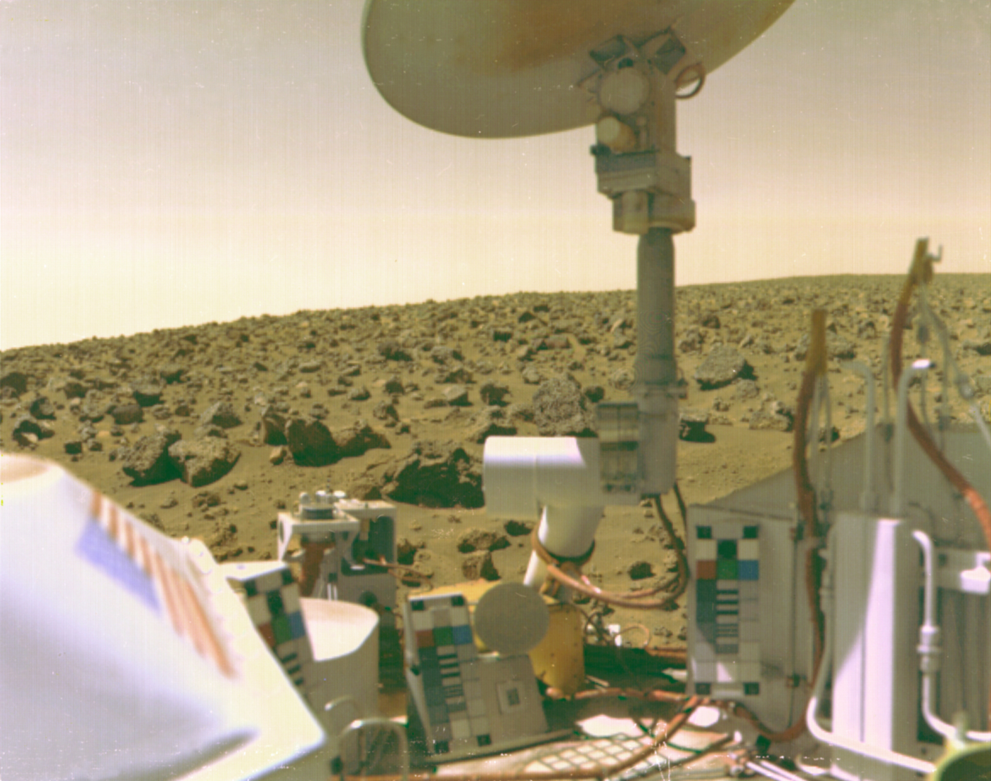
Viking 2
on Mars
(1975)
First mission to:
Land spacecraft on Mars
Notes:
Viking found a place in history when it became the first American mission to land a spacecraft safely on the surface of Mars. Viking 1 launched Aug 20, 1975 and Viking 2 on Sept 9, 1975. Each spacecraft consisted of a lander and an orbiter. The missions were the first attempt to determine the geological composition of the planet. Viking 1 reached Mars orbit June 19, 1976 and Viking 2 began orbiting Aug 7, 1976. The landers provided the first close up look at the surface, monitored variations in the atmospheric conditions over several years and determined the size of the atmospheric aerosols. The orbiter cameras observed new terrain and provided clearer detail on known features by mapped 97% of the Martian surface.

Slide 16
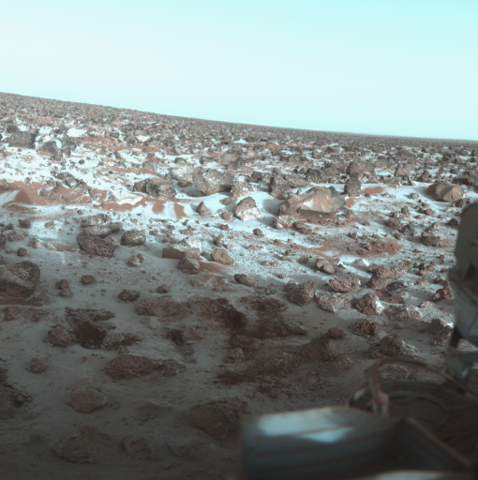
Viking 2 image
Showing ice on
Mars (1979)
Scientists believe that the ice layer is less than 0.001cm thick.
Notes:
This color photo of the surface of Mars was taken by Viking Lander 2 at its Utopia Planitia landing site on May 18, 1979, and relayed to Earth on June 7. It shows a thin coating of water ice on the rocks and soil. Scientists believe dust particles in the atmosphere pick up bits of solid water. That combination is not heavy enough to settle to the ground. But carbon dioxide, which makes up 95 percent of the Martian atmosphere, freezes and adheres to the particles and they become heavy enough to sink. Warmed by the Sun, the surface evaporates the carbon dioxide and returns it to the atmosphere, leaving behind the water and dust. The ice seen in this picture is extremely thin, perhaps no more than one-thousandth of an centimeter thick.

Slide 17
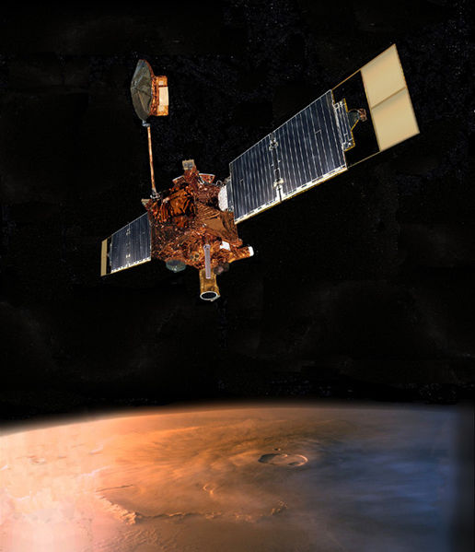
Mars Global
Surveyor
(1996)
Mapped the surface.
Notes:
Mars Global Surveyor was a global mapping mission, carrying a suite of science instruments designed to study the entire Martian surface, atmosphere and interior composition. It was launched from Cape Canaveral on Nov 7, 1996. It used a new technique for orbit insertion called aerobraking, using frictional drag as it skims through the upper atmosphere to alter the shape of its orbit. This helps reduce the amount of propellant and therefore weight of the spacecraft. The Surveyor made landmark discoveries with images showing gullies and debris flow suggesting there may be sources of liquid water at or near the surface. The spacecraft ceased operation in 2006.

Slide 18
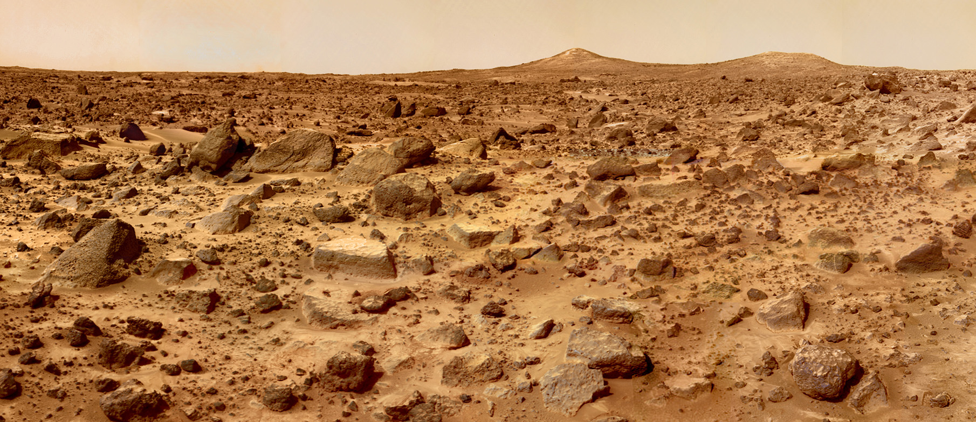
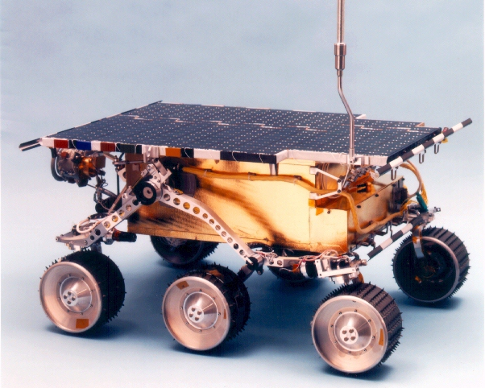
Mars Pathfinder (1996)
Top speed is 2 feet per minute (0.02 miles /hour)
Notes:
The Mars Pathfinder was launched Dec 4, 1996. It was the first mission in NASA’s Discovery Program of low-cost, rapidly developed planetary missions. The rover, named Sojourner, was the first robotic rover to successfully land on the Martian surface. It used an innovative method of for landing by inflating airbags to cushion its final impact. It landed July 4, 1997. It survived for three months until the end of Sept 1997. The rovers travel speed was about 2 feet per minute.

Slide 19
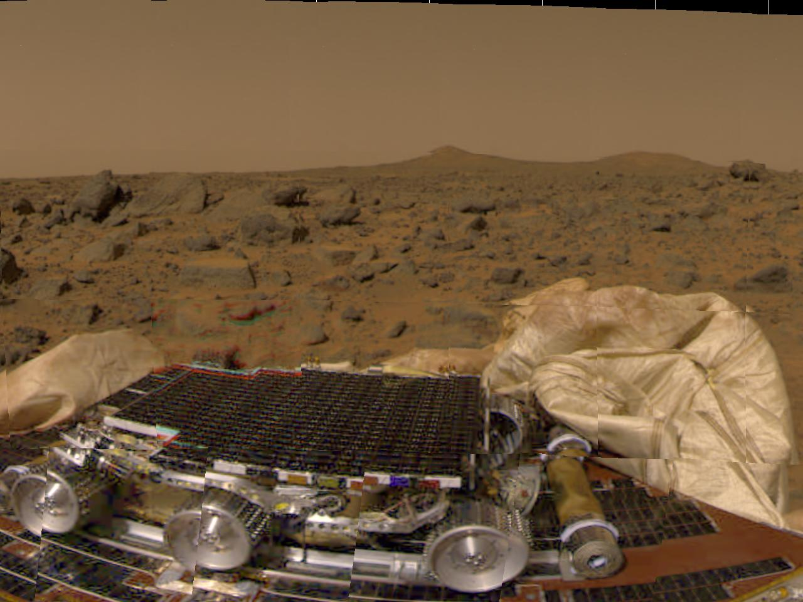
Pathfinder on Mars
Notes:
Post landing image of the Pathfinder rover on its lander.

Slide 20
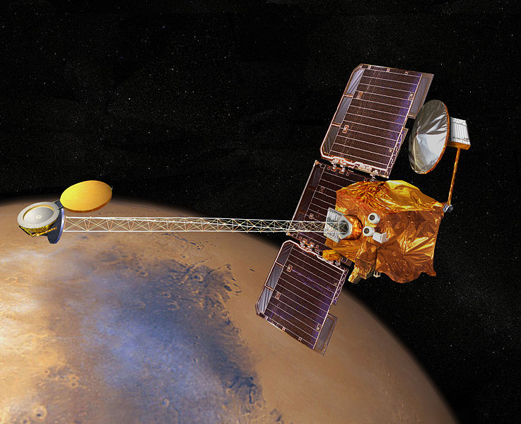
Mars Odyssey (2001)
Studies Mars seasons
Broadcasts signals from Robots to Earth
Notes:
The Mars Odyssey mission was launched from Cape Canaveral on April 7, 2001. In Oct 2001, it fired its main engine to slow down for entry into the Martian orbit. It continues to support its mission successfully and is the longest serving spacecraft at the red planet. Its longevity has enabled it to study seasonal weather changes from year to year, and provide the most detailed mapping of the planets surface. The spacecraft also served as a communication relay, handling most of the data sent by Mars Phoenix (2008) and the Exploration Rovers Spirit and Opportunity (2004-present).

Slide 21
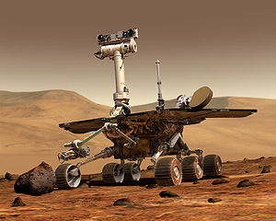
Mars Exploration Rovers
(2003: Spirit and Opportunity)
- Studies Mars surface
Notes:
Two Mars Exploration Rovers, Spirit and Opportunity, were sent in 2003 to further explore the terrain on the Martian surface.
https://mars.nasa.gov/mars-exploration/missions/mars-exploration-rovers/
Spirit was launched from Cape Canaveral on June 10, 2003 (landing January 4, 2004) and Opportunity launch followed on July 08, 2003 (landing January 25, 2004).

Slide 22
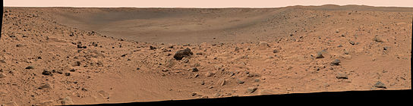
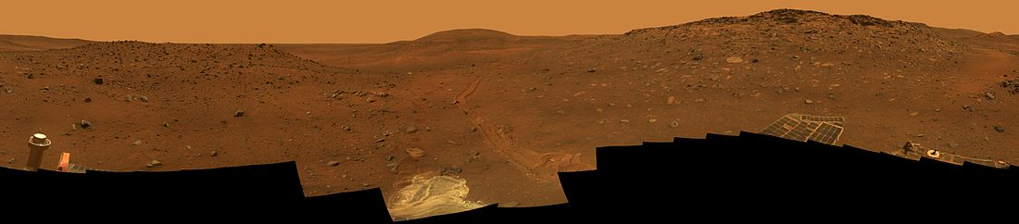
Spirit Rover Visited Sites
Bonneville Crater
Stationary location view
Notes:
Spirit landed on Mars Jan 4, 2004, three weeks before its twin. Its mission length was designed for 90 days. In March 2006 , the right front wheel ceased working, after covering 4.2 miles. The rover drove backwards, dragging the dead wheel. Then on May 1, 2009 the rover Spirit unfortunately got stuck in soft sand. Scientific data was still collected during its role as a stationary platform. It’s odometer had recorded 4.8 miles during its traverse on Mars. Attempts by JPL to communicate with Spirit ceased on May 24, 2011. It is believed that the batteries got so low, it shut down its internal clock.

Slide 23
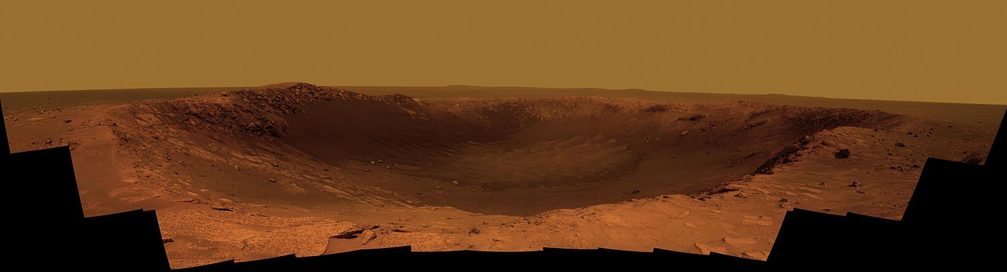
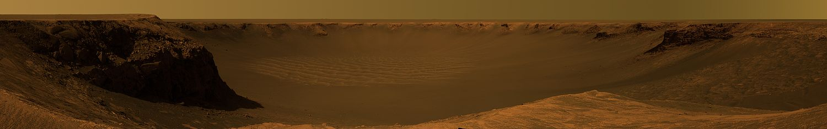
Opportunity Rover Visited Sites
Santa Maria Crater
Victoria Crater
Notes:
Opportunity landed on Mars Jan 25, 2004. From late April 2005 to early June, Opportunity was stuck in soft sand also. Over a six week period, and with Earth based simulations, the wheel was freed from the sand. The rovers total odometer mileage as of April 19, 2010, was 17.4 miles. Opportunity continues on its journey to Endeavour Crater.

Slide 24
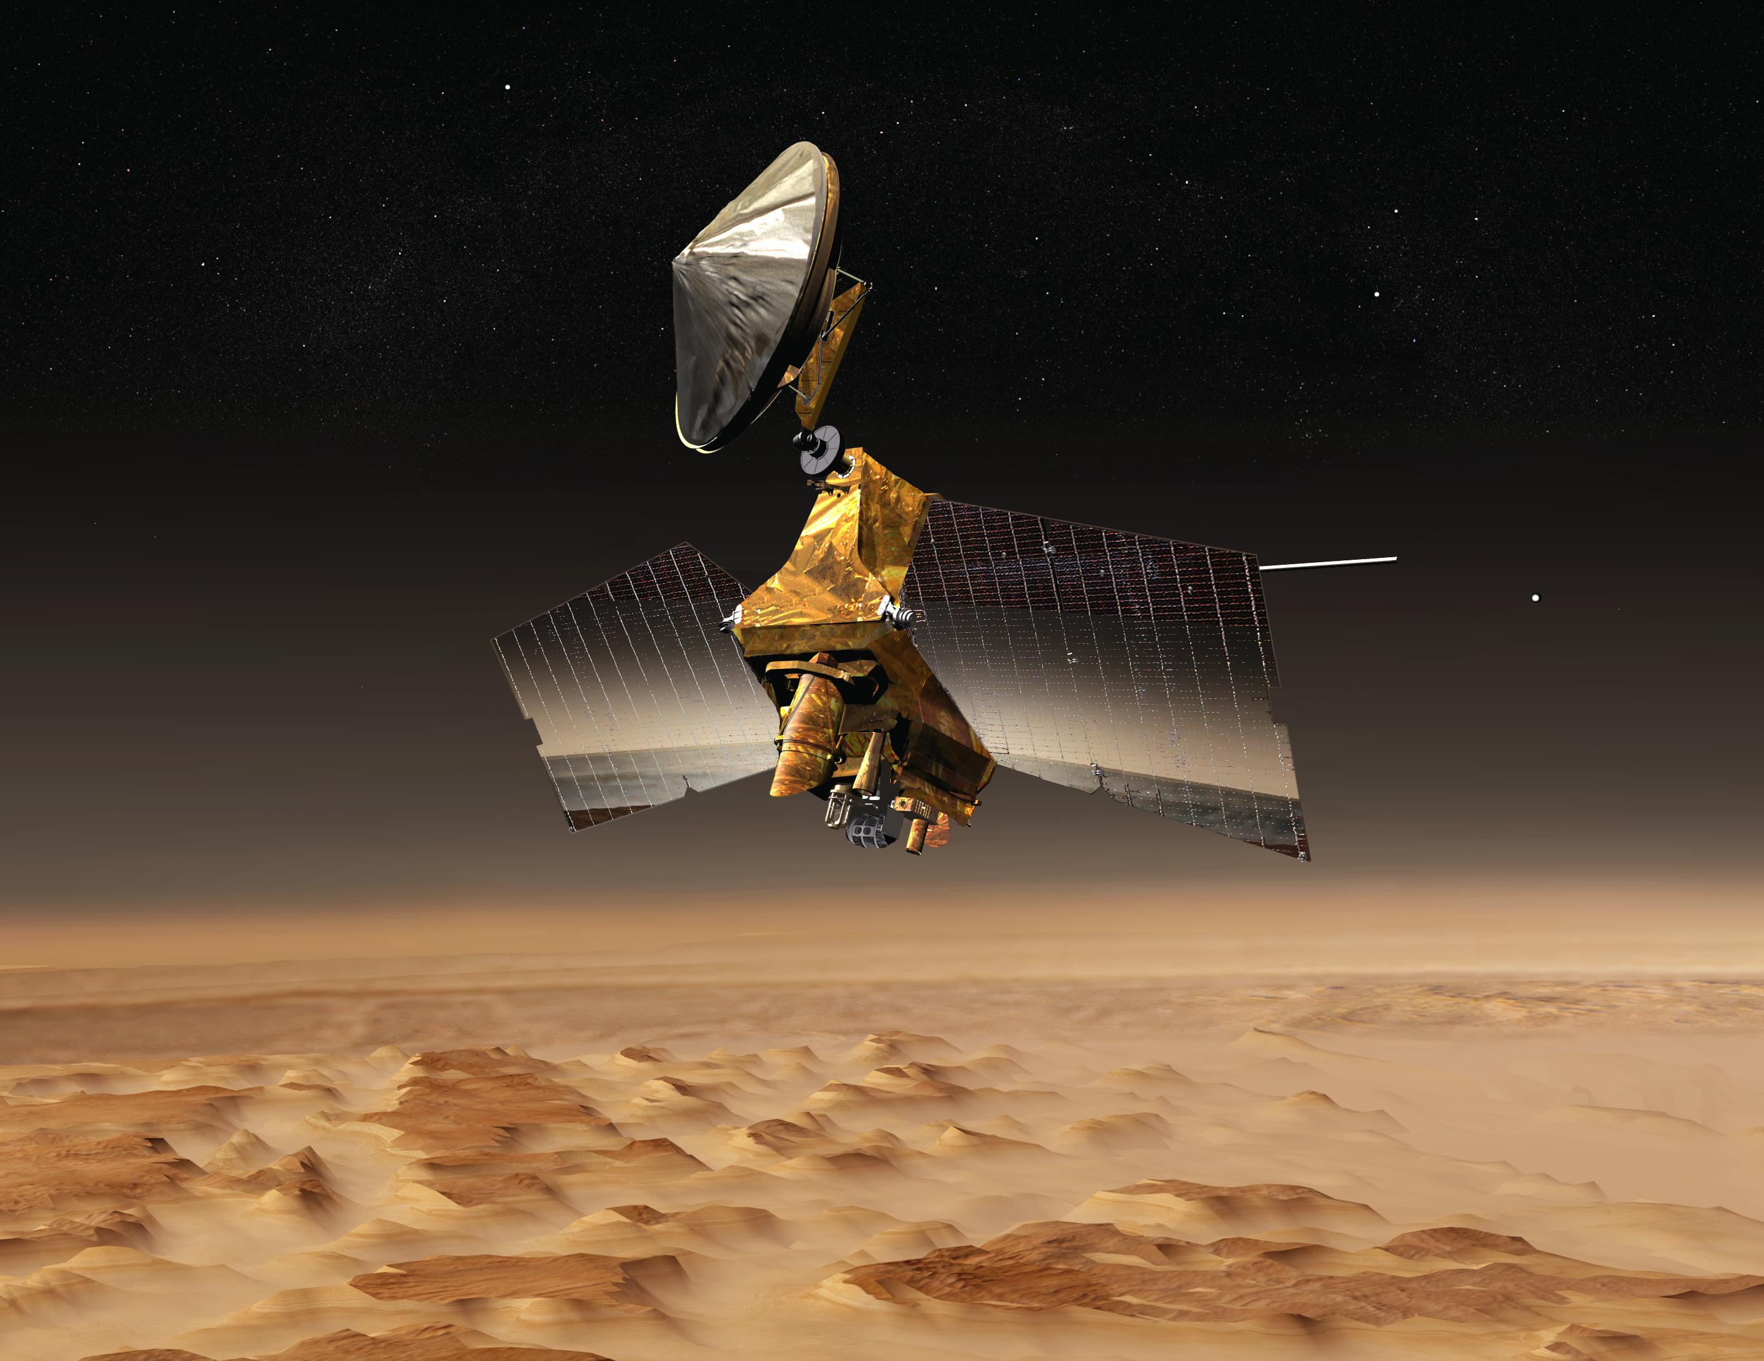
Mars Reconnaissance Orbiter
(2005)
Transmits information and pictures of terrain.
Notes:
The MRO spacecraft was launched Aug 12, 2005 to perform detailed observations, potential future landing sites for future missions and provide high data rate communication relay for those missions. It reached Mars on March 10, 2006 after a seven month journey. Its two year primary science mission is complete and there have been two extensions. The spacecraft continues to send data and it has sent more than 70,000 images of Mars.

Slide 25
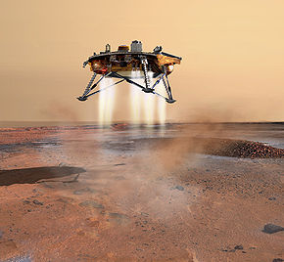
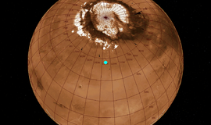
Mars Phoenix Lander
(2007)
Landing Site near the
North pole
Confirmed the presence of ice in 2008
Notes:
The Phoenix mission launched from Cape Canaveral on Aug 4, 2007 and landed May 25, 2008 near the Mars north pole. It’s main objective was to study the geologic history of water and climate change and evaluate habitability in the ice soil boundary. The mission was concluded on Nov 10, 2008 during the beginning of the Martian cold winter. On July 31, 2008, Phoenix confirmed the presence of water on Mars.

Slide 26
Mars Science Laboratory
(2011: Curiosity)
-Assist to determine the feasibility to live in the planet.
-Analyzes samples similar to the Phoenix Lander and the Pathfinder
Notes:
The MSL rover named Curiosity launched in Nov 2011. After it lands in August 2012, its mission is to determine the planets habitability. It will analyze samples similar to the Phoenix lander and the Pathfinder mission. It is five times the size of the rovers Spirit and Opportunity with ten times the scientific instrument capability. It is the size of a mini-cooper car.

Slide 27
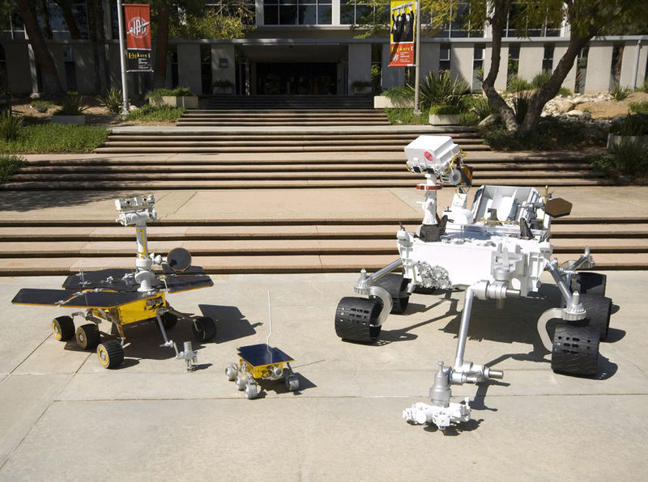
Comparing Size of Rovers
2003 1996 2011
Notes:
The differing sizes of the Mars rovers; Pathfinder, Exploration Rover and MSL.

Slide 28
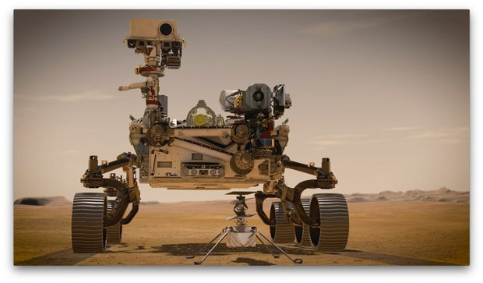
Mars 2020
(Launched on 07/30/2020, Landed on 02/18/2021)
Mission Goals
Goal 1: Determine whether life ever existed on Mars
Goal 2: Characterize the Climate of Mars
Goal 3: Characterize the Geology of Mars
Goal 4: Prepare for Human Exploration
Perseverance
Ingenuity
An enhanced brain will permit Perseverance to figure out its path on Mars autonomously up to five times faster than Curiosity. ...
The chassis, or body, is about 12 centimeters longer than Curiosity's. It is also heavier at 1,025 kg (2,255 lbs) compared with
Curiosity's 899 kg (1,978 lbs). (Credit: https://magazine.caltech.edu/post/mars-2020-evolution-of-a-rover)
Notes:
https://mars.nasa.gov/mars2020/spacecraft/rover/#:~:text=The%20Mars%202020%20rover%2C%20Perseverance,%2C%20and%202.2%20meters%20tall).
(Credit: https://magazine.caltech.edu/post/mars-2020-evolution-of-a-rover)

Slide 29
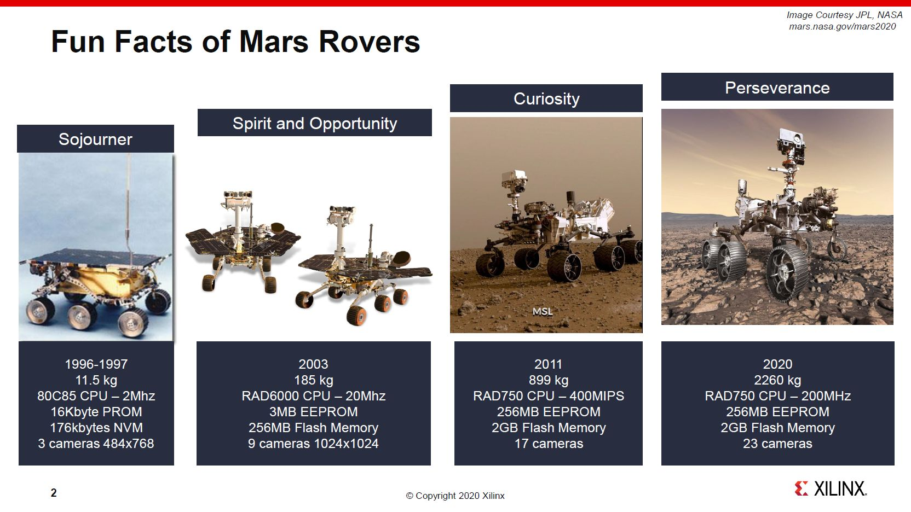
2020
1,025 kg
Photo Credit: Copyright 2020 XILINX
Notes:
The differing sizes of the Mars rovers; Pathfinder, Exploration Rover and MSL.

Slide 30
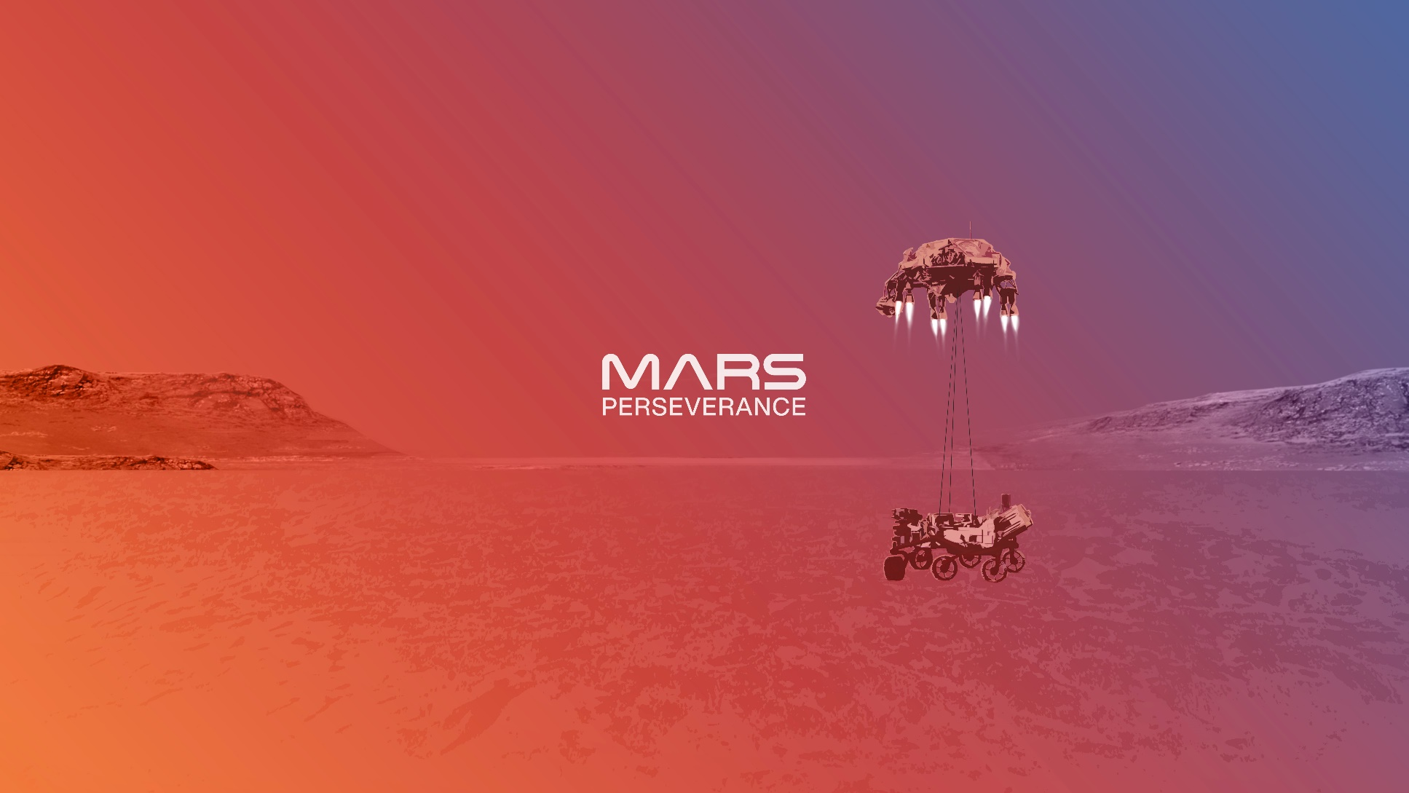
Perseverance Rover’s Descent and Touchdown on Mars

Slide 31
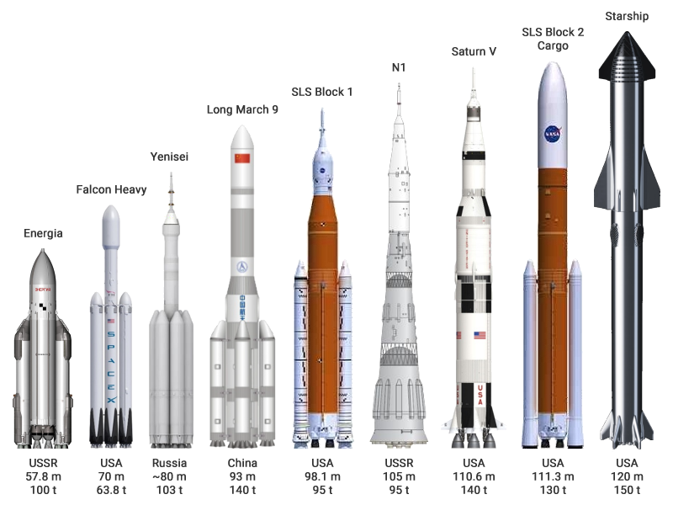
Super heavy launch vehicles
Notes:
https://en.wikipedia.org/wiki/SpaceX_Starship#/media/File:Super_heavy-lift_launch_vehicles.png

Slide 32
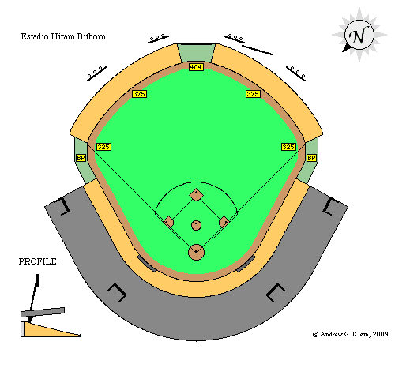
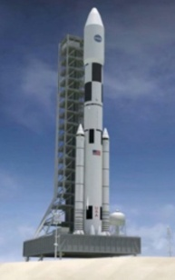
SLS Heavy’s length vs Baseball Field
SLS Heavy-Lift
33 stories + base
111.3 m (about 365 ft tall)
Boeing 747
76.3 m (250 ft)
Dimensions are approximated
Not to scale.
Notes:
Next Chart: Some NASA Space Launch Vehicles
https://www.nasa.gov/sites/default/files/atoms/files/sls_core_stage_fact_sheet_01072016.pdf

Slide 33
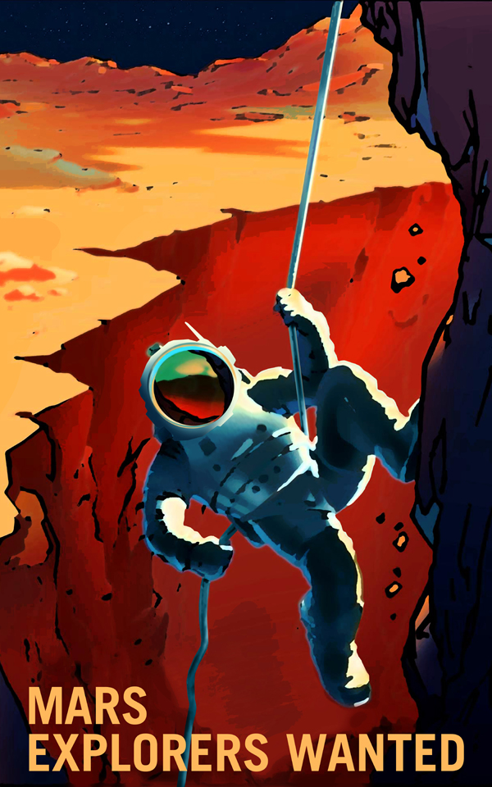
Mars Mission Concept … with Humans
https://www.youtube.com/watch?v=lN7Q8l4dFaU
Notes:
8 minutes + 30 seconds
Fission Surface Power Systems (FSPS)
Fission is a splitting of something into two parts.

Slide 34
Super heavy launch vehicles
Crew Capsule
Notes:
https://en.wikipedia.org/wiki/SpaceX_Starship#/media/File:Super_heavy-lift_launch_vehicles.png
Before sending humans to Mars, SpaceX plans to launch a Starship carrying cargo in 2022. If the mission goes smoothly, the target date to send the first humans to the Red Planet is the year 2024.
https://www.tesmanian.com/blogs/tesmanian-blog/mars-2022

Slide 35
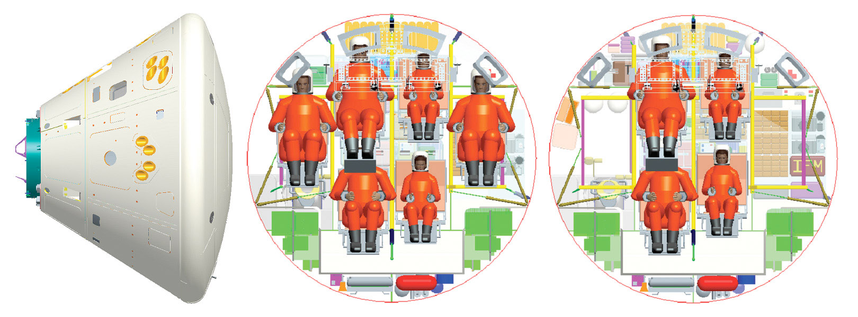
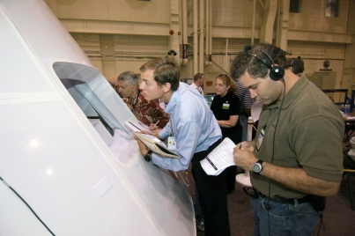
Crew configuration for Moon / Mars
Moon
Mars
Notes:
The differing sizes of the Mars rovers; Pathfinder, Exploration Rover and MSL.
https://www.theregister.com/2008/08/12/space_shuttle_replacement_delayed/

Slide 36



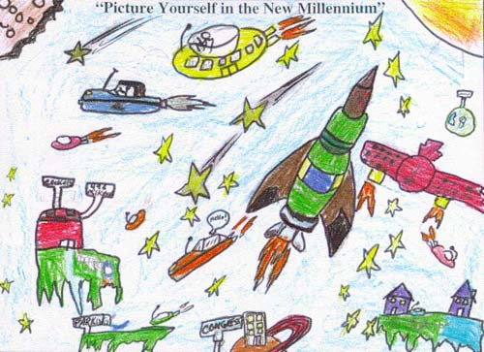

Possible STEAM Skills of Crew
Science →
Technology →
Engineering →
Arts →
Mathematics →
Notes:
STEM

Slide 37
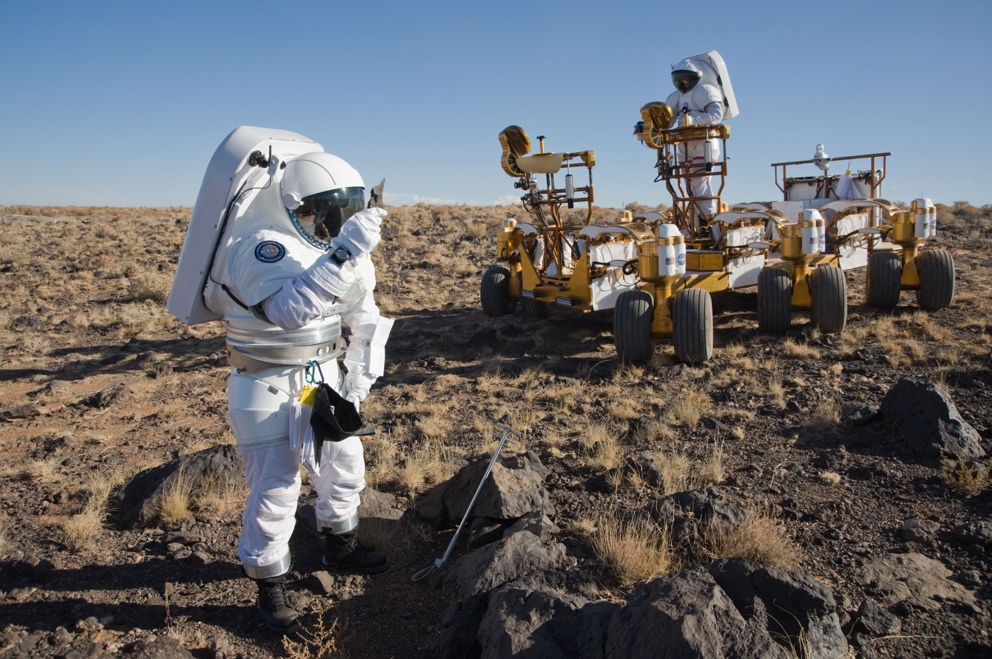
Developing Skills on Earth
Notes:
Desert Research And Technology Studies (RATS) annually practice analog operations.

Slide 38
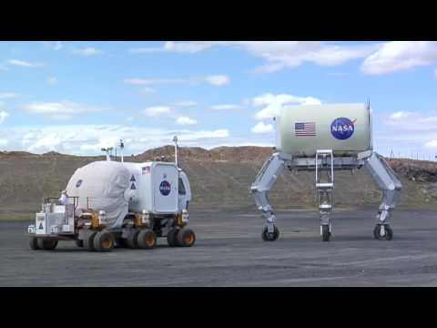
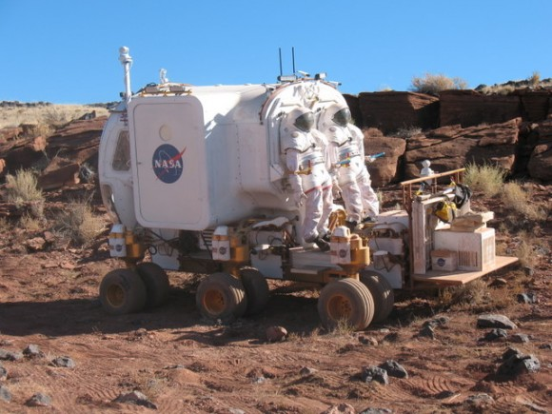
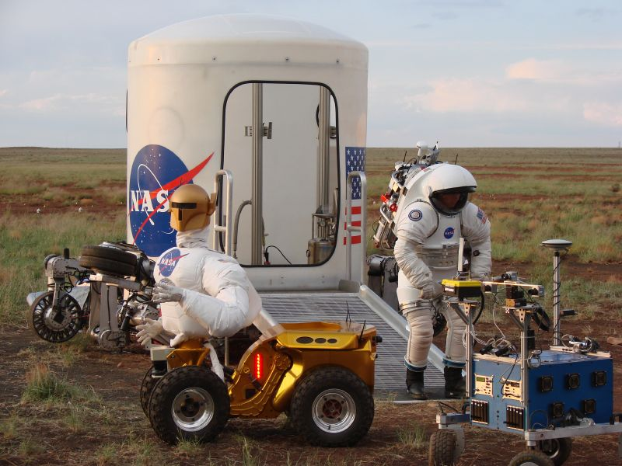
Training on Earth for a Mars Mission
Notes:
Desert Research And Technology Studies (RATS) annually practice analog operations.

Slide 39
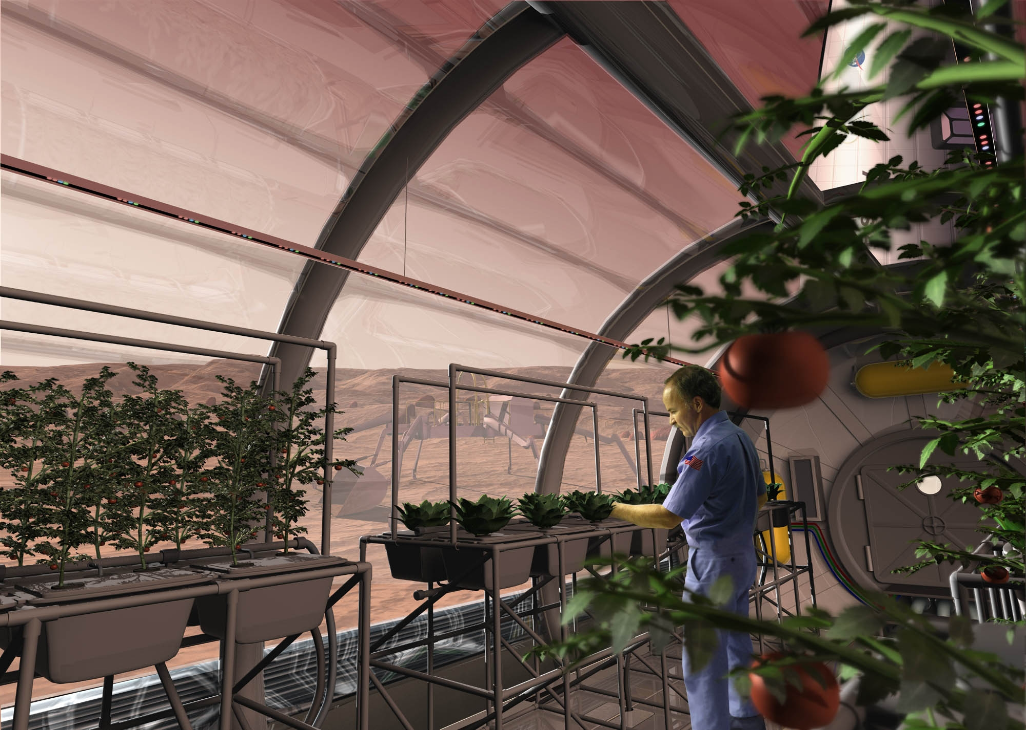
Importance of Research with Plants
Notes:
Artistic rendering of Dr. Ray Wheeler in Mars’s Greenhouse. Robot in background.

Slide 40
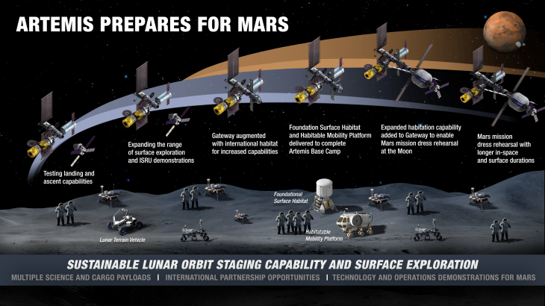
Learning from Lunar Missions
Notes:
https://techcrunch.com/2020/04/03/nasa-details-how-it-plans-to-establish-a-sustained-human-presence-on-the-moon/

Slide 41
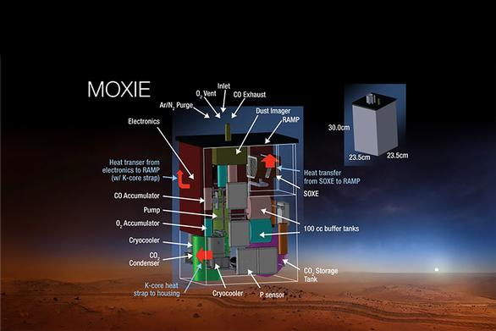
Using Lunar Resources
MOXIE = Mars OXygen In-situ resource utilization Experiment
Notes:
https://techcrunch.com/2020/04/03/nasa-details-how-it-plans-to-establish-a-sustained-human-presence-on-the-moon/

Slide 42
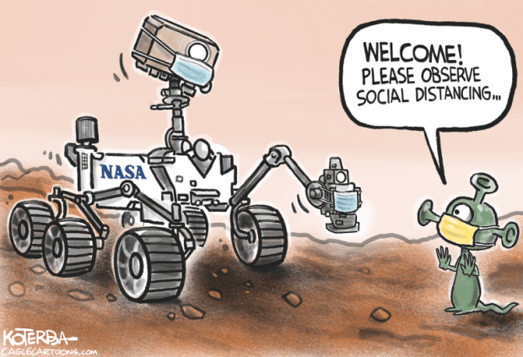
Why can’t we find life on Mars?
Notes:
8 minutes + 30 seconds
Fission Surface Power Systems (FSPS)
Fission is a splitting of something into two parts.

Slide 43
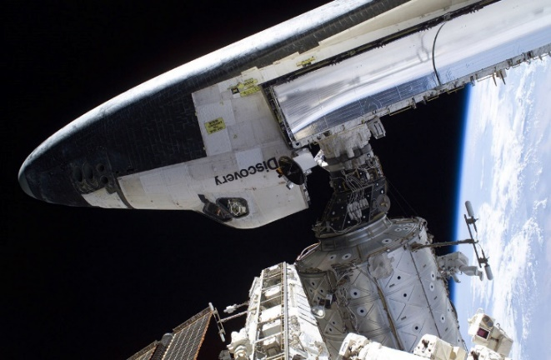
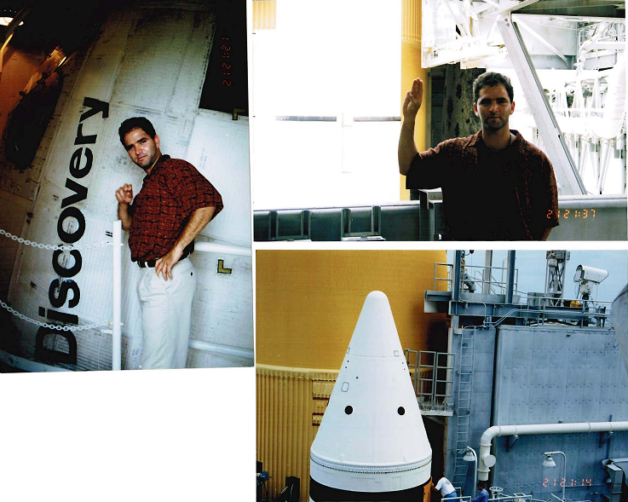
References
NASA Fact Sheet Library
  http://spaceflight.nasa.gov/spacenews/factsheets/index.html
  https://www.nasa.gov/sites/default/files/atoms/files/sls_core_stage_fact_sheet_01072016.pdf
Perseverance Rover’s Descent and Touchdown on Mars
  https://www.youtube.com/watch?v=-l7MM9yoxII
Mars Exploration Rovers
  http://spaceflight.nasa.gov/spacenews/factsheets/index.html
How to Get to Mars (video)
  https://www.youtube.com/watch?v=XRCIzZHpFtY
MOXIE (video)
  https://www.mos.org/mos-at-home/sparks-of-science/mars-moxie

Slide 44
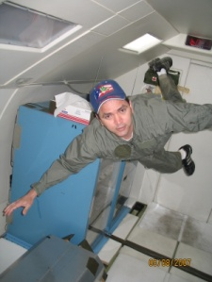
Missions to
Mars!
Your questions, comments and suggestions
are welcomed !
National Aeronautics and Space Administration
Thanks !
Thanks !
Félix A. Soto Toro, Ph.D., PMP
Felix.A.Soto-Toro@NASA.gov
Kennedy Space Center, FL
www.nasa.gov
Notes:
Mars is the fourth planet from the sun and is named after the Roman god of war.

Slide 45
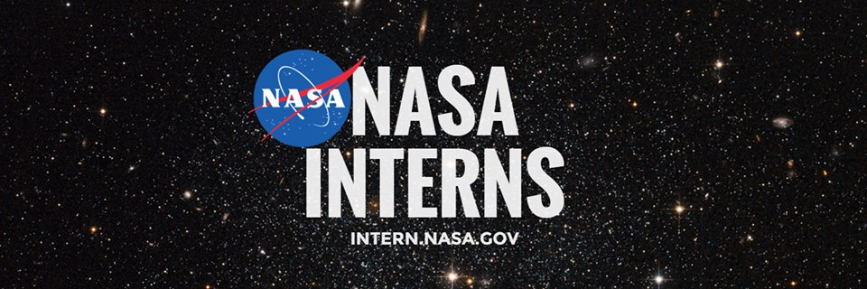
Educational Opportunities

Slide 46
Backup Slides

Slide 47
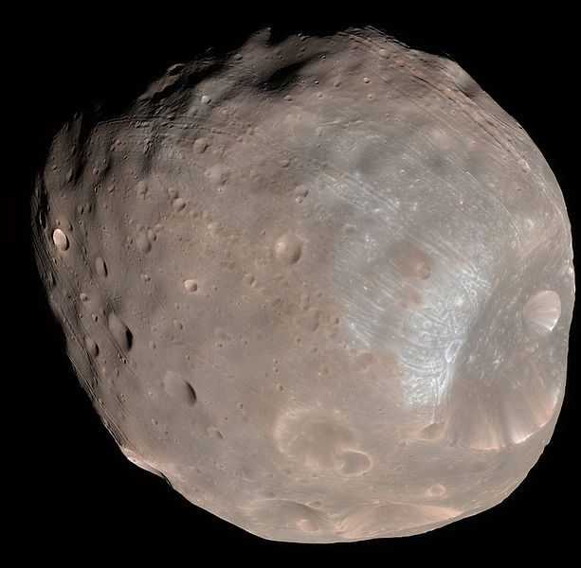
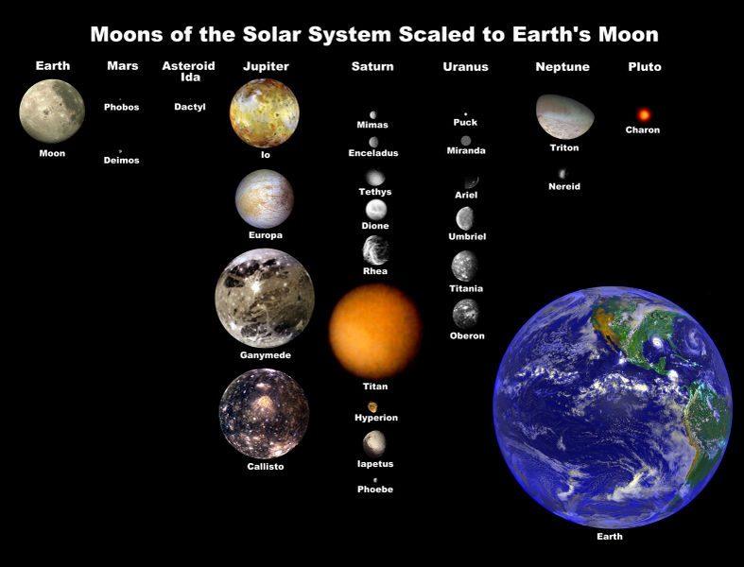
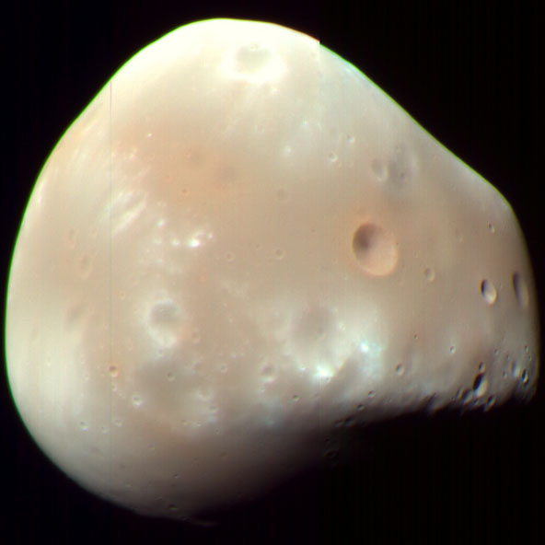
Mars’ moons
Moons Comparison
Phobos:
128 times smaller than Earth’s Moon !
Phobos
27 km long
Deimos
15 km long
Notes:
Mars two moons are small and irregularly shaped. They may be captured (by Mars gravity) asteroids.

Slide 48

Earth vs Moon
Notes:
Reference: https://scentofpine.org/gw101-1/

Slide 49

Moon’s distance from Earth
Notes:
Reference: https://www.rmg.co.uk/stories/topics/how-far-away-moon

Slide 50
Why send Robots to Mars ?
Biological Sciences Research
Geological y Geochemical Sciences Research
Study Planet’s Formation
Measure Surface Radiation
http://mars.jpl.nasa.gov/msl/mission/science/objectives/
Notes:
Objectives
Mars Science Laboratory: Mission Objectives
To contribute to the four science goals and meet its specific goal of determining Mars' habitability, Mars Science Laboratory has the following science objectives.
Biological objectives:
Determine the nature and inventory of organic carbon compounds
Inventory the chemical building blocks of life (carbon, hydrogen, nitrogen, oxygen, phosphorous, and sulfur)
Identify features that may represent the effects of biological processes
Geological and geochemical objectives:
Investigate the chemical, isotopic, and mineralogical composition of the martian surface and near-surface geological materials
Interpret the processes that have formed and modified rocks and soils
Planetary process objectives:
Assess long-timescale (i.e., 4-billion-year) atmospheric evolution processes
Determine present state, distribution, and cycling of water and carbon dioxide
Surface radiation objective:
Characterize the broad spectrum of surface radiation, including galactic cosmic radiation, solar proton events, and secondary neutrons

Slide 51

Start working on your Journey
Step | Year | Age | Preparation
1 | 2021 | 16 | 10th Grade
2 | 2022 | 17 | 11th Grade
3 | 2023 | 18 | 12th Grade
4 | 2028 | 23 | Graduate from College
5 | 2030 | 25 | Graduated with Masters Degree (+ 3 years at job)
6 | 2033 | 28 | Eligible to apply to become an Astronaut
7 | 2034 | 29 |  | Selected as an Astronaut
8 | 2037 | 32 |  | Selected for Mars Mission
9 | 2039 | 34 |  | Fly to Mars !
10 | 2041 | 36 |  | Return to Earth !
This could be you !
Notes:
There are no age restrictions for the program.
Astronaut candidates selected in the past have ranged between the ages of 26 and 46, with the average age being 34.
*The 2009 US class age average: 37 years old. Age Spectrum: 30 – 43. Additionally, there were 3 Japanese and 2 Canadian Astronauts selected.

Slide 52
Recommendations
  Your sole goal in life should not be to become an Astronaut !
  Have Faith.
  Obtain skills that will benefit both you and your employer.
  Establish interesting, challenging but feasible goals.
  Become a Role Model.
  Promote Mentorship.
  Share your knowledge.
  Maintain clean mind and body.
  Your aptitude will help you and other to determine your altitude.
  Respect yourself and others.
  Balance your life activities.
  Apply your learned and acquired skills to your professional and personal life.

Slide 53

NASA is not the only one Training to
Go to MARS !
Notes:
http://www.youtube.com/watch?v=n4tgkyUBkbY
http://www.mars-one.com/

Slide 54
Why send Humans to Mars ?
Mission Objective
  It is Mars One's goal to establish a human settlement on Mars.
Human settlement of Mars is the next giant leap for humankind. Exploring the solar system as a united humanity will bring us all closer together.
Mars is the stepping stone of the human race on its voyage into the universe.
Human settlement on Mars will aid our understanding of the origins of the solar system, the origins of life and our place in the universe.
As with the Apollo Moon landings, a human mission to Mars will inspire generations to believe that all things are possible, anything can be achieved.
http://mars-one.com/en/mission/mission
Notes:
Mission & Vision
Mars One’s Mission Objective
It is the Mission Objective of Mars One to establish a human settlement on the planet Mars in 2023.
Vision of Mars One
Mars One believes human exploration of the solar system should be a global effort, greater than the ambition of an individual nation. Mars exploration offers an opportunity to celebrate the power of a united humanity.
As with the Apollo Moon landings, a human mission to Mars will inspire generations to believe that all things are possible, that anything can be achieved. Mars One believes it is not only possible, but imperative that we establish a permanent settlement on Mars in order to accelerate our understanding of the formation of the solar system, the origins of life, and of equal importance, our place in the universe

Slide 55

No sólamente NASA está entrenando
Notes:
http://pillownaut.blogspot.com/2011/06/365-days-for-mars-500.html
15 minutes

