Slide 1

Where can students apply for space program-related internships ?
Félix A. Soto Toro, Ph.D., PMP
Felix.A.Soto-Toro@NASA.gov
Kennedy Space Center, FL
03/23/2021
*Percentages have not been verified

Slide 2
Space Program Industry Partners
Federal Employees include:
NASA
Department of Defense
NOAA
Percentages are not official

Slide 3
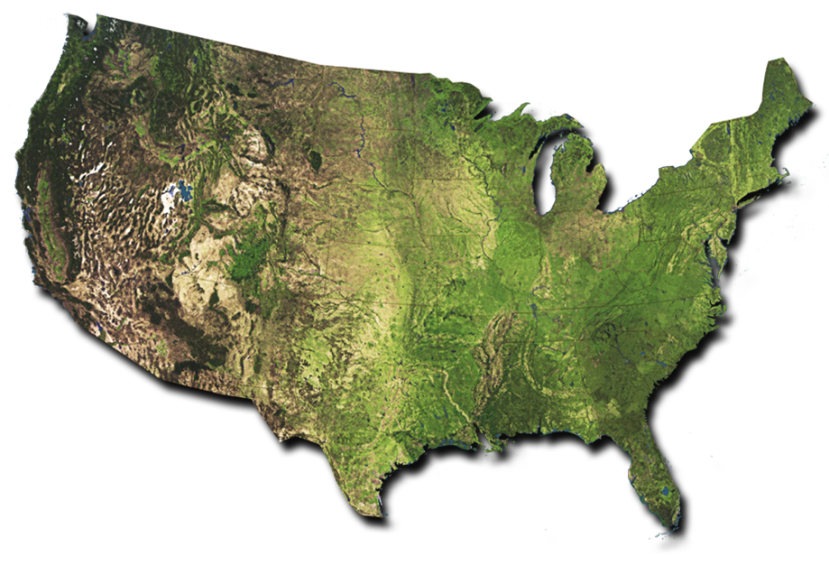
NASA Centers and Facilities
National Aeronautics and Space Administration Created by Congress in 1958
Glenn Research Center
Aeronautic and Spacecraft Technology
Cleveland, OH
Goddard Space
Flight Center
Science Missions
& Telescopes
Greenbelt, MD
Ames Research Center
Aerospace and Small Spacecraft
Moffett Field, CA
Katherine Johnson (Headquarters)
Washington, D.C.
Armstrong Flight
Research Center
Atmospheric Research
& Testing
Edwards, CA
Langley Research Center
Aviation & Space Research
Hampton, VA
Wallops Flight Facility
Flight and Launch range services
Wallops Island, VA
White Sands Test Facility
Hazardous Ops Tests and Analyses
Las Cruces, NM
Johnson Space Center
Human Space Flight Operations
Houston, TX
Kennedy Space Center
Spacecraft Processing, Launch and Landing
Titusville, FL
Marshall Space
Flight Center
Space Transportation
& Propulsion Systems
Huntsville, AL
Jet Propulsion Laboratory
Deep Space Robotic
Rovers & Networks
Pasadena, CA
Michoud Assembly Facility
New Orleans, LA
Stennis Space Center
Shuttle Engine Testing
Stennis Space Center, MS
Not to Scale
Notes:
NASA Centers and Facilities
https://www.nasa.gov/about/sites/index.html
Next Chart: NASA Organization Chart

Slide 4
Internships with NASA
Program | Commitment by NASA | Website | Academic Level
Pathways (also known as Co-Op) | Depends on NASA’s funding, skills needed and student’s performance | https://intern.NASA.gov | College Sophomore thru PhD candidates
OSTEM | No | https://nasa.force.com/s/login/ | Junior in High School thru PhD candidates

Slide 5
Internships with NASA Contractors*
Company Name | Website
Boeing | https://jobs.boeing.com/internships
California Institute of Technology | https://jpl.jobs/
Lockheed Martin Space Operations | https://www.lockheedmartinjobs.com/college-students
SpaceX, Inc. | https://www.spacex.com/internships/
Etc. | https://en.wikipedia.org/wiki/List_of_NASA_contractors https://nasa.fandom.com/wiki/List_of_NASA_contractors
Click here to view the ranking of the top 20 U.S. NASA contractors in fiscal year 2019, by contract value.
*NOTES
Students selected for these positions are NOT NASA employees.
Academic Levels accepted are at the discretion of each employer. Check their respective websites.

Slide 6
Internships with NASA Sub-Contractors*
Visit each of these contractors' webpages and find out who they outsource work to…
Company Name | Website
Boeing | https://jobs.boeing.com/internships
California Institute of Technology | https://jpl.jobs/
Lockheed Martin Space Operations | https://www.lockheedmartinjobs.com/college-students
SpaceX, Inc. | https://www.spacex.com/internships/
Etc. | https://en.wikipedia.org/wiki/List_of_NASA_contractors https://nasa.fandom.com/wiki/List_of_NASA_contractors
Click here to view a list of 2019 Deep Space Exploration Systems Suppliers
*NOTES
Students selected for these positions are NOT NASA employees.
Academic Levels accepted are at the discretion of each employer. Check their respective websites.

Slide 7

Thanks for your invitation !
Félix A. Soto Toro, Ph.D., PMP
Felix.A.Soto-Toro@NASA.gov
Kennedy Space Center, FL

