Slide 1
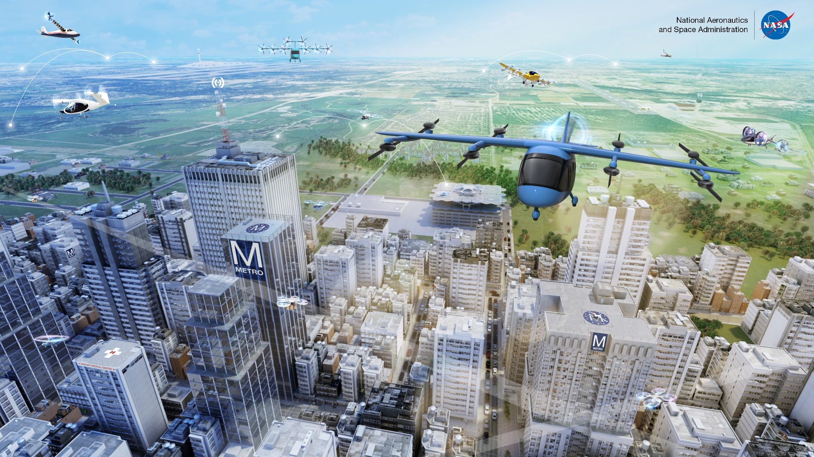
What is Advanced Air Mobility (AAM)?

Slide 2
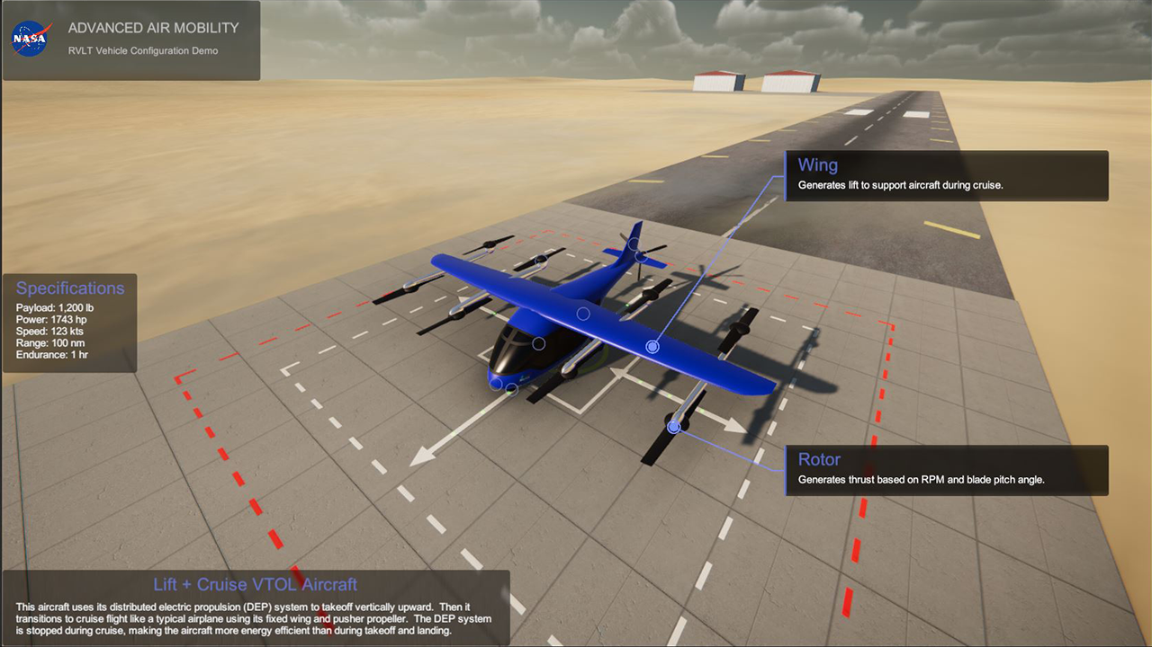
What is an eVTOL?
electric Vertical Takeoff and Landing

Slide 4
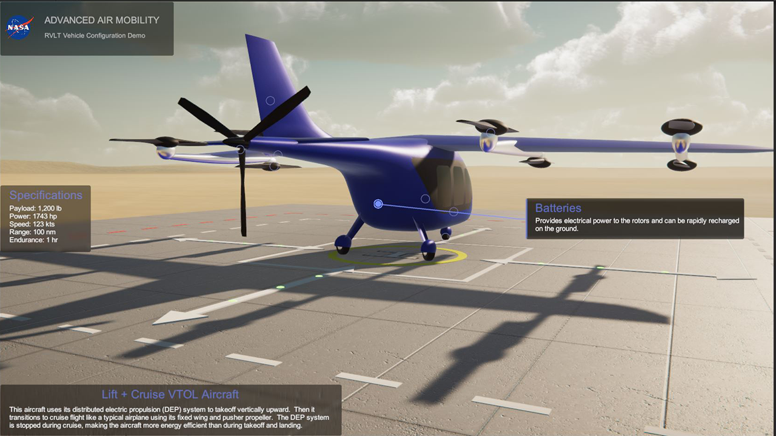

Slide 5
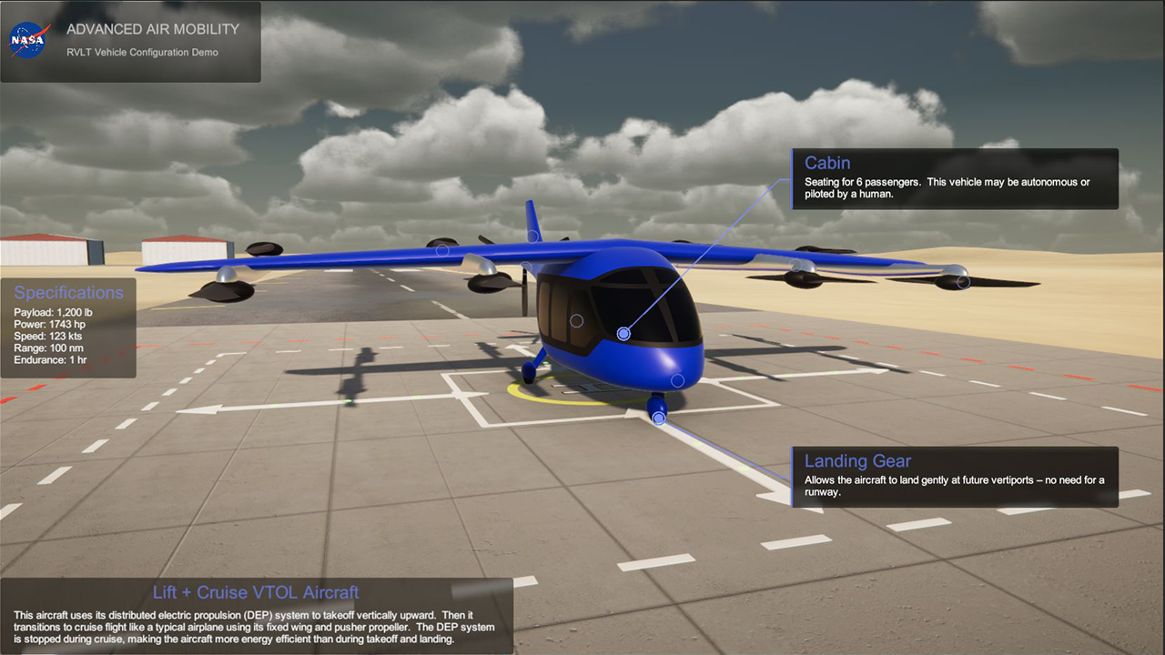

Slide 6


What are the Benefits of Advanced Air Mobility?
Access
Community
Sustainable

Slide 7
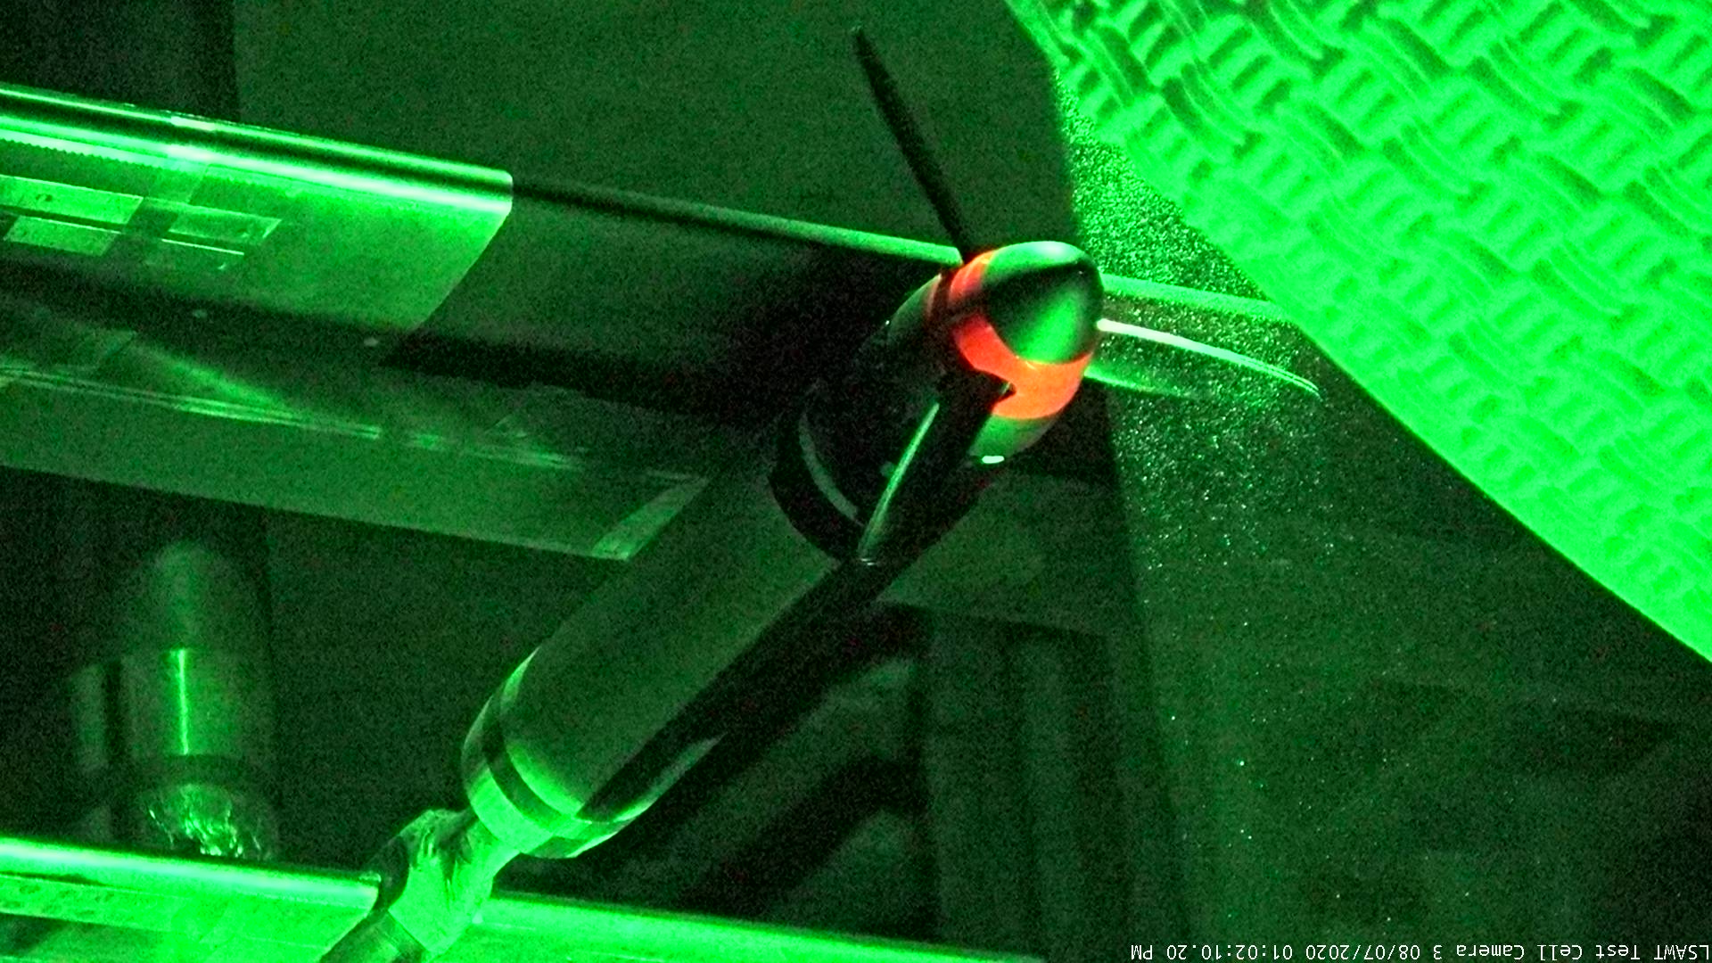
What does a Research Aerospace Engineer at NASA do?

Slide 8
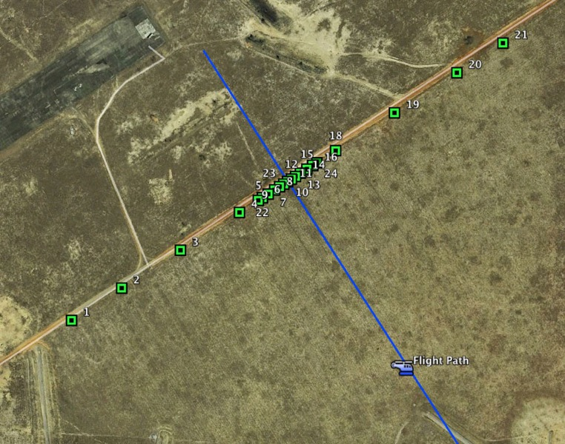
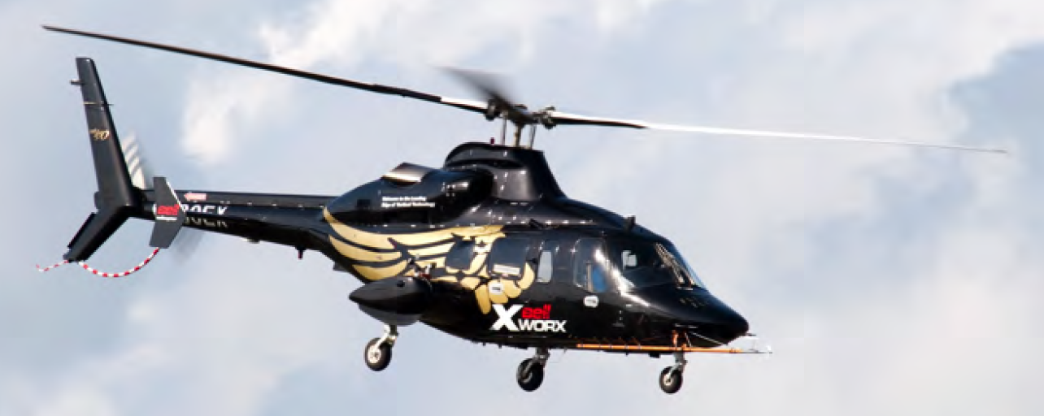

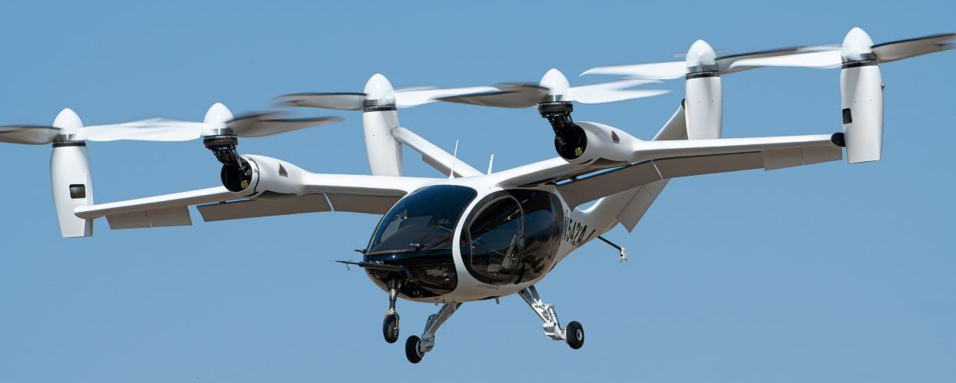

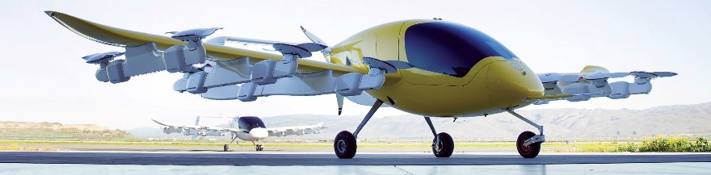
What does a Research Aerospace Engineer at NASA do?
Watts, M. E., Greenwood, E., Smith, C. D., Snyder, R., and Conner, D. A., “Maneuver Acoustic Flight Test of the Bell 430 Helicopter Data Report,” NASA/TM-2014-218266, May 2014.
https://evtol.news/joby-s4
https://evtol.news/kitty-hawk-cora/
Trade names and trademarks are used in this report for identification only. Their usage does not constitute an official endorsement, either expressed or implied, by the National Aeronautics and Space Administration.

Slide 9

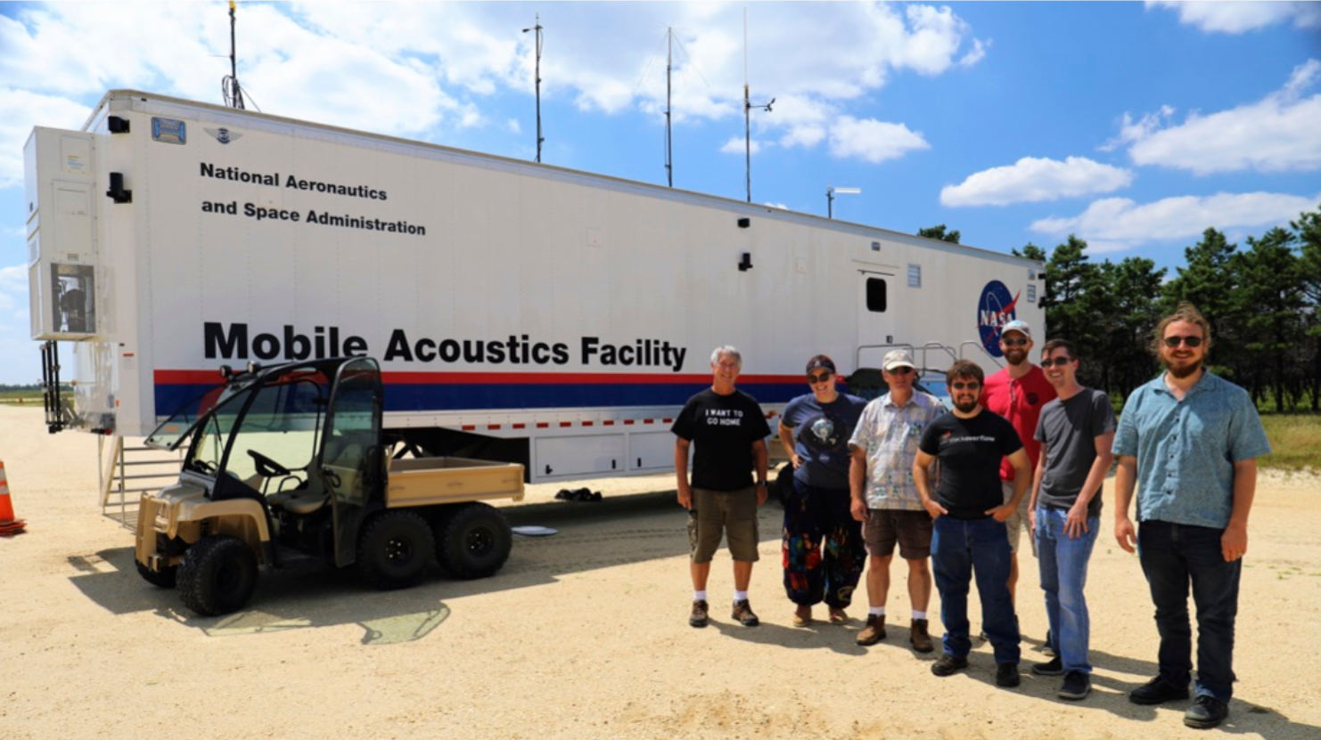

What is work life like at NASA?
Questions

