Slide 1
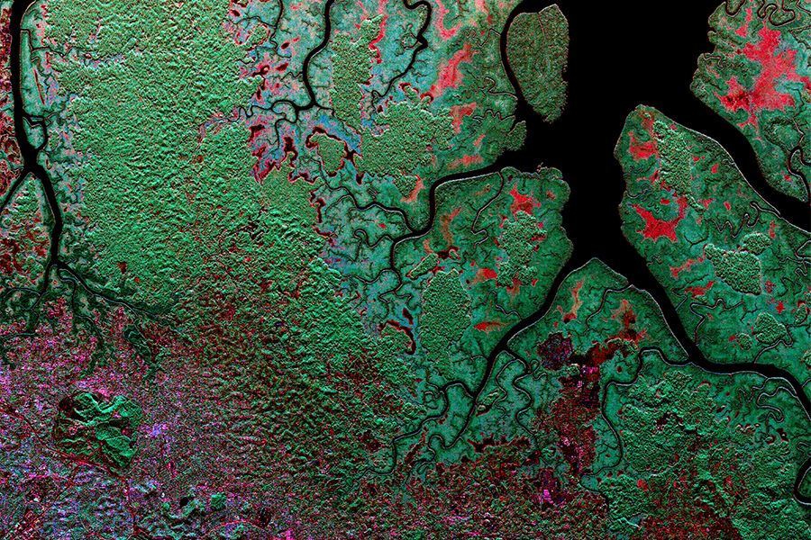


Data Management Plans to Enable Open Science
Kaylin Bugbee
Applications Data Manager
NASA Marshall Space Flight Center, Huntsville, AL

Slide 2
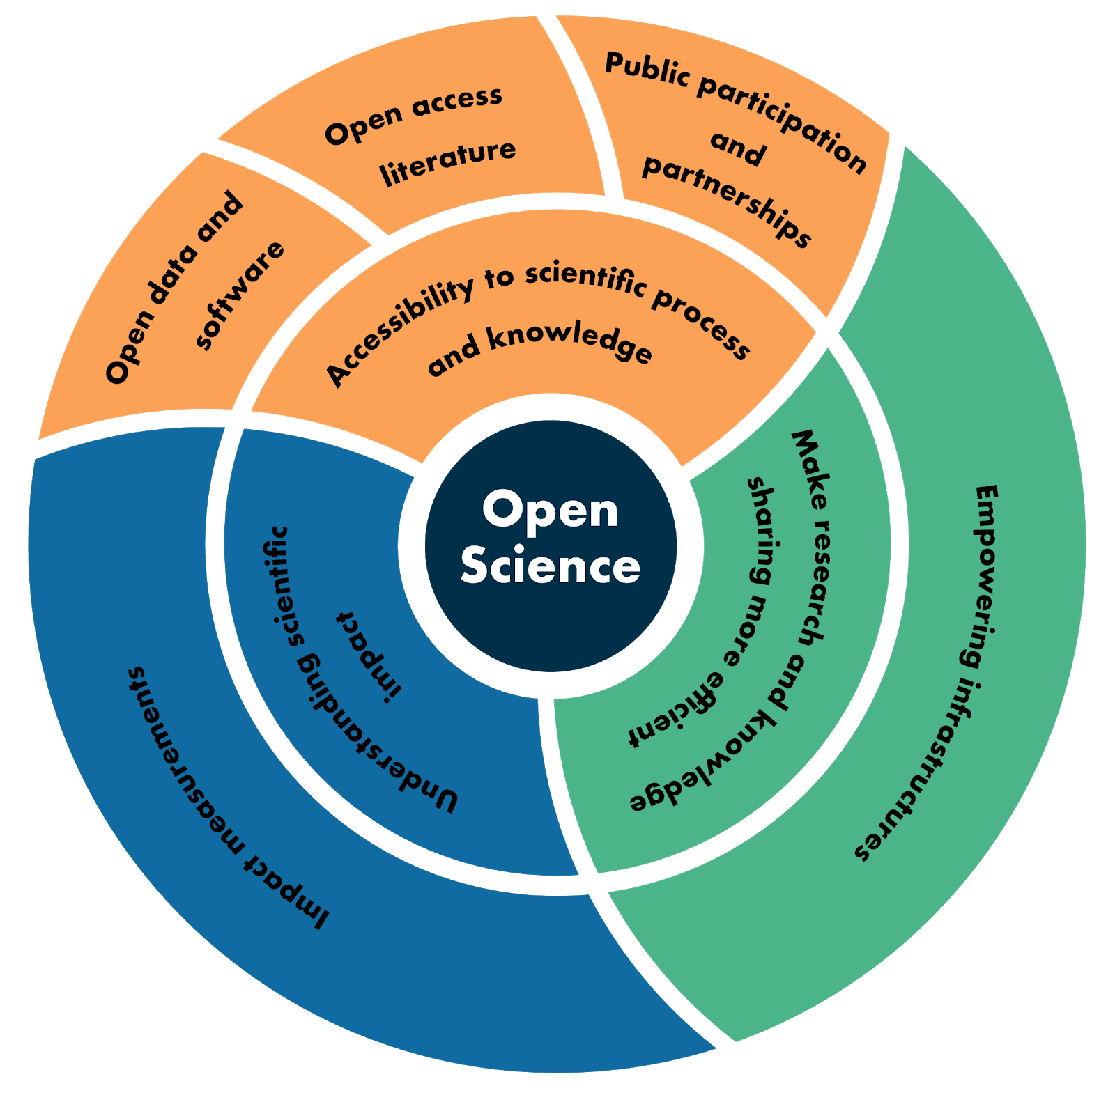
What is Open Science?
Open science is a collaborative culture enabled by technology that empowers the open sharing of data, information and knowledge within the scientific community and the wider public to accelerate scientific research and understanding
3 broad focus areas within open science
Citizen science is made possible by open science
R. Ramachandran, K. Bugbee, and K. Murphy. “From Open Data to Open Science,” Earth and Space Science Open Archive, 2020. https://doi.org/10.1002/essoar.10505011.1.
Notes:
Accessibility to the process in combination with open data, software and literature
Also contributes back to open science by making the process and products of citizen science research open

Slide 3
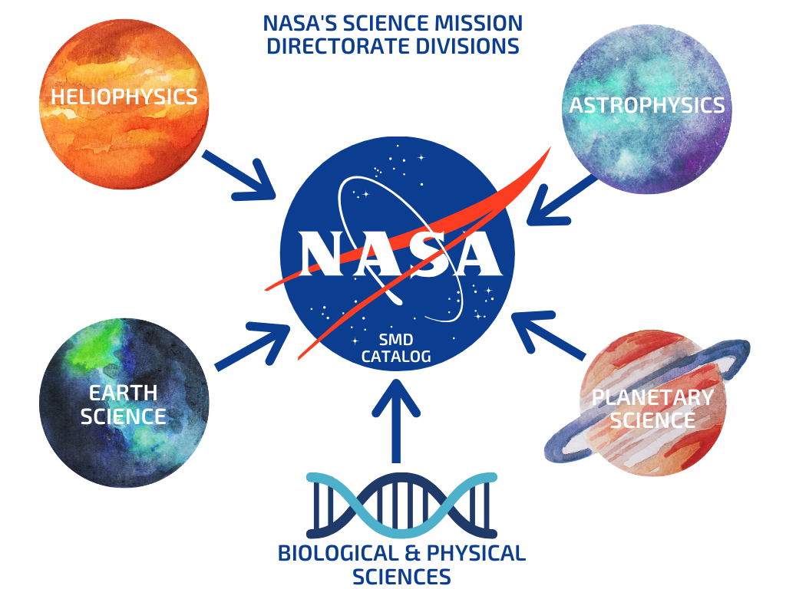
NASA’s Commitment to Open Science
Goal: Develop and implement capabilities to enable open science¹
There are several activities to support this including
  Developing an SMD-wide open data and software policy
  Providing a free and open unified journal server
  Developing a SMD data catalog to support discovery and access to scientific data across the divisions
Citizen science data are an important part of the SMD data ecosystem and would be a valuable addition to the cataloging effort
Notes:
Want to provide the foundational components of an open science ecosystem

Slide 4
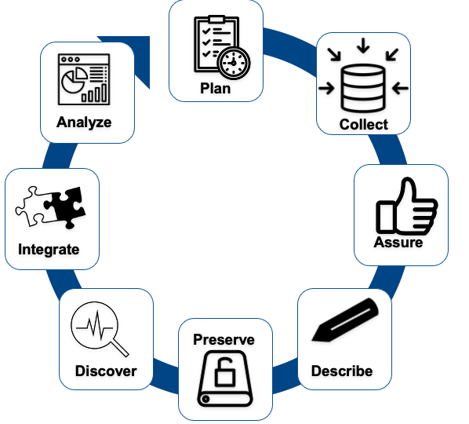
What is a Data Management Plan?
Describes how you will manage data throughout the life of a project and what you will do with the data after the project ends ²
Applies to all parts of the data lifecycle
DMPs typically are written for data
For citizen science, a DMP should also include descriptions about:
  The research process
  The project itself
Data Life Cycle as described by DataONE

Slide 5
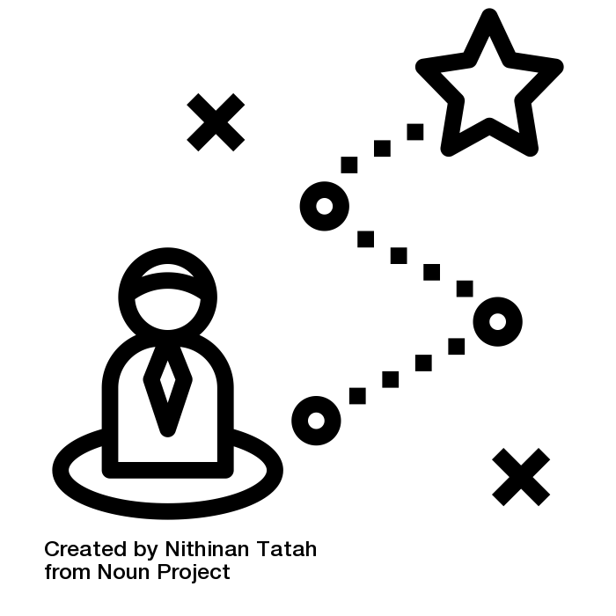
Benefits of a Data Management Plan
Publicly available DMPs encourages open science and transparency about the scientific process
Lowers barriers to participation
  Reassures participants by providing information on data collection protocols and data quality processes
Serves as a roadmap to help you strategically manage your data
Notes:
strategic by Nithinan Tatah from the Noun Project

Slide 6
Citizen Science Data and Information Needs
3 types of data and information that should be included in a DMP:
  Project description
  Research process and data collection protocols
  Data and software
Aligns with PPSR metadata model concepts
Research Process
Data
Project
Notes:
Public Participation in Scientific Research

Slide 7
Data Management Plan Resources
DMPTool
Free, open-source, online application that helps you create data management plans
Data Management Plan (DMP) Template for Data Producers
From NASA’s Earth Science Data System
Provides guidelines on creating a consistent and compliant DMP
DataONE’s Primer on Data Management: What you always wanted to know* but were afraid to ask
Highlights the basics of data management
Examples of Data Management Plans
See examples of DMPs for research proposals

Slide 8
Questions?
Contact me at:
Kaylin.m.Bugbee@nasa.gov

Slide 9
References
https://science.nasa.gov/science-pink/s3fs-public/atoms/files/SDMWG%20Strategy_Final.pdf
Recknagel, F., W. Michener. 2006. Ecological Informatics. Springer, Cham. https://doi.org/10.1007/978-3-319-59928-1

