Slide 1
Earth Day at KSC
22 April 2021
Becky Bolt
Wildlife Ecologist
Herndon Solutions Group, LLC
NASA Environmental and Medical Contract # 80KSC020D0023
Mail Code NEM-022, Kennedy Space Center, FL 32899

Slide 2
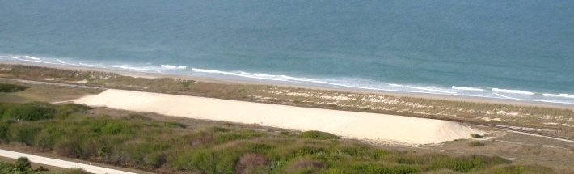
Shoreline Restoration on Kennedy Space Center: Creating Functioning Dunes from Piles of Sand
Rebecca Bolt
Wildlife Ecologist
Earth Day, 22 April 2021

Slide 3
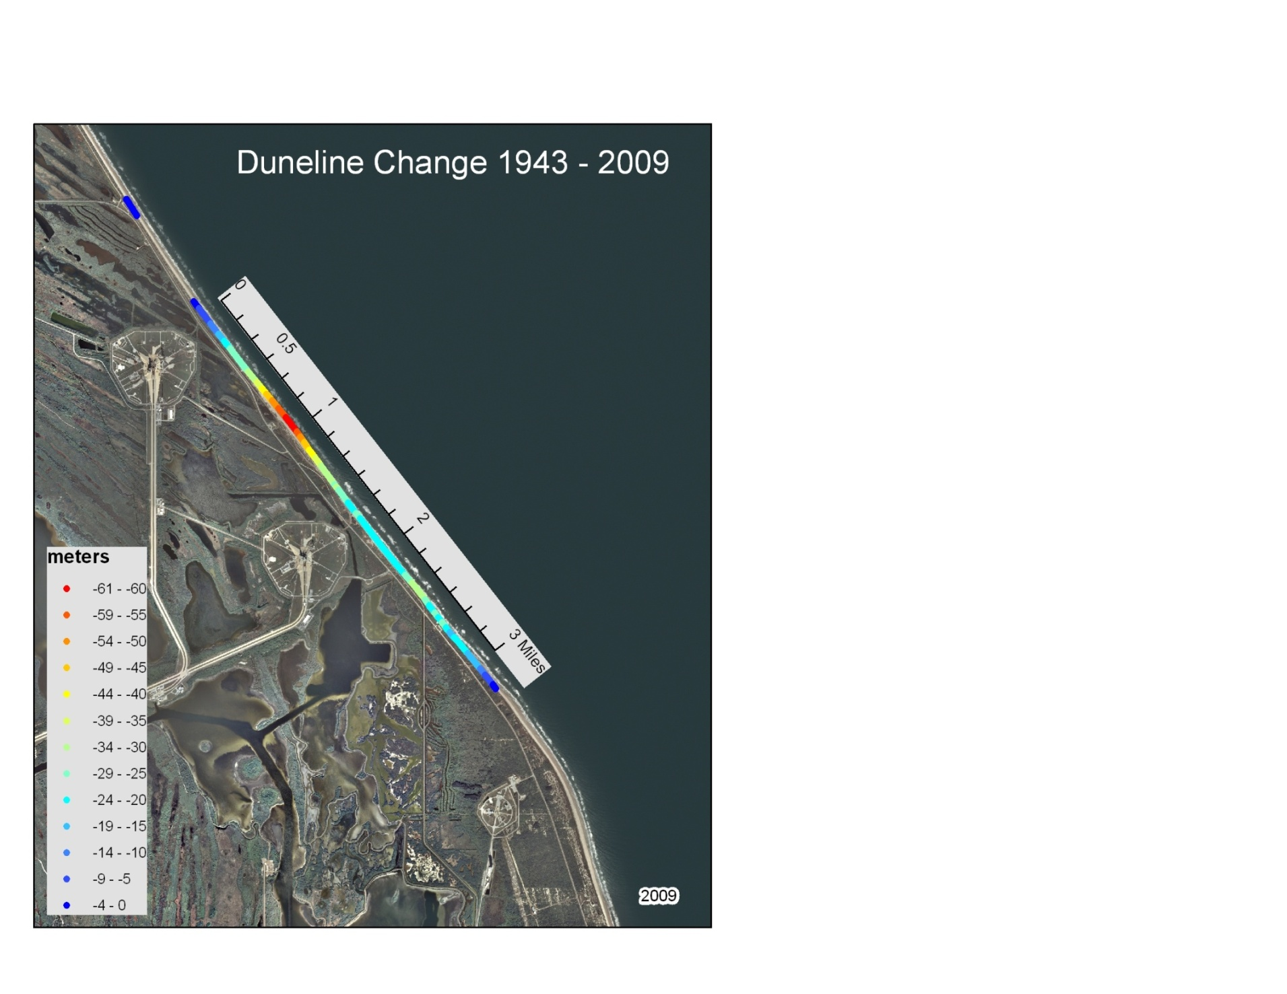
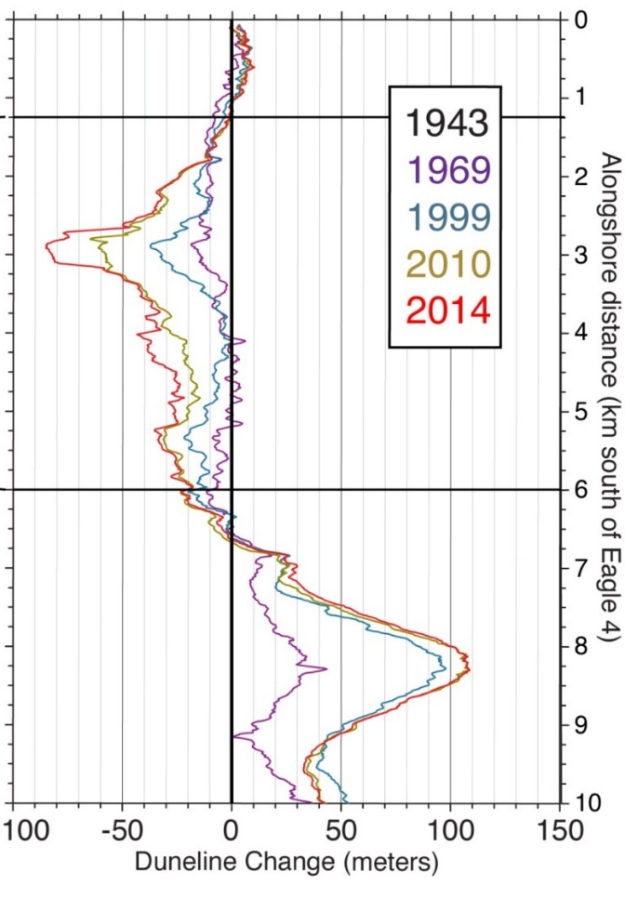

Why?
> 300 ft recession of the shoreline since 1943
2020

Slide 4
Recent Shoreline History
1999 Hurricane Floyd - lost 50 ft of shoreline
2004 Hurricanes Charley, Frances, Jeanne - dune breached
2005 Restoration of primary dune
2007 Nor’easter offshore for two weeks - dune breached
2008 Tropical Storm Fay
2008 Restoration of primary dune

Slide 5
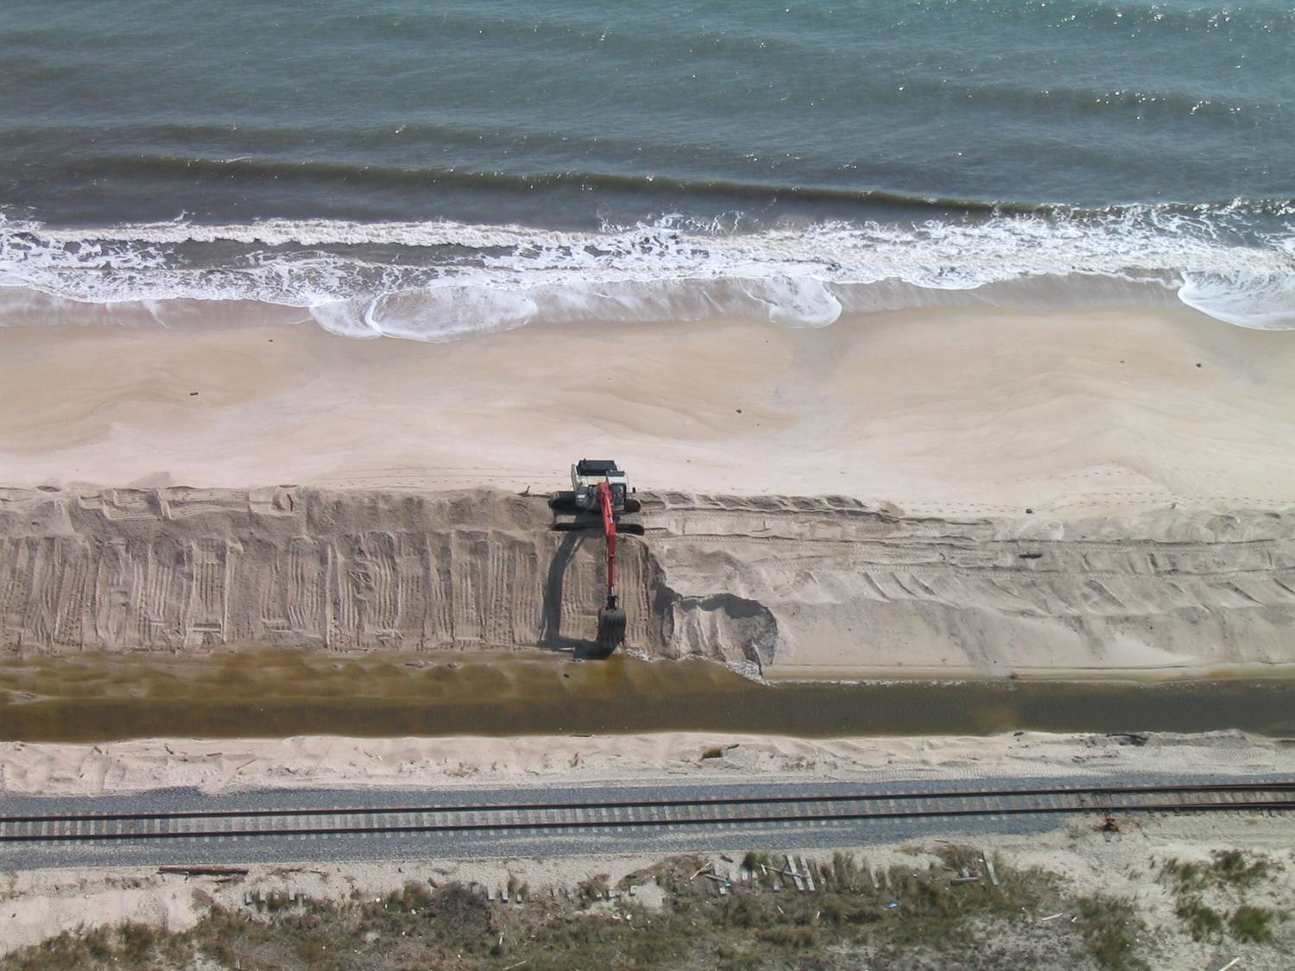
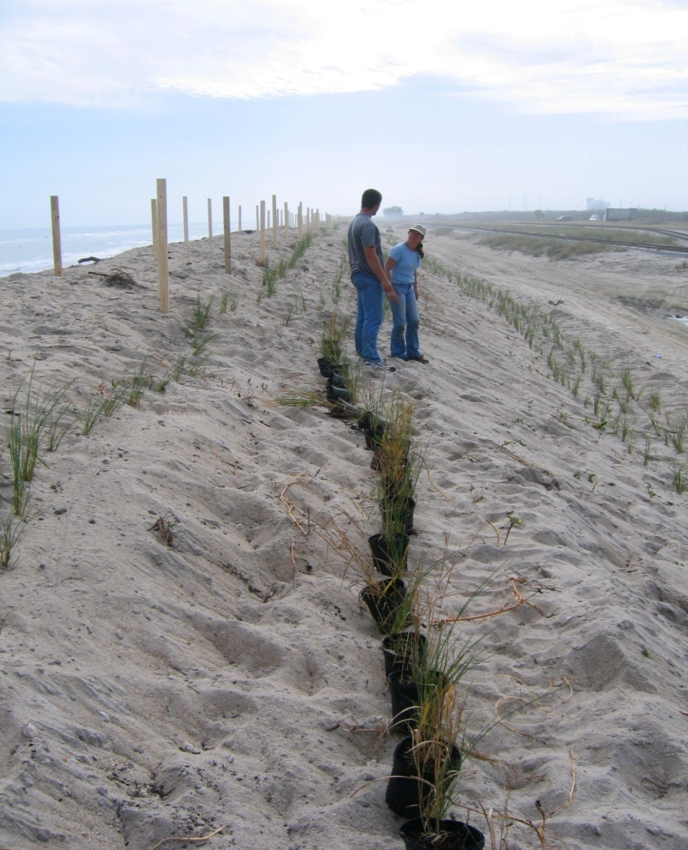
Previous Restoration Efforts

Slide 6
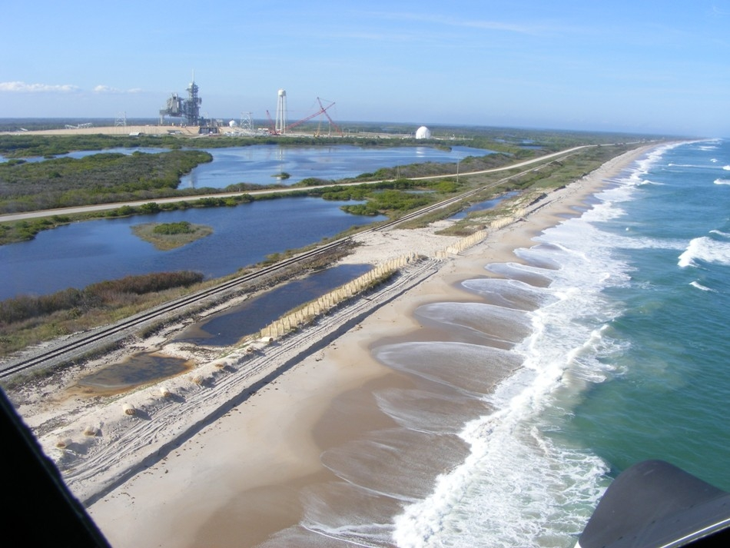
Washover

Slide 7
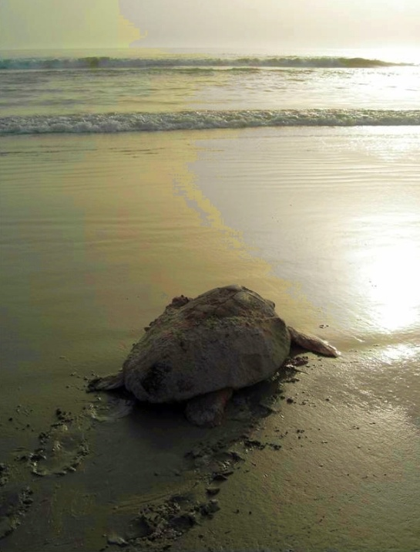
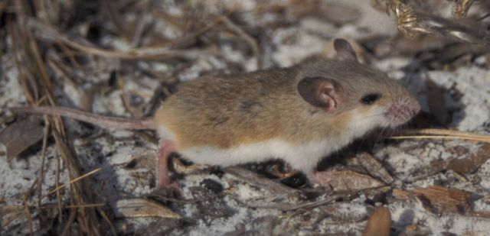
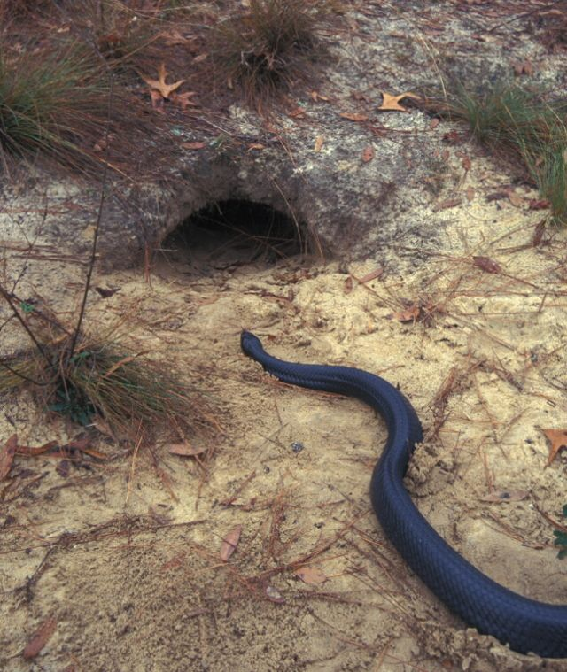
Being threatened:
Millions of $ of space-related facilities and infrastructure that are currently being refurbished and used for the next generation of space exploration
Large expanse of relatively undisturbed (by humans) coastal habitat that supports several federally protected wildlife species.
What to do????

Slide 8
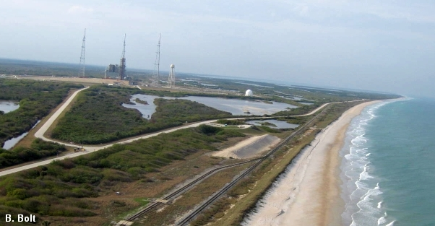
Inland Dune Creation
(aka “Managed Retreat”)

Slide 9
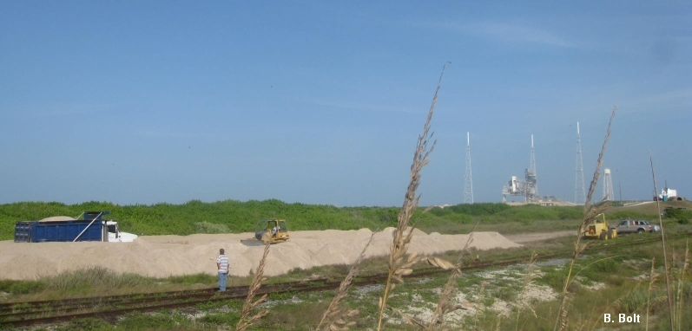
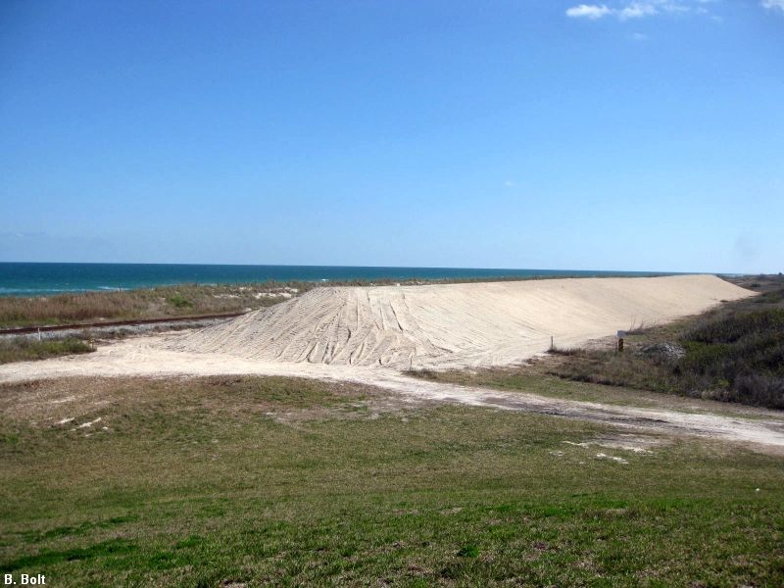
Pilot Dune
A Cooperative Experiment between NASA,
U.S. Air Force, and U.S. Fish & Wildlife
30,000 cubic yards of free sand from Cape Canaveral AFS
755 ft long
85 ft wide
15 ft tall
Constructed between July 2010 and January 2011.

Slide 10
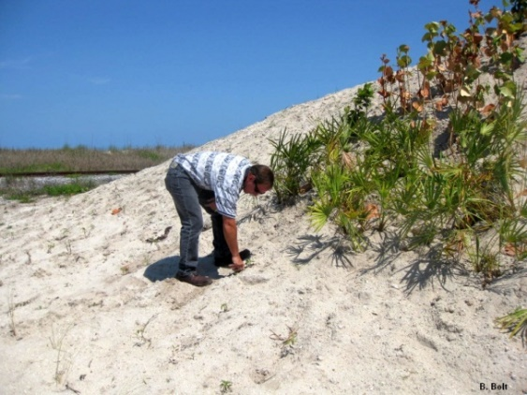
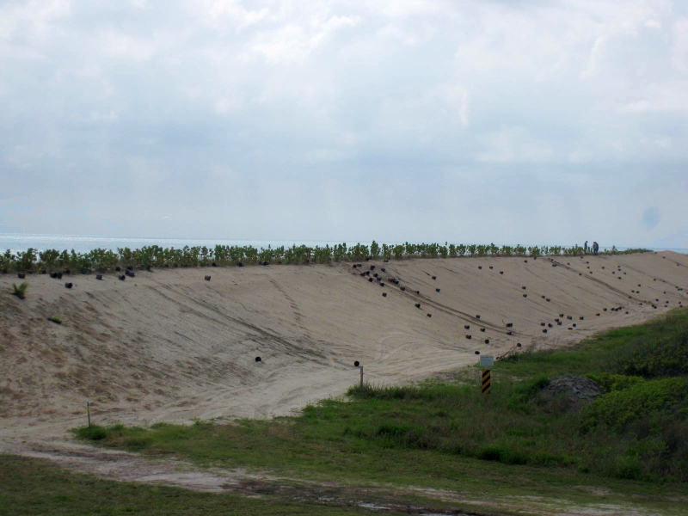
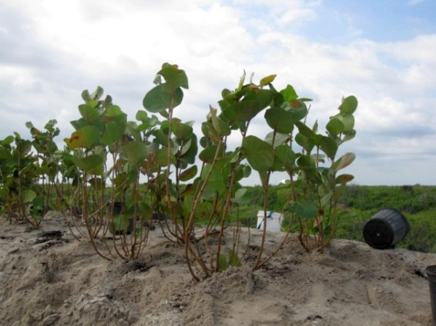
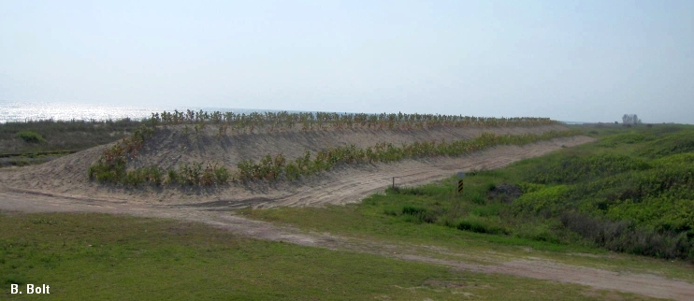
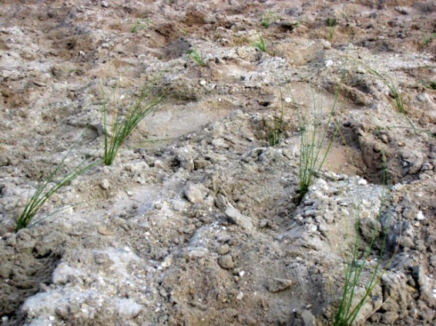
April 2011
16,000+ native plants

Slide 11
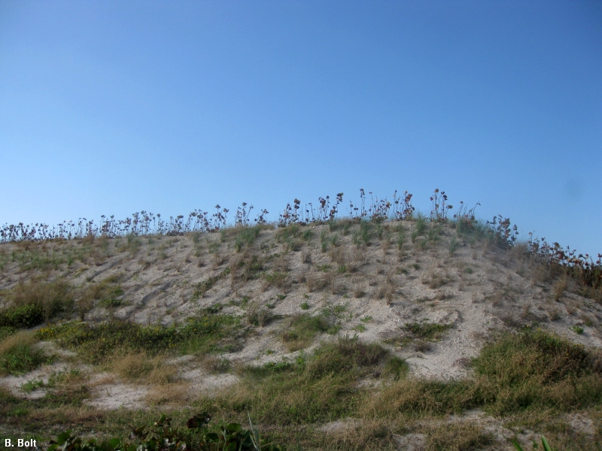
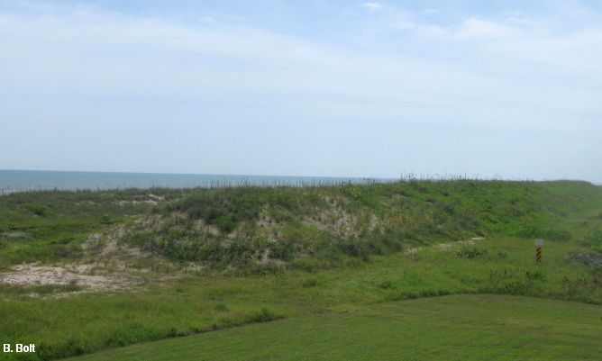
October 2011 (6 months)
August 2012 (16 months)

Slide 12
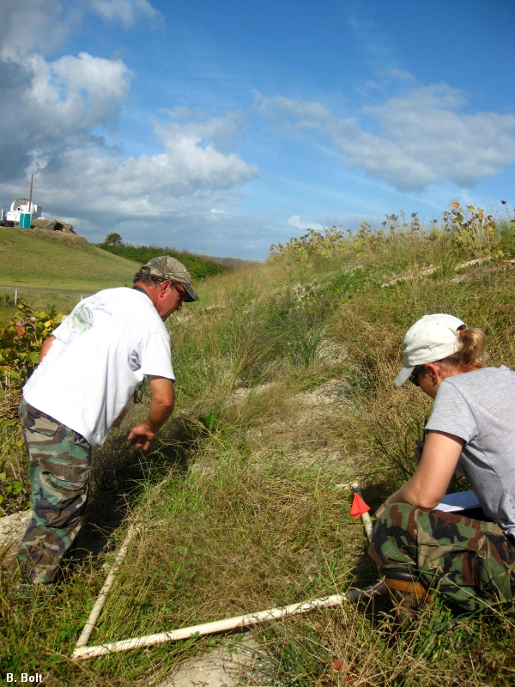
Vegetation Monitoring

Slide 13
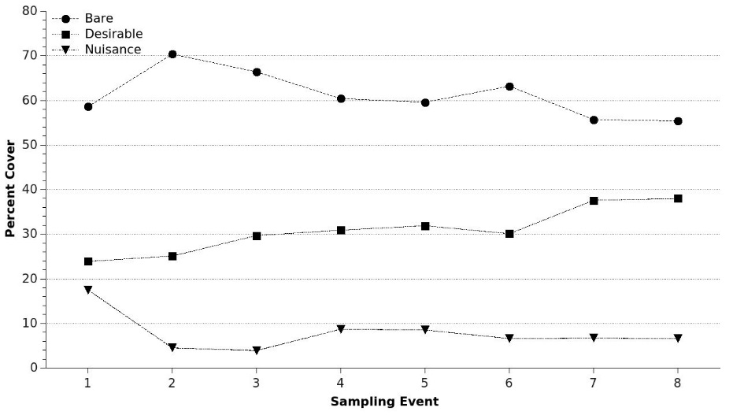
Results - Vegetation
Take home: Coverage of “good” plants increased over time and the coverage of “bad” plants decreased.

Slide 14
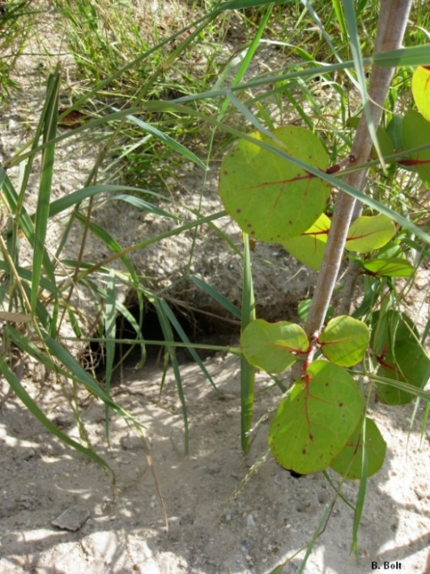
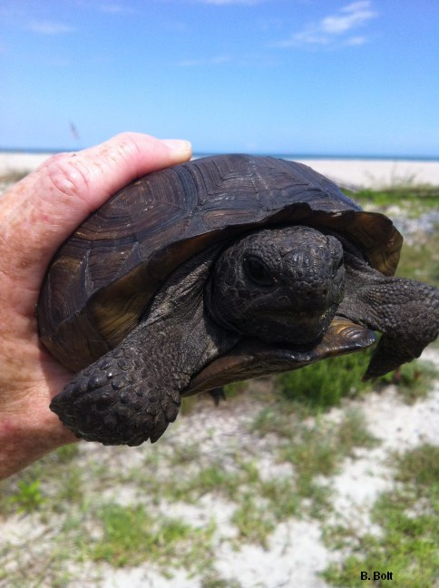
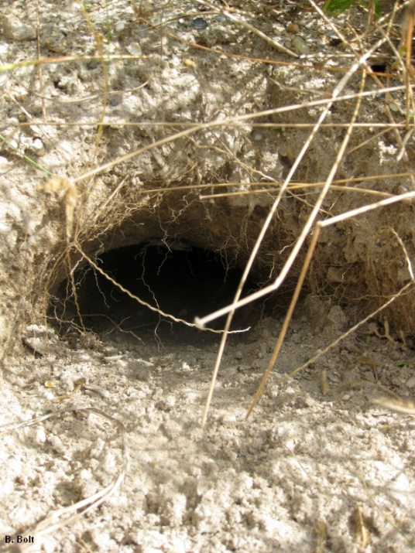
Results - Tortoises
Nov. 2011 and Feb. 2012: 3 burrows; all occupied
May 2012: 5 burrows; all occupied
Aug. 2012: 13 burrows; 5 occupied
Aug. 2013: 25 burrows; 11 tortoises
10 tortoises captured, measured, and marked

Slide 15
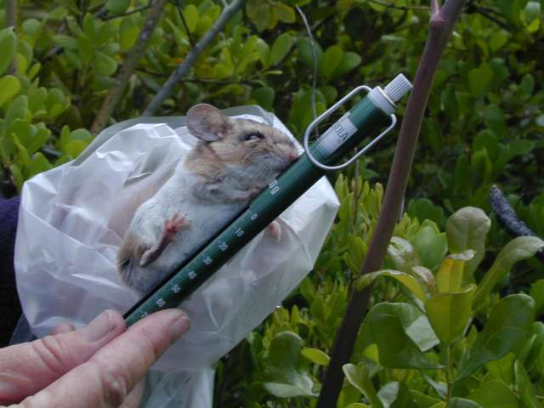
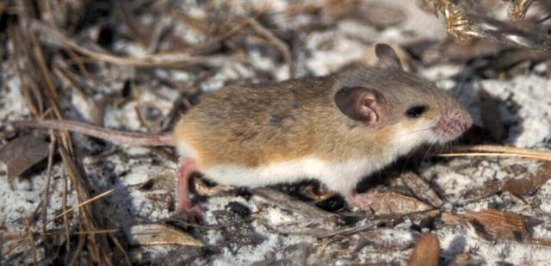
Results – Southeastern Beach Mice
Nov. 2011 – Aug. 2013:
72 different beach mice and 110 recaptures

Slide 16
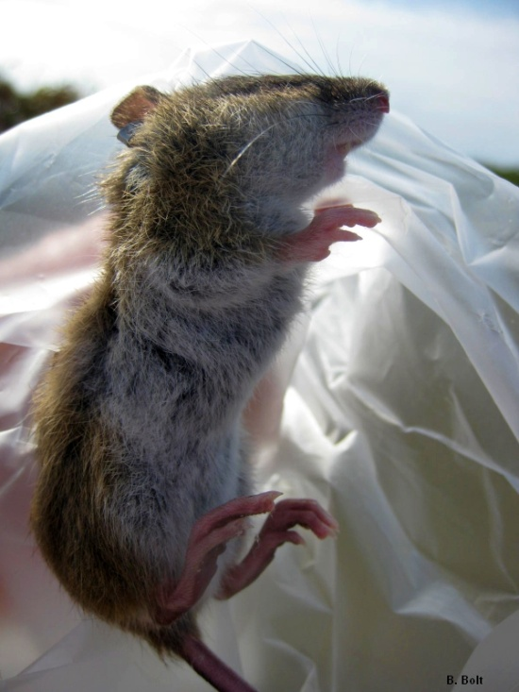
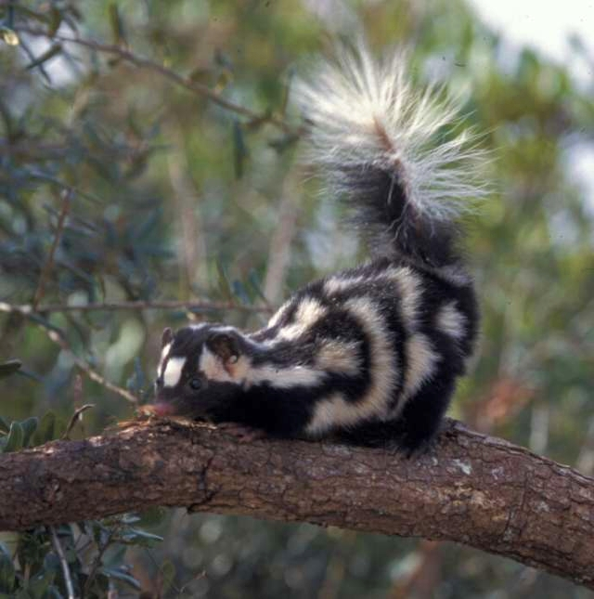
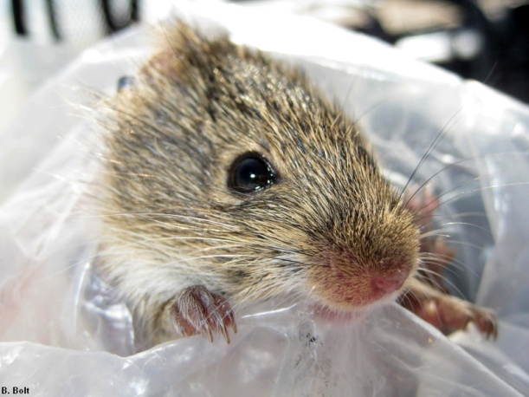
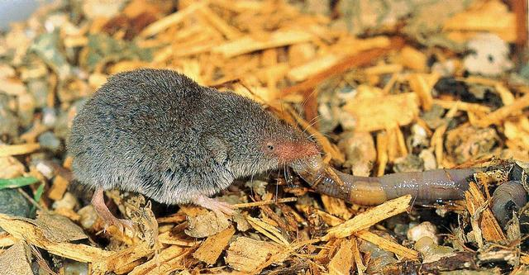
Other small mammals captured:
Cotton mice (7), Cotton rats (10), Spotted skunks (6), Least shrew (1)

Slide 17
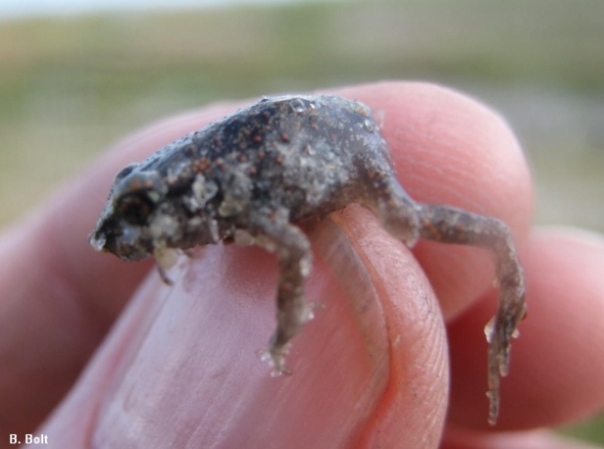
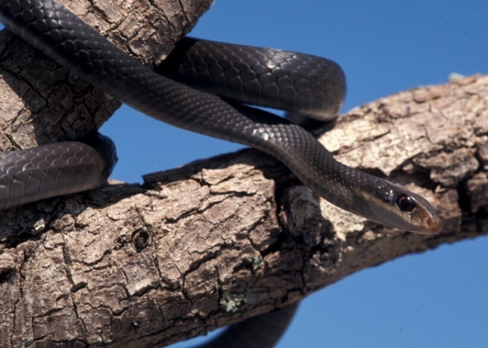
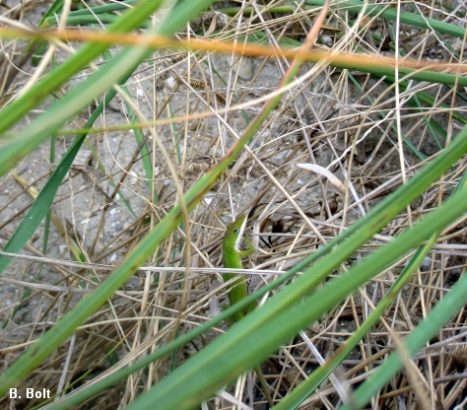
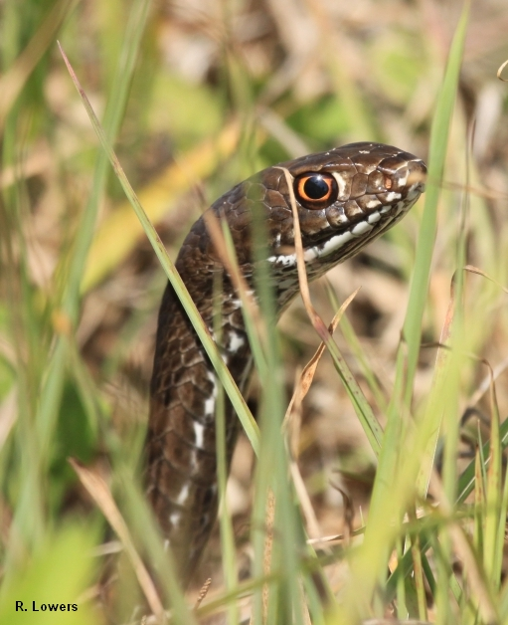
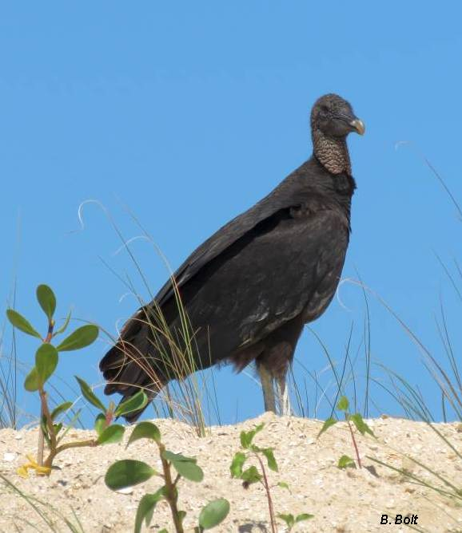
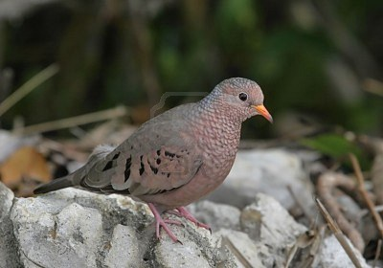
Incidental Observations

Slide 18
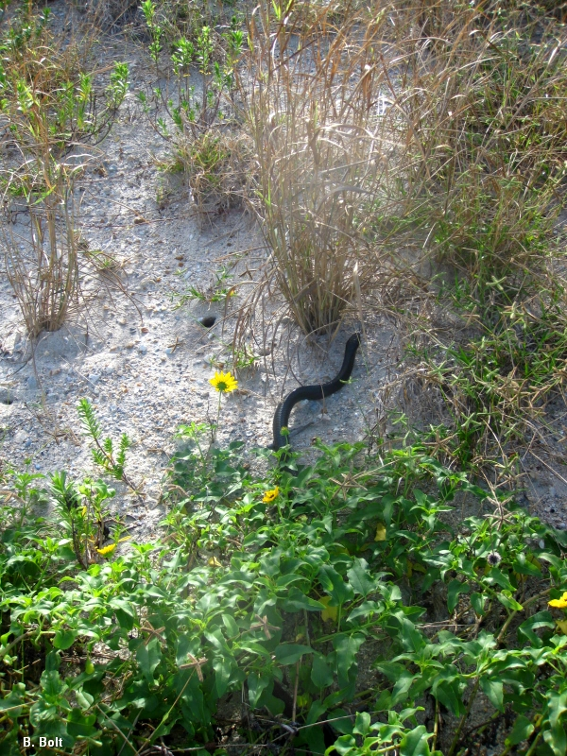
Eastern Indigo Snake
Female
4 ft total length
PIT tagged

Slide 19
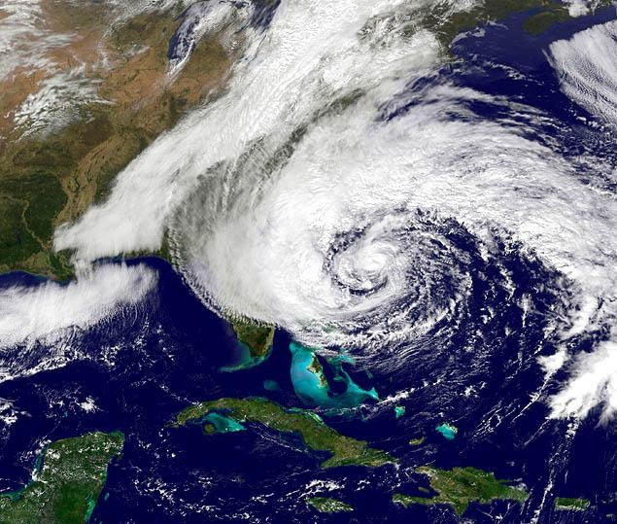
Hurricane Sandy – Nov. 2012

Slide 20
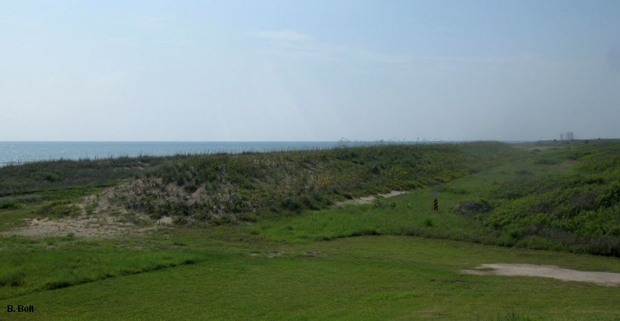
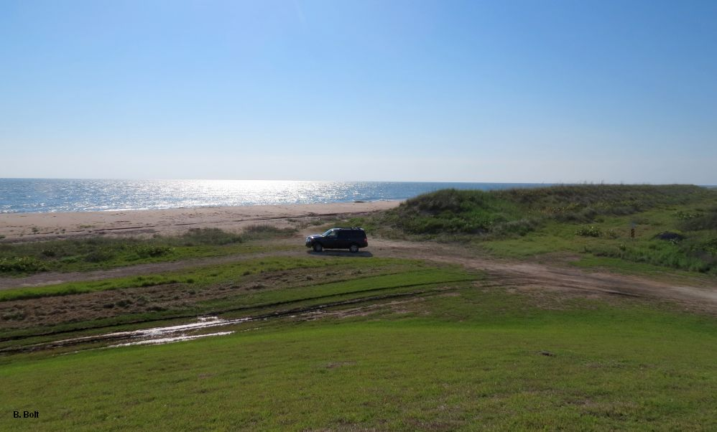
Before Sandy
After Sandy

Slide 21
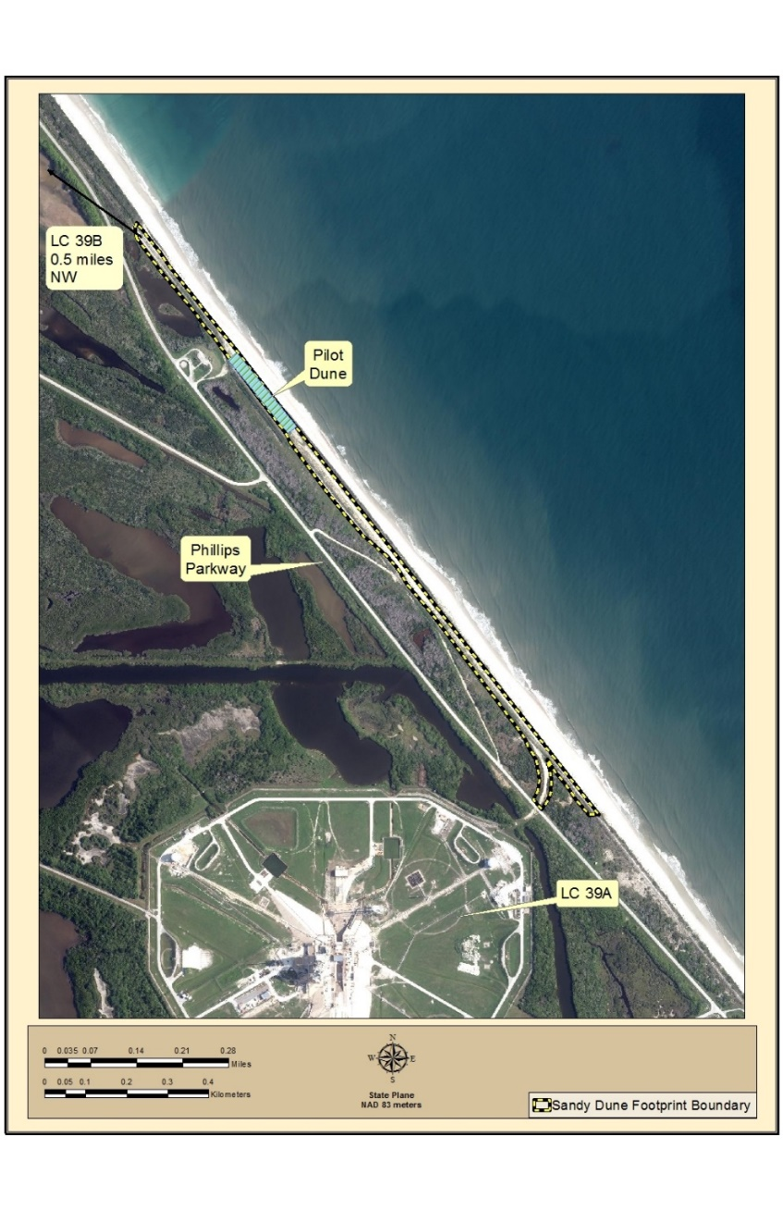
Extent of Sandy Dune

Slide 22
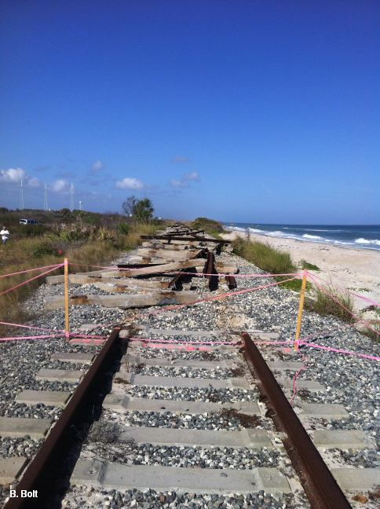
Preconstruction
Rail Removal

Slide 23
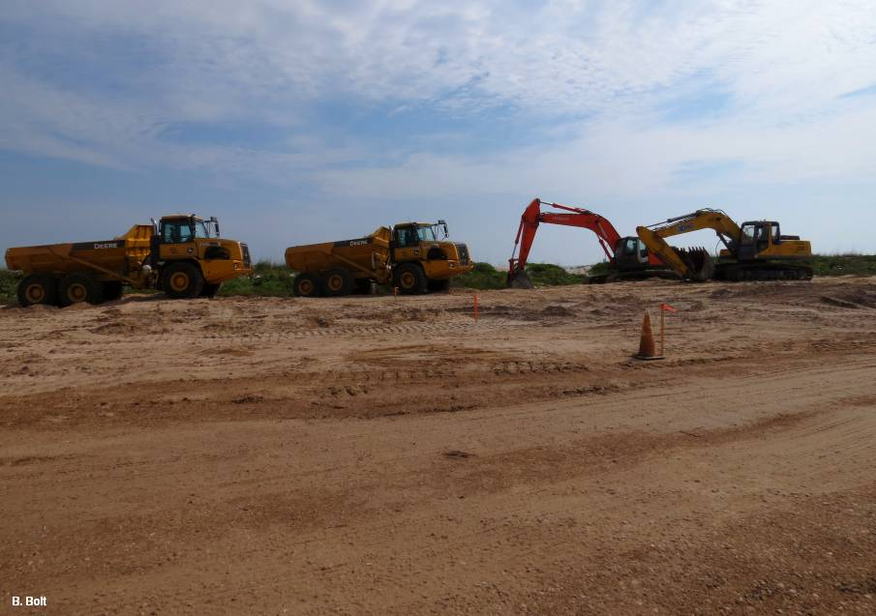
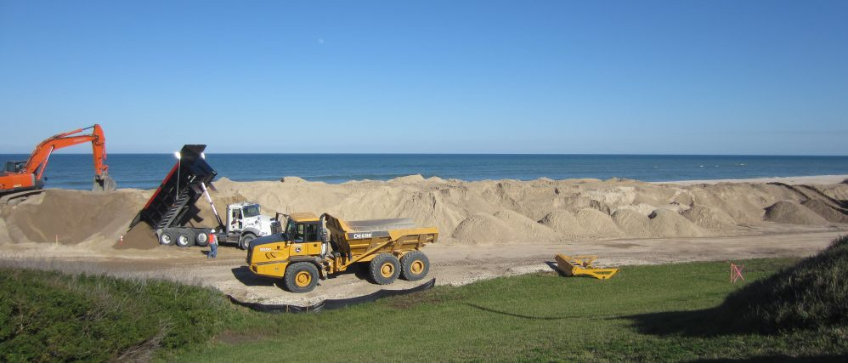
106,000 cubic yards of sand
1.1 mi long
30 - 60 ft wide
12 ft tall
Constructed 2013/2014

Slide 24
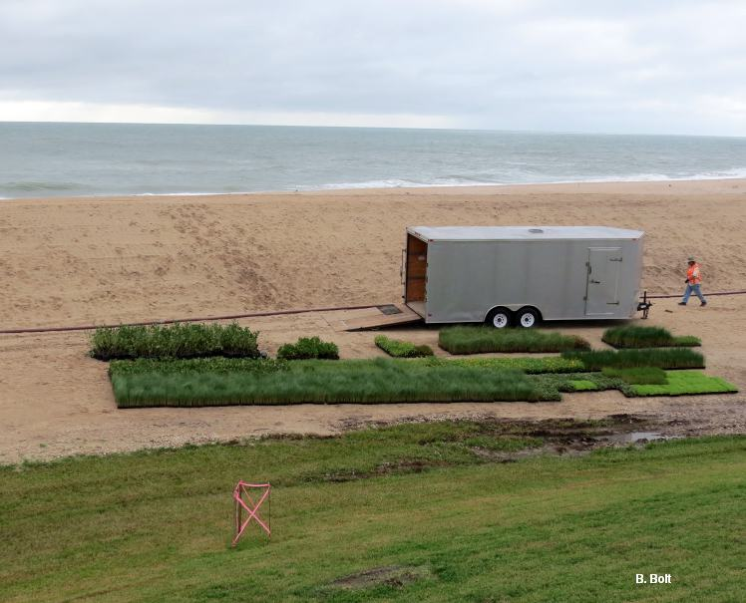
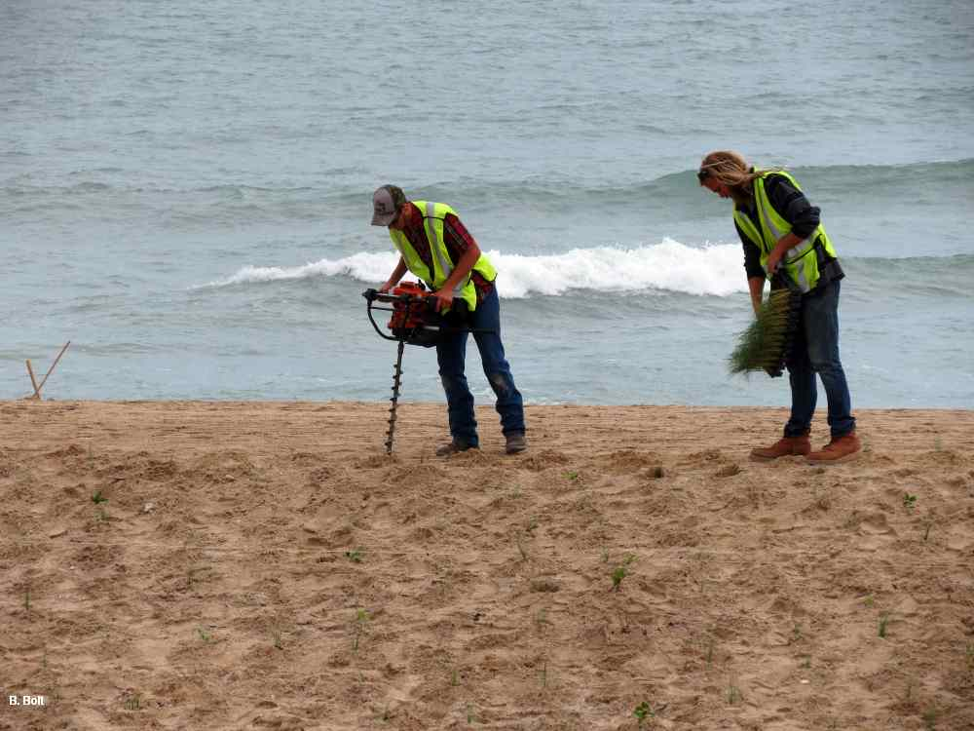
180,000 native plants
23 different species

Slide 25
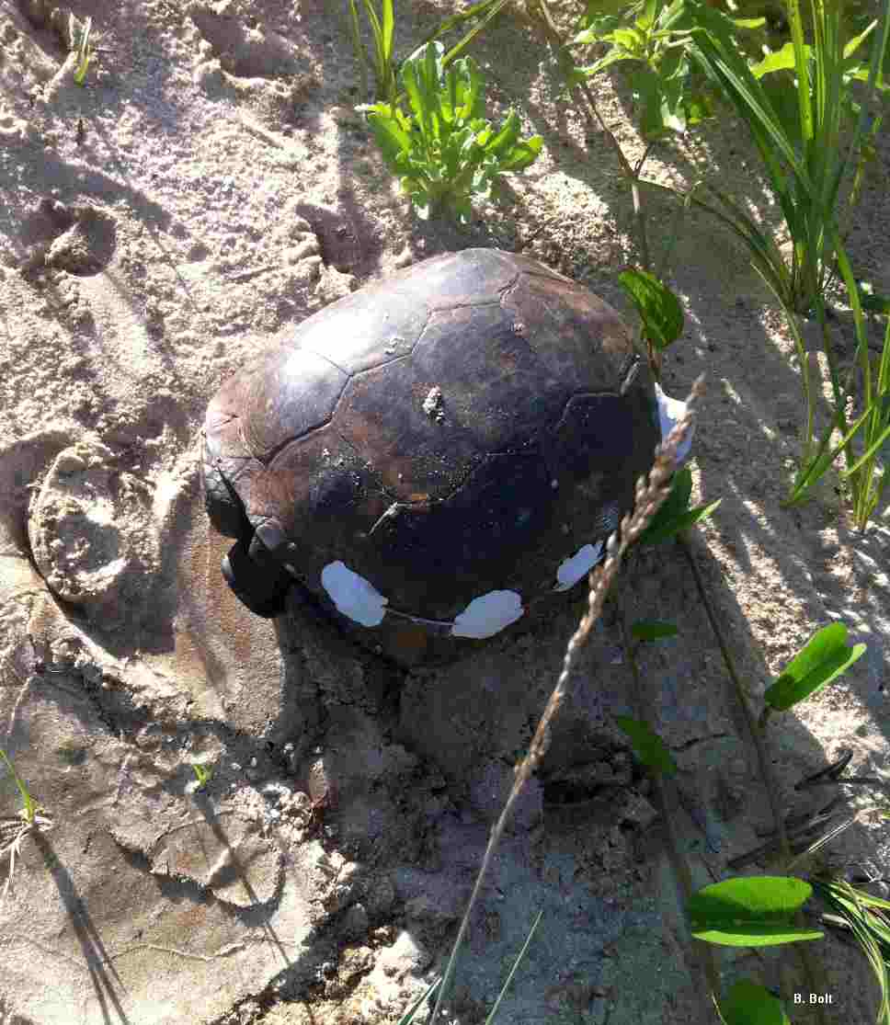
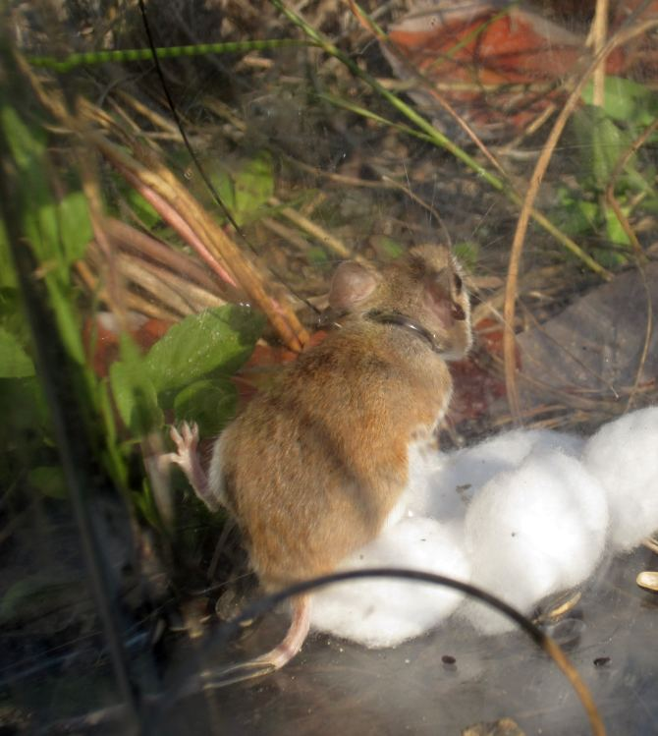
Radiotracking

Slide 26
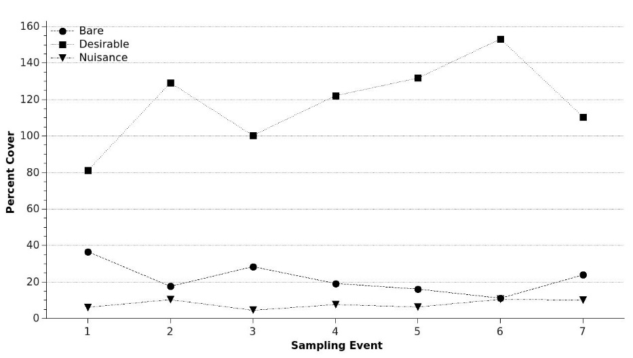
Results - Vegetation

Slide 27
Tortoise Monitoring Results
Three months before there were burrows on the dune
Lots of tracks and feeding on the dune from the beginning
Home range sizes were comparable to those further inland
Tortoises/acre were highest on the pilot dune, followed by the Sandy dune, lowest on the adjacent natural dunes

Slide 28
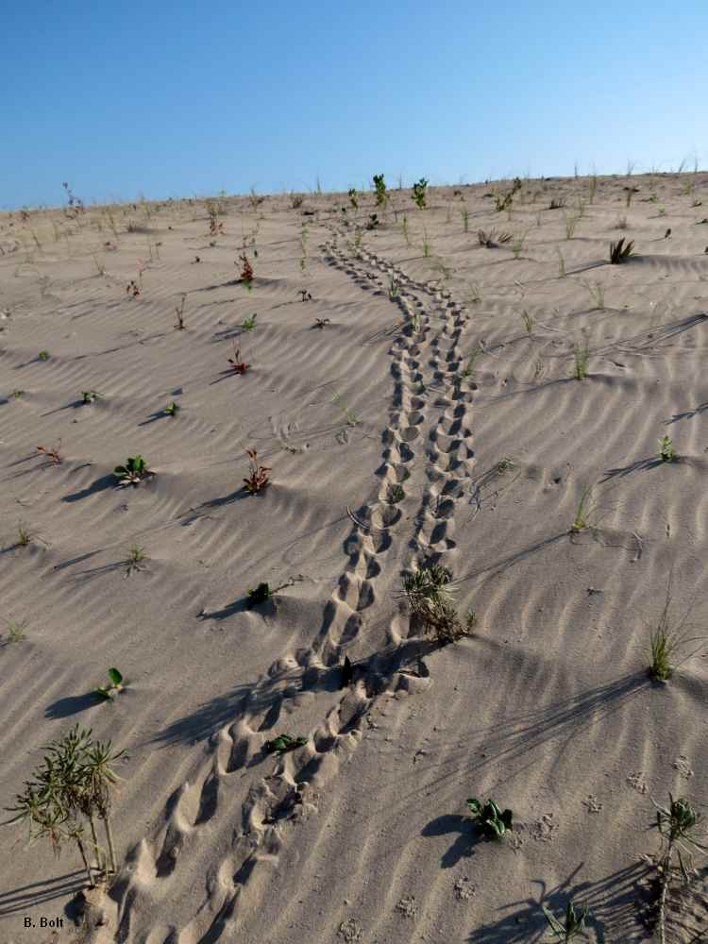

Tortoise Use of the New Dune

Slide 29

Mouse Radiotracking and Trapping Results
Used dune very quickly
Crossed back and forth over the dune
More than one mouse in a single burrow
More than one mouse using a burrow at different times
Female moved 547 yds in two nights

Slide 30



Reptiles Use of a Created Dune versus a Natural Dune

Slide 31




Camera Array Pictures

Slide 32

Hurricane Matthew – Oct. 2016

Slide 33

Sandy South
Pilot
Sandy North

Slide 34

Washover

Slide 35

Matthew Dune
March 2018 – March 2020
3.6 miles

Slide 36

Hurricane Dorian – Sep. 2019

Slide 37

Eastern Face Erosion

Slide 38

Dorian Restoration
March – April 2021
2,000 feet

Slide 39

Working Ahead of the Restoration

Slide 40
Take Home Message
While it will not prevent the shoreline erosion caused by storms, dune creation and restoration has proven to be an effective strategy for simultaneous protection of NASA assets and conservation of important wildlife habitat.

Slide 41
Questions? mary.r.bolt@nasa.gov
The work was conducted under Integrated Mission Support Services, LLC,
Kennedy Environmental and Medical Contract # NNK16OB01C
and
Herndon Solutions Group LLC, NASA Environmental and Medical Contract # 80KSC020D0023.

