Slide 1
Trutinor:
A Next-Generation Earth Radiant Energy Instrument
Presentation at Hampton University
March 24, 2021
Science Directorate (E302):
Cindy Young, PI, NASA LaRC
Patrick Taylor, Science PI, NASA LaRC
Constantine Lukashin, NASA LaRC
Engineering Directorate (D203)
Mike Cooney, NASA LaRC
Trevor Jackson, NASA LaRC
External partners:
Bill Swartz, APL
Rand Swanson, Resonon
Christine Buleri, Quartus Engineering
Joseph Shaw, Montana State University

Slide 2
Outline:
Science problem
Mission need
Requirements
Instrument design
Milestones and progress
Impacts of COVID-19
Path forward

Slide 3
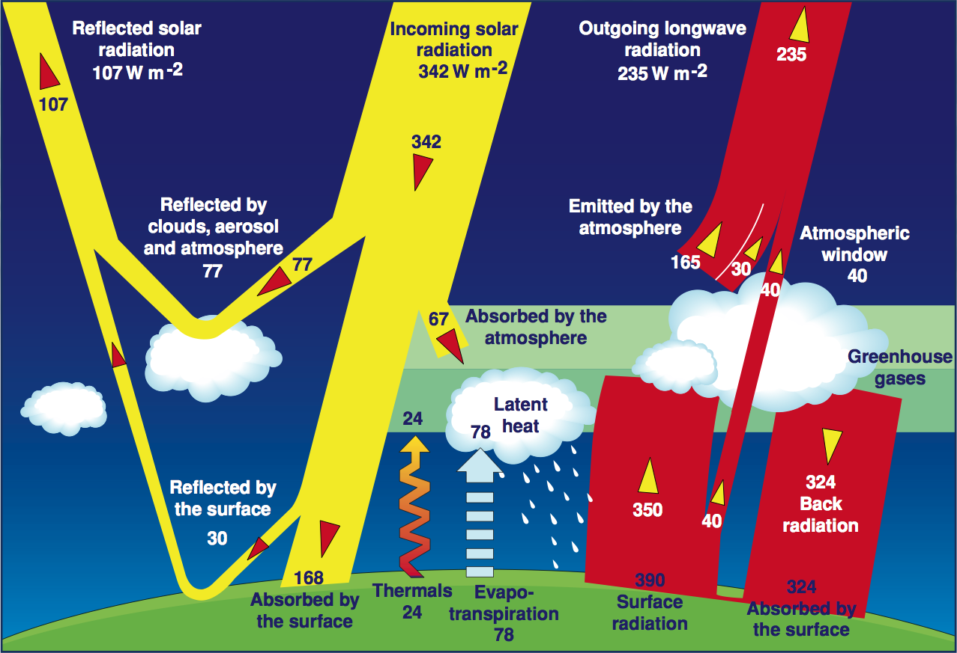
Earth & Atmosphere Energy System
Calculate top of atmosphere (TOA) Shortwave (SW ) and Longwave (LW) fluxes:
Fnet = Fdown – Fup
Ftotal = Fnet, SW + Fnet, LW

Slide 4
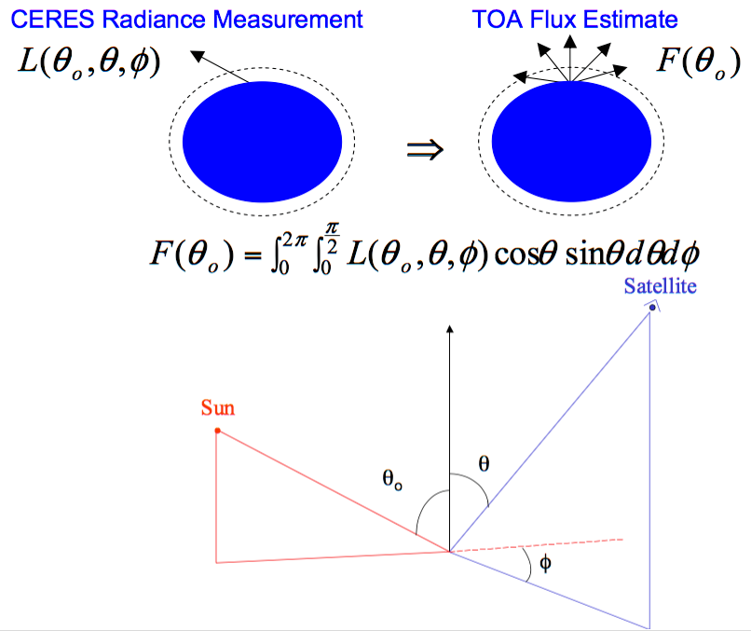
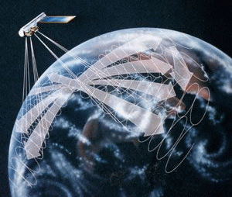
Flux inversion Requirements - ADMs
CERES data taking mode for ADMs:
Rotation Azimuth Plane (RAP)
ADMs are defined for every physical scene type

Slide 5
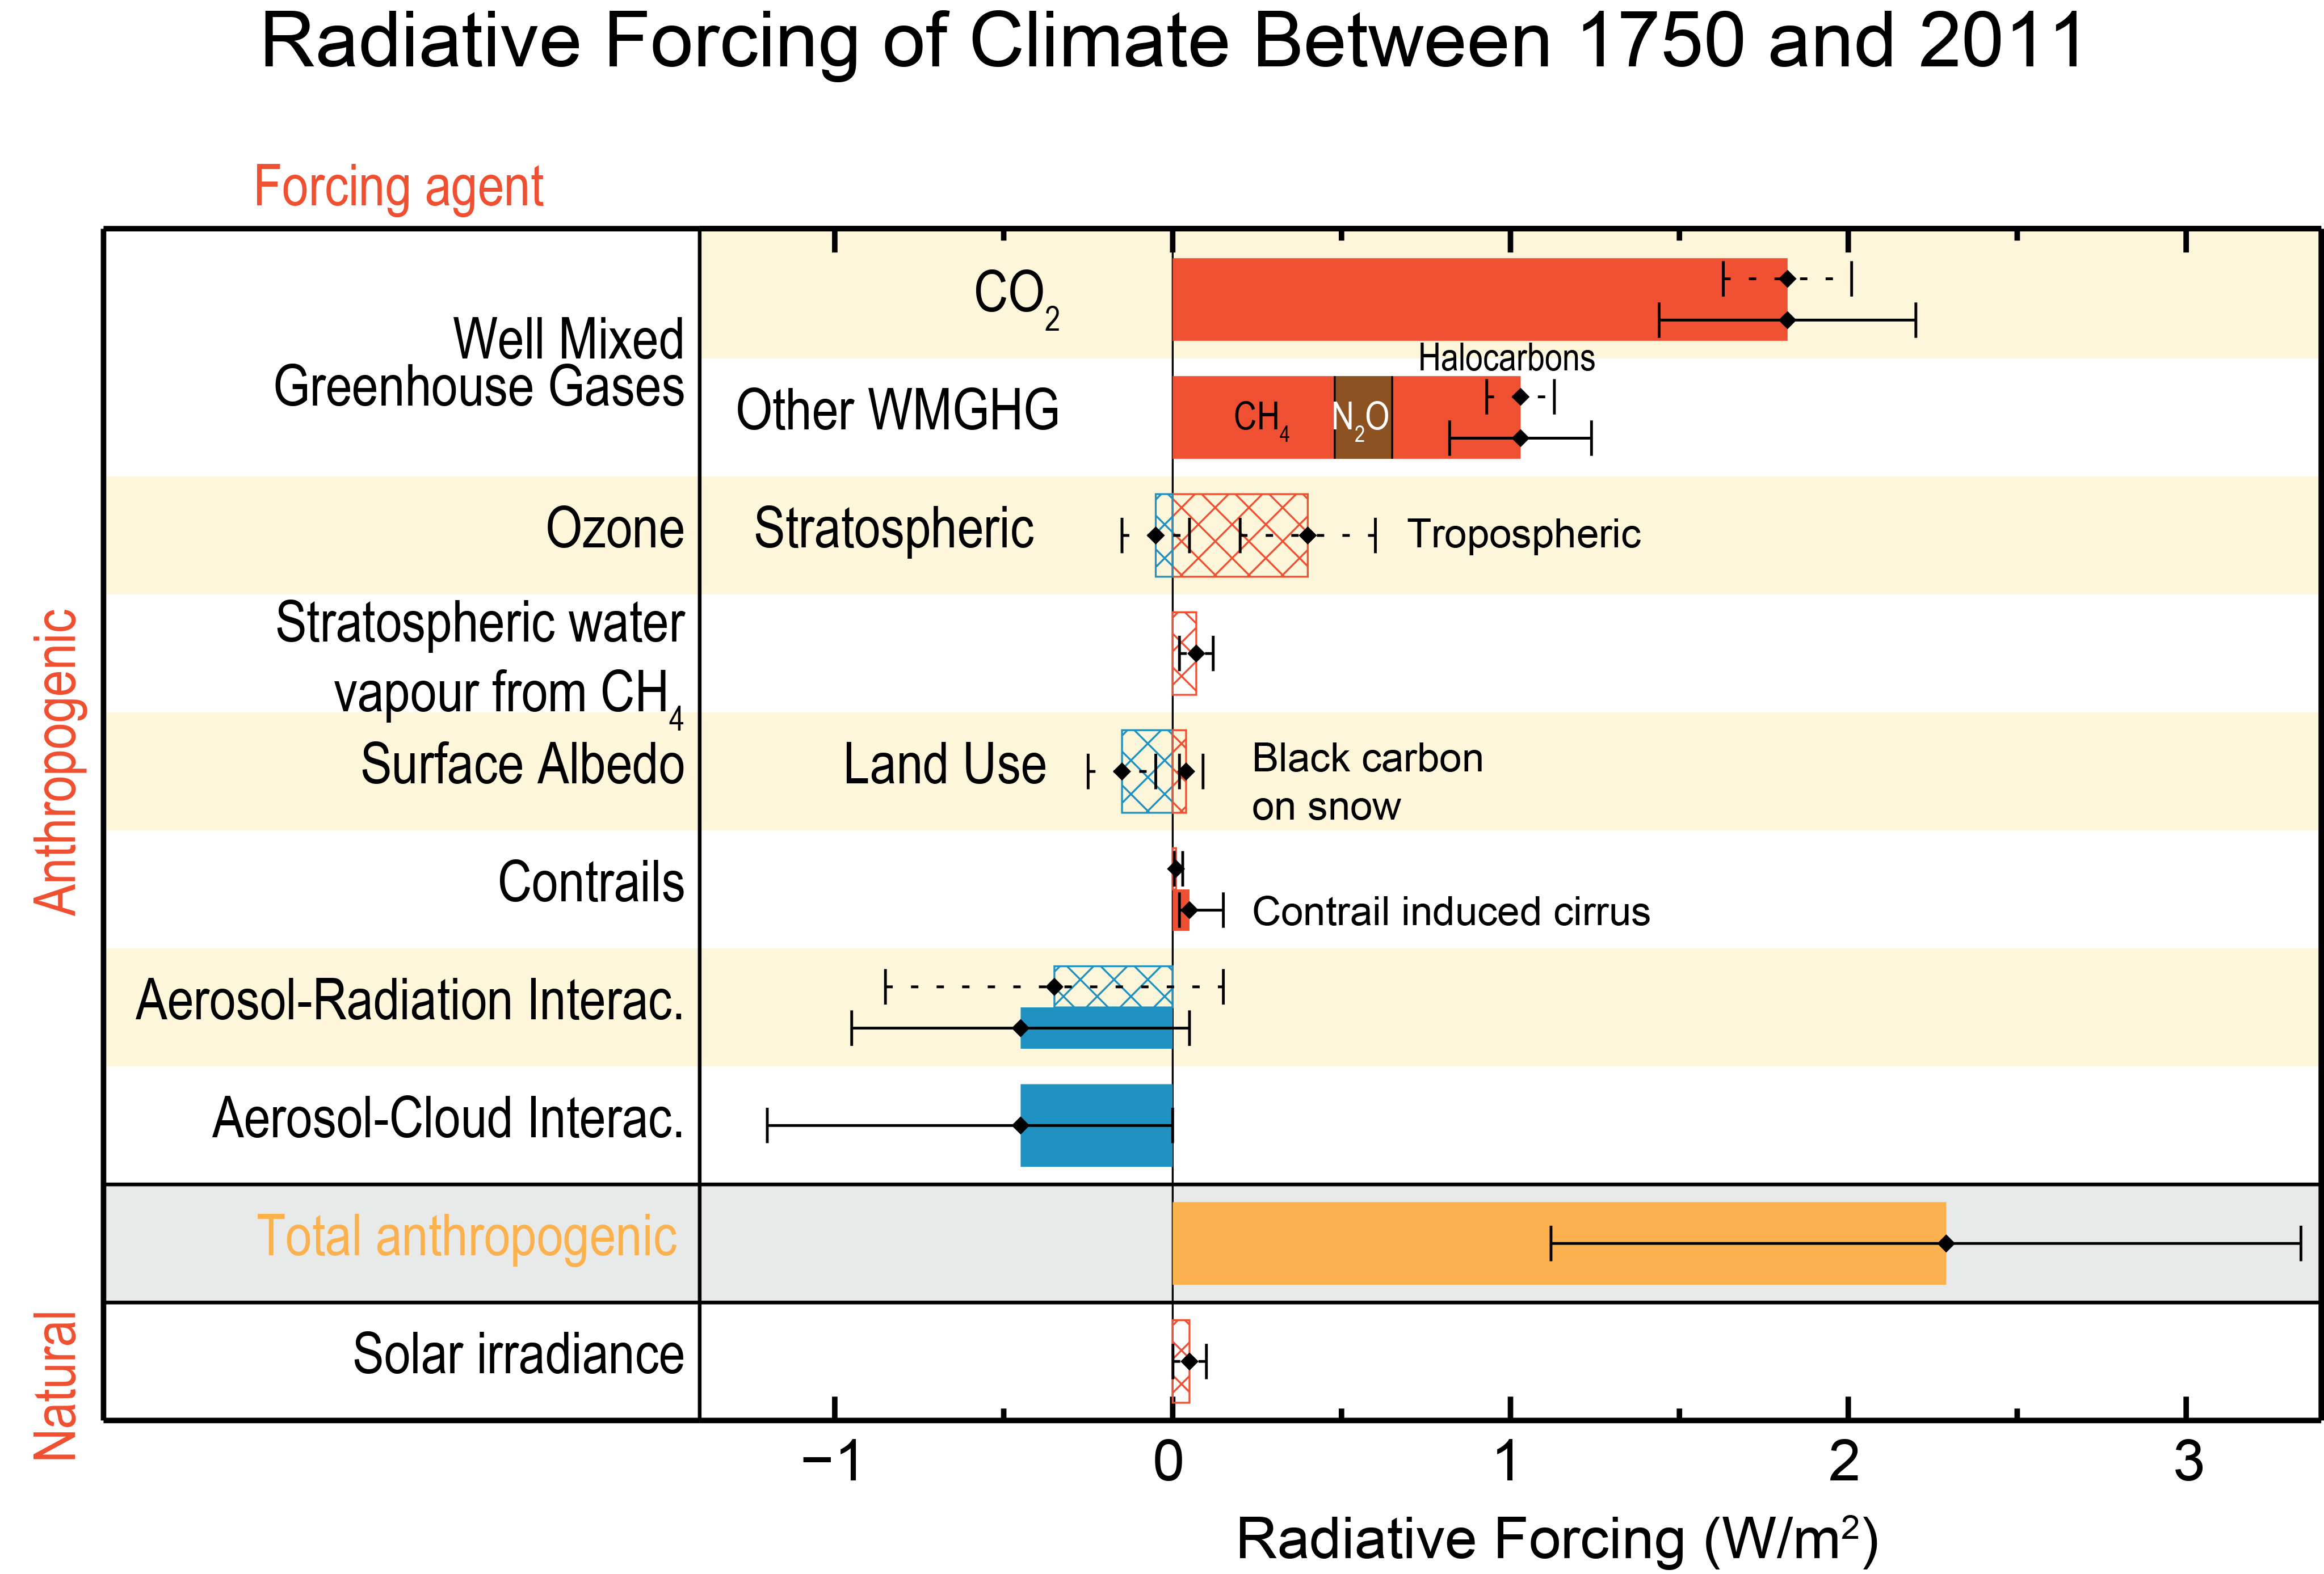
ERB data and Climate Change: Radiative Forcing
ERB data provides constraints on the climate forcing.

Slide 6
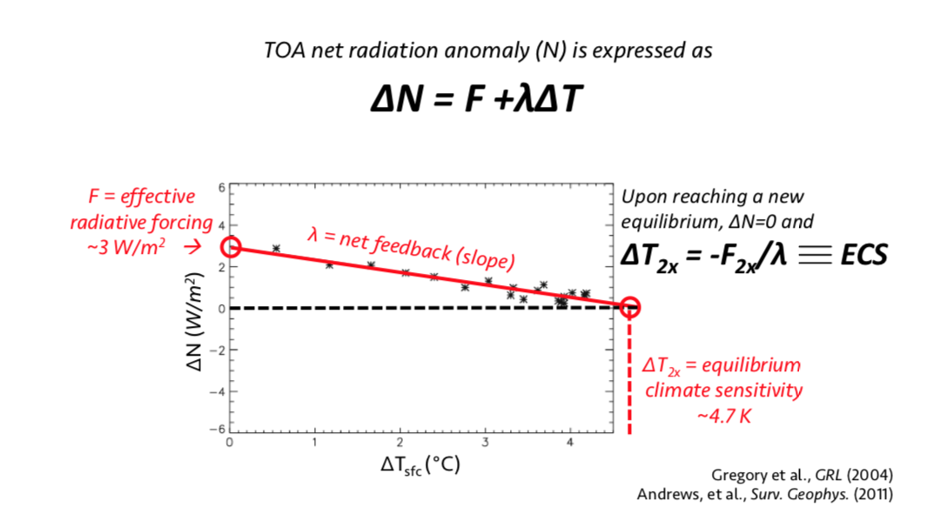
ERB data and Climate Change: Climate Sensitivity
The key question is...how much will the climate warm per unit increase in radiative forcing?
Sometimes referred to as the ”standard model for climate response and forcing”
Monitoring the TOA ERB necessary to use this approach to constrain climate sensitivity.
Notes:
Decadal rate of change in the clear-sky SW ADRE from CERES EBAF (top) and the GFDL AM3 model
(bottom). A positive (negative) trend indicates a decrease (increase) in the amount of radiation scattered
to space by aerosols. (From Paulot et al., 2018).

Slide 7
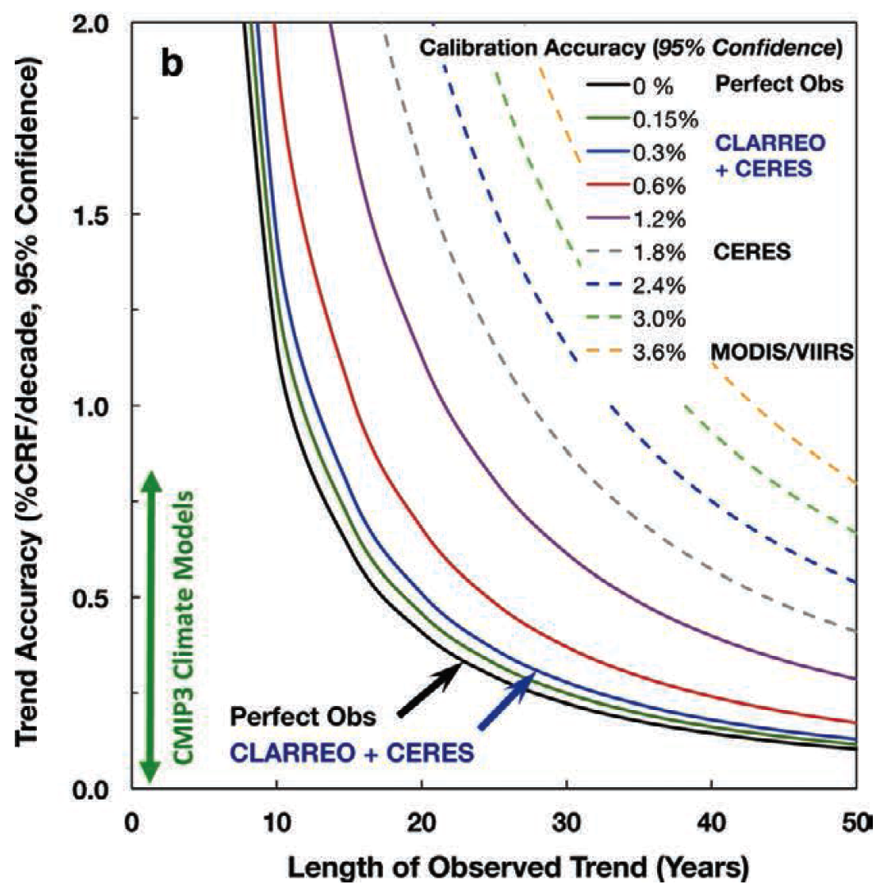
It takes a long time to detect a trend in the data record
Figure shows the quantitative impacts of observational accuracy on the ability to detect trends for climate variables (Shea et al., 2017). Wielicki et al (2013)
As the accuracy of observing system increases, the time to detect a trend decreases

Slide 8
Long-term ERB Vision:
The science and societal implications dictate the need for a continuous ERB climate data record from now into the foreseeable future.
A gap would produce an irreparable effect (at least in our lifetime) on climate science.
Current approach is costly.
Trutinor Philosophy:
Enable a >100-year long, continuous ERB climate data record capable of resolving the key outstanding challenges in climate science (climate sensitivity, cloud feedback, and aerosol forcing) while providing a foundation for the next generation of climate scientists to pose new questions, through a sustainable, cost-effective instrument.
Continuously update design as new technologies become available
Design a highly accurate instrument to make the measurement as robust as possible against gaps.

Slide 9
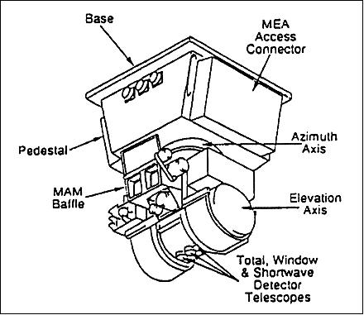
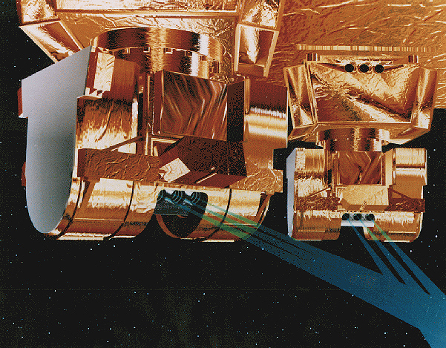
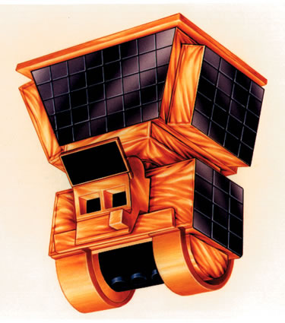
CERES Instruments
CERES instrument layout
CERES/RBI instrument layout is driven by accommodation requirements for Terra/Aqua/NPP/JPSS-1

Slide 10
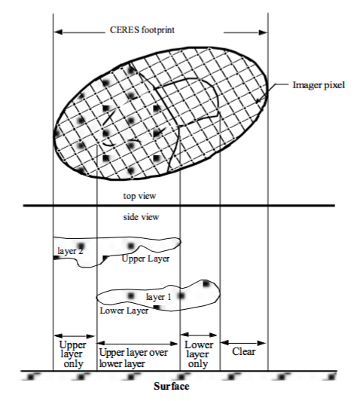
CERES and Imager Measurements
SPATIAL:
Near simultaneous measurements of CERES and Imager
CERES FOV = 20/25 km at nadir
(10 km on TRMM)
Imager pixel = 1 km
(4 km for VIRS/TRMM)
SPECTRAL:
CERES is broadband
Imager is spectral multi-bands

Slide 11
Mission Constraints
Orbit maintenance and accurate pointing
Ability to obtain imager information either by:
  flying on the same bus or
  in near-coincidence (~3 minutes, TBD)
Measurement accuracy at least as good as for CERES
ADM data collection (multi-angular sampling)
Optimized (low) mission cost
Free-flying satellite

Slide 12
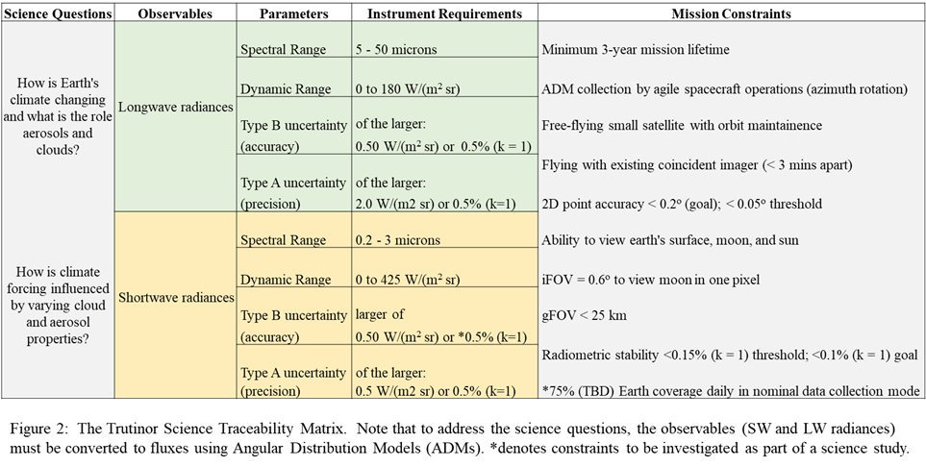
Trutinor Science Traceability Matrix

Slide 13
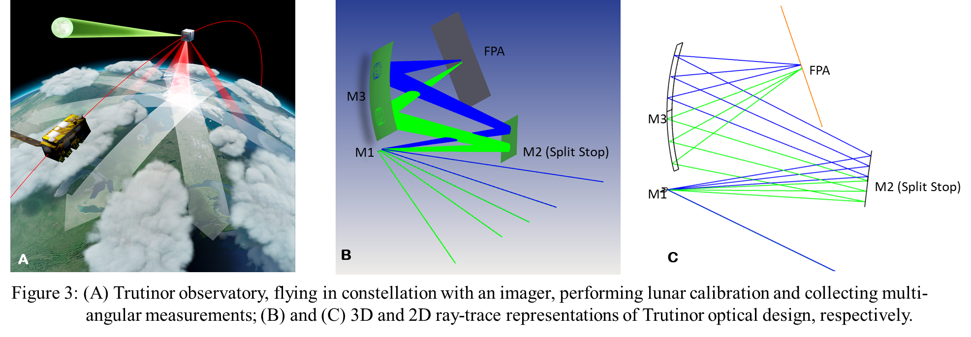
Instrument design
Notes:
Combine two channels with one optical train. Two focal points on detector; split mirror. 2 different rows on the detector.

Slide 14
Calibration Options: Shortwave
Internal Sources, like CERES, OMI:
- Lamps, current controlled (OMI)
- Lamps, PD monitored (CERES)
Vicarious Sources, primary deserts: Lybia-4, Rail Road Valley
Solar Diffuser, like CERES:
- No solar diffuser monitor, fast degradation
Solar Diffuser + Solar Diffuser Monitor, like MODIS/VIIRS/MISR:
- Can achieve 3% accuracy
Direct Solar Views with Aperture (0.5mm), like HySICS
- To be demonstrated
Direct Lunar View with the same optical path
- SeaWIFS has best results for relative calibration at 0.12% over 12 years
Direct Lunar View with the same optical path
- Absolute calibration to be established by ARCSTONE

Slide 15
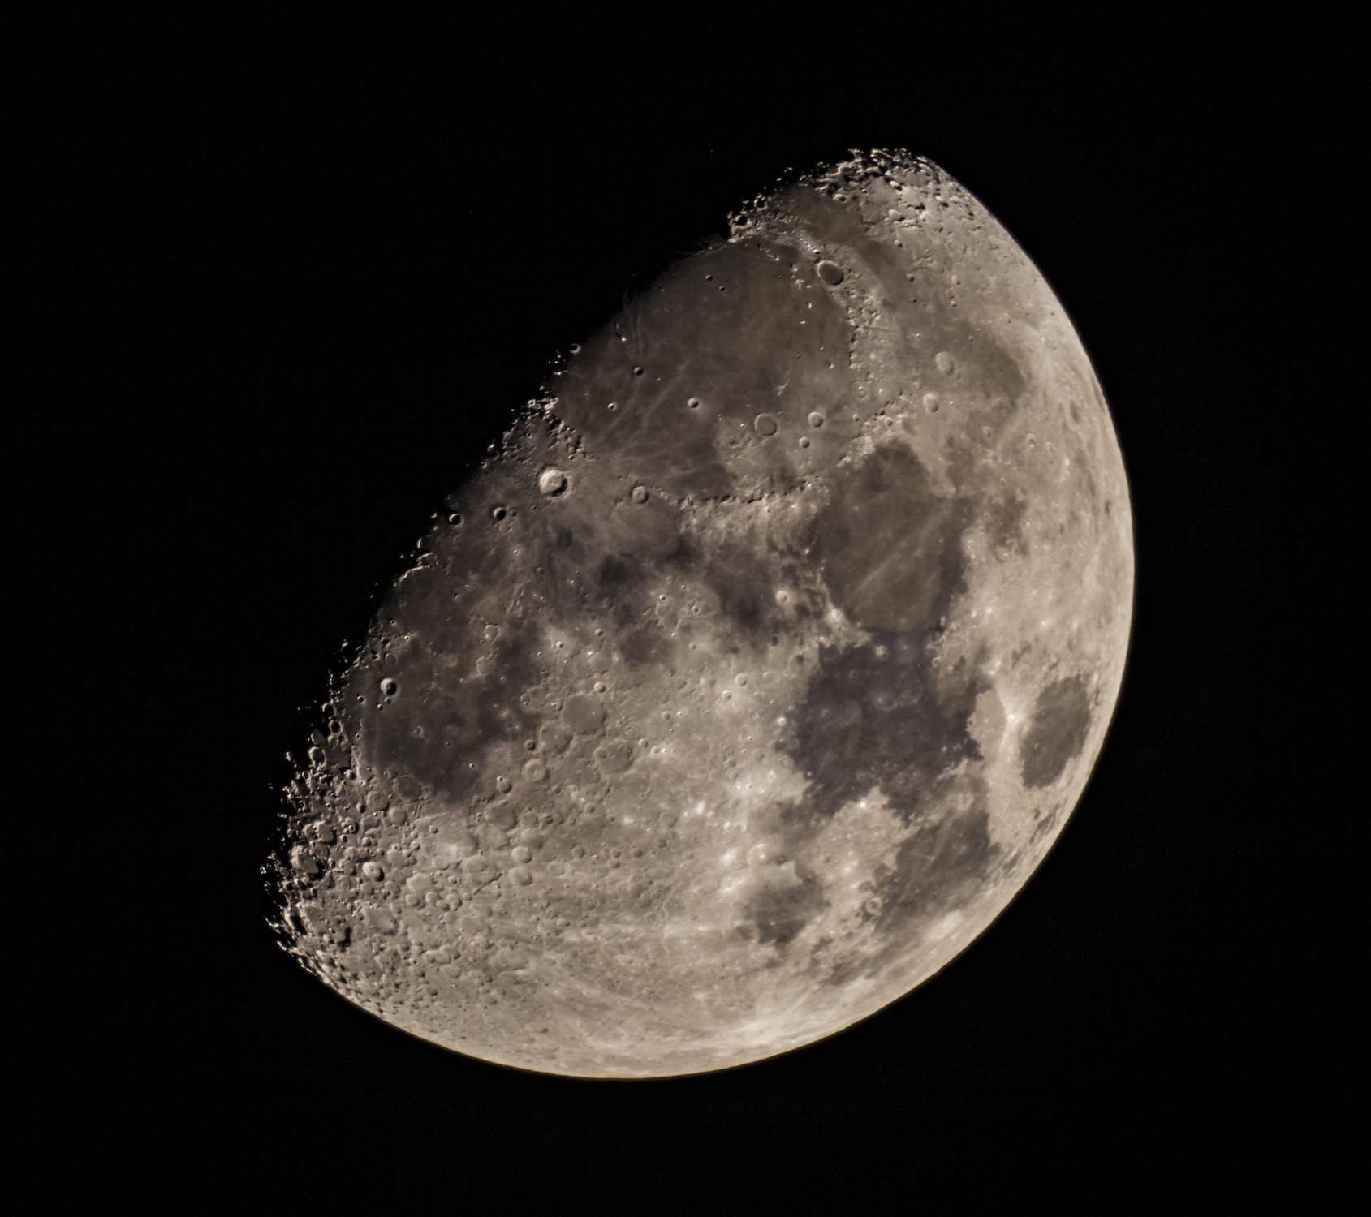
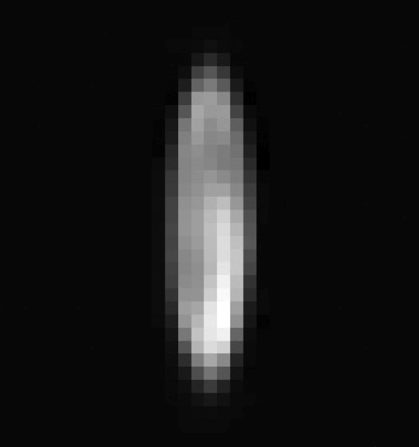

Moon: Potentially Accurate Source for Calibration On-orbit
Measurement accuracy is directly related to the information content of the dataset. Measurement accuracy is critical to EOS! Current EOS cannot handle data gaps. Need overlapping observations: CERES, MODIS/VIIRS, Landsats, PACE/SeaWIFS, etc.
Calibration reference: Lunar Spectral Irradiance (entire disk)
SeaWiFS gain stability: 0.13% (k=1) over 12 years
Accuracy of current Lunar Model (ROLO): 5 – 10%
On-Orbit Calibration Need:
Absolute accurate spectral
irradiance for all lunar phase angles and libration states.
Expected Impacts:
Quality of data products
Long-term consistency
Handling data gaps
Reduces instrument size, mass, power
Reduce complexity
Accurate CubeSat sensors
Lunar image by SeaWIFS
2019, C. Lukashin
Reflectance of Lunar surface stable to < 10⁻⁸ / year

Slide 16
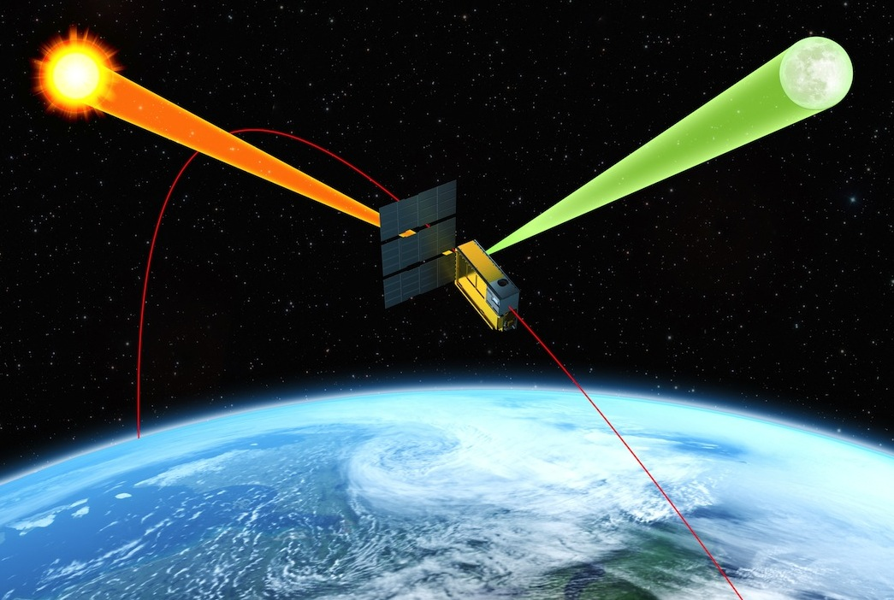
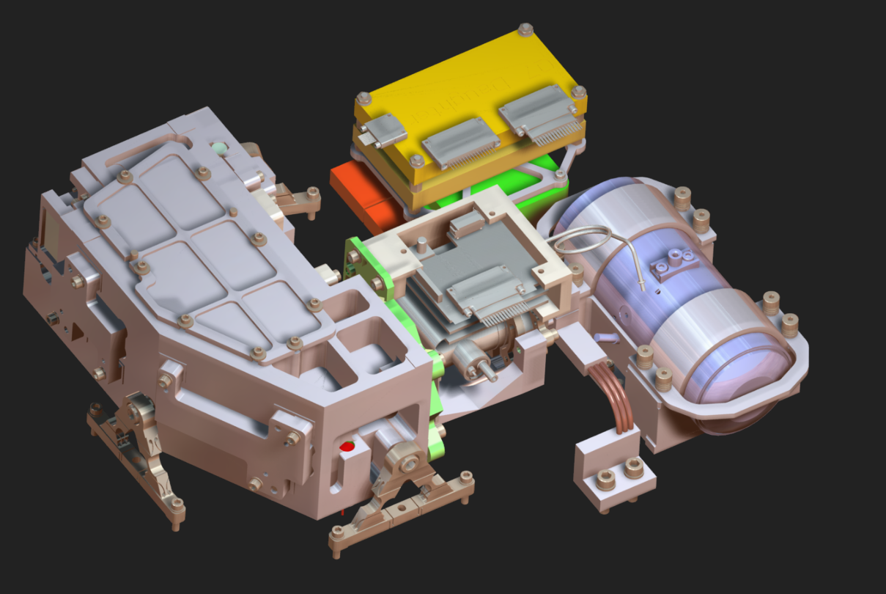
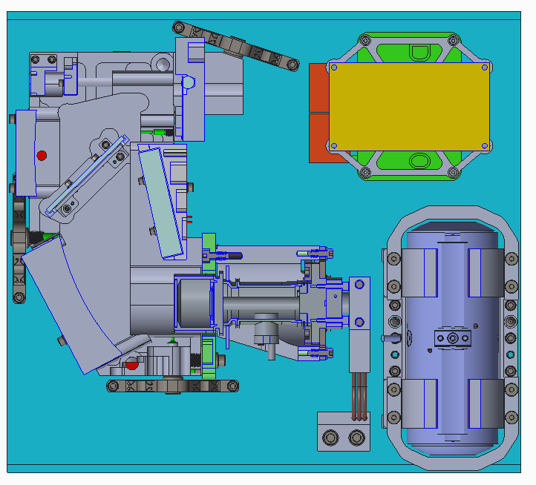
ARCSTONE Objectives:
To enable on-orbit high-accuracy absolute calibration for the past, current, and future reflected solar sensors in LEO and GEO* by providing lunar spectral irradiance as function of satellite viewing geometry and specified wavelength.
To design, build, calibrate and validate a prototype instrument, demonstrate form-fit-function for a 6U observatory with compliance in size, mass, power, and thermal performance.
ARCSTONE Concept:
Accurate measurements of Lunar Irradiance from Space with an Instrument flying on 6U CubeSat (courtesy BCT) in LEO.
* Planetary instruments: OSIRIS Rex Camera suite [Golish et al., 2020]
Optical Bench
Electronics
TRL_{current} = 4 TRL_{out} = 5
IDCA
Progress of ARCSTONE instrument Design

Slide 17
ARCSTONE Mission Concept
Concept of Operations and Data Products:
Data to collect: Lunar spectral irradiance every 12 hours, 10 minutes
Data to collect: Solar spectral irradiance for calibration (daily)
Combined uncertainty < 0.5% (k=1)
Spectrometer with single-pixel field-of-view about 0.7º (no scanning !)
Sun synchronous orbit at 500 – 600 km altitude
Spectral range from 350 nm to 2300 nm, spectral sampling at 4 nm
1 year: Improvement of current Lunar Calibration Model (factor of 2 – 4);
3+ years: New Lunar Irradiance Model, improved accuracy level (factor of 10).
Key Technologies to Enable the Concept:
Approach to orbital calibration via referencing Sun (TSIS measurements):
Demonstration of lunar and solar measurements with the same optical path
using integration time to reduce solar signal -- Major Innovation !
Pointing ability of spacecraft now permits obtaining required measurements
with instrument integrated into spacecraft.
6U CubeSat Spacecraft Bus:
courtesy of Blue Canyon Technologies (BCT)
BCT 6U XB6 Spacecraft pointing:
Accuracy 0.002º (1-sigma) in 3 axis
Stability 1 arc-sec over 1 sec

Slide 18
ARCSTONE Mission: Key Performance Parameters
Key Parameters | Threshold Value | Goal Value
Accuracy (reflectance) | 1.0% (k=1) | 0.5% (k=1)
Stability | < 0.15% (k=1) per decade | < 0.1% (k=1) per decade
Orbit | Sun-synch orbit | Sun-synch orbit
Time on-Orbit | 1 year | 3 years
Frequency of sampling | 24 hours | 12 hours
Instrument pointing | < 0.2º combined | < 0.1º combined
Spectral Range | 380 nm – 900 nm | 350 nm – 2300 nm
Spectral Sampling | 8 nm | 4 nm
ARCSTONE MISSION CONOPS:
1. Lunar spectral irradiance observations:
Every 12 hours
Close to polar locations
Multiple measurements within 5– 10 minutes to improve SNR
2. Solar Spectral Irradiance observations (solar calibration):
Multiple measurements to get required SNR
This is radiometric calibration to the TSIS reference
3. Dark images:
Multiple measurements with closed shutter
Before every lunar and solar observations
4. Dark field (to calibrate out shutter temp):
Multiple measurements of dark space
5. Field-of-view sensitivity characterization:
Calibration of instruments alignment
Spectral calibration:
On-board spectral calibration
7. Spacecraft pointing calibration and other checks:
Defined by the BCT for calibration of spacecraft functions
8. Stand by mode:
Mode between observations
9. Data Downlink Mode
10. Safe Mode (if required)
* * Threshold Values considered as success criteria
Reference for radiometric requirements (ROLO, T. Stone):
Lunar Phase Angle = 75º;
Irradiance = 0.6 (micro W / m² nm)
Wavelength = 500 nm
* 6U CubeSat accommodation Study is completed

Slide 19
Calibration Options: Longwave
Internal Sources, like CERES, MODIS, VIIRS
- Blackbody: cavities and plates
Internal Sources with melting material cells, like RAVAN, CLARREO IR
- Materials: Hg, Ga, Water
Can Moon be used as LW calibration source ?

Slide 20
Detector Technology
Thermopile
  Ex. JPL built for RBI (Single/dual diode)
    ~8ms, 500 V/W, 1.1nW NEP, Reflectance: 0.94 | 1.16 | 4-20% (VIS, MIR, FIR)
Thermistor
  Ex. Hamamatsu 3-5µm, 5-14µm (Linear array)
    ~8ms, 65 V/W, 2nW NEP, Reflectance: ~1% to 15% (Aeroglaze Z-306)
Microbolometer
  Ex. BBR 0.25-50µm (30 pixel array)
    ~19ms,
(Long term) Graphene Bolometer
  Ex. MIT, LaRC, etc

Slide 21
Block Diagrams
Notes:
First test breadboard before design all pieces (systems blocks represent).

Slide 22
Milestones and Progress:
Developed small sat mission concept (TRL 2)– 100% complete
Received Center Transformation funds to procure detector– 100% spent
IRAD FY2020 selected for funding
ESTO IIP not selected; Team voted to continue IRAD project as planned
Attended detector training at INO (completed)
Detector delivered and breadboard design finalized (100% complete)
Vacuum pump procured and delivered (100% complete)
Submitted NTR on concept (no patent was pursued)
First paper on concept in Remote Sensing (100% complete)
Working with optics vendors to get mirrors (99% of optics received from vendors)
Plans to characterize microbolometer array (10% complete)
Plans to assemble breadboard and test it (60% complete)
Publish 2nd paper on instrument tests (0% complete)

Slide 23
Impacts of COVID-19:
COVID-19 has caused some delays, but has not been a showstopper:
Could not work with detector at Langley, so we have shipped it to Montana
Resonon Inc. was working at reduced capacity
Montana State campus had outbreak problems
Optical vendors were impacted as well, so there were delays in obtaining mirrors
LaRC employees cannot visit Resonon/Montana State during detector characterization and breadboard testing
Cancellation/rescheduling of conferences
Despite some setbacks due to COVID, we believe that we are on track to finish the detector characterization and breadboard testing during Summer 2021.

Slide 24
Publication

Slide 25
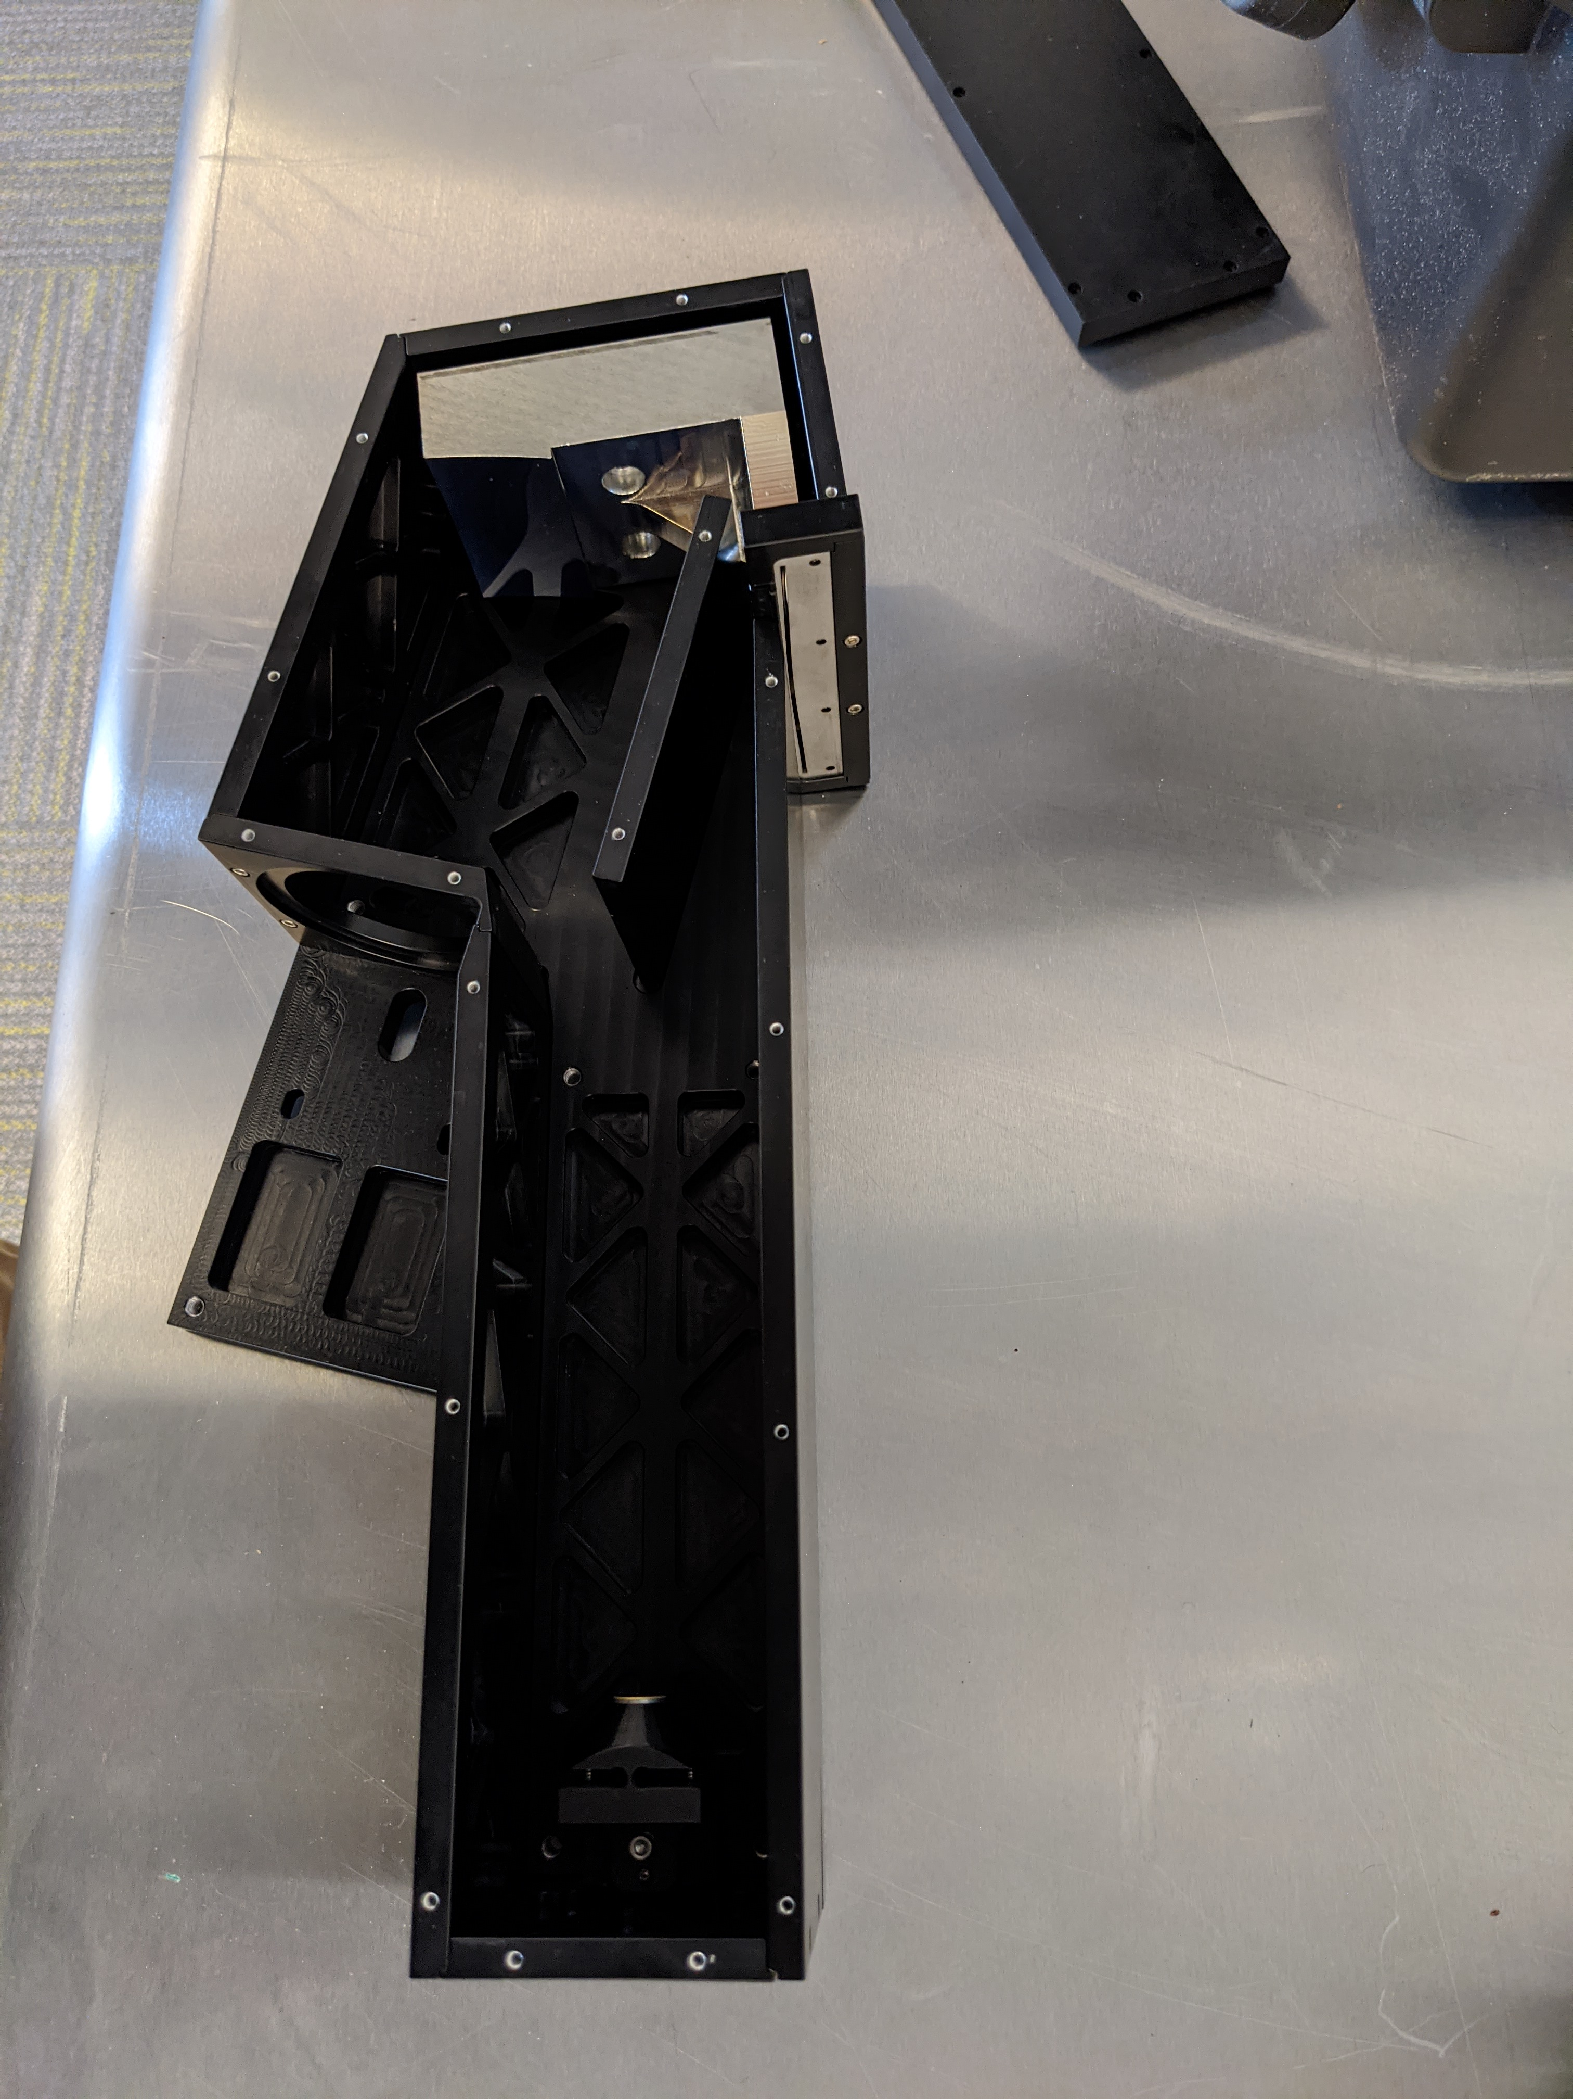
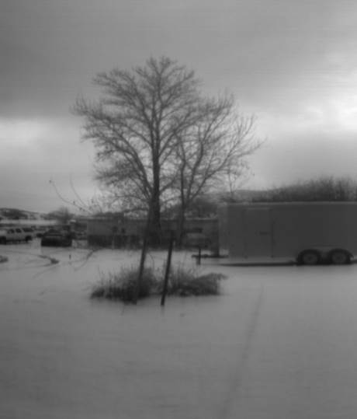
Breadboard Progress

Slide 26
Path Forward
FY19: Trutinor science requirements & trades (IRAD), TRL1
FY19: Trutinor instrument(s) concept & concept review (IRAD), TRL2
FY21: Trutinor concept publication (IRAD)
FY21: Trutinor instrument breadboard & testing (IRAD), TRL3
FY21: IRAD closeout, followed by breadboard test publication
Scientists will continue to do studies on requirements. Additional publications will likely result from these.
We believe that maturing Trutinor components and science requirements will be valuable for ERB missions in the future.
Vision for Trutinor’s lasting contribution

Slide 27

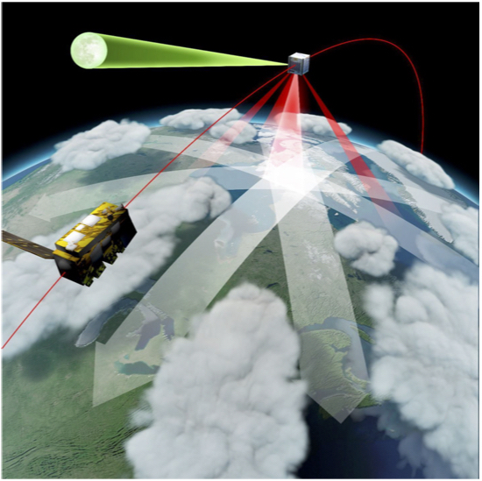
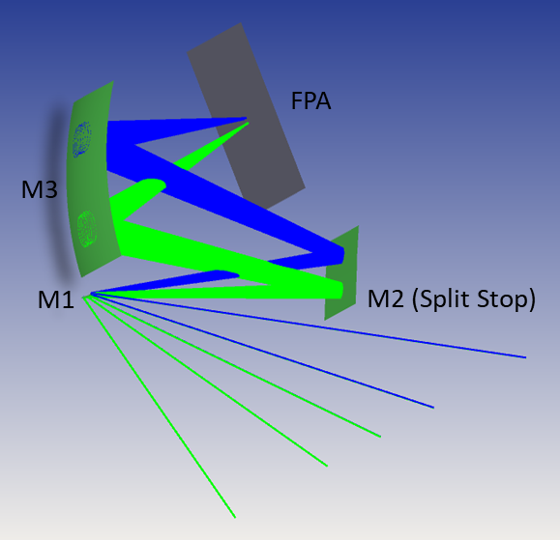
Trutinor: Next-Generation Earth’s Radiant Energy Instrument
PI: Dr. Cindy Young, NASA LaRC
Objectives:
Trutinor mission concept: Compact Instrument free-flying in formation with an imager.
Data Gap: Current technology, such as CERES, created an Earth Radiation Budget record by relying on multi-instrument overlap. The accuracy of current instruments is not sufficient to handle a potential data gap, which is very probable with the cancellation of the RBI project.
Objective: Develop a new compact instrument, capable of flying on a small satellite in formation with imagers in low Earth orbit.
Objective: Instrument with improved accuracy, SI-traceable measurement uncertainty, and the ability to handle potential gaps in the climate data record.
Trutinor instrument concept: push-broom imaging of Earth in broadband SW and LW channels.
Approach/Innovation:
End of Year Deliverables
Breadboard design and build
Derive science requirements for continuation of the accurate Earth radiation climate record.
Derive Trutinor measurement requirements.
Identify mission and instrument design trades.
Focus on advanced concepts:
(1) Compact instrument flying on a small satellite in
constellation with imagers
(2) Instrument with improved SI-traceable
measurement accuracy on-orbit
Next Steps:
Detector characterization
Breadboard tests
Project closeout
Annual IRAD Resources
0.23 FTE, $90 K procurement
Partnerships:
R. Swanson (Resonon, Inc), B. Swartz (APL),
J. Shaw (MT State U), C. Buleri (Quartus Engineering)
TRL_{start} = 2 TRL_{out} = 3
04/07/2020

