Slide 1


swSim: A GPU implementation of Ultrasound Inspection Simulation
Elizabeth Gregory, William Schneck III, & Erik Frankforter
Tuesday, April 27, 2021

Slide 2
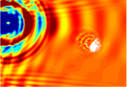
The Value of Simulation
Simulation can:
  Provide insight into underlying interaction phenomena and energy paths.
  Predict and quantify energy-damage interaction.
  Extract features correlated with relevant parameters.
  Optimize inspection setup.
  Help establish confidence in inspection results.

Slide 3
Goals for swSim
Human Readable Inputs with XML
Easy editing
Easy sharing
Procedurally generation via outside tools
Easily Buildable Problems
Modular approach
Problem agnostic
Robust Tool for Long Use Life
Robust Testing with Test Driven Development
Unit and case testing
Test during development
Automatic Testing
Sharable Outputs with VTK
Easy data visualization
Already optimized parallel output
Self documenting output files
Trade names and trademarks are used in this report for identification only. Their usage does not constitute an official endorsement, either expressed or implied, by the National Aeronautics and Space Administration.

Slide 4
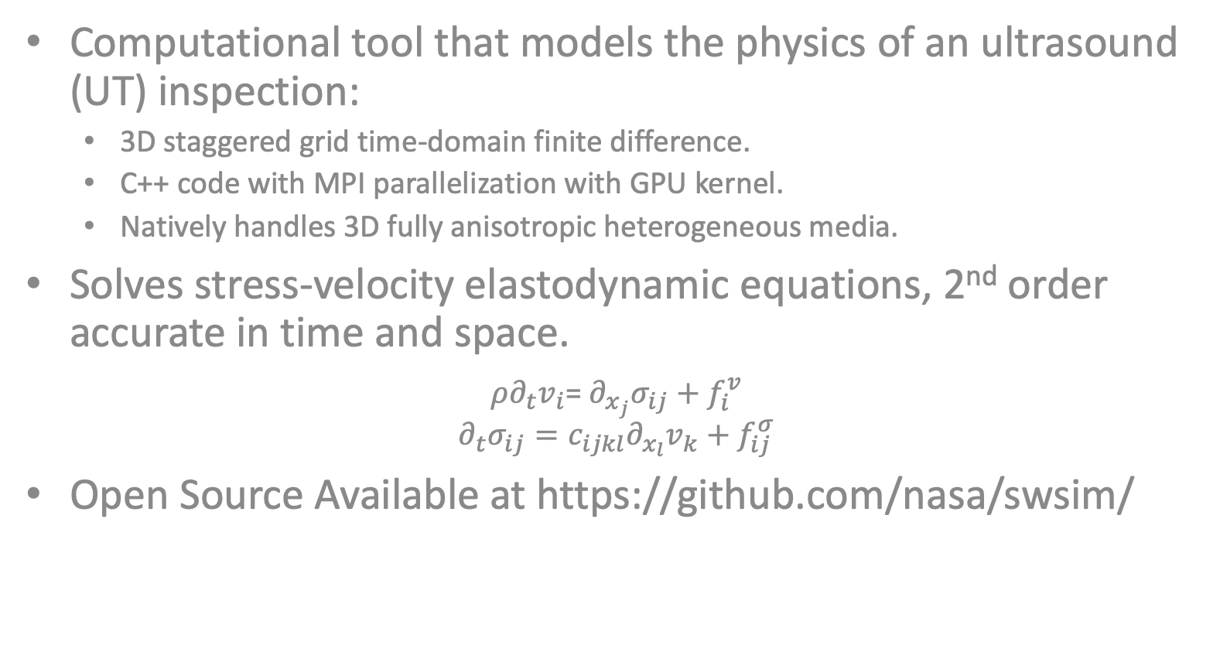
Solid Wave Simulation (swSim) Description
Computational tool that models the physics of an ultrasound (UT) inspection:
  3D staggered grid time-domain finite difference.
  C++ code with MPI parallelization with GPU kernel.
  Natively handles 3D fully anisotropic heterogeneous media.
Solves stress-velocity elastodynamic equations, 2nd order accurate in time and space.
$ρ∂_{t}v_{i}$= $∂_{x_{j}}σ_{ij}+f_{i}^{v}$
$$∂_{t}σ_{ij}=c_{ijkl}∂_{x_{l}}v_{k}+f_{ij}^{σ}$$
Open Source Available at https://github.com/nasa/swsim/
$σ_{xx},σ_{yy},$ $σ_{zz}$
$$τ_{xz, }τ_{yz, }τ_{xy }$$
$$v_{x},v_{y},v_{z}$$
Repeating unit cell for ultrasound simulation algorithm – rotated staggered grid (RSG) finite difference
Trade names and trademarks are used in this report for identification only. Their usage does not constitute an official endorsement, either expressed or implied, by the National Aeronautics and Space Administration.

Slide 5
Simulation Structure
Kernel Composer GPU
Read Input Parameters
Read Geometry
Partition Geometry
Create State Variable Vectors
Register Host Data
Create State Transition Matrices
Register Operations
Simulation Complete?
Yes
No
Write Output
Map data from GPU
Advance kernel to saving ‘checkpoint’
Decommit
Trade names and trademarks are used in this report for identification only. Their usage does not constitute an official endorsement, either expressed or implied, by the National Aeronautics and Space Administration.

Slide 6
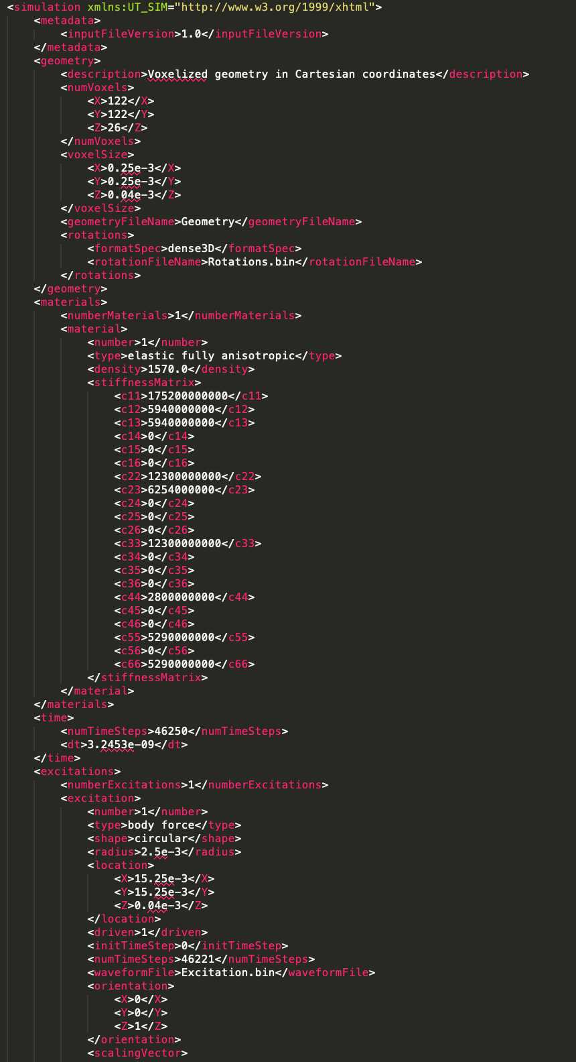
Input
Parameters
Geometry:
  Volume envelope in units of number of cells.
  Cell size in units of length.
Other file names.
Material properties for every material in the simulation:
  Density
  21 unique stiffness values
Time domain:
  Time step size
  Simulation duration in time steps
Transducer parameters.
Files
Input xml for all parameters.
Geometry binary file to define the geometry and material for each cell.
Plane Counts binary file lists the number of cells in each y-z plane along the x-axis. Allows for partitioning without reading in the entire geometry file.
Rotations binary file provide the 3 axis material orientation for each cell.

Slide 7
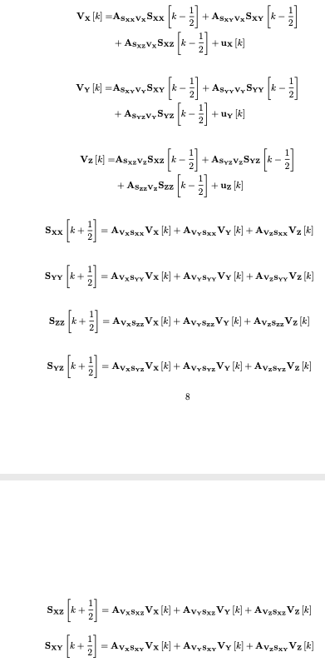
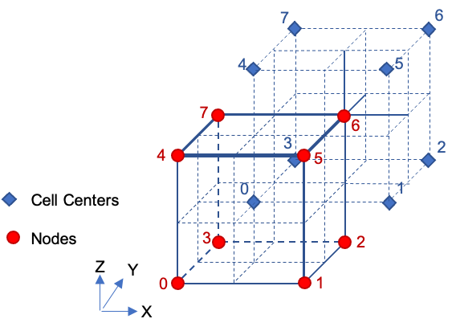
Computational Scheme
Three cardinal velocities calculated at nodes.
Six stress calculated at cell centers.
Transition Matrices are defined as Eigen Sparse Matrices.
Trade names and trademarks are used in this report for identification only. Their usage does not constitute an official endorsement, either expressed or implied, by the National Aeronautics and Space Administration.

Slide 8
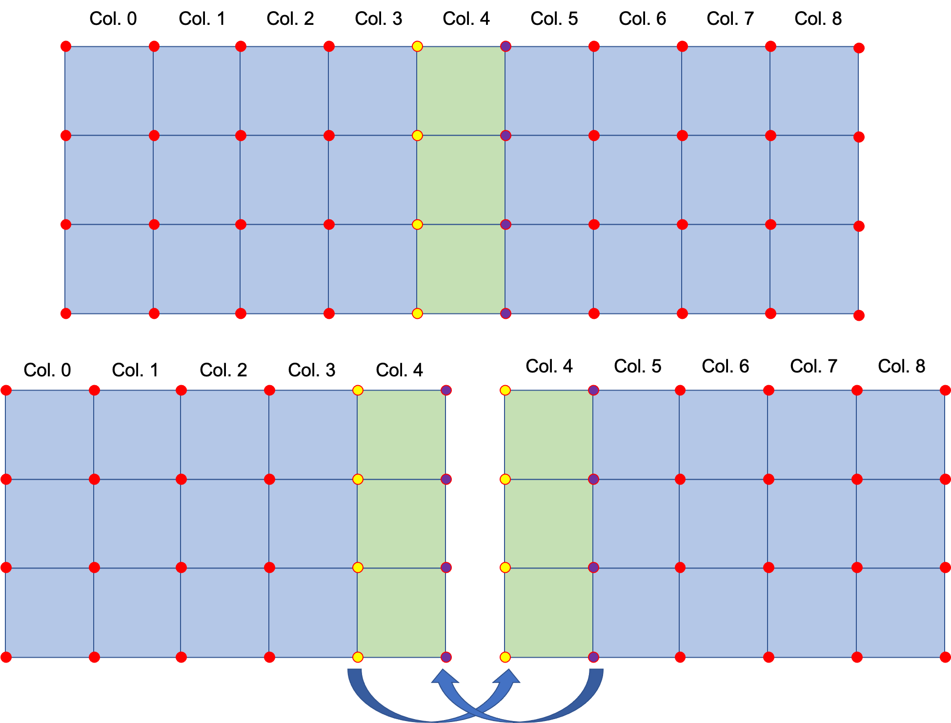
Parallelization
Partitioning in One Axis.
One plane of duplicated cells.
Two planes of duplicated nodes.
Communication between processes only consists of one plane of nodes at each boundary.
Duplicated calculation in parallel to save communication time.
Trade names and trademarks are used in this report for identification only. Their usage does not constitute an official endorsement, either expressed or implied, by the National Aeronautics and Space Administration.

Slide 9
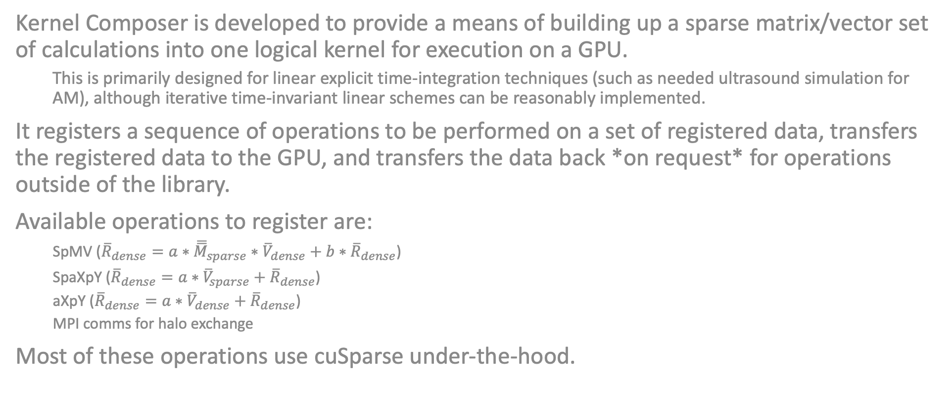
Kernel Composer
Kernel Composer is developed to provide a means of building up a sparse matrix/vector set of calculations into one logical kernel for execution on a GPU.
  This is primarily designed for linear explicit time-integration techniques (such as needed ultrasound simulation for AM), although iterative time-invariant linear schemes can be reasonably implemented.
It registers a sequence of operations to be performed on a set of registered data, transfers the registered data to the GPU, and transfers the data back *on request* for operations outside of the library.
Available operations to register are:
  SpMV (${\overline{R}}_{dense}=a∗{\overline{\overline{M}}}_{sparse}∗{\overline{V}}_{dense}+b∗{\overline{R}}_{dense}$)
  SpaXpY (${\overline{R}}_{dense}=a∗{\overline{V}}_{sparse}+{\overline{R}}_{dense}$)
  aXpY (${\overline{R}}_{dense}=a∗{\overline{V}}_{dense}+{\overline{R}}_{dense}$)
  MPI comms for halo exchange
Most of these operations use cuSparse under-the-hood.
Trade names and trademarks are used in this report for identification only. Their usage does not constitute an official endorsement, either expressed or implied, by the National Aeronautics and Space Administration.

Slide 10
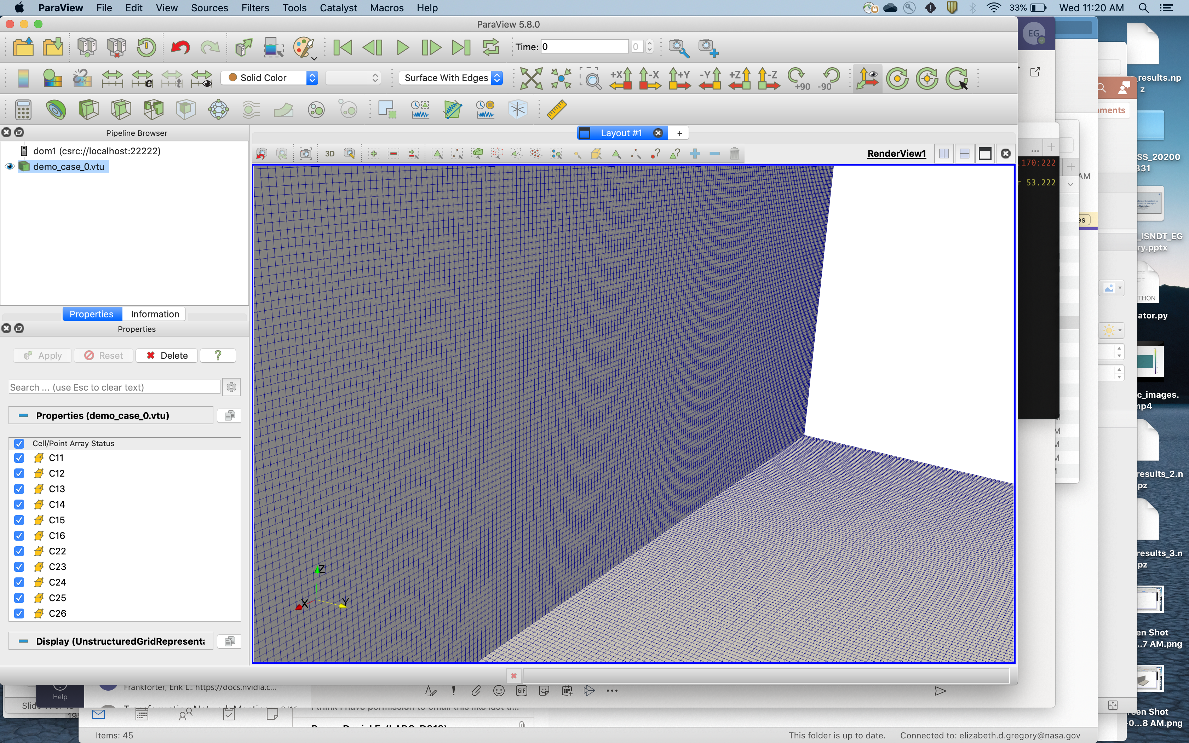
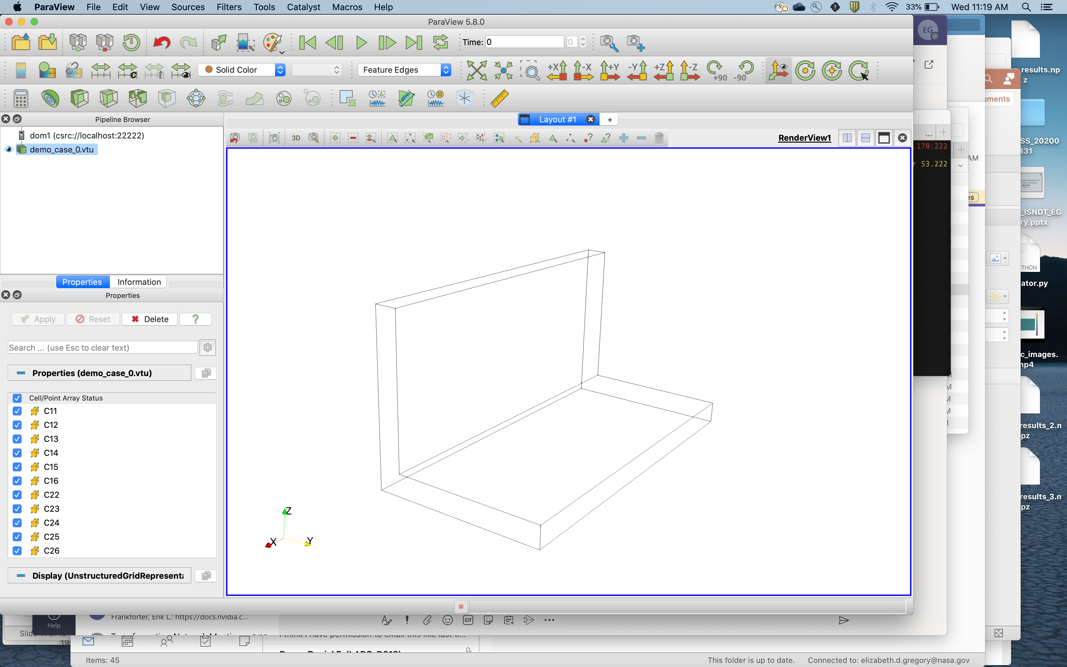
VTK Structured Mesh Output
Read and processed by Paraview.
Lightweight.
Easily parallelizable.
Mixed xml and binary format.
Multiple output values in a single file.
Opensource format readable by other applications.
Trade names and trademarks are used in this report for identification only. Their usage does not constitute an official endorsement, either expressed or implied, by the National Aeronautics and Space Administration.

Slide 11
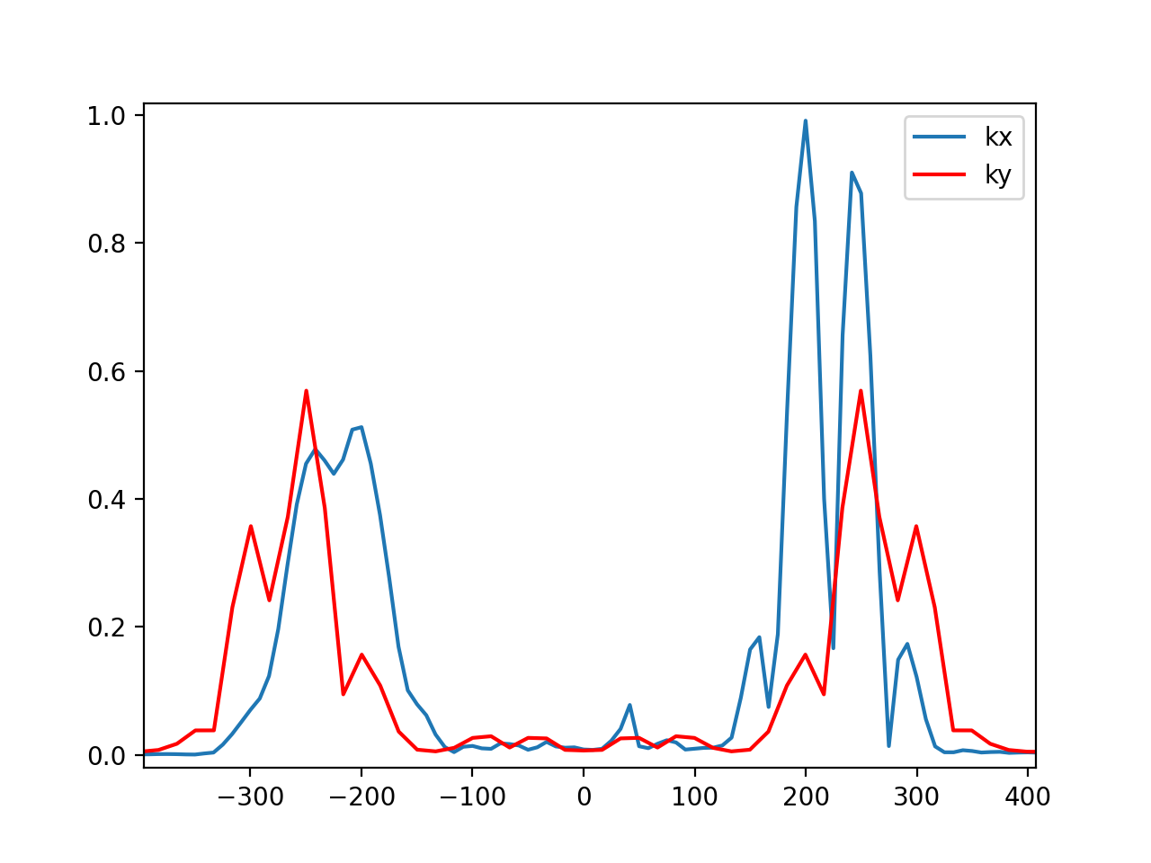
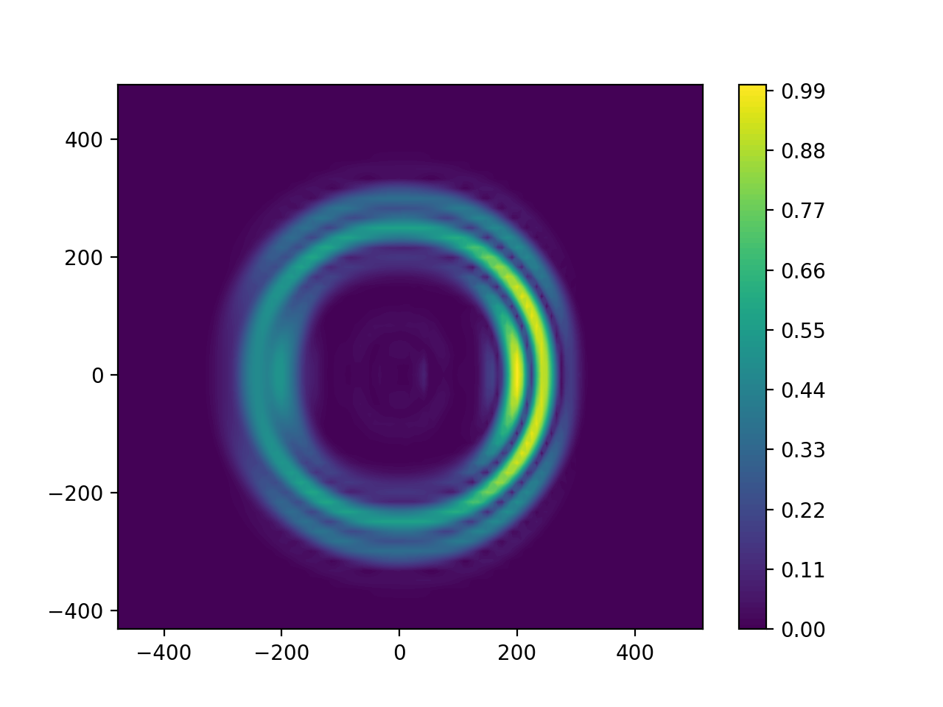
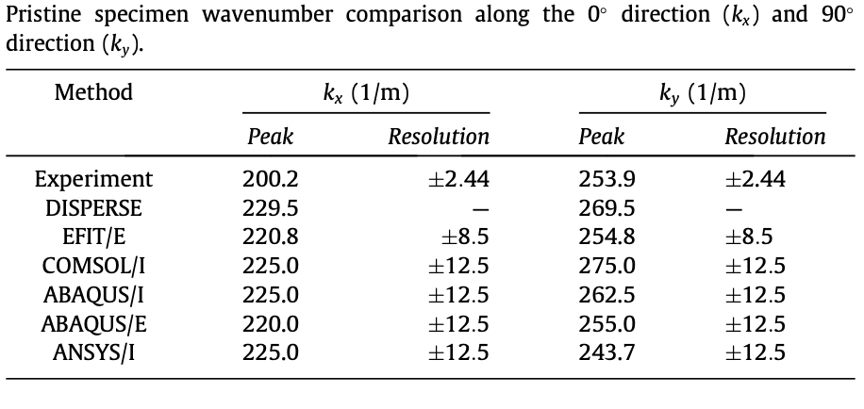

Validation and Verification
Kx = 201 m⁻¹ $±8.3$ Ky = 251 m⁻¹ $±8.3$
Leckey, Cara AC, et al. "Simulation of guided-wave ultrasound propagation in composite laminates: Benchmark comparisons of numerical codes and experiment." Ultrasonics 84 (2018): 187-200.

Slide 12
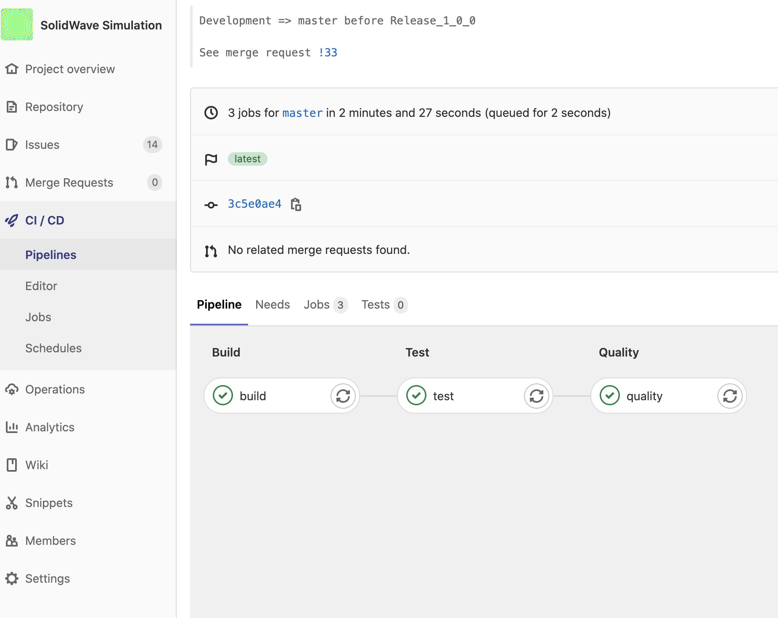
Testing
Test Driven Development:
  Testing developed using Googletest framework. Per Googletest guidance a version is of Googletest is included in the repository.
  All Public Function have accompanying Tests.
Continuous Integrate:
  GitLab CI/CD testing pipeline was used to execute tests each time changes are merged to the Master branch.
  Allows for difference Tests for Different Branches.
  Prevents errors from making it past release.
Trade names and trademarks are used in this report for identification only. Their usage does not constitute an official endorsement, either expressed or implied, by the National Aeronautics and Space Administration.

Slide 13
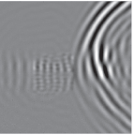
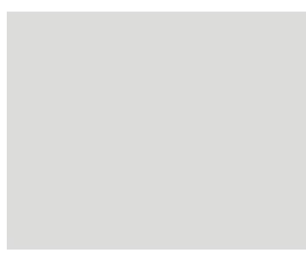
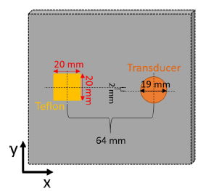
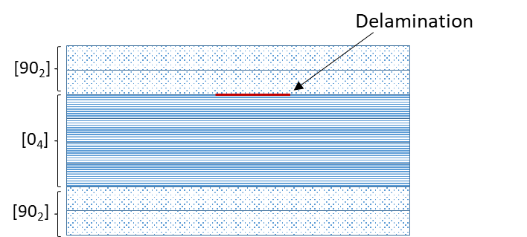
Comparison to Benchmark
v_{z} surface wavefield
Experimental
Simulated
Experimental, FEM, and in-house code benchmark:
  Normal incidence contact transducer. Delamination via Teflon insert between 2nd and 3rd ply.
  Full wavefield capture via laser Doppler vibrometry (LDV).
Mode conversion and reflection off delamination edges.
Velocity/wavenumber/wavelength changes above delamination observed via simulation and LDV.
Run time comparison with COMSOL, Abaqus, ANSYS, cpu RSG
 | T_{run} (hours) | # DoF (10⁶) | Memory (GB)
COMSOL | 19.5 | 7.77 | 266
ABAQUS Implicit | 40 | 1.7 | 28
ABAQUS Explicit | 53 | 26 | 30
ANSYS | 170 | 10 | 16
swSim | 0.02-0.62 | 17.1 | 41.9
Between 2-3 orders of magnitude faster simulation time for converged model, using comparable compute resources
Leckey, Cara AC, et al. "Simulation of guided-wave ultrasound propagation in composite laminates: Benchmark comparisons of numerical codes and experiment." Ultrasonics 84 (2018): 187-200.

Slide 14
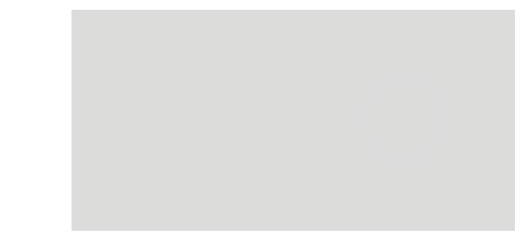

Example Results – Flat Bottom Hole
Transducer
Transducer
60 mm
20 mm
19 mm
0.92 mm
120 mm
64 mm
120 mm

Slide 15
Drawbacks
Geometry inputs are very big. Using an opensource mesh application could reduce this burden but would limit editing and geometry creation.
Partitioning is not optimized. Using a parallel matrix library might help but would also induce other complexities.
The Input Sources are not optimized.
The Burden is on the user to create a problem with a source and appropriately sized cells.
No implementation of variable cell interfaces.

Slide 16
Future Work
Incorporate the RSG code into a new, more versatile simulation tool developed in-house.
Simulation of actual parts that will then be scanned at LaRC for further validation.
UT and CT inspection for Ti-6Al-V4 dog-bone specimen.
  Use for UT model validation for Additively Manufactured (AM) material systems,
Parametric exploration with High Performance Computing simulation tools:
  Application to AM specimens following acquisition of experimental data.
  Down-selection of key inspection parameters (based on domain expert and/or sensitivity analysis).
  Parametric exploration over key parameters (design of experiment, parameter calibration, optimization, etc.).
Notes:
Single Simulation
Prediction of wavefield, waveforms (A-scans)
Assess microstructural effects on inspection characteristics
Capability to tune relative to experimental A-scan data
Parametric Studies
Sweep transducer location → Simulated C-Scan
Sweep transducer characteristics → Optimize Inspections
Sweep flaw parameters → Inspectability
Impetus to move from one-off simulation to parametric studies
Better inform the practice of UT inspection
Moving towards more parametric studies requires
Efficient solvers for physics-based simulation
Tools for model generation & postprocessing
Standard interface and model data formats

