Slide 1

National Aeronautics and Space Administration
ATTAM/EOA Steering Committee Update
Jimmy Kenyon
Director, Advanced Air Vehicles Program
March 24, 2021

Slide 2
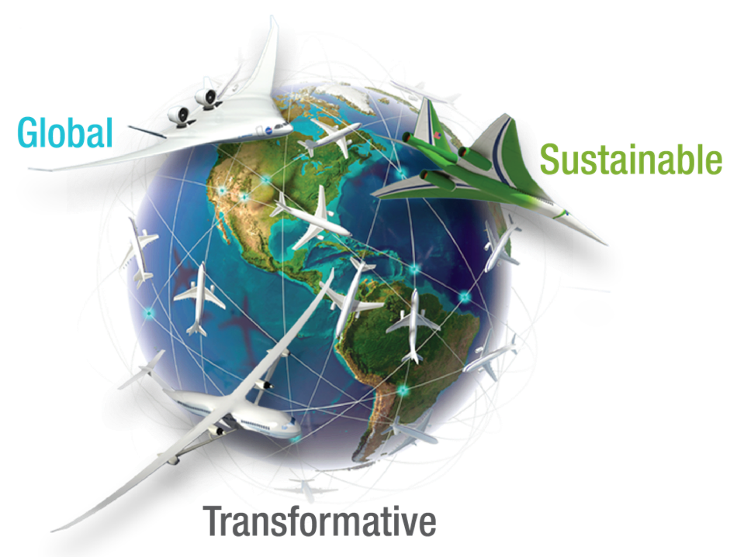
NASA Aeronautics – Vision for Aviation in the 21st Century
ARMD continues to evolve and execute the Aeronautics Strategy
https://www.nasa.gov/ aeroresearch/strategy
U.S. leadership for a new era of flight

Slide 3
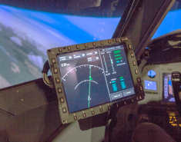











Research Programs Align with Strategic Thrusts
AIRSPACE OPERATIONS & SAFETY
ADVANCED AIR VEHICLES
INTEGRATED AVIATION SYSTEMS
AOSP
AAVP
IASP
PROJECTS
ATM Tech Demonstrations*
UTM*
ATM-X
System-Wide Safety
PROJECTS
Advanced Air
Transport Technology
Hybrid Thermally Efficient Core**
Hi-Rate Composite Aircraft Manufacturing**
Commercial Supersonic Technology
Revolutionary Vertical Lift Technology
Advanced Composites*
Hypersonic Technology
PROJECTS
UAS in
the NAS*
Flight Demonstrations
and Capabilities
Low Boom Flight Demonstrator
Electrified Powertrain Flight Demonstration**
Advanced Air Mobility
MISSION PROGRAMS
Integration and Flight
TRANSFORMATIVE AERONAUTICS CONCEPTS
AEROSCIENCES EVALUATION & TEST CAPABILITIES
TACP
AETC
PROJECTS
Convergent Aeronautics Solutions
Transformational Tools and Technologies
University Innovation
GROUND FACILITIES
SEEDLING PROGRAM
PORTFOLIO OFFICE
Subsonic
Transonic
Supersonic
Hypersonic
Propulsion
Test Technology
* Projects end in FY 2020/21
** Projects start in FY 2021

Slide 4
Thrust 2: Innovation in Commercial Supersonic Aircraft

Slide 5
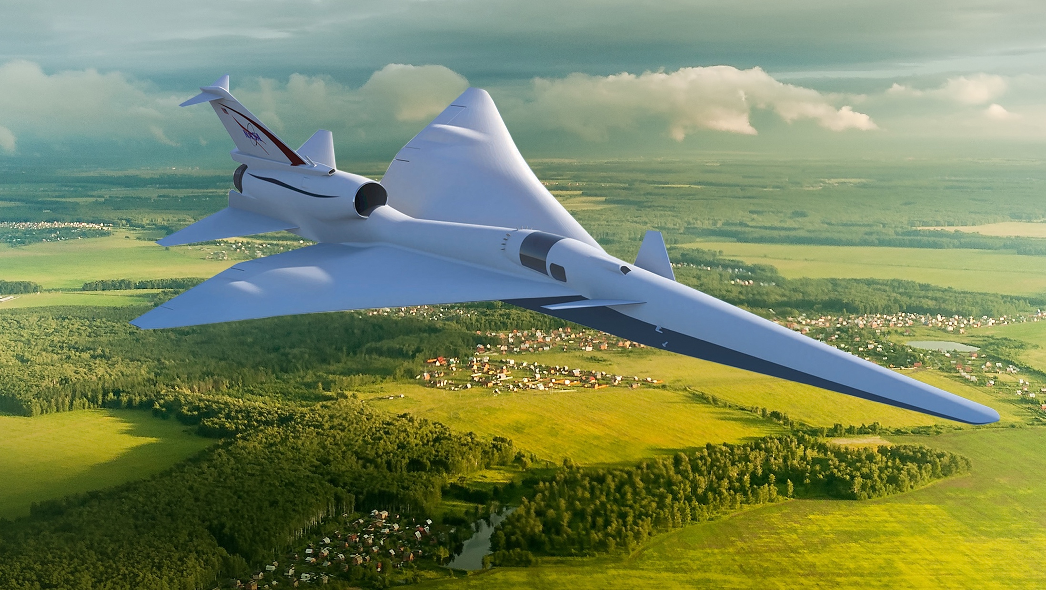
Overcoming the Barrier to Overland Flight
Standards to Replace Current Prohibitions
New Environmental Standards are needed to open the market to supersonic flight
An En Route Noise Standard is the biggest challenge
Requires proof of new design approaches, test procedures and response metrics
No relevant data exists to define limits - community data from large, diverse population is a requirement
Standard must be accepted internationally

Slide 6
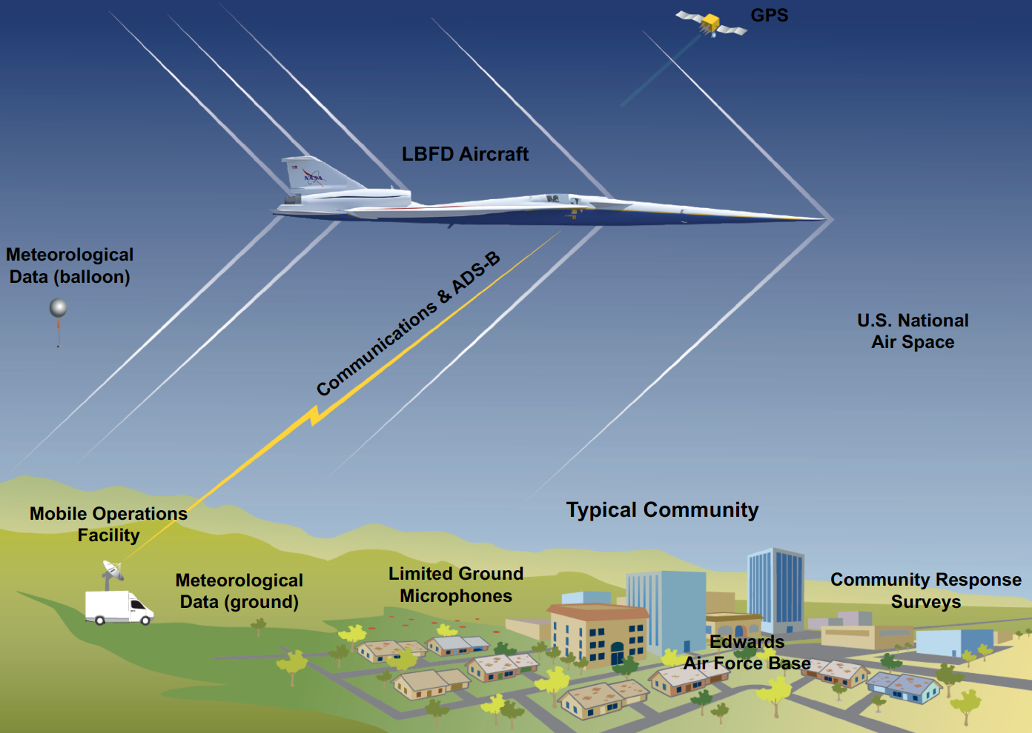
Low Boom Flight Demonstration Mission
Phase 1 – X-59 Aircraft Development (FY18 - 22)
Detailed design
Fabrication, integration, ground test
Checkout flights
Subsonic and supersonic envelope expansion
Phase 2 – Acoustic Validation (FY22 - 24)
Aircraft operations & support, range ops, support aircraft
Ground and in-flight measurement capabilities
Validation of X-59 boom signature and prediction tools
Development of acoustic prediction tools
Phase 3 – Community Response (FY24 - 26)
Initial community response overflight study
Multiple campaigns (4 to 6) over representative communities and weather across the U.S.
Noise exposure measurements and community response surveys

Slide 7
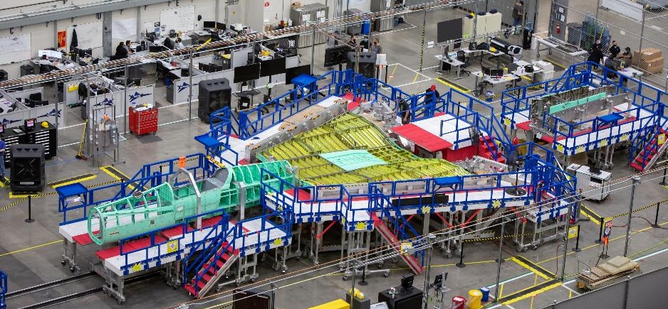
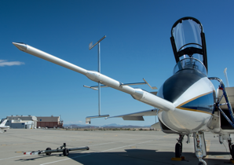
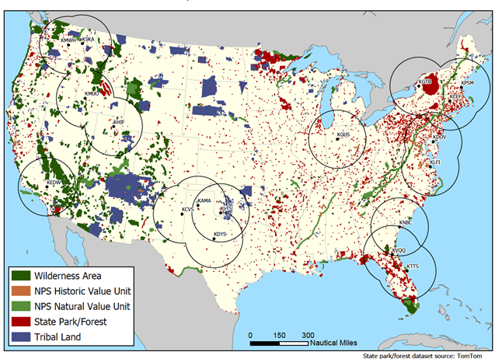
Low Boom Flight Demonstration Progress
Significant progress despite COVID-19 pandemic impacts
X-59 Aircraft Development
Design and drawings complete
Assembly and systems testing underway
Acoustic Measurement
Awarded contract for Ground Recording System development
Continuing progress on airborne acoustic measurement systems
Community Test Planning
Test airfield selection process underway
Test support team contract solicitation in progress
Conducted Community Test International Workshop
International Standards Development
On-going engagement with ICAO CAEP and international research community
Image Credit: Lockheed Martin
Potential Community Test Airfield Locations Combined with Regions of Noise-Sensitive Considerations
Notes:
FAA engagement: TO BE VERIFIED BY LORI
FAA Office of Environment & Energy:
Coordination with ASCENT COE on Over the Top Boom (with PSU), High Altitude Emissions (Projects 47 and 48)
Guidance/input on community response planning
Support for and engagement with ICAO; specifically STCA modeling and LTO noise predictions
Support for the Notice of Proposed Rulemaking for supersonic aircraft

Slide 8
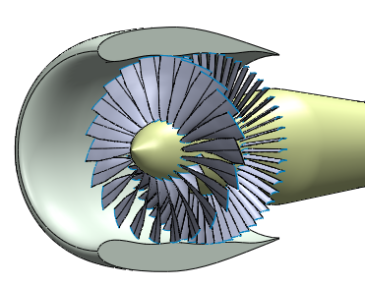
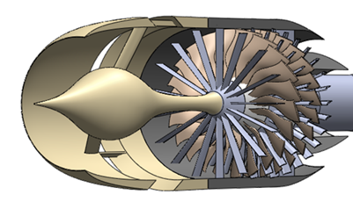

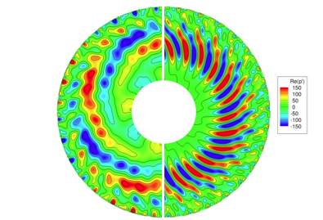
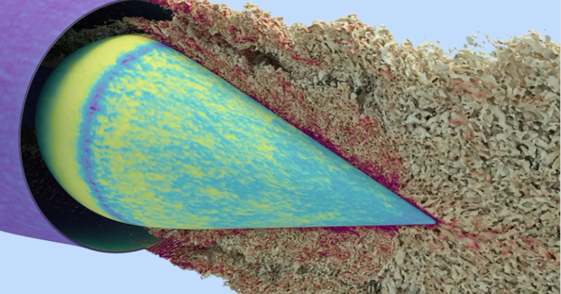
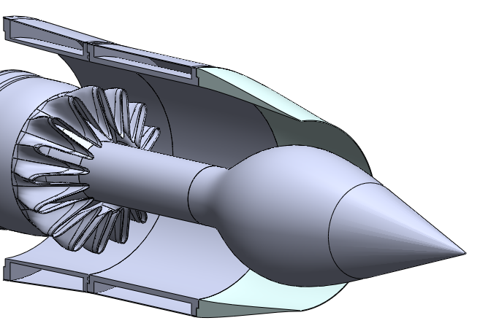
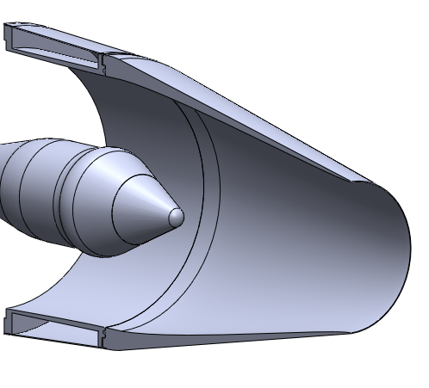
LTO Noise Prediction Uncertainty Reduction
New effort reduce uncertainty in LTO noise predictions
Noise Uncertainties
LTO Noise prediction uncertainty is a key problem for emerging supersonic market
FAA’s NPRM based on NASA predictions for ICAO, despite large uncertainty
Launched new Technical Challenge to reduce uncertainty in prediction of noise for supersonic aircraft
Physics-based simulations of supersonic-relevant inlet, fan, and nozzle designs with OEM input
Input to system-level tools and Monte Carlo simulations
Data releasable for impact on international regulators
Potential validation approaches being assessed
Conventional Product Development
2019 ICAO Study Supersonic
Test
Prediction
Cumulative
EPNL
Design
Prediction
Fan
Jet
Notes:
Although there have been budget cuts to our airport noise work, we are still committed to kicking off a new technical challenge. We have descoped it to be focused on reducing the uncertainty in LTO predictions. As shown the uncertainty in the predictions for LTO noise are currently much larger than that for subsonic vehicles.
We had a contract with GE to design and test a releasable flow-path and fan which we re-negotiated to include just the design aspect. The budget profile shown highlights that we were able to fully fund that renegotiated contract to offset our inability to get the CTPE contract awarded. This allowed us to obligate most of our FY20 funding and that contract should complete in FY21. The TC will be planned with the ability for on ramps for testing if budgets allow.
But we feel even with this reduced scope, this work is so critical that it needs to be raised to the level of a technical challenge.
Develop a releasable flow-path and fan design for a commercial supersonic transport relevant geometry to enable Landing/Take-Off noise predictions and testing.

Slide 9
Thrust 3: Ultra-Efficient Subsonic Transports

Slide 10
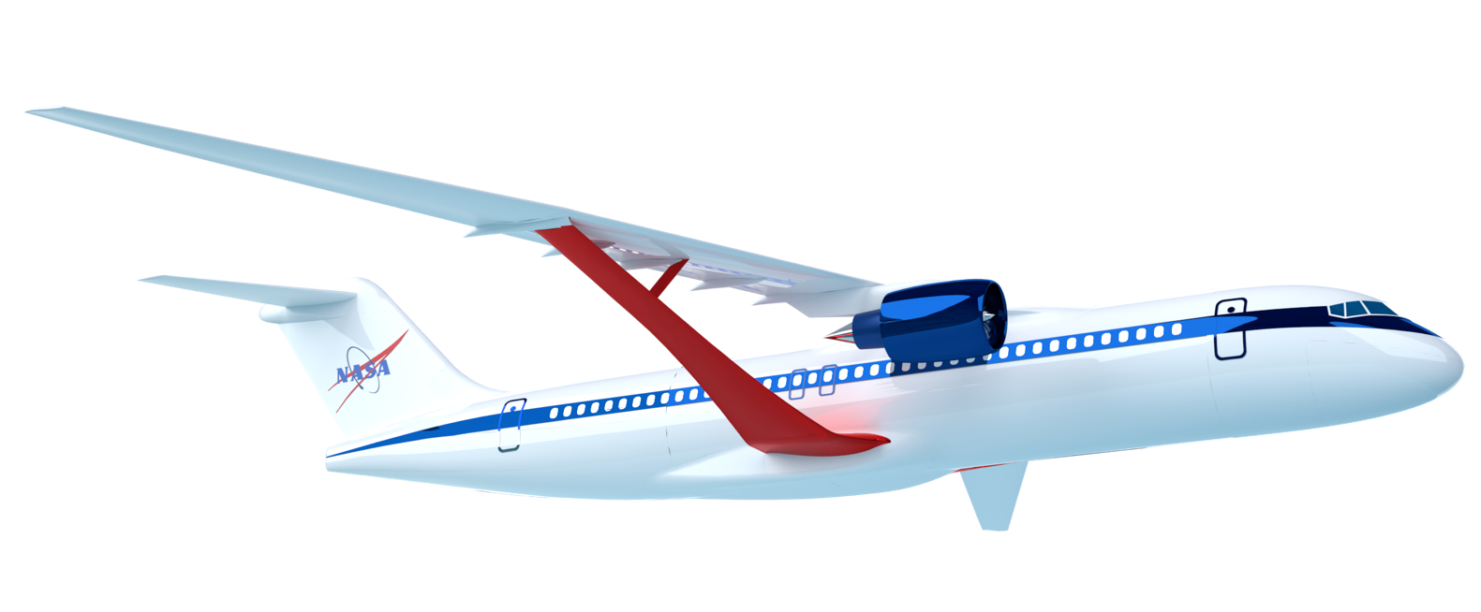


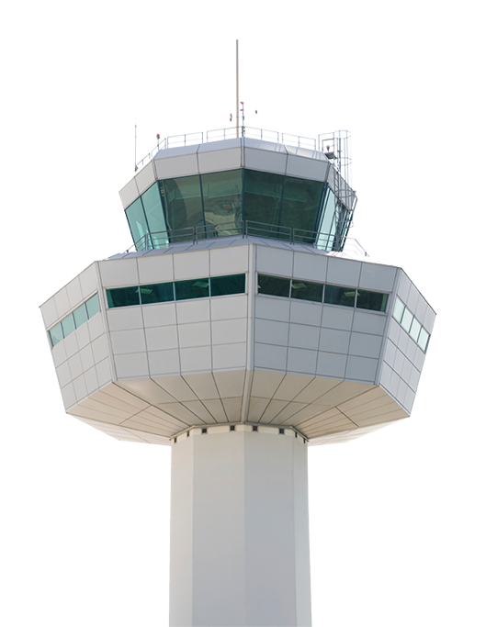
3 Pillars to a More Sustainable Future
USE
LESS ENERGY by aircraft design
USE CLEANER ENERGY full lifecycle
USE LESS ENERGY by how you fly

Slide 11
Carbon Impact Across the Global Commercial Fleet - 2018
289 million metric tons (912 Mt carbon)
65% International / 35% Domestic
Industry Carbon Goal 2050 (ATAG Waypoint 2050)
Carbon neutral growth from 2020
Reduce fleet carbon emission by 50% from 2005 (from 650 Mt to 325 Mt with fleet growth)
Single Aisle Aircraft Families emit the most carbon (38%), 92% of which is flying ≤ 2000 nm (2302 miles)
SA Fuel Burn by Range
Volpe Preliminary Data - used with permission final data to be published in Chapter 1 of 2022 ICAO Environmental Report)
Notes:
More precisely US Gov Internal, not just NASA per Volpe. Permission to use with the NAC received from Volpe on 3/9/21
288.82 million metric tons of Jet A is 95.46 billion gallons
US TOTAL is 69.64 MMT or ~ 24% of global total …. 23.02 billion gallons, 9 international departing, 14.02 domestic
NOTE: the SA 126- 210 seat class captures the 737 and A320 families + the A220-300 (A220-100 is < 125 pax)
NOTE: 912 Mt (million metric tonnes) in 2018. from ATAG, 2005 was 650 Mt so the -50% goal at fleet level for 2050 is 325 Mt. 912 is 39% higher than 650, and the fleet needs to get to 325 Mt or better

Slide 12
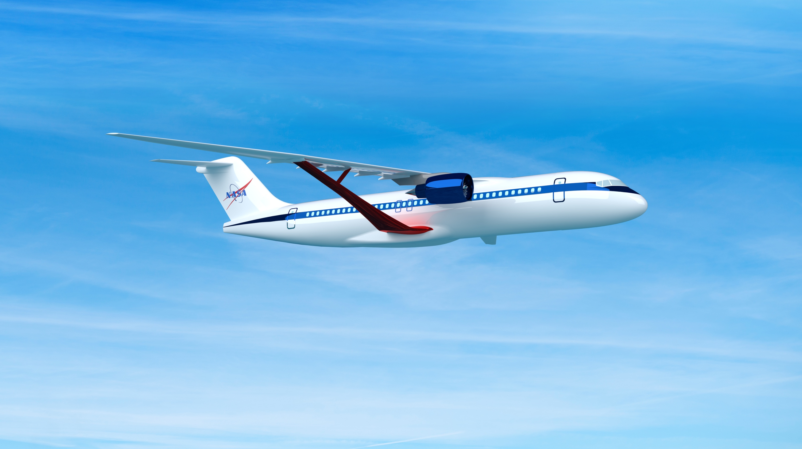
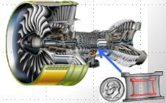
Subsonic Transport Strategy
Ensure U.S. industry is the first to establish the new “S Curve” for the next 50 years of transports
Transonic Truss-Braced Wing
5-10% fuel burn benefit
Small Core Gas Turbine
5-10% fuel burn benefit
Electrified Aircraft Propulsion
~5% fuel burn and maintenance benefit
High-Rate Composite Manufacturing
4x-6x manufacturing rate increase

Slide 13
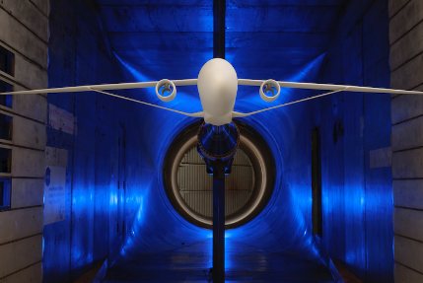
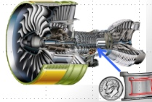
Next Gen Transports: Integrated Technology Development
Technology Readiness Target
Model Based Systems Analysis & Engineering
Flight Test
Leverage the Asset –
Future Spirals
Sustainable Flight Demonstrator (SFD)
AATT - Transonic Truss Braced Wing
Hi-Rate Composite Aircraft Manufacturing
(HiCAM)
Mfg Demo & Structural Test
Hybrid Thermally Efficient Core (HyTEC)
Core Demonstration & Test
Planned
Notional
Electrified Powertrain Flight Demonstration (EPFD)
Flight Test
AATT - Electrified Aircraft Propulsion
Achieve TRL 6 in time for Industry Product Decision-Making
Notes:
1 slide

Slide 14
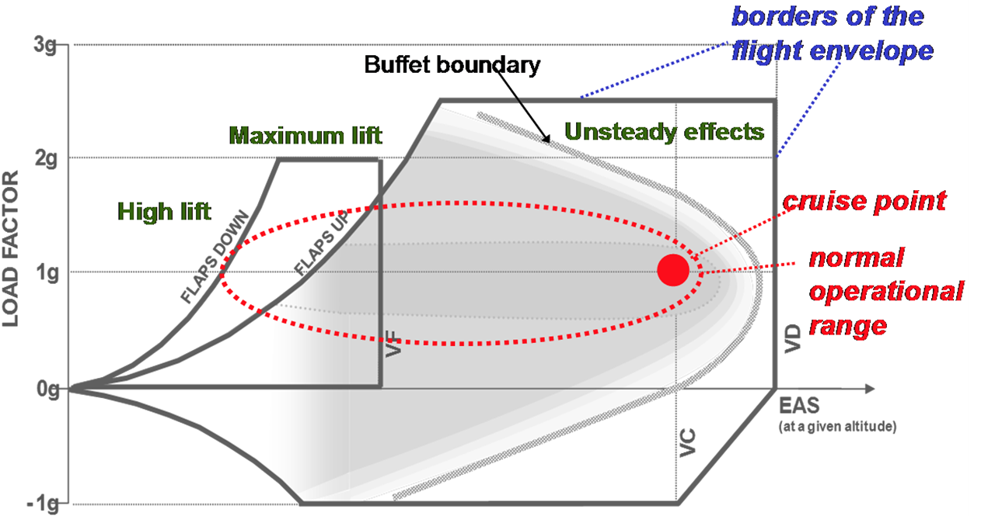
AATT – TTBW Technology Maturation
increase confidence in TTBW technology integrated in the aircraft system
Further maturation and risk reduction of TTBW technology
Focus on edge-of-envelope performance, safety, and environmental concerns.
Buffet Boundary Prediction
Stall Characteristics
High-Lift System Integration
Acoustic Assessment
Icing Impact
Thin Wing Design/Unique Joints
Approach:
Identify key barriers at critical flight points that will impact performance of the TTBW technology
Perform high-fidelity prediction, testing and validation to increase confidence in fuel burn benefit
Wing Section Fab
New Technology Challenge launched

Slide 15
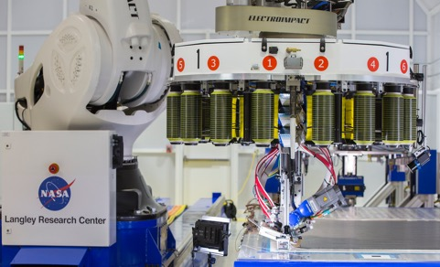
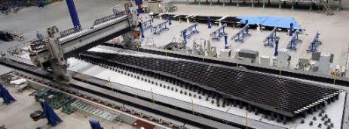
New Projects in Formulation
Accelerating development and demonstration of key technologies
Hybrid Thermally Efficient Core (HyTEC)
High-rate Composite Aircraft Manufacturing (HiCAM)
Goal: 5-10% Fuel Burn Improvement
Reduce engine core size, increase thermal efficiency
Enable up to 20% electrical power extraction
Core/Engine Ground Test (TRL 6) by 2026
Goal: 4-6x Manufacturing Rate Increase
High-rate manufacturing and assembly technologies
Model-based engineering tools
Large Structure Ground Test (TRL/MRL 6) by 2027
NRA for technology development to be released soon
Meeting of Experts on partnership strategy being planned for this spring

Slide 16
Thrust 4: Safe, Quiet, and Affordable Vertical Lift Air Vehicles

Slide 17
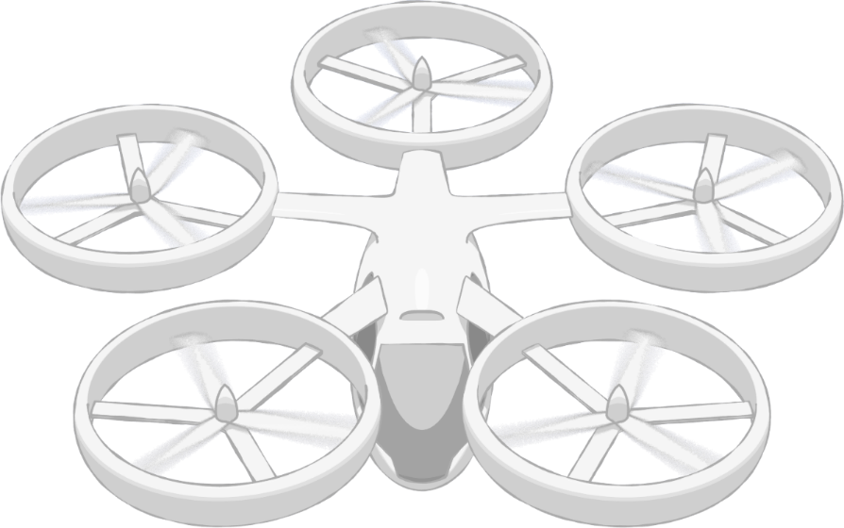



Strategic Thrust 4 Safe, Quiet, and Affordable Vertical Lift Air Vehicles
Community Integration
Community Integration
Airspace & Fleet Operations Management
AAM Community Outcome
Deliver a validated
1) system concept and
2) corresponding set of requirements
for a safe and scalable AAM transportation system.
Airspace System Design & Implementation
Airspace Design & Operations
Vehicle Development & Production
Individual Vehicle Management & Operations
Vehicle Development & Operations
Advanced Air Mobility (AAM) Vision
Revolutionize mobility in and around metropolitan areas by enabling a safe, efficient, convenient, affordable, and accessible air transportation system for passengers and cargo

Slide 18
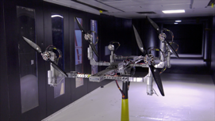
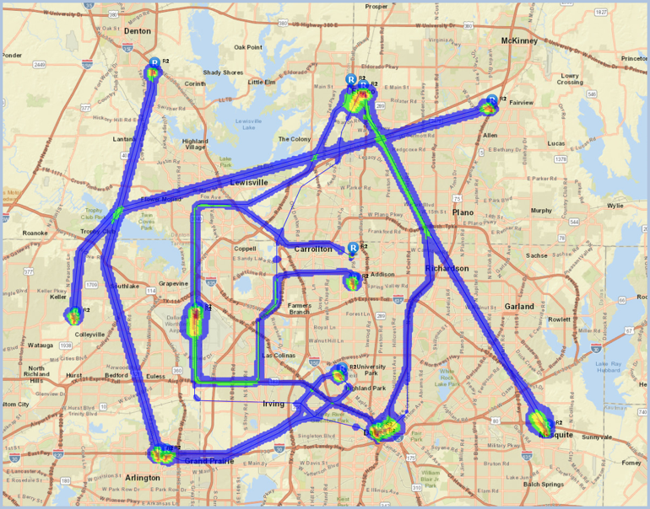
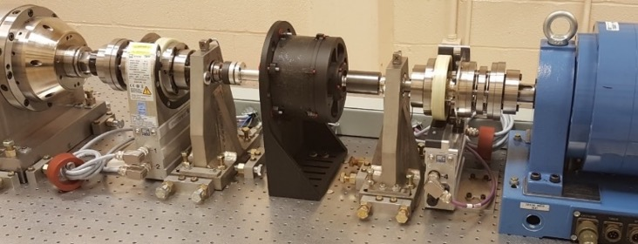
Revolutionary Vertical Lift Technology Project
Noise & Performance of Multi-Rotor Vehicles
Fleet Noise
National Campaign
Reliable & Efficient Propulsion Components

Slide 19
Hypersonics

Slide 20
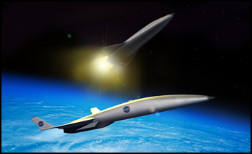
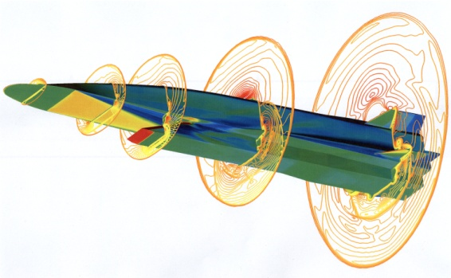
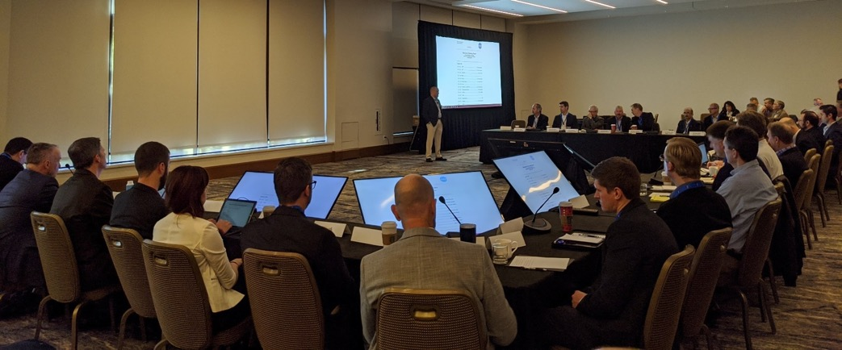
Hypersonic Technology Project
Fundamental Research on Dual-Use Applications
Strong DoD Partnership
Industry Engagement on Future Commercial Hypersonic Vision

Slide 21
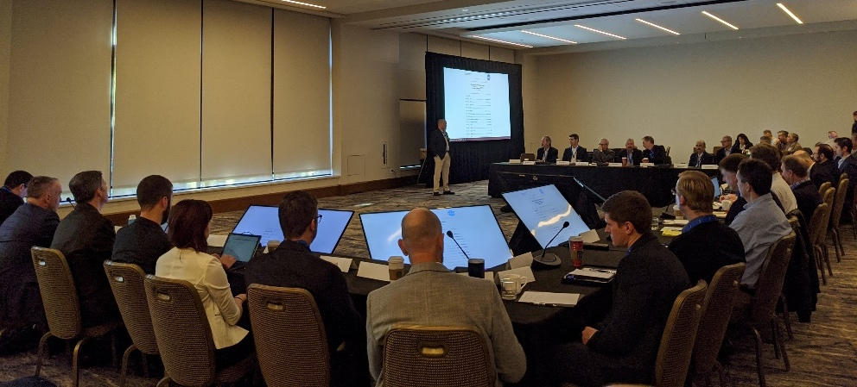
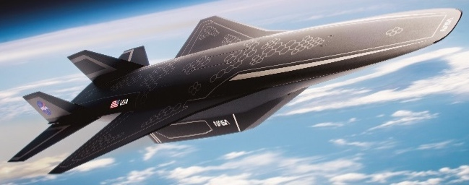
Hypersonic Strategy Assessment
Enabling routine, reusable, airbreathing hypersonic flight
Industry announcements reveal interest in commercial applications
Workshop held to understand interest and identify needs
Independent market study
Regulatory and data protection concerns
Hypersonic ground and flight test capability
Technology development
Assessing strategy in light of growing industry interest
Emerging industry vision for potential future commercial hypersonic market

Slide 22
Independent Market Studies
Potentially viable markets for high-speed air transportation
Favorable High-Speed Market Characteristics
Key Findings
SAIC: Commercial and private segments are most viable. Cargo demand not strong for civil use.
Deloitte: Commercial, private, and cargo are all viable segments. Top routes vary by segment.
Barriers largely similar to commercial supersonic flight, e.g., certification, LTO noise, emissions, field length, airspace integration
Concern with export controls and market impacts
Industry Feedback on Results
Favorable markets in a speed regime between NASA’s current supersonic and hypersonic portfolios
Desire to extend market study to explore additional areas (e.g., including transpacific routes and alternative aircraft fuels)
Interest in potential synergy between civil and defense applications for lowering required investment
Role for NASA in facilitating working group with FAA, Department of State, Department of Defense, airport authorities, and industry to address certification, regulatory, and environmental barriers
 | SAIC (with Bryce Space and Technology) | Deloitte (with SpaceWorks & NIA)
Mach | 3 | 2 - 4
Range | 4500 nmi | 4000 nmi – 4500 nmi
Number of routes⁽¹⁾ | 300 | 90
Aircraft Size (# PAX) | 10 GA or 50 Commercial | 20 to 50
Aircraft Cost | $200M - $300M | $131M - $228M⁽²⁾
⁽¹⁾ Deloitte only considers over water routes
⁽²⁾ Mach 3 at 4500 nmi

Slide 23
Wrap-up

Slide 24
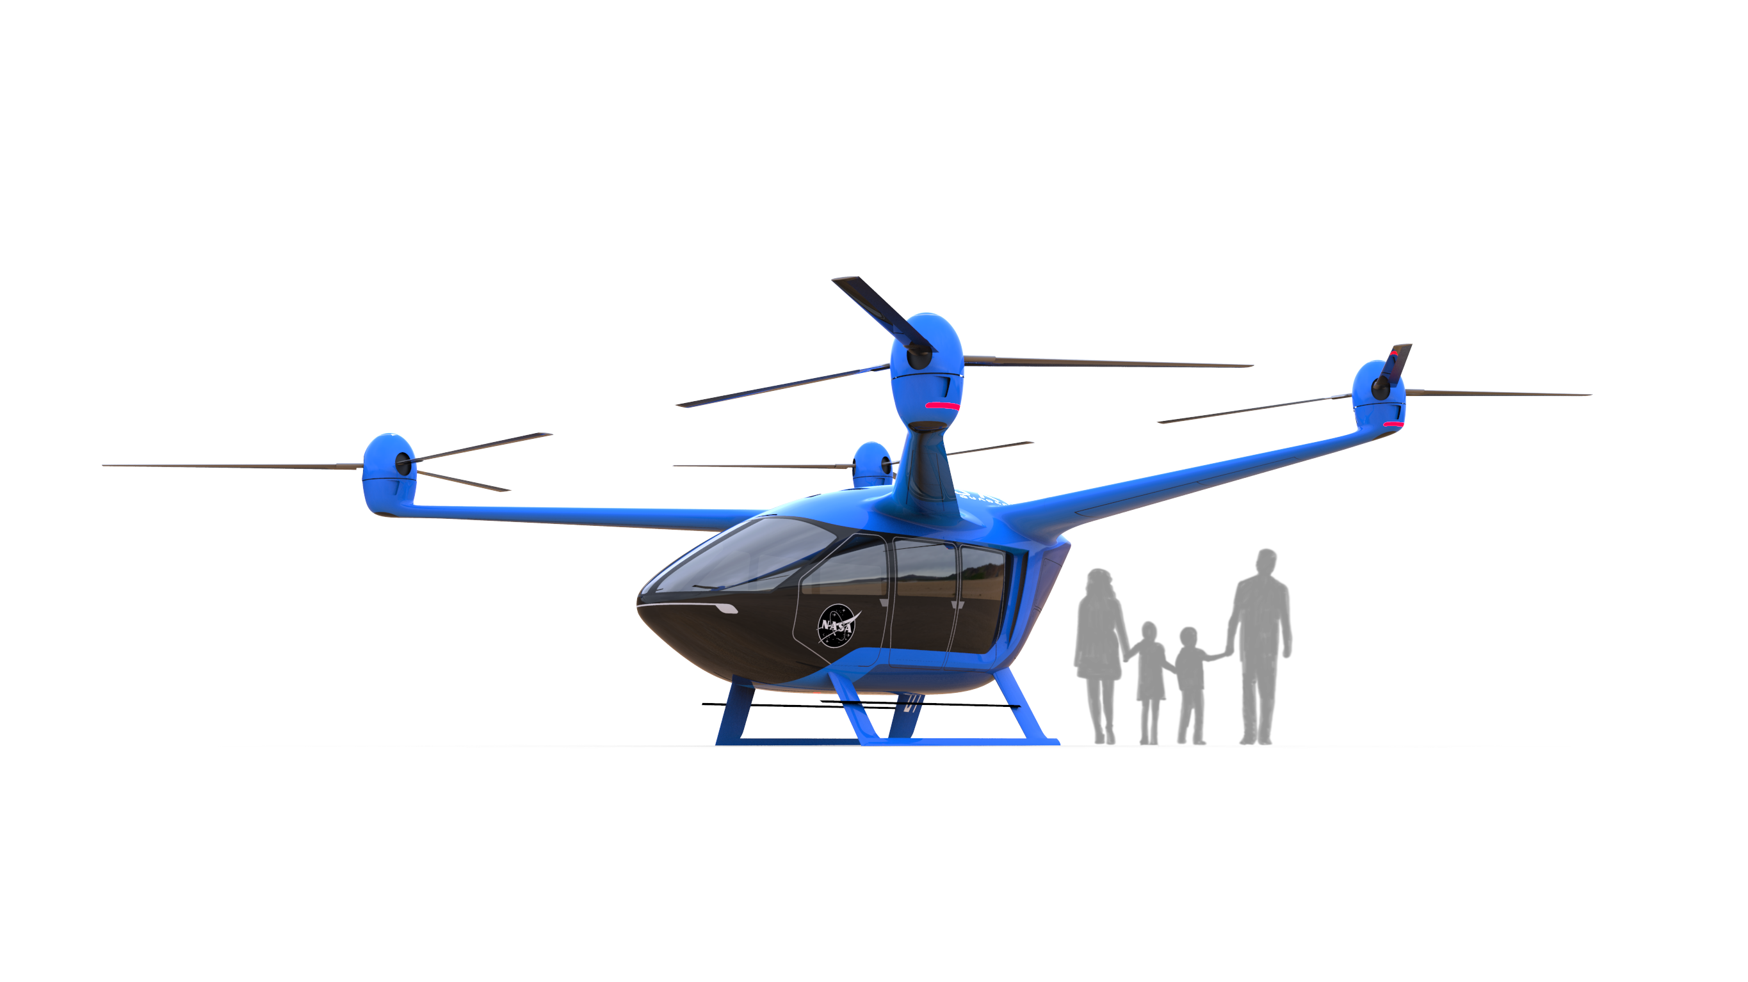
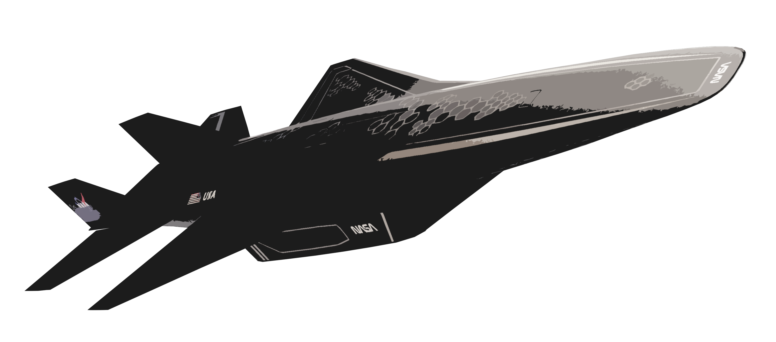
A New Era of Flight Is Emerging
Breaking down barriers to open new markets, advance U.S. competitiveness, and make air travel better for all Americans and for people around the world
Next Generation Subsonic Transports
Making commercial air travel more sustainable
Advanced Air Mobility
Allowing people to move about more easily
Commercial Supersonic Flight
Addressing environmental barriers to connect people faster
Hypersonic Flight
Enabling a future vision for hypersonic transport
Creating new “S” curves for the next 50 years of aviation

Slide 25
