Slide 1
Resource Mapping in Extreme Environments
Sang H. Choi
Robert W. Moses
NASA Langley Research Center
Hampton, VA

Slide 2
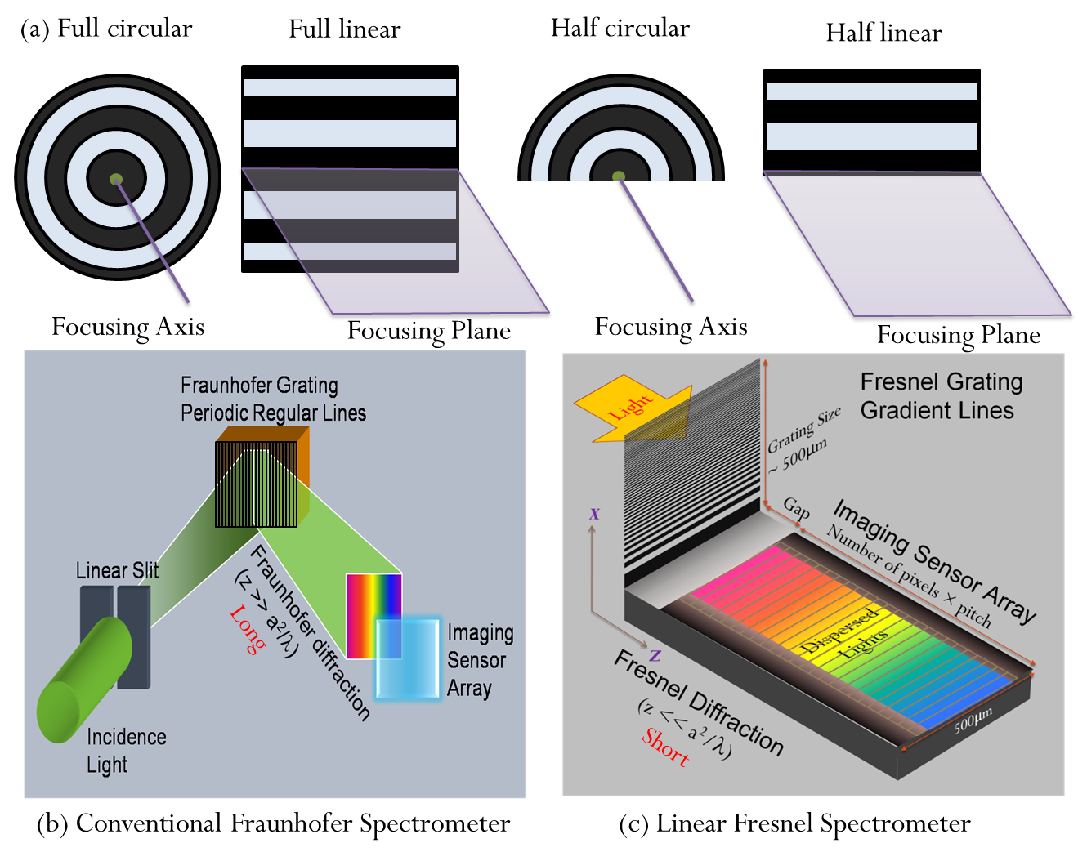
Linear Fresnel Spectrometer
(a) Full Circular Full Linear Half Circular Half Linear

Slide 3

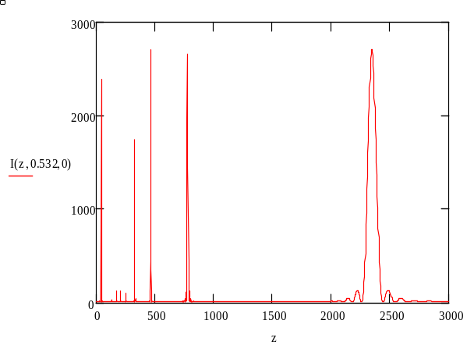
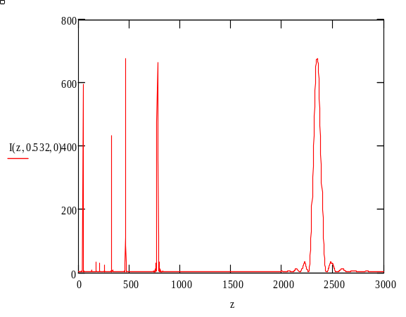
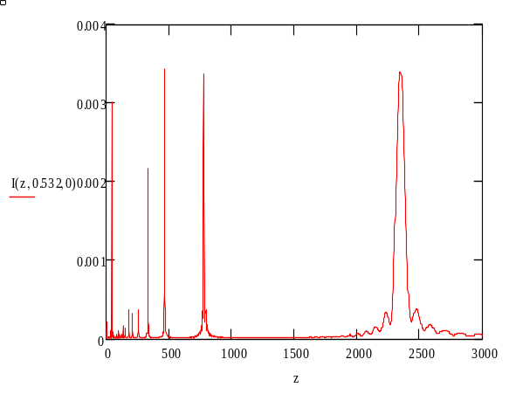
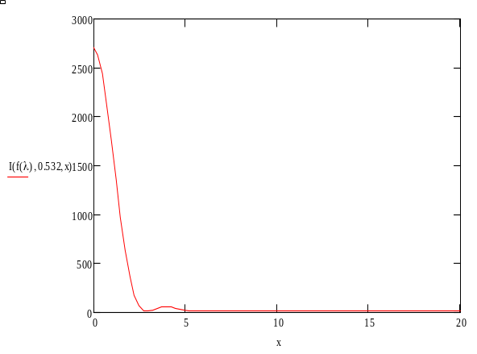
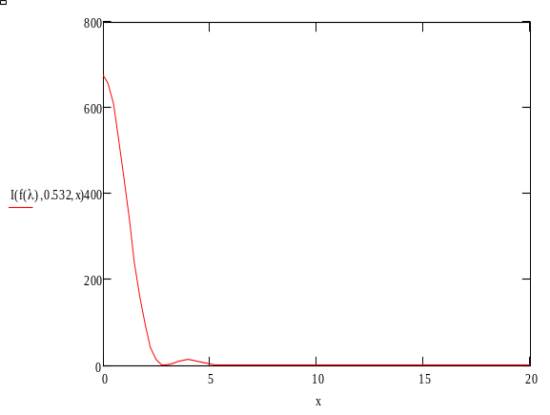
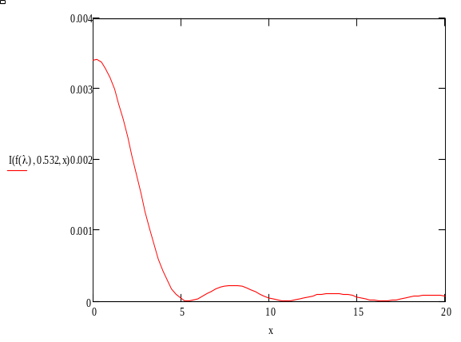
Comparison of Circular vs. Linear
Full Circular
Half Circular
Half Linear
Total Spot
Intensity
Total Spot
Intensity
Intensity per
unit Y-length

Slide 4
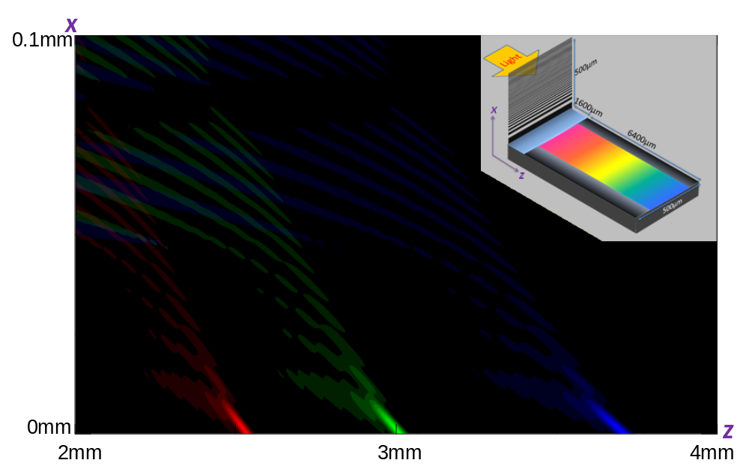
Fall of Three Lights onto Detector Surface
(632, 532, 432nm) 156 Lines in 500 μm

Slide 5
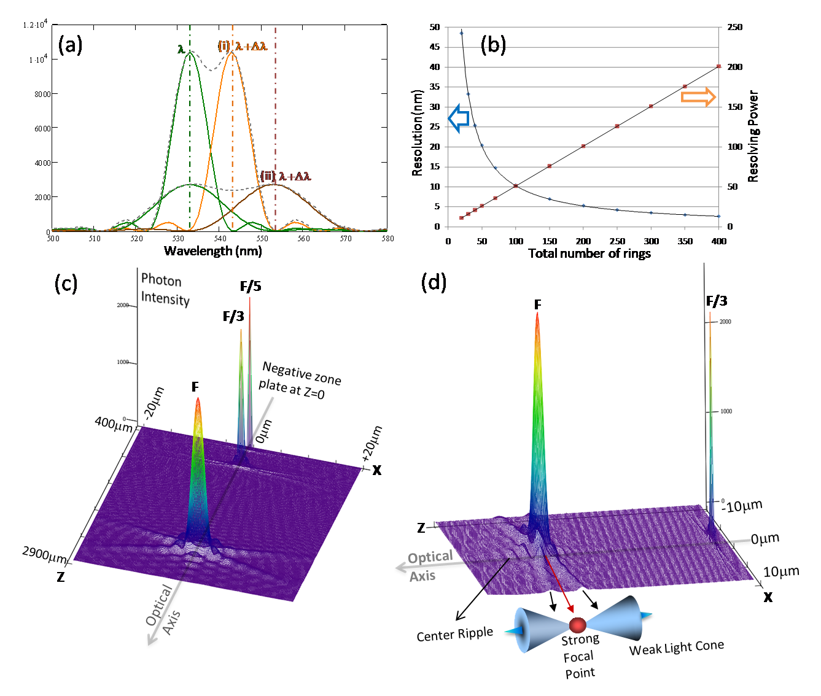
Spectral Data & Resolution
50
250
45
40
200
35
30
150
25
Resolving Power
Resolution, nm
20
100
15
10
50
5
0
0
0
50
100
150
200
250
300
350
400
Total Number of Lines per 2 mm

Slide 6
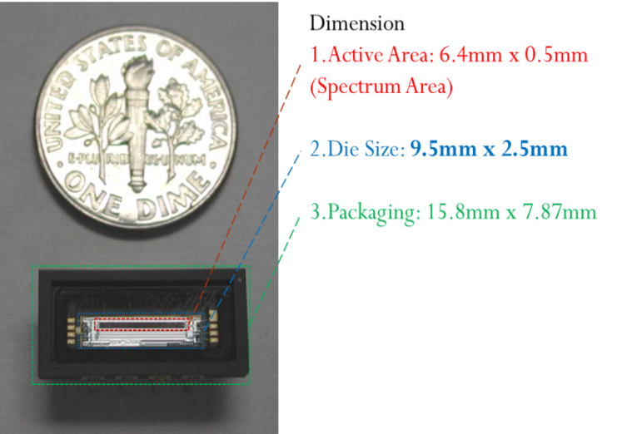
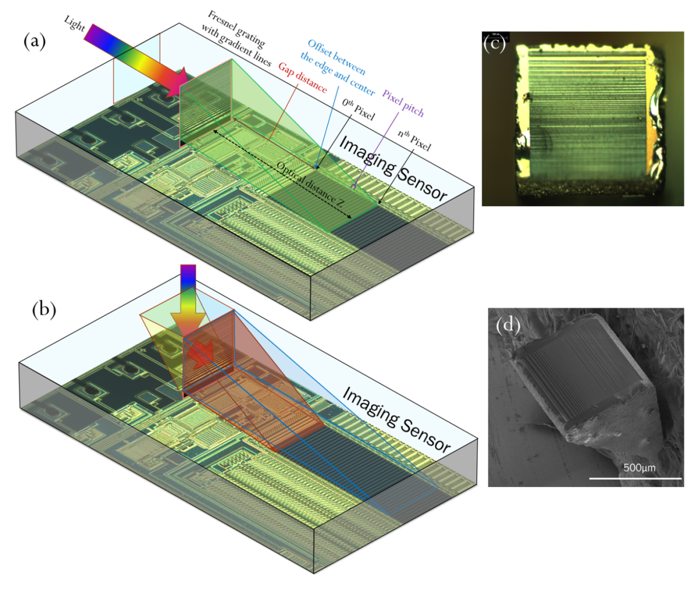
Spectrometer Chip
700µm

Slide 7
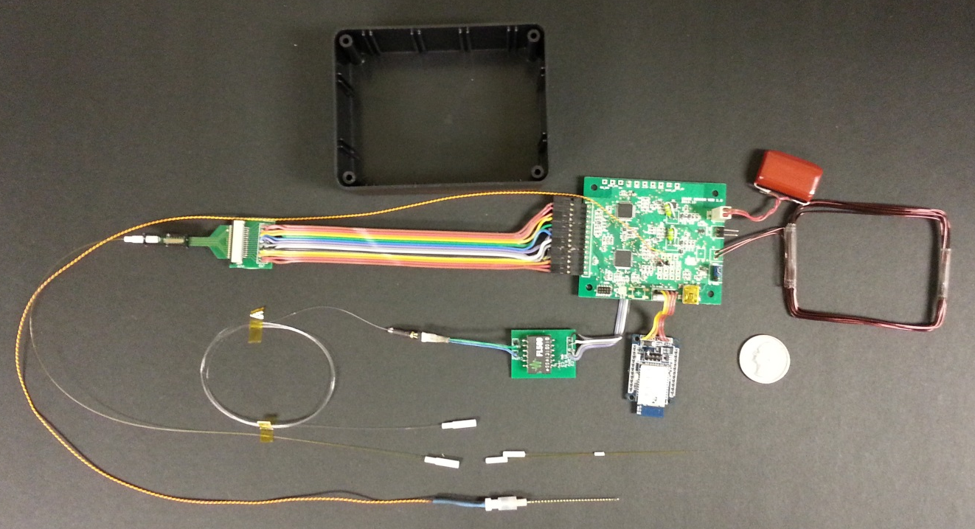
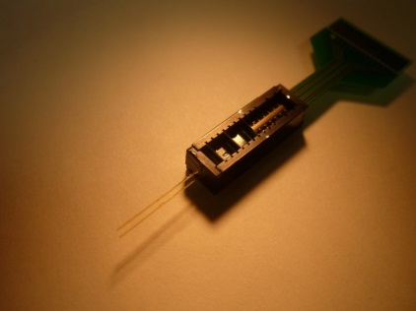
1-D Scan Prototype System
μ-Spectrometer
Supercapacitor
System Electronics
Coin-25¢
WPT Coil
Bluetooth
Opto-Coupler
Optical Sensing Probe
Laser Diode Driver
Electrical Stimulation Electrode
Laser Diode

Slide 8
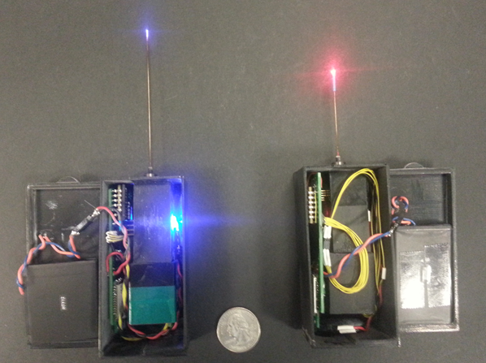
Laboratory Sensing Modules
Surface Enhanced Raman Spectrometer
Fluorescence Spectrometer

Slide 9
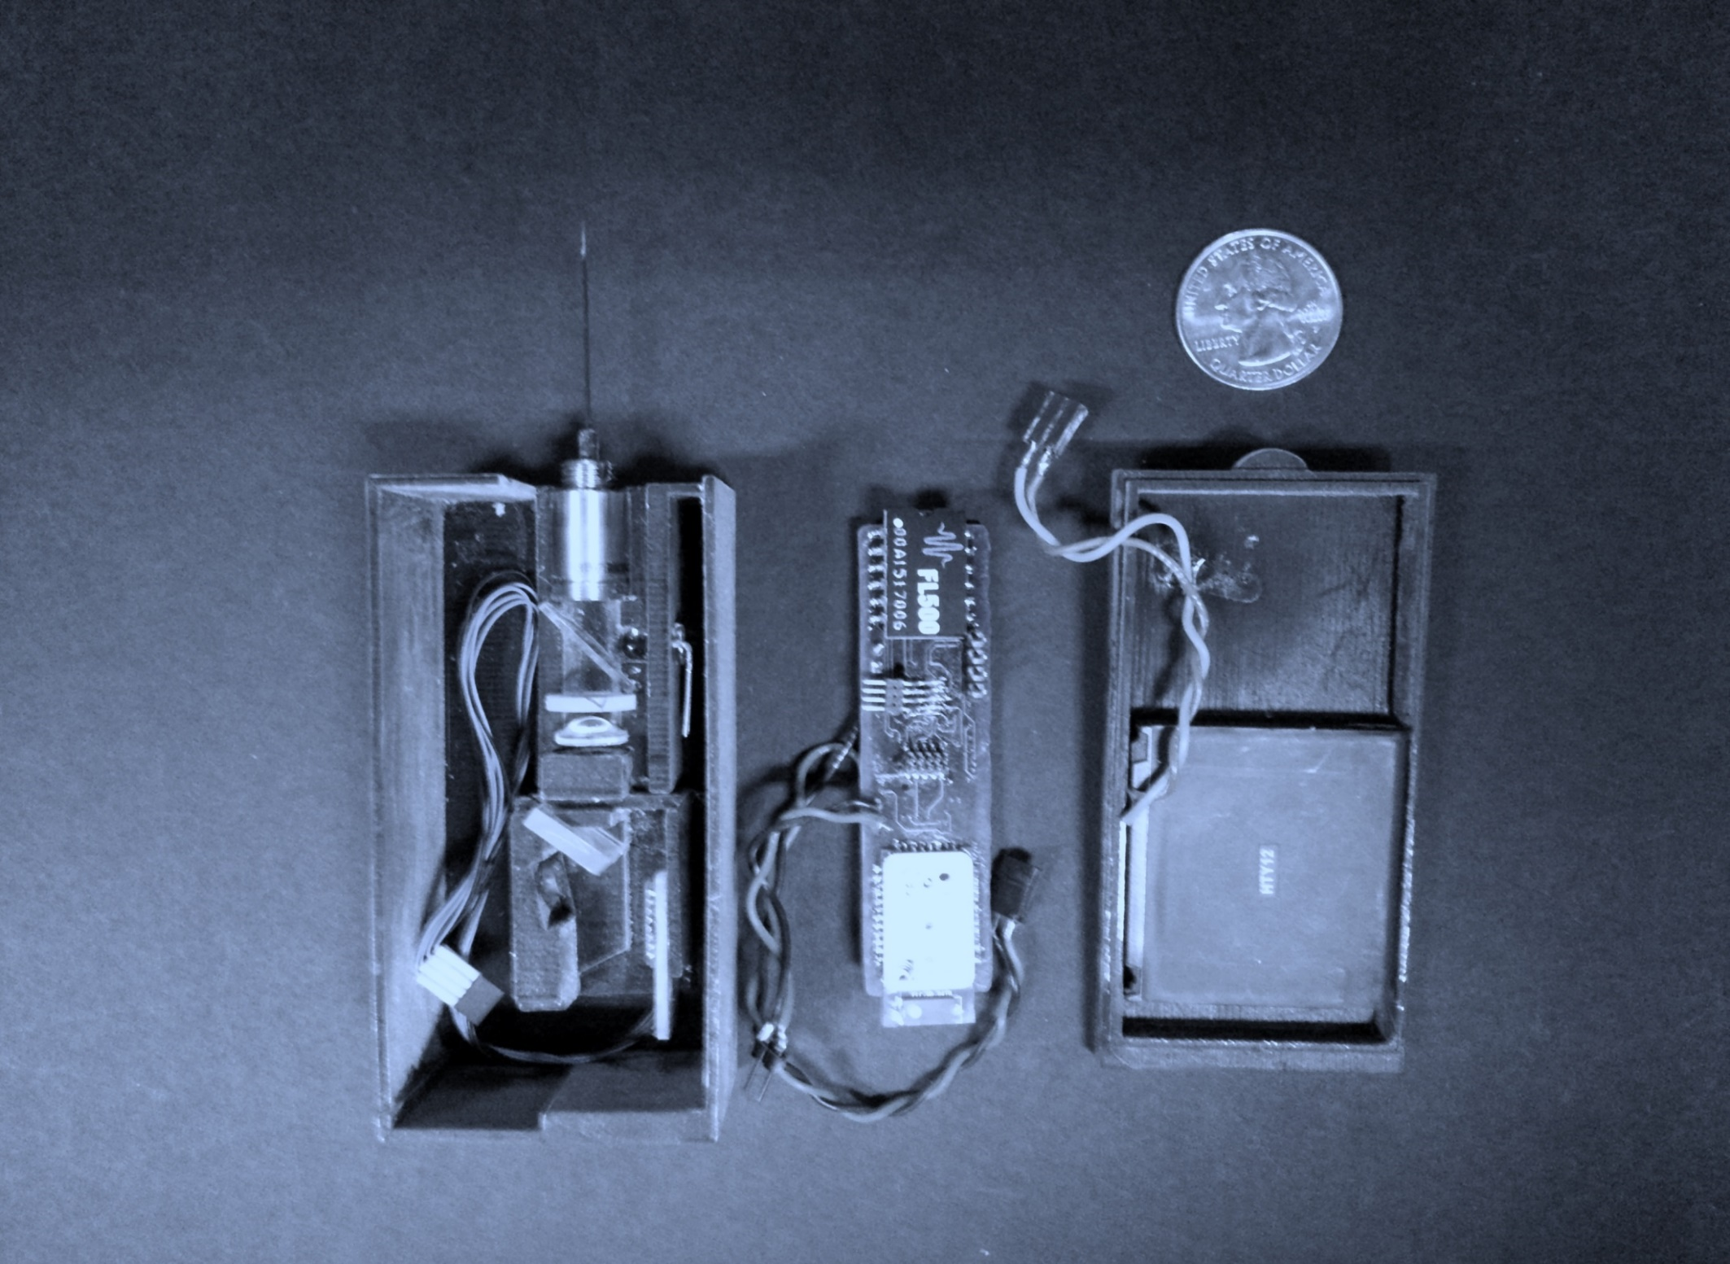
Sensing Probe
Laser Diode Driver
Beam Collimator
Microcontroller
Dichroic Filter
Battery
Linear Grating
Bluetooth Module
CMOS Image Sensor

Slide 10
Dopamine Sensing Results
Arbitrary Unit
Pixel

Slide 11
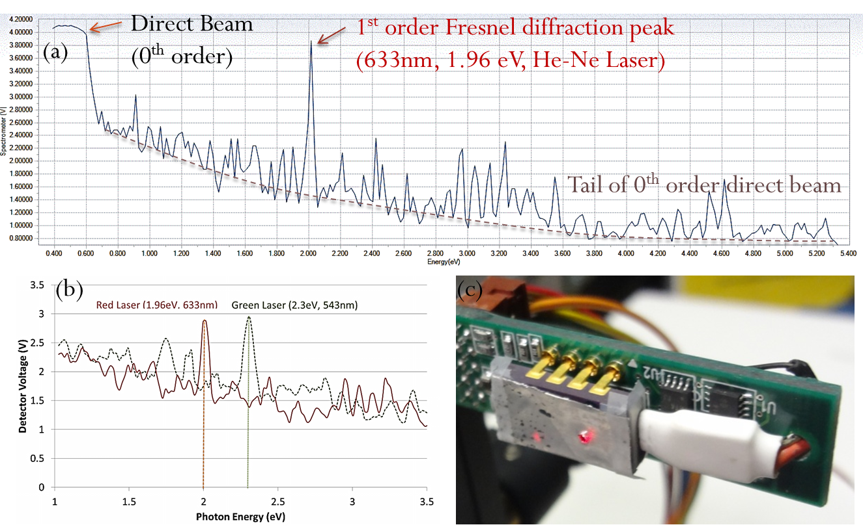
Acquired Optical Data

Slide 12
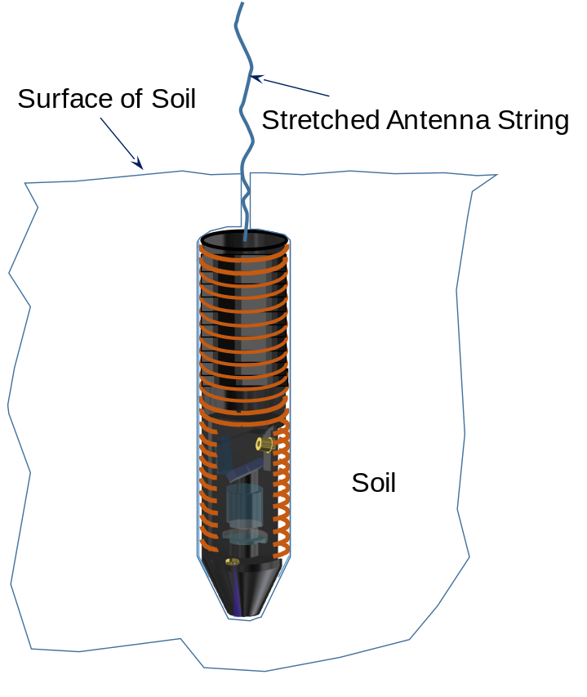
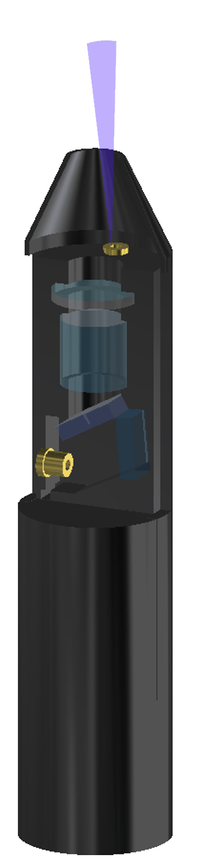
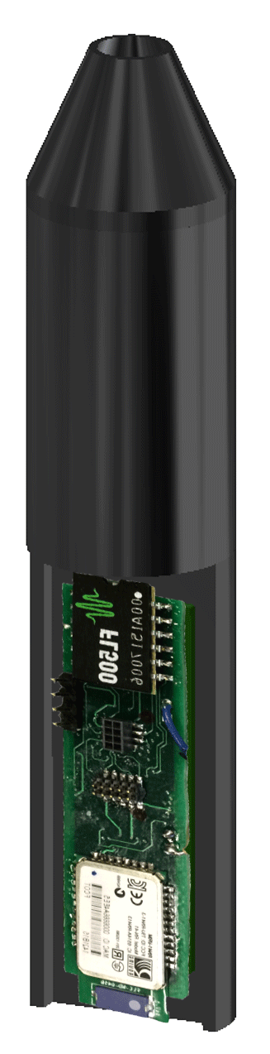
Bullet µ-Spectrometer
Micro-Spectrometer
Principle of Fresnel diffraction
Light source: Deep or vacuum UV from burst-mode LED
Pulse mode power feed from super-capacitor
Bullet-like consumable micro-spectrometers
Shooting by compressed air gun
Super-capacitor with
Control & Telemetry
Electronics
Micro-Spectrometer
Optics
< 7.5 cm
Soil
< 2.5 cm
Langley invented micro-spectrometer meets
NASA Roadmap 8.3.3.6

Slide 13
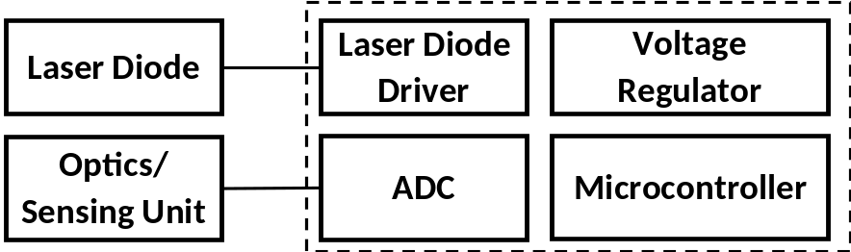
Bullet µ-Spectrometer
Charging Coil
Releasable Antenna Coil
Super-capacitor
Laser or LED
Light
Target
Laser Diode
or LED
LD or LED
Driver
Telemetry System
Optics/
Sensing Unit
Optical Window
Fluorescence or
Luminescence

Slide 14
Gas Gun for Bullet µ-Spectrometer
Array of Circumferentially
Arranged Magnets
Barrel
Compressed Gas
Gas Release Trigger
Magazine of
Micro-Spectrometer Bullets
Load Spring

Slide 15
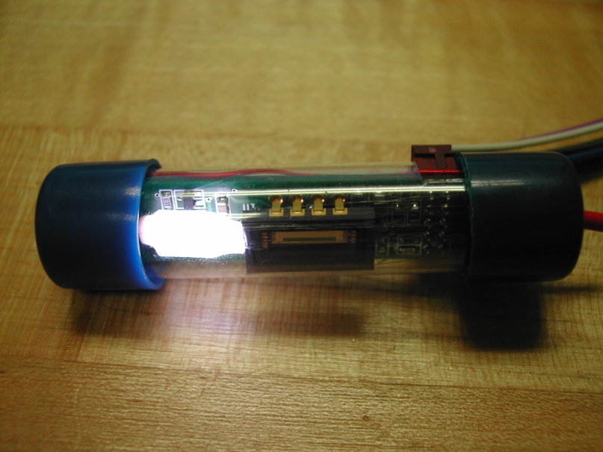
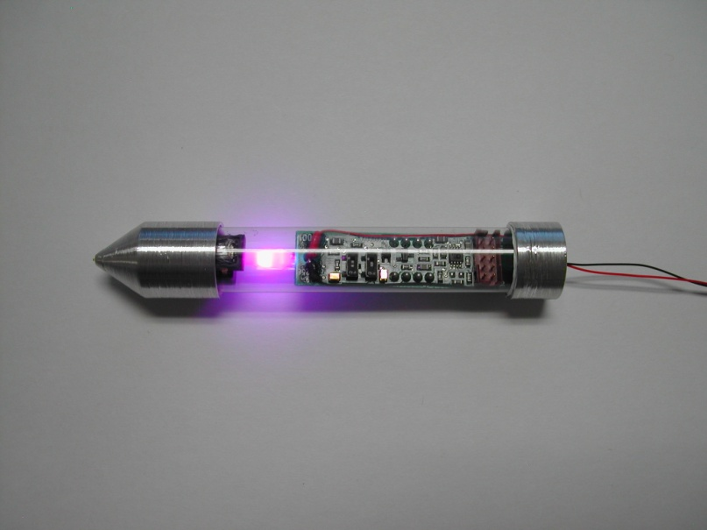
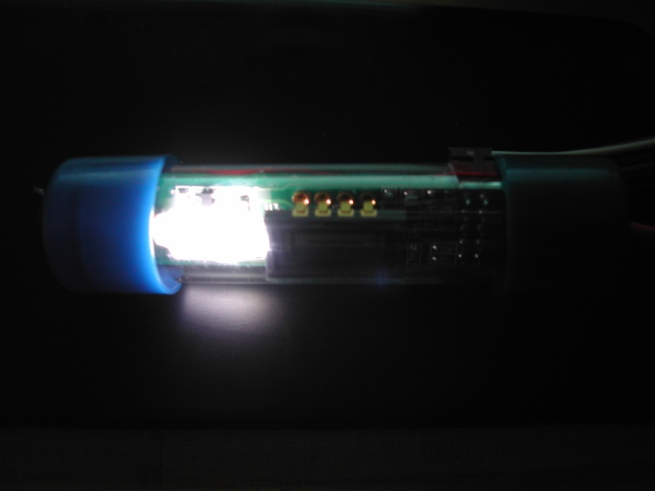
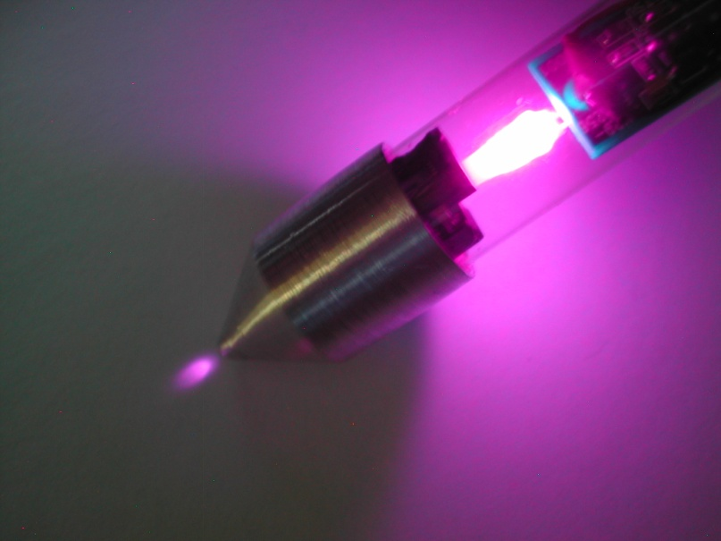
Lunar Soil Probe Device Models
Body illumination with white LED
Head illumination with UV(330nm) LED

Slide 16
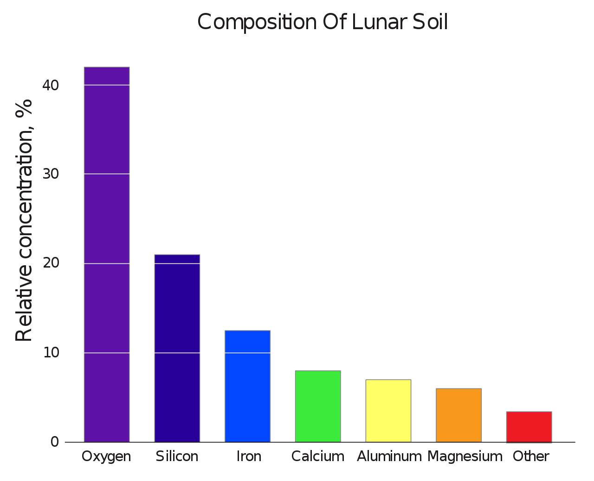
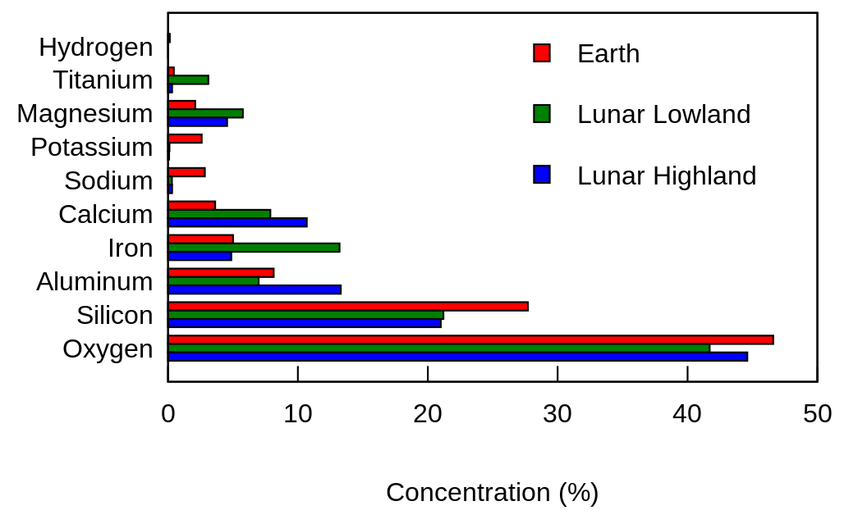
Composition of Lunar Regolith
https://en.wikipedia.org/wiki/Lunar_soil#/media/File:Moon_vs_earth_composition.svg
https://en.wikipedia.org/wiki/Lunar_soil#/media/File:Composition_of_lunar_soil.svg

Slide 17
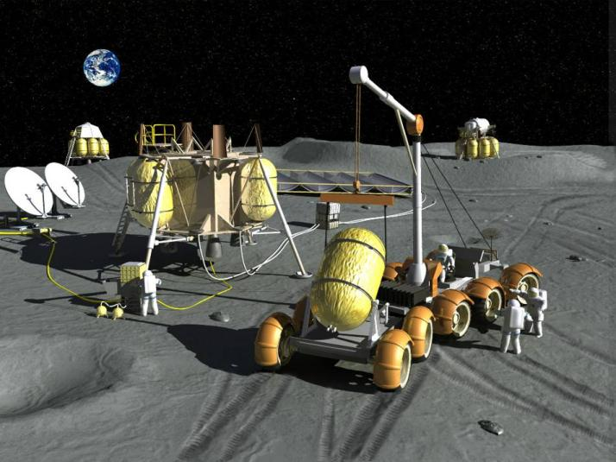
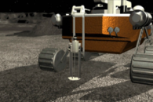
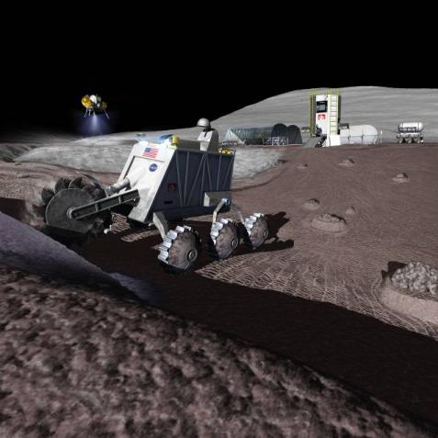
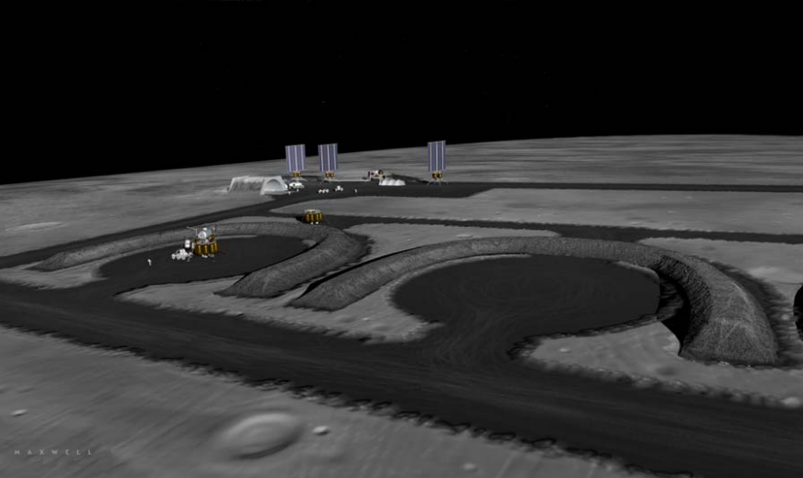
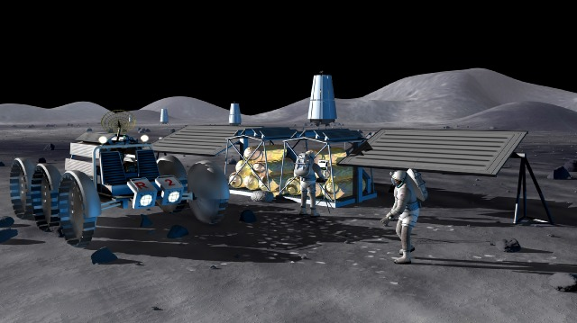
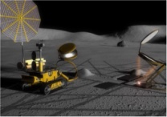
Excavation & Regolith Processing for H₂ & O₂ Production, Binders & Aggregates
Images credit: NASA
Resource Prospecting: Looking for Resources
Propellant Processing with Lander & Pad Infrastructure
Thermal Energy Storage Construction
Construction of Consumables Depots for Crew & Power ( O₂, H₂)
Habitat, Hangars, Dust Free Zones, Landing Pads, Berm, and Road Construction

Slide 18
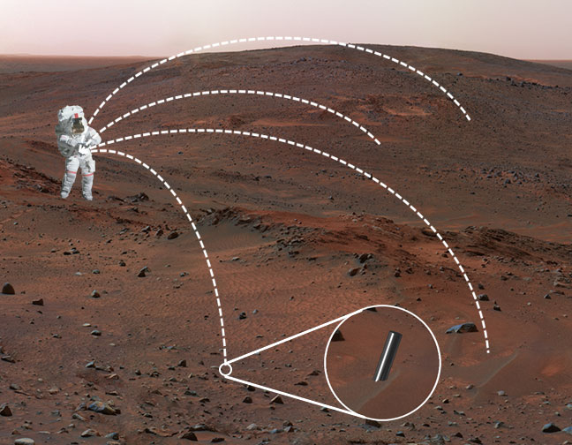
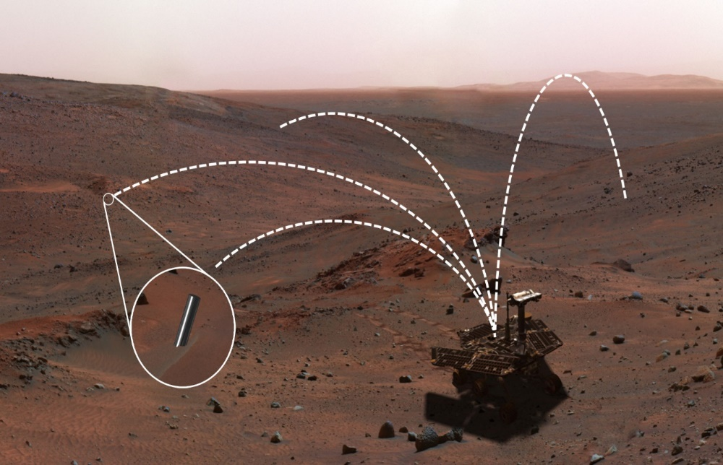
Mars Soil Assay by Bullet µ-Spectrometer
Astronaut with Micro-Spectrometer Gun
Rover with Micro-Spectrometer Gun
Bullet-like consumable micro-spectrometers are shot out broadly to assay organic and inorganic components of Lunar/Mars/Asteroids soils.

Slide 19
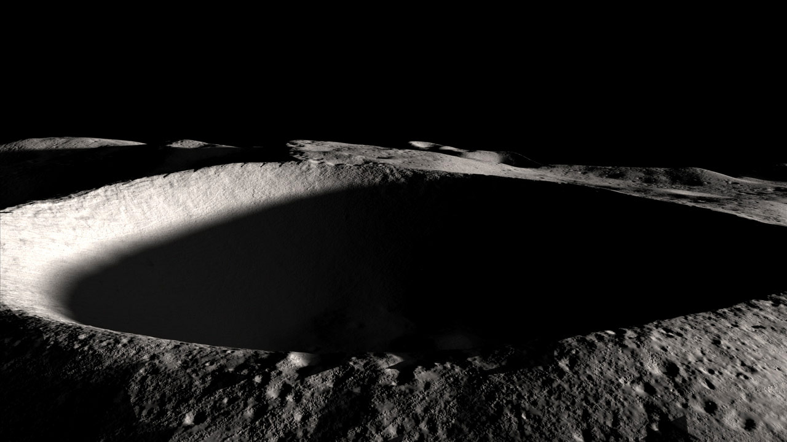
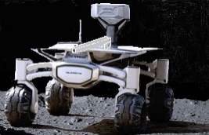
Lunar Soil Assay by Bullet µ-Spectrometer
Penetration of Bullet μ-Spectrometer into Steep Hillside and Bottom of Crater

Slide 20
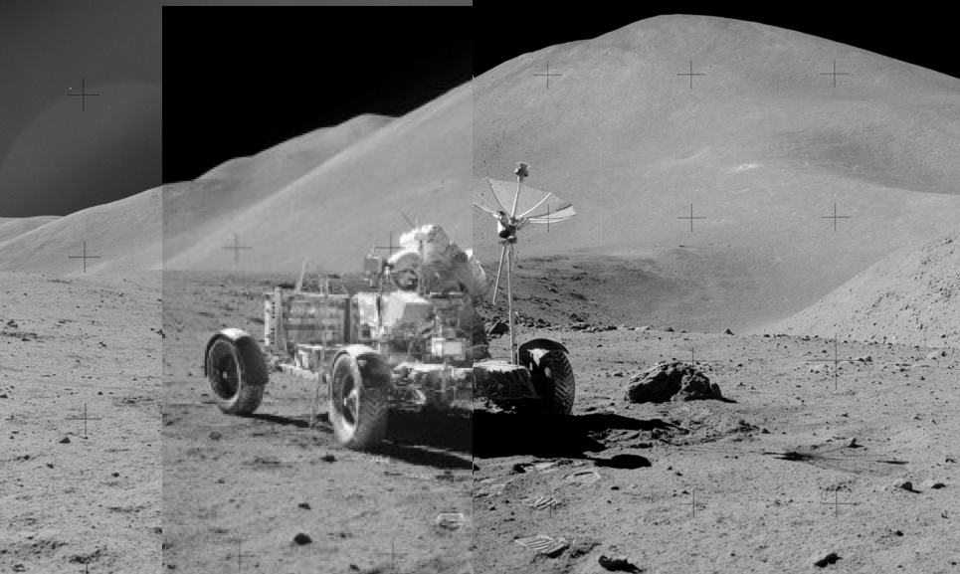
Lunar Soil Assay by Bullet µ-Spectrometer
Bullet μ-Spectrometer Penetration into Lunar Soil

Slide 21
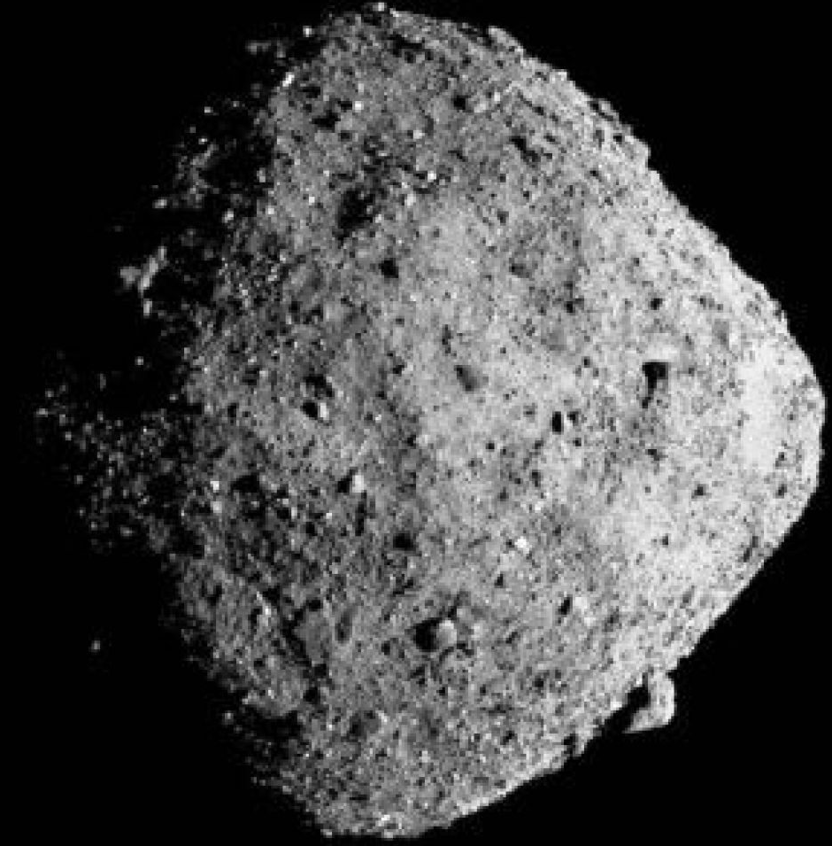
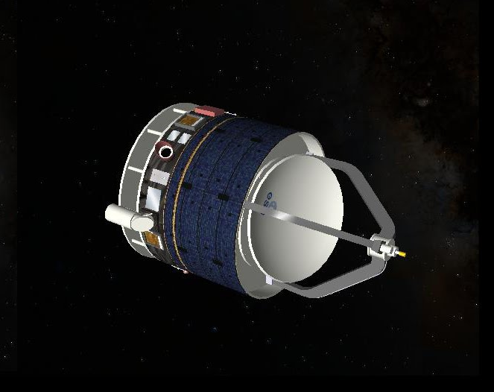
Asteroid Soil Assay by Bullet µ-Spectrometer
Penetration of Bullet μ-Spectrometer
into Asteroid

Slide 22
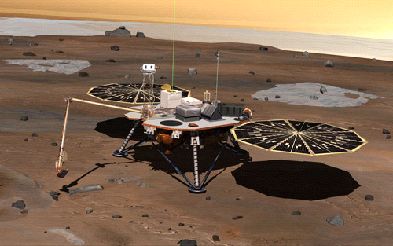
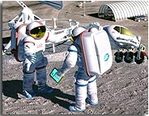

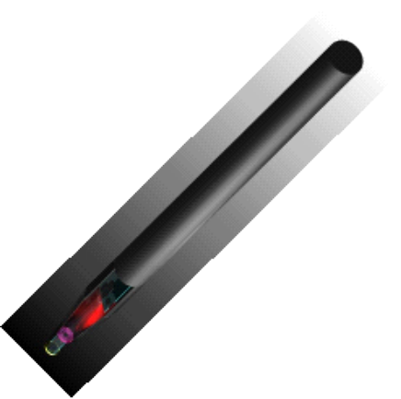


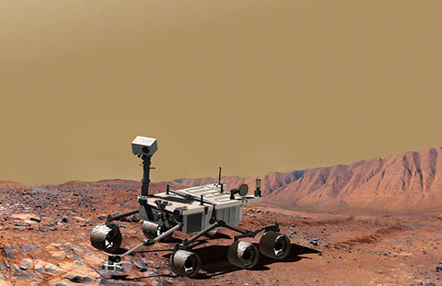


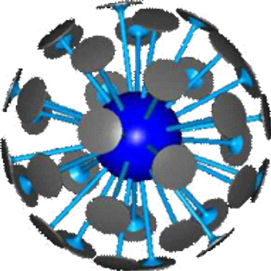
µ-Spectrometer for Lunar & Mars Exploration
µ
-
SM
Probes for
Future Mars Lander
µ
-
SM Imbedded
Astronaut Shoes
and Rover Tires
Mars Science Lab
Images
Credit NASA
?
-
spectrometer
µ
-
SM Imbedded
Tumbleweed Rover

Slide 23
Concluding Remarks
  Applications of micro-spectrometer bullets were defined for mineral mapping on Moon and Mars, especially hillsides and deep bottom floor of craters
  Laboratory model was fully developed and tested for dopamine samples
  Bullet type of micro-spectrometer and shooting gun were designed for space applications
  Based on the spectral data of minerals, line and pixel densities of the micro-spectrometer will be tailored for measurement accuracy and clarity
  Device components, such as avalanche photo-diode, burst-mode LED, cylindrical super-capacitor, and telemetry, require further development for enhanced and versatile performance of bullet shape micro-spectrometers
  Collaborative activities are planned under an international partnership

