Slide 1
AIAA SOSTC
NASA CARA
Best Practices for Autonomous Maneuvering
Megan R. Johnson
7 April 2021

Slide 2
Agenda
Background
  Changing Space Environment
  Operational need for autonomous maneuvering
NASA Best Practices for Autonomous Maneuvering
Overview of Conjunction Assessment Approaches
  Identifying and mitigating potential conjunction events when autonomously maneuvering

Slide 3
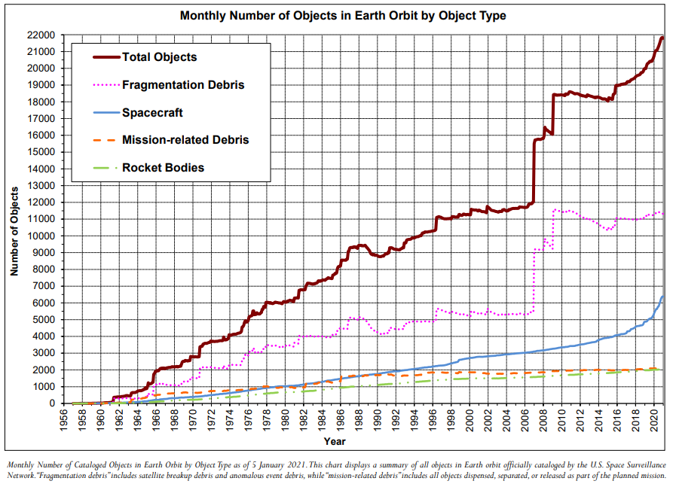
The Changing Space Environment
The space environment, and particularly the Low Earth Orbit (LEO < 1300 km altitude), has changed dramatically in the last two years
  77% increase in total payloads on orbit and many more preparing to launch
  More unique spacecraft Owner/Operators bringing individual perspectives on space operations
  Increased tracking capabilities and cataloging of smaller debris objects
Changes in the space environment and mission CONOPS drive a need for spacecraft automation
Feb. 2021 Orbital Debris Quarterly News
https://orbitaldebris.jsc.nasa.gov/quarterly-news/pdfs/odqnv25i1.pdf

Slide 4
Ground-based vs.
On-Board Trajectory Guidance
Ground-Based Trajectory Guidance | On-Board Trajectory Guidance
Human-in-the-loop trajectory guidance ensures that computed maneuvers, modeled in ephemeris data, can be shared with the entire space community Proven to be reliable for safety of flight for many years of spaceflight operations Does not scale well for large constellations of spacecraft | On-board, automated trajectory guidance allows for large constellations of spacecraft to exist by substantially increasing efficiency of flight control Intended trajectory and maneuvers may not be communicated to the ground in advance of maneuver execution making communication of plans difficult or impossible
Whether ground-based or on-board, if future maneuvers plans are not shared amongst spacecraft Owner/Operators (O/O), there is a real risk that two maneuvering spacecraft will cause a collision.

Slide 5
Future of Autonomous Maneuvering and Current Best Practices
Autonomous Maneuvering, in general, is a new capability
Best Practices presented here are based on current known capabilities and existing framework for communicating and performing conjunction assessment (CA) on maneuver plans
Addressing CA for autonomous maneuvering is a complicated and currently unsolved problem
Long-term would like to see:
  Central clearinghouse for near-real-time sharing of ephemerides amongst relevant O/Os so that maneuvers plans can be communicated directly to appropriate O/Os
  “Rules of the Road” developed for mitigating close approaches: for two autonomously maneuverable missions, who moves and who stays put?
  Inter-constellation communication

Slide 6
Best practices

Slide 7
NASA CARA Best Practices
NASA CARA has published a set of Collision Avoidance (CA) Best practices
  https://nodis3.gsfc.nasa.gov/OCE_docs/OCE_50.pdf
  Document developed in partnership with industry
  Published December 2020
  Includes best practices for both autonomous and non-autonomous flight; many items apply to both types of spacecraft operations
  Living document that can be updated as new or updated best practices are identified
Best Practices identified in Section 6.5—Automated Trajectory Guidance and Maneuvering—presented here

Slide 8
Best Practices
A. When an autonomously controlled satellite computes any maneuver to alter its orbit for mission or CA purposes, communicate maneuver details to the operating ground control early enough to enable a USSPACECOM screening and appropriate action in response to the screening results.
B. Share maneuver plans with USSPACECOM both as a maneuver notification report and a predicted ephemeris.

Slide 9
Best Practices
C. Deploy an accurate on-ground satellite emulation capability to predict and share the behavior of the autonomously controlled satellite in predicted ephemerides.
D. Execute the maneuver as planned unless an alteration is required for safety of flight once a maneuver is autonomously planned and communicated to the ground
E. Include the ability to pause or abort from the ground, for safety

Slide 10
Best Practice Notes
Best Practice A and C can both be implemented to increase ability of O/O to provide accurate ephemerides and maneuver plans to community
  At a minimum, one of these methods (downlinking ephemeris/maneuver plans or deploying accurate ground-emulator) should be employed
Ephemeris with modeled maneuver should be available far enough in advance to enable screening by USSPACECOM and communication of results to other O/Os
  At least 24 hours prior to maneuver execution
  Once screened, maneuver plan should not change unless for safety of flight
Future improvements to communication amongst O/Os could reduce lead time needed to identify potential conjunction events
  Spacecraft CA maneuver lead-time could be reduced to just a few hours, which could eliminate many CA actions (since risk should typically fall off to the time of closest approach)

Slide 11
Overview of conjunction assessment approaches

Slide 12
Overview of CA Approaches
Autonomously planned maneuvers can be screened to identify potential collisions using different techniques
  Plan maneuvers sufficiently far in advance that screening can be completed on-ground (Best Practice A and/or C)
  Constrain autonomous maneuvering planning enough such that swaths of potential maneuvers can be analyzed on-ground against screening data
  Use USSPACECOM screening data to perform conjunction assessment on-board
Best practices for CA for autonomous maneuvering still being identified/developed

Slide 13
Comparing CA Approaches
Screening Approach | Pros | Cons
Screen maneuvers on ground | Matches existing paradigm for planning and screening spacecraft maneuvers Using downlinked maneuver plans or accurate ground-based emulator ensures screened data matches executed data Sufficient time available to communicate screening results and potential conjunction events with other O/Os | May require more “lag time” between planning and execution than available or desirable Larger spacecraft contact burden – may need downlink and uplink contacts for each maneuver
Constrain autonomous maneuver planning | Sets of potential maneuvers can be evaluated on the ground providing flexibility in final maneuver time/size/direction | Limits maneuver potential of the spacecraft which may be undesirable for mission constraints/objectives Need sufficiently large screening volume and appropriate toolset to identify possible conjunction events against potentially large numbers of maneuver times/sizes/directions
On-board Autonomous CA | Long-term solution to screening planned maneuvers and predicted spacecraft trajectory Near-real-time implementation of CA should reduce execution of avoidance maneuvers as timelines can be condensed significantly | Full close-loop solution may be difficult to implement Requires robust process for uplinking screening data to spacecraft Does not eliminate need to communicate maneuver plans to wider space community

Slide 14
Summary and Conclusion
Both autonomous and non-autonomous spacecraft O/Os have a vested interest in protecting their payloads and the space environment
Autonomous maneuvering payloads can upend existing procedures for communicating trajectory information to other O/Os
Presented here are practices to ensure communication of critical maneuver and ephemeris information to the space community
Performing entire conjunction assessment process for autonomously maneuvering spacecraft still being understood and best practices developed

Slide 15
Back up slides

Slide 16
NASA CARA Support
The Conjunction Assessment Risk Analysis (CARA) team has been supporting NASA missions since 2005
  What began as a small set of NASA Missions has grown into over 75 maneuverable and non-maneuverable payloads receiving routine CA support from the CARA team
CARA has researched, implemented, and championed many best practices to improve spacecraft and orbit regime safety
  O/O provided ephemeris and covariance
  New Pc methods such as Brute Force Monte Carlo (BFMC) and 3D Nc Pc
  Published a “CA Handbook” through NASA in December 2020

Slide 17
NASA NID
4.4 Autonomous Flight Control and Navigation
4.4.1 For spacecraft using autonomous flight control and navigation, the project manager shall:
  a. Use an emulation capability that reasonably predicts the behavior of the autonomous flight controller to generate predicted ephemerides according to the requirements of Sections 4.2.1 and 4.3.1.b of this directive.
  b. Routinely send predicted ephemerides to CARA or FOD for screening prior to maneuver execution with sufficient time to perform such screenings, receive results, and abort maneuver execution, if necessary, as defined in the CAOIA.
  c. Once a maneuver is autonomously planned and this plan has been communicated to the ground for inclusion in the predicted ephemeris to be screened, execute the maneuver as planned unless an alteration is required for safety of flight.
  d. Possess and, if required, use a capability to halt expected autonomously planned maneuvers for safety-of-flight reasons.
  e. Notify CARA or FOD of all maneuvers initiated autonomously

