Slide 1
NASA Human Research Program (HRP) Analog Use and Lessons Learned
William ‘Brandon’ Vessey PhD
Deputy Element Scientist for Flight Analogs, ROI

Slide 2
Presentation Overview
HRP Analogs
Lessons Learned
Capability Gaps
A ‘Best in the World’ Isolation Analog for HRP

Slide 3
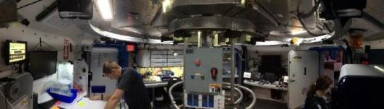
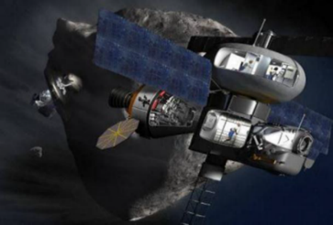
HRP Analogs
Why does HRP use Analogs?
  Analogs provide conditions similar to some (but not all) conditions encountered in space flight such as:
    Isolation
    Confinement
    Physiological stressors
    Environmental danger
Benefits to HRP
  Studies completed more quickly and less expensively than flight studies
  Used as a “proving ground” before studies or countermeasures are implemented in space
  A more “controlled” environment, often more repeatable scenarios, and higher sample size than available in space

Slide 4
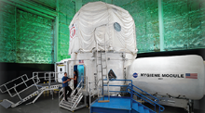
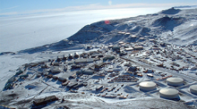
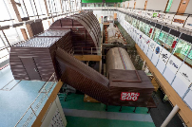
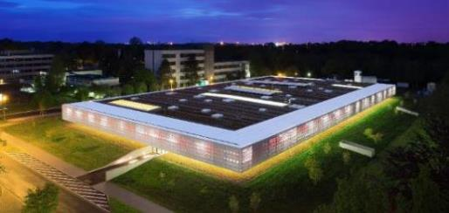
Analogs Currently Used by HRP
Isolated, Confined, Control
Isolated, Confined, Extreme
Human Exploration
Research Analog (HERA)
Antarctic Stations (NSF)
Physiological Deconditioning
IBMP Ground-based
Experimental Complex (NEK)
:envihab

Slide 5
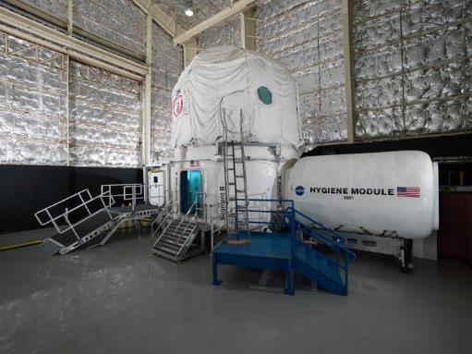
HERA
The Human Exploration Research Analog (HERA) was acquired by HRP in 2013
Two-story, four-port habitat unit. Cylindrical with a vertical axis, and connected to a simulated airlock and hygiene module
Missions implemented for the purpose of human research in an isolated, confined, and controlled environment
Total space: 148.1 m³
  core (56.0 m³)
  loft (69.9 m³)
  airlock (8.6 m³)
  hygiene module (14.1 m³)

Slide 6
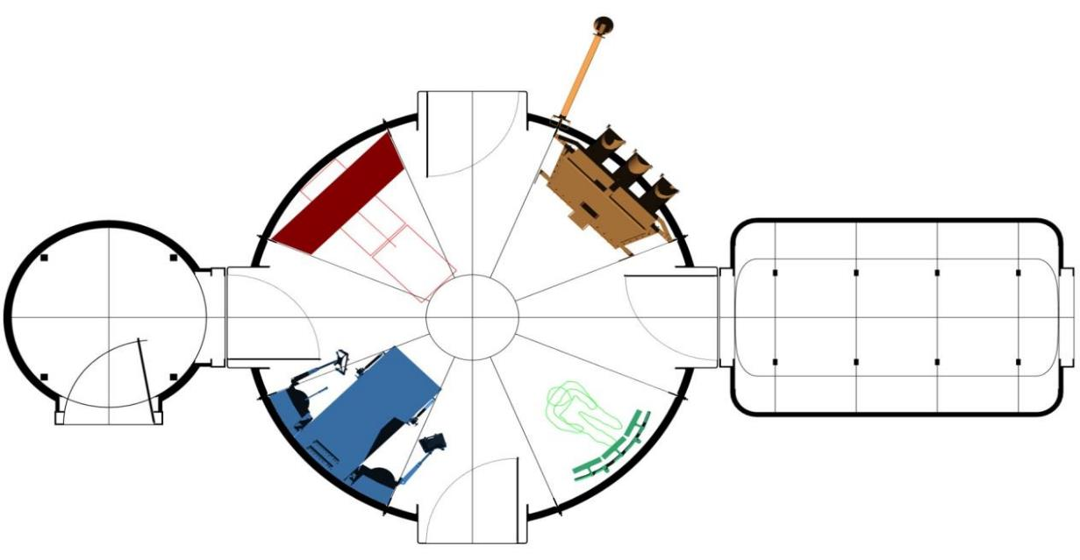
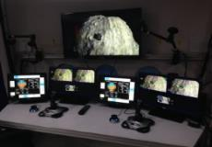
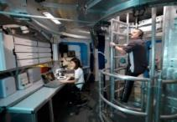
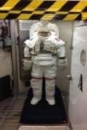
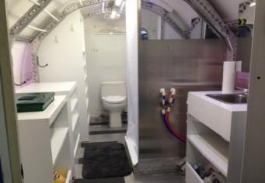
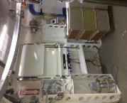
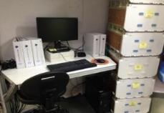
HERA Interior (1st floor)
47’ (14.3 m)
Medical Science Station
19.3’ (5.9 m)
Flight
Deck
13.25’ (4.0 m)
8.5’ (2.6 m)
Hygiene Module
Airlock
Core
Toilet
Sink
Shower
To porch and ramp
Maintenance Workstation
Operations Console
Hygiene Module

Slide 7

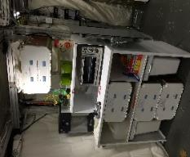
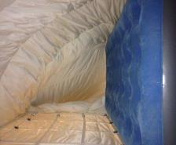
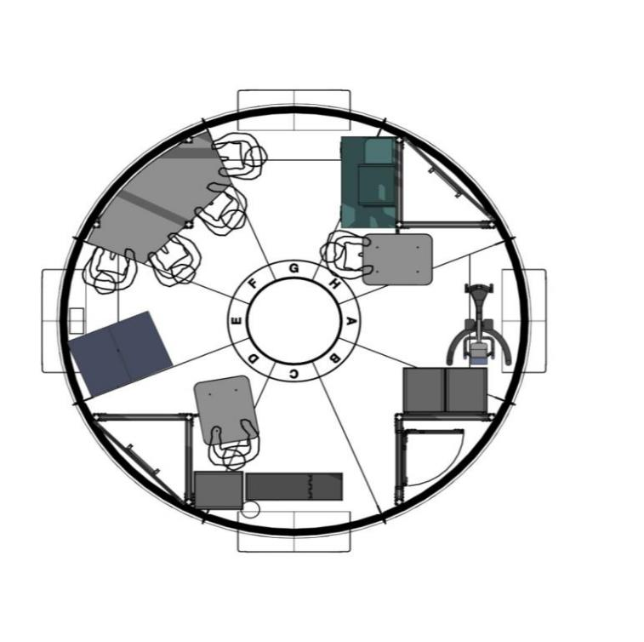
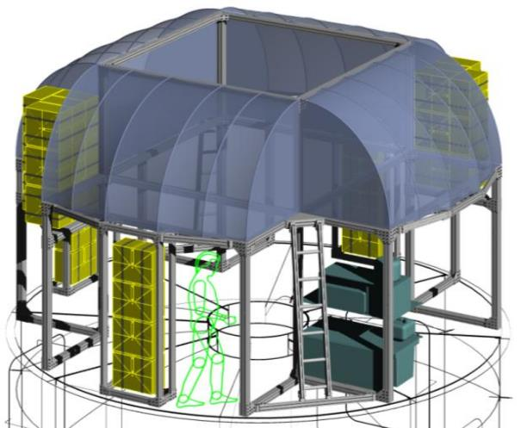
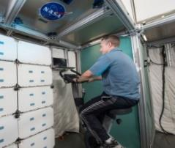
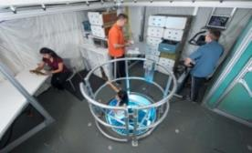
HERA Interior (2nd floor & Loft)
Wardroom table
Galley
Crew Quarters
Crew Quarters
Aerobic exercise device
2nd floor
Loft

Slide 8
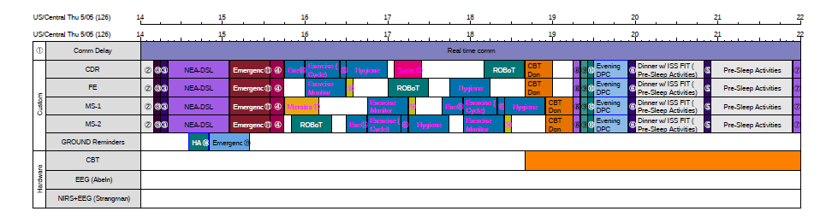
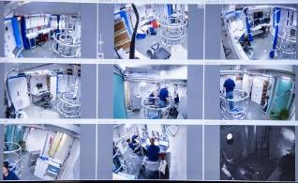
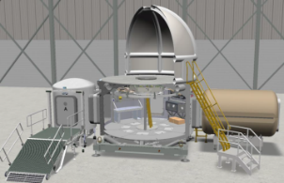
HERA Campaigns
Provides realistic mission scenario, controlled light and dark cycles, comm delays to simulate distance from Earth, remote conditions of exploration scenarios
4 test subjects per mission, 4 missions per research campaign
Campaign = 1 integrated suite of research investigations
All 4 missions in campaign are “identical”, simulate a space flight mission to exploration destination – transit and rendezvous phases
Since 2017 missions are 45-days of isolation with ~2-weeks of BDC/Training pre- and 1 week post-mission debrief/data collection

Slide 9
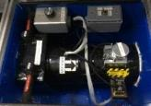
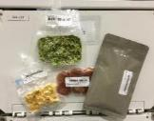
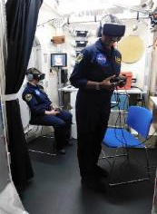
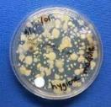
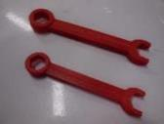
HERA Capabilities
Facility and systems developed to support research and mission fidelity
Habitat systems
  Voice loop communication system, with variable comm delay
  Simulated Environmental Control and Life Support System (ECLSS)
  Flight (MMSEV) simulator, Virtual Reality EVA simulator
  Surveillance cameras and microphones
  Programmable lighting system
Operational processes
  HERA Mission Control Center (MCC) support
  Full-day timelines for operational and research activities
Support for researcher hardware (ex. robotic arm simulator, landing simulator, wearable sensors)

Slide 10
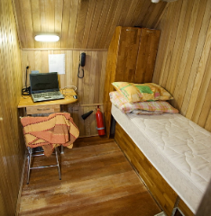
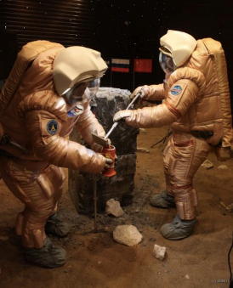
NEK
Ground-based Experiment Complex (NEK) operated by IBMP in Moscow, Russia
Realistic mission activities, controlled light and dark cycles, comm delays to simulate distance from Earth, remote conditions of exploration scenarios, long duration studies
The NEK platform of consists of four experimental chambers (50 m3, 100 m3, 150 m3, 250 m3 ) that may be used (or not) to simulate different mission phase scenarios
Capabilities include boots-on-the-ground EVA,
plant growth area, exercise area,
individual crew quarters
Long duration missions planned: 4-month (2019, ongoing), 8-month (2020), and 12-month (2021)
Nominal crew sizes of 4 – 6; can support up to 10

Slide 11
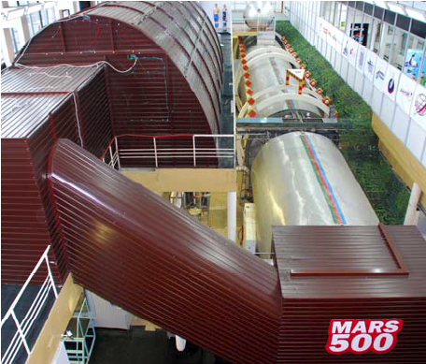

Slide 12
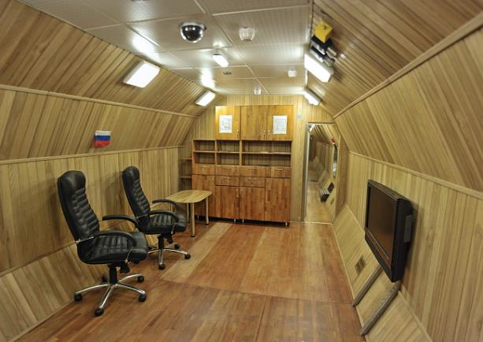
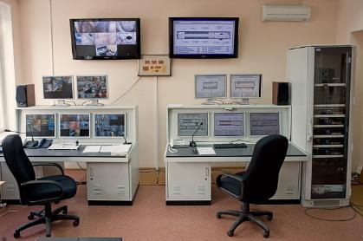
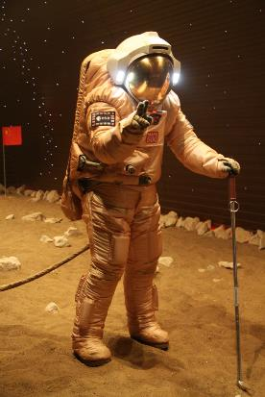
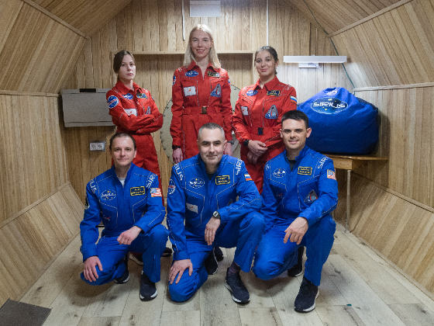
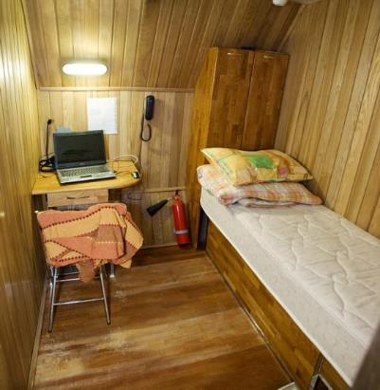
NEK Capabilities
Pressurized Facility
Volume and configuration comparable to a spacecraft
Artificial atmospheric environment
Isolation from Earth’s daily changing environment
Mission Control
Simulated communication time delays
EVA
Multinational Crews
Sleeping Quarters

Slide 13
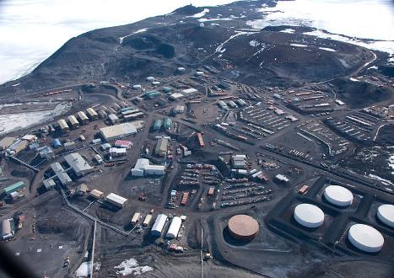
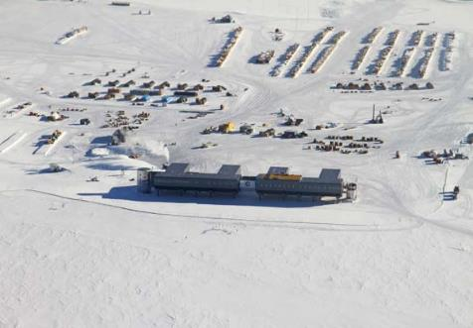
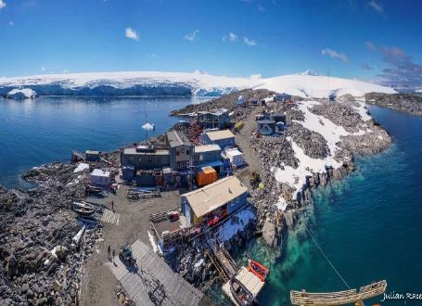
National Science Foundation (NSF) Antarctic Stations
Environment provides isolation, confinement and extreme/hostile conditions
Currently, 3 stations used for HRP research – McMurdo, Amundsen-Scott (South Pole), and Palmer Stations
  Availability for HRP research studies is limited, NSF plays role in determining studies allowed to go to ice
  NSF provides logistics support for research hardware, supplies, etc.
Subjects recruited from staff members on-station
  McMurdo (Coastal) – 100 during winter, ~1000 during summer
  South Pole Station (Interior, high altitude) – 50 during winter, up to 150 during summer
  Palmer (Coastal) - ~15 during winter, up to 45 during summer

Slide 14
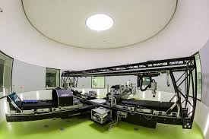
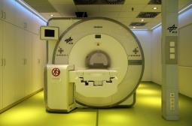
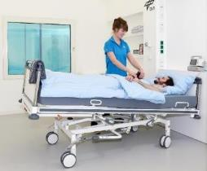
:envihab
Bed rest facility operated by DLR’s Institute for Aerospace Medicine in Cologne, Germany
Simulated reduced gravity, altered atmospheric CO2 environment
Capabilities include head down bed rest of various durations, increased CO2 atmosphere, short-arm centrifuge, on-site MRI, lab and testing support
30-day study conducted in 2017, and 60 day (x2) in 2019
Up to 12 subjects simultaneously

Slide 15


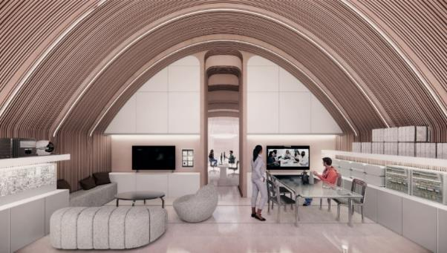
Upcoming NASA Capability: CHAPEA
The Crew Health and Performance Exploration Analog (CHAPEA) is a set of three 1-year analog missions that will begin in 2022, simulating Mars surface missions
  The Goal: Measure health and performance outcomes from operationally relevant inputs to determine risks to astronaut health and performance
      Inputs include spaceflight food system, mission-relevant timelines, isolation, confinement, resource restrictions, communication challenges, and contingency situations
NASA worked with Bjarke Ingels Group to design the CHAPEA habitat; ICON will 3d-print the habitat at the Johnson Space Center
  Integration: CHAPEA incorporates expertise throughout NASA to provide the highest mission fidelity possible, with focuses on EVA operations, crew autonomy, flight hardware functionality, and addressing lessons learned from previous analog missions and remote environments
  Data: CHAPEA will collect more than 17,000 data points per analog mission
  Opportunities: Multiple NASA areas of interest will leverage CHAPEA to demonstrate operational concepts for Mars surface missions, including dust mitigation, in-space manufacturing, virtual reality technology, trash management, space suit design, logistics, inflatable surface structures, and more

Slide 16


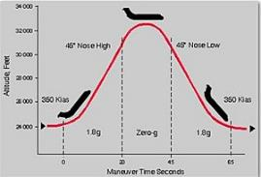
Upcoming HRP Capability:
Parabolic Flight
NASA Research Operations and Integration (ROI) is currently integrating a complement of studies using parabolic flight as a spaceflight analog
Additional capabilities for HRP:
  Carry out experiments on human subjects under conditions of normal, reduced, zero, or hypergravity conditions for short periods of time (~30 seconds).
  Evaluate the performance of experiments in a relevant, space-like environment prior to deploying the studies to spaceflight
  Test hardware, procedures and protocols in variable gravity conditions in order to improve quality and success rate

Slide 17
HRP Analog Lessons Learned
No one analog can meet all science needs perfectly
Crew selection and the mission design are just as or more important to mission fidelity as the facility/habitat
Target a ‘spaceflight realistic’ balance of operational tasks and research tasks
If missions will have multiple research studies properly integrating those studies is critical for quality research outcomes
There is no single right way to implement communication delay, approach should be dictated by mission and science requirements
For long communication delays, these can be capped at 5 minutes one-way, will provide roughly the same effect as longer delays

Slide 18
HRP Analog Lessons Learned
Realistic crew autonomy is not all about communication delay, though it is an important component
In even shorter missions food and the food system are critical components of mission fidelity and can have significant psychological impacts
Habitat volume should be balanced between needed capabilities and realism, too much available volume removes a significant spaceflight stressor
The approach to communication with and news from the outside world needs to be carefully considered relative to fidelity and crew needs

Slide 19
HRP Analog Lessons Learned
Medical and psychological support must balance keeping the crew healthy and stable, allowing the mission to progress, while not interfering with mission or research fidelity
Outside sounds are one of the most consistent issues in isolation analogs that will mentally pull a crew out of the simulation mindset
There appears to be an important shift in team dynamics around the 6-8 month point in longer studies
Crew conflicts, with mission control/support but especially within the crew, need to be carefully managed to prevent significant impacts to the mission and science

Slide 20
Gaps in Current Analog Capabilities
‘Naïve’ mission control and support
  Analog mission control and support personnel are generally aware of, and involved in implementing, experimental manipulations or stressors
  This limits the types of multi-team system research that can be done
  A concept of a ‘naïve’ mission control supported by an ‘experiment’ mission control could be useful for mission fidelity and research
Operational tasks with measurable performance metrics
  There are few available high fidelity operational tasks that are repeatable, complex, adaptable, and produce meaningful performance metrics
  Having performance metrics to compare to other variables is critical in identifying the operational impacts of various research findings
  These are needed at the individual, team, and multi-team levels

Slide 21
A ‘Best in the World’ Isolation Analog for HRP – Some Key Capabilities
Volume constrained but technically dense habitat mimicking spaceflight vehicles
  Including multiple working or simulated habitat systems for crew interaction and maintenance
Multicultural crew including US crewmembers
High fidelity planetary surface simulation linked to/surrounding habitat
Complex individual and team tasking built into the habitat and mission design, some of which produces performance data
Flexible habitat layout
Sufficient in-habitat storage to eliminate/limit need for resupply
On-site sample storage and lab capabilities for biological samples
On-site or nearby physiological scanning capabilities (e.g., MRI)
High fidelity mission control supporting the mission consisting of both a ‘naïve’ and ‘experiment’ MCC team
Built-in communication delay capabilities
Astronaut selection-like screening and selection process for crew
Flexible timeline approach allowing both structured and crew-scheduled activities
Video, audio, and proximity monitoring capabilities
Crew training approach allowing for sufficient technical and procedural knowledge to be built to support operating inside technically complex habitat

Slide 22
Questions?

Slide 23
Backup Slides

Slide 24
Additional Information on HERA

Slide 25
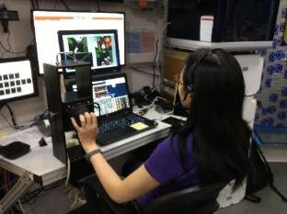
Scope of Research in HERA
Typically 15-20 studies ongoing during each HERA campaign across a range of topics:
Behavioral health
Teamwork
Resilience and adaptability
Performance
Diet, immune system, and the microbiome
Habitability
Exercise
Communication delay and autonomy
Crewmember selection and crew composition
Mission planning
Neurological changes
Sleep and fatigue
Task performance with flight-like hand controllers
HERA sleep station interior view

Slide 26
Data Collected in HERA
Types of data collected to date in HERA include (but are not limited to)
Psychological
  Surveys (mood, stress, teamwork)
  Cognitive performance
  Interpersonal interaction sensors
  Sleep monitoring (actigraphy)
Physiological
  Cardiac (HR, BP, ECG)
  Sensorimotor sensors
  MRI (pre-post only)
  Brain activity (EEG)
Biological
  Blood
  Saliva
  Urine
  Fecal
Observational
  Video
  Audio
  Task performance
  System usage (e.g., timeline, food)
~30 data collection sessions per day per subject
Rate of data collection has been maintained with increased study duration

Slide 27
Summary of HERA Campaigns
Campaign 1 (2014)
  7 days
  13 Studies
Campaign 2 (2015)
  14 days
  13 Studies
Campaign 3 (2016)
  30 Days
  22 Studies (3 DLR)
Campaign 4 (2017/2018)
  45 days
  20 Studies (3 DLR)
  Total through 2018
    68 studies
    68 subjects
Campaign 5 (2019/2020)
  45 days
  14 Studies

Slide 28
HERA Subjects
‘Astronaut-like’ individuals, using a modified version of astronaut minimum selection requirements
30-55 years old
Demonstrated technical skills (e.g., Masters in STEM, equivalent years experience, military experience)
Pass a JSC physical and psychological assessment
No medications
No dietary restrictions
BMI 29 or less
74 inches or less in height

Slide 29
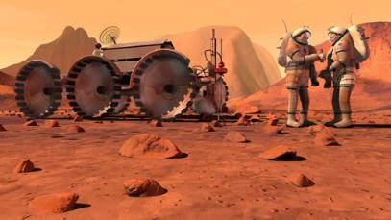
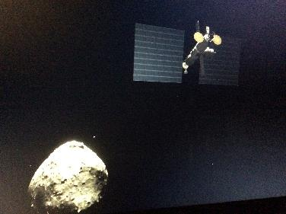
Mission Scenario
  Determines the types of activities the crew will do during the mission
    Tasks related to mission objectives
    Crew health and safety
  Provides crew with an context for the mission, allowing crew to engage in the simulation and forget about real world
    Provides sense of purpose, goals, teamwork environment
  Provides a unique research environment and level of operational mission fidelity not available in most laboratories
    Developed by personnel with experience
    and expertise in spaceflight operations
Mission scenarios define the HERA simulation

Slide 30
Simulated Mission Phases
Mission Phase |  | Scenario Duration | Simulated Duration | Actual Mission Day
1 | Orion launch, dock with Habitat vehicle, transit burn | 2 days | 1 day | MD1
2 | Transit to Geographos (comm delay phase in) | 330 days | 18 days | MD2 – MD19
3 | Proximity Ops with Geographos (comm delay, 5 min one-way) | 21 days | 5 days | MD20 – MD24
4 | Transit to Earth (comm delay phase out) | 360 days | 20 days | MD25 – MD44
5 | Enter in Earth orbit, Orion undocks and lands | 2 days | 1 day | MD45
Total |  | 715 days | 45 days

Slide 31
Crew Daily Schedule
Timeline Activity | Duration (hrs)
Post-sleep, morning meal | 1.5
Morning DPC, daily prep | 1.0
Private conferences | 0.5
Work - science & ops | 6.5 – 7.5
Midday meal | 1.0
Exercise | 1.25
Evening DPC | 0.5
Pre-sleep, evening meal | 2.0
Daily activity schedule similar to ISS flight plans
  Subjects awake at 0700, off duty at 2300 (CST)

Slide 32
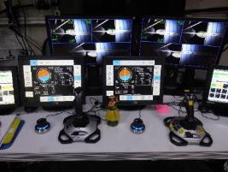
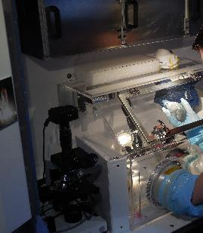
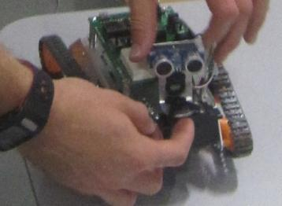


Mission Operations Tasks
Mission Objectives
  Multi-mission Space Exploration Vehicle (MMSEV) Flight
  Simulator & Virtual Reality EVA
Planetary Geology
  Asteroid Sample Processing
Educational Payload Operations
  Robotic Vehicle Concept
  Animal Biology
  Plant Biology
Human Research
  Microbiome
  Mini PCR
  Body Measures
Public Affairs Office Events
Vehicle Operations
  Crew Health – Medical Drills
  Vehicle Safety – Emergency Drills
  Systems Status
  Housekeeping

Slide 33
Stressors/Manipulations
Used to increase fidelity (Ops ) and support research objectives (PI)
  Simulate the types of stressors expected to occur naturally during long-duration space exploration missions
  Implement study-specific stressors and research manipulations
Examples
  Full day (e.g., sleep deprivation)
  Within task (e.g., unexpected failure)
  Operational (e.g., comm delay)

Slide 34
Additional Information on NEK

Slide 35
Scope of Research in NEK
80 total studies
  7 HRP
  73 non-HRP
Investigators from
  US
  Russia
  France
  Germany
  Canada
  Italy
Topics include
  Individual psychology
  Team dynamics
  Training
  Cardiovascular
  Exercise
  Microbial
  Immune
  Microbiome

Slide 36
Additional Information on Antarctic

Slide 37
Scope of Research in Antarctica
Smaller number of studies than other analogs
  1-2 per station
Data collected
  Surveys
  Journals
  Saliva samples
Topics include
  Mental health
  Team dynamics
    Roles
    Team composition
    Shared mental models
  Immune system

Slide 38
Additional Information on :envihab

Slide 39
VaPER vs. AGBRESA
VaPER (2017)
  Subjects in strict head-down tilt with elevated CO2 for 30d
  Effects of conditions on physiology/cognition
  Found SANS-related issues, particularly for eyes, new finding on ground
AGBRESA (current)
  Subjects in strict head-down tilt with artificial gravity countermeasure (centrifugation) for 60d
  Effectiveness of AG countermeasures on physiological/cognitive changes
  Control group for VaPER (HDT or CO2?)

Slide 40
Scope of Research in :envihab
Typically 4-8 HRP research studies
Example data collected
  MRIs
  DXAs
  Ultrasound
  Blood
  Cognitive performance
Topics include
  Neurostructural
  Performance
  Ocular
  Bone
  Muscle
  Sensorimotor
  Cardiovascular

