Slide 1
Schlieren Capabilities for Arc-Heated Testing
Prepared by: Brett Bathel (brett.f.bathel@nasa.gov), Joshua Weisberger (joshua.weisberger@nasa.gov), Steve Jones (stephen.b.jones@nasa.gov)
NASA Langley Research Center

Slide 2
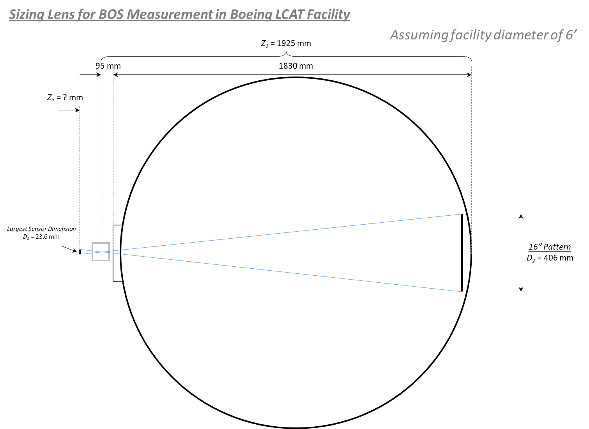
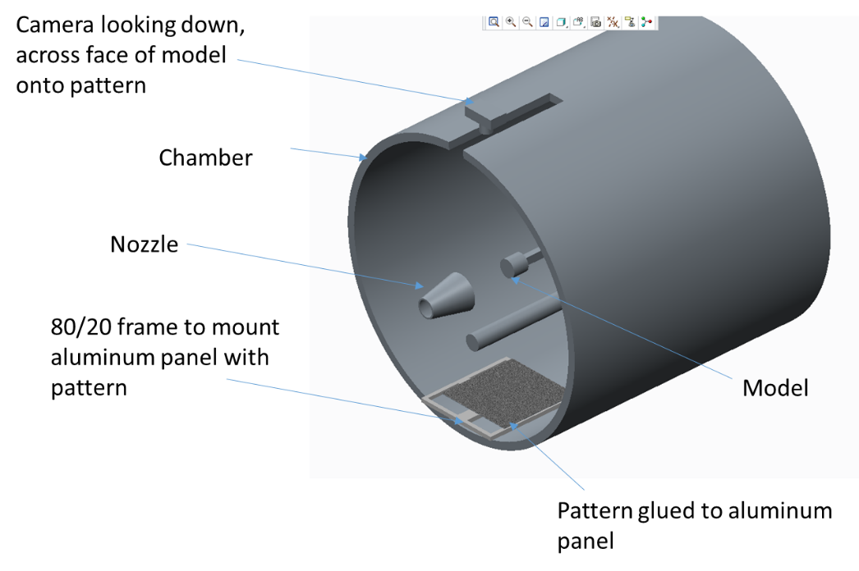
Schlieren-Based Imaging for LCAT Facility – Facility Overview
Understanding is that LCAT facility has both single-side optical access (side window) and two-sided optical access (top and bottom windows)
  Are the top and bottom windows considered to be ‘schlieren quality’?
    Meaning fabricated such that the surface flatness was known and any wedge angles are aligned
  Do these two windows provide a direct line of site through the test section?
  What are the window diameters?
from Matt Wells (LaRC), 2016

Slide 3
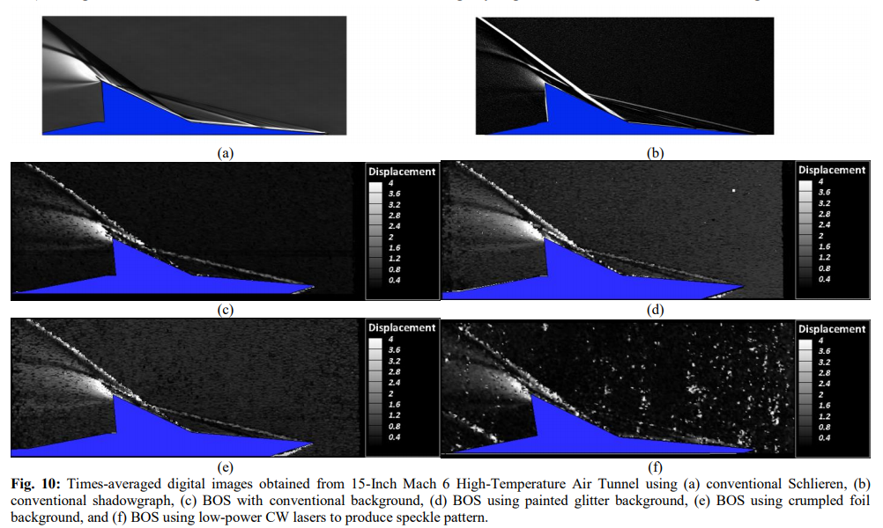
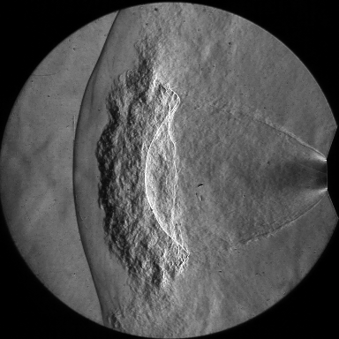
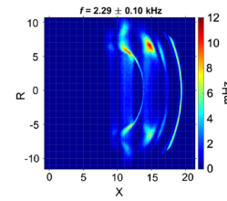
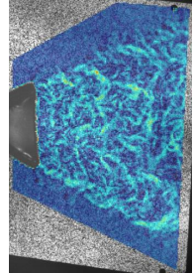
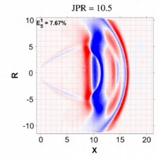
Schlieren-Based Imaging for LCAT Facility – Schlieren Capabilities
Model is a wedge-cylinder
  Assuming boundary layer thickness of approximately 2-3 mm
  How well resolved does the boundary layer flow need to be? (pixels/mm)
  What field-of-view is needed?
  What framing rates are needed to adequately describe the flow?
    Low-speed/time average, high-speed (≥ 100 kHz) to capture unsteady phenomena, ultra high-speed (MHz)?
Sensitivity
  Path-integrated: Schlieren, shadowgraph, direct shadowgraph, BOS
    Schlieren provides best sensitivity/cleanest images
    Direct shadowgraph and BOS are easiest to implement
    BOS is most quantitative
      We’re developing tomographic BOS for volumetric quantitative density measurements
      Recent advancements in analysis methods have drastically improved sensitivity
  Less path-integrated: Focusing schlieren
    Similar sensitivity to conventional schlieren, but can reject signal away from focal plane – may be important is shear layers from facility nozzle obscure flow physics of interest
≈ 50 mm
≈ 75 mm
≈ 25 mm

Slide 4
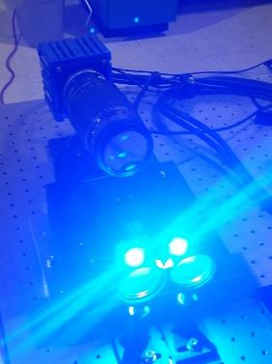
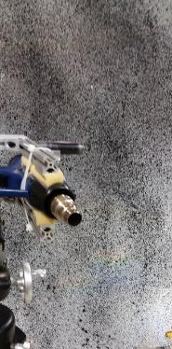
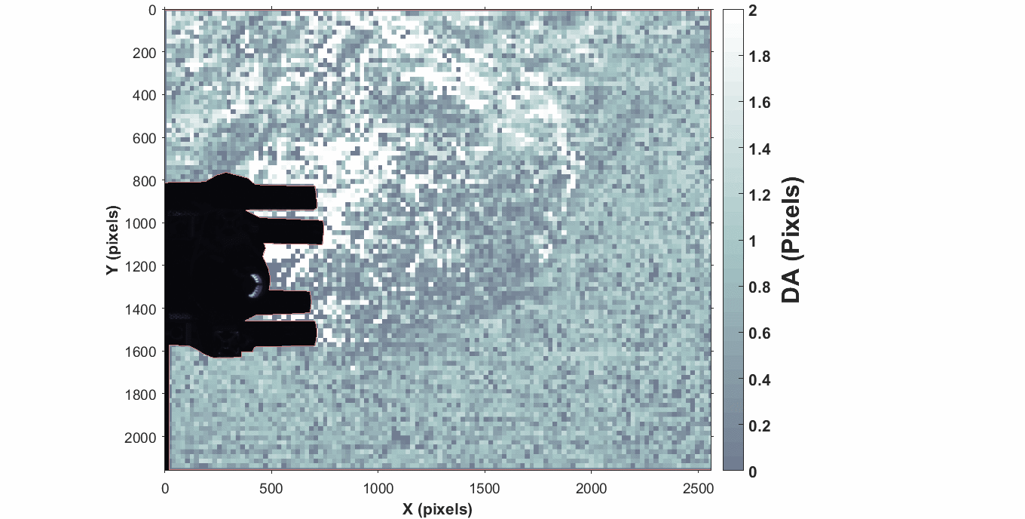
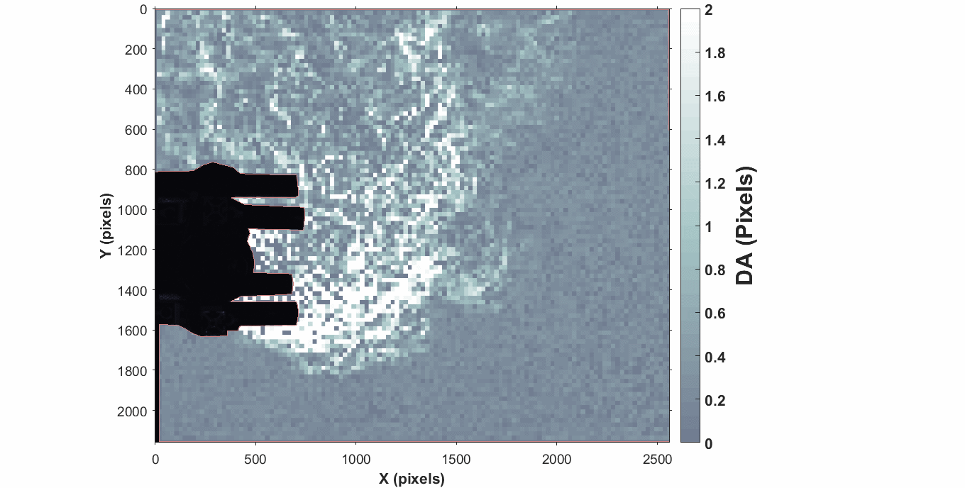
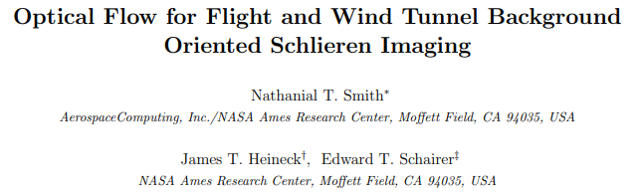
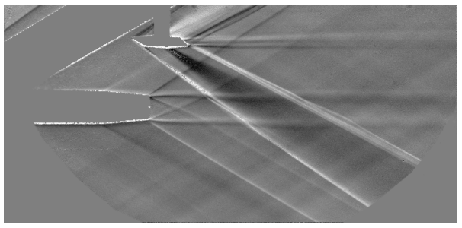
Schlieren-Based Imaging for LCAT Facility – Prior LCAT Entry
Prior entry we recommended the following
  BOS with patterned retro-reflective background
  Blue LED illumination to move away from most visible and NIR emission most likely present in flow
  Spectral low-pass filter on camera to further reject most visible and NIR emission
Lessons learned
  The choice of camera matters – Commercial Nikon camera with noise suppression algorithms tries to correct the very thing we’re trying to measure (pattern shifts)
Current capabilities
  We have significantly advanced processing algorithms for improved sensitivity
  Numerous research-grade cameras to provide greatly enhanced sensitivity/resolution
  High-speed capabilities (framing at 100s of kHz, MHz possible)

Slide 5
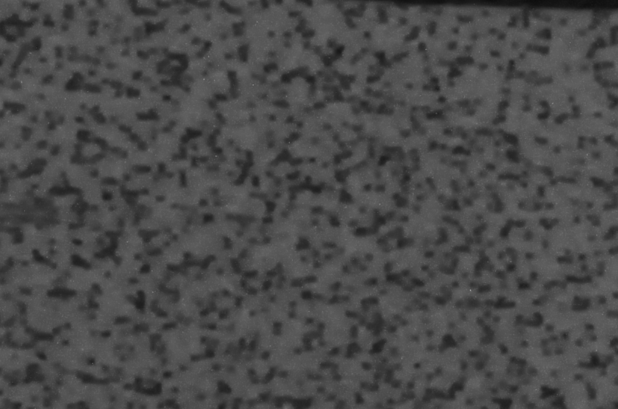
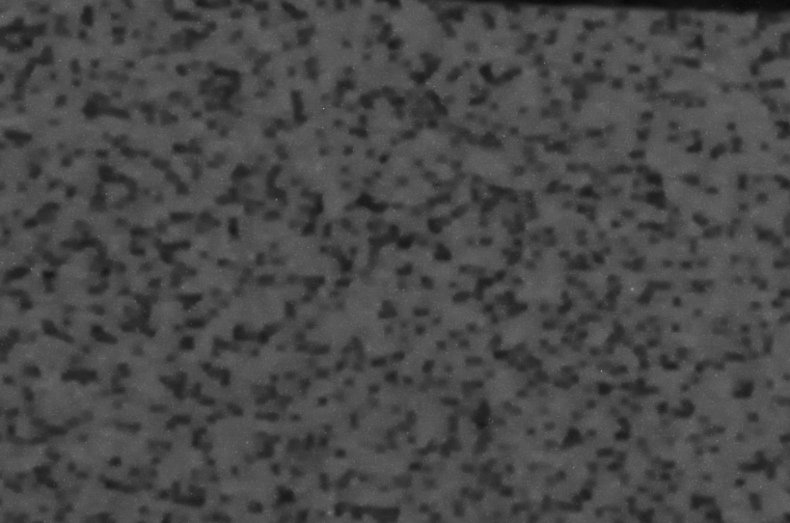
Duster Results from Boeing LCAT
Examples of pattern shifts resulting from non-density-related issues (noise correction?, white balance?, etc.)
- Dots appear to either shift or appear/disappear between images
Put charts into slide-show mode and click back and forth between images 1 (no-flow) and 2 (duster flow)
Pattern shifts resulting from density variation
Duster
1
2

Slide 6
Prior boundary layer measurements
Schlieren Imaging

Slide 7
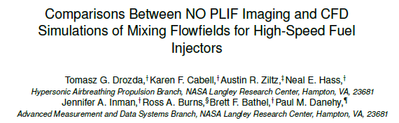
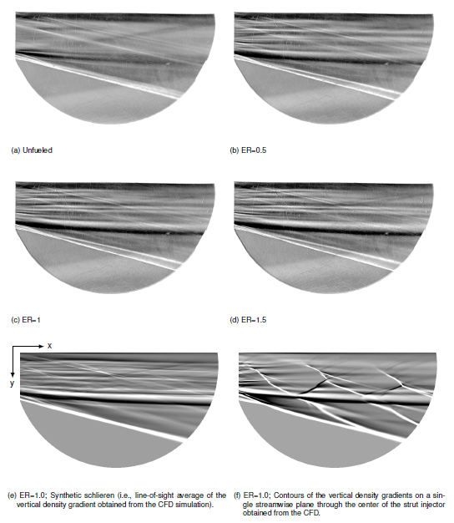
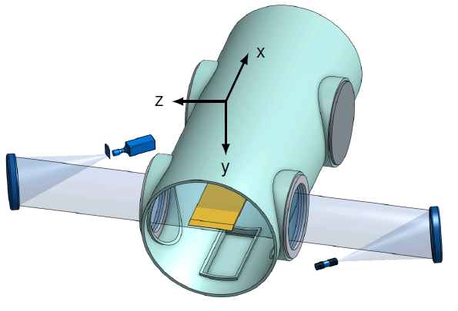
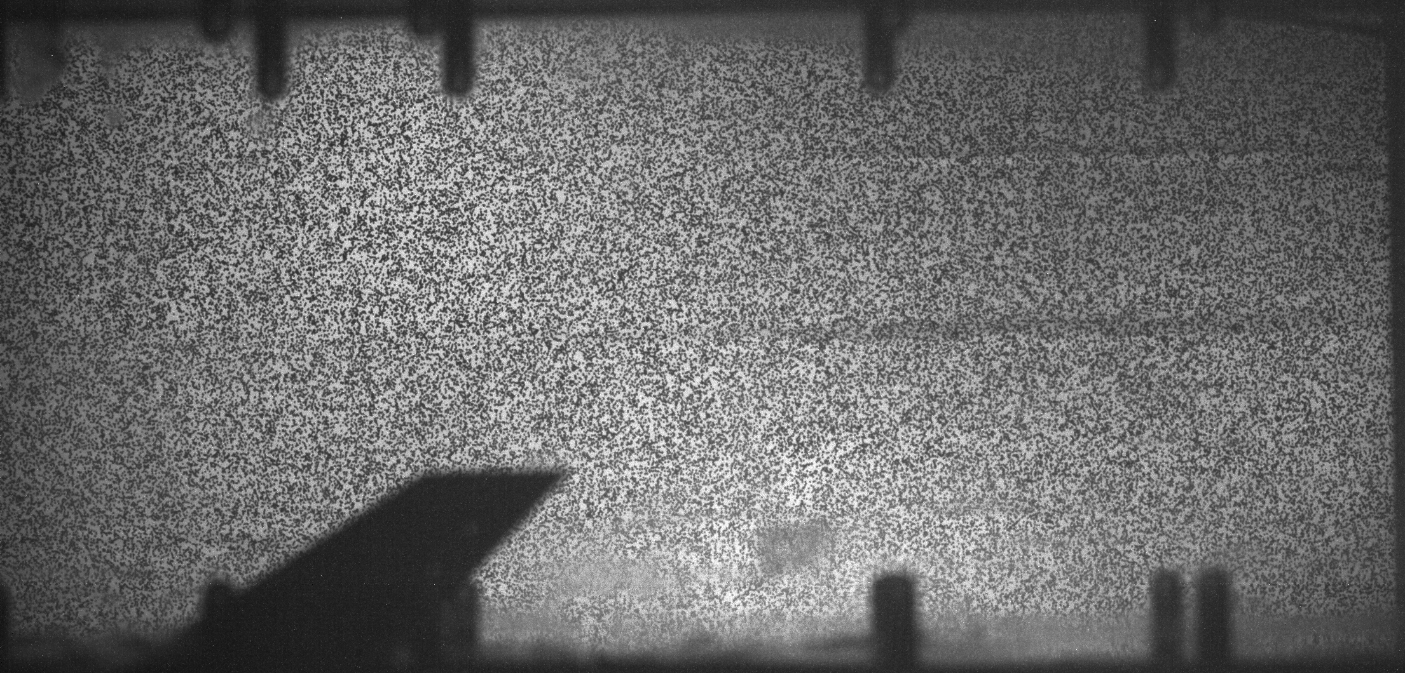
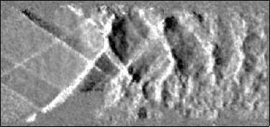
Langley Arc-Heated Scramjet Test Facility (AHSTF) and Mach 2 Flow Facility
Fuel-Air Mixing Experiments in AHSTF
  Comparison of CFD to NO PLIF and schlieren images
  Low-speed (70 Hz) schlieren imaging with a 20 W white LED illuminator
    Small (≈ 1”×1”×1”) machine vision cameras work well for this type of application
      Global shutter, small pixels, high bit depth (> 8)
  Relative motion between camera and AHSTF resulting from facility vibration corrected through software
BOS Visualization of Fuel-Air Mixing in Mach 2 Flow
  Low-speed cameras (50 Hz) captured influence of mixing schemes on shock train
    LaVision Imager sCMOS 5.5 Mpixel camera (16-bit)
    Note, retro-reflective material was NOT used as the BOS background, instead heavy weight paper was used

Slide 8
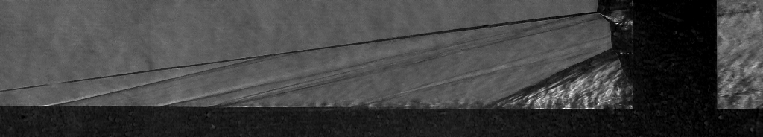
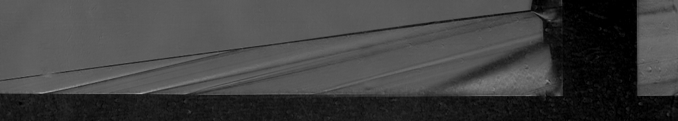
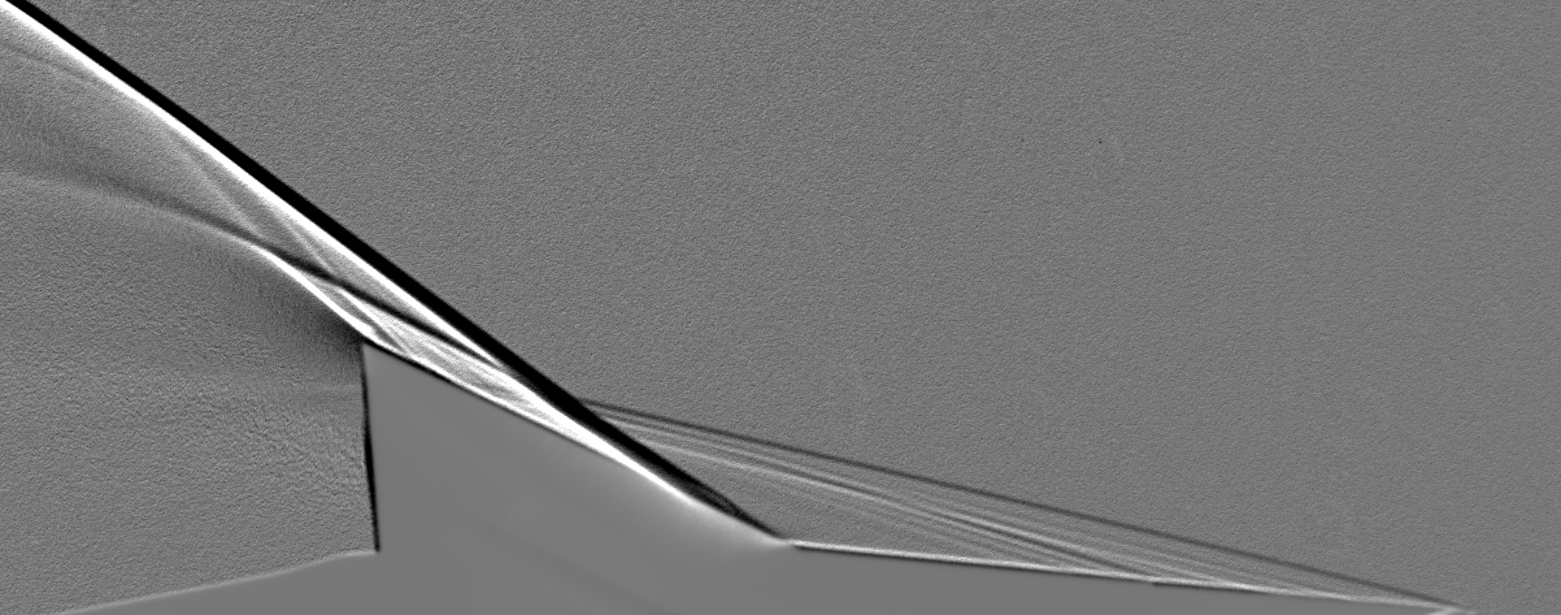
Langley 20-Inch and 15-Inch Mach 6 Air Tunnels
High-Speed Imaging of Shockwave/Boundary-Layer Interaction in 20-Inch Mach 6 Air Tunnel
  Pulsed LED light source (< 1 μs), 100 kHz framing rate
  Visualization of interaction region to identify spectral and modal characteristics specific to laminar, transitional, and turbulent incoming boundary layers
  Imaging optics can be changed to better resolve boundary layer
Compression Corner Visualization in 15-Inch Mach 6 Air Tunnel
  Used a variety of schlieren-based techniques to visualize wedge model flow with compression ramp
  3M Scotchlite 7610 (900X) retroreflective background used for shadowgraph
Time-resolved
Averaged
Schlieren w/Parabolic Mirrors
Shadowgraph w/Retroreflective Background

Slide 9
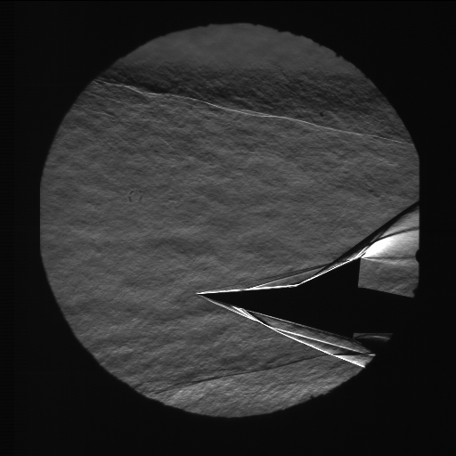
Talking Points for LCAT Testing
Challenges associated with schlieren imaging
  Never attempted in LCAT, although bottom window was installed to enable the technique
  Is lower window matched to top window (parallelism, surface quality)?
    Could instead perform shadowgraph imaging with retroreflective background and only use top window
  Relative motion between test article and camera during a run, when a vacuum is applied, and when the cabin is heated
  If time-resolved images are desired, nozzle shear lay and large temperature differences between cabin and nozzle flow will produce interfering flow structures
    Focusing schlieren
Challenges associated with BOS imaging
  Placement of BOS background
    As background is brought closer to flow, sensitivity drops (smaller lever arm) but resolution increases (aperture can be opened up more)
  Type of background
    Retroreflective material is not necessary if only time-average images are needed
    Could splatter black BBQ paint on a metal or ceramic surface
  Can appropriate view of model be obtained from side window?
Schlieren w/Parabolic Mirrors
15-Inch Mach 6

Slide 10
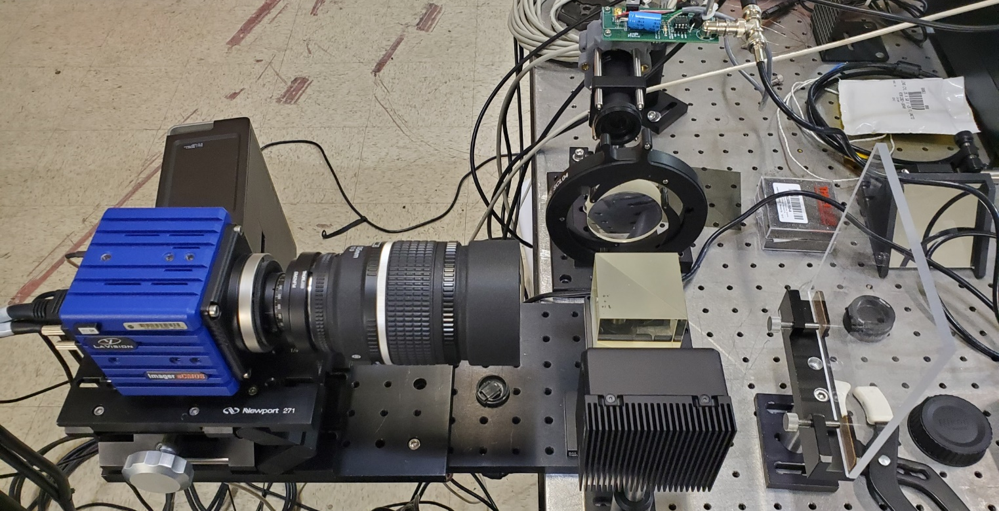
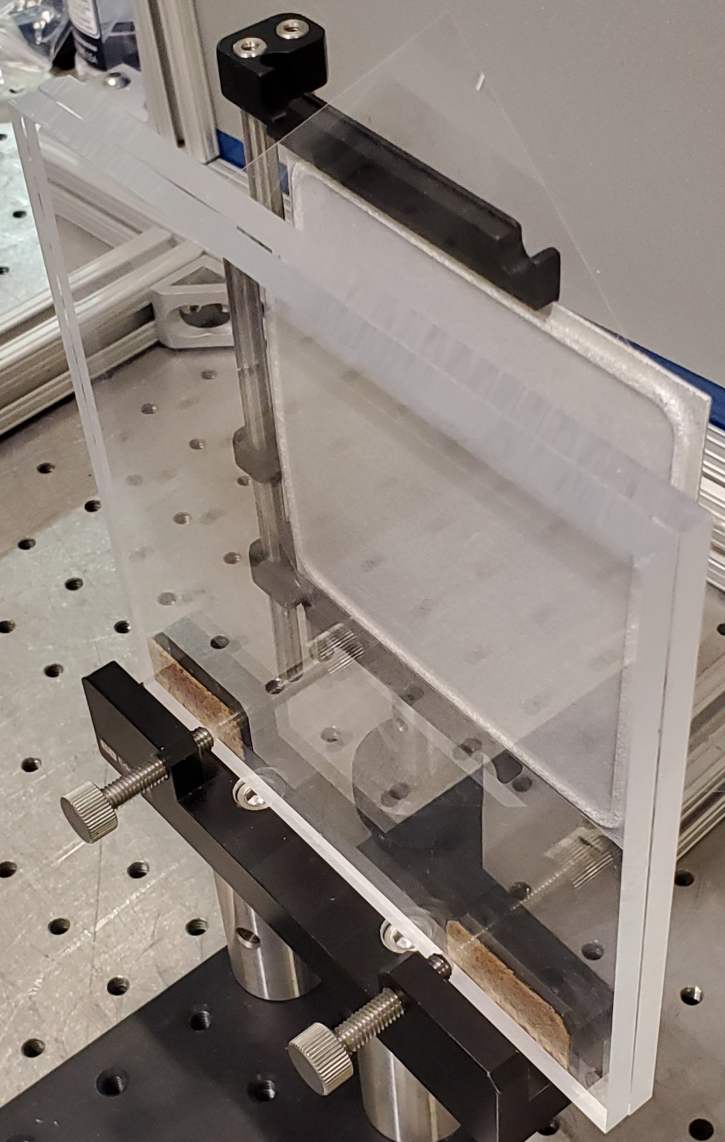
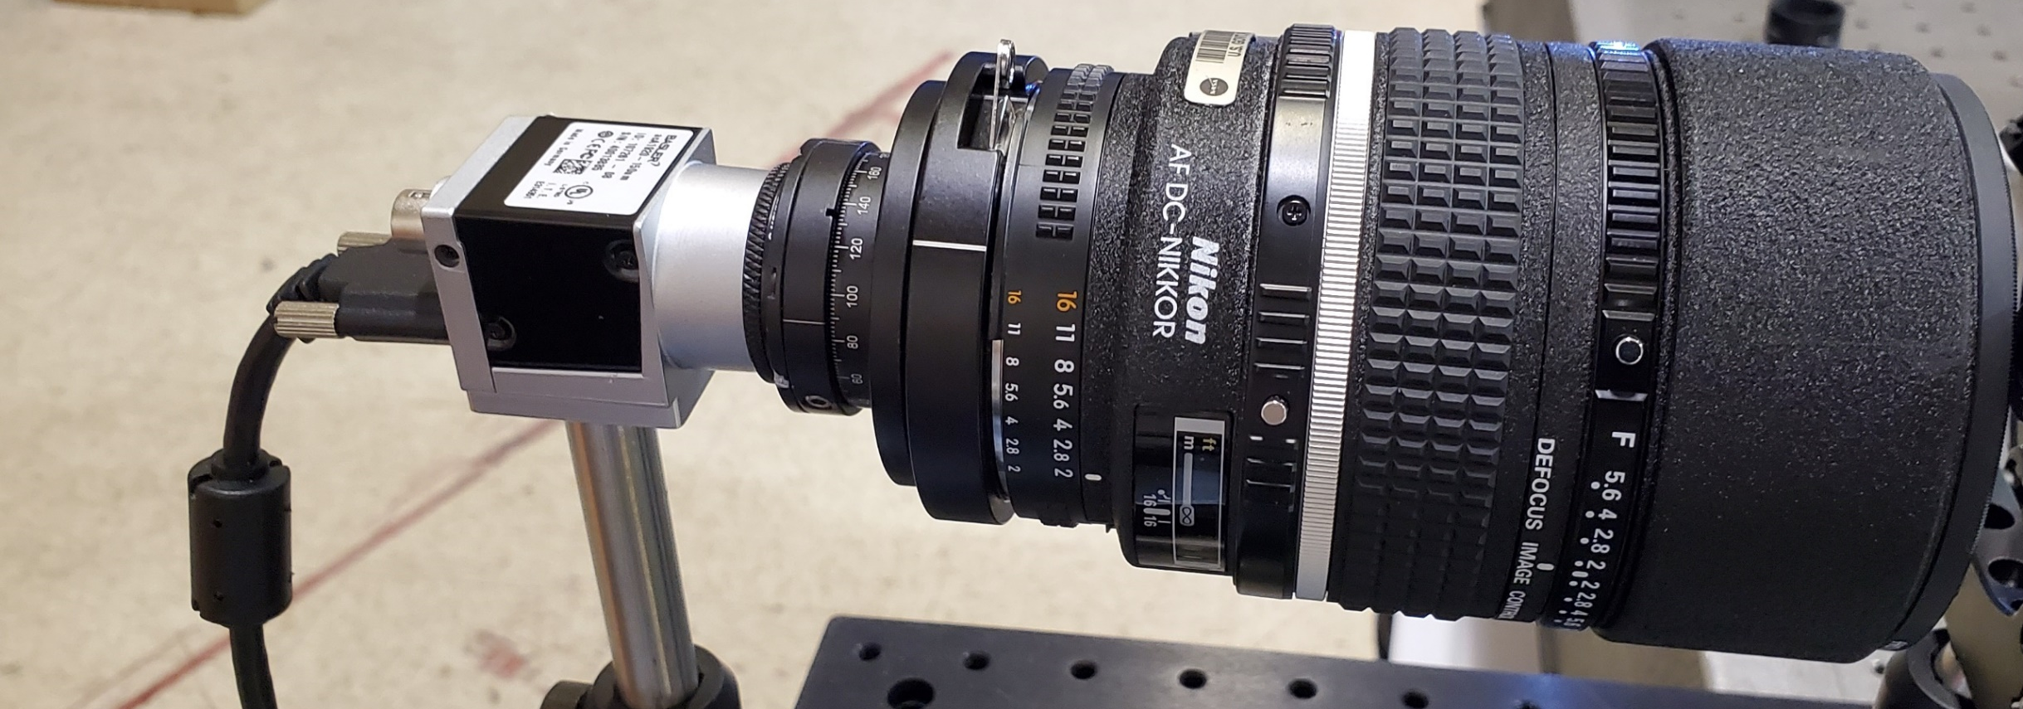
Experimental Setup
Retrolite Material
Pulsed LED Light
Collimating Lens
LaVision Camera
135 mm Lens
Camera-Side Window
105 mm Lens
Basler Camera
Background-Side Window

Slide 11
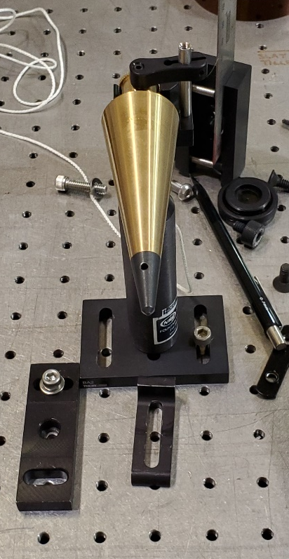
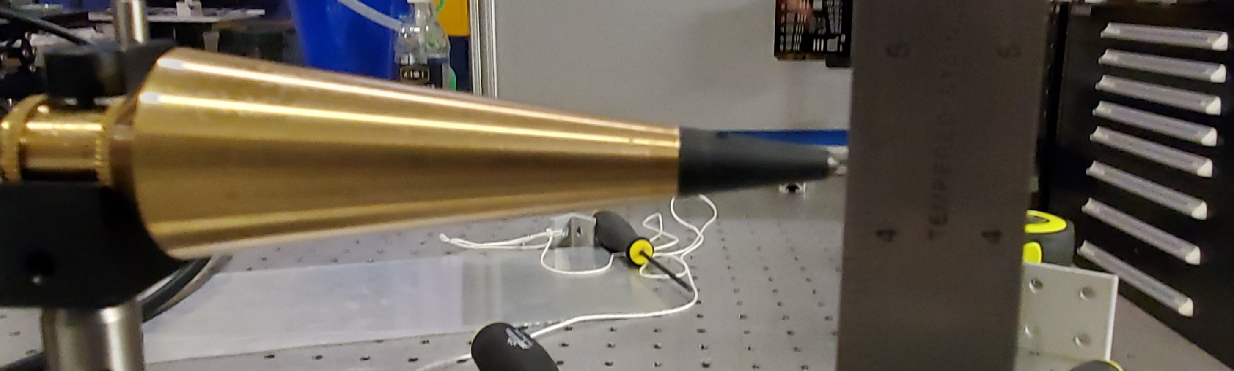
Experimental Setup
Model (Top View)
Model (Side View)

Slide 12
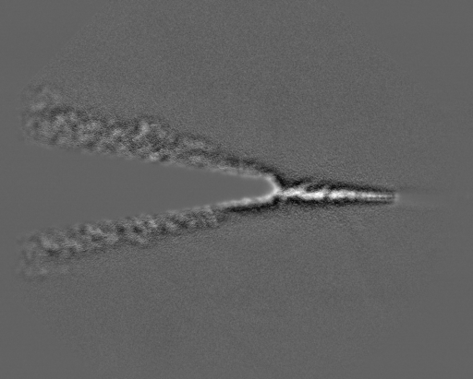
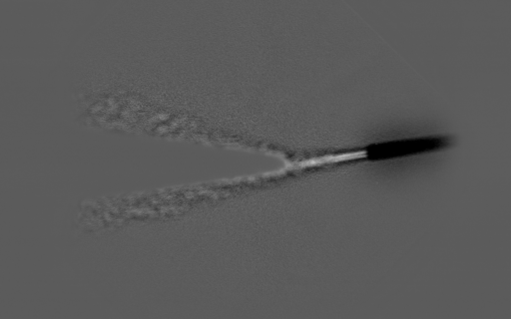
Sample Results
Play in Slideshow Mode
Basler acA1920-150um ($600)
10-bit, 4.8 μm pixels, 1920×1200 pixel sensor
Framing rate up to 150 fps
Using 20 μs LED pulses for these images
Nearly unlimited data acquisition (limited by storage on computer)
LaVision Imager sCMOS ($30K)
16-bit, 6.5 μm pixels, 2560×2160 pixel sensor
Framing rate up to 50 fps
Using 5 μs LED pulses for these images (higher sensitivity)
Can achieve 632 s of data at 38 Hz framing rate at 1120×900 pixels

