Slide 1




March 31, 2021 | Gates Foundation Learning Lesson
Weather and Climate:
Data in Action
Brent Roberts, NASA MSFC
SERVIR, Weather and Climate Thematic Lead

Slide 2



Weather and Climate Services
Lesson Objectives
Describe the big picture production and flow of weather and climate information to support decision-makers
  Sources and Types of Forecast Information
  Scope and Mandates
  Data Integration
Learning by example (3 from SERVIR)
  Crop Yield Forecasting
  Regional Drought Outlook
  Severe Weather Threats
Data
Weather and Climate Forecasts
ASOS
Satellites
Radiosondes
Models
Services

Slide 3
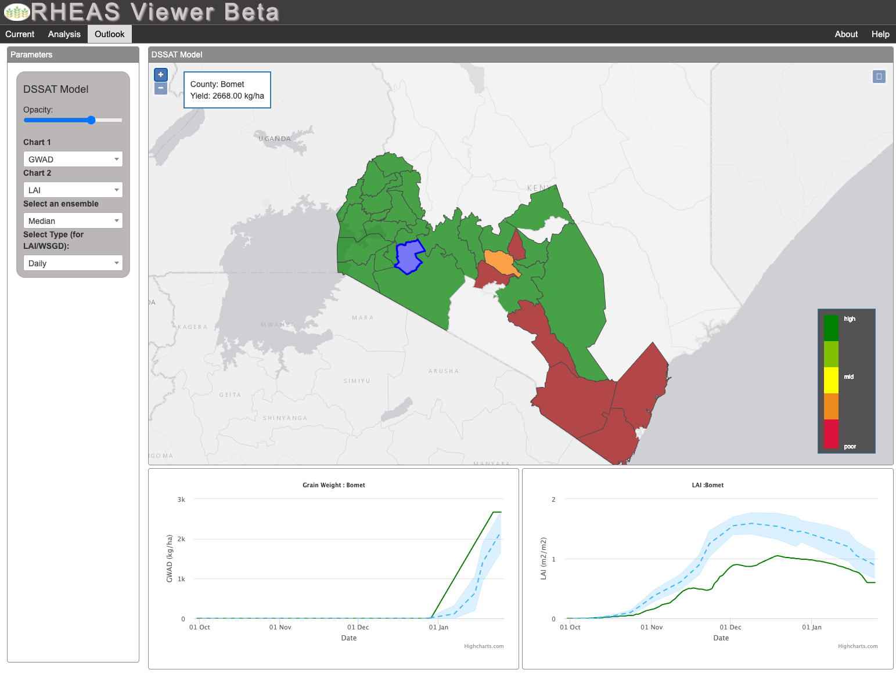
Example 1: Crop Yield Forecasting
Regional Hydrologic Extremes Assessment System (RHEAS)
  Framework for providing nowcast and forecasts of hydrologic and agricultural forecasts — e.g., streamflow and crop yields
  System has been deployed in multiple regions including Eastern Africa and Southeast Asia
Grain Weight
Leaf Area Index

Slide 4
Example 1: Crop Yield Forecasting
What users need is not always what is directly from weather and climate models
  There are many uses for basic weather data — precipitation, temperature, humidity, etc. — especially on short time scales
  Advanced planning, however, often requires the use of application models such as DSSAT or hydrologic models
  Application models need to be initialized and run forward with forecasts on temperature, humidity, winds, and radiation
DSSAT
Grain Weight
Leaf Area Index

Slide 5
Global Weather Forecasting 101
How (2-Step Process)
      Analysis (or Initialization)
          A “best-guess” state of the atmosphere and surface boundaries is determined by integration of the global observing system — radiosondes, surface stations, planes, buoys, satellite remote sensing, etc. — using the process of data assimilation
          2. Forecasting model
    The governing equations of atmospheric dynamics and thermodynamics are encoded (i.e., discretized) into numerical weather prediction (NWP) models
    Global models are now routinely run at spatial scales of 10-30km and employ numerous parameterizations to account for processes at unresolved scales — convection and the turbulent boundary layer (~0-1km), in particular.
Courtesy of WMO: https://public.wmo.int/en

Slide 6
Global Weather Forecasting 101
Who, What and When
Global models are typically run by national or regional meteorological services with an operational mandate and required investments in computing resources for model development, data production and distribution
Model forecasts generally consist of:
      State variables such as winds, temperature, and humidity
  Flux variables such as precipitation, radiation, and surface turbulent forcing
  Global models are run on operational schedules varying from 2x to 4x daily with cycles usually at 00,06,12,and 18Z each with forecasts up to 15-days into the future
Data Assimilation
Analyze observations onto a model grid for best-guess starting point
Model Forecasting
15-day forecasts generated every 2x to 4x daily at 10-30km resolution
Application Models
Use model forecasts to generate sector-specific forecast products
National/Regional Met Services —
e.g., US NWS, NCEP, ECMWF, UKMO, etc.
End-Users

Slide 7
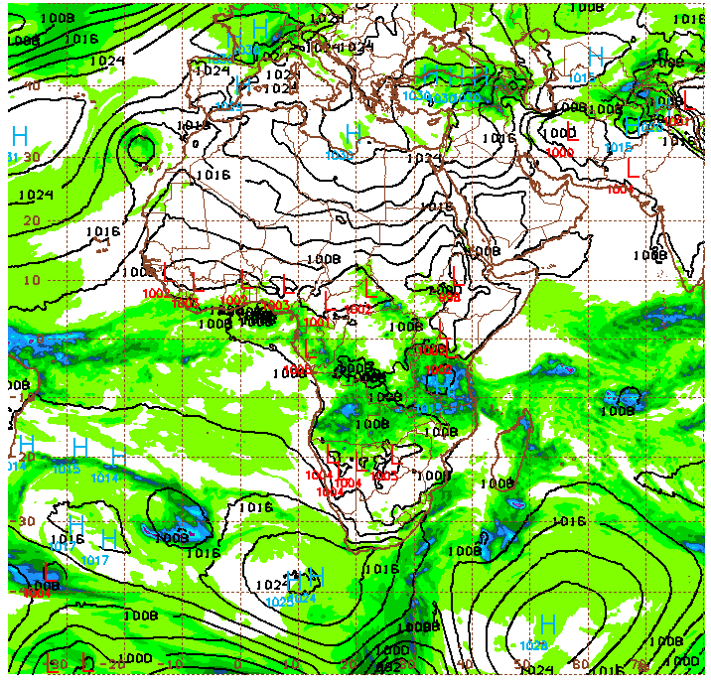
Global Weather Forecasting Examples
Examples
                Global Forecasting System (GFS) from US NWS at 13km with a recent upgrade (March 22, 2021) using the Unified Forecasting System (UFS)
                European Centre for Medium-Range Weather Forecasts at 9km to 18km resolution (ECMWF) at 9km to 18km resolution
                Unified Model (UM) from United Kingdom Meteorological Office at 10km
                Example of “seamless” prediction model with the goal of using a single NWP for weather prediction, seasonal forecasting, and climate projections
24-hr Rainfall and Sea Level Pressure
NOAA GFS: https://mag.ncep.noaa.gov/

Slide 8
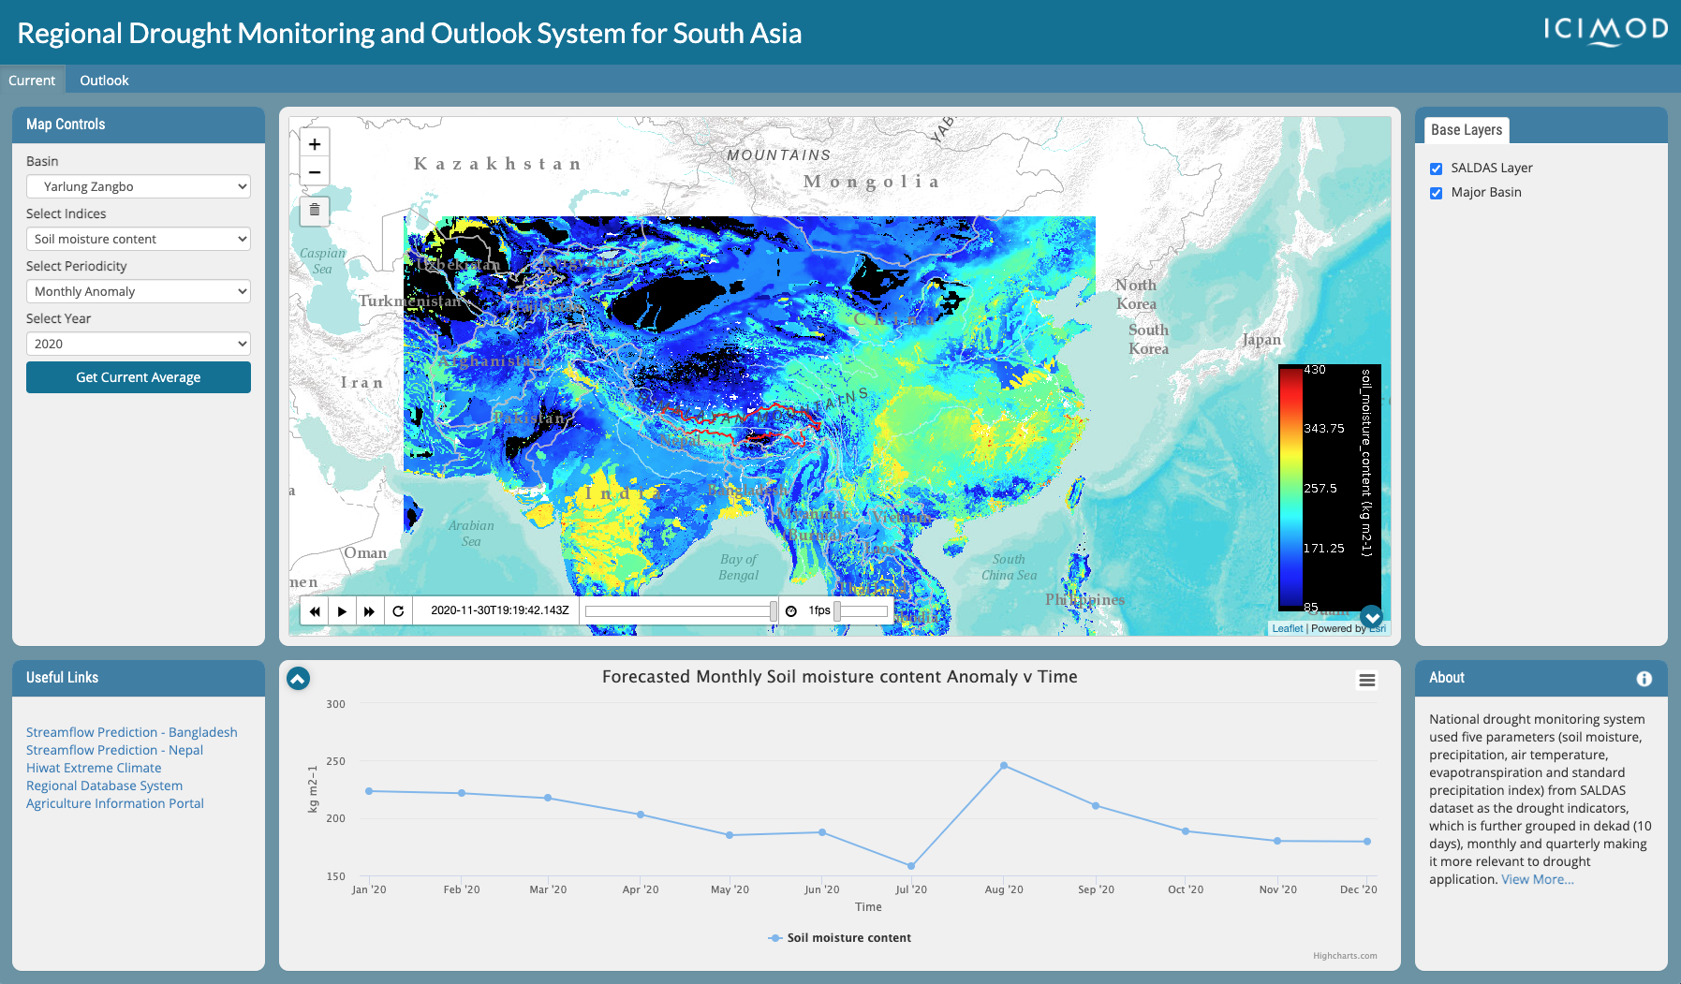
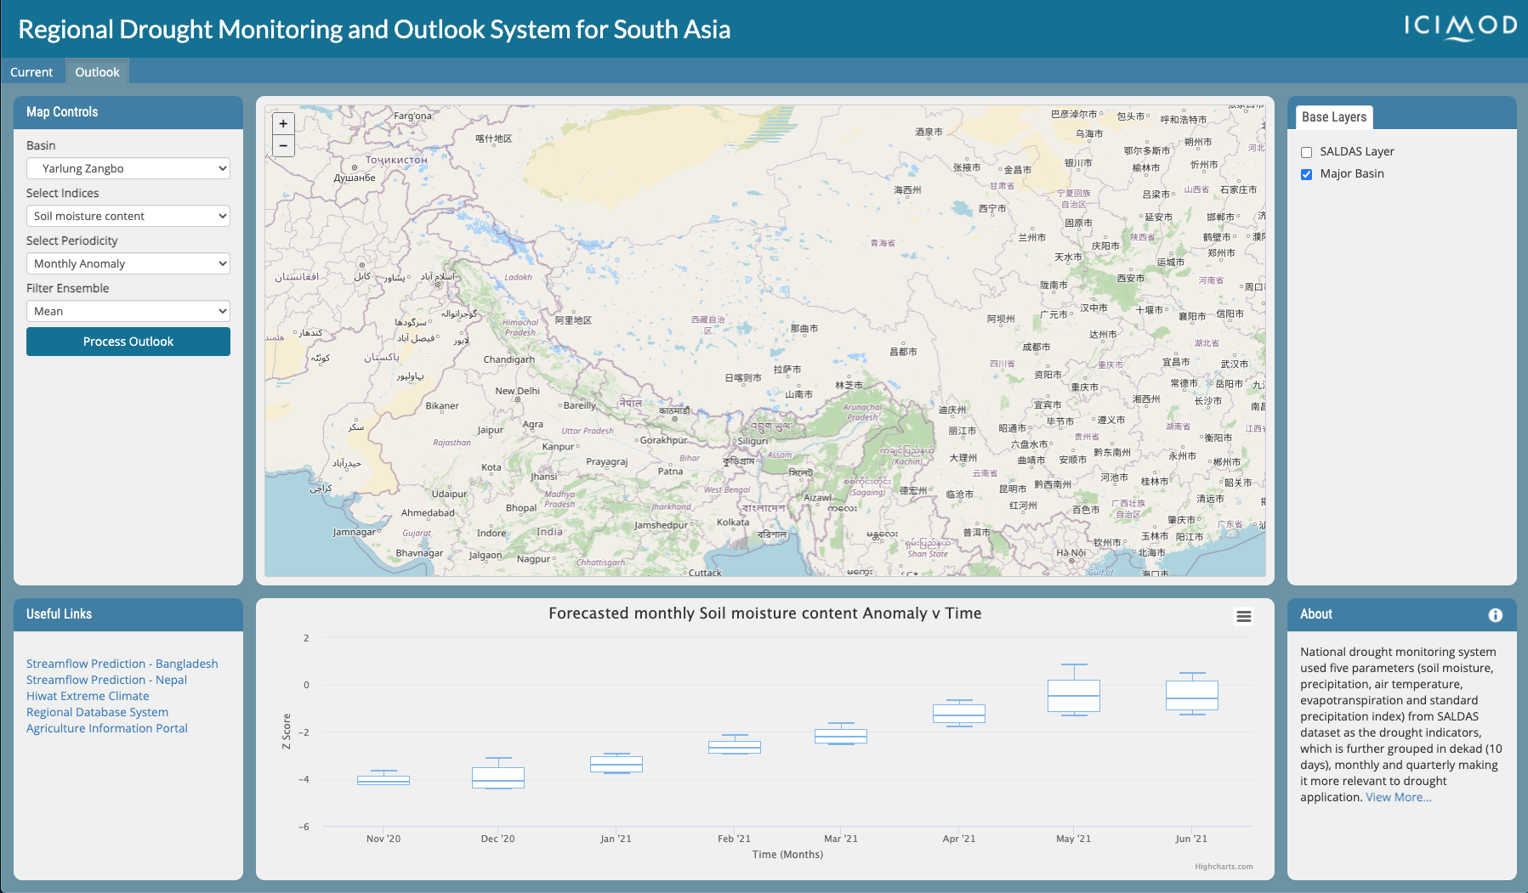
Example 2: Regional Drought Outlook
Regional Drought Monitoring and Outlook System for South Asia
  An integrated land data assimilation system providing real-time monitoring and outlooks deployed by regional institution ICIMOD (International Centre for Integrated Mountain Development)
Soil Moisture
2
Soil Moisture Anomalies
0
Wintertime Drought
Z-Score
-2
-4
Nov’20
Dec’20
Jan’21
Feb’21
Mar’21
Apr’21
May’21
Jun’21
Courtesy of ICIMOD: http://tethys.icimod.org/apps/regionaldrought/

Slide 9
Example 2: Regional Drought Outlook
Long-term outlooks require subseasonal to seasonal forecasting systems
  SALDAS is powered by seasonal forecasts from the NASA Goddard Earth Observing System subseasonal to seasonal prediction system (GEOS-S2S)
Users often need forecasts placed into historical context
  Reanalyses and Hindcasts can be used to create long term records for evaluating climate anomalies by running the model using historical observation archives
Soil Moisture
2
Soil Moisture Anomalies
0
Wintertime Drought
Z-Score
-2
-4
Nov’20
Dec’20
Jan’21
Feb’21
Mar’21
Apr’21
May’21
Jun’21
Courtesy of ICIMOD: http://tethys.icimod.org/apps/regionaldrought/

Slide 10
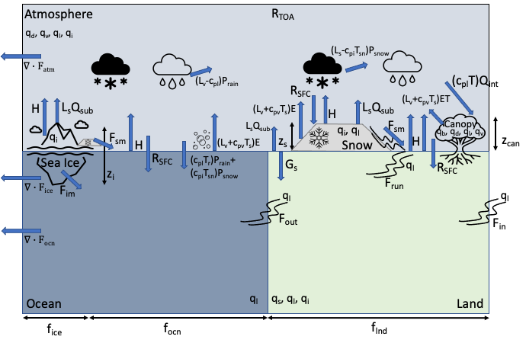
Subseasonal and Seasonal Forecasting
How
      1. Earth System Coupled Modeling
          Predictability at S2S timescales arises through the coupled exchanges of energy and water between Earth’s atmosphere, land, ocean, and cryosphere subsystems. Complex interactions mediate the low-frequency behavior of the climate.
          The interactions at longer time scales are more
          uncertain and require ensemble prediction systems
          to provide probabilistic scenarios
Earth System Energy Exchanges
          2. Initialization and Simulation
    Coupled modeling now must address initialization of the land and oceanic stores of energy and water. Assimilation strategies include:
      Uncoupled: Systems initialized independently and run asynchronously
      Weakly-Coupled: Systems initialized independently but run coupled
      Strongly-Coupled: Systems initialized and run jointly

Slide 11
Subseasonal and Seasonal Forecasting
Who, What and When
Multi-model ensemble prediction systems are produced by operational modeling centers and research institutions following coordinated protocols as part of larger projects (e.g., NMME, C3S, SubX)
Forecasts of precipitation, air temperature, and sea surface temperature are provided and used for graphical forecast products; Hindcasts (20+ years) are made and used to support bias correction and computation of anomalies
They are usually run at 25-50km resolution with forecast lead times of 6-9 months
Data Assimilation
and Hindcasts
Assimilation of Atmosphere, Oceans, and Land
Model Forecasting
6-9 month lead forecasts at 25-100km from 4x daily to 1x month
Application Models
Use model forecasts to generate sector-specific forecast products
Hindcasts of 20+ years supporting skill evaluation and bias corrections
Temperature, Precipitation, Circulation
Model biases often need to be removed
Bias-Correction
Downscaling
Graphical Forecast
Products (Ensemble)
National/Regional Met Services and Research Institutions — NMME, C3S, SubX Projects
End-Users

Slide 12
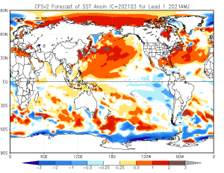
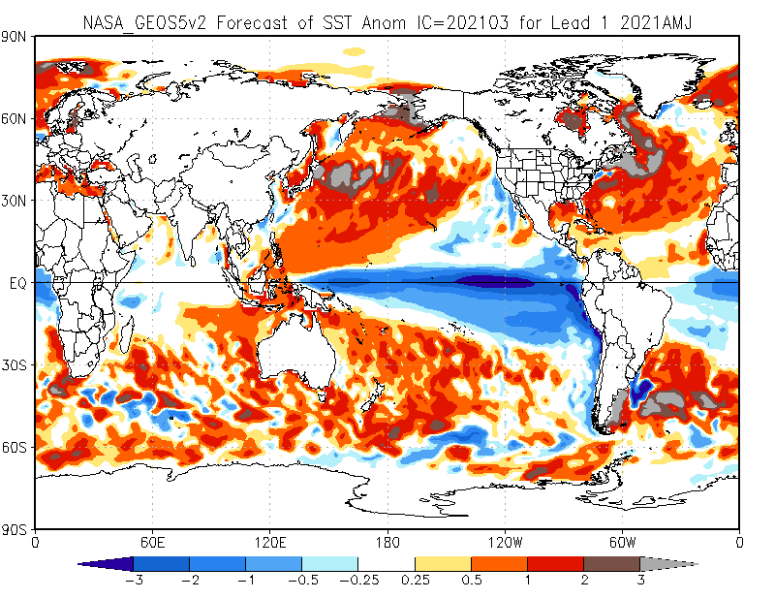
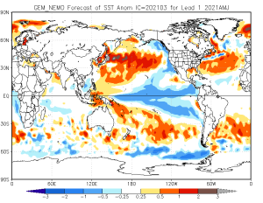
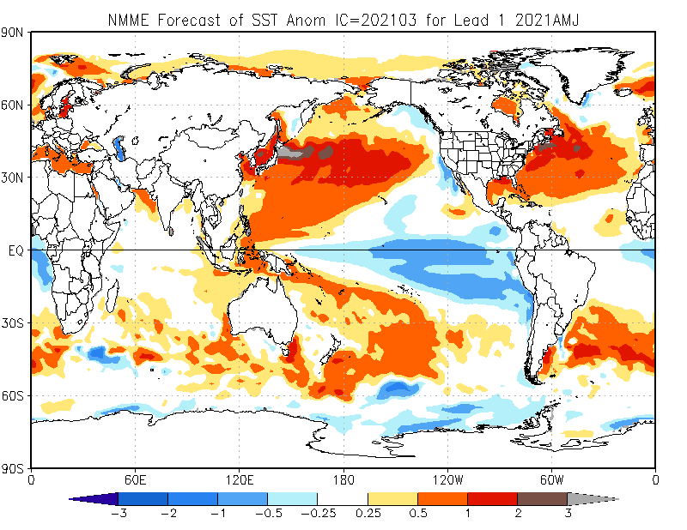
Subseasonal and Seasonal Forecasting
Sea Surface Temperature Forecasts for Apr-Jun 2021
Examples
North American Multi-Model Ensemble (NMME), 6-9 month forecasts produced about 1x month
Copernicus Climate Change Service (C3S) Seasonal Forecasts, 6-month forecasts produced 1x month
SubX (Subseasonal Experiment), 32–45 day outlooks
CFS
GEOS-S2S
NEMO
NMME
Courtesy of NOAA CPC: https://www.cpc.ncep.noaa.gov/products/NMME/

Slide 13
Climate Projections and Downscaling
Climate Projections for Long Term Planning
Much of what has been described for subseasonal and seasonal climate forecasting is also appropriate for modeling of climate projections at the decadal to inter-decadal time scales.
However, there is less emphasis on initialization and a strong focus on sampling plausible green house gas forcing scenarios in the system.
Again, large sets of coordinated (e.g., CMIP) multi-model, multi-ensemble systems are needed to sample potential future outcomes and attempt to separate the anthropogenic forced climate signal from climate noise generated by internal variability.
Finally, bias correction and downscaling techniques are often necessary to address the lower resolution of models and provide more tailored information for regional to national to local scales.

Slide 14
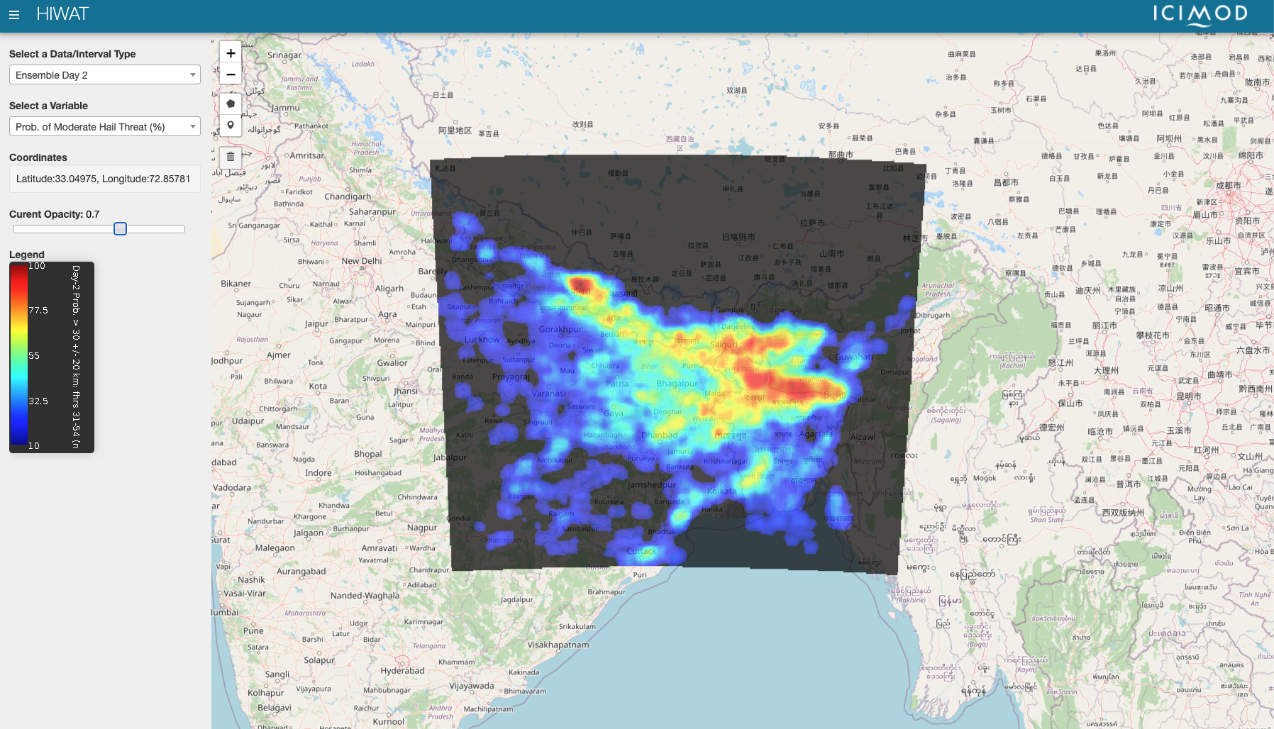
Example 3: Severe Weather Threat
High Impact Weather Assessment Toolkit (HIWAT)
  A limited-area, high-resolution triggered ensemble prediction system for severe weather threat developed for South Asia
Probability of Moderate Hail Threat
Courtesy of ICIMOD: http://tethys.icimod.org/apps/hiwat/

Slide 15
Example 3: Severe Weather Threat
Regional modeling systems can provide more accurate forecasts by resolving small scale processes in regions of complex terrain
    HIWAT uses Weather and Research Forecasting (WRF) model
There are many derived metrics that can be developed to communicate threats
    Impact-based forecasting is a rapidly emerging area that focuses on incorporating information on impacts and risks to end-users
    Ex: What does a probability of hail mean to a farmer? To an insurance company?
Probability of Moderate Hail Threat
Courtesy of ICIMOD: http://tethys.icimod.org/apps/hiwat/

Slide 16
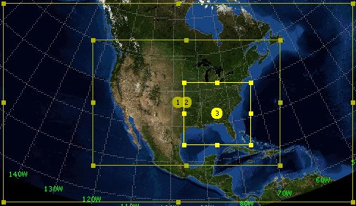
Regional Modeling
      1. Limited Area Models
          At scales less than 4km, some elements of convection are able to be resolved and thus these models are called “convection-permitting” .
          Larger scale models (>10km) typically require convective parameterizations, but critical assumptions are often violated in the intermediate or “gray zone”.
          Perturbed-physics ensembles are used to provide better characterization of uncertainties by running simulations with multiple parameterization schemes.
Example of Nested Regional Grids
Courtesy of Jon Case, ENSCO
          2. Initialization and Simulation
    Regional models require the supply of regional boundary conditions.
    Boundary conditions are provided by global weather forecast models and thus biases in those coarser models are inherited by the regional models.
    Computational requirements are severe at high-resolution and thus simulations are shorter

Slide 17


Integration and Delivery
Weather and Climate Forecasts
Data Providers
End Users
Data archival, distribution, and visualization are also critical elements
  Common data formats include NetCDF-4/HDF and Gridded Binary (GRIB/GRIB2)
  A widely used file server technology is Unidata’s Thematic Real-time Environmental Distributed Data Services (THREDDS). This supports most common formats, multiple forms of data access endpoints (WMS, WCS, OPeNDAP, etc.), allows virtual aggregation of datasets, and efficient subsetting services.

Slide 18
The Big Picture
Whether assessing yields forecasts, conducting regional drought outlooks, or developing an early warning system for severe weather threats, the infrastructure of Weather & Climate forecast information production is essential.
Weather and Climate Forecasting Infrastructure
  Government, Research, and Private organizations with differing mandates
  Integrating observations into complex global numerical weather prediction (NWP) and coupled Earth System Models
  Making forecasts at short, medium-range, subseasonal to seasonal, and interannual to interdecadal time horizons
  Placing those forecasts into context with historical reanalyses and hindcasts
  And developing information products for end-users through use of application models and visualization tools

