Slide 1
CST Inlet Treatment Modeling
National Aeronautics and Space Administration
Aikaterini Stylianides
Pathways Intern, Acoustics Branch
PhD Student, Penn State University
NASA Glenn Research Center
www.nasa.gov
Notes:
Name (duh)
Pathways intern at Glenn research center in the acoustics branch
PhD student studying acoustics at Penn State

Slide 2
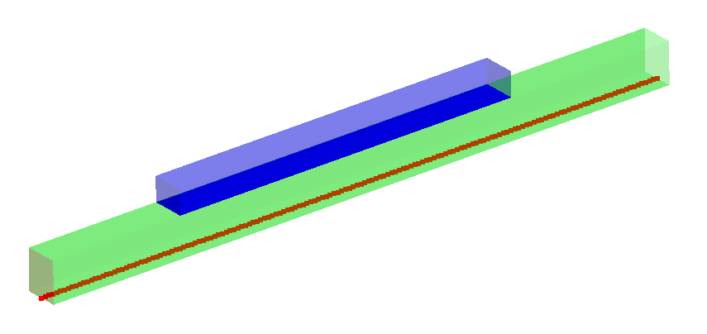
Overview
Objective – Modeling of varying liner properties in Actran through the use of the Grazing Flow Impedance Tube (GFIT) geometry
Approach – Build a model of the GFIT in Actran, model three liner properties without flow, compare for confidence
Status – GFIT model is built, three liners without flow are modeled and compared
Next Steps – Add flow to simulation, model honeycomb liners
Notes:
- Green is the tube(?), blue is where the liner goes, red is 161 microphones
- Compare to data
- No flow right now

Slide 3
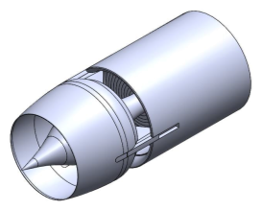
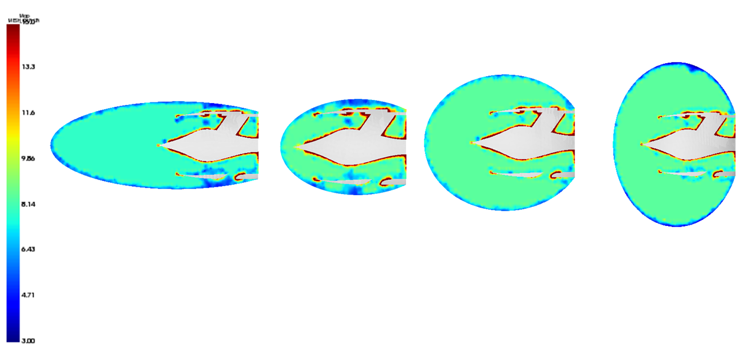
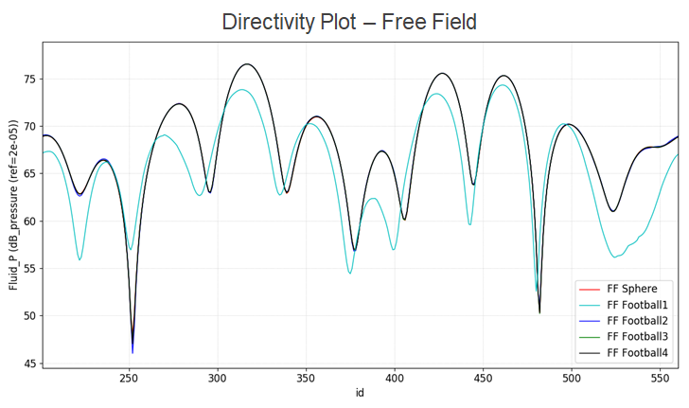
Past Work
Domain size study of LM1044 supersonic inlet (Summer 2020)
Domain | Volume (m³) | 3D Elements | Elements per Wavelength | Computation Time
Football1 | 20.49 | 252655 | 4.13 | 4m37s
Football2 | 13.65 | 218021 | 4.06 | 2m31s
Football3 | 32.25 | 287618 | 4.09 | 9m03s
Football4 | 50.36 | 330759 | 3.03 | 14m21s
Football 1 at 400 Hz takes 14 GB
Notes:
Summer work
- Domain study -> okay to cut it down without flow which is what this study was done over
- Not okay when flow is added
- Subsonic study though

Slide 4
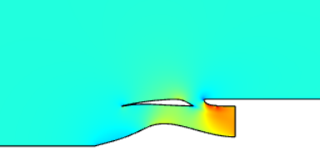
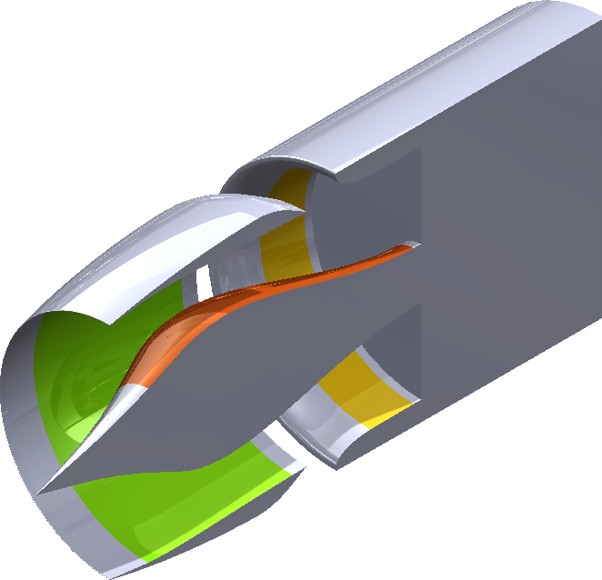
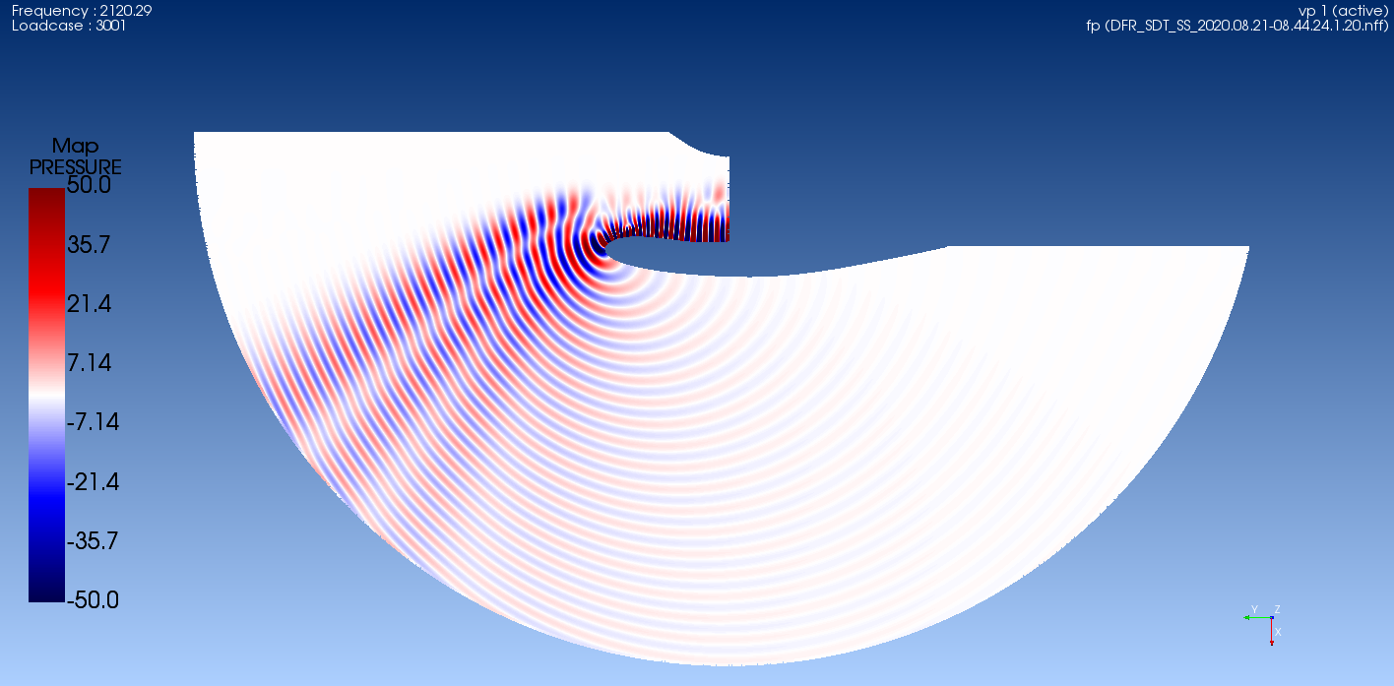
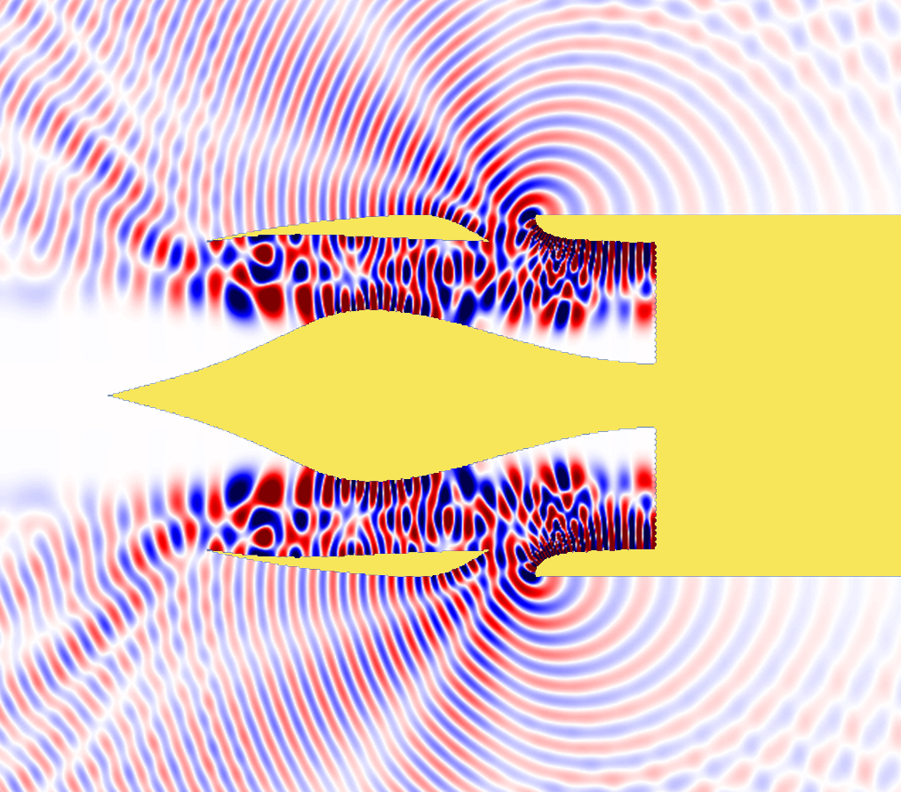
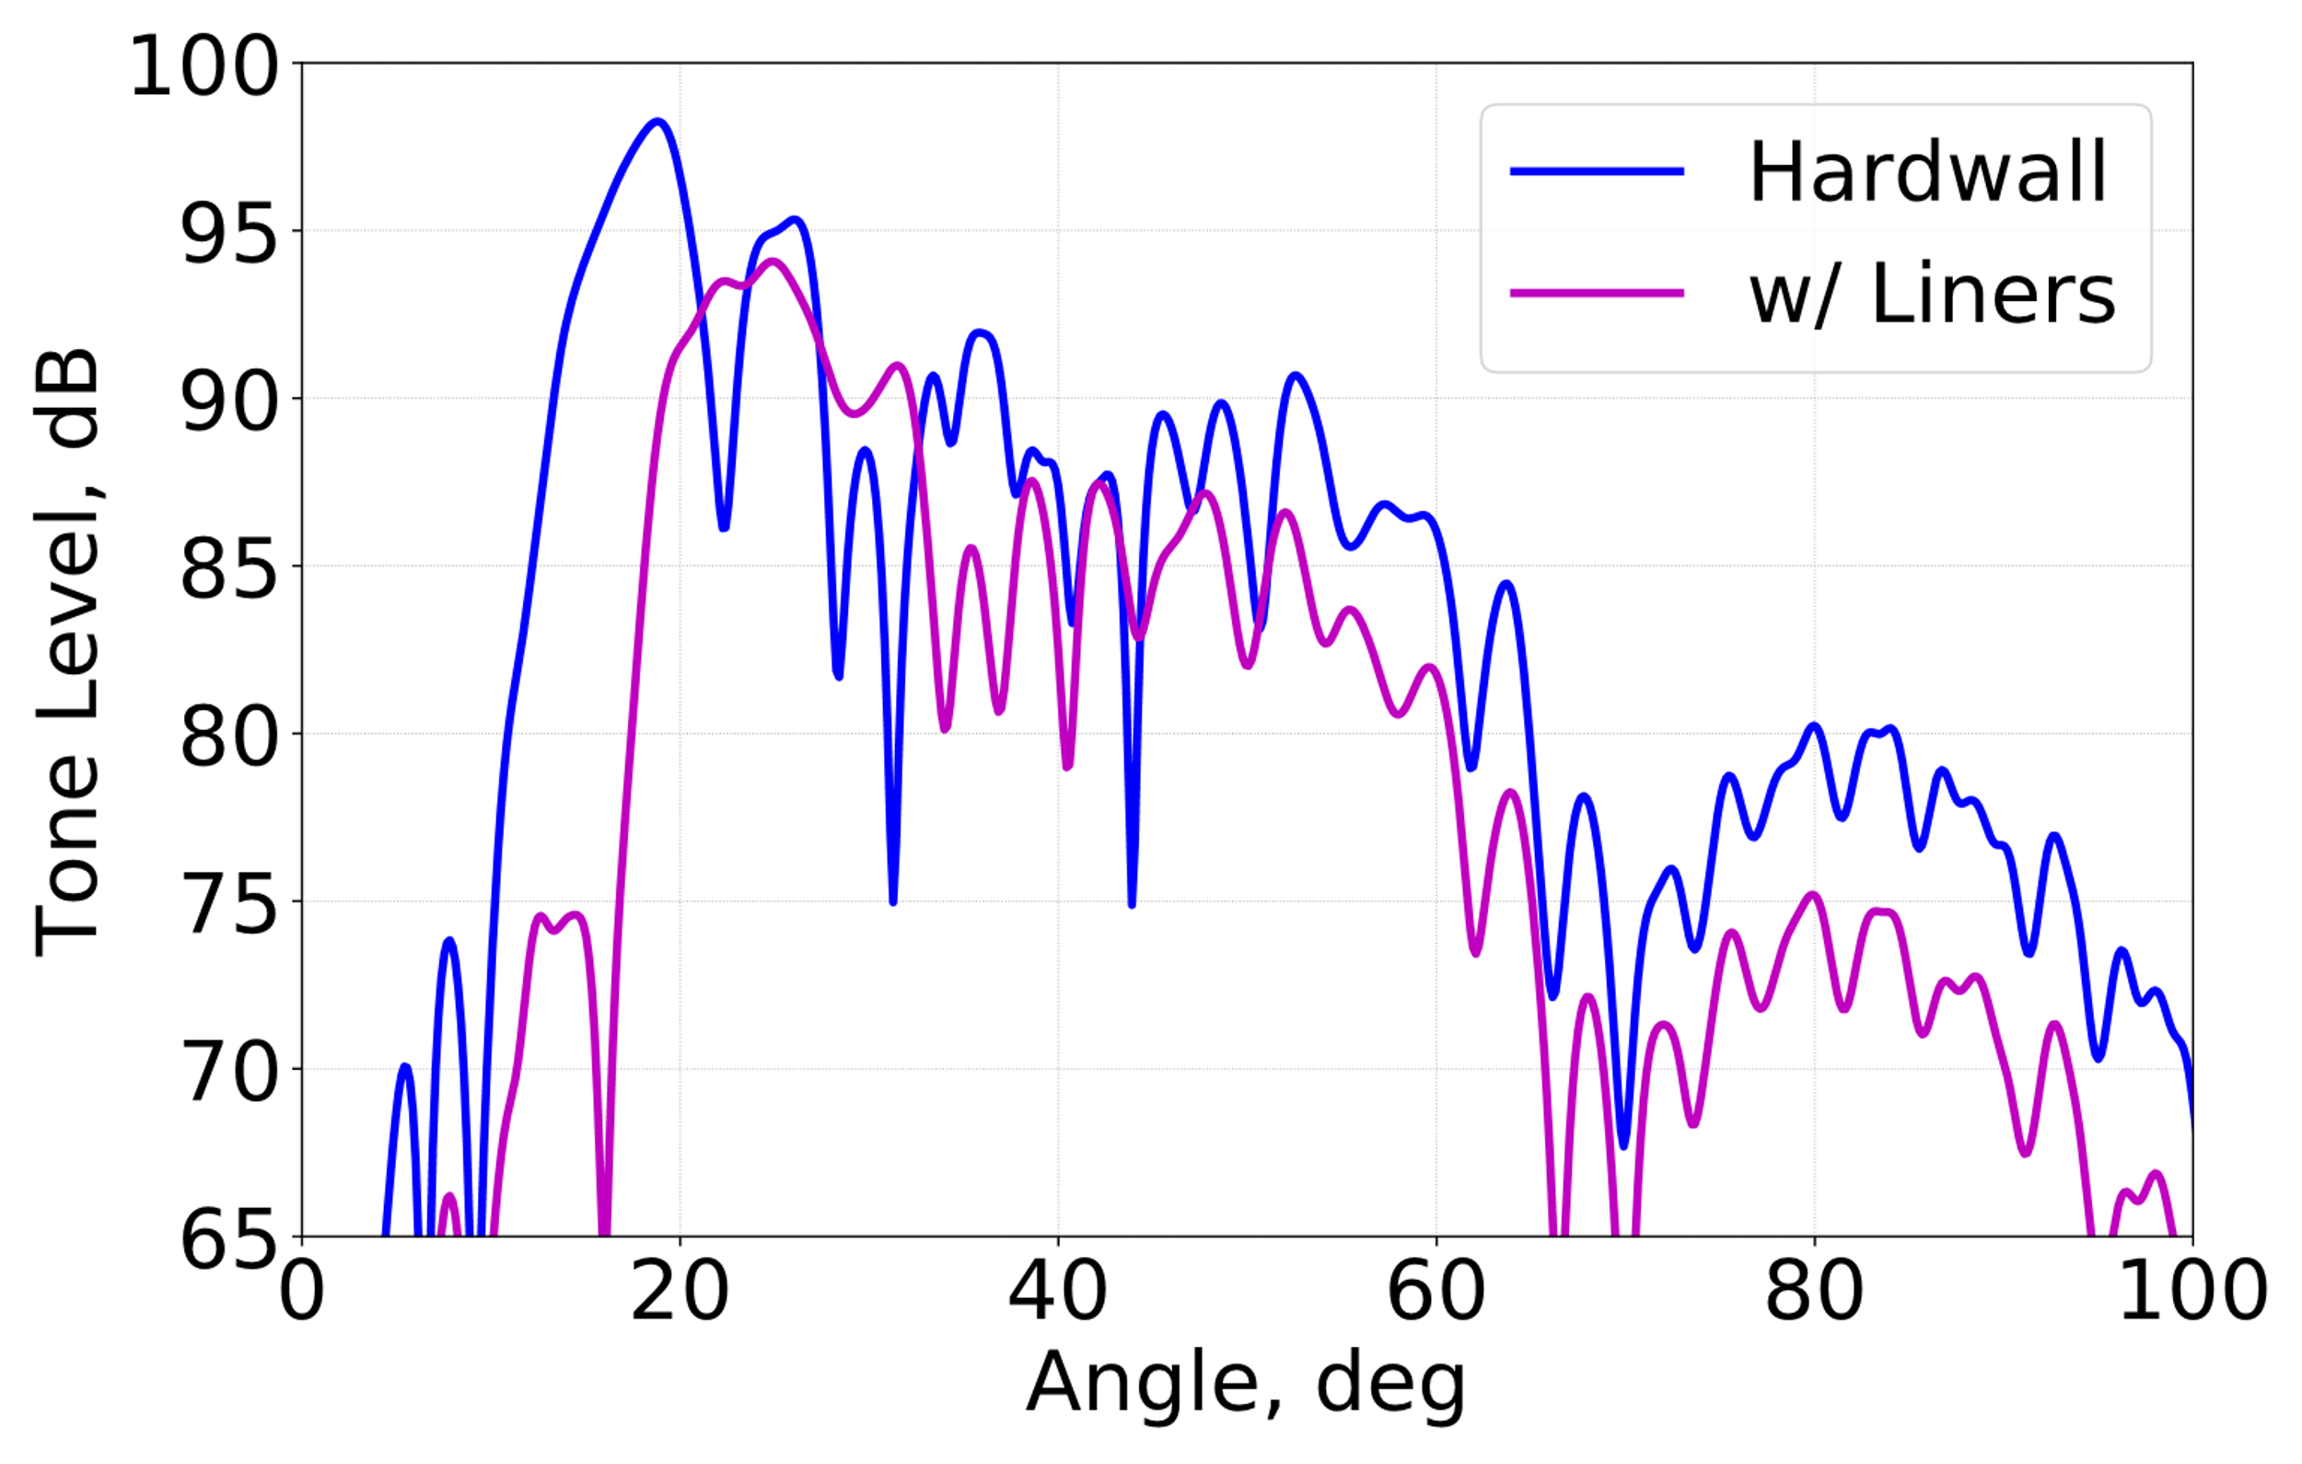
Current Members and Activities
Use of COMSOL and various flow models for flow solutions with acoustics (Svetgoff)
Correction for supersonic inlet geometry effect (Stephens)
Model sensitivity to liner placement (Stephens & Svetgoff)
Centerbody Liner
Outer Duct Liner
Upstream Cowl Liner
Notes:
Alex:
Use COMSOL to compute flow field around the inlet
Map relevant variables to acoustic mesh, run acoustic analysis
David:
We have good subsonic models, but supersonic models are still a WIP
Both:
- Three places, looks at what position would be the best bang for your buck

Slide 5
Actran Liner Methods
Testing different methods of modeling liners and liner properties to find the most accurate way to add them to an Actran simulation
In order to make sure that these results were accurate, a model of the Grazing Flow Incidence Tube (GFIT) was built to compare predictions with GFIT data and COMSOL predictions
Noah Schiller and Martha Brown’s papers on modeling the GFIT were used as a basis for these simulations
“Experimental Evaluation of Acosutic Engine Liner Models Developed with COMSOL Multiphysics”. Schiller, Jones. NTRS: https://ntrs.nasa.gov/citations/20170005768
“Uncertainty Analysis of the Grazing Flow Impedance Tube”. Brown, Jones, Watson. NTRS: https://ntrs.nasa.gov/citations/20120010286
Notes:
GIFT is at langley

Slide 6
Approach
Studied the COMSOL model of the GFIT (Schiller) and built the GFIT in Actran based off of that method
Modeled three liner conditions in order to validate the methods
Perforate over air
Ceramic Fiber
Perforate over Ceramic Fiber
This model currently has no flow
Notes:
Actran has a specific boundary condition called “acoustic liner” that uses a perforation and a “fluid” material
Liner properties are inputted using complex speed of sound and density as a “fluid”
ANIMATION I’m only showing the Ceramic Fiber condition as it is the only case I can actually compare data to

Slide 7
Ceramic Fiber Liner
Notes:
Here are the 12 frequencies that were run, so in the lower frequencies we see about a 10dB drop, while the reduction becomes more erratic with the increase in frequency

Slide 8
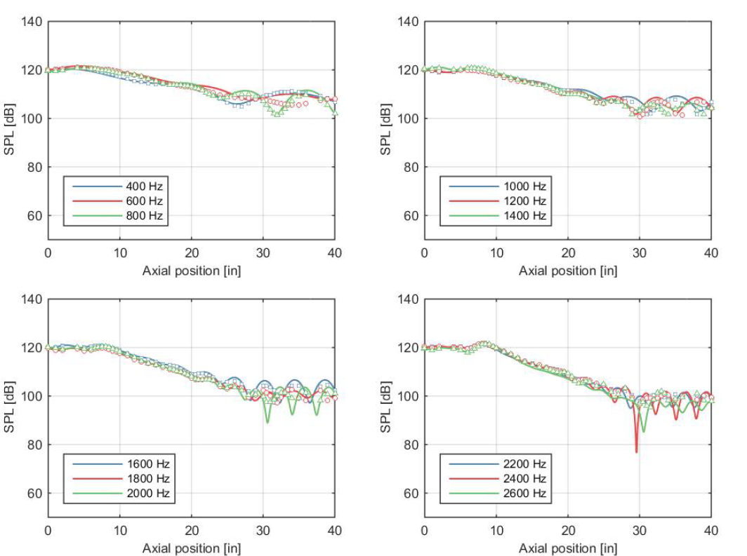
Ceramic Fiber Liner
For lower frequencies, the Actran results match the 10dB drop found in Schiller’s paper
The broadband curves do follow different paths, which is something to study in the future
Notes:
The top graph shows the predictions I collected from the Actran model, while the lower graph is the data Noah Schiller collected, with the Gfit measurements being indicated by the markers and the solid lines showing the COMSOL predictions

Slide 9
Ceramic Fiber Liner
For the higher frequencies, the decibel drop found in the Actran results is about half that found in Schiller’s data
This highlights a problem with the model to be researched in the future
Notes:
The three liner cases have been run and compared
Although this cannot be a perfect comparison in relation to some of the data in Schiller’s paper, it provides a basis for the work and proves that the model runs

Slide 10
Next Steps
Compare Actran predictions with GFIT data
Compare Actran predictions with COMSOL predictions
Add flow to the model
Model a honeycomb structure
Best practices so there is confidence in the codes
Apply to the NASA Superfan

