Slide 1
AIAA SOSTC
NASA CARA
Event Case Studies
R.A. Baker
M.R. Johnson
7 April 2021

Slide 2
Outline
CARA Process Overview
  Nominal Event Evolution
Event Case Studies
  Case Study 1: Event Actionability
  Case Study 2: Maneuverable Secondary Payload
Summary
Back-up Slides
  Case Study 3: Space Weather Impacts
  CARA OSA Overview

Slide 3
CARA process overview

Slide 4
CARA Process Overview
Resident Space Objects (RSOs) are divided into multiple orbit regimes based on Apogee and Perigee
  Low Earth Orbit (LEO) regime contains majority of RSOs and CARA-protected assets
  Events within the LEO regime considered for this presentation
CARA assets screened daily to predict close approach events with RSOs
  LEO screening identifies events up to 7 days into the future, but planning most often begins in earnest 2-3 days prior to an event Time of Closest Approach (TCA)
Event planning takes place between CARA and Mission Operations Team
  Identify, plan, and screen potential mitigation maneuvers
  Determine maneuver Go/No Go based on event Pc at decision time

Slide 5
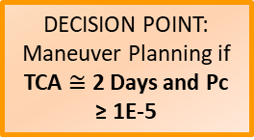
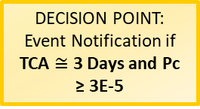
Nominal Event Timeline
3-7 days prior to TCA
  Review event details; identify advanced analysis needed for any events
  Orbit Determination (OD)s of objects are flagged, manually reviewed and evaluated by the CARA OSAs
  Secondary O/O contacted to coordinate mitigation plans (if applicable)
  Review space weather predictions
1-3 days prior to TCA
  CARA contacts mission team and event planning begins should Pc remain high
  Mitigation maneuvers are screened for post-maneuver events
0.5 day to TCA
  Final go/no go to perform mitigation maneuver based on latest available event Pc
0. Conjunction Identification, Internal Analysis, and Monitoring
7 Days > TCA ≥ 3 Days
All Identified Events
Stop Planning – Monitor Only
DECISION POINT:
Event Notification if
TCA $≅$ 3 Days and Pc ≥ 3E-5
Initial Notification and Request for Planning Timeline
no
yes
Stop Planning – Monitor Only
DECISION POINT:
Maneuver Planning if
TCA $≅$ 2 Days and Pc ≥ 1E-5
2. Maneuver
Planning
no
yes
Waive Maneuver – Monitor Only
DECISION POINT:
Maneuver Go / No-Go if TCA ≤ .5 Day and Pc ≥ 1E-4
3. Maneuver Execution
no
yes
TCA
Notes:
Event with potentially active secondary (timeline shifts for coordination with secondary- investigate maneuverability status, reach out to secondary o/o)
Secondary OD: LUPI/DC span long, no recent tracking (more than 7-10 days)
Additional analysis required, reach out to OSAs and Analysis team to evaluate the actionability of the OD (go into more detail during the case studies presented)
Low Rel Vel: additional analysis required monte carlo

Slide 6
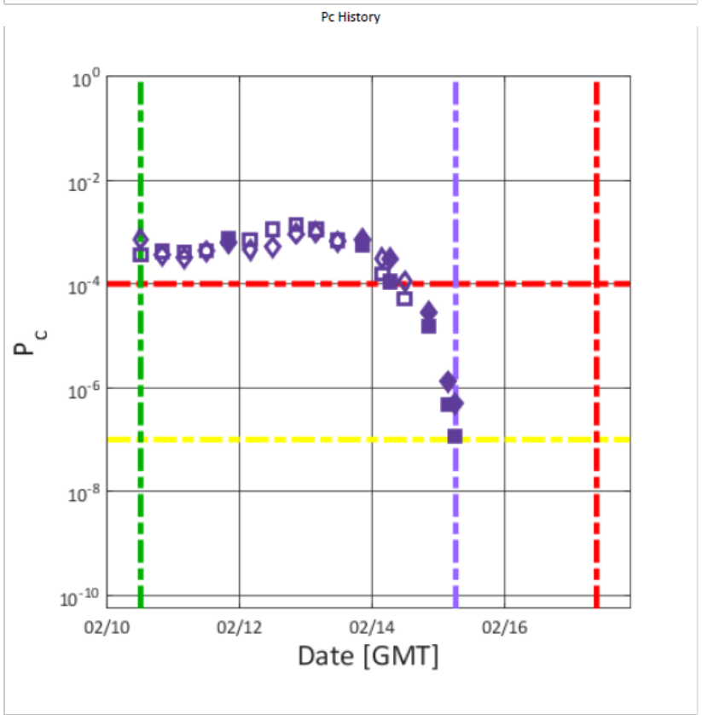
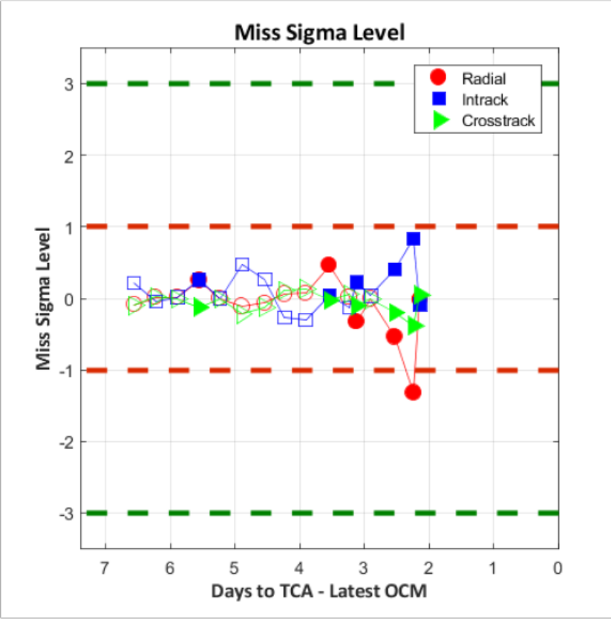
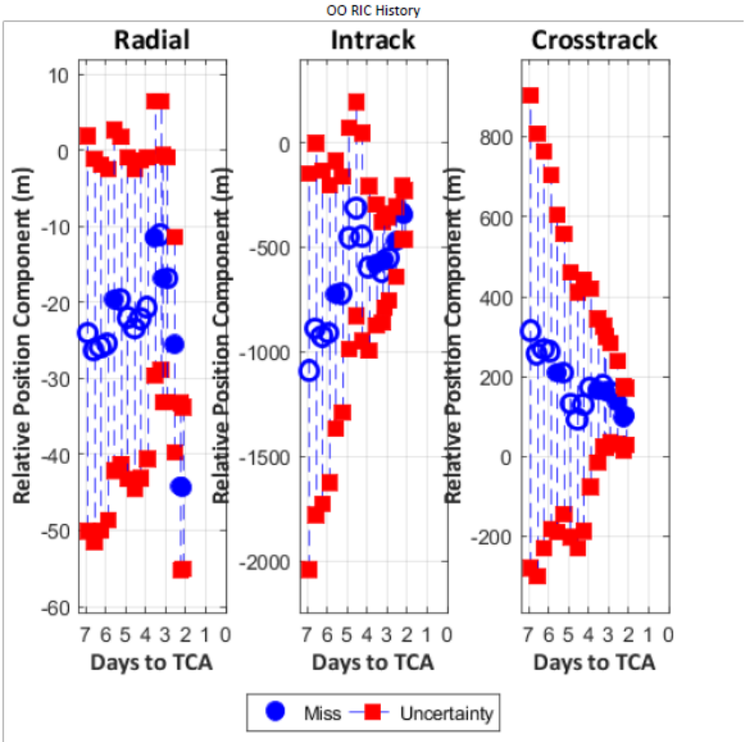
Nominal Event Progression
In plots
Miss Components with Error Bars
Radial, In-track, Cross-track miss components +/- 1-sigma uncertainty
Covariance contracts as TCA approaches given updated tracking, improved atmospheric predictions, and other event factors
Probability of Collision (Pc) vs Time
Pc identified at high levels and/or increases to peak before decreasing to low levels prior to TCA
Mitigation action needed if Pc does not decrease at Go/No Go prior to TCA
Miss Sigma Plot
Identifies how an event’s miss components have changed compared to previous screening data
Small changes can indicate high confidence in solution or stale data

Slide 7
Event Timeline Notes
Nominal Event Timeline not applicable to all events
  Late Notice events can be identified within one day to TCA leaving little time for in-depth analysis
    Poorly-tracked secondaries can cause significant event changes when new tracking is received
    Discrete space weather events can be mismodeled or not modeled in future propagation causing unpredictable state changes
  Communication and coordination with another spacecraft O/O can require extra planning time
All high Pc (> 1E-4) events require mitigation, if mission capabilities exist to do so
  Minimal number of events have questionable OD/state predictions requiring further analysis to determine if active mitigation is appropriate

Slide 8
Event Case Studies
Case Studies presented here offer situations where the nominal event timeline or baseline set of analyses was not sufficient
  These types of events can be uncommon or even rare
  Robust CONOPS not always developed to identify and evaluate these edge-case events
The goal of this presentation is to bring awareness to some of these edge case scenarios so that other O/Os can be prepared if they are encountered during routine operations

Slide 9
Case study 1:
Event actionability

Slide 10
What is Event Actionability?
Event Actionability considers a minimum data quality needed to pursue a mitigation action
Two Line Elements (TLEs), for example, do not provide enough data for CA
  State estimate based on GP solution; no covariance available
SP solution and covariance is available for vast majority of events, but occasionally the OD quality is questionable
  Object has not been tracked in some length of time
  RSO characteristics vary such that quality of OD solution and future propagation can have substantial differences
    High drag, small debris objects vs. well-tracked large payloads

Slide 11
How is Event Actionability Determined?
OD Actionability Question – USSPACECOM ASW Solution
  To evaluate if the OD properly represents the object’s state and uncertainties
  OD characteristics evaluated based on “definitive” and “predicted” portions
Definitive solution – solved-for trajectory based on tracking data
  Determine whether a GP or SP solution is being used
    GP solution will use “default covariance” and should not be used as a basis for CA – this occurs rarely
  OBS_USED to ACTUAL_OD_SPAN Ratio for the object
    How much tracking data is used over the OD Span?
    OBS_USED/3 provides approximate number of individual tracks in definitive OD
    Appropriate ratio varies per object and orbit regime
  What is TIME_LASTOB_END?
    Indicates recency of latest tracking data
    Some objects/orbit regimes can sustain accurate solution with longer tracking gaps
  What is the WEIGHTED_RMS (WRMS)?
    WRMS near unity indicates high confidence in OD solution, WRMS > 3 indicates questionable OD quality

Slide 12
How is Event Actionability Determined?
Predicted solution – propagated trajectory using definitive OD
  Object Characteristics (SEDR, CD_AREA_OVER_MASS (BC))
    High EDR, Ballistic Coefficient (BC) can indicate drag susceptible object; errors in atmospheric prediction exacerbated by high drag objects; shorter OD spans and propagation time preferred
  Force models applied (SOLAR_RAD_PRESSURE)
    Solar Radiation Pressure can affect RSOs with an altitude > 500 km
  Atmospheric predictions
    Has the atmosphere been perturbed by space weather events?
“Correct” OD parameters vary for each object
  Some OD solutions and predictions may be “good enough” for CA even if improved solution would be preferred
  Inaccuracies in OD captured in covariance data for each object
What about OD actionability for an O/O-provided ephemeris?
  More difficult to analyze as less data available for O/O ephemerides compared to USSPACECOM ASW solutions – case studies here focus on ASW OD solutions

Slide 13
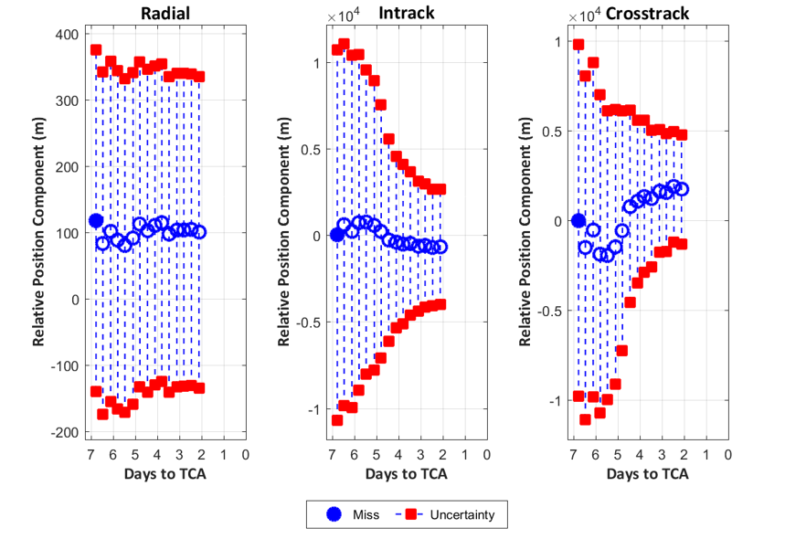
Part 1: Inactionable Event
Background
  Event with debris object first identified at 7 days to TCA
    Probability of Collision (Pc) was a moderate risk 4e-5); high enough Pc that mitigation planning considered
  Continued to monitor for new tracking data; formally evaluated OD at 3 days to TCA
    Secondary Object TIME_LASTOB_END > 14 days
    OBS_USED to ACTUAL_OD_SPAN = 1.7 with ~6 tracks over 10.5 days
OD Review
  Definitive OD showed limited but sufficient data over the OD span; WRMS of 2.24 somewhat elevated
  At 3 days to TCA, secondary object TIME_LASTOB_END > 14 days, decreasing confidence in OD prediction accuracy
  SEDR = 9.2E-4 W/kg; CD_AREA_OVER_MASS = .42 m2/kg
Miss Component History shows:
Relatively large event uncertainties RIC 1-sigma [238, 4155, 3802] m
Some, but limited covariance contraction as TCA approached
Notes:
Secondary Object LUPI Span began 14 December 2020 (three weeks prior to this identification)

Slide 14
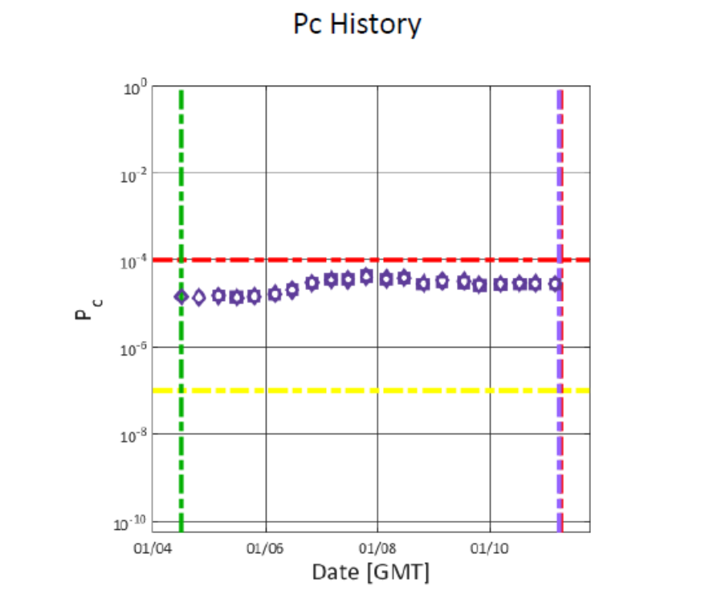
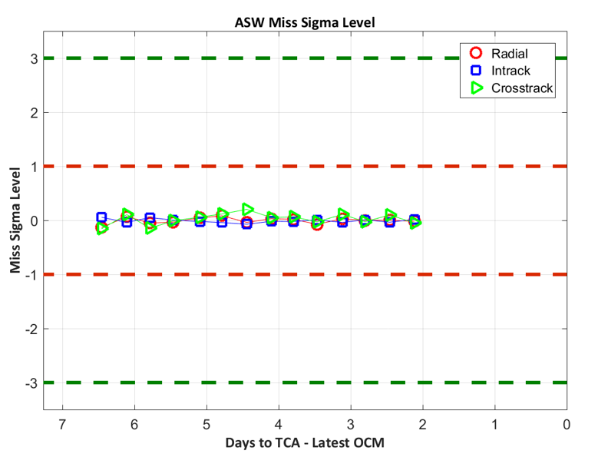
Part 1: Inactionable Event
Event deemed inactionable unless new tracking received
  Lack of recent tracking leading to ~18 days of propagation time biggest driver in this assessment
CARA Recommended no maneuver unless future tracking indicated high risk
  Maneuver could not be shown to be necessary and could be more risky than taking no action
  No additional tracking received prior to TCA; no maneuver performed
Pc History Plot Shows:
Pc calculation showed minimal changes through event evolution
Pc never increased above 1E-4 Red Threshold requiring event mitigation
Miss Sigma Level Plot Shows:
Without updated tracking or large changes in atmospheric predictions, event updates “in-family” with negligible changes update to update
If new tracking received, likely to see large state change indicated on this plot

Slide 15
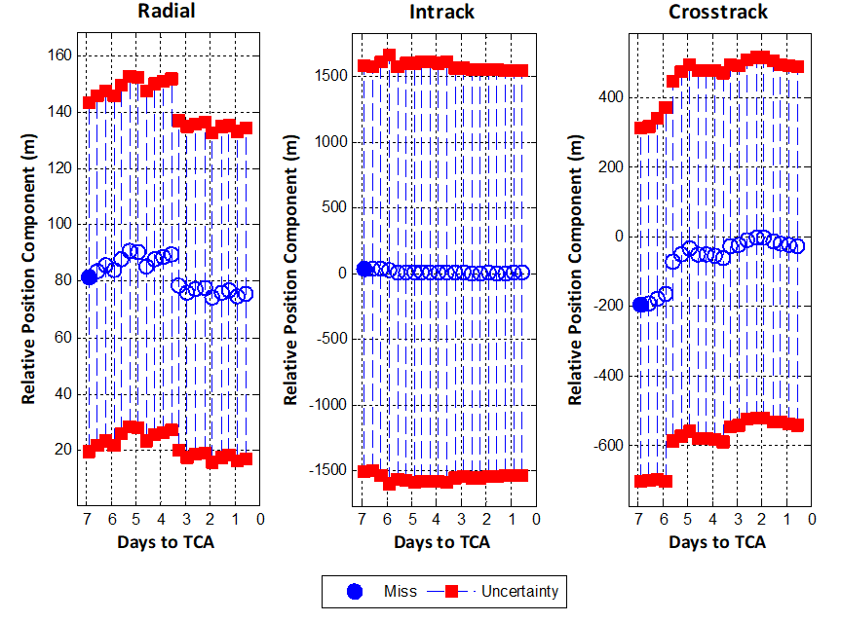
Part 2: Actionable Event
Event Background
  Event with debris object first identified at 7 days to TCA
    Probability of Collision (Pc) was a high risk (2.8e-3)
  Multiple mitigation options screened daily prior to TCA
  As event evolved no new tracking included in OD solution
  Pc remained high close to TCA and mission performed mitigation maneuver
OD Review
  Definitive OD showed sufficient data over the OD span; OBS_USED to ACTUAL_OD_SPAN = 2.2 with ~13 tracks over 17 days
  WRMS of 1.8 indicates confidence in definitive OD
  At 3 days to TCA, secondary object TIME_LASTOB_END ~5 days ago; not significant cause for concern
  SEDR = 1E-4 W/kg; CD_AREA_OVER_MASS = .18 m2/kg
Miss Component History shows:
Relatively moderate event uncertainties RIC 1-sigma [58, 1543, 515] m
Essentially no covariance contraction as TCA approaches

Slide 16
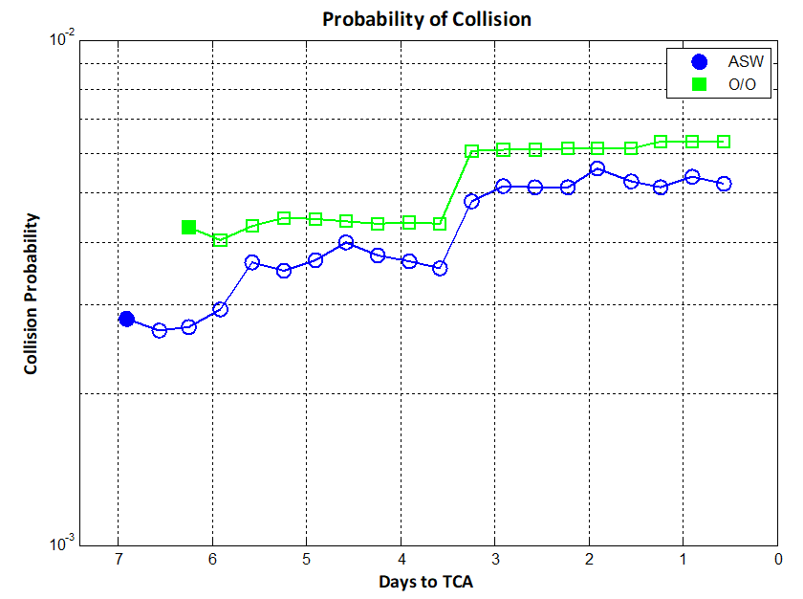
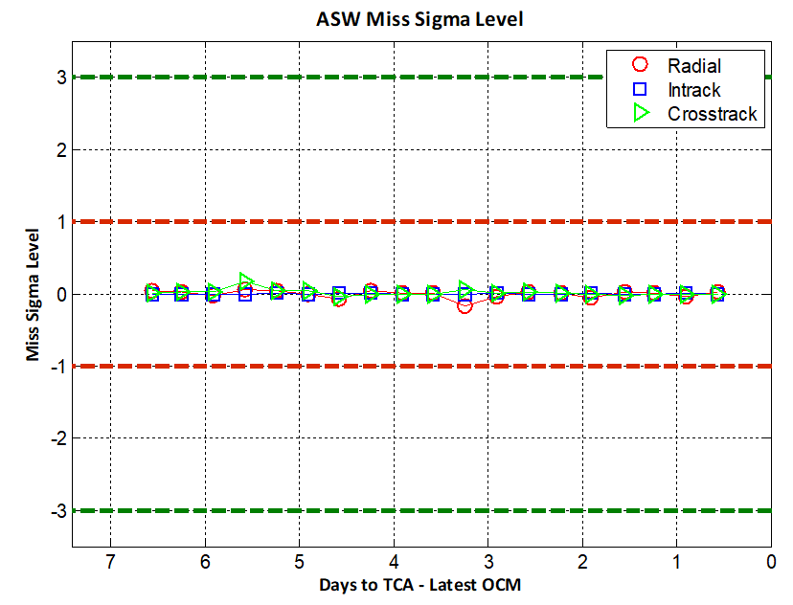
Part 2: Actionable Event
Based on quality of definitive OD and predicted trajectory event deemed actionable
  Receiving daily tracking can increase OD confidence, but is not required to determine OD solution is good enough for CA
  Object had been well-tracked and solar activity was low, therefore propagation from time of last track to TCA short enough to recommend acting based on high Pc
New tracking received shortly after TCA
  Confirmed minimal state change and Pc expected to have remained high even with additional tracking
Pc History Plot Shows:
Pc calculation showed minimal changes through event evolution
Pc never increased above 1E-4 Red Threshold requiring event mitigation
Miss Sigma Level Plot Shows:
Without updated tracking or large changes in atmospheric predictions, event updates “in-family” with negligible changes update to update
If new tracking received, likely to see large state change indicated on this plot

Slide 17
Event Actionability:
Comparison and Summary
Both events presented had large gap in new tracking data relative to majority of events reviewed by CARA but one was determined actionable and the other inactionable
Lack of recent tracking does not always mean an event is inactionable
  What defines recent? Depends on event/object characteristics
  Low altitude/high drag objects may need several tracks per day to maintain quality solution
  High altitude/low drag objects can sustain longer periods without new tracking
Need to consider both definitive and predictive portions of OD Solution or Ephemeris
  Post-maneuver solutions often have increased uncertainties
Different ephemeris sources have variable data quality
  Has covariance been tuned? What atmospheric model is being used for propagation?

Slide 18
CASE Study 2: active secondary

Slide 19
Background on Active Payloads
Active maneuverable payloads can add CA complications
  What is considered maneuverable?
  Any ability for a spacecraft to change its orbit trajectory in a non-Keplerian way.
  This includes chemical propulsion, low or electrical thrust, and differential drag
  Non-maneuverable payloads can be treated the same as debris from a CA perspective
Maneuverability Complications
  USSPACECOM OD does not incorporate any maneuvers into orbit predictions so all O/Os are reliant on O/O ephemeris data to communicate maneuver information
  Need to confirm if another payload is actively maneuvering or planning to maneuver if a conjunction event is identified between two payloads
  If two payloads are conjuncting, who moves?
  How can two O/Os communicate successfully their intentions to maneuver or not?

Slide 20
Background on Active Payloads
O/O ephemeris solutions
  Currently need to be provided to USSPACECOM for screening via Space-Track.org for other spacecraft O/Os to have cognizance of future predictions
  Need accurate O/O ephemeris with maneuver predictions to have confidence that event predictions reflect actual situation on orbit
    State predictions, covariance realism, and maneuver modeling all important
    Maneuver predictions include trajectory changes due to differential drag/changes in spacecraft drag configuration
Using Space-Track.org and Contacting an O/O
  Space-Track.org provides maneuverability and contact information
  This information needs to be set by each O/O and should be routinely reviewed for accuracy
  CARA uses the contact information provided to communicate high interest events, confirm maneuver capabilities, and coordinate mitigation actions

Slide 21
CARA Active Payload Process
5-7 days to TCA consider the following criteria:
  Yellow Pc (>1e-7)
  Miss < 500 m (LEO) and <5 km (NONLEO) regardless of Pc
  Miss criteria included due to varying CONOPS other O/Os may have
For any “potentially active payloads” meeting this criteria, begin with space-track.org flagging
  Active/Dead
  Maneuverability: Yes/No/UNKNOWN
If the spacecraft is found to be maneuverable or the maneuverability status is unknown CARA will reach out to the secondary o/o to inquire about the maneuverability and coordinate mitigation efforts
Can also analyze possible maneuverability by plotting TLEs

Slide 22
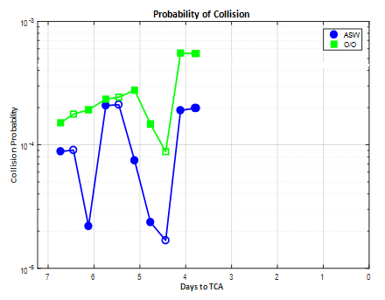
Active Payload Event
CARA Mission versus a maneuverable secondary object
Event Background
  Event first identified just under 7 days to TCA
    High risk using mission O/O solution (~2e-4)
  At ~ 5 days to TCA CARA mission and the Secondary O/O were contacted
    Secondary O/O confirmed that the spacecraft had no maneuvers planned prior to TCA and would monitor event
  At ~1 day to TCA CARA mission performed RMM
    Pc remained high throughout event evolution
    All efforts were coordinated with the secondary owner/operator through the event to ensure only one mission maneuvered

Slide 23
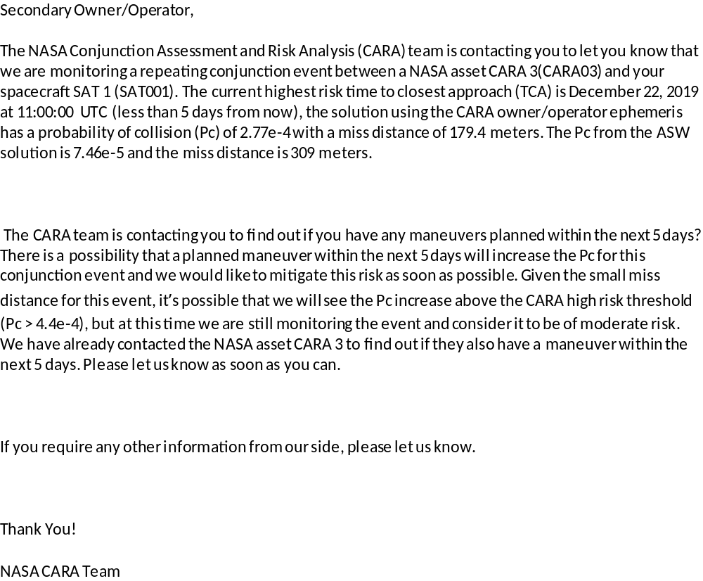
Email Example
Email Example sent from the CARA team to a potentially active secondary O/O
  Conveys operational/maneuverable status of CARA asset
  Describes intentions of CARA asset to perform a mitigation maneuver should Pc remain high close to TCA
  Asks secondary O/O to communicate any maneuver plans and if possible, not maneuver prior to TCA to minimize potential of spacecraft maneuvering into each other

Slide 24
Active Payload Summary
The collaborative effort between the CARA team, CARA mission, and Secondary O/O was important for a safe outcome
  Cooperation from the Secondary O/O was essential
    Sharing maneuver plans
    Agreeing not to maneuver
Areas of improvement for all O/Os
  Maneuverable Status flagged appropriately on Space-Track.org
  Current contact information updated in Space-Track.org
  Ephemerides delivered at a regular cadence to the 18th for screening
    Nominally planned maneuvers modeled in the ephems
  Some contact information on Space-Track.org listed as private reducing ability to coordinate between O/Os

Slide 25
Summary and Conclusions
Many if not most events will present themselves early in the screening cycle allowing maximum time to evaluate and respond
A small subset of events require additional analysis, coordination, or may be identified as high risk close to TCA
  Poor or questionable OD quality
  Secondary is a maneuverable payload
  Unpredictable space weather events
  Low relative velocity or persistent events
  Multiple event solutions Pc calculations in disagreement
Developing procedures for addressing edge case scenarios improves response outcomes

Slide 26
Back up slides

Slide 27
Case Study 3:
Space weather

Slide 28
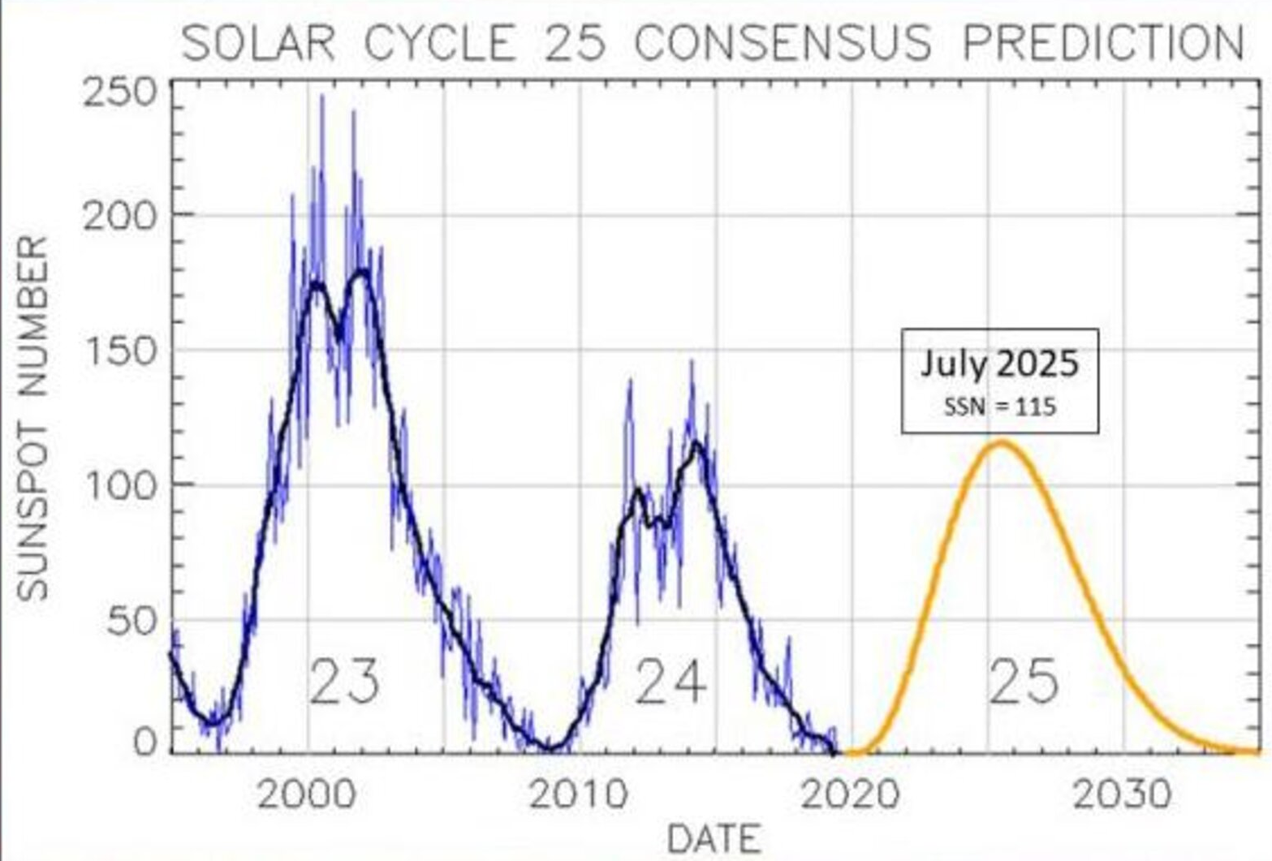
Space Weather
Impact of Space Weather events (solar flares, coronal mass ejections (CMEs)) difficult to incorporate into atmospheric density predictions and future object propagation
Previous solar maximum in 2014-2015 CARA observed:
  Increased event uncertainties causing dilution/inflation of event Pcs
  Large discrete state changes due to mismodeled space weather
Moving towards next solar maximum with a peak in 2025
Source: https://svs.gsfc.nasa.gov/13776

Slide 29
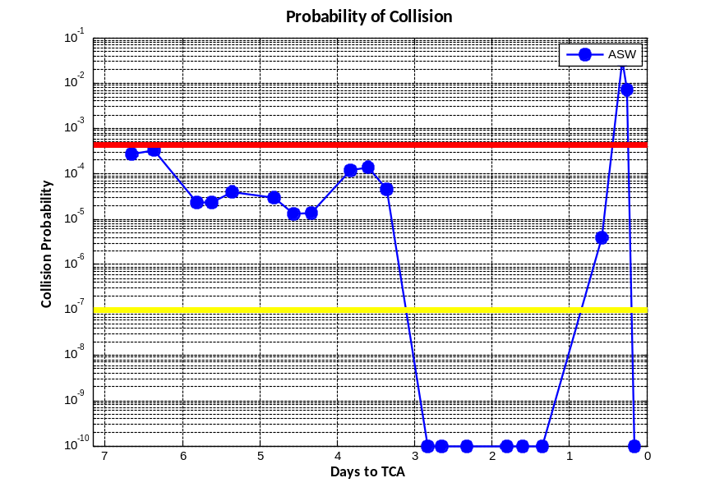
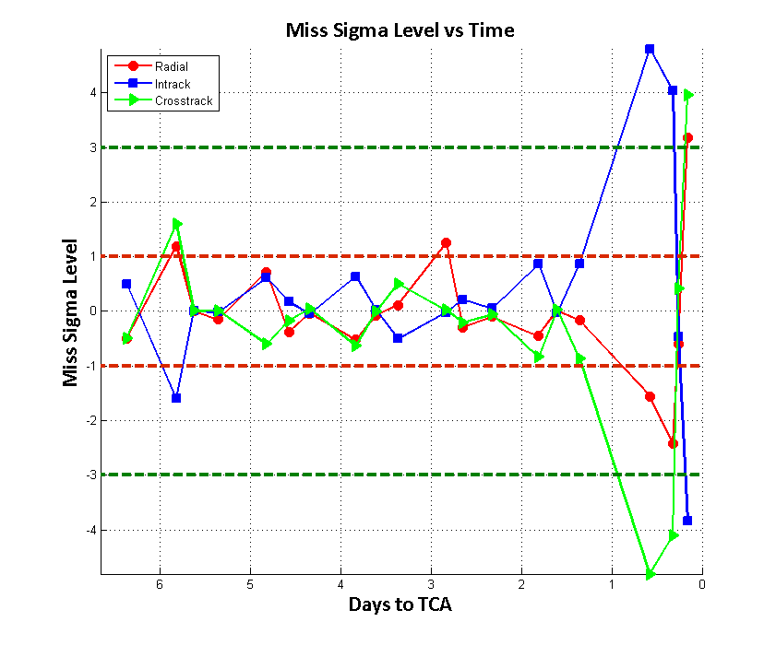
Space Weather Event
CARA Mission versus a debris object
Event Background
  Event first identified at 7 days to TCA
    High Pc ~2E-4
  At ~ 3 days to TCA Pc dropped to 0 and remained low through ~1 day to TCA
    New tracking received on secondary during this time
  With less than 8 hours to TCA Pc increased to 3E-2
    Limited time to respond
    Known space weather activity caused concern in prediction accuracy
    Miss sigma level plot showed state updates changed by > 3 sigma from previous estimates in all three components

Slide 30
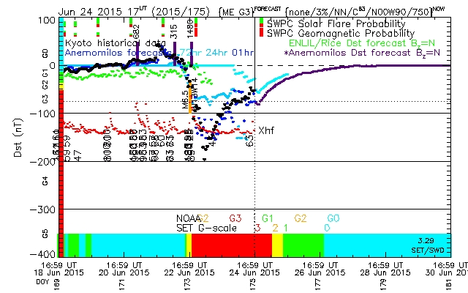
Space Weather Event
Large space weather event occurred less than 24 hours prior to TCA
Event severely underpredicted with Dst minimum:
  Dst is the geomagnetic index measured in nanoTeslas (nT)
  24 hours to TCA: -75 nT
  1 hr to TCA: -150 nT
  Definitive: -200 nT
Secondary debris object susceptible to high drag
  EDR: 2E-3 W/kg
  Ballistic Coefficient: .5 m²/kg
  Impacts of atmospheric mismodeling exacerbated by object characteristics
24 hours to TCA
1 hour to TCA
The SET Space Weather Alert Portal data are provided for scientific use courtesy of Space Environment Technologies.
Notes:
Dst as new(er) geomagnetic index
Measures Earth horizontal magnetic field disturbance, especially southern-directed magnetic field perturbation
Four worldwide measurement sites at different latitudes
South Africa, Japan, Hawaii, and Puerto Rico
Also can be measured from DMSP payload
Continuous (rather than discretized) measurement

Slide 31
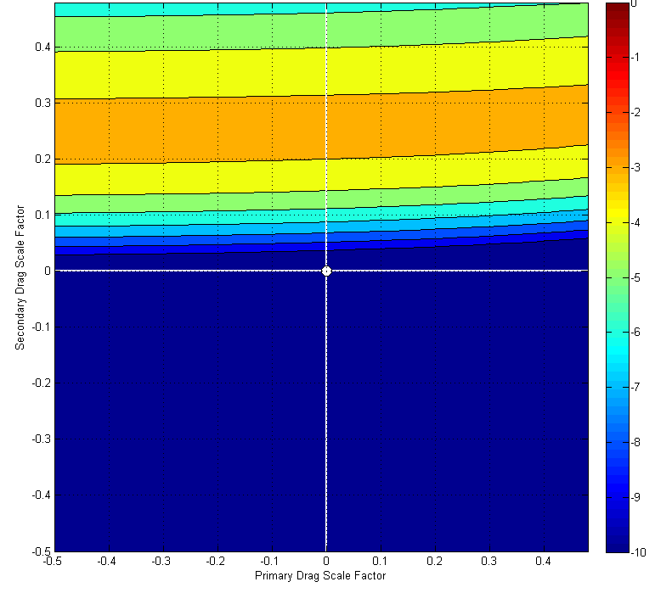
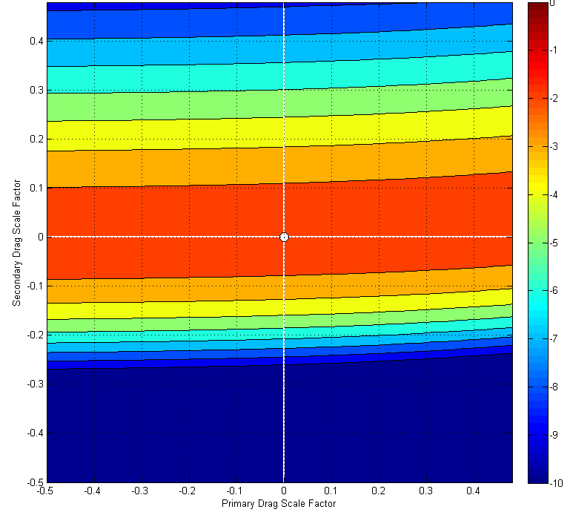
Space Weather Trade Space Tool
CARA tool developed during previous solar cycle
Evaluates sensitivity of an event’s Pc to atmospheric density modeling
Tool does not indicate whether atmospheric predictions likely to be accurate
Some events insensitive to mismodeling
  Off-peak SWTS output indicates mismodeled atmospheric density could lead increase of Pc to high risk levels
  Once the Pc was predicted to be high, any further mismodeling only expected to decrease Pc
Low Pc Update
High Pc Update

Slide 32
Space Weather Summary
Discrete space weather events can cause significant changes to OD solutions and thus event details
  Phenomena are difficult to predict
  Some large state changes could be accurate but accuracy unknown until after the space weather event occurs
Variability in space weather and its impact on atmospheric density can increase high interest events
  Increased covariance can lead to inflated Pc
  Late notice events leave limited time to evaluate data accuracy and perform maneuver planning

Slide 33
CARA OSAs
CARA OSAs at the 18th SPCS (VAFB) are dedicated analysts for the NASA CARA Team
  Perform three LEO (~00:00, 08:00, 16:00 UTC) and two NONLEO (~00:00 and 16:00 UTC) screenings daily
  Manually evaluate ODs that are flagged
  Evaluate tasking levels
  Perform off-nominal screenings as requested
  Run Automatic Observation Notification (AON) process for a specific list of HIEs
    Process runs every 15 minutes and notifies the OSA that an observation was received for a secondary object
    Both the primary’s and secondary’s OD are manually evaluated and a one vs one screening is performed
    Results are provided to the CARA Analysts and the mission
Notes:
Flags include unreasonable expected force parameter values, long LUPI spans,

