Slide 1
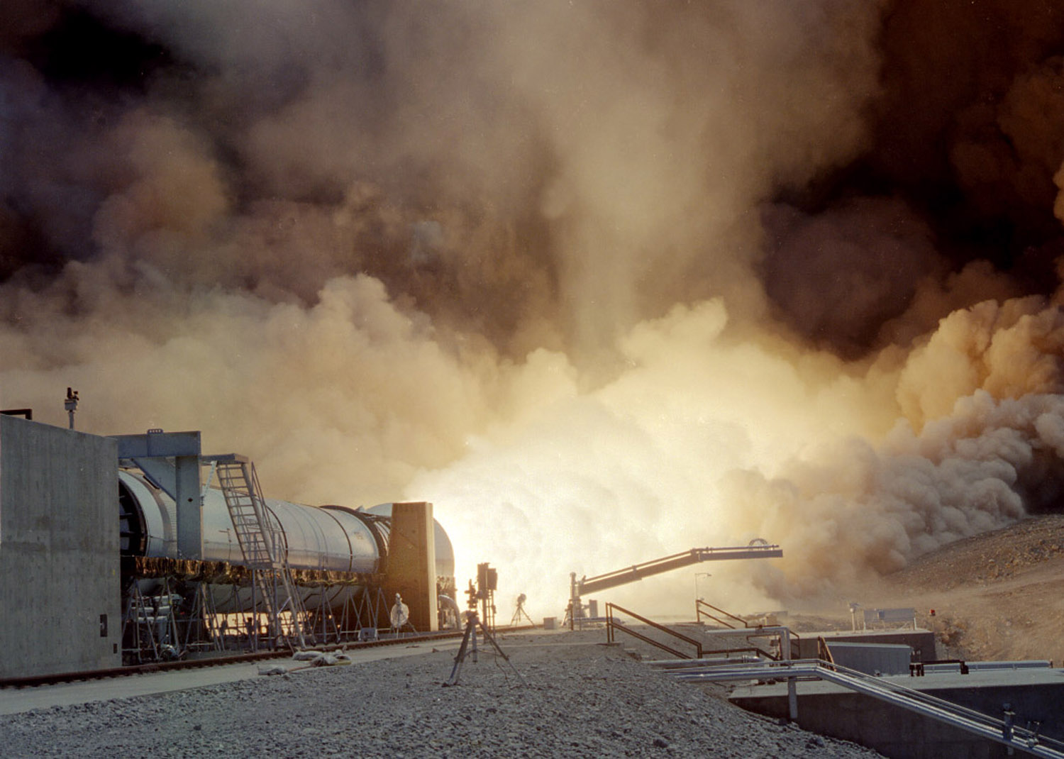
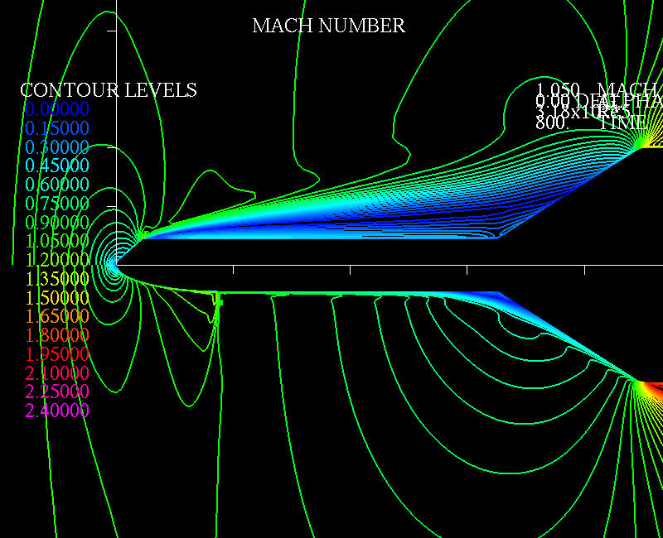

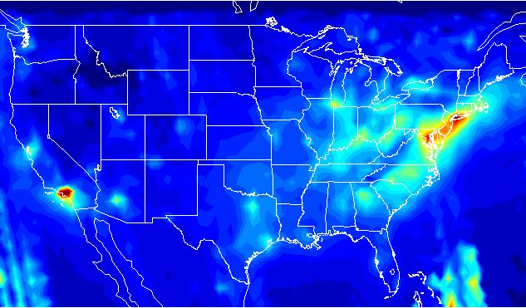

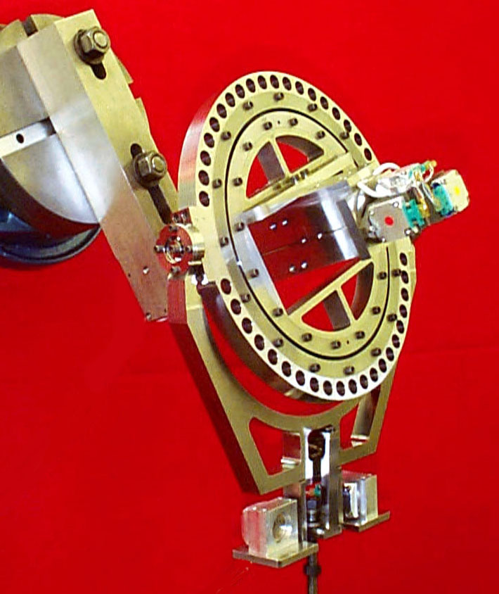
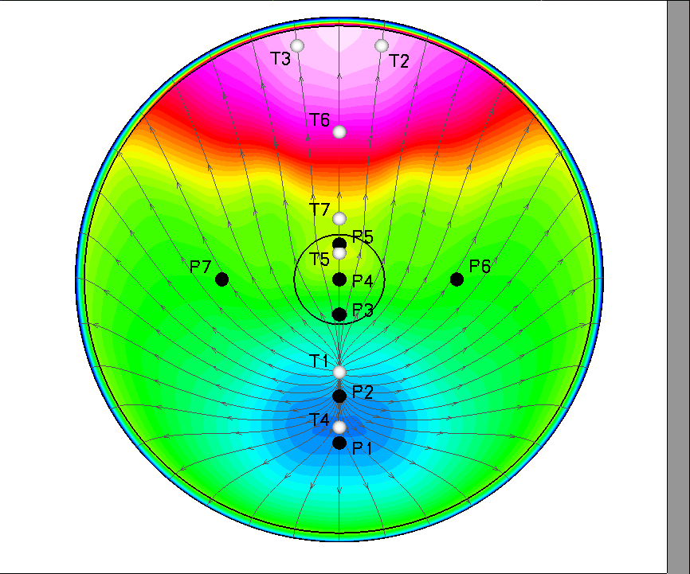
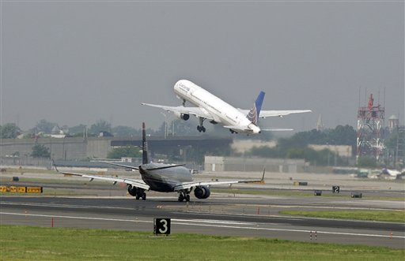
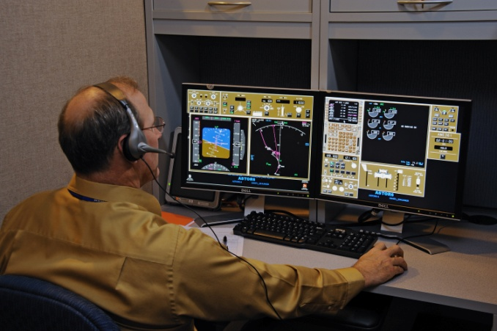
Space Launch System Design:
A Statistical Engineering Case Study
Peter A. Parker, Ph.D., P.E.
peter.a.parker@nasa.gov
National Aeronautics and Space Administration
Langley Research Center
Hampton, Virginia, USA
April 12, 2021
Defense and Aerospace Test and Analysis Workshop
DATAWorks 2021

Slide 2
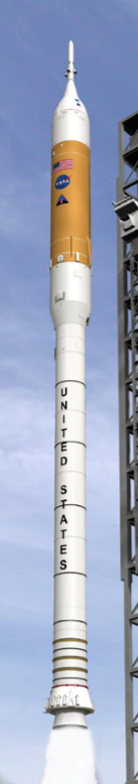
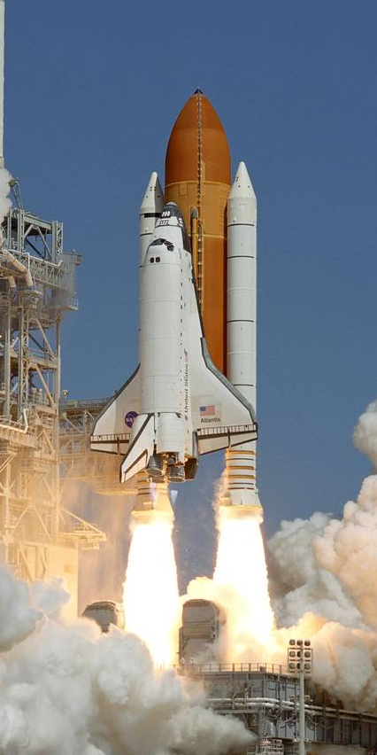
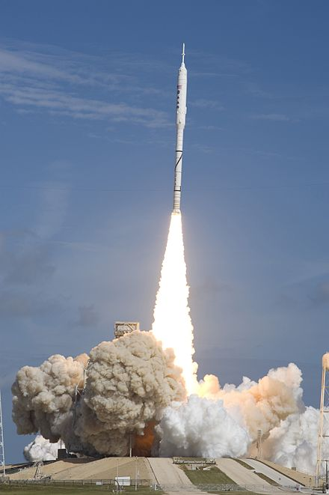
Case Study Overview
Ares I
Shuttle
Flight Test
Full Scale Static Firing

Slide 3
Background and Motivation
NASA leveraged heritage architecture for a new space launch system to minimize technical risk, cost, and schedule
Heritage components subjected to new requirements, beyond the heritage test capabilities
New vehicle design predicted to be overweight, and the program sought mass reduction
All system components scrutinized for potential weight savings by identifying those with the largest uncertainty and/or design margin
The roll torque reaction control system of the reusable solid rocket motor was identified as having a high uncertainty in its requirements, lacking adequate test data, and physical understanding and therefore potentially being overdesigned resulting in excess weight
How large does the reaction control system need to be?

Slide 4
Consequences of Results
Mass is “king” in launch systems, affecting rocket performance and mission payload capability
Excess mass is a lifecycle cost on every subsequent launch. Once a system gets onboard, it’s hard to get it back off.
Insufficient roll control authority could result in unstable flight, potential loss of the test vehicle, collateral damage on the ground, and ultimately, in the production vehicle, loss of payload (if unmanned), loss of crew if astronauts are onboard.

Slide 5
Data, Champions, Stakeholders
Previous firings were unsuccessful in obtaining “high confidence,” adequate measurements or roll torque
Unclear what could or should be done to improve the measurements and report uncertainty within the time constraints
  Options : (1) Increase confidence in existing experimental and theoretical data or (2) Develop a new strategy for testing
NASA’s independent technical authority engaged, critical leadership buy-in, reporting to NASA’s Chief Engineer
  Culturally, little experience and comfort with design of experiments
Organizational challenges with competing motivations and metrics (1) Program, (2) Independent technical authority, (3) Contractors.
Safety critical: personnel, facility, and the test article are all high-value assets
Large, Complex Challenge …
on the most powerful solid rocket motor in the world.

Slide 6
Interdisciplinary Team
Incomplete corporate knowledge on original system design
  No single expert to ask, and current discipline experts disagreed
Interdisciplinary team was formed, cross-cutting organizations
  System Engineers
  Rocket Propulsion Scientists
  Guidance, Navigation, and Controls
  Test Facility Operators
  Safety and Mission Assurance Specialists
  Software Engineers
  Mechanical Engineers
  Measurement System Design and Calibration Engineers
  Statisticians
How did a statistician get invited?

Slide 7
Initial Problem Definition
Measure internal roll torque during firing to provide design requirements for the reaction control system.
Broad requirement of “measure roll torque” was accepted and most of the focus was on getting the data.
Precise problem definition and the utility of the measurement in the subsequent simulation were not an initial focus.
As it turned out, we measured roll torque well, but not under the most relevant test conditions.
Lesson learned: #1
  Should have pressed for a clearer understanding of how the measurement would be used in the system analysis.
We felt that “they knew what they wanted”, so we worked hard at the problem element “we knew how to solve best” rather than pressing to define the right question.

Slide 8
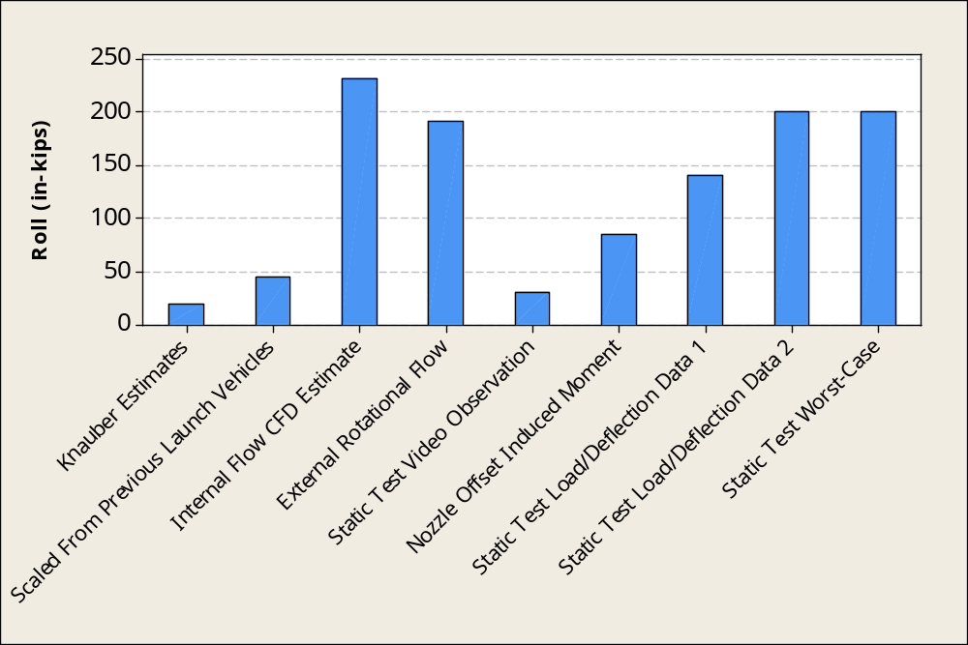
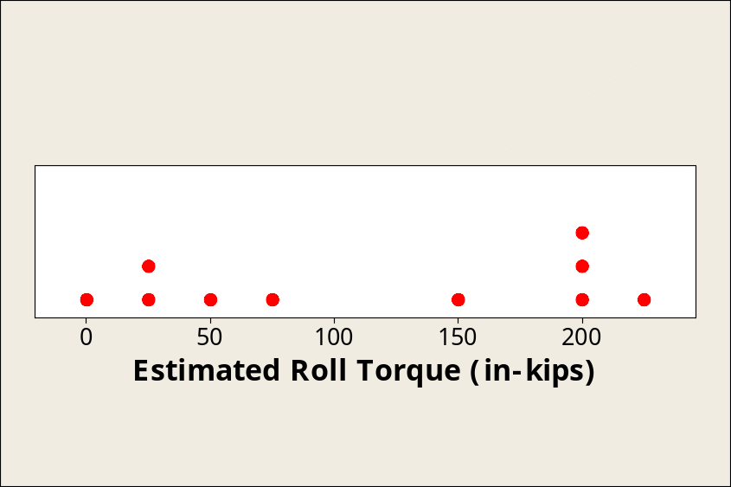
Starting Estimates of Internal Roll Torque
25 in-kip bins
Discipline-centric estimates, no consensus
No uncertainties on estimates
Design Requirement set at 200 in-kips

Slide 9
Experimental Campaign
Developed a strategy of nesting and sequencing of multiple experimental design and analysis phases, feeding into each other to provide the high-level “answers” needed for decision makers
Facility Calibration Experiment Design
  Before and after the firing to calibrate the measurement system
Rocket Firing Design – Test Article Characterization, Flight Simulation
  Strategically plan activities during the 120 seconds of firing time
Combine the Facility and Test Article Characterization Models
Uncertainty Characterization and Communication of Responses
Iterative, continuous interpretation of the results with the subject-matter experts of both the test article and the test facility to reach consensus
Our deliverables became input parameters in flight simulation

Slide 10
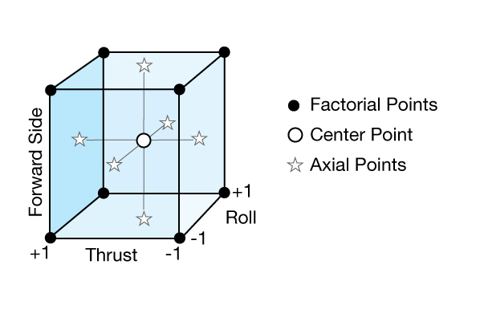
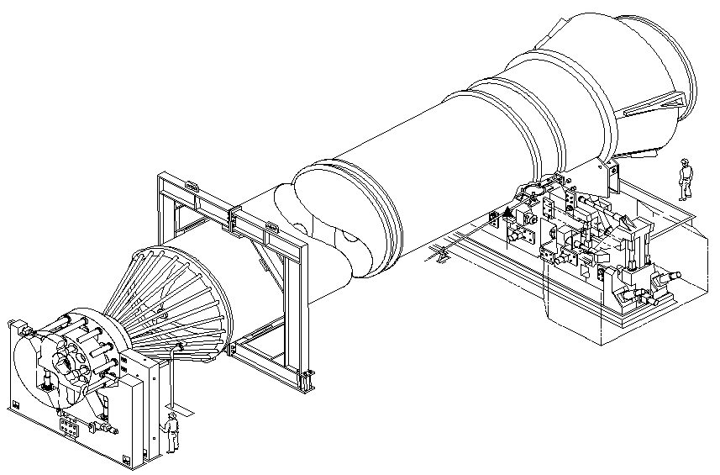
Facility Characterization Design
Factorial combination limits
Pseudo, Near replicates
Restricted randomization
Nonreplicated whole-plots
Roll Torque
Face-Centered Central Composite
Adapted response surface approach
Five-dimensional, second-order response surface for 5 responses
Inverse prediction with estimated uncertainty
Axial
Side

Slide 11
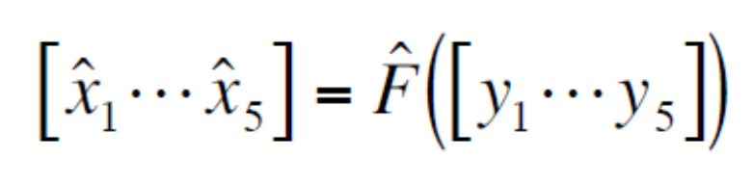
Response Surface for Characterization
Response Surface Methods adapted for a nontraditional application
  Characterization, not optimization
  Mathematical model is the product, not optimized factor settings
  Confirmation points over the entire design space, not sensitivity to the location of optimum performance
Inverse Prediction of Second-Order Response Surface
Inverse prediction intervals were approximated through a localized mapping from classical forward regression intervals to the inverse space
Parker, Vining, Wilson, et al. (2010) “The Prediction Properties of Classical and Inverse Regression for the Simple Linear Calibration Problem,” JQT
Parker and Finley (2010) “Advancements in Aircraft Model Force and Attitude Instrumentation by Integrating Statistical Methods,” AIAA Journal of Aircraft

Slide 12
Rocket Nozzle Duty Cycle
Interest: Measure roll at nozzle null points
5 locations, without dwell
  (0, 13, 60, 72, 106 seconds)
+ Pitch
+ Rock
8
+ Yaw
6
+ Tilt
4
2
- Yaw
Deg
0
- Pitch
-2
-4
-6
-8
0
20
+Pitch
Pitch
+Yaw
Yaw
+Rock
±Tilt
40
60
80
100
Time (sec)
120

Slide 13
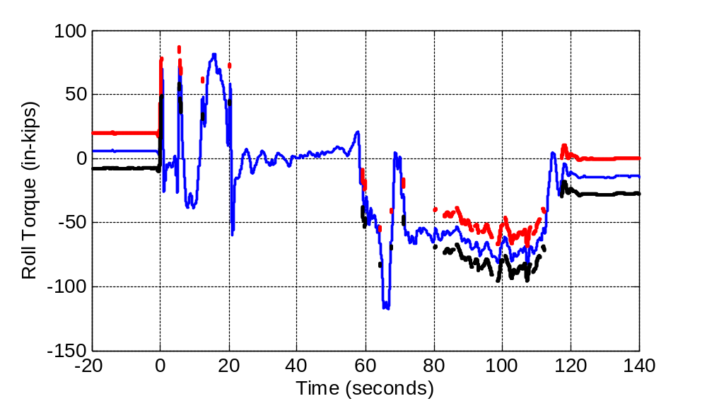
Full-Scale Motor Firing Results
mean roll torque
upper prediction interval
lower prediction interval
Prediction intervals were provided only where they were supported by experimental data
Nozzle null points
  (0, 13, 60, 72, 106 sec.)

Slide 14
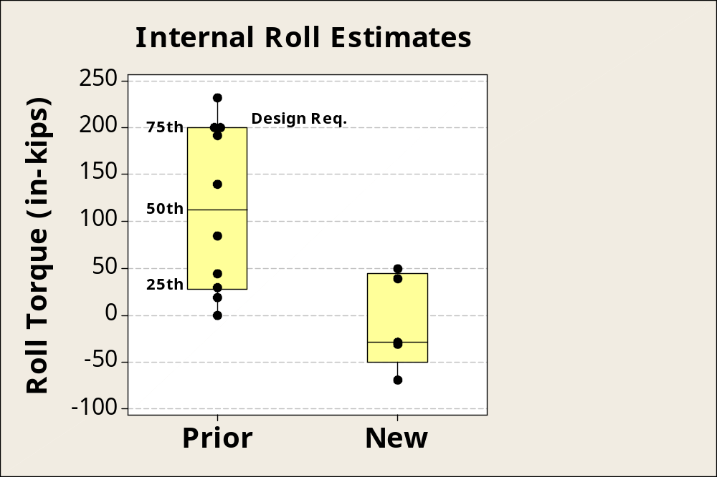
Static Rocket Firing Data Interpretation
Developed a defensible, consensus methodology to estimate roll torque in collaboration with subject matter experts
Results
Consensus estimate incorporating subject-matter knowledge:
  -8 ± 13 in-kips
Test Data
Original requirement of 200 was significantly reduced, with quantified uncertainty

Slide 15
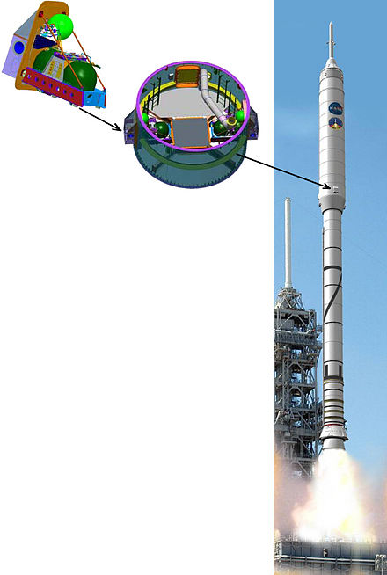
Flight Test Validation
Flight test validation of ground test experimental campaign
Ares IX launched on Oct. 28, 2009
Successful flight
Roll Reaction Control System
Reaction control system was active in the flight test
Flight data reconstruction confirmed low roll torque as predicted from ground testing

Slide 16
Challenging Statistical Techniques
Restricted randomization in a destructive (irreversible) test presented challenges for rigorous inference
No pure replicates for experimental error, pseudo and near-replicates
Restricted factor combinations due to infrastructure and safety issues
Experimental design constraints resulted in restrictions on the predictive model
Inverse prediction of a five-factor, second-order response surface for five responses
Interval estimation of the inverse regression
Interpreting interactions, previously assumed to be zero, were critical in estimating roll torque and communicating value
Building a consensus estimate with statistical rigor

Slide 17
Statistical Engineering Lessons Learned
Precise objectives were not defined until after the first test was completed - earlier, strategic involvement would have accelerated the learning process
Success was not based on a single statistical tool, rather it was based on defining the right questions and integrating and extending multiple methods
Changes to a complex and expensive process, embedded for decades takes leadership and demonstrated benefits
Significant impact requires changing the normal operating process, rather than a one-time solution

Slide 18
Case Study Summary
Critical Features
  Collaboration with other science and engineering disciplines
  Synergistic combination and extension of statistical methods
  Embedded into standard work processes
Outcomes
  Defined the right questions
  Guided strategic resource investment
  Efficiently generated knowledge and stimulated insights
  Accelerated research and development
Statistical Engineering was application focused and impact driven, and broadened the influence of statistical thinking and methods

Slide 19
Case Study Impact and Insights
Project: Significant reduction in roll reaction control system design requirement uncertainty that allowed for mass reduction
Discipline: Recognition of a statistician’s value at the leadership level
  Agency level team awards from the NASA Administrator
  Pivotal demonstration motivated organizational changes within NASA to establish Statistical Engineering teams
  Resulted in follow-on work for 5+ years in defining additional rocket motor performance requirements
Statistical Engineering Discipline Insights
How would I teach someone how to attack this problem?
  Knowing DOE/RSM was necessary, but not sufficient
What were the critical skill sets necessary to be successful?
Where do you find people with these skill sets?

Slide 20
Acknowledge Collaborators
Steve Gentz (NASA)
Paul Roberts (NASA)
Ray Rhew (NASA)
Jonathan Jones (NASA)
Geoff Vining (VT)
Laura Freeman (VT)
Tyler Nester (ATK)
Mick McLennan (ATK)

