Slide 1
DPLR-NEQAIR Coupler Tutorial
Jeffrey Hill
Aaron Brandis
Brett Cruden
Joey Schulz

Slide 2
Road Map
Problem Statement
Solution Process Overview
The coupler utility
  Build & Installation
  Subcommand Overview
Example Simulation: Fire II @ 1636s
  Inputs
  Pipeline Configuration
  Pipeline Initialization
  Run Submission
  Run Review
  Sample Results

Slide 3
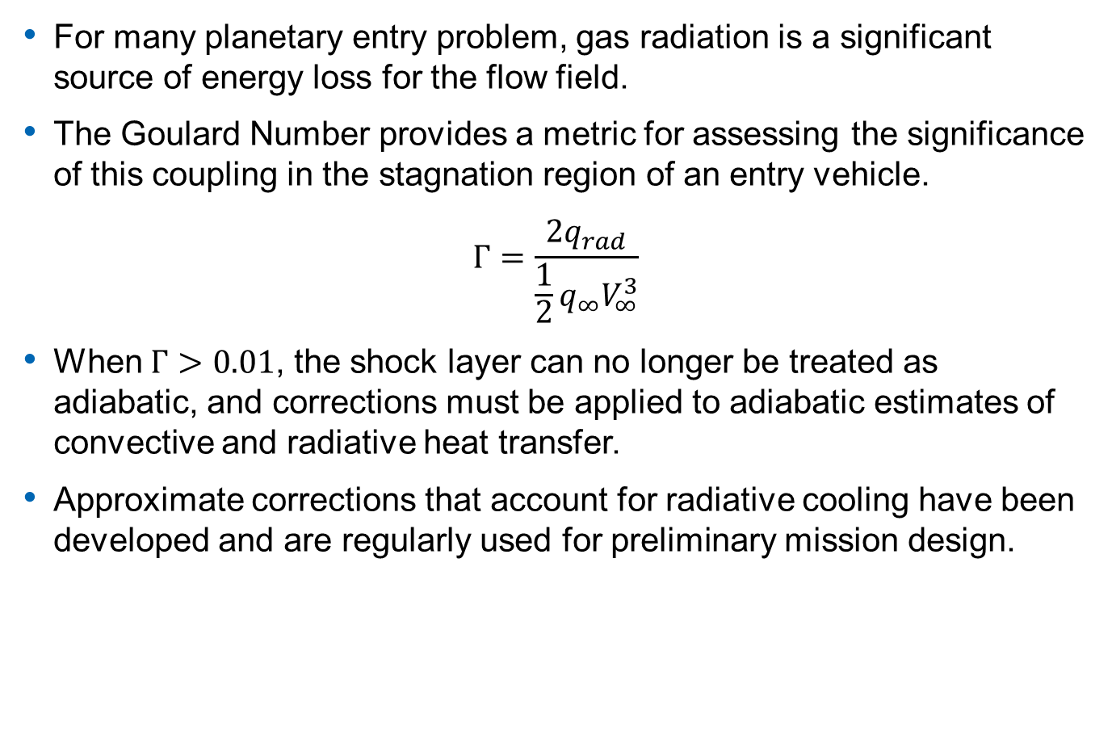
Problem Statement
For many planetary entry problem, gas radiation is a significant source of energy loss for the flow field.
The Goulard Number provides a metric for assessing the significance of this coupling in the stagnation region of an entry vehicle.
$$Γ=\frac{2q_{rad}}{\frac{1}{2}q_{∞}V_{∞}^{3}}$$
When $Γ>0.01$, the shock layer can no longer be treated as adiabatic, and corrections must be applied to adiabatic estimates of convective and radiative heat transfer.
Approximate corrections that account for radiative cooling have been developed and are regularly used for preliminary mission design.
The DPLR-NEQAIR coupler enables improved treatment of radiative cooling for blunt bodies, bypassing the need for ad-hoc correction factors.

Slide 4
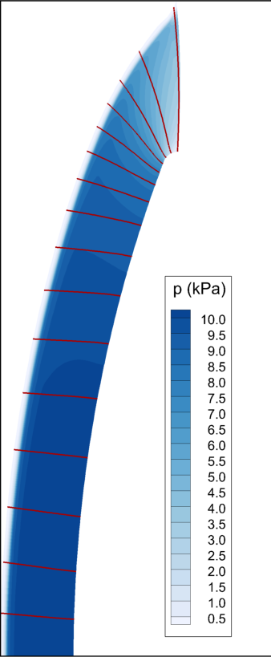
Solution Process Overview
Treatment of radiation coupling is handled via “loose coupling” of the DPLR and NEQAIR codes.
  Starting from an uncoupled DPLR solution, wall-normal grid lines are extracted from the solution and converted into 1D lines of sight for NEQAIR based on arc-length.
  NEQAIR is run on each line of sight, computing radiative losses for each grid cell along the line and the resulting heat flux at the wall.
  The NEQAIR results are compiled, and the resulting radiation source term is passed back to DPLR, which then updates the flow solution.
  The process is repeated until convergence.
NEQAIR
Lines

Slide 5
Disclaimers
The approach presented here is not novel or state-of-the-art.
  We have simply improved the quality of the tool with a few tweaks to improve robustness and accelerate time-to-solution.
The method presented here is not applicable to all flow fields.
  Solves 1D RTE for wall-normal gridlines using tangent slab approximation.
  Accurate for forebody attached flows, but not for wakes.
The method presented cannot handle general computational grids.
  Requires single-layer, block-structured grid topologies where grid lines span from the freestream to the vehicle surface.
We are actively developing a method for solving 3D RTE on general unstructured meshes, but this capability is targeting the US3D flow solver.

Slide 6
Full Resolution Loosely Coupled
Start
Source Terms
DPLR
Flow Data
(HDF5)
Radiation Data
(HDF5)
NEQAIR

Slide 7
Coarsened Loosely Coupled
Start
Source Terms
DPLR
Coarsening
Interpolation
Flow Data
(HDF5)
Radiation Data
(HDF5)
NEQAIR

Slide 8
The coupler utility
The coupler utility is the key program that enables (relatively) straight forward coupling of DPLR and NEQAIR:
  Written mostly in Python 3, with some associated utilities written in Fortran
  Automates data extraction, processing, and reformatting tasks
  Tailors job execution scripts for running on the available HPC platform
  Enables inspection/updating of the coupler pipeline as analysis proceeds
Build and Installation:
  Coupler is fully integrated into the DPLR build system
  Simply add “-DDPLR_WITH_COUPLER=ON” to the list of command line arguments passed to CMake.
  Requires the HDF5 library and Python 3.6+ with h5py module
  See the DPLR manual for further details of the build

Slide 9
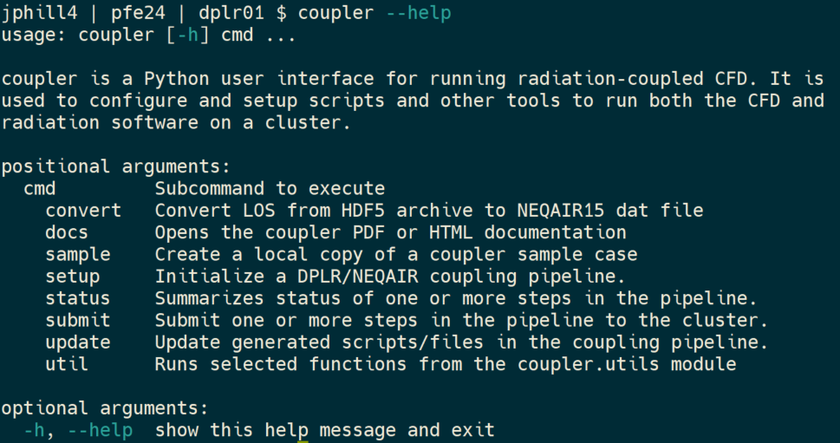
Subcommand Overview

Slide 10
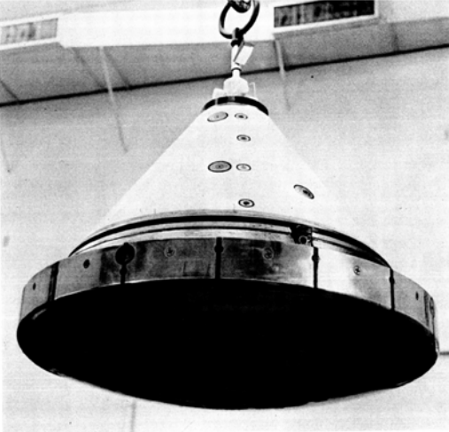
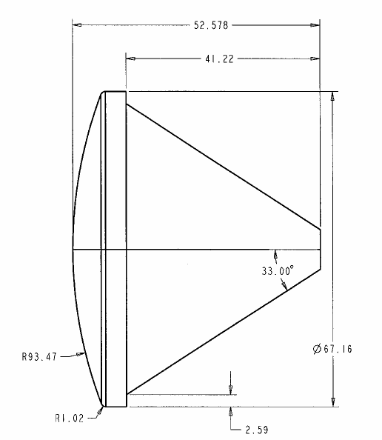
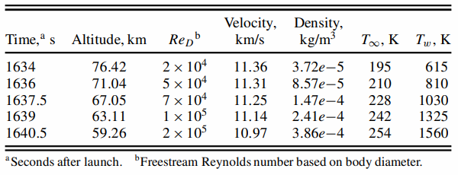
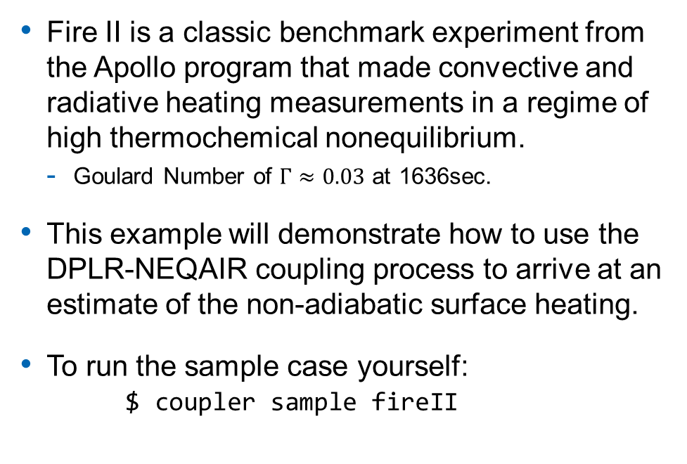
Example Case: Fire II
Fire II is a classic benchmark experiment from the Apollo program that made convective and radiative heating measurements in a regime of high thermochemical nonequilibrium.
  Goulard Number of $Γ≈0.03$ at 1636sec.
This example will demonstrate how to use the DPLR-NEQAIR coupling process to arrive at an estimate of the non-adiabatic surface heating.
To run the sample case yourself:
$ coupler sample fireII

Slide 11
Inputs
Before starting the coupling process, the following inputs must be available:
  Uncoupled DPLR Solution: A pgrx/pslx pair defining the grid and flow field without radiation coupling. The grid should be aligned to the bow shock, with sufficient resolution to resolve the non-equilibrium region behind the shock.
  DPLR Baseline Control File: This defines the basic procedure for converging an uncoupled flow field from a “warm start”. For simple forebody flows, 3000-5000 iterations with CFL ramped from O(1) to O(1000) over the first ~1500 iterations works well. The coupler utility will manage all control flags related to radiation coupling.
  NEQAIR Baseline Control File: This defines the radiation physics model and solution method to be used for each 1D line of sight. Before proceeding with coupling, tests should be run on representative lines of sight to verify the relevant physics (e.g. band systems) are included with appropriate spectral resolution.
  (Optional) POSTFLOW Control Files: The coupler utility provides a hook to run user-supplied POSTFLOW inputs after each stage of the coupling process. This allows the user to extract data that can be used to help assess solution quality and convergence.

Slide 12
Pipeline Configuration
The coupler pipeline itself is configured via a single INI-style input file with six main sections:
  COUPLER_SETUP
  DPLR_SETUP
  NEQAIR_SETUP
  SYSTEM_SETUP
  OPTIONS
  *_BATCH
    e.g. DPLR_BATCH, NEQAIR_BATCH, etc.
A detailed description of all key-value pairs that can appear in each section is provided in the manual.

Slide 13
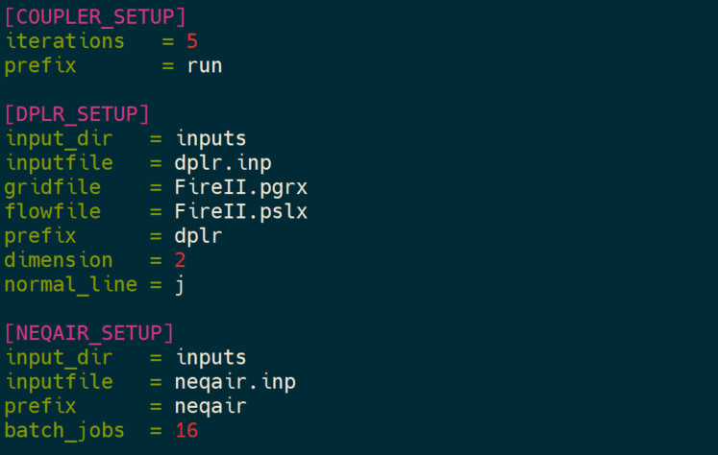
Pipeline Configuration

Slide 14
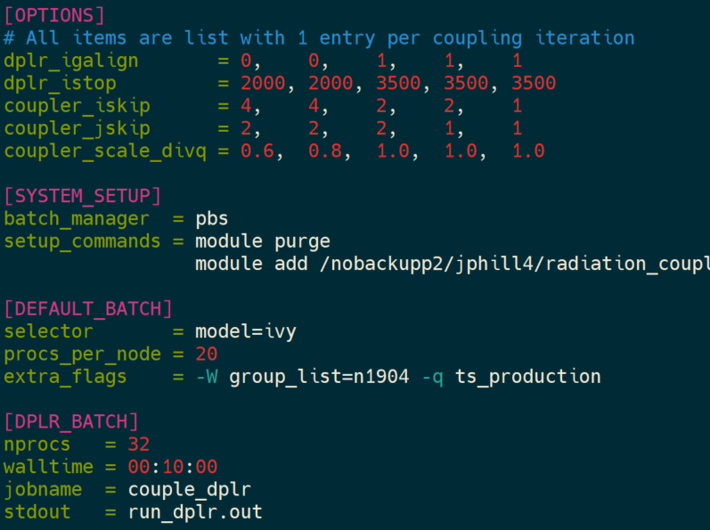
Pipeline Configuration

Slide 15
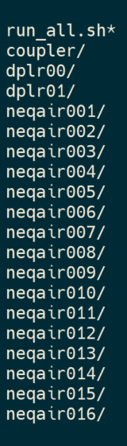
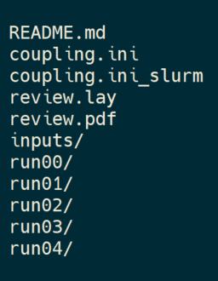
Pipeline Initialization
Once the configuration is set, simply invoke the setup subcommand:
$ coupler setup –i <config_file>
`qsub run_all.sh` to manually submit all jobs in the run.
Where lines of sight are extracted, coarsened, grouped, interpolated, reassembled.
Where incoming DPLR solution is placed at the start of the run.
Where DPLR will be re-run with updated radiation source term.
Where each NEQAIR batch job runs its assigned group of lines.

Slide 16
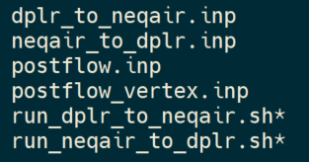
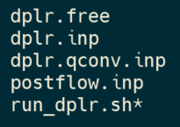

Pipeline Initialization

Slide 17
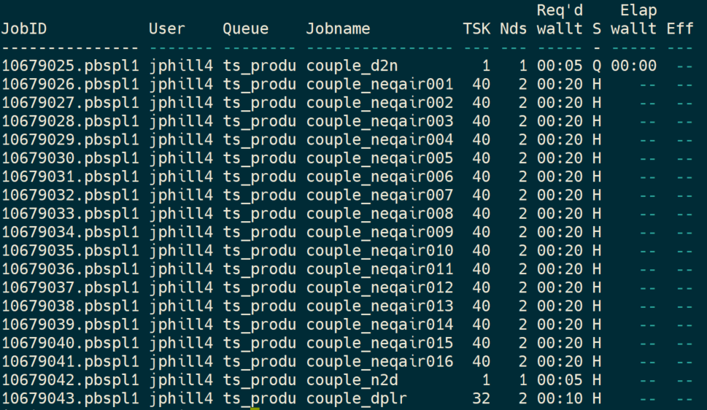
Run Submission
To submit one or more runs:
$ coupler submit run00 run01 …
When a run is submitted, a multiple jobs will be submitted to the scheduler with dependency specifications.
  Ensures, e.g., NEQAIR does not run until all lines of sight are generated, DPLR does not run before all NEQAIR jobs complete, etc.
  Similarly, ensures run01 only executed if run00 successful, etc.

Slide 18
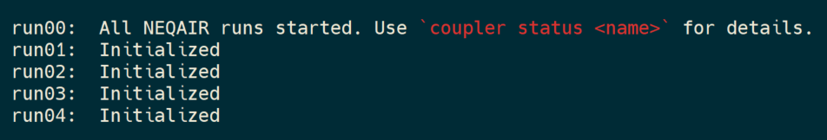
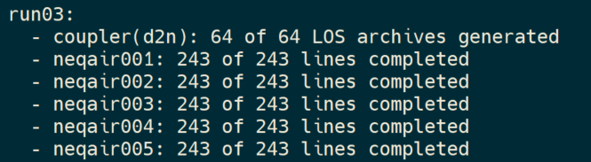
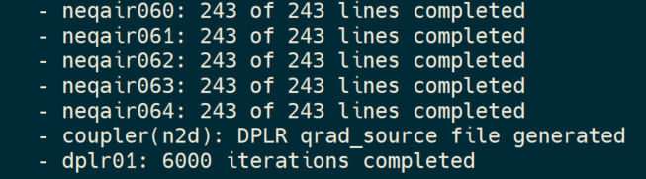

Run Review
Principal mechanism for checking progress is `coupler status`:
$ coupler status
$ coupler status run03
$$⋮$$

Slide 19
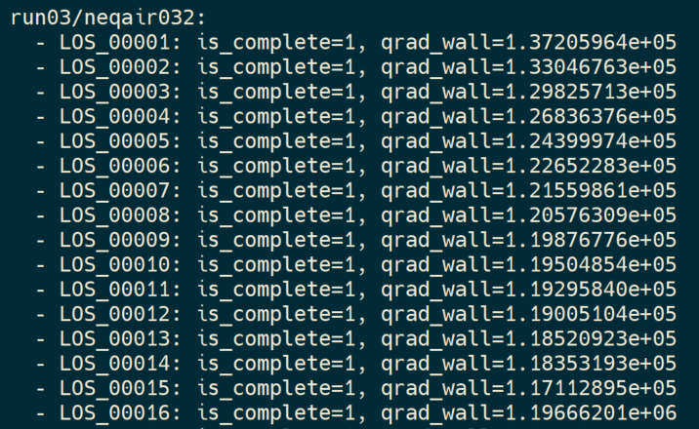

Run Review
$ coupler status run03/neqair032
$$⋮$$

Slide 20
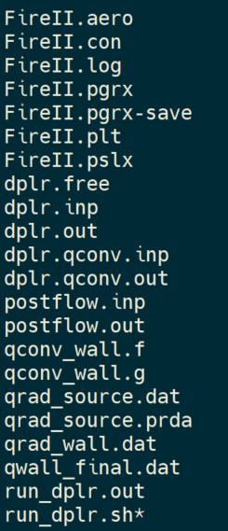
Run Review
At the end of each coupling cycle, several useful files are generated in the dplr01 directory:
The usual DPLR convergence file
Tecplot formatted radiative source term
Tecplot formatted wall heating profiles

Slide 21
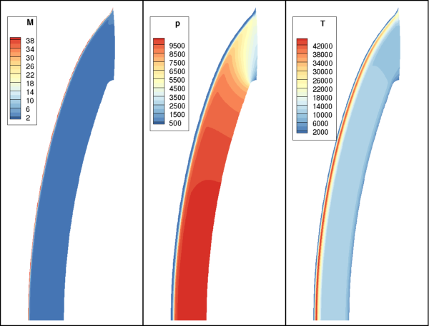
Sample Results

Slide 22
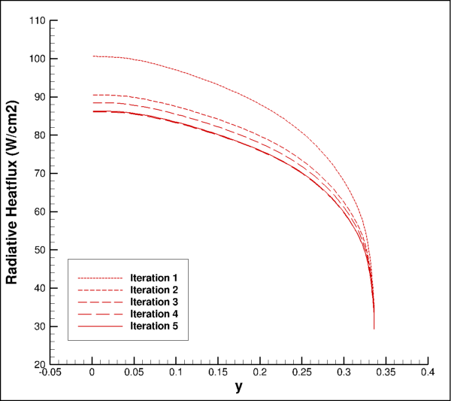
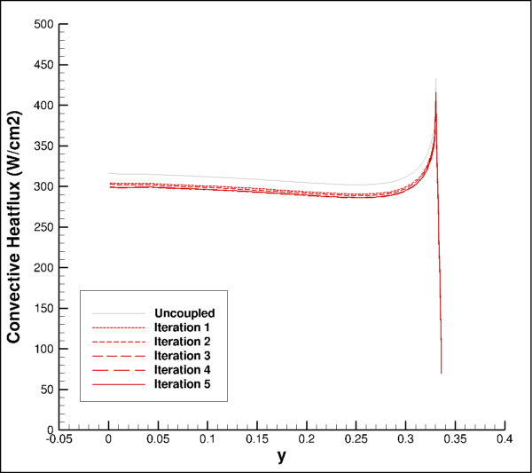
Sample Results
Convergence achieved in ~4 iterations.
Radiative heat flux is the slowest to converge.

Slide 23
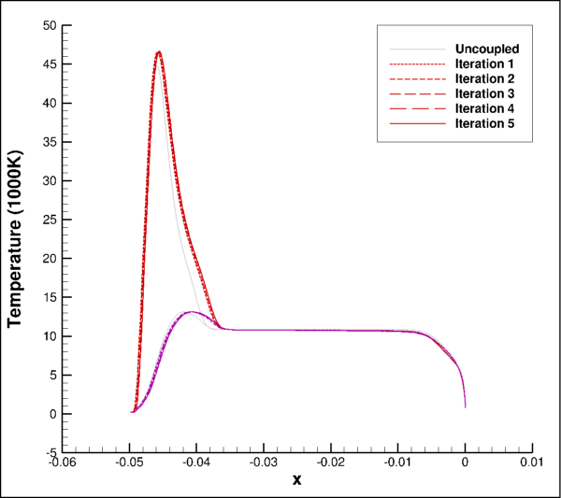
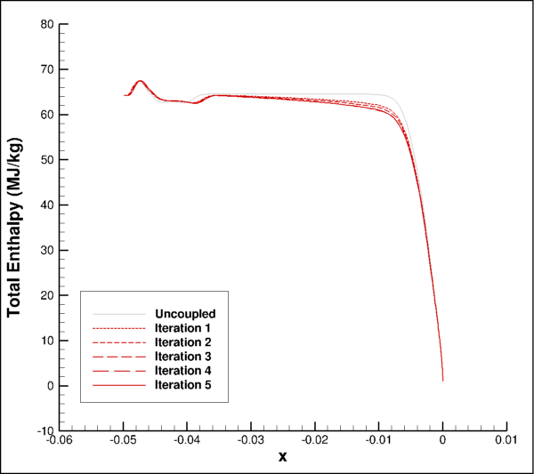
Sample Results

Slide 24
Questions?

