Slide 1
Considerations for Spacecraft Passivation
Mike Squire – Nasa Engineering and Safety Center
Improving Space Operations Workshop
April 7, 2021

Slide 2
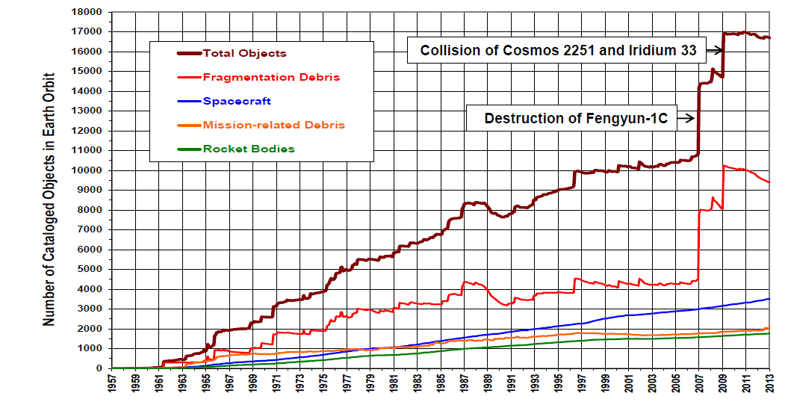
Why End of Mission (EOM) Passivation
Fragmentation products account for largest share of orbital debris
  Much from decommissioned spacecraft and spent launch vehicles
Explosions/break-ups historically have created more debris than collisions
Passivation = removal of stored energy from spacecraft systems
  Reduce likelihood of energetic debris-producing events (e.g., explosions)
  Passivation may also reduce debris for smaller collisions
NASA Engineering and Safety Center (NESC) study (2020) recommended guidelines for passivation
NASA Orbital Debris Program Office
Notes:
Problem we are trying to solaunch vehiclee is orbital debris and its creation
What is passivation and why is passivation…

Slide 3
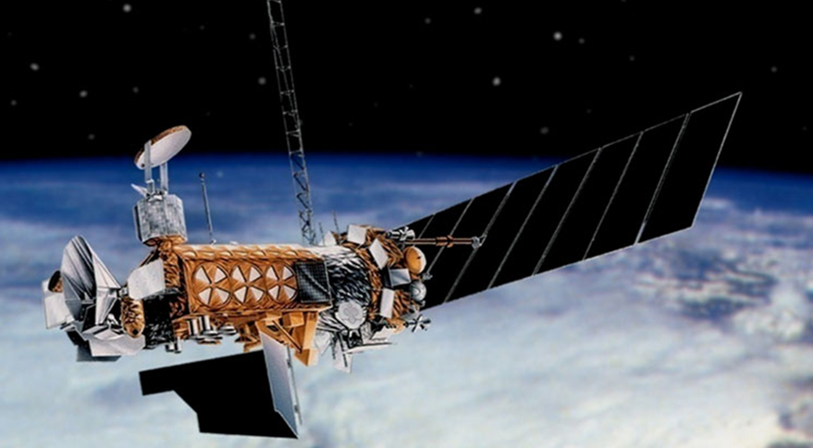
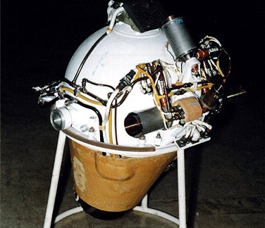
Break-up Examples
Defense Meteorological Satellite Program (DMSP) Weather Satellites
  4 out of 9 block 5D2 DMSP vehicles broke up on orbit
  Attributed to battery rupture caused by internal short
NOAA-16 Weather Satellite
  Decommissioned in orbit in 2014
  Break-up in November 2015
  Attributed to battery rupture caused by overcharging
Delta 62 Upper Stage
  Break-up in 1973
  Attributed to breach in common bulkhead leading to propellant mixing
  Other Delta I/II upper stage break-ups recorded
Russian Proton Fourth Stage SOZ Motors
  ~50 known fragmentations
  Attributed to overpressurization of residual propellant of mixing due to breach

Slide 4
Definitions of Passivation
NASA Standards
  Objective to prevent debris-producing events on decommissioned spacecraft
  Deplete all onboard sources of stored energy
    Discharge batteries
    Vent pressure vessels
  Disconnect energy-generation sources
    Open circuit between solar arrays and bus/batteries
Soft vs. Hard Passivation
  Hard passivation = completely discharge and vent, disconnect power sources
  Soft passivation = actions that will remove (or acceptably reduce) chance of debris generation
Reasons for soft passivation
  Avoid single point failure design in electrical power system
  Design constraints prevent venting all the way to vacuum

Slide 5
Electrical Power Systems

Slide 6
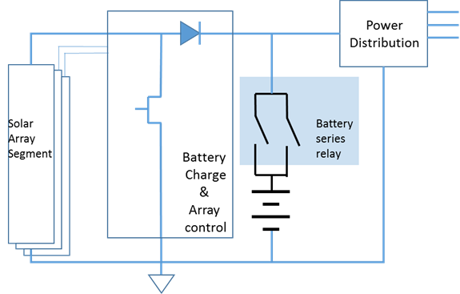
Electrical Power Systems (EPS)
Major Components
  Generation
    Solar arrays for Earth-orbiting satellites
  Storage (batteries)
  Distribution
EPS Hard Passivation
  Completely discharge all batteries
  Physically disconnect solar arrays from batteries and electrical distribution system
    Prevent recharging of discharged batteries
Alternatives for solar array passivation
  Off-pointing solar arrays – if can be verified to stay that way
  Shunting – must verify arc production not sufficient to cause fragmentation
Simplified Battery-on-the-bus EPS

Slide 7
Lithium-ion Batteries (LIB)
Characteristics
  High specific energy, high operating voltage
  Tolerates many charging cycles
  Used in spacecraft and some launch vehicles
  Concerns for after EOM: overcharging, thermal runaway
Thermal runaway (TR)
  Rapid, uncontrolled temperature increase in a damaged battery
  TR severity a function of state of charge (SoC) and battery configuration
    Reduced SoC = reduced TR risk
  Testing by FAA showed no TR with 30% SoC for 18650-format cell
    30% SoC at EOM is less energy than 30% at mission start due to degradation
    International Air Transport Association also recommends 30% passivation level
Over-discharge: discharge below manufacture’s recommended minimum SoC
  Can cause internal shorting damage to electrodes and current collectors
  Risk occurs when repeatedly cycling a cell that has been over-discharged
    Don’t recharge an over-discharged cell
Notes:
Over-discharge – there’s a lower limit specified by the manufacturer

Slide 8
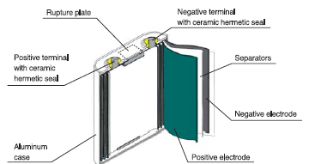
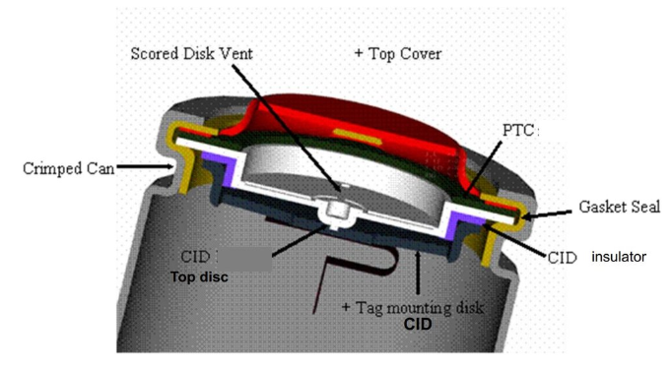
LIB Safety Features
Soft passivation may be acceptable with built-in safety features such as:
  Positive temperature coefficient (PTC) devices
    Reduces current through cells in event of high current or over-temperature
    Battery can continue to function when reset
  Current interrupt devices (CIDs)
    Releases connection of the positive terminal, interrupting the circuit, if battery overcharges
    Permanently disables battery
  Pressure relief devices like burst discs and scored rupture plates
  Internal fusible links/external fusing
  Shutdown separators
  Radiant thermal barriers
  Heat removal paths
Small-format 18650 Cell
Large Format Cell

Slide 9
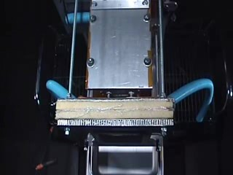
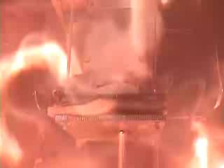
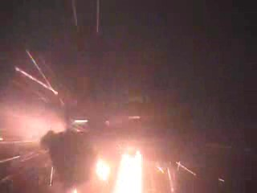
Hypervelocity Impact Testing -- Batteries
Reviewed results of ISS and European Space Agency (ESA) HVI battery testing
Most testing performed at 100% SoC
No examples of vehicle-wide fragmentation (i.e., explosion) failure modes
  TR, when it occurred, did cause venting and material ejection from the battery
  Not all impacts resulted in TR
2012 GS Yuasa LIB HVI Test with 10 mm Projectile

Slide 10
Alkaline Batteries
Types
  Ni-Cd, Ni-H₂, Ag-Zn
Characteristics:
  Lower energy density than LIBs
  Not as susceptible to thermal runaway as LIBs
  Limited recharging capability
  Hydrogen and oxygen gas can form at electrodes due to self-discharge
Ag-Zn primarily used in launch vehicle flight termination systems (FTS)
  Disconnect switches not allowed in FTS
  No recharge capability concern (no solar panels)
Passivation
  Absence of solar panels = no disconnect required from batteries
  Reduce SoC to level that reduced self-discharge – silver monoxide plateau (~1.6 V open circuit)

Slide 11
Pressurized Systems

Slide 12
Pressurized Systems
Components
  Propellant tanks (fuel and oxidizer)
  Pressurant tanks
  Distribution system
EOM Fragmentation Causes
  MMOD impact
  Rupture due to material embrittlement over time and exposure
  Overpressurization due to heating, component failure, propellant decomposition
  Propellant mixing due to one of the above
Hard Passivation
  Draining and depressurization of all pressure vessels to ambient (vacuum)
Soft Passivation
  Depletion to below a threshold deemed “safe”
  Safety devices such as relief valves, burst disks, etc.

Slide 13
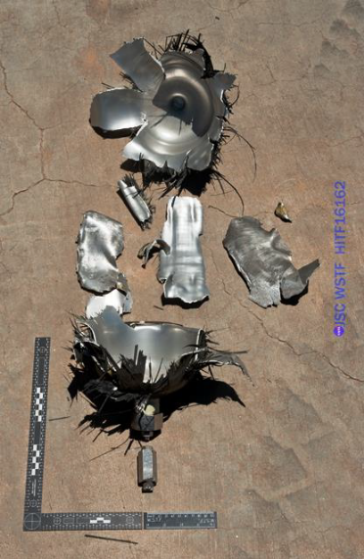
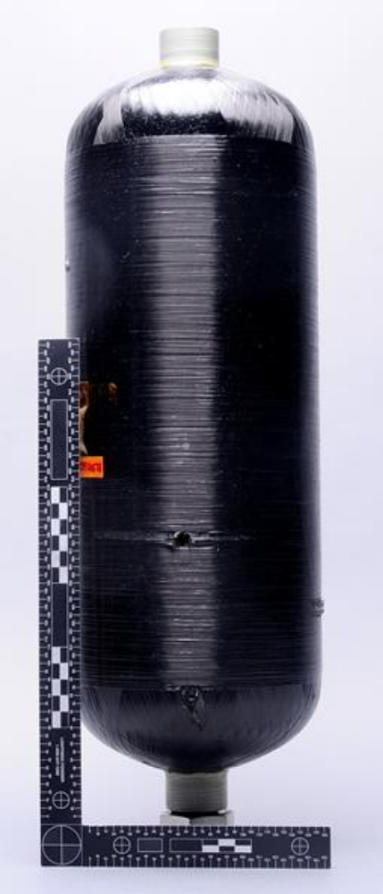
Tank Impact Testing
Limited data on partially empty pressure vessels (usually tested on full tanks)
Data available for hypervelocity impact (HVI), high velocity, and low velocity impacts
  Low velocity analogous to tank and FOD drops
  HVI and high velocity simulated MMOD impacts
Impact on the gas side of a pressure vessel (e.g., in the region of a diaphragm with gas) gives damage characteristics similar to entire tank being pressurized
  Corresponding results for impact on liquid side
Shielding is effective means of reducing likelihood of rupture
Pressure vessels did not rupture when pressurized to <15% of burst pressure
Pressurized
Unpressurized

Slide 14
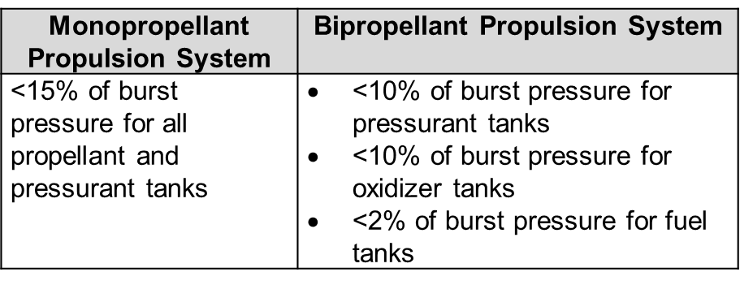
Soft Passivation Guidelines
Based on NASA and ESA experience
A. Depressurize tanks/system to:
Or
B. Demonstrate probability of MMOD-induced debris event is below mission-defined threshold, and demonstrate by analysis final pressure cannot increase due to environmental or other sources above burst pressure

Slide 15
Other Pressure Systems Recommendations
Verify pressurant tanks are permanently isolated from propellant tanks or depressurized sufficiently so that valve failure will not overpressurize propellant
Ensure permanent separation of oxidizer and fuel in bipropellant systems
For liquids that decompose (e.g., hydrazine):
  Verify remaining mass is <2% of initial mass,
  OR
  Confirm by testing or analysis that decomposition of assumed residual will not result in pressures above rated burst

Slide 16
Analytical Tools to Determine Soft Passivation Thresholds
End of Life (EOL) Stored Tank Energy Compared to Energy Needed to Burst
  EOL stored energy a function of EOL pressure, temperature
  EOL energy to burst a function of design and anticipated tank and material degradation
  Can be applied to metallic or COPVs
MMOD Risk
  Rupture limit equations can provide MMOD particle critical size
  Estimate the number of critical-sized orbital debris particles until EOL using MMOD risk assessment tools
  Can be converted to a probability
Decomposition Pressure Increase
  Propellant decomposition may increase pressure
  Use initial fill fraction, Dalton’s Low of Partial Pressures, decomposition behavior
  Example in report for hydrazine is conservative, but does show significant pressure increase
  Fluid dynamics model better solution for more accurate results

Slide 17
Concluding Remarks
EOM planning requires a different mindset than operations mindset of preserving functionality
Spacecraft can be made more resistant to EOM break-ups through design and passivation
100% hard passivation is elusive – acceptable limits can be established
Spacecraft that are no longer in orbit will produce no debris (deorbit intact objects after EOM)
Architectural decisions (e.g., shielding) that improve mission success can also improve EOM protection

Slide 18
Questions?

