Slide 1

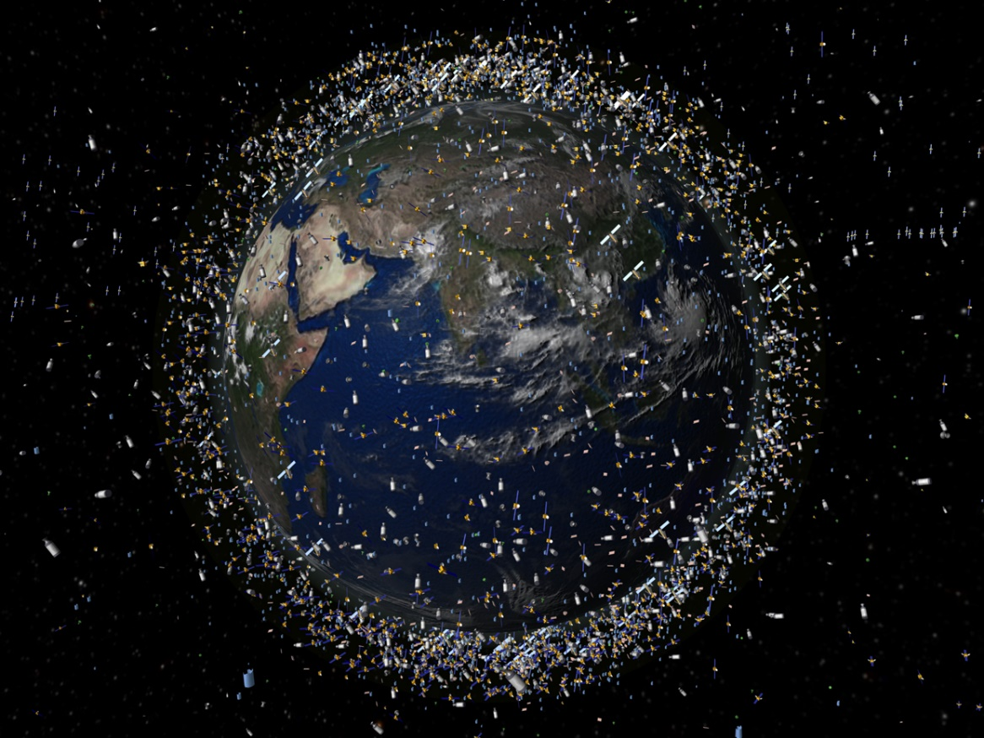
Conjunction Assessment (CA) Support Overview for the EOS Satellites
Image Credit: https://scitechdaily.com/images/Space-Debris-Objects-Low-Earth-Orbit-scaled.jpg
Presented By: Syed Hasan
NASA EOS Lead CA Engineer
syed.o.hasan@nasa.gov
Presentation Date: 04/07/2021

Slide 2
Agenda
CA Data Organization
CA Engineer Personnel
Devolved Support
CRMS Overview
CRMS Reports
CRMS Manual Support
HIE Statistics
2020 Statistics Roll-Up
Interesting HIEs in 2020
Future EOS CA Plans

Slide 3
CA Data Organization
The Combined Space Operations Center (CSpOC), located at Vandenberg Air Force Base (VAFB) in California provides Space Situational Awareness (SSA) data for the NASA Earth Observing System (EOS) Aqua, Aura, and Terra satellites
This data is posted multiple times a day to space-track.org by the Conjunction Assessment Risk Analysis (CARA) Orbital Safety Analysts (OSAs)
The Earth Science Mission Operations (ESMO) Collision Risk Mitigation System (CRMS) tool downloads this data and performs conjunction assessment risk analysis and determines mitigation maneuver solutions based on specific spacecraft constraints
The Flight Dynamics Support (FDS) team generates ephemerides based on each of these maneuver solutions and delivers them to space-track.org for screening
The decision-making responsibility regarding risk-mitigating maneuvers is left to each individual Mission Director (MD), who seeks consultation from the EOS CA Engineers

Slide 4
CA Engineer Personnel
EOS CA Engineer Staff
Syed Hasan – CA Engineer
Ian Crum – CA Engineer
Max Fisher – Backup CA Engineer
Joshua Bowman – Backup CA Engineer
Primary Daily CA Operational Duties
Evaluate CRMS summary report data content
Check if any flags are triggered in summary report and take actions
Assess Orbit Determination (OD) quality of secondary objects
Confirm consistency between Astrodynamics Support Workstation (ASW) and Owner/Operator (O/O) data for High Interest Events (HIEs)
Run OSA HIE worklist tool and verify events are tasked appropriately
Evaluate automated maneuver planning reports
Generate manual maneuver trade space reports as needed
Evaluate space weather conditions
Input HIE metrics and generate statistical reports
Monitor and coordinate special ephemeris screenings with OSAs

Slide 5
ESMO/CARA Devolved Support
Parallel Operations for ESMO/CARA Devolution was successfully completed on 09/25/19, after 6 months of demonstrating achievement of satisfying various success criteria items, including several special case scenarios
The following prime responsibilities have been incorporated by ESMO since Devolution parallel operations was completed:
  Ephemeris generation/delivery to space-track for screening
  Conjunction Data Message (CDM) retrieval from space-track for data assessment
  Direct contact with CARA OSAs for data processing support
  Analysis and action for all HIEs that violate Probability of collision (Pc) maneuver thresholds
  CA GO/NO-GO decision making at Command Authorization Meetings
  Notification to NASA Headquarters regarding maneuver plans
  Reporting of HIE statistics and actions taken for each event

Slide 6
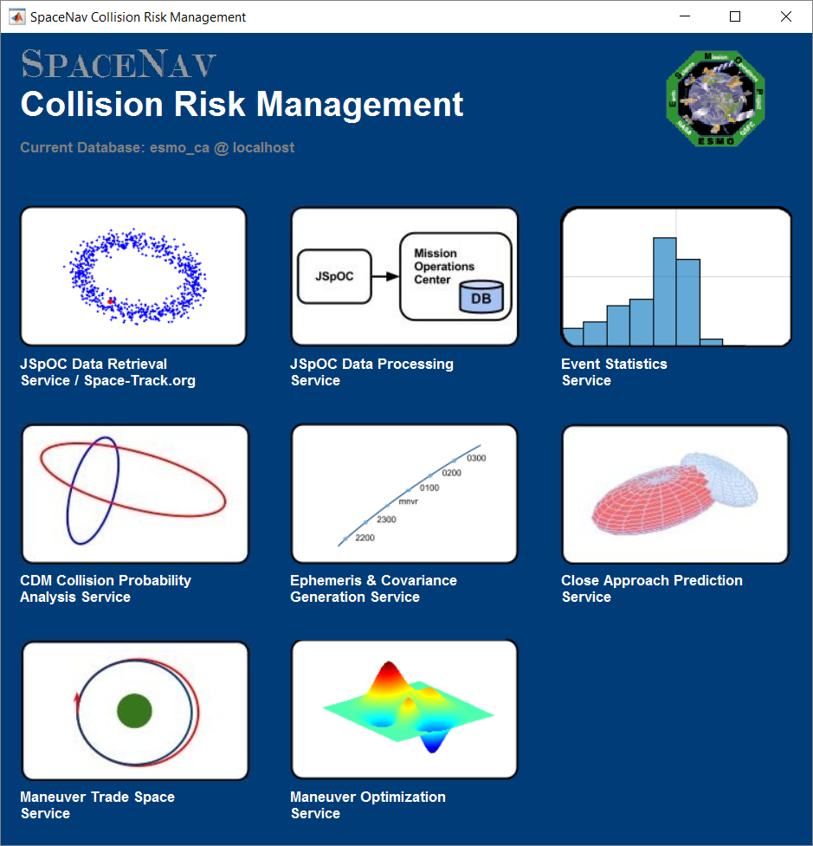
CRMS Overview
The Collision Risk Management System (CRMS) in-house tool used by EOS has been created and is maintained by SpaceNav.
It is used by our team to quantify and mitigate high-risk collision events.
The software is configured to run through automation, where various sets of analyses are performed, and the results are automatically delivered via email to necessary recipients.
The software can also be executed manually by the CA Engineer for analysis that isn’t covered through automation or requires a different output from what the automation has produced.

Slide 7
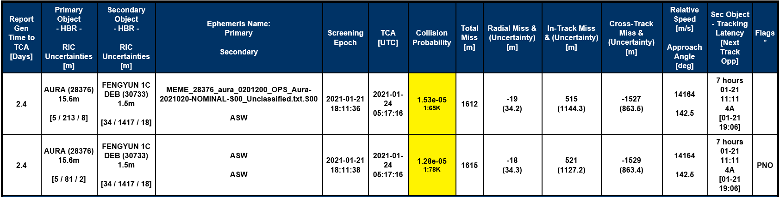
CRMS CA Summary Reports
CRMS delivers a summary report to us three times a day during nominal CSpOC screening times. The reports come in at ~4 AM, ~1 PM and ~8 PM ET daily. Additional reports also come in between for special maneuver screenings and primary vs. secondary only screenings.
The summary report for Aura in the image below shows several parameters for each event, including the objects information, data source, screening and close approach time, Pc, miss distance and uncertainty (covariance), and tracking information. The time of the last track, and time of the next tracking opportunity, are always key factors in the maneuver planning decision making process. The report also contains flags, which identify potential issues in the data which require specific courses of action.
Color-codes used by CRMS for Pc:
Pc < 1E-5 | 1E-5 ≤ Pc < 1E-4 | 1E-4 ≤ Pc < 1E-3 | 1E-3 ≤ Pc < 1E-2 | Pc ≥ 1E-2
White | Yellow | Orange | Red | Black

Slide 8
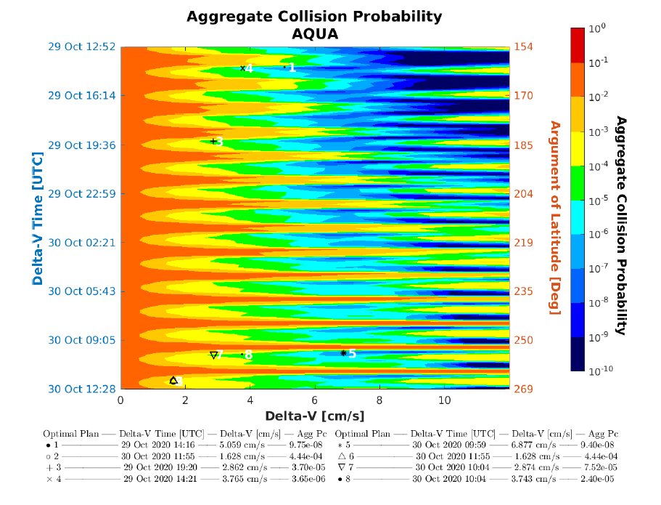
CRMS Maneuver Reports (1 of 3)
CRMS delivers a maneuver planning report to us every time a conjunction event falls within our configurable planning threshold, which is currently set to TCA ≤ 3 days and Pc ≥ 1E-5.
When maneuver planning is triggered by such an event, CRMS generates an automated maneuver plan which includes an aggregate Maneuver Trade Space (MTS) plot with objects of concern up to 3 days after the TCA of the triggering object.
The MTS plot is the heart of the maneuver planning report, although other useful information is also given. Underneath the plot, eight optimal maneuver plans are provided, which correspond to configured constraints we set in the database. Currently these constraints are set to no science box requirement for optimal plan 1, and the 0, 10 and 20 kilometer box requirements for optimal plans 2-4, for the 24-hour time period. Options 5 to 8 are the same as 1 to 4, except constrained in time to the last 2.5 revs prior to the Time of Closest Approach (TCA).

Slide 9
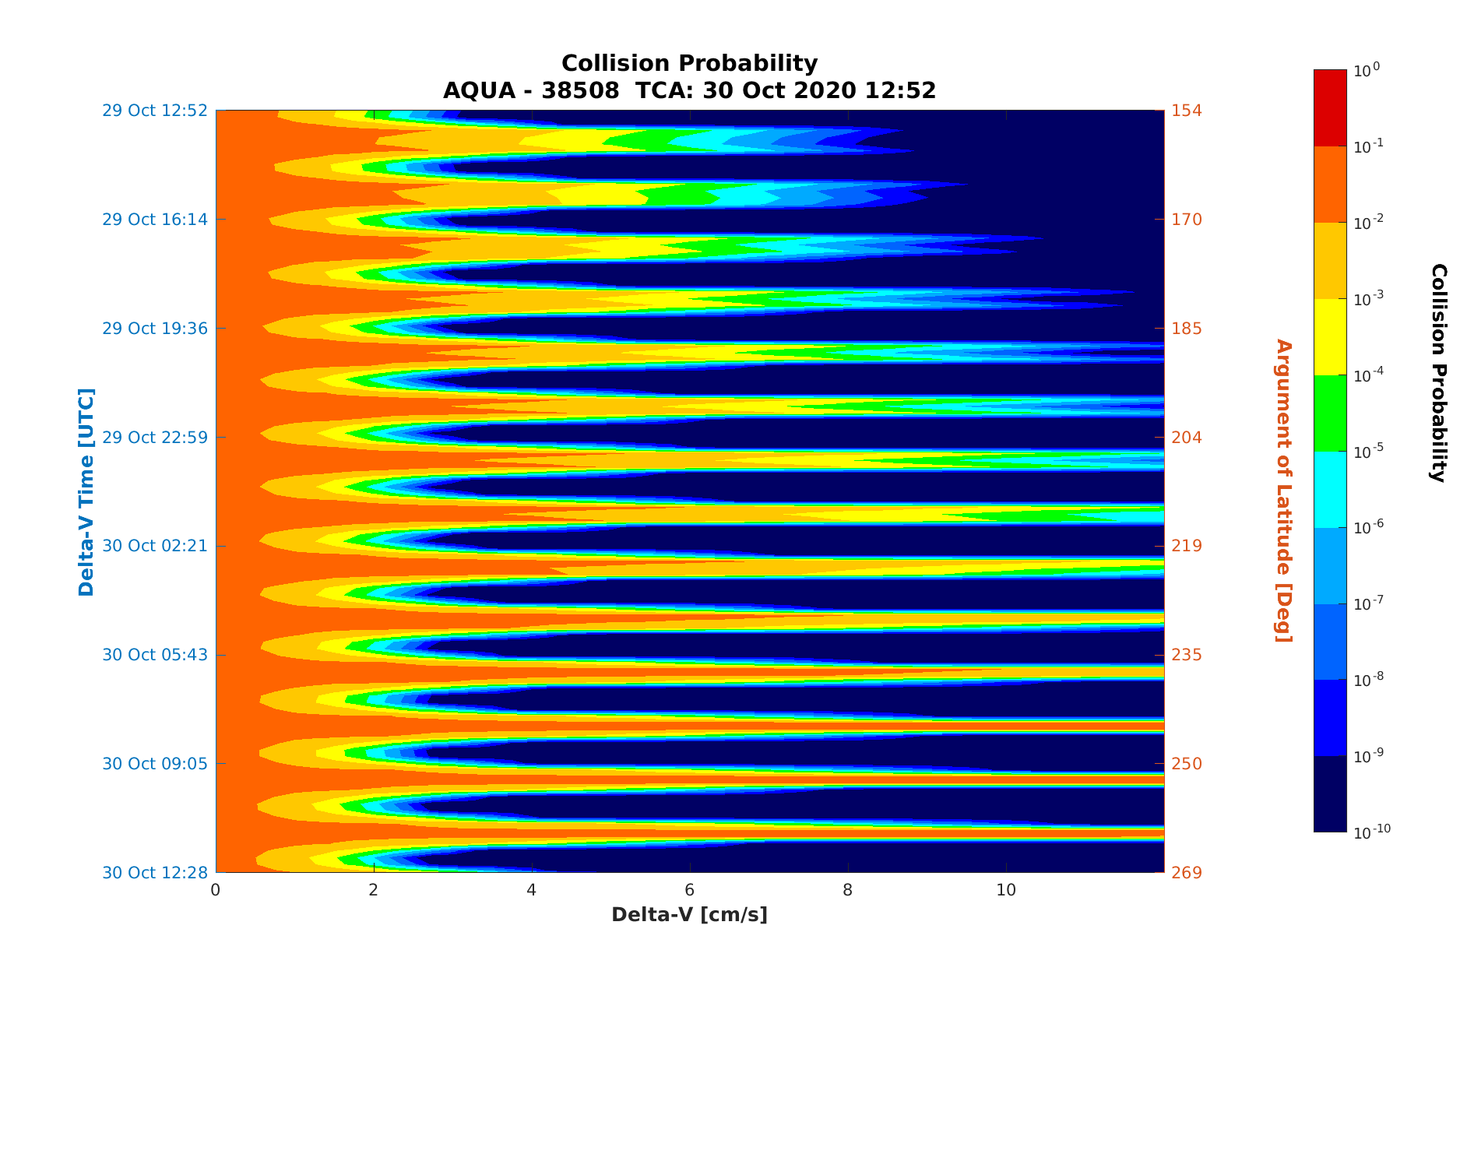
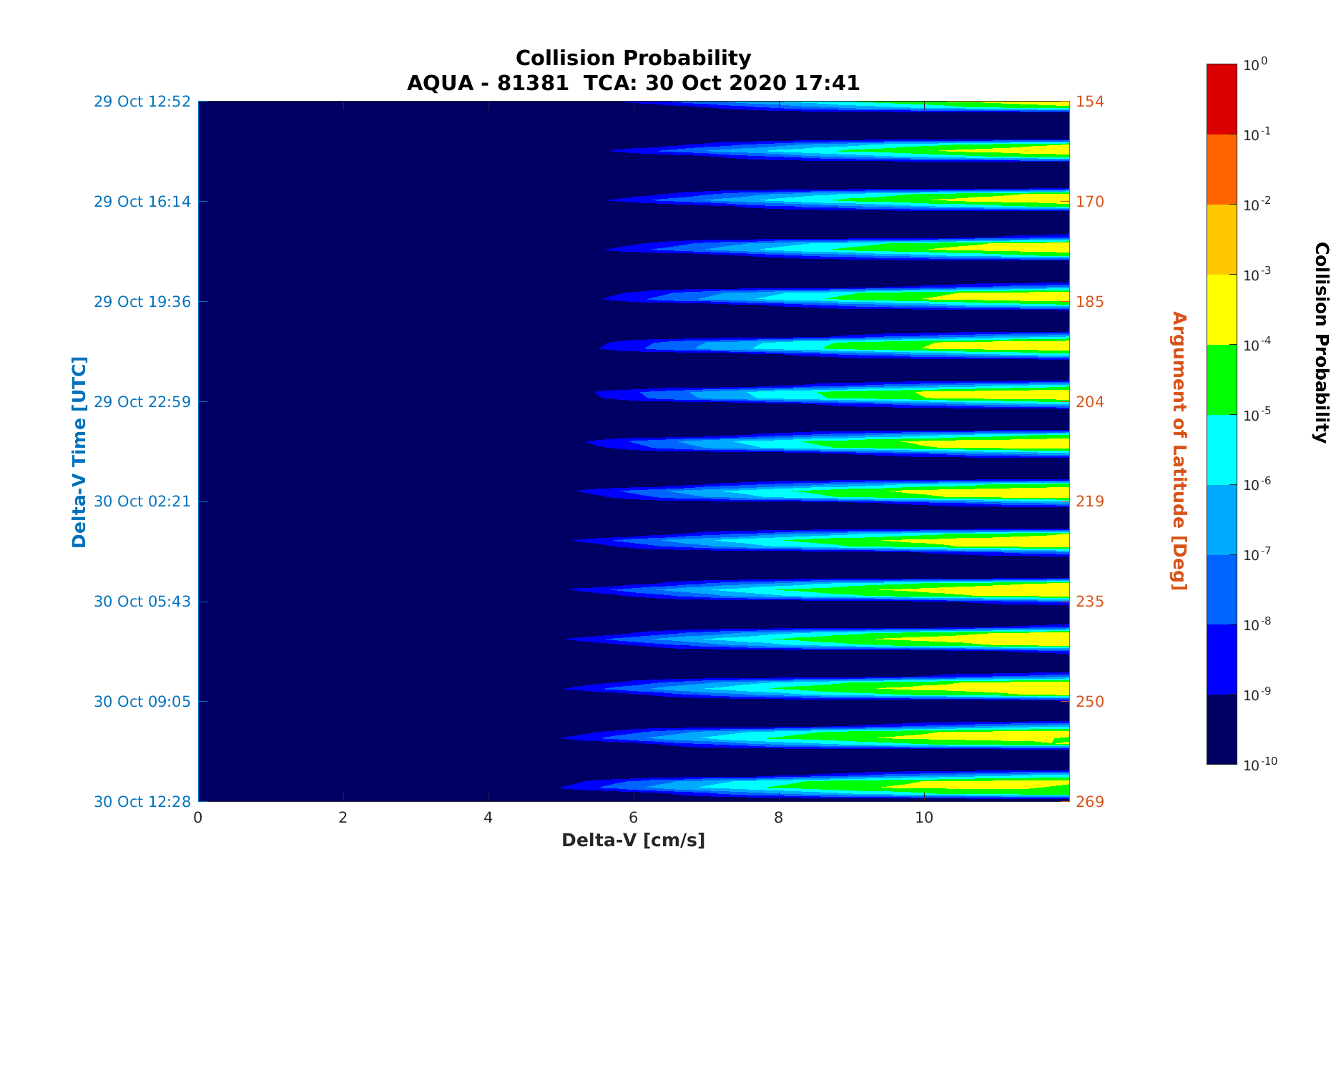
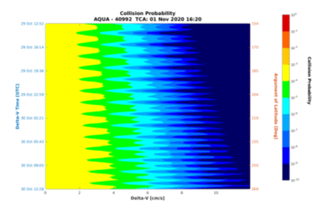
CRMS Maneuver Reports (2 of 3)
Along with the combined aggregate Pc MTS plot, the CRMS maneuver planning report also provides individual event MTS plots. This information is very useful for the CA Engineer to analyze what impact each individual event has to the overall risk assessment. Some events get better with a maneuver, while some can get worse (like the one in the top right box) and some don’t change at all. The CA Engineer must factor the event’s time to TCA and Pc levels to decide if an event should be considered or ignored for maneuver planning.

Slide 10
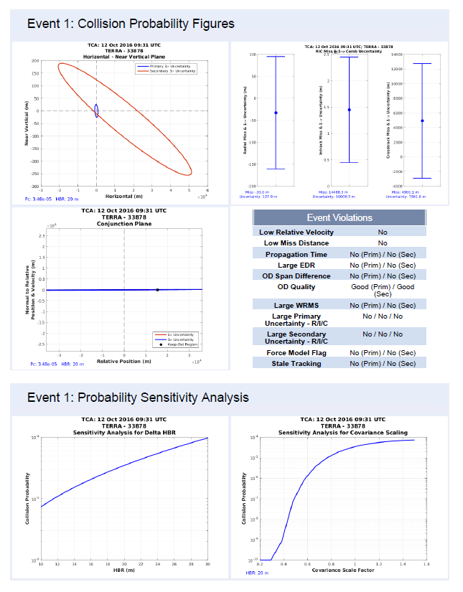
CRMS Maneuver Reports (3 of 3)
Along with the MTS plots, the CRMS maneuver planning report also contains detailed plots and charts for each secondary object of concern (identified through user-defined thresholds). It is important for the CA Engineer to analyze the orbit determination quality, Pc and miss distance trends, and sensitivity analysis of any secondary object that poses a threat to our spacecraft, so that proper planning can be taken.
The Probability Sensitivity Analysis plots display how the Pc changes if the Hard Body Radius (HBR) radius is adjusted, as well as how the Pc changes if the covariance is adjusted (which is also very useful for planning because more tracking data can mean inflation or deflation in covariance)

Slide 11
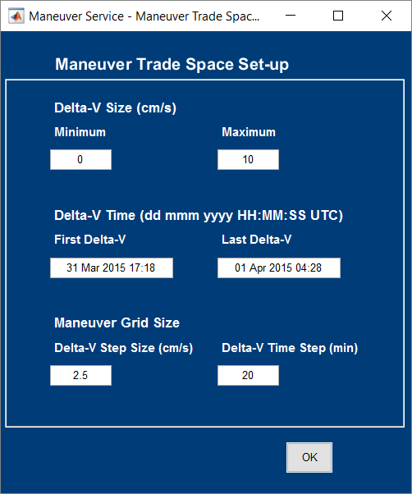
CRMS Manual Support
Often the CA Engineer is required to open up CRMS and run a service manually through the utilities provided in the system. This occurs in instances such as:
  The automated maneuver planning report does not provide a desirable risk mitigation solution
  The mission desires to use different parameters instead of the default values
  The automated maneuver planning report does not include a critical post-maneuver secondary object of concern
  The mission desires to see an MTS plot for an event that did not trigger the maneuver planning thresholds
  Summary reports show that a routine orbit maintenance maneuver leads to a potential HIE, therefore manual processing is required to determine how altering the routine maneuver can decrease the risk

Slide 12
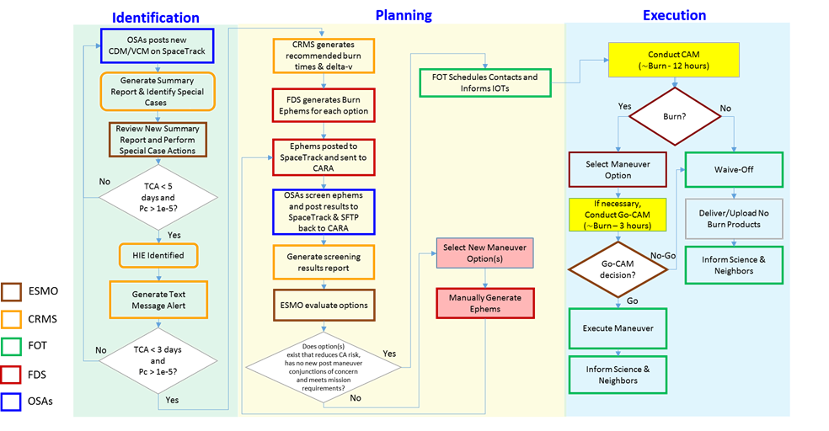
ESMO CA Process Flow

Slide 13
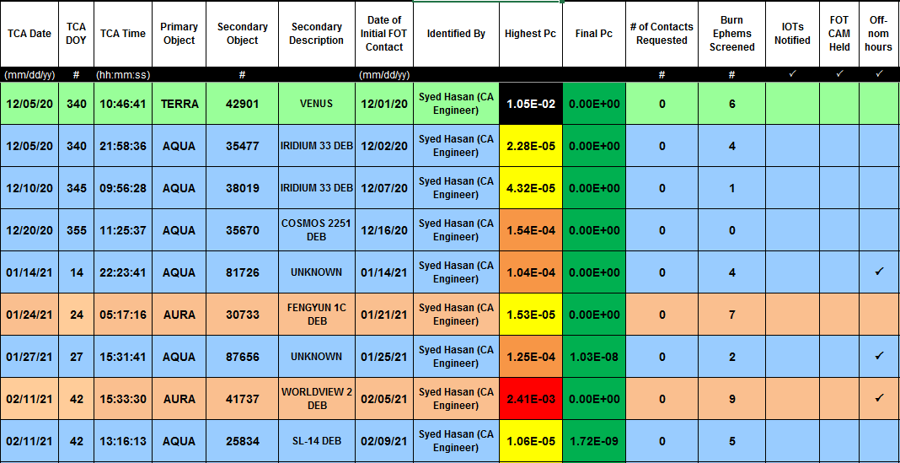
HIE Statistics
Another important responsibility of the EOS CA team is to keep statistics for every conjunction event that is classified as an HIE. HIE details are tracked in a spreadsheet along with several important details about the support provided for maneuver planning. These details are used for providing statistical plots which are used for monthly reporting, as well as special request reports requested by the MDs.

Slide 14
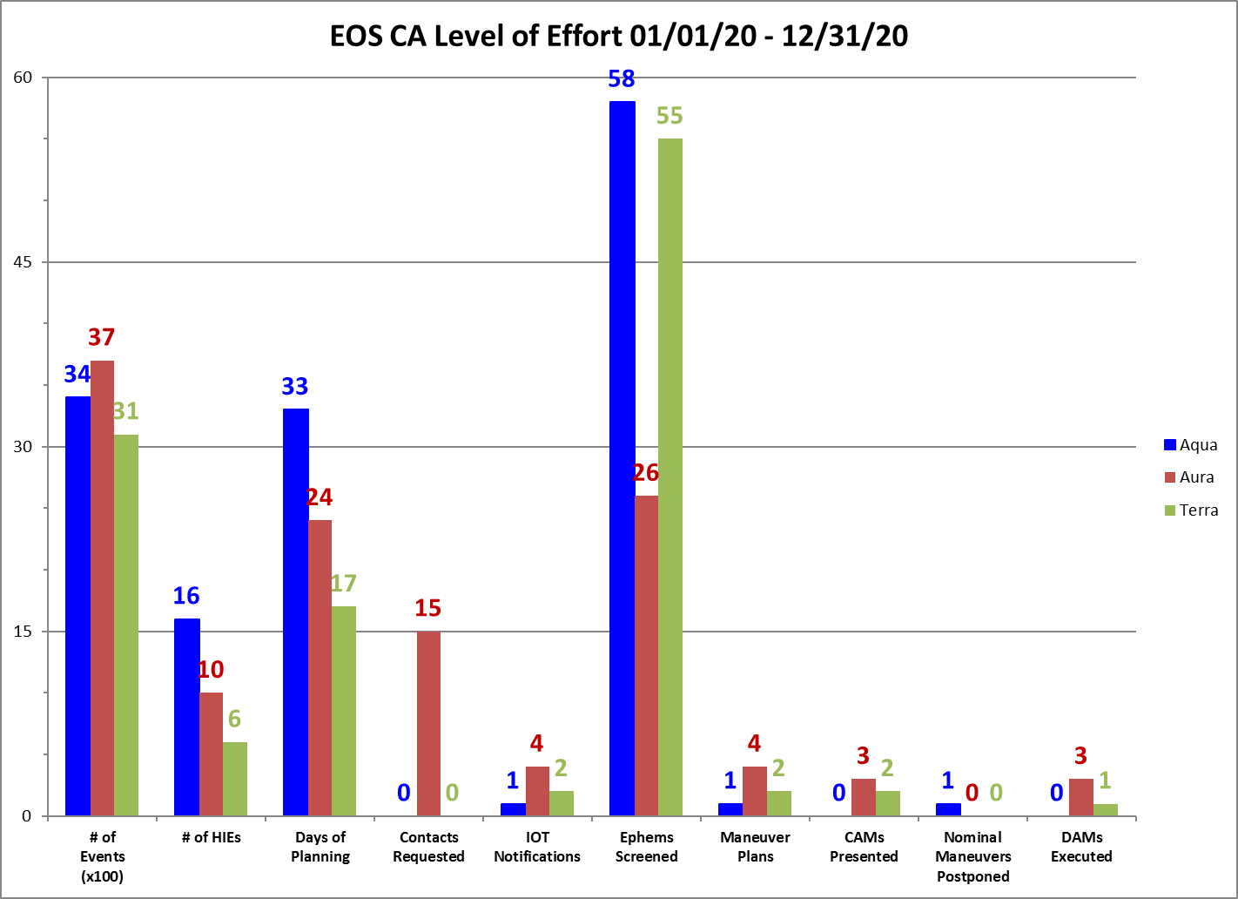
2020 Statistics Roll-Up
Below are some statistics for HIE support during 2020, which demonstrate the number of events dealt with in the duration of a year and the number of Debris Avoidance Maneuvers (DAMs) executed.
2020 Conjunction Event Support Summary
Satellite Name | # of Events | # of HIEs | # of Ephems Screened | Maneuvers Postponed | DAMs Executed
Aqua | 3378 | 16 | 58 | 1 | 0
Aura | 3683 | 10 | 26 | 0 | 3
Terra | 3124 | 6 | 55 | 0 | 1
Total EOS | 10185 | 32 | 139 | 1 | 4

Slide 15
Interesting HIEs in 2020
Terra vs. 80326 (Unknown) - TCA on 1/10/20 at 21:55:17 GMT
  Jumped in Pc on the morning of TCA from E-12 to E-3
  Once maneuver planning began, we verified that there were no more tracking opportunities until TCA
  Risk mitigation maneuver was executed successfully
  Max Pc: 4.2E-3 / Final Pc before TCA: 4.1E-3
Aura vs. 13809 (Cosmos 1275 Deb) - TCA on 9/19/20 at 20:03:13 GMT
  Pc started off high at an E-3 level but dropped significantly with updated tracks and reduced covariance
  Miss distance remained low at 74m total miss & 74m radial miss
  Small maneuver was planned and successfully executed to increase the miss distance to 103m total & 103m radial
  Max Pc: 8.1E-3 / Final Pc before TCA: 7.2E-23
Terra vs. 42901 (Venus) - TCA on 12/05/20 at 10:46:41 GMT
  High risk (E-2) conjunction event with Venus secondary which was not labeled as maneuverable in CDM
  CA Engineer reached out to CARA OSA with concern that payload is active, based on investigation, and OSA reached out to Venus O/O at CNES with CA Engineer contact information
  After communication and coordination with CNES, it was identified that VENUS is maneuverable and determined VENUS will perform a DAM to mitigate the risk, which was successfully executed
  Max Pc: 1.1E-2 / Final Pc before TCA: 0.0E+0

Slide 16
Future CA Plans for EOS
Validate upcoming new CRMS Release and deploy to operations
Analyze CDMs and derived parameters for past events to gain a better understanding of how tracking updates impact covariance values
Implement High Interest Event alert system for late notice high risk conjunction events
Update CA process as needed to account for any future changes at the CSpOC or new advancements in the CA environment

Slide 17
Back-Up Slides

Slide 18
Probability of Collision Thresholds
The Probability of collision (Pc) is the principal metric used to specify the risk of collision between the primary object (our satellite) colliding with the secondary object of concern. In the image below, Pc thresholds are defined and classified by color for our missions to specify what course of action is recommended for the MD.
 | Pc Thresholds | Odds Range | Course of Action | Sample Scenarios
Green | <1.0e⁻⁵ | 1:100,000 to 0 | No DAM
Yellow | (1.0e⁻⁴-1.0e⁻⁵) | 1:10,000 to 1:100,000 | Altered DMUM/No DAM | Re-plan Nominal DMUM burn time or execute DMUM early if available For well-tracked objects with small miss distances
Orange | (1.0e⁻³-1.0e⁻⁴) | 1:1,000 to 1:10,000 | DAM | Solution within mission/science requirements and low uncertainties
Red | (1.0e⁻²-1.0e⁻³) | 1:100 to 1:1,000 | DAM | Execute even if outside mission/science requirements
Black | ≥1.0e⁻² | 1:1 to 1:100 | DAM | Maneuver at all costs Even if Ongoing Anomaly (Non-Maneuver Component)

Slide 19
ESMO CA PROCESS ENHANCEMENT
HISTORIC PROCESS | CURRENT PROCESS
Identify HIE via visual inspection of CARA Summary Report | Identify HIE via text message sent by CRMS and visual inspection of CRMS Summary Report
Call HIE Briefing Meeting to gather details of conjunction with CARA presenting HIE slides | CRMS produces maneuver report with all conjunction details and mitigation options
Pick mitigation solutions from selecting points off a Maneuver Trade Space Plot | CRMS produces new report every time new data is received and recomputes mitigation solutions
Flight Operations Team (FOT) schedules additional contacts | FOT schedules additional contacts
FDS generates ephems for each maneuver solution (~ 1 hr per ephem) | FDS generates ephems for each maneuver solution automatically based on output from CRMS
CARA transfers ephems to CSpOC for screening | FDS automatically transfers ephems to CARA & SpaceTrack (JSpOC) for screening
JSpOC transfers screening results back to CARA | JSpOC posts screening results on SpaceTrack & sends to CARA
CARA generates screening results report and briefs interested parties | CRMS generates screening results report automatically based on CDMs posted to SpaceTrack
MD/Team selects or iterates on final solution | MD/Team selects or iterates on final solution
Hold Command Authorization Meeting (CAM) | Hold CAM
Execute DAM or Waive-Off (Maneuver included in daily command load with manual instrument configurations with 1-2 days needed prior to maneuver) | Execute DAM or Waive-Off (Maneuver in telemetry monitoring command sequences with 2 hours lead time needed)
Black text = Manual
Blue text = Automated

Slide 20
Parallel Ops Success Criteria (1 of 2)
In order for ESMO to complete devolution parallel operations, the following criteria items had to be successfully demonstrated (with artifacts) to the CARA team:
 | Success Criteria | Date Verified by ESMO | Date Verified by CARA
1 | Deliver ephemerides for each ESMO mission to the CARA OSAs | 3/26/19 | 3/26/19
2 | Receive and process all CDMs for each nominal screening (3 times per day) for all missions | 3/26/19 | 3/26/19
3 | Deliver DAM ephemerides for special screening by the CARA OSAs | 3/26/19 | 3/26/19
4 | Receive and process all CDMs from a special screening | 3/27/19 | 3/26/19
5 | Process a routine “red” event (by CARA threshold), including maneuver planning and maneuver screening and selection | 4/13/19 | 4/13/19
6 | Process a routine “yellow” event (by CARA threshold) | 3/26/19 | 3/26/19
7 | Process a routine “green” event (by CARA threshold) | 3/26/19 | 3/26/19
8 | Exercise special screening during OSA off hours | 8/14/19 (*Simulation) | 8/14/19 (*Simulation)
9 | Process a late-notice red event (<12 hrs to TCA or to Burn for some circumstances) | 8/14/19 (*Simulation) | 8/14/19 (*Simulation)
10 | Exercise headcount request | 6/23/19 | 8/1/19
11 | Exercise the NASA HQ notification process | 3/26/19 | 3/26/19
12 | Request and receive updated tasking for a secondary object | 8/21/19 | 9/16/19
13 | Execute an OD quality assessment with the CARA OSAs for a poorly tracked object, including requesting and receiving a 1v1 | 9/16/19 | 9/16/19

Slide 21
Parallel Ops Success Criteria (2 of 2)
 | Success Criteria | Date Verified by ESMO | Date Verified by CARA
14 | Address event determined to have inactionable OD | 9/25/19 (*Simulation) | 9/25/19 (*Simulation)
15 | Process a red or yellow event with inadequate 2-D Pc requiring Monte Carlo runs | 4/18/19 | 4/18/19
16 | Process an event with flagged covariance due to: Non-positive definite covariance on ASW primary or secondary “Default”, “Zero”, or “Missing” Covariance on primary ASW “Default”, “Zero”, or “Missing” Covariance on Secondary | 8/9/19 (*Simulation) | 8/9/19 (*Simulation)
 |  | 8/9/19 (*Simulation) | 8/9/19 (*Simulation)
 |  | 8/9/19 (*Simulation) | 8/9/19 (*Simulation)
17 | Process an event with flagged covariance due to: O/O Covariance missing on Secondary “Default”, “Zero”, or “Missing” Covariance on primary and secondary | 8/9/19 (*Simulation) | 8/9/19 (*Simulation)
 |  | 8/9/19 (*Simulation) | 8/9/19 (*Simulation)
18 | Exercise the Secondary O/O Contact Procedure Potentially active non-restricted country Potentially active restricted country No action needed; mission determined to be non-maneuverable/inactive | 5/8/19 | 5/29/19
 |  | 4/19/19 | 4/19/19
19 | Address event with different ASW and O/O Pc values to determine appropriate action | 8/9/19 (*Simulation) | 8/9/19 (*Simulation)
20 | Exercise Classified Information Communication process | 8/14/19 (*Simulation) | 8/14/19 (*Simulation)
21 | Exercise Breakup indications scenario | 4/23/19 | 5/29/19
22 | Generate and report metrics for CARA | 4/04/19 | 4/04/19

Slide 22
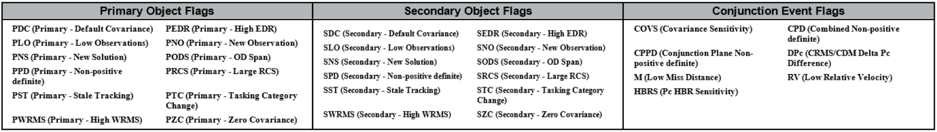
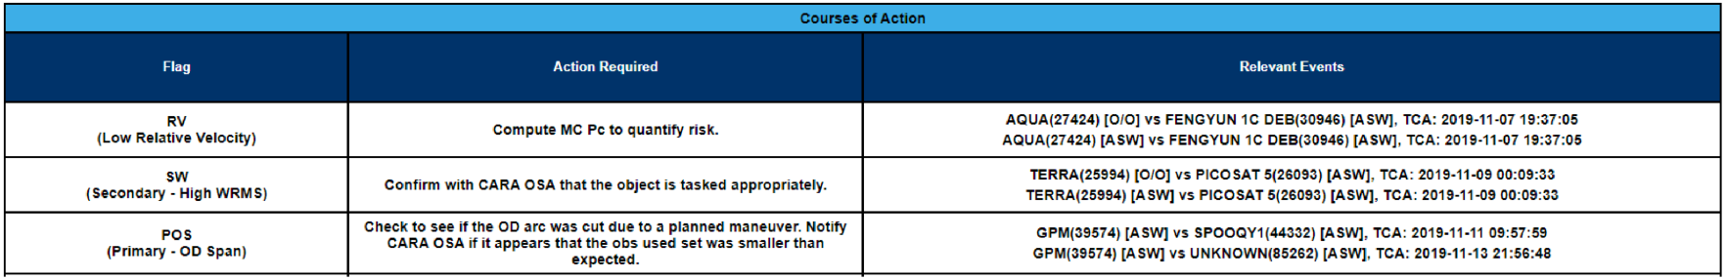
Special Case Flags and Actions
CRMS has a total of 31 flags, that are triggered off violations based off data in the CDMs
CRMS flags are organized into 4 different categories:
  Atypical Covariance – Missing or unexpected covariance matrix
  OD Quality - Indicators of a poor or questionable state solution
  State Information – Ancillary information for a given object
  Conjunction Event Information – Conjunction event specific
Several flags were recently added to CRMS to address edge-cases and outliers
A courses of action table was added to the CRMS summary report in our latest system release, which provides the correct action required for the special cases that arise

Slide 23
Abbreviations/Acronyms List
  ASW – Astrodynamics Support Workstation
  CA – Conjunction Assessment
  CAM – Command Authorization Meeting
  CARA – Conjunction Assessment Risk Analysis
  CDM – Conjunction Data Message
  CRMS – Collision Risk Management System
  CSpOC – Combined Space Operations Center
  DAM – Debris Avoidance Maneuver
  DMUM – Drag Make-up Maneuver
  EOS – Earth Observing System
  ESMO – Earth Science Mission Operations
  FDS – Flight Dynamics Support
  FOT – Flight Operations Team
  GMT – Greenwich Mean Time
  HBR – Hard Body Radius
  MD – Mission Director
  MTS – Maneuver Trade Space
  NASA – National Aeronautics & Space Administration
  OD – Orbit Determination
  OSA – Orbital Safety Analyst
  O/O – Owner/Operator
  Pc – Probability of Collision
  SSA – Space Situational Awareness
  TCA – Time of Closest Approach
  VAFB – Vandenberg Air Force Base

