Slide 1
EV Potential Partnerships with RUAG
Spacecraft & Vehicle Systems Department
Angelia Walker, Director
Paula Decesaris, Deputy Director
4/6/2021

Slide 2
EV30 Composites Capabilities
Broad experience base in a variety of aerospace structures from components to fully integrated launch vehicles
Structural design and analysis of large scale metallic and composite structures
Thermal analysis of composite structures and components
Dynamic design optimization (e.g. mass optimization while meeting frequency target)
Acoustic testing of composite panels and measuring vibration response
Pyrotechnic and Non-pyrotechnic separation systems for small and large applications (e.g. Mars Ascent Vehicle, SLS Payload Adaptor)
Transmission of pyro shock in composite structures

Slide 3
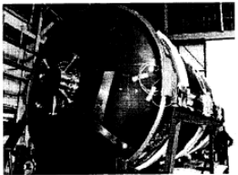
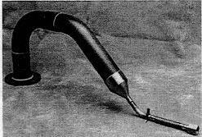
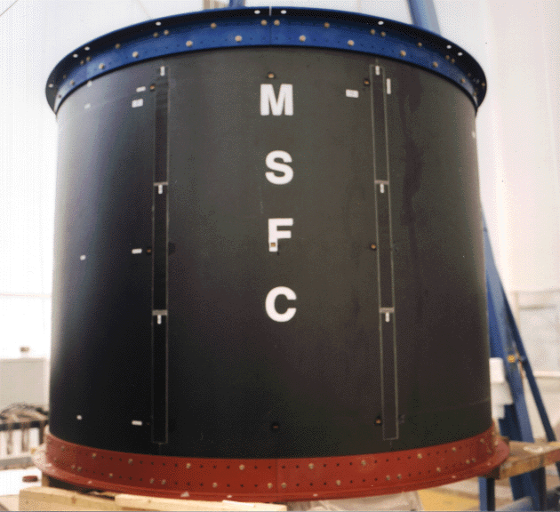
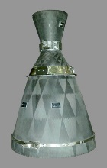
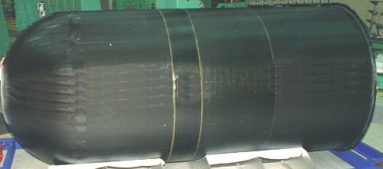
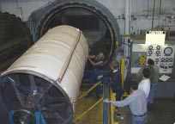
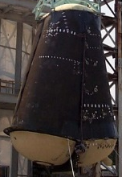
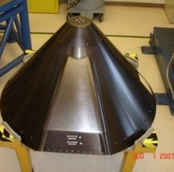
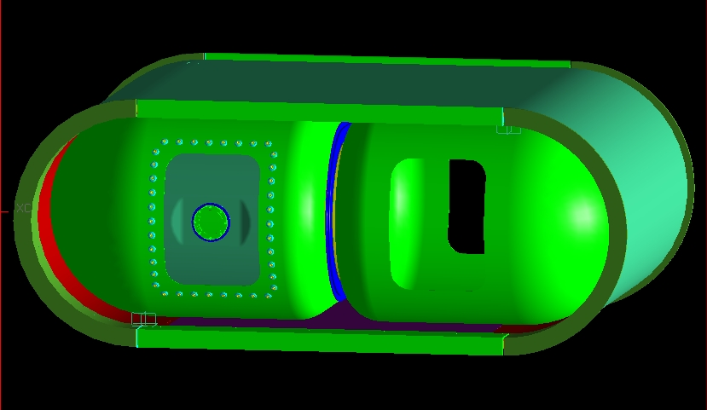
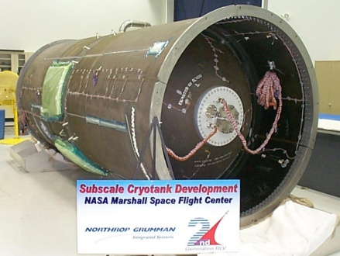
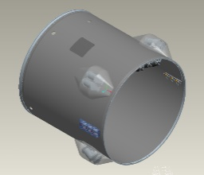
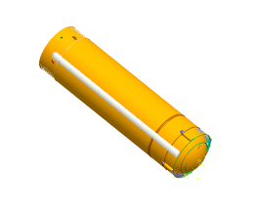
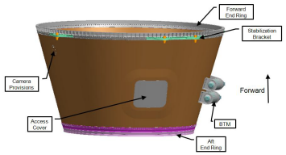
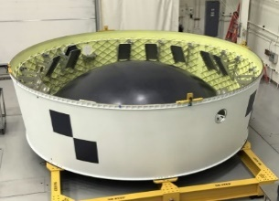
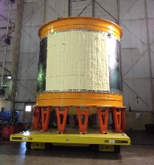
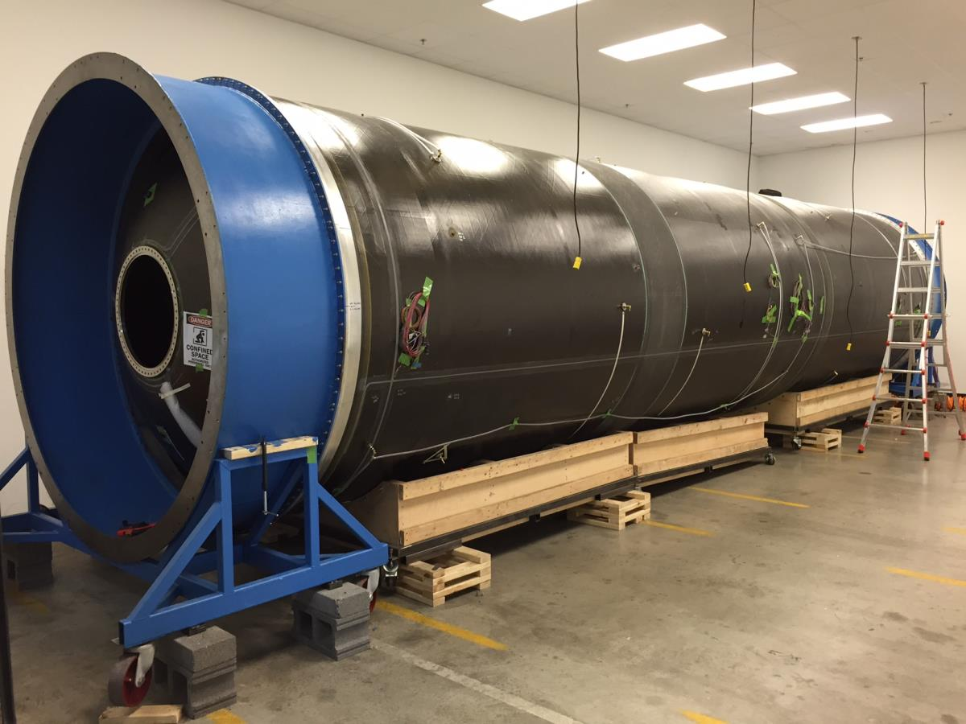
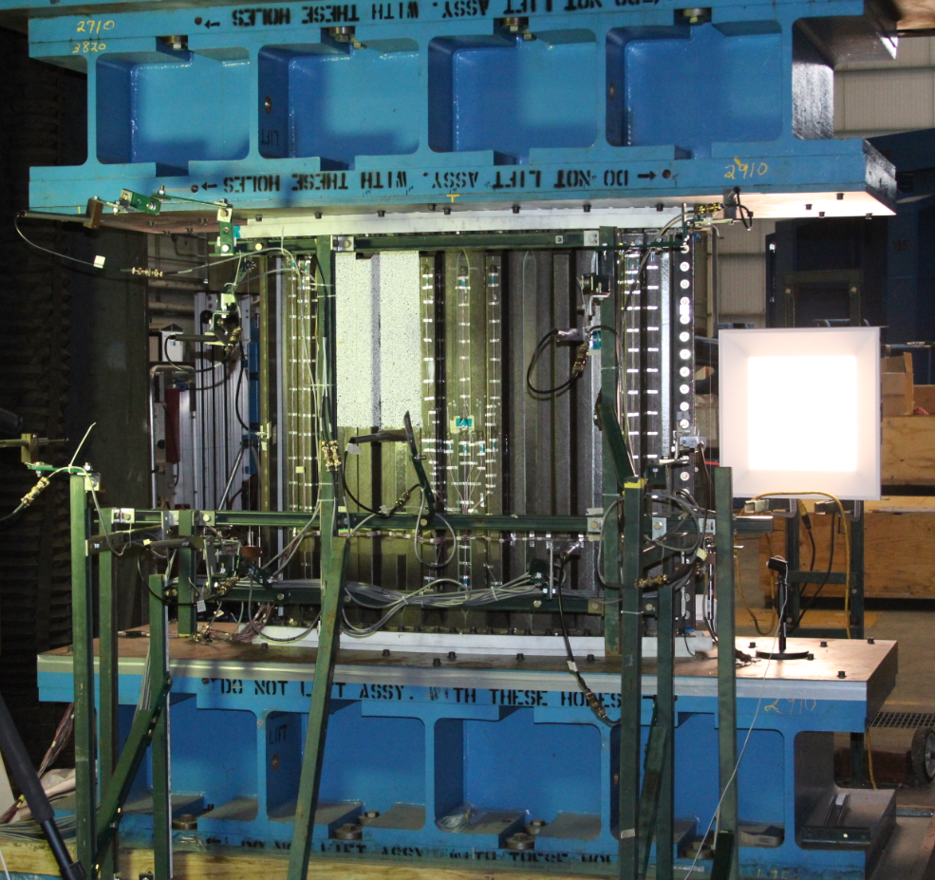
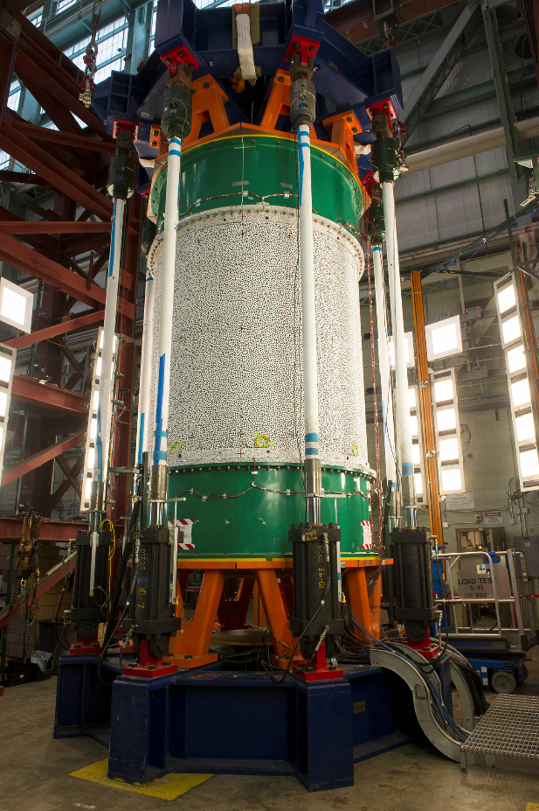
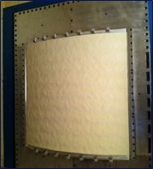
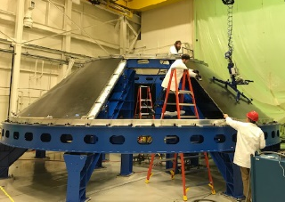
EV30 Composites Experience
DC-XA LH2 Tank & Feedline
MSFC Intertank
Fastrac Nozzle
Composite RP Tank
X-34 LOX Tank
X-33 LH2 Tank
External Tank Nose Cone
Cryogenic, Conformal Common Bulkhead, Aerogel-insulated Tank (CBAT)
Space Launch Initiative LH2 Tank (NGC)
Ares I Interstage, Upper Stage Systems Tunnel & Frustum
SLS MSA
Diaphragm
Cryotank Technologies
& Demonstration (CCTD)
Composite Tank Set
(Common Bulkhead)
Comp. Skin Stringer
Manu. Demo/Test
Shell Buckling
Knockdown
Factor (SBKF)
Acoustic Blanket
Response on
Comp. Panels
SLS Payload
Adaptor (PLA)
Fabrication
Design & Build
Oversight
Design
3

Slide 4
EV30 Potential Composites Partnerships
Evaluating the impacts of advanced composites manufacturing techniques on design and analysis methodologies:
  Out-of-Autoclave (OOA) Composites
  Thermoplastics
  Composite welding using ultrasonics
  Composite rings
  Additive Manufacturing (AM)
  Bond-line certification (i.e. process control, NDE, analysis)
Mass reduction and performance enhancement of thermal radiators, heat exchangers, and other components using composites
Clamp Band applications for long duration in-space missions
Large diameter Clamp Band assemblies for larger class payloads

Slide 5


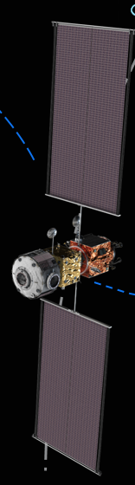
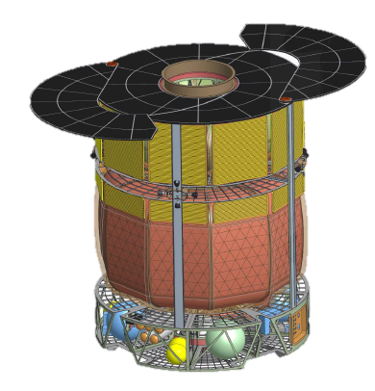
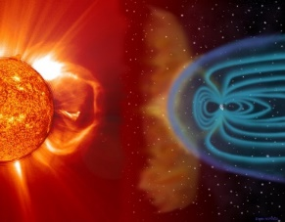
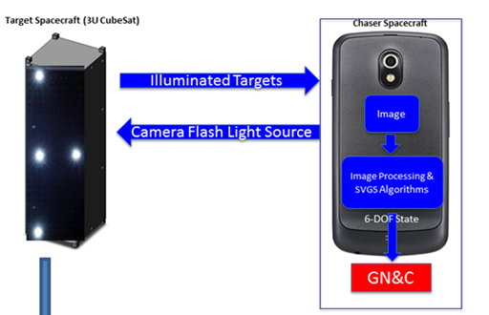
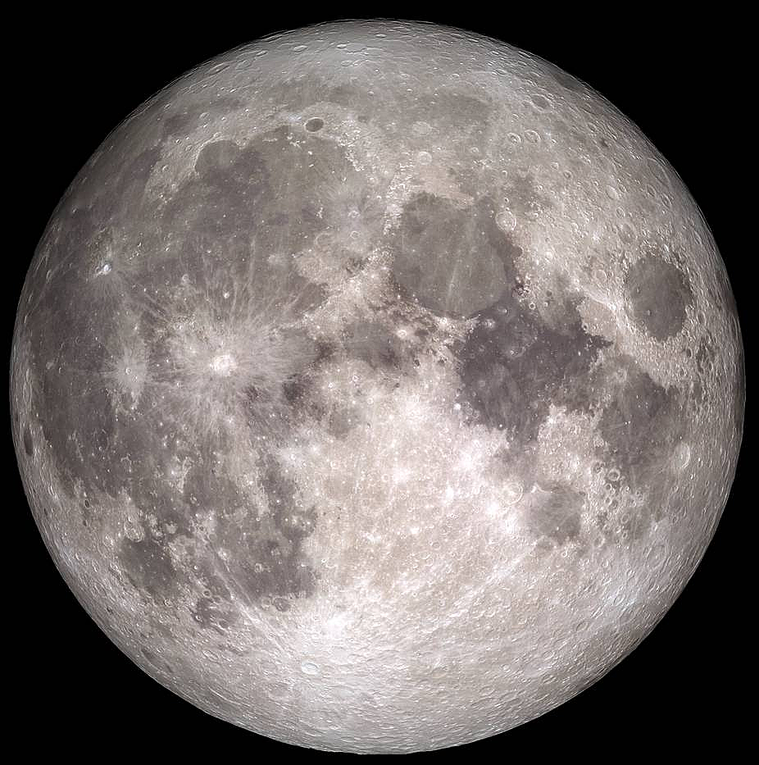
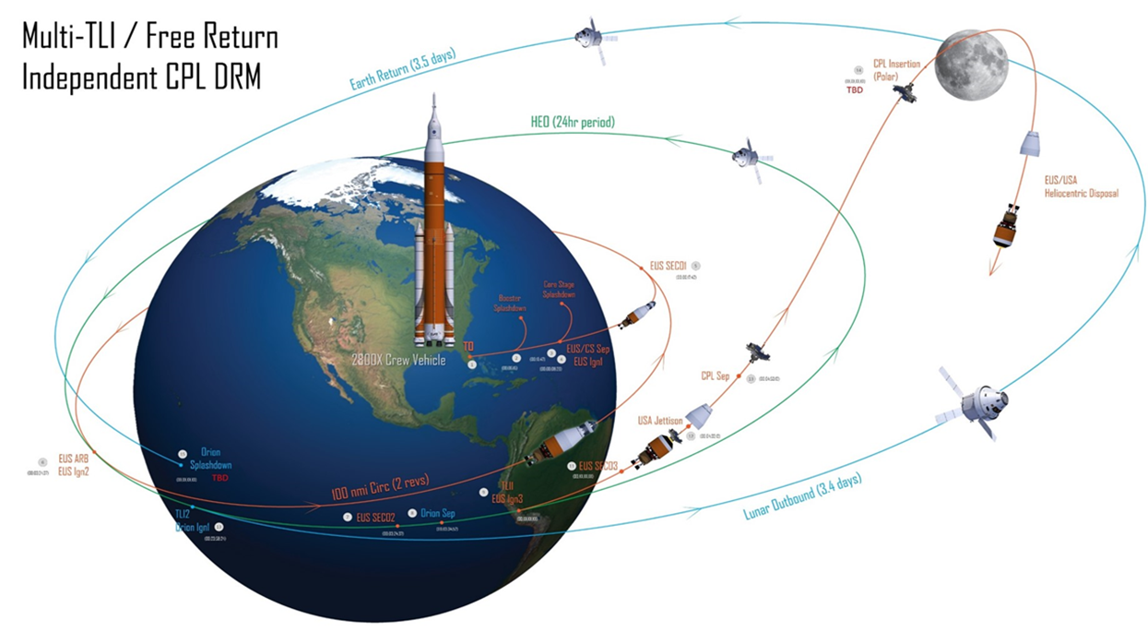
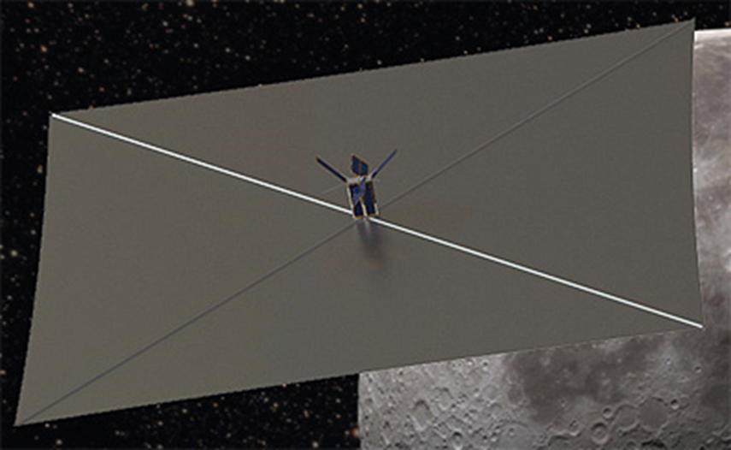
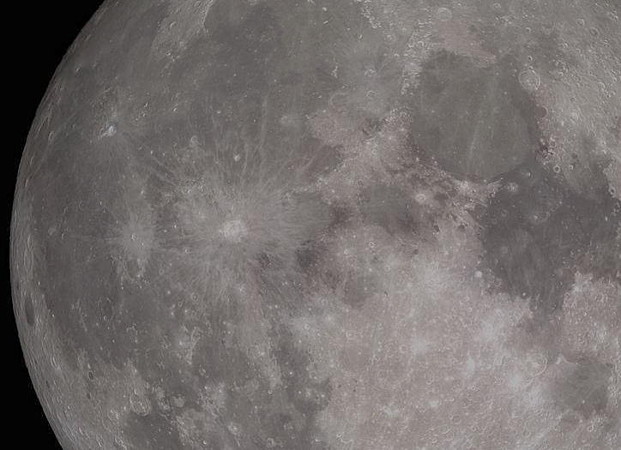
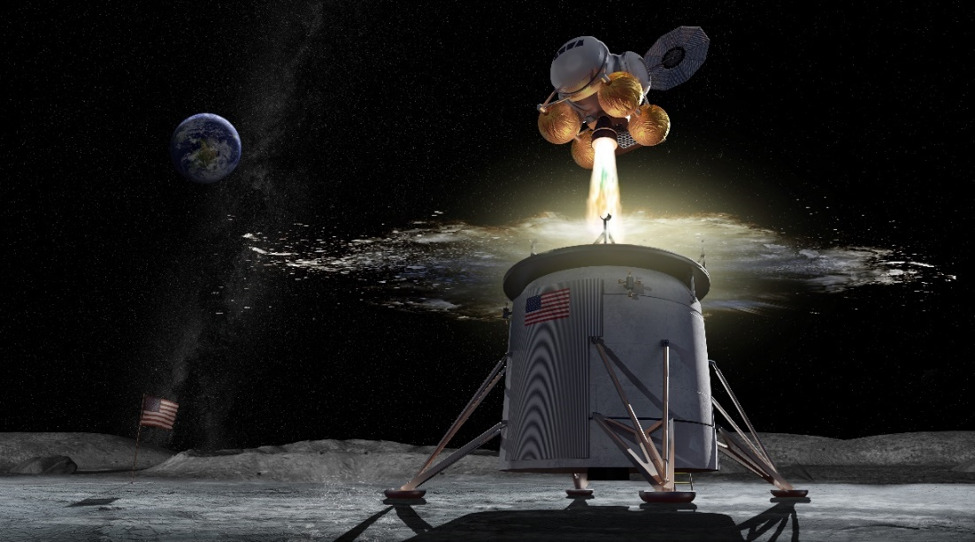
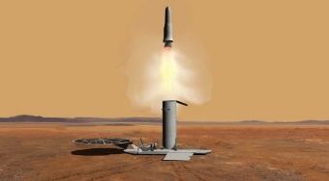
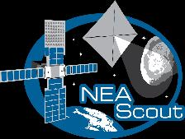
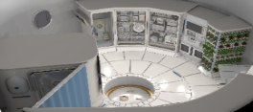
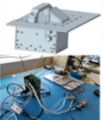
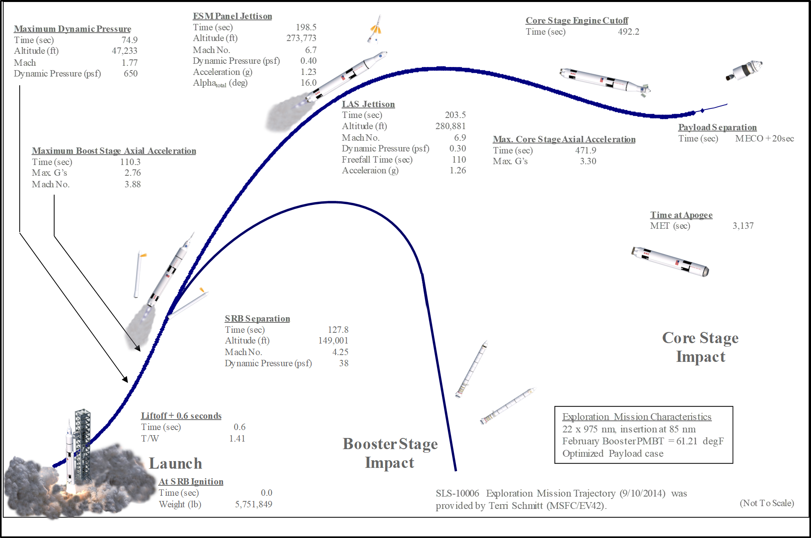
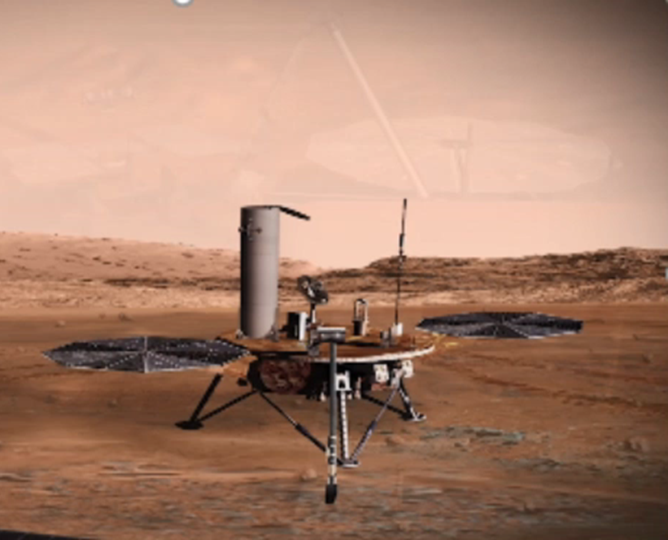
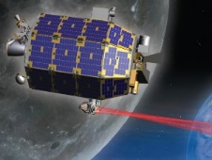
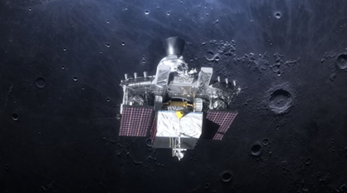
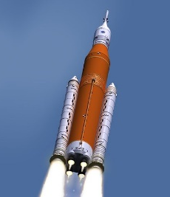
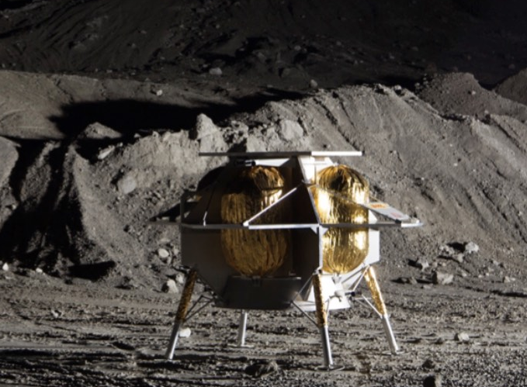
MSFC Capabilities within the Flight Mechanics & Analysis Division/EV40
Natural Environments
Across All Phases of Flight
Cruise and Proximity Operations
Mission Design, Trajectory Optimization, Vehicle Steering, Attitude Determination and Control, Relative Navigation Sensor and Algorithm Development, Approach Guidance, Sensor Integration, Divert Algorithm Development, Multibody-Dynamics, Inter-space Navigation and Awareness
Extensive expertise characterizing: ionizing radiation, meteoroids, plasma, spacecraft charging, natural thermal,
lunar surface (regolith, ejecta, etc.), & atmospheric environments
Characterization defined for SLS, Orion, EGS, Gateway,
Human Landing Systems, and Exploration EVA via Cross Program Design Specification for Natural Environments
(SLS-SPEC-159)
SVGS
Artemis 1 SLS
NEAScout
SLS Mission
Trajectory Design and Optimization (including end-to-end), Inertial Navigation and Initial State Determination, Ascent Guidance, Vehicle TVC-based Control, 6DOF Vehicle Simulation, Liftoff Clearance, Verification and Validation, Vehicle Abort Design, Human-rating Requirements, Beacon-aided Navigation, Sensor Fusion and State Estimation, Landing Guidance Algorithms, Vehicle RCS-based Control, In-situ Navigation
Lunar Node 1
Beacon
MAV
MAV
Integrated System Health Management
System Functional Design & Analysis for Autonomous Flight; Algorithm Design, Integration, Modeling, and Test for Nominal and Off-Nominal Autonomous Operations; cFS Limit Checker Auto-code, Nominal Mission Management; Fault/Failure Determination and Response Functions (Monitored Conditions and Response Reporting, Redundancy Management, Safing, Aborts); Integrated Vehicle Level State Analysis Modeling & Test, Failure Propagation Analysis, Mission Timeline Contingency Support, Abort Analysis (Abortability, False Positive/Negative Rates, Hazards, Risks Support to S&MA); Anomaly Resolution Teams
LADEE
VIPER
CFD
SLS
Descent, Landing,
and Ascent
Astrobotic
(CATALYST)

Slide 6
EV40 Potential Pseudolite Development Partnership
Need for broad architectures for lunar Position, Navigation & Timing (PNT) support
  Includes constellations and beacons on surface and in orbit
  Supports lunar landing, descent, surface, and orbital operations
  Lunar Comm and Nav Services RFI one example of impetus of the need.
MSFC developing technologies to demonstrate these approaches in ground and lunar demos
Opportunity:
  Co-develop and test application of GPS-like signals for lunar architecture support
    Both transmitter and receiver of these signals
    Key differentiator is to move baseband signal out of L-Band for lunar operations (conflict with Space Science requirements)
  Test networks of pseudolites in surface applications

Slide 7
EV30 Contact
Marshall Space Flight Center
Structural Design & Analysis Division
Division Chief: Chad Summers
(256) 544-7353
chad.a.summers@nasa.gov
Deputy Division Chief: Janet Sisk
(256) 961-9649
janet.w.sisk@nasa.gov

Slide 8
EV40 Contact
Marshall Space Flight Center
Flight Mechanics & Analysis Division
Division Chief: Glenn Overbey
(256) 544-6053
glenn.overbey@nasa.gov
Deputy Division Chief: Dwight England
(256) 544-7644
dwight.england@nasa.gov

