Slide 1
Assessing Next-Gen Spacesuit Reliability:
A Probabilistic Analysis Case Study at NASA
Jim Warner¹, Patrick Leser¹, Paul Leser¹, Geoffrey Bomarito¹, Austin Cole²
NASA Langley Research Center
Virginia Tech
DATAWorks 2021
April 13th, 2021

Slide 2

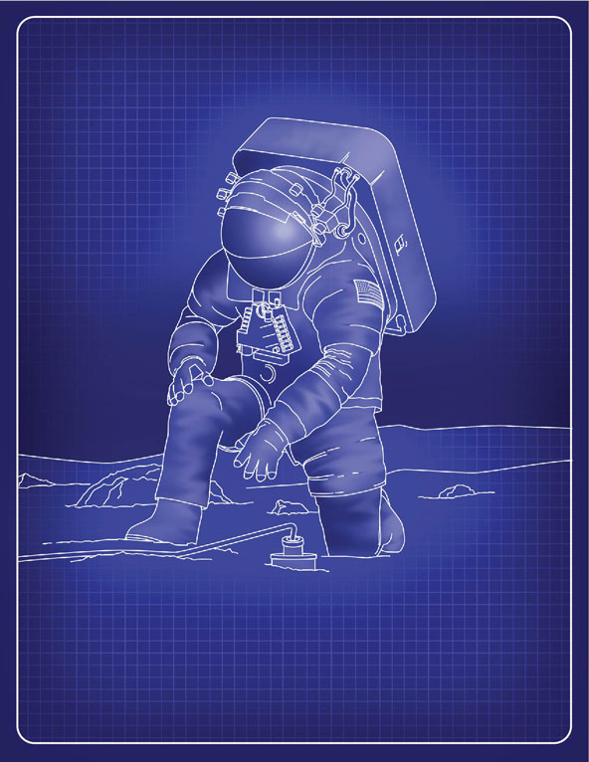
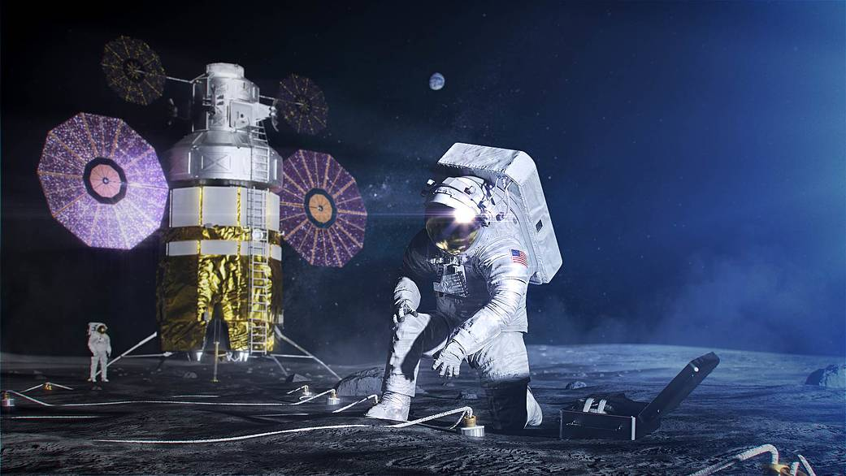
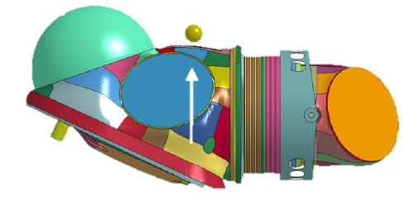
Motivation
Designing the Exploration Extravehicular Mobility Unit (xEMU) spacesuit
Traditional approach of considering worst-case type loading and applying conservative factors of safety for certification was likely to be infeasible
Instead: introduce & verify a probabilistic requirement based on the probability of no impact failure (PnIF)
https://www.nasa.gov/specials/artemis/
Impact Damage Simulation
Probability of impact location
Mission-related probabilities
Material Uncertainties
Variability in lunar regolith
Probability of fall
Impact velocity uncertainty
Probability of rock size

Slide 3
Case Study Overview
Motivated by the xEMU, a case study was conducted to demonstrate the application of uncertainty quantification (UQ) to estimate spacesuit reliability
  A previous generation of spacesuit (Z-2) was considered for demonstration
Case study demonstrated approaches for overcoming two common challenges in reliability analysis:
  Computational expense associated with using high-fidelity models
  Quantifying uncertainty in model input parameters
Research focus of the project: leveraging & developing multifidelity UQ methods for efficient and accurate reliability estimation

Slide 4
Assessing Design Reliability with UQ
Input Parameters
Structures & Materials
Spacesuit Design
Prob
Prob
Reliability
Param2
Param1
Inputs
Output
Prob
Strength parameters
Max. Stress
Damage Index
...
Failure Threshold
Param3
Computational Model
Load parameters
Probability
Loads
Output
Prob
Prob
Param1
Param2
Prob
Param3
The reliability of a spacesuit design could be straightforwardly assessed with Monte Carlo simulation if:
1) A validated computational model for the spacesuit is available
2) Reliable estimates for uncertainty in all input parameters are available
3) Computation time is not an issue
Notes:
Point out

Slide 5
UQ Workflow for Assessing Design Reliability
Input Parameters
Structures & Materials
Spacesuit Design
Prob
Prob
Prob
Param A
Param B
Param C
Prob
Prob
Reliability
Param2
Param1
Inputs
Output
Prob
Prob
Prob
Prob
Failure Threshold
Param D
Param E
Param F
Strength parameters
Max. Stress
Damage Index
...
Param3
Computational Model
Load parameters
Probability
Loads
Prob
Prob
Prob
Output
Param A
Param B
Param C
Prob
Prob
Param1
Param2
Prob
Prob
Prob
Prob
Param D
Param E
Param F
Param3
Sensitivity Analysis
  Sensitivity analysis identifies the most influential system parameters to properly focus effort/resources in a probabilistic analysis
In this work: sensitivities computed using delta moment-independent measures [1]
[1] Plischke et al. Global sensitivity measures from given data. 2013.

Slide 6
UQ Workflow for Assessing Design Reliability
Input Parameters
Structures & Materials
Spacesuit Design
Model Calibration
Prob
Prob
Param2
Reliability
Param1
Inputs
Output
Prob
Strength parameters
Max. Stress
Damage Index
...
Failure Threshold
Param3
Computational Model
Experimental Data
Load parameters
Probability
Loads
Output
Prob
Prob
Laboratory Testing
Param1
Param2
Prob
Param3
  Model calibration explicitly quantifies model input uncertainties using experimental data (can be used to improve or update initial assumptions)
In this work: calibration performed using Bayesian inference and Markov Chain Monte Carlo sampling [2]
[2] Kennedy & O’Hagan. Bayesian calibration of computer models. 2001.

Slide 7
UQ Workflow for Assessing Design Reliability
Input Parameters
Structures & Materials
Spacesuit Design
Prob
Prob
Reliability
Param2
Param1
Inputs
Output
Prob
Strength parameters
Max. Stress
Damage Index
...
Failure Threshold
Param3
Computational Model
Load parameters
Probability
Loads
Output
Prob
Prob
Param1
Param2
Prob
Param3
Uncertainty Propagation
  Uncertainty propagation produces probabilistic predictions of quantities of interest (QoIs) and determines system reliability given quantified model input uncertainties
In this work: reliability estimated using multifidelity importance sampling [3]
[3] Peherstorfer et al. Multifidelity importance sampling. 2015.

Slide 8
Multifidelity UQ Methods
Surrogate Modeling
Multifidelity Methods
Replace expensive high-fidelity model with fast low-fidelity model for more efficient (but biased) UQ
Combine high-fidelity and low-fidelity model predictions for accurate & efficient UQ
Inputs
Physics Simulation
Outputs
Data
Inputs
Machine Learning
Outputs
Data
Inputs
Machine Learning
Physics Simulation
Outputs
Multifidelity methods vs. other advanced UQ methods
Relatively straightforward extension of a commonly used approach (surrogate modeling)
Generally perform well for high dimensional problems
Lend themselves to a hierarchical UQ analysis:
  Surrogate model based-analysis
  Multifidelity analysis
  High-fidelity analysis
Increasing rigor & analysis time

Slide 9
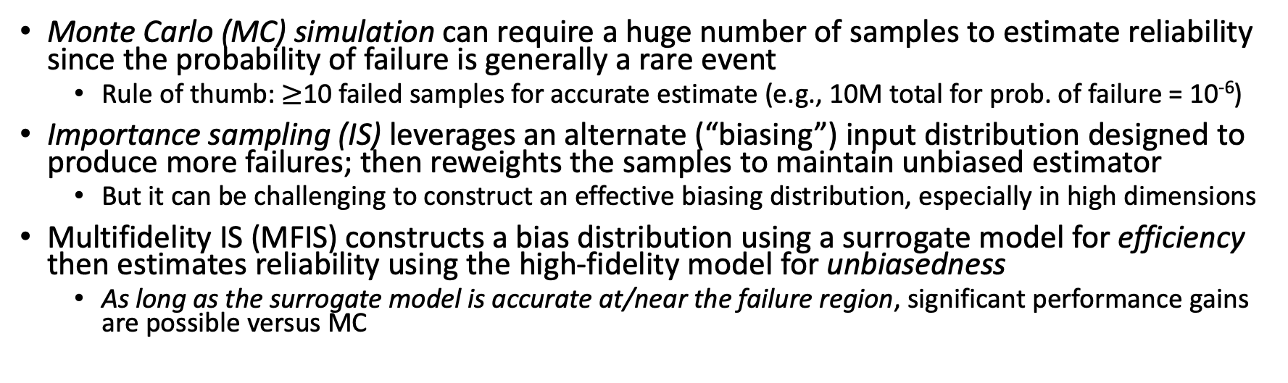
Multifidelity Importance Sampling (MFIS)
Biasing distribution
Failure Threshold
Probability
Reliability
Strength
Computational Model
Probability
Probability
Output
Load
Monte Carlo (MC) simulation can require a huge number of samples to estimate reliability since the probability of failure is generally a rare event
  Rule of thumb: $≥$10 failed samples for accurate estimate (e.g., 10M total for prob. of failure = 10⁻⁶)
Importance sampling (IS) leverages an alternate (“biasing”) input distribution designed to produce more failures; then reweights the samples to maintain unbiased estimator
  But it can be challenging to construct an effective biasing distribution, especially in high dimensions
Multifidelity IS (MFIS) constructs a bias distribution using a surrogate model for efficiency then estimates reliability using the high-fidelity model for unbiasedness
  As long as the surrogate model is accurate at/near the failure region, significant performance gains are possible versus MC

Slide 10
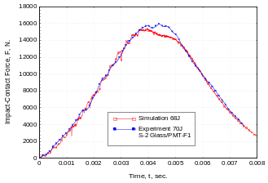
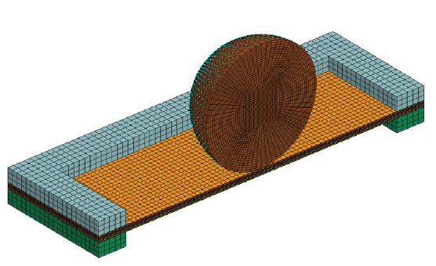
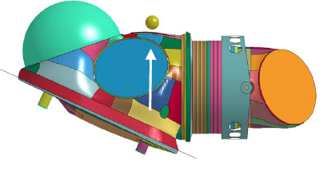
Case Study: Z2 Spacesuit Reliability
Given: existing test data & models for the Z2 spacesuit:
LVI Test Data
Dyna Coupon Model
Dyna Assembly model
Goal: estimate the probability of no impact failure (PnIF) in the Z2 suit due to impact
  Sensitivity analysis to identify the most/least important material model parameters
  Model calibration to quantify uncertainty in the material model parameters
  Uncertainty propagation to predict PnIF
Assumptions/simplifications:
  Impact load uncertainty is the result of specified variability in impact velocity only
  Failure criteria based on max contact force in lieu of a TBD leak rate formula for xEMU
  Parameter uncertainty only considered for one of two composite laminate materials; other parameters fixed at nominal values
Notes:
*coupon model – 2 hours on 4 CPU cores
*assembly model - 16 hours on 10 CPU cores

Slide 11
Step 0: Computational Efficiency
Useful models are often expensive
  Coupon model: 2 hr on 4 CPU cores; Assembly model: 16 hr on 10 CPU cores
  Training a surrogate model still requires a lot of computational resources
Developed SimTools for easy, parallel execution of finite element simulations
  Interfaces with common FEA codes (Abaqus, LS-Dyna, Marc)
  Automated job submission/monitoring using NASA’s Portable Batch System (PBS)
Parallel execution of models
Input Distributions or bounds
Inputs
CPU
CPU
CPU
AM1 | … | VEL
12.4 | … | 1.0
14.3 | … | 1.4
… | … | …
13.1 | … | 1.1
CPU
Prob
Inputs and Outputs
Param1
x | y | x | k | d | e | 3
1 | 2 | 3 | 5 | 2 | 5 | 3
3 | 3 | 3 | 2 | 2 | 2 | 3
3 | 2 | 2 | 2 | 2 | 2 | 2
0 | 9 | 8 | 6 | 5 | 4 | 3
CPU
CPU
CPU
CPU
Prob
…
Param3
Prob
CPU
CPU
CPU
CPU
Impact Velocity
Example: Needed full suit simulations for 200 different inputs; Ran 15 simulations at a time on 10 processors each
  Performed 1+ years of serial computation time in around 1 week of wall time, minimal user effort
Notes:
Point out

Slide 12
Step 1: Sensitivity Analysis
Input Parameters
Material Parameters
Z2
Design
Prob
Prob
Prob
Param A
Param B
Param C
Prob
Prob
Param2
Param1
Inputs
Output
Reliability/PnIF
Prob
Prob
Prob
Prob
Assembly Model
Failure Threshold
Param D
Param E
Param F
Material Model
Max. Force
Leak Rate
...
Param3
Probability
Load Parameters
Impact Load
Loads Analysis
Suit fall probability
Suit impact mapping
Impact analysis
Output
Prob
Prob
Param1
Param2
Prob
Param3
  Goal: Identify most/least important material model parameters to identify a subset that can be fixed at nominal values for the remaining UQ process
Notes:
Point out

Slide 13
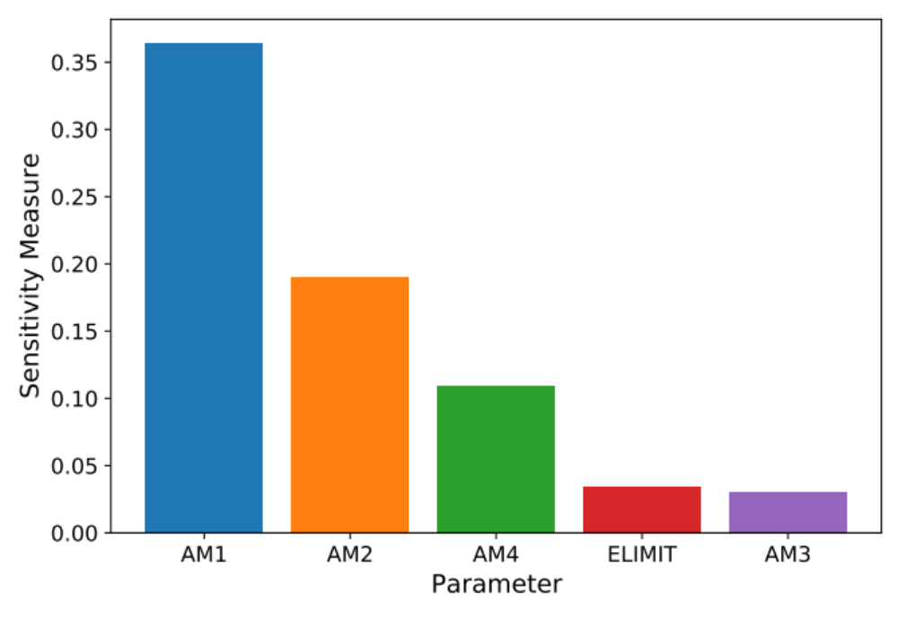
Sensitivity Analysis
Global Sensitivity Analysis was used to rank the material parameters based on how much effect each has on the predicted force vs time using the FEM coupon model
Material Model Parameters¹
AM1-AM4: Strain softening coefficients for different damage modes
ELIMIT: Element eroding axial strain
Selected Parameters
Note: Additional parameters OMGMX & EEXPN fixed at nominal values provided by SMEs
1. MAT162 User Manual Version 17A-2017.

Slide 14
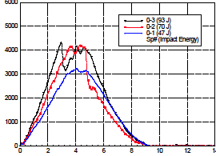
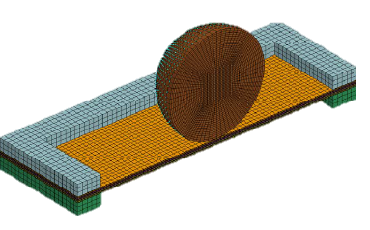
Step 2: Material Parameter Calibration
Impact Test Data
Input Parameters
Material Parameters
Z2
Design
Model Calibration
Coupon Model
Prob
Prob
Param2
Param1
Inputs
Output
Reliability/PnIF
Prob
Assembly Model
Max. Force
Leak Rate
...
Failure Threshold
Material Model
Param3
Probability
Load Parameters
Impact Load
Loads Analysis
Suit fall probability
Suit impact mapping
Impact analysis
Output
Prob
Prob
Param1
Param2
Prob
Param3
  Goal: Estimate uncertainty in material parameters based on given impact test data using Bayesian inference and Markov chain MC sampling
Notes:
Point out

Slide 15
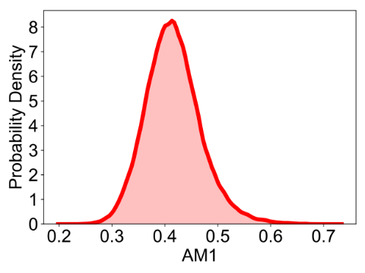
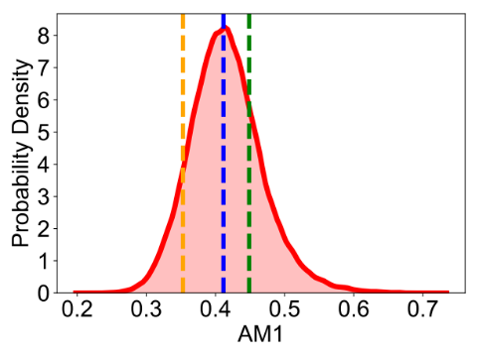
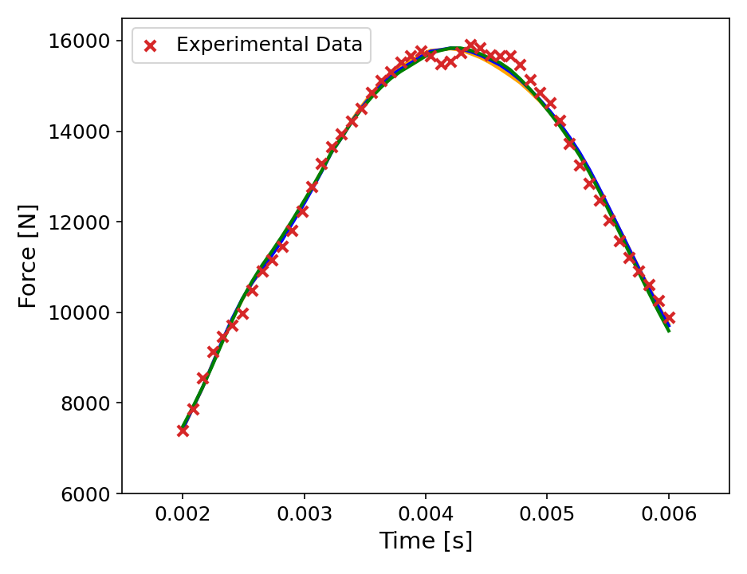
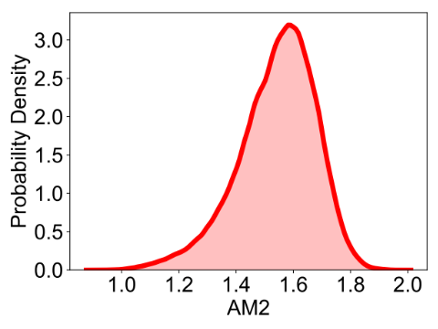
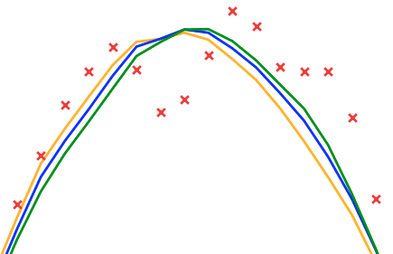
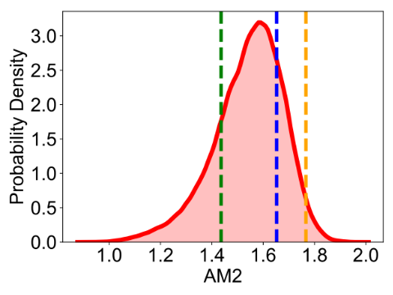
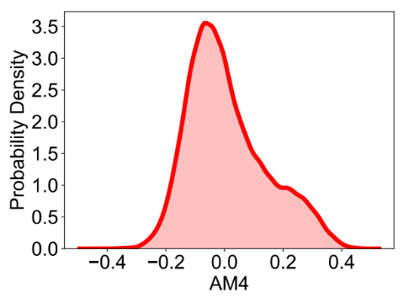
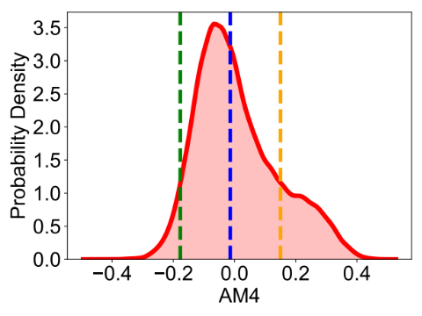
Material Calibration Results
Calibrated Material Uncertainty
3 Random Samples
Coupon Surrogate Model
Different material parameter values result in comparable agreement with experimental data; probabilistic model calibration considers a range of plausible values
Notes:
“assumed” is a best guess without data; adding on estimated error with Gaussian

Slide 16
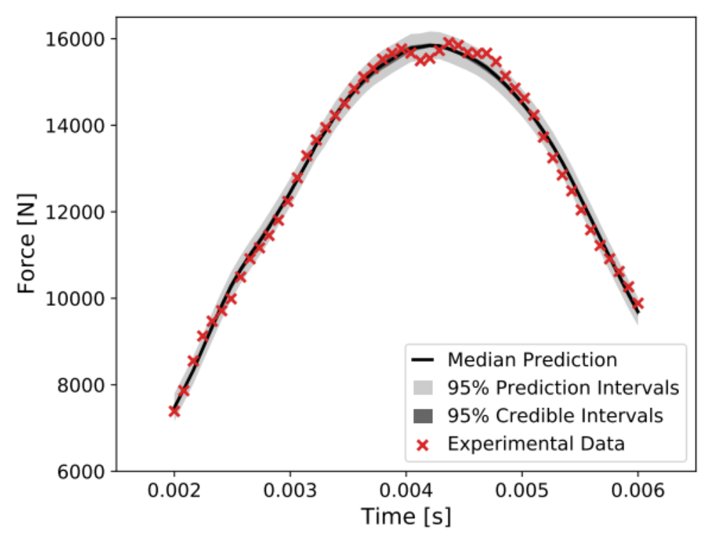
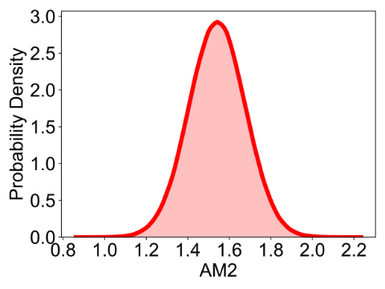
Material Calibration Results
Calibrated Material Uncertainty
Propagating material uncertainty with MC simulation
Coupon Surrogate Model
Credible intervals contain 95% of simulations
Prediction intervals contain a future data point with 95% probability
Notes:
“assumed” is a best guess without data; adding on estimated error with Gaussian

Slide 17
Step 3: Uncertainty Propagation
Impact Test Data
Input Parameters
Material Parameters
Z2 Design
Model Calibration
Coupon Model
Prob
Prob
Param2
Param1
Inputs
Output
Reliability/PnIF
Prob
Material Model
Assembly Model
Max. Force
Leak Rate
...
Failure Threshold
Param3
Probability
Load Parameters
Impact Load
Loads Analysis
Suit fall probability
Suit impact mapping
Impact analysis
Output
Prob
Prob
Param1
Param2
Prob
Uncertainty Propagation
Param3
  Goal: Estimate the probability of no impact failure in the Z2 spacesuit under materials/load uncertainties using MFIS
Notes:
Point out

Slide 18
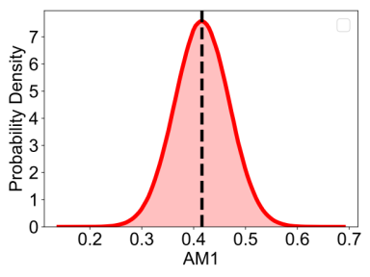
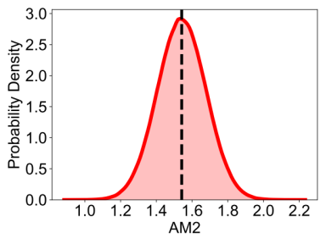
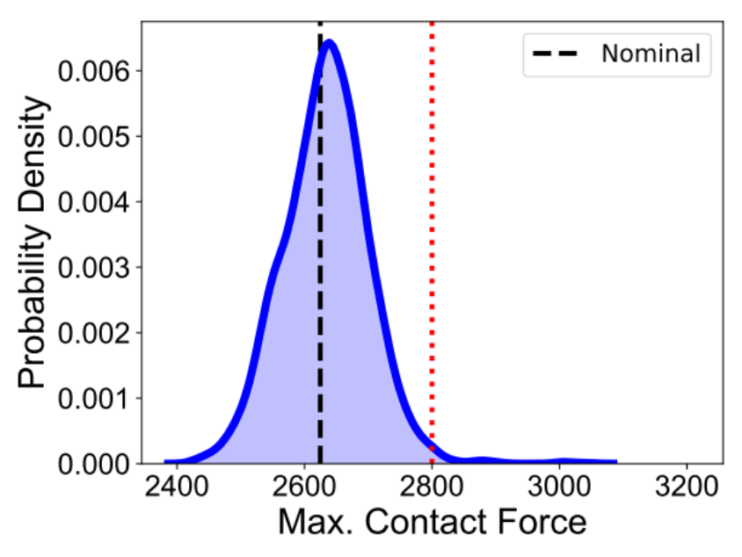
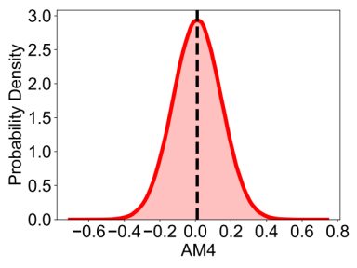
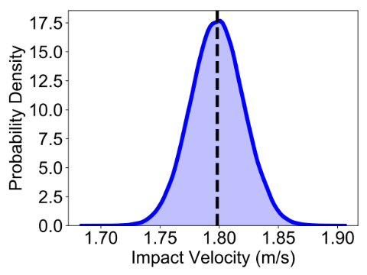
Uncertainty Propagation Results
Estimating Z2 reliability using high-fidelity MC simulation
Input Distributions
Material Parameters
Output Distribution
Nominal
Nominal
Z2 Suit Model
Failure Threshold
Nominal
Load Parameters
Reliability Estimate
 | High-fidelity MC
Reliability (PnIF) | 0.9932
# FEM evals | 2500
Nominal
 | High-fidelity MC | Multifidelity IS | Low-fidelity MC
Reliability (PnIF) | 0.9915 | 0.9930 | 0.9852
# FEM evals | 2500 | 450 | 200

Slide 19
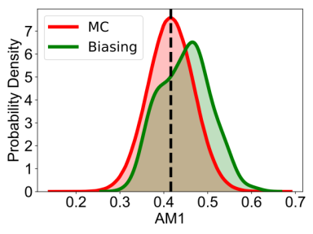
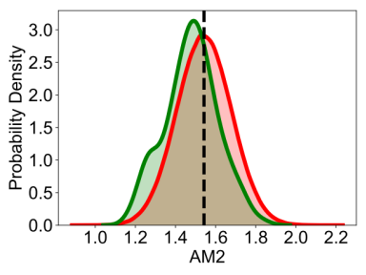
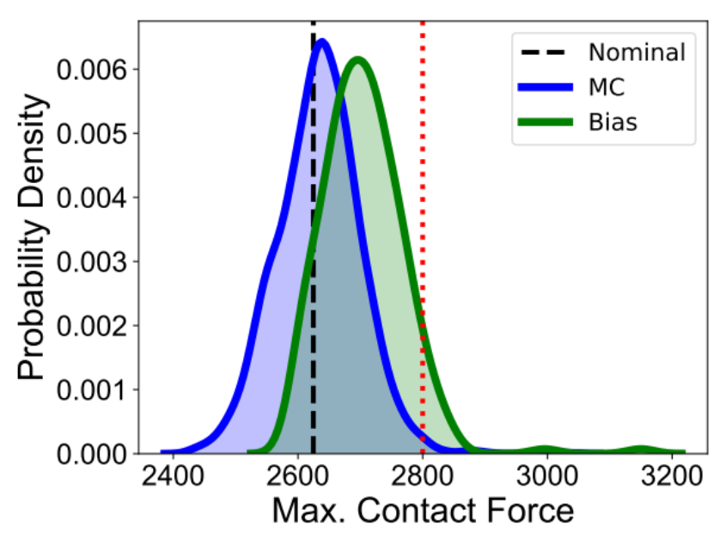
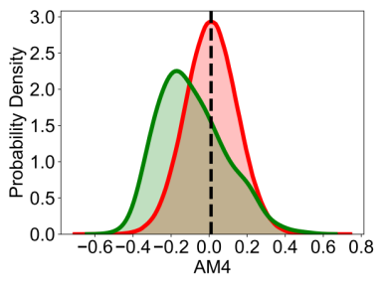
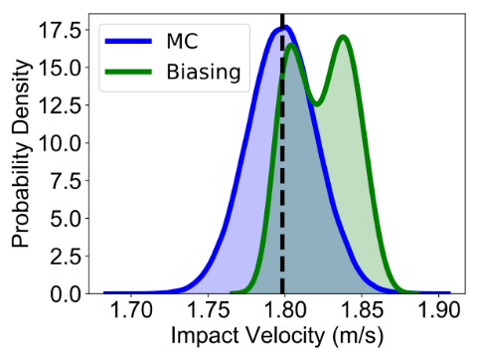
Uncertainty Propagation Results
Estimating Z2 reliability using MFIS
Input Distributions
Biasing failure rate: 6.4%; MC failure rate: 0.68%
Material Parameters
Output Distribution
Nominal
Nominal
Z2 Suit Model
Failure Threshold
Failure Threshold
Nominal
Load Parameters
Reliability Estimates
 | High-fidelity MC | MFIS | Low-fidelity MC
Reliability (PnIF) | 0.9932 | 0.9930 | 0.9852
# FEM evals | 2500 | 450 | 200
Nominal

Slide 20
Summary
Demonstrated UQ workflow for assessing reliability of Z-2 spacesuit:
  1) Sensitivity analysis, 2) model calibration, 3) uncertainty propagation
  Overcame computational burden using high performance computing (with the help of SimTools), surrogate modeling, and multifidelity methods
  Showed that ignoring materials/loads uncertainties can overestimate reliability
MFIS was demonstrated to be an efficient alternative to MC simulation for estimating reliability
  A biasing distribution constructed using a surrogate model resulted in a 9.5X higher failure rate
  Motivated research on surrogate models designed for superior accuracy near failure region (focus of next presentation)

Slide 21
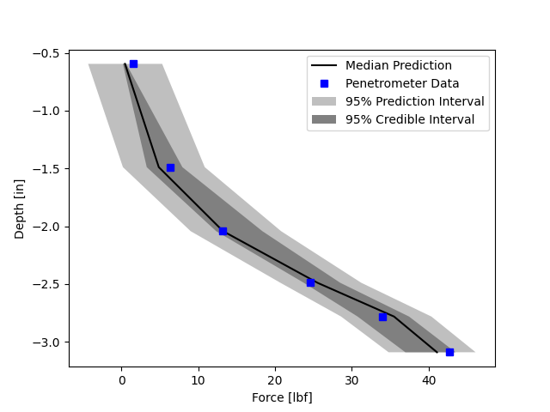
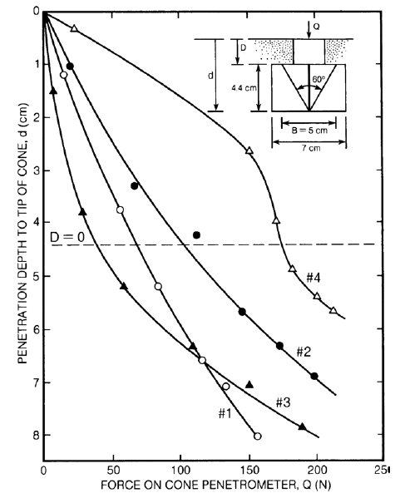
Future Work – xEMU Certification
The capabilities developed and lesson learned under the presented case study are currently being applied under the xEMU certification effort
E.g., soil model calibration for simulating impact on lunar regolith
Most Influential Soil Model Parameters
Sensitivity Analysis
Calibrated soil model vs data
Apollo mission lunar data
LS-Dyna Penetrometer Model
Model Calibration
Calibrated Soil Model
Penetrometer Measurement Data

Slide 22
Questions
References:
  [1] Plischke et al. Global sensitivity measures from given data. 2013.
  [2] Kennedy & O’Hagan. Bayesian calibration of computer models. 2001.
  [3] Peherstorfer et al. Multifidelity importance sampling. 2015.
  [4] Warner et al. Assessing next-gen spacesuit reliability: A probabilistic analysis case study. In review.
Email: james.e.warner@nasa.gov

