Slide 1
Efficient Manufacturing Process Development Summary Report
Brief Summary of Completion / Accomplishment:
Automated Fiber Placement (AFP) Defects Process Model: Developed and delivered a physics-based model to predict pre-preg tack and simulate the AFP process at the roller contact point. Model includes quantified tack force as a function of process parameters, ply geometry exported from path simulation software, and quantified resin pressure. Model was demonstrated to predict trends observed for relationship between process parameters, part geometry, and out-of-plane defects the formed.
Process Models Validation & DFM Software Complete: DFM software suite (e.g., HyperSizer, Central Optimizer, CAPP Module, Vericut Composite Programming, and process models) were evaluated. Team Members completed the functional checkout of the DFM tools using company-specific composite panel designs and provided feedback to DFM and process model developers. Each software package was updated based on Member feedback.
Design for Manufacturing (DFM) Software Validated: the DFM central optimizer and the Computere Aided Process Planner (CAPP) module were updated based on team member evaluations. Updated software includes: Optimization with AFP fiber directions and laps/gaps; automated re-sizing the laminates to resolve negative margins caused by the presence of AFP features by applying “sizing knockdowns” generated from importing and analyzing AFP data.
Beginning TRL 1, Final TRL 6

Slide 2
Efficient Manufacturing Process Development Publications
Author(s) | Title | Where presented
Sayata Ghose, Kevin Malik, Brice Johnson | Slit Tape Buckling and AFP Defect Prediction | SAMPE 2018
Victoria E. Hutton, Alireza Forghani, Paulo Silva, Curtis Hickmott, Thammaia Sreekantamurthy, Christopher J. Wohl, Brian W. Grimsley, Brian Coxon, Anoush Poursartip | A Validation Study of a Physics-based Tack Model for an Automated Fiber Placement Process Simulation | SAMPE 2019
Tyler B Hudson, Nicolas Auwaijan, and Fuh-Gwo Yuan | Guided wave-based system for real-time cure monitoring of composites using piezoelectric discs and phase-shifted fiber Bragg gratings | Journal of Composite materials, Aug 2018
Kevin Malik, Sayata Ghose, Geoffrey Butler, and Kurtis Willden | Cure Process Defects in Composite Laminates | SAMPE 2019
Curtis Hackmott, Alireza Forghani, Victoria Hutten, Frank L. Palmieri, Brian W. Grimsley, Brian Coxon, Goran Fernlund, Anoush Poursartip | A Numerical and Experimental Approach for Modeling Porosity Due to Entrapped Air and Volatiles Off-gassing During Manufacturing of Composite Structures | SAMPE 2019
Daniel Zebrine, Pavel Šimáček, Mark Anders, Navid Niknafs Kermani, Suresh Advani, and Steven Nutt | Modeling And Simulation of The Co-Cure Of Honeycomb Core Sandwich Structures | SAMPE 2020
Navid Niknafs, et al. | Porosity Predictions during Co-cure of Honeycomb Core Prepreg Sandwich Structures | Composites Part A: Applied Science and Manufacturing Volume 132, May 2020, 105824
Jeron Moore, Andre Colvin, Sayata Ghose, Brice Johnson | Design for Manufacturing: Laminate Focused Design and Analysis Tools for Automated Composites Manufacturing | SAMPE 2019
August Noevere, Craig Collier, Ramy Harik | Integrated Design and Manufacturing Analysis for Automated Fiber Placement Structures | SAMPE 2019
Joshua A. Halbritter, Ramy Harik, Clint Saidy, August Noevere, Brian W. Grimsley | Automation of AFP Process Planning Functions: Importance and Ranking | SAMPE 2019
August T. Noevere, Craig S. Collier | Design for Manufacturing Tool for Automated Fiber Placement Structures - Verification and Validation | SciTech 2020

Slide 3
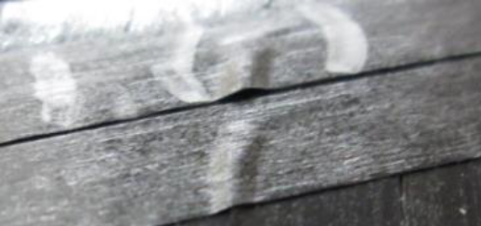
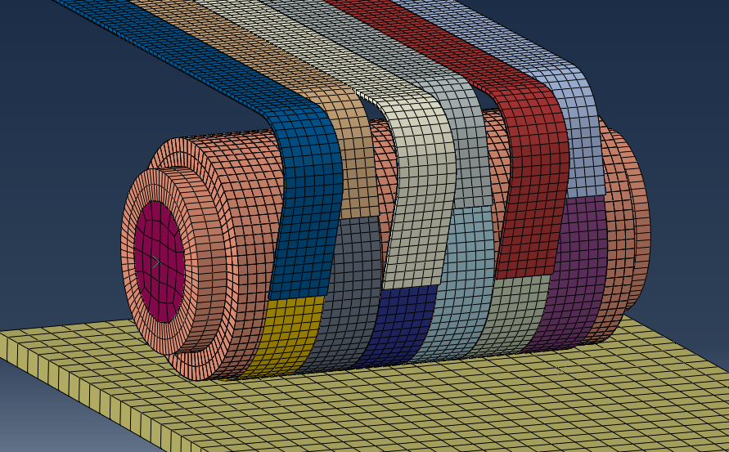
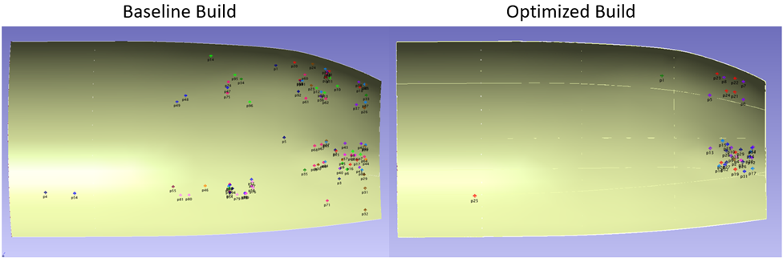
Composites: Efficient Manufacturing Process Development
Problem
Composite parts are susceptible to manufacturing defects that are a function of processing parameters. Manufacturing process development for high quality parts is trial and error, resulting in a long product development time.
Objective
Develop and demonstrate new computational methods to relate manufacturing parameters to defect formation and connect to commercial design and analysis software to allow structural optimization while resolving predicted manufacturing issues.
Results
Developed a COMPRO model to predict puckers and wrinkles during automated fiber placement and demonstrated to predicts trends observed in manufacturing experiments.
Developed LAMINATE cure model to predict porosity and fiber waviness; demonstrated 80% accuracy to 3% porosity, while out-of-plane waviness results are qualitatively consistent with experiments, but not quantified
Enhanced commercial VERICUT software, adding automation of steps, laminate manager, and defect stackup, which enabled auto distribution of defects
Models integrated; Design for Manufacturing (DFM) software demo
Significance
Reduced manufacturing development time with fewer iterations and quality issues; Reduced likelihood of rework
Out-of-plane AFP Defects (puckers)
Model of AFP Roller, Tow, and Tool
Demonstrated
DFM tools in fuselage build: reduced observed defects by 65%
Baseline Build
Optimized Build

