Slide 1
Developing Autonomous Medical Capabilities for Exploration Spaceflight
Dr. Kris Lehnhardt and Dr. Ben Easter
Element and Deputy Element Scientist
Exploration Medical Capability
NASA Human Research Program
April 2021
“Expanding the Boundaries of Space Medicine and Technology”

Slide 2
Outline
Exploration challenges
Define autonomy
Sliders
Bandwidth
Yule study – the challenge of comm delay is real.
Lab analysis – Hemacue and rHealth, Raman spectroscopy, Urinary calcium measurement
Imaging – Stellarray, Butterfly
SBIRs on autonomous capabilities – e.g. Jayant
CDS
AMOS – procedure guidance
IVGEN and IV placement
(Detect, decide, do)

Slide 3
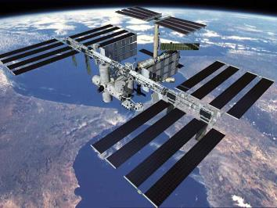
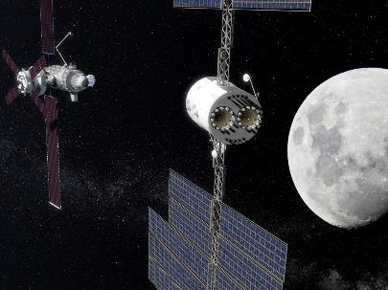
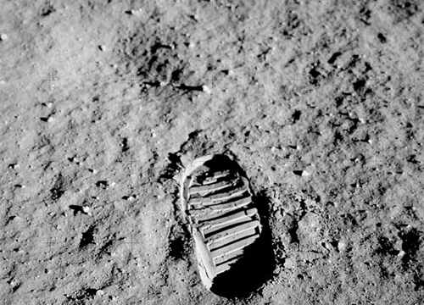
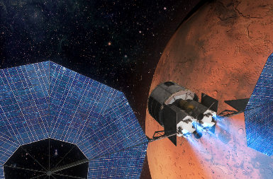
Today, Tomorrow, and the Future
ISS
Gateway
Boots on the Moon
Mars Transit
Increasing exposure to Hazards
Current State
180–360 day mission duration with strong consumables resupply
Real-time communications = decision making centered at MCC
Regular sample return to Earth allows detailed analysis if unknown problems develop
In the event of an emergency, crew to be stabilized and evacuated (generally <1 day to terrestrial care)
Limited on-board medical knowledge/skills/abilities (Earth reliant)
Exploration Class Missions
650 to > 900 day mission duration with Zero Consumables Resupply
No Real-time communications = crew must autonomously address emergencies; MCC serves in more of a supporting role
Primary enabler for autonomy is access to information – no sample return requires on-board analytical capabilities
Limited mass, power, volume, and data will require crew health systems to be integrated with the vehicle.
No Evacuation = crew must have sufficient supplies plus knowledge/skills/abilities to fully manage medical/health issues independently

Slide 4
Risk Drivers for Medical System Needs
Mission Duration
&
Hazard Exposure
Resupply &
Evacuation
Capability
On-Board
Decision Making
(comm delay)
On-Board
Capabilities
Shorter
Possible
Minimal
Less
Influencers
Mission duration and high-level objectives
Distance from Earth
Acceptable mission risk
Time to definitive medical care
Health and performance needs
Level of training for on-board medical provider(s)
Technology developments and medical advances
Crew selection and pre-flight health status
Longer
Impossible
Substantial
More

Slide 5
What does “autonomy” mean for medical capabilities?
As the need for on-board decision making and on-board medical capabilities increases for exploration missions, autonomy means progressive Earth independence
New paradigm when compared with medical operations in low Earth orbit
Examples of autonomous medical capabilities
In-situ analysis (versus sample collection and return to Earth for analysis)
Enhanced medical procedure in-mission support
Advanced computing tools to support on-board clinical decision-making
Efficient and novel uses of on-board resources to minimize re-supply needs

Slide 6
In-situ analysis
Laboratory and Pharmaceutical

Slide 7
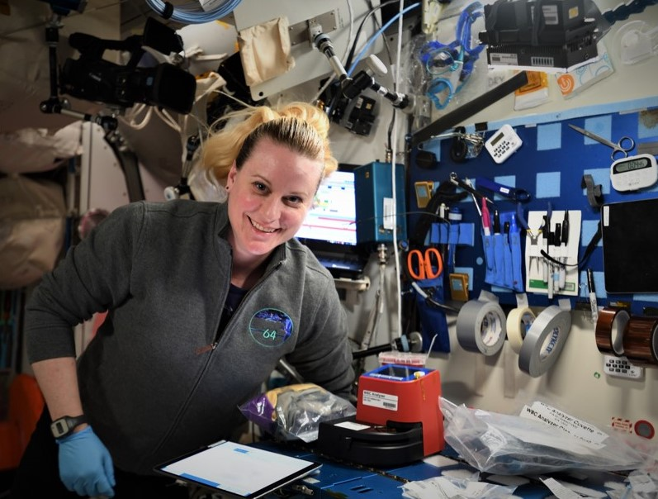
HemoCue® Technology Demonstration
ISS on-board testing is currently in-process
Doctors on Earth commonly use a white blood cell count to aid in their diagnosis of sick or injured patients
This technology has the ability to rapidly provide total and differentiated white blood cell counts in the spaceflight environment with Earth lab-accurate results
Uses include diagnosing illness and monitor conditions such as a bacterial/viral infection or radiation exposure, track the response to treatment, and assess the severity of an illness in-mission
Successful integration of an on-board medical capability for blood analysis could provide an important tool for meeting the medical diagnostic needs of exploration missions beyond low Earth orbit.

Slide 8
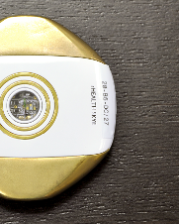
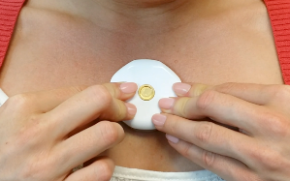
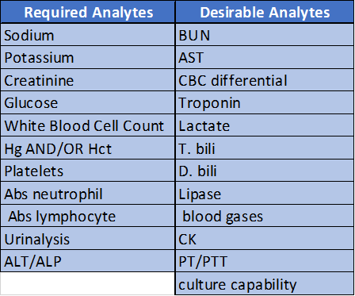
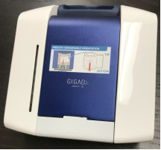
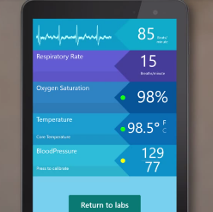
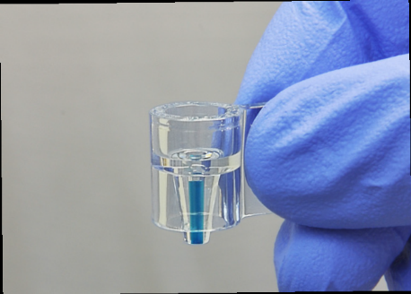
rHEALTH ONE® - ISS Technology Demonstration in development
Integrated blood analyzer and vital signs sensor
Cytometry measures blood cells, light level measures hemoglobin and nano-strips measure other analyte concentrations

Slide 9
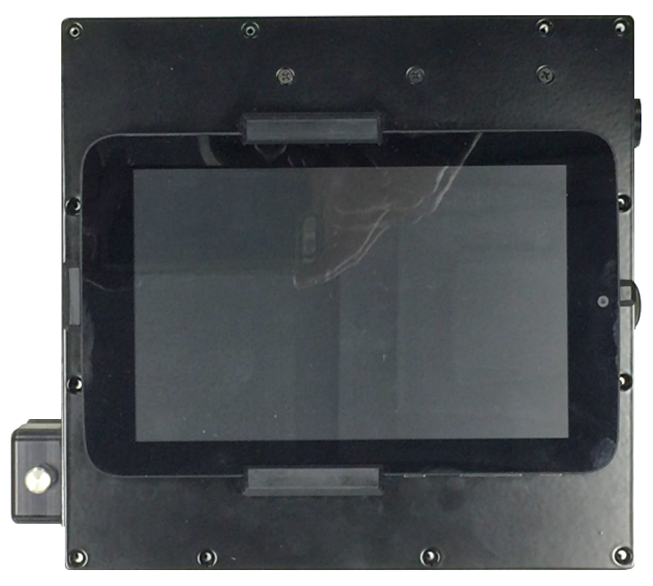
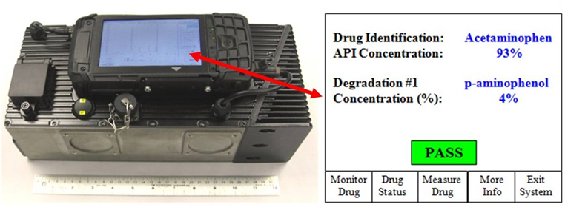
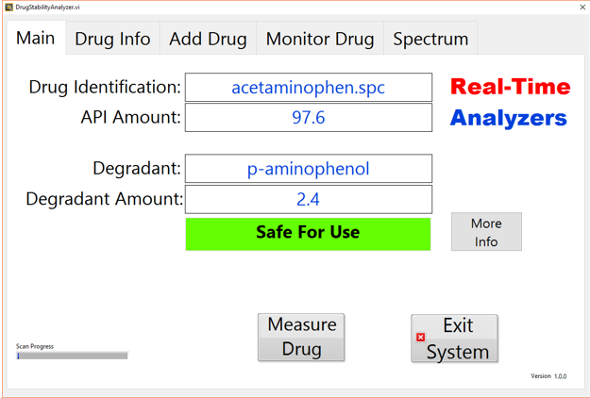
Real-Time Medication Stability Assessment
Potential future technology demonstration could include Raman spectrometer & automated indexing mechanism to align pharmaceuticals for analysis
Capability could be integrated into future exploration medical systems to increase confidence in medication effectiveness after long-duration exposure to the spaceflight environment

Slide 10
Medical procedure support

Slide 11
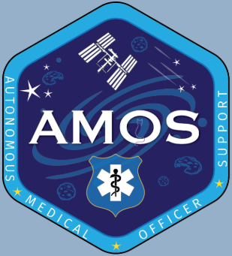
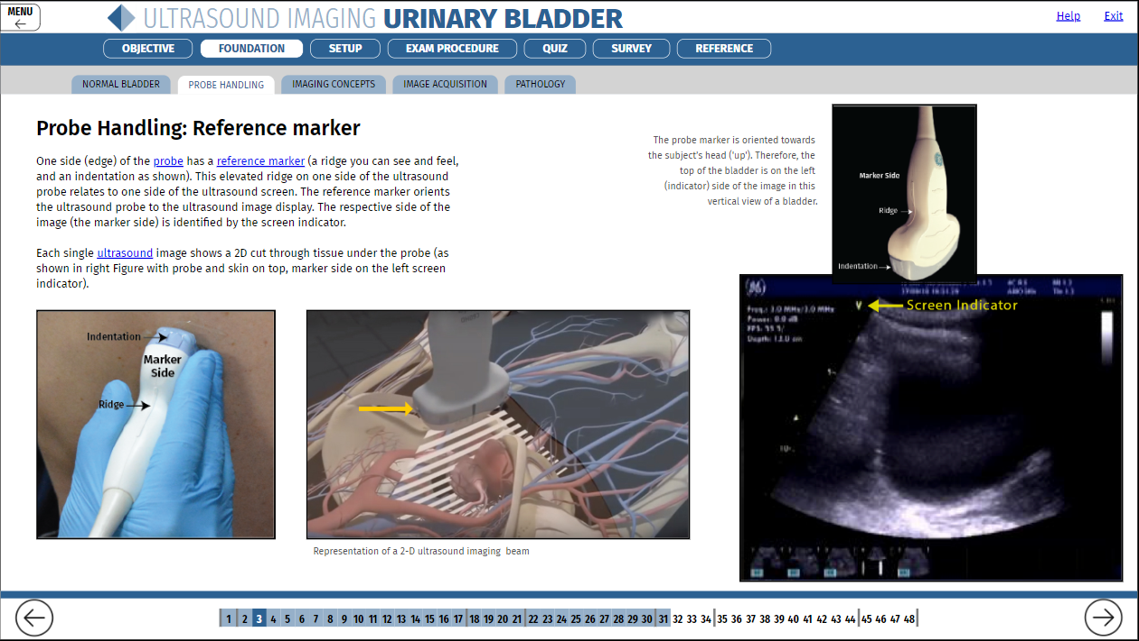
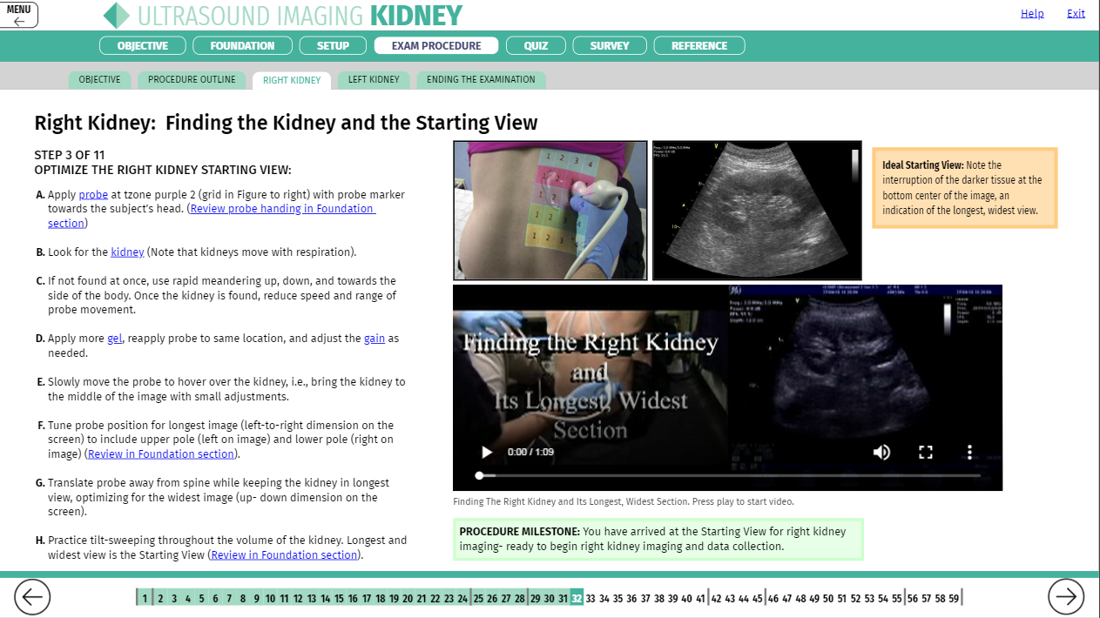
Autonomous Medical Officer Support (AMOS) Software
Description:
Software tool that can fulfill three functions:
  Prefight training
  Onboard just-in-time (JIT) or refresher training
  Guidance for autonomous medical procedures
Intuitive menu-driven, human-centered, modular design
Current modules include kidney and urinary bladder ultrasound
Platform technology - extensible to other non-medical subject areas
Purposes:
Enhance telemedicine capabilities
Enable autonomous procedure performance
Streamline training and skill retention
ISS technology demonstration completed – Spring 2020

Slide 12
On-board clinical decision-making support

Slide 13
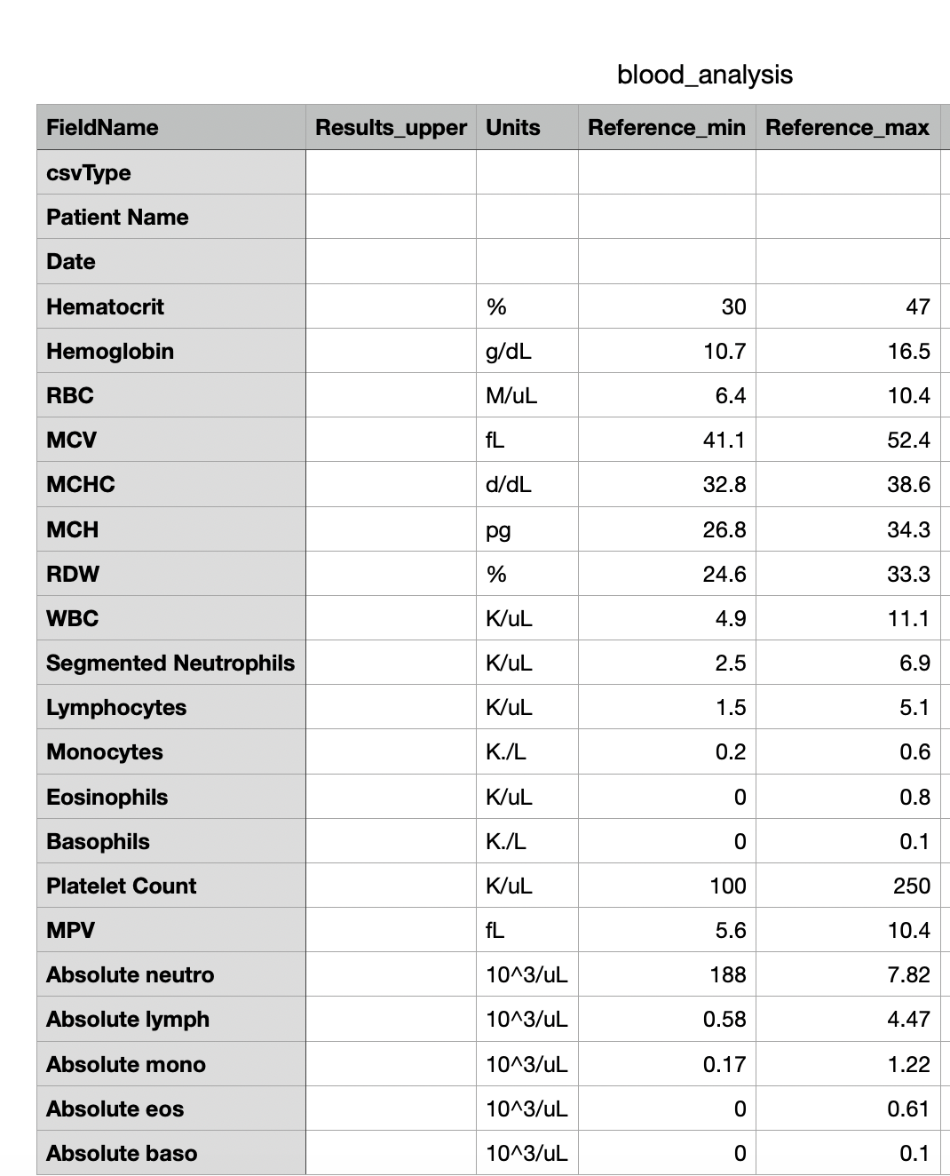
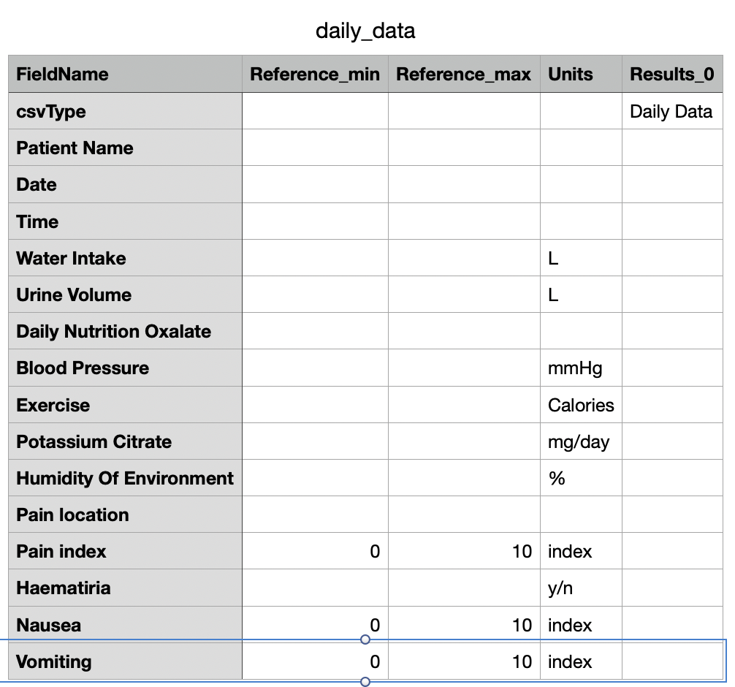
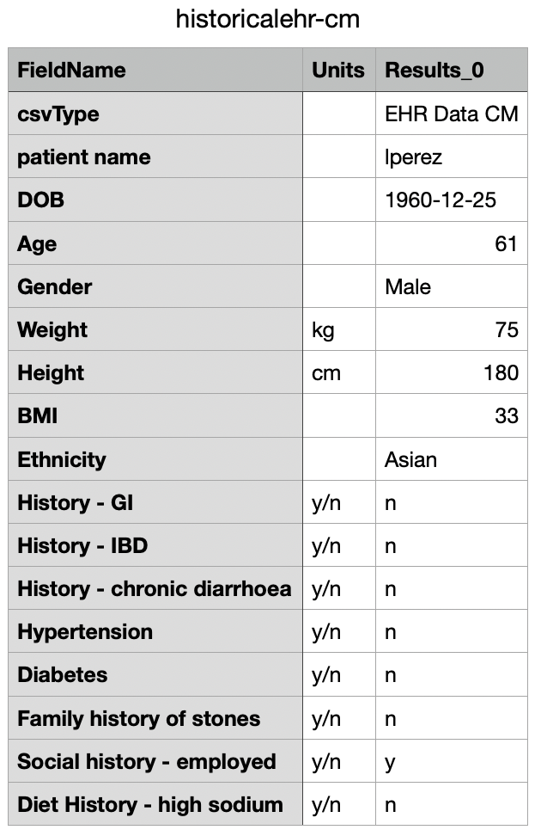

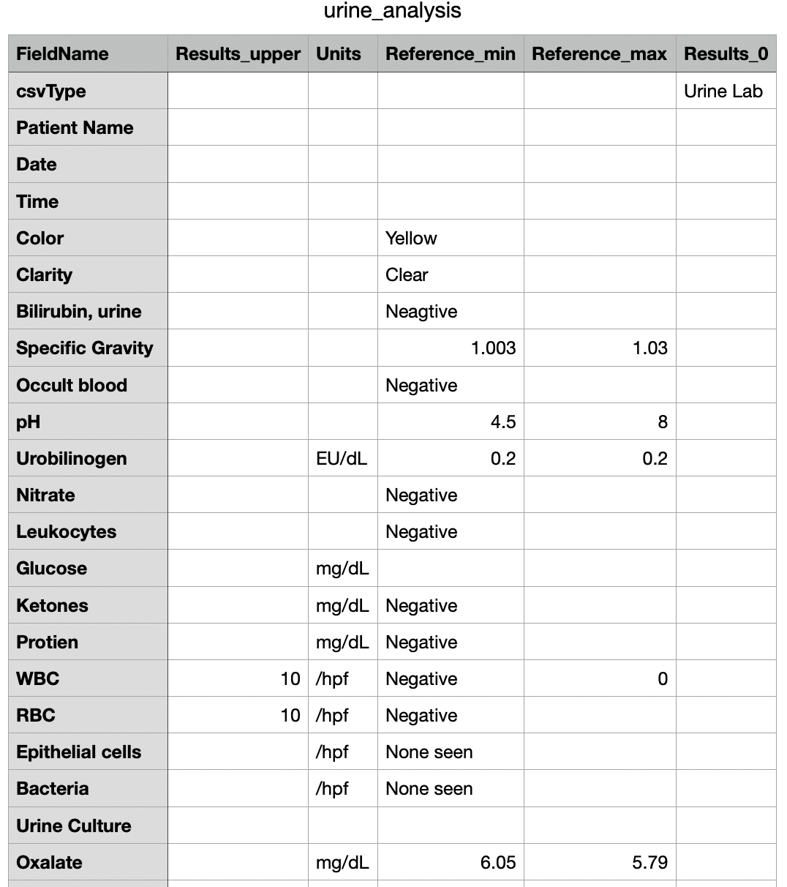

Clinical Decision Support (CDS) Project
  For exploration missions, computational and data resources will play an important role in maintaining crew health, wellness, and performance (where the crew will need to be more self-reliant)
  CDS objectives include:
    Develop potential requirements for an in-vehicle integrated crew health and performance (CHP) data management and clinical decision support system
    Enhance on-board applications of health and performance knowledge and information to enable the crew to make complex clinical decisions that would otherwise be made by Earth-based support personnel
CLINICAL
User Interface
Model
Model
Decision
Model
Data Bus
Data
Architecture
Database
Database
Clinical Decision Support System

Slide 14
Novel uses of on-board resources

Slide 15
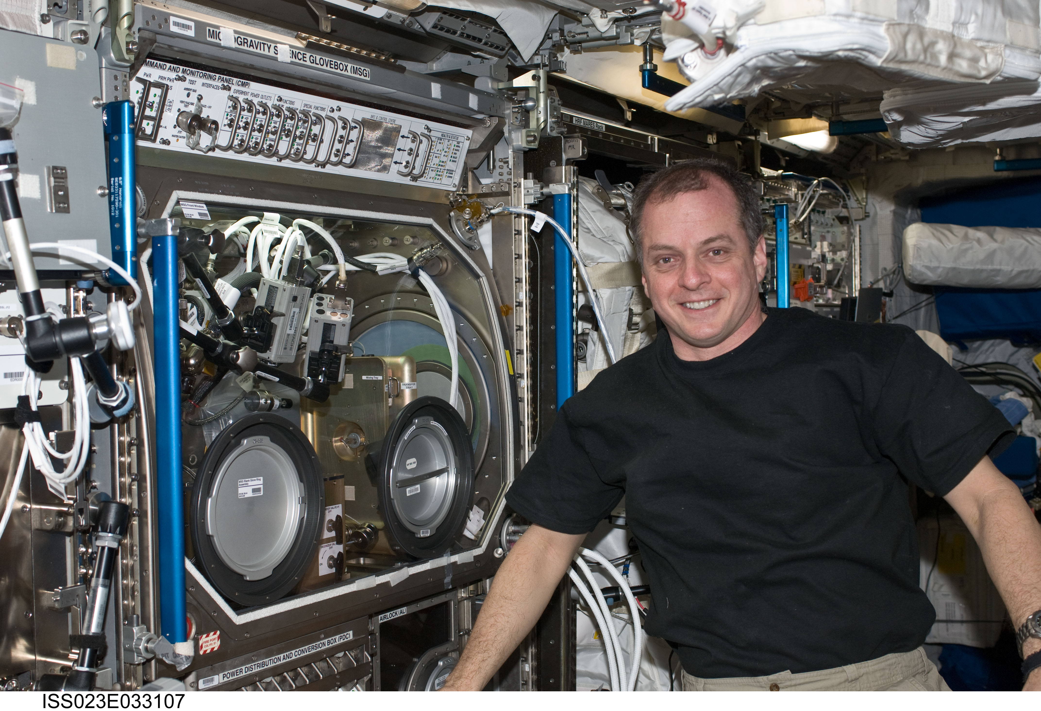
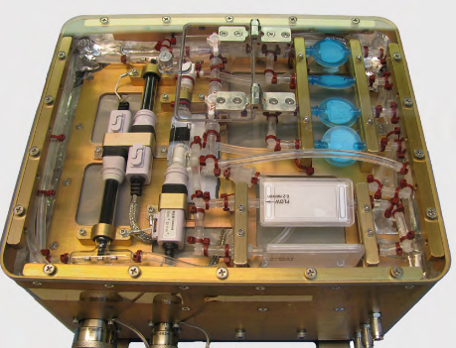
ExMC/GRC Projects ELA Portfolio
Intravenous Fluid Generation (IVGEN)
Developed and delivered a compact water purification system producing sterile water for injection from potable water on-board ISS
Needs:
  Produce sterile water in sufficient quantities as needed for medical operations
  Mass limitations and access to refrigeration limit the type and volume of IV fluids that can be carried aboard a spacecraft
  Solution must require significantly less volume and mass than flying IV fluids from Earth
ISS Tech Demonstration—Expedition 23
  Utilizing in situ potable water, demonstrated:
    Purification and bubble removal
    Sterilization
    Microgravity mixing
    Compliance with medical standards
Work beginning now to:
  Miniaturize capability
  Integrate with life support systems

Slide 16
Summary
The NASA Human Research Program has been working on autonomous medical capabilities for a decade
Many necessary steps in order to gain acceptance and buy-in from all stakeholders:
  Ground development and testing
  Creation of new approaches to medical protocols and procedures
  Deployment into analog environments
  Technology demonstrations on ISS, in lunar orbit, and on the lunar surface
  Transition to operations
Increased effort now to integrate these progressively Earth independent capabilities into future medical and vehicle systems for the Moon and Mars

Slide 17
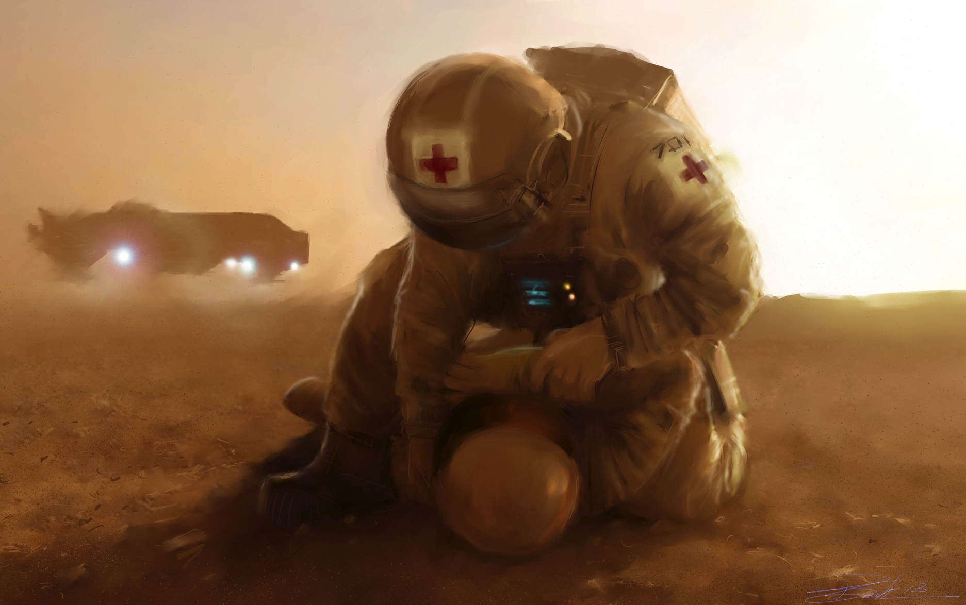
Discussion

