Slide 1
Accurate Strength & Life Prediction Summary Report
Brief Summary of Completion / Accomplishment:
Progressive Damage Subcomponent Validation: Completed test/analysis correlation for four-stringer test articles with initial damage, Teflon inserts or impact damage, subjected to static loading and single-stringer specimens with Teflon inserts subjected to fatigue loading. The analyses predicted well the observed damage modes and sequence of damage events and predicted max loads within 15% of the average experimental failure load for the four-stringer panel with Teflon inserts.
High Energy Dynamic Impact Complex Subcomponent Validation: Post-test simulations of the sub-scale curved configured test article were conducted with LS-DYNA MAT162, MAT261 and Peridynamics and compared with test results. For backside deflection in the mid-bay area, Peridynamics showed the best correlation with test data at -17.5% error of the peak value, meeting the minimum success criterion. MAT162 and MAT261 over-predicted the deflection at 103.5% and 38.3% respectively. For the threshold penetration velocity the MAT261 model provided the most accurate prediction, with an error of less than 4% compared to the test result, meeting the stretch success criterion.
Rapid Design Tools - Optimizer Demo on Component: BVID/CAI and Ply-Drop (UTRC), 2-Bay Crack (Spirit/Boeing), Post-buckling and Bonded Joint (Collier), were validated through exercising the tools and comparing results to test data. Team members (Collier, Aurora, Spirit AeroSystems, Boeing, Northrop Grumman, UTRC, NASA) used the HyperSizer® stress framework with rapid tools integrated to analyze/size global finite element models of company-specific structures. Some members reported qualitative and quantitative benefits using the stress framework regarding design cycle times.
Beginning TRL 2, Final TRL 5-6

Slide 2
Accurate Strength & Life Prediction Publications
Author(s) | Title | Where presented
Dávila, C. G., and Bisagni, C., | Fatigue Life and Damage Tolerance of Postbuckled Composite Stiffened Structures with Indentation Damage | Journal of Composite Materials; p. 931-943; 52; 7, June 2017
Lyle R. Deobald, Gerald E. Mabson, Steve Engelstad, M. Prabhakar Rao, Mark Gurvich, Waruna Seneviratne, Shenal Perera, T. Kevin O’Brien, Gretchen Murri, James Ratcliffe, Carlos Davila, Nelson Carvalho, Ronald Krueger | Guidelines for VCCT-based Interlaminar Fatigue and Progressive Failure Finite Element Analysis | NASA/TM–2017-219663
Steven Wanthal, Joseph Schaefer, Brian Justusson, Imran Hyder, Stephen Engelstad, Cheryl Rose | Verification and Validation Process for Progressive Damage and Failure Analysis Methods in the NASA Advanced Composites Consortium | American Society for Composites (ASC) 2017
C Davila | A Cohesive Fatigue Model based on the S-N Diagram | American Society for Composites (ASC) 2018
Alex S. Selvarathinam, Nelson V. De Carvalho, Banavara R. Seshadri, Vivian Johnson, William M. Johnston, Wade C. Jackson, Cheryl Rose, Thomas K. O'Brien | Validation of Floating Node Method Using Three-Point Bend Doubler Under Quasi-Static Loading | SciTech 2019
Endel V. Iarve, Kevin H. Hoos, Hari K. Adluru, J. Scott McQuien, Yu-Jui Liang | Fatigue Life Prediction of Rotor Spars by Using Discrete Damage Modeling | NASA/CR-2019-220279
Andrew C. Bergan, Frank A. Leone Jr., Stewart Boyd, Imran Hyder, Joseph D. Schaefer | Computational Considerations in Scaling the Application of Progressive Damage Analysis Methods from Coupons to Sub-Components | 34th American Society for Composites Technical Conf, Sept 2019
Frank A. Leone, Kyongchan Song, Cheryl A. Rose, Wade C. Jackson | Progressive Damage Analysis of Post-Buckled Stiffened Panels under Static Compressive Loading | SciTech 2020
A. C. Bergan, S. J. Murphy, and L. F. Miles | Analysis of Open Hole Compression Specimens Using the CompDam Continuum Damage Mechanics Model | NASA/TM-2020-5009618
Eric M. Roberts, Brian P. Justusson, Joseph D. Schaefer, Steven P. Wanthal | Improved Benchmarking of Cohesive Elements in Abaqus Standard for Predicting Disbond and Delamination in Composite Structures | SciTech 2021

Slide 3
Accurate Strength & Life Prediction Publications (cont.)
Author(s) | Title | Where presented
Matthew Molitor, Brian Justusson, Jaffar Iqbal, Alan Byar, Mostafa Rassaian | Verification Benchmarks and Validation of MAT261 for High Energy Dynamic Impact Applications | SciTech 2019
Shyamsunder, L.; Khaled, B.; Rajan, S.D.; Goldberg, R.K.; Carney, K.S.; DuBois, P.; and Blankenhorn, G. | Implementing deformation, damage, and failure in an orthotropic plastic material model | Journal of Composite Materials, DOI:10.1177/0021998319865006, 2019
Akhil Bhasin, Suresh Raju Keshavanarayana, Luis Gomez, Aswini Kona Ravi, Brian P. Justusson, Gerardo Olivares | Progressive Damage and Failure Analysis of Bonded Composite Joints at High Energy Dynamic Impacts | 34th American Society for Composites Technical Conf, Sept 2019
Cuenca, F., Weckner, O., Silling, S. | Building Block Approach For Determination of Ballistic Limit of Composite Panels Using Peridynamics | SciTech 2020
David Manan, Jeongho Kim, Gautam Gopinath, Gulperi Aksel, Peter Finnigan, Larry Foster, Rajiv Naik | Development of LS-DYNA MAT261 Material Parameters for Tri-axially Braided Composite Materials | SciTech 2020
Sorini, C.; Chattopadhyay, A.; and Goldberg, R.K. | An Improved Plastically Dilatant Unified Viscoplastic Constitutive Formulation for Multiscale Analysis of Polymer Matrix Composites Under High Strain Rate Loading | Composites Part B: Vol. 184, 107669, 2020
Patrick Enjuto, Mark Lobo, Tomas H. Walker, Gerardo Pena, Eric Cregger, and Steven Wanthal | Investigation of Stiffening Effects on Notch Growth Trajectory of Composite Stiffened Panels with Large Transverse Notches | SciTech 2019
Craig S. Collier | Unified Analysis of Aerospace Structures Through Implementation of Rapid Tools into a Stress Framework | SciTech 2020
Stephen P. Jones, Bertram Stier, Brett A. Bednarcyk, Evan J. Pineda, Upul R. Palliyaguru | Verification, Validation, and Limits of Applicability of a Rapid Bonded Joint Analysis Tool | SciTech 2020
Luke Borkowski, Rajesh S. Kumar, Upul R. Palliyaguru | Efficient Framework for Coupled Analysis of Impact Damage and Compression-After-Impact Strength of Composite Laminates | Composite Structures / Elsevier, 2020

Slide 4
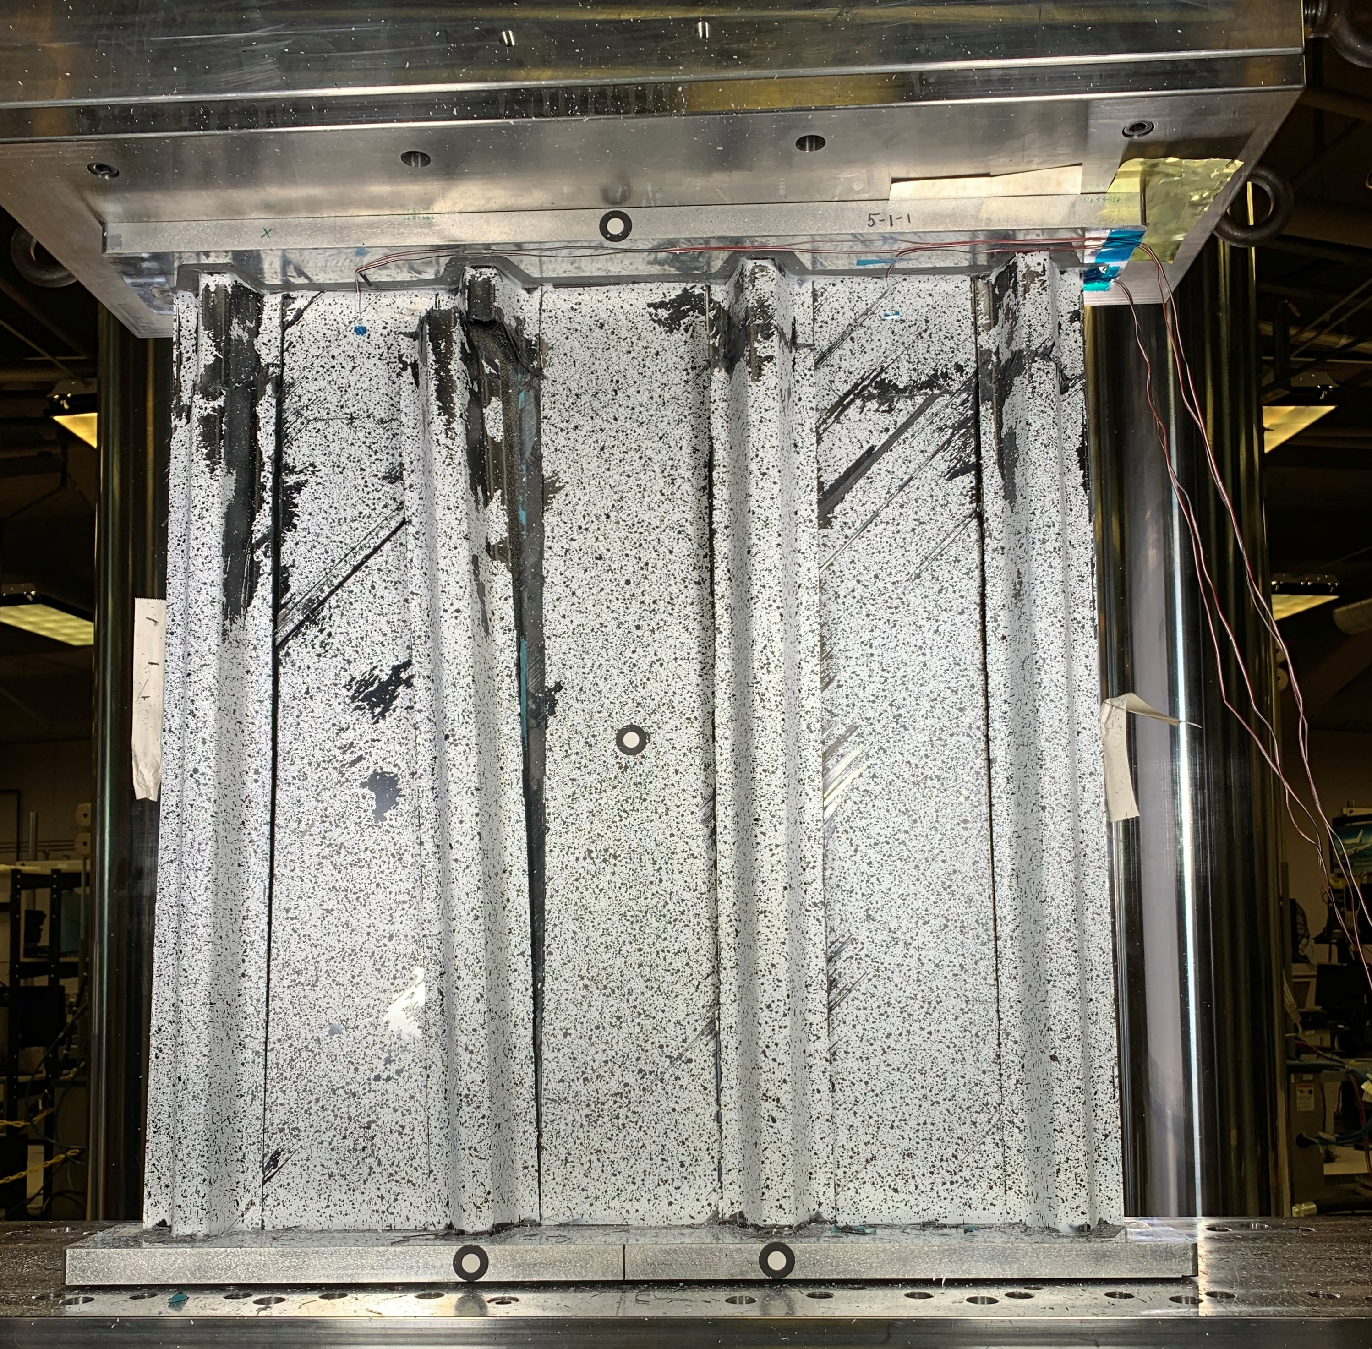
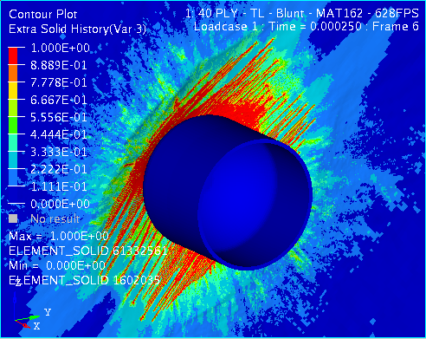
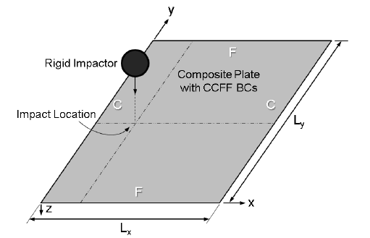
Composites: Accurate Strength & Life Prediction
Problem
Lack of confidence in strength and life prediction tools for composite structures results in extensive (lengthy and costly) test programs.
Objective
Develop validated strength and life prediction tools with known accuracy for complex composite structures and standardized procedures for their reliable use.
Results
Developed high fidelity analysis methods to reliably predict the onset and progression of damage in postbuckled composite stiffened panels with impact damage, predicting strength within 15% of tests.
Developed high energy dynamic impact analysis methods able to predict threshold penetration velocity within 20% of test results.
Developed Rapid Analysis Tools able to predict within 30% the effect of in-service damage, and manufacturing defects on performance.
Demonstrated validated analysis tools with subcomponent tests and transitioned tools, standardized procedures, benchmark cases, and V&V processes.
Significance
Validated analysis tools and standardized procedures transitioned to industry partners can reduce design iterations during development and reduce validation testing.
Predicted peak load within 15% of test
Predicted threshold velocity within 20%
Improved, reliable analysis methods provide confidence needed to reduce testing
Predicted residual strength after impact within 20% of tests

