Slide 1
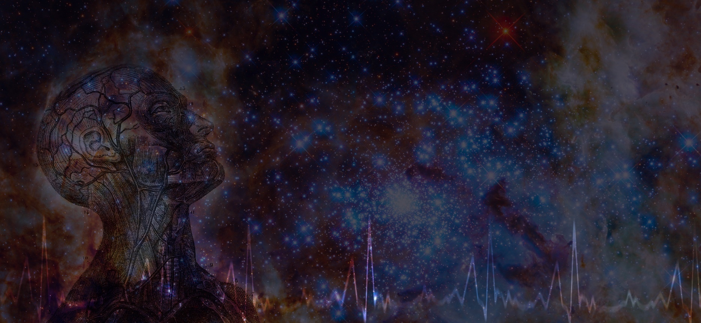
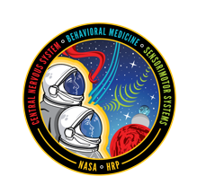

Sleep, Circadian Rhythms, and Workload in Spaceflight
A.P. Mulavara¹, A. M. Whitmire², T. J. Williams², A. Hanson², J. Roy Choudhury¹, and E. Flynn-Evans³
¹ KBR, Houston, TX
² NASA Johnson Space Center, Houston, TX
³ NASA Ames Research Center, Moffet Field, CA

Slide 2
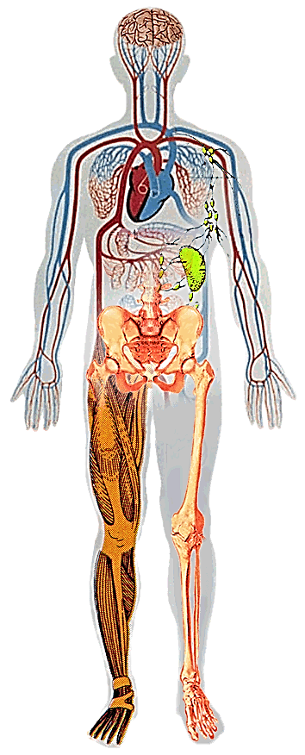
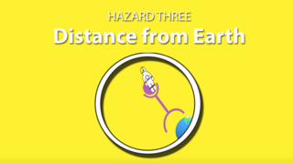
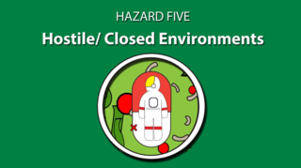
Introduction
  Balance Disorders
  Fluid Shifts
  Cardiovascular Deconditioning
  Muscle Atrophy
  Bone Loss
Drives the need for additional “autonomous” medical care capacity – cannot come home for treatment
Acute In-flight effects
Long-term cancer risk
CNS-Cognitive
Vehicle Design
Acceleration/Vibration/ Noise
Environmental – CO₂ Levels, Toxic Exposures, Water, Food,
  Decreased Immune Function
Behavioral aspect of isolation
Sensory deprivation
Sleep disorders (circadian dysregulation)
Notes:
Risks associated with spaceflight can be categorized or grouped according to the occurrences of factors/hazards that contribute to them. Here are five of them including altered G, space radiation, distance from earth, isolation and closed environment.
Considerable amount of research work over the years have shown that each of these spaceflight hazard independently cause deleterious effects on physiological systems both during the mission and some have prolonged effects after the mission has ended over the longer term.
Having identified these traditionally held hazards, From program perspective you are always on the lookout for black swan events that can potentially cause outlier/extreme effects on crew health that in hind sight one would feel that could have been predicted if evaluated systematically.
One such example is the combinatorial effects across multiple hazards of space radiation, Bmed and Altered gravity where each individual hazard has shown deleterious effects and now what do we expect the combination of the three risks spanning on CNS risks due to could end up to be bigger than the three individually.

Slide 3
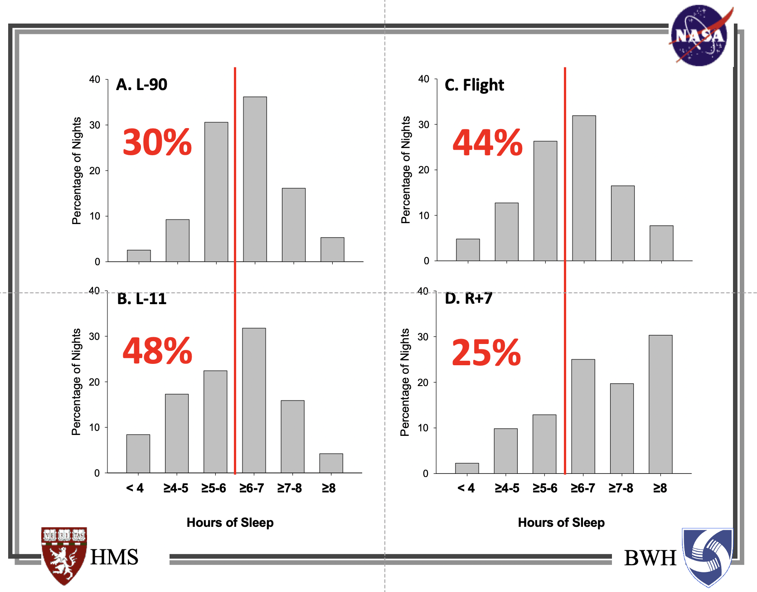
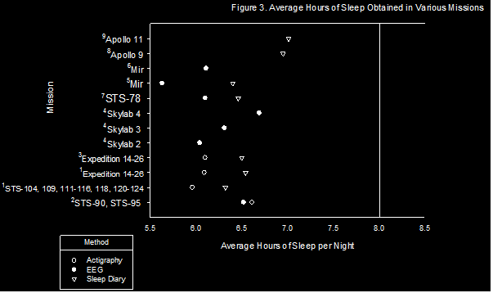
Crewmembers Average Six Hours of Sleep during Spaceflight
Short-duration spaceflight
Long-duration spaceflight: ISS
Real et al. 2016

Slide 4
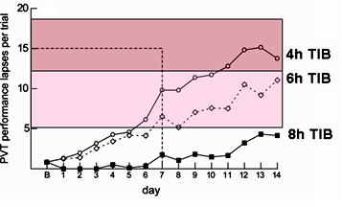
Sleep-Dependent Performance Outcomes
Psychomotor Vigilance Task relative to TIB
    Seven days of sleep similar to quantities experienced by astronauts leads to lapses of attention equivalent to lapses seen after one night of total sleep deprivation
    After 11 nights of reduced sleep (4-6 hours “time in bed”, TIB), lapses of attention correlate with lapses seen after 2 nights of total sleep deprivation (Van Dongen et al., 2003)
2 nights sleep deprivation
1 night sleep deprivation
National Trnsportation Safety Board (NTSB, Rosekind, 2013) estimates fatigue* leads to degradation of 20 – 50%+ in:
Reaction time
Judgment
Communication
Mood
Memory
Attention
Situational awareness
And increases:
Microsleeps - Attentional lapses - Impulsivity
Apathy - Irritability - Under-evaluation of threats
NTSB estimated (2008) that fatigue, even given increased automation, contributes to 20-30% of transport accidents (15-20% in aviation specifically)
* Presence of one or more of risk factors

Slide 5
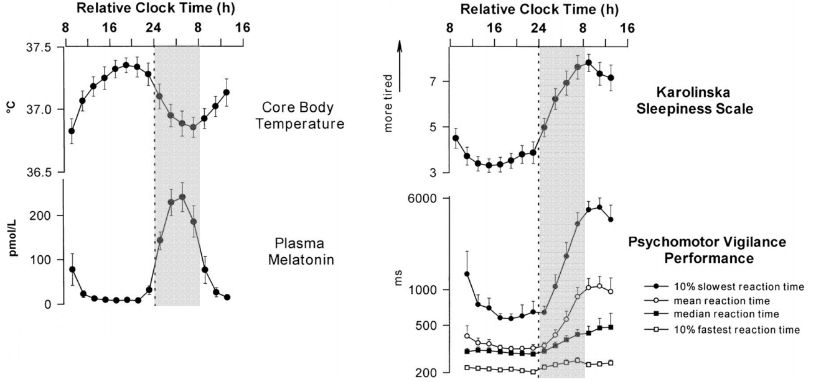
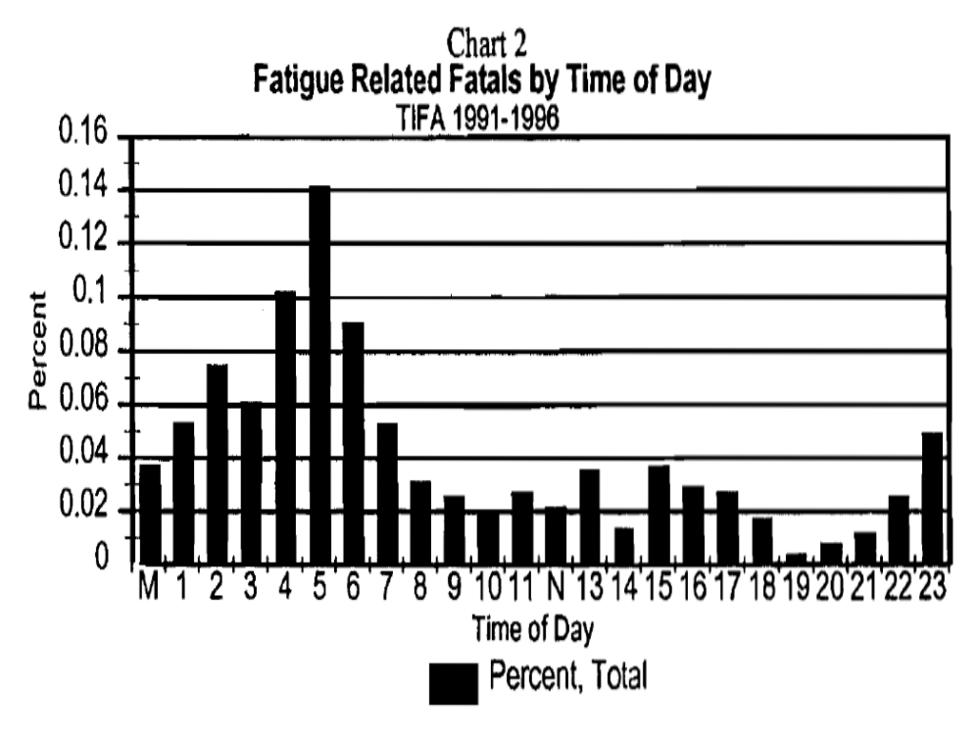
Circadian Desynchronization
The ‘body clock’ or circadian pacemaker controls the timing of most 24-hour behavioral and physiological rhythms including the sleep-wake cycle, alertness and performance rhythms, hormone production, temperature regulation, and metabolism.
Circadian Desynchronization: Loss of simultaneous occurrence between circadian rhythms and the environment
Single vehicle trucking accidents

Slide 6
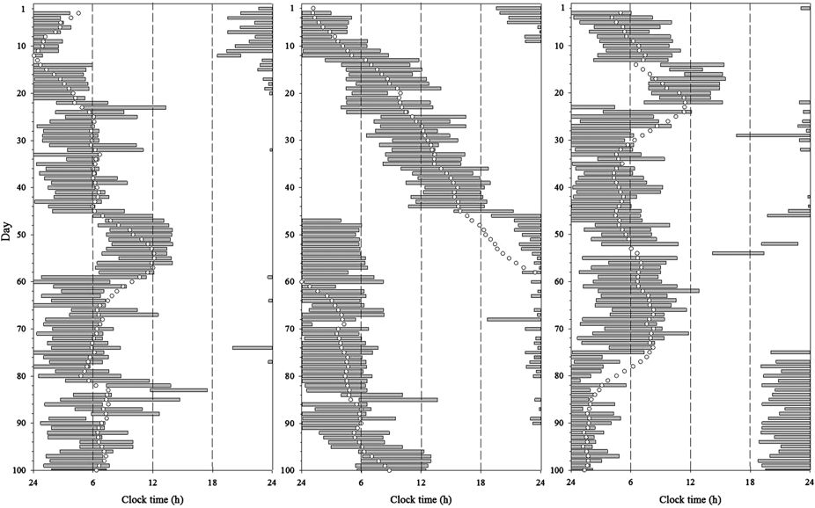
Spaceflight: Circadian Misalignment Associated with Short Sleep and Increased Medication Use
Sleep-Wake Actigraphy During Spaceflight (PIs: Drs. Charles Czeisler, Laura Barger, Erin Flynn-Evans)
Relevance to Spaceflight: Circadian misalignment causes shorter sleep and increased medication use.
20% of nights were misaligned during long-duration flights
Sleep duration was 1 hour longer during circadian aligned vs. misaligned sleep episodes (6.4 +/- 1.2 h vs. 5.4 +/- 1.4 h)
23% of misaligned sleep episodes were during docking
medication use increased during circadian misaligned vs. aligned sleep episodes
  Sleep medications taken = 11% of sleep episodes when aligned, 24% of sleep episodes when misaligned
  All medications taken = 49% of days when circadian aligned, 69% of days when circadian misaligned
Flynn-Evans et al. Nature Micro 2014
Notes:
Inflight data include 1,066 nights on Shuttle (n=78 before EVA) and 3,201 nights on ISS. Terrestrial data collection intervals include 3,109 nights from Shuttle crewmembers and 904 from ISS crewmembers.

Slide 7
Sleep Pressure Markers Associated with Reduced Performance During Spaceflight
Sleep pressure markers during wakefulness were measured in 5 astronauts throughout their 6-month ISS mission using electroencephalographic recordings
Performance on a Soyuz docking simulation was associated with an increase in sleep pressure markers when reaction times were slower
Reaction time on the docking simulation slowed during 2 months in space
Petit et al. (2019)
Notes:
Animation 1: Another study by Bock and Bloomberg (PI: Otmar Bock) reported/ measured ability to perform manual control while being simultaneously tasked – pressing a button press pattern – during and after spaceflight in four subjects.
Animation 2: They reported that astronauts make more errors while the degree of difficulty of the secondary task increased. More importantly, this effect lasted the duration of spaceflight (6 months) and also showed up after landing back on Earth. Investigators pointed to the lack of cognitive reserve or reduced cognitive reserve available to multi task in microgravity.

Slide 8
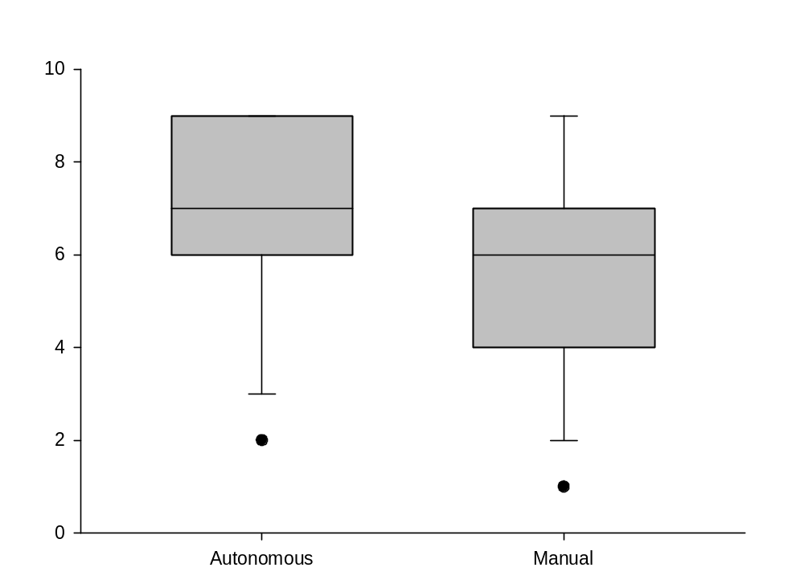
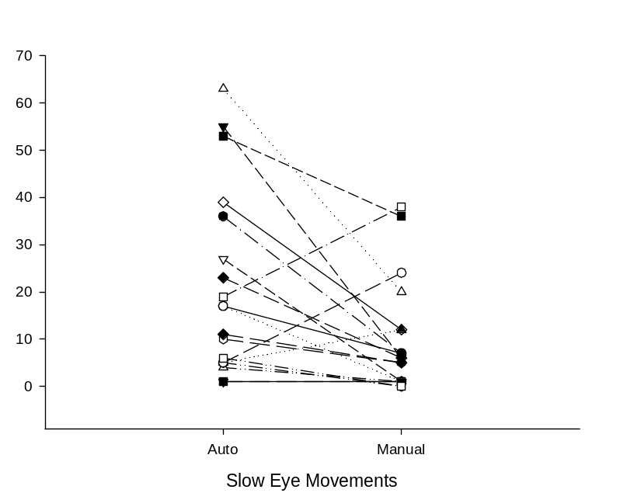
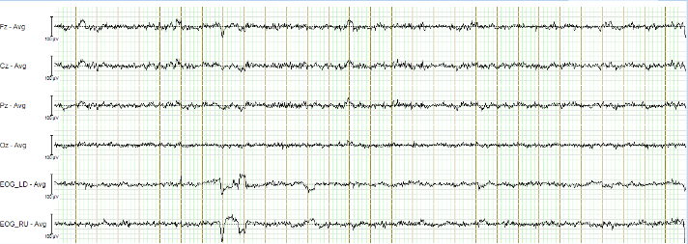
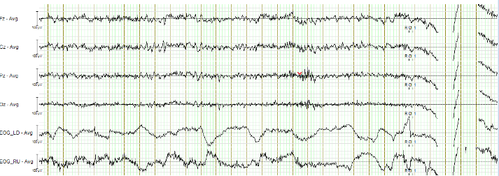
Interaction between Supervision of Autonomous Systems and Sleep Loss
Relevance to Spaceflight: Autonomous systems are unlikely to be a panacea and may yield new challenges for training and response to such systems.
While supervising an autonomous vehicle (relative to manual control):
Individuals rate themselves as sleepier
Individuals have more microsleep and slow eye movement episodes
Sleepy
Alert
Wong et al. in preparation 2019

Slide 9
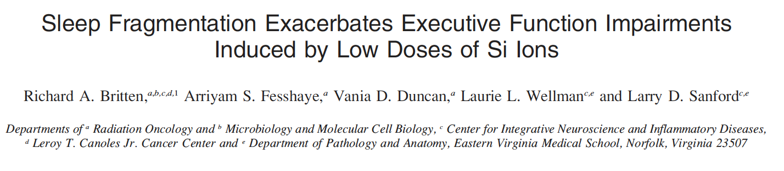
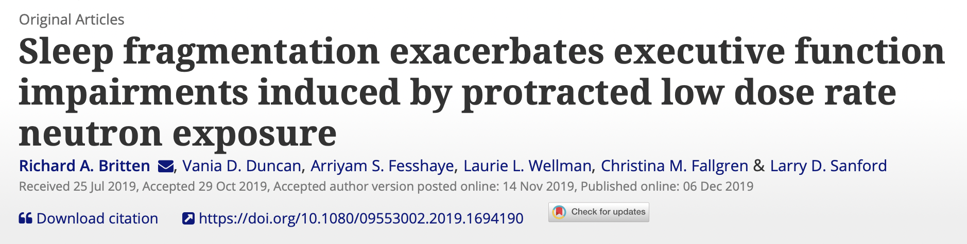
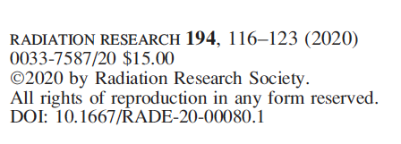

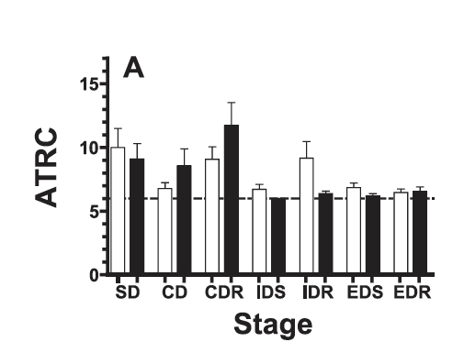
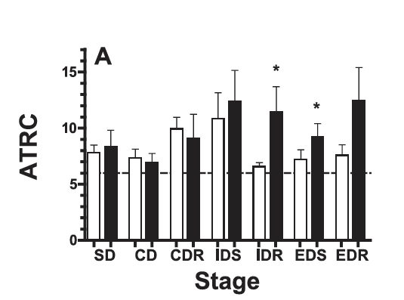
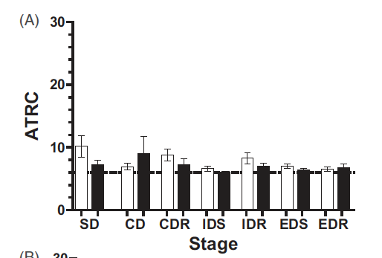
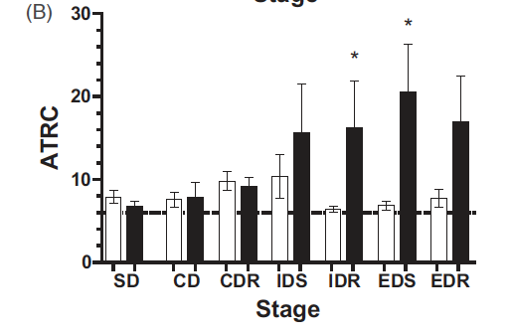
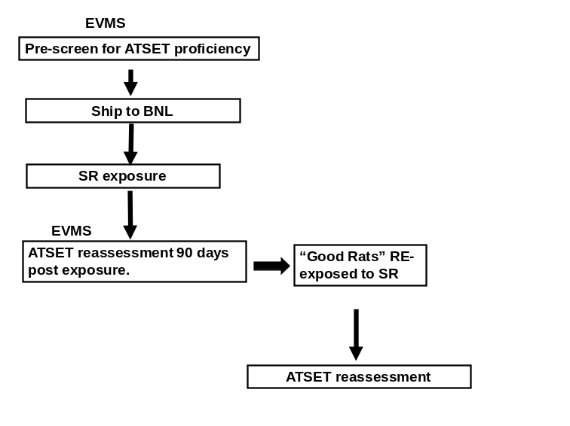
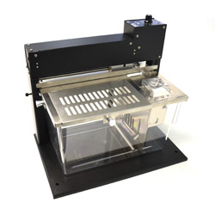
Sleep fragmentation unmasking of latent ATSET deficits following neutron and Si radiation exposures
SD – Simple Discrimination
CD – Compound Discrimination
CDR – Compound Discrimination Reversal
IDS – Intra Dimensional Shift
IDR – Intra Dimension Reversal
EDS – Extra Dimensional Shift
EDR – Extra Dimensional Reversal
ATSET – attentional set-shifting
ATRC – attempts to reach criteria
SR – space radiation
EVMS – Eastern Virginia Medical school
BNL – Brookhaven National Laboratory
Sleep Fragmentation Chamber (Lafayette Instrument Co., Lafayette, IN)
“Good Rats” exposed to sleep fragmentation
Si Radiation:
Whole-body irradiation with 600 MeV/n Si ions at the NASA Space Radiation Laboratory. Sham (n = 14); Si irradiation 5 cGy (n = 11)
Neutron radiation:
Radiation spectrum and dosimetry (Borak et al. 2019). The rats were exposed to neutrons for 15.9–18.3 h/day (accounting for the decay of the source; N.30),
SleepFragmentation:
Rats placed in Sleep Fragmentation chamber, Active/Sleep (Dark/Light), Sweep time 2 mins, Allows dozing but not deep (REM) sleep.

Slide 10
Synergistic Effects?
Null-hypothesis - Risks are non-interacting and do not act disproportionately on different receptors, and risk can be predicted based on response to single hazard
1. Each crewmember has a certain capacity to tolerate all 3 individual stressors
2. Additivity: one risk could be substituted for another (same mechanism of action)
3. Independence: different mechanisms of action, leading to addition of individual responses (i.e., specific-stress response relationships)
4. Challenge:
a. Quantitatively predicting the combined effects of the risks
b. Characterize and categorize stressors according to domain of action
c. Observed combination response and theoretical expectation
Paracelsus: biological effects of toxicant amplified when individual is weakened by additional, unfavorable factors
Liess et al. (2016)

Slide 11


