Slide 1


Future Proofing the Aerospace Supply Chain
Aerospace Supply Chain
Parimal Kopardekar, PhD (PK)
Director, NASA Aeronautics Research Institute (NARI)
Parimal.H.Kopardekar@nasa.gov

Slide 2
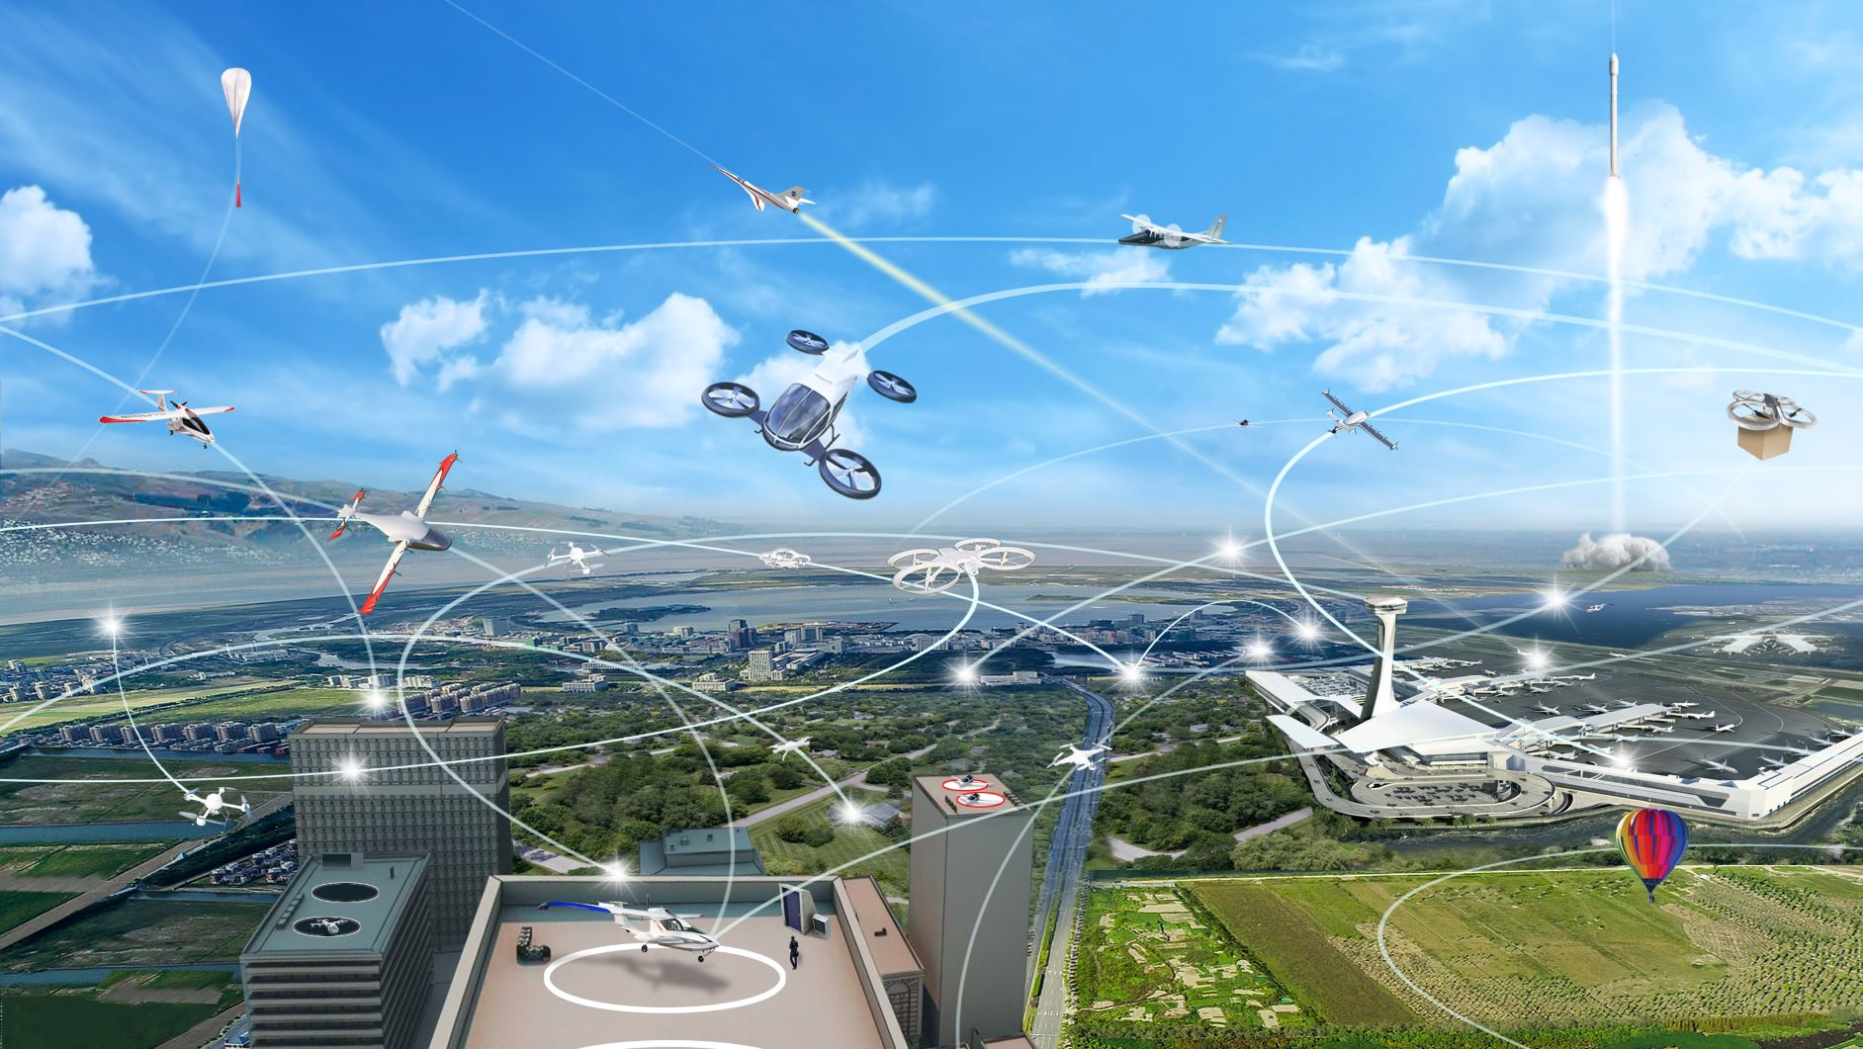
End-to-End
Air Transportation
Increased use of electric propulsion and air vehicles of all sizes are likely to impact future transportation options and society
Currently, transportation is one of the key factors for location of businesses and housing
In future, aviation can get closer to businesses and housing

Slide 3
Needs
Many calls, texts, and interactions about looking for suppliers and manufacturers
Over-molding
Actuators
Electric motors
Propellers
Casting
Many other components and manufacturing needs
Aerospace Needs Sustainable Supplier, Manufacturer, and MRO Network

Slide 4

  Opportunities
  Environmental footprint
  Aircraft development cycle
  Aircraft production rate
  Supply chain resiliency

