Slide 1
Verification and Validation of Elastodynamic Simulation Software for Aerospace Research
Erik Frankforter, William Schneck III, Elizabeth Gregory, Cara Leckey
NASA Langley Research Center, Hampton, VA
Nondestructive Evaluation Sciences Branch (NESB)
DATAWorks Defense and Aerospace Test and Analysis Workshop
April 12, 2021

Slide 2
Outline
Background – Computational nondestructive evaluation at NASA Langley
Verification & Validation (V&V) Needs – Research Simulation Software
Verification Practices – NESB High Performance Computing Software
Validation Approaches - 1D & 3D Elastodynamic Simulation
Conclusions

Slide 3
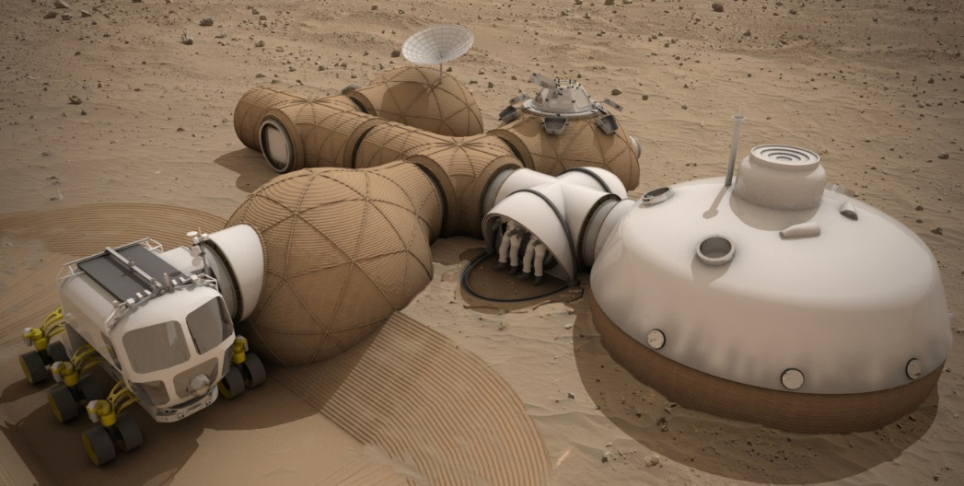


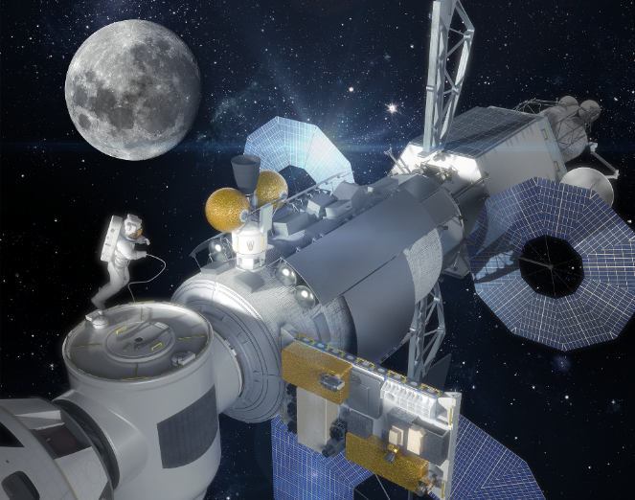
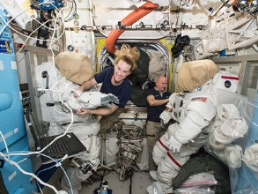
Nondestructive Evaluation (NDE) for Aerospace Applications
Commercial Crew to ISS
Space Launch System (SLS)
Beyond LEO
Asteroid, Mars
Human Habitation of Mars
International Space Station
Human Exploration
Long-Duration Space Habits

Slide 4
Nondestructive Evaluation Sciences Branch (NESB)
NESB
Advanced NDE Solutions
Emerging NDE Technologies
Physics-Based Models
Advanced Data Analysis and Interpretation
SHM Sensor Implementation and Interrogation
Advanced Nondestructive Evaluation (NDE) Solutions
  Development of unique solutions using state-of-the-art NDE technologies such as Eddy Current, Ultrasound, Thermography and X-ray CT
Emerging NDE Technologies
  Development of unique NDE technologies such as Terahertz, wavefield imaging, nonlinear ultrasound, Raman spectroscopy
Physics-Based Modeling
  Development of both computational and analytic models
Advanced Data Analysis and Interpretation
  Development of advanced analytic methods to interpret large complex data sets and machine learning algorithms
SHM Sensor Implementation and Interrogation
  Development of advanced methods of applying and interrogating sensors for structural health monitoring

Slide 5
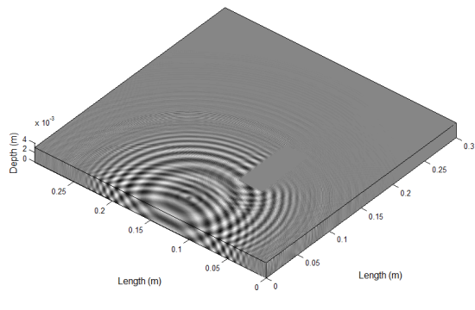
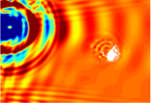
Elastodynamic Simulation for NDE
Elastic wave excitation
e.g. ultrasonic transducer, pulse laser,
piezoelectric wafer
Wave-damage interaction and propagation carrying damage information
Elastic wave detection
e.g. ultrasonic transducer, laser Doppler vibrometer, piezoelectric wafer
Verified & validated simulation can be used to:
  Provide insight into underlying interaction phenomena and energy flow paths
  Extract features and correlate with relevant inspection parameters
  Enable consideration of nondestructive evaluation (NDE) during the design stage
  Develop methodologies for challenging part inspections, or enable inspections of otherwise intractable scenarios

Slide 6
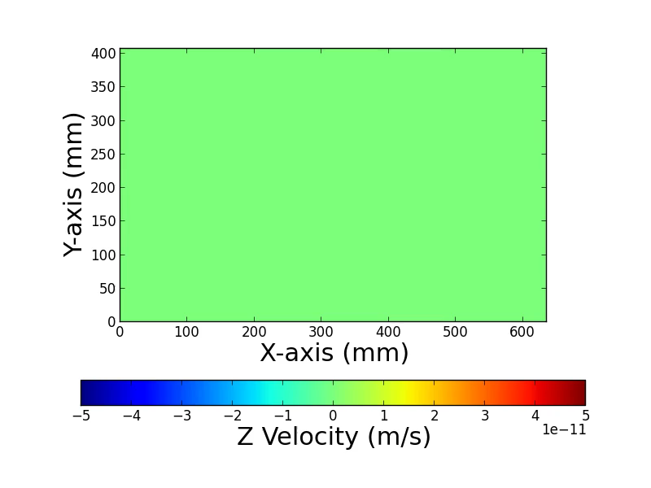
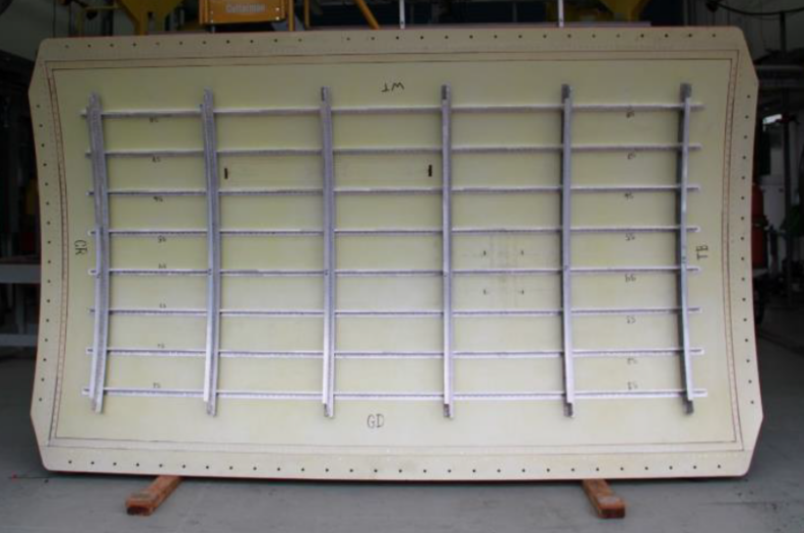
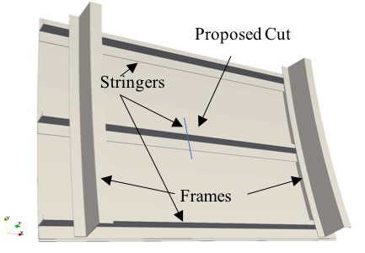
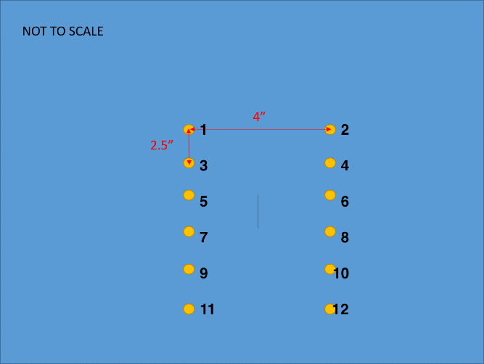
Elastodynamic Simulation – SHM for Aeronautics
Elastodynamic simulation for structural health monitoring (SHM) system assessment on an Al 2024-T3 panel
  Collaboration with the Federal Aviation Administration
Vertical Cut = 0.1 mm wide 60 mm long
73”
Image from FAA
Gregory, Elizabeth D., William C. Schneck III, Cara AC Leckey, and Paul Swindell. "Simulation assisted guided wave structural health monitoring of aerospace structures." In AIP Conference Proceedings, vol. 2102, no. 1, p. 130006. AIP Publishing LLC, 2019.

Slide 7
Elastodynamic Simulation Software
Commercial Software
NASA NESB Custom Software
COMSOL
ABAQUS
ANSYS
OnScale
Pogo
CIVA
EFIT (1D & 3D)
Lebedev
RSG
Numerical instability
(in some conditions)
Simulation Software Considerations
1. Physics solved (including multi-physics, absorbing boundaries)
2. Domain/algorithm restrictions
3. Maturity, utilities, documentation, verification & validation (V&V)
4. Application program interface (API)
5. Speed / high performance computing (HPC)
  e.g. GPUs, MPI-parallelism, cloud computing
6. Extensibility, source code access
Open Source or In-House Software
Extensible to suit the needs of a project
Improved testability
Tailorable for emerging hardware
Balanced against time, costs, risks of development
3D Elastodynamic Simulation
(Open Sourced by the NESB)
SolidWave Simulation (swSim)
GPU-accelerated elastodynamics
https://github.com/nasa/swsim/
https://nasa.github.io/swSim/
PanNDE
Modular architecture simulation
https://github.com/nasa/PanNDE/
https://nasa.github.io/PanNDE/

Slide 8
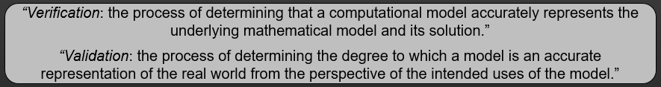
V&V – Conventions and Guidelines
Definitions per (ASME V&V 10-2006)
Verification (software) vs. verification (algorithm)
Involves gathering evidence of applicability
  Specificity of validation for a particular model for a particular use
Hierarchical validation for complex systems
  Challenges with levels of uncertainty that can present in a research environment
Guidelines (non-exhaustive):
  ASME V&V 10-2006: Guide for Verification and Validation in Computational Solid Mechanics
  AIAA G-077-1998(2002): Guide for the Verification and Validation of Computational Fluid Dynamics Simulations
  DOD 5001.61: Modeling and Simulation (M&S) Verification, validation, and Accrediation (VV&A)
  NASA Procedural Requirement (NPR) 7150.2C: NASA Software Engineering Requirements
    Directives for software planning, development, testing, maintenance, operations, and assurance (and others)

Slide 9
V&V and Characteristics of (Research) Simulation Software
Strong V&V Practices Provide…
Assurances of applicability
Reliability, shareability
  Reducing technical debt
  Increasing technology readiness level (TRL)
Extensibility, maintainability
  Research Software Characteristics
Small teams wearing multiple hats
  Domain expert, developer, QA, …
Research results can be as relevant as software developed
Intrinsic uncertainties in simulation algorithms, methodologies
Barriers
Time Pressures
Expertise Requirements
Contrasting Priorities
Approaches to address…
Time pressures → prioritize V&V practices that speed up development process
(reduce debugging, improving workflows, etc.). Often require skill development
Expertise Requirements → leveraging culture, specialization, mentorship in small teams
Contrasting Priorities → addressing tradeoff between quality/replicability and publication
  Long-term & strategic research goals may have higher V&V requirements
  Cultural and institutional barriers in traditional research metrics
  Ongoing challenge to address, but with progress (e.g. open source software journals)

Slide 10
Research Software
Verification Practices

Slide 11
Software Verification Practices at the NESB
Workflows
Version Control (e.g. git)
Code Reviews
Development Tools (Cross-Platform Compilation, Static Code Analyzer, etc.)
Development
Guides & Standards
Quality Agreements
Software Architecture, Library Usage
Mentorship, Specialization, etc.
Testing
On-demand testing at various levels (unit, integration, etc.) using testing framework
Continuous Integration / Continuous Deployment (CI/CD) pipelines
Automatic Test Coverage Assessment
Documentation
Issue Tracking
README, installation guide, etc.
Documentation generators (e.g. Doxygen)
Descriptive Naming Practices

Slide 12
Workflows – Research Software Development
Master
Development
Feature 1
Feature 2
Use of version control workflow
  Guidelines and workflow agreements from start of development
Integration of code verification practices at well-defined times, e.g.
  Regular code reviews (we’ve been reviewing upon merges to master & development)
  Automatic test suite run upon every push & merge

Slide 13
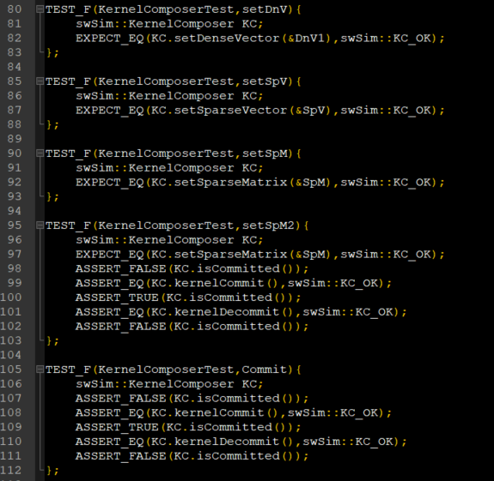
Software Testing
Gradually building evidence and confidence of proper functionality
  Less & faster debugging
  Better assurances of expected functionality
Test types & coverage based on needs
  Unit tests
  Integration tests
  End-to-end testing
  etc.
Test framework with archival tests
  Archival tests > command line debugging
  Intrinsic benefits to having testable code
  Benefits from level of precision needed to run archival tests (compared to visual debugging)
Unit and integration tests from open source C++ swSim codebase
(for registration of GPU SpMV operations)

Slide 14
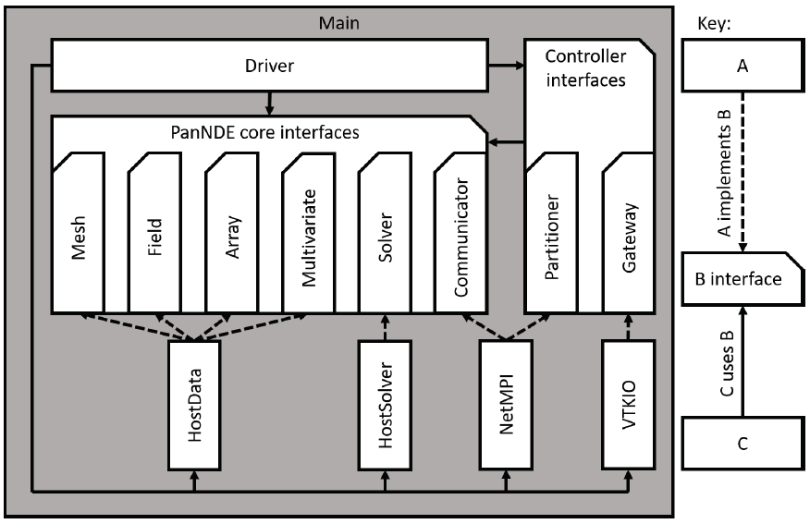
Software Architecture
Emphasis on^{1,2}
  delineation between components (e.g. single responsibility principle)
  interconnection between components (dependency inversion)
Influence of modularization:
  Extensibility (e.g. physics solved is ‘just another module’)
  Maintenance of independent components
  Reduction in technical debt
During development:
  Encapsulation of MPI reduced overhead of testing and maintenance
  Insulation from I/O library allowed pivoting from CGNS to VTK
  Modularization allowed porting mesh and I/O modules to another project
Simplified architectural diagram
PanNDE elastodynamic simulation software
1. R. Martin, Clean Architecture: A Craftsman's Guide to Software Structure and Design, Prentice Hall, 2018.
2. O'Connell, Matthew, et al. "Application of the Dependency Inversion Principle to Multidisciplinary Software Development." 2018 Fluid Dynamics Conference. 2018.https://doi.org/10.2514/6.2018-3856

Slide 15
Validation Examples

Slide 16

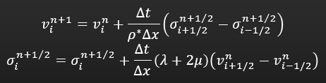
BatterEFIT – 1D Elastodynamic Simulation
1D elastodynamic finite integration technique (EFIT), inspection for Li-metal battery defects
  Time-explicit, 2nd order accurate leapfrog technique
  Heterogeneous scheme – properties assigned to cell centers. Density averaging between cells implicitly encodes boundary/interface conditions
  Developed in Python
Applied for limited use case UT inspection
  Pulse-echo, through-transmission, resonant ultrasonic spectroscopy (RUS)
  Suitable for fluid-solid-poroelastic systems
  Assumptions: normal incidence, planar wave front, flat layers, frequency restrictions for poroelasticity
1D EFIT approach presented in: Ibrahim, Asriana, et al. "One dimensional EFIT modeling
and experimental validation of dynamic interfacial bonding." Mechanical engineering letters 3 (2017): 16-00605.

Slide 17
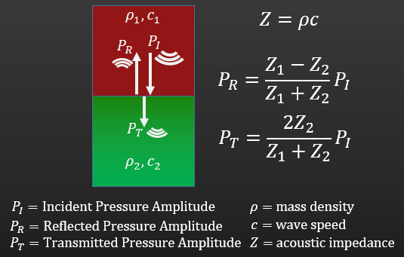
1D Validation Cases
Bulk wave speed
Traction free boundaries
  Total internal reflection
  180° phase shift post-reflection
  Doubling of velocity amplitude at traction free boundary
Bi-material interfaces
  Stress/velocity transmission/reflection amplitudes
  Phase reversal from high to low impedance material
  Lack of phase reversal from low to high impedance material
Conservation of energy throughout simulation
Conservation of momentum throughout simulation
Comparison to well-established theory and analytical solutions
(with a legacy of empirical backing)

Slide 18
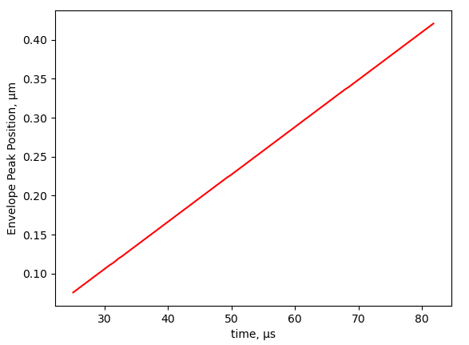



Select Validation Case – Bulk Wave Speed
Pressure wave speed
Excitation: 5 count Hann windowed sine wave, 200 kHz
Tracked peak of signal envelope over time
  $c_{theory}=6078.6\frac{m}{s}$
  $c_{simulation}=6075.4\frac{m}{s}$
  0.0526% error
$$E=70.3 GPa$$
$$ν=0.33$$
$$ρ=2819 kg/m^{3}$$
Al 5052

Slide 19
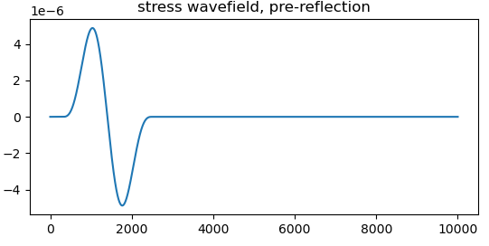
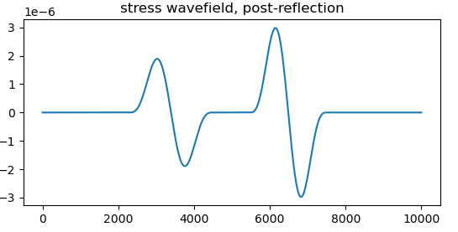


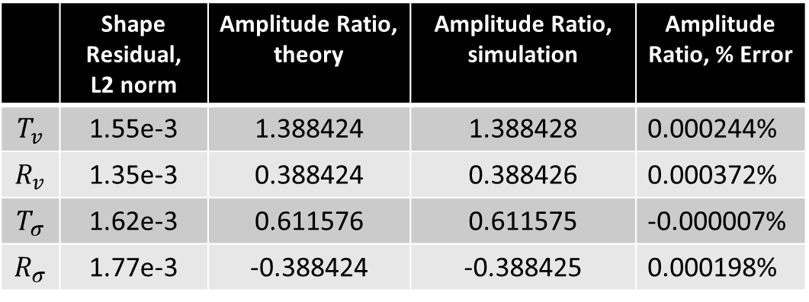
Select Validation Case – Bi-Material Interface
Cu 110
Al 5052
Bi-material interface
  Low to high impedance material
Calculated:
  Transmission and reflection coefficients
  (shown as amplitude ratio below)
  Shape residuals (via L2 norm, normalized to signal amplitude)
    Relative amplitude / phase shift built in via signal convolution
$$E=115. 1 GPa$$
$$ν=0.33$$
$$ρ=8874 kg/m^{3}$$
$$E=70.3 GPa$$
$$ν=0.33$$
$$ρ=2819 kg/m^{3}$$
 | Shape Residual, L2 norm | Amplitude Ratio, theory | Amplitude Ratio, simulation | Amplitude Ratio, % Error
$$T_{v}$$ | 1.55e-3 | 1.388424 | 1.388428 | 0.000244%
$$R_{v}$$ | 1.35e-3 | 0.388424 | 0.388426 | 0.000372%
$$T_{σ}$$ | 1.62e-3 | 0.611576 | 0.611575 | -0.000007%
$$R_{σ}$$ | 1.77e-3 | -0.388424 | -0.388425 | 0.000198%

Slide 20
V&V – 3D Elastodynamic Simulation Software
Geometric Manifolds (e.g. Faces, edges, corners)
Boundary & Interface Conditions
Degree of Anisotropy
Single component – applicability of algorithm influenced by combinations of features
Multiple components – importance of addressing various and complex interface conditions
Frequently cannot test all combinations in available time
  Importance of stress testing algorithms

Slide 21
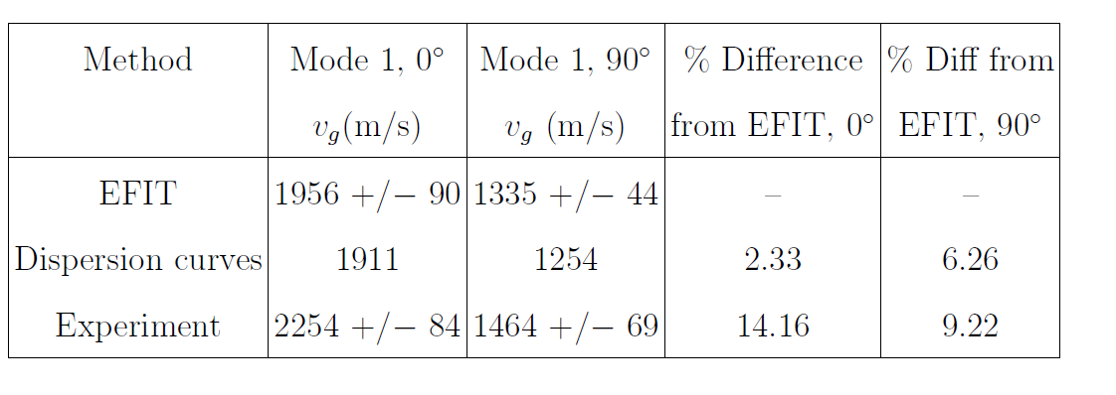
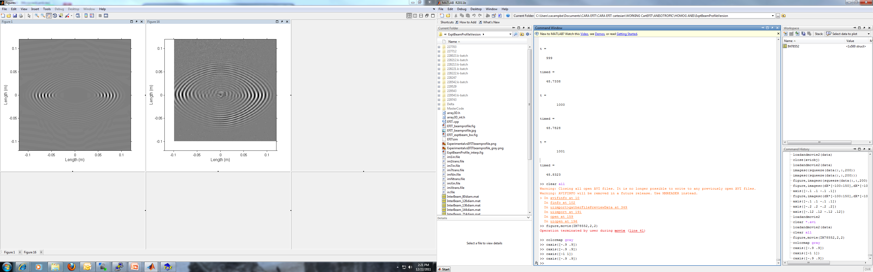
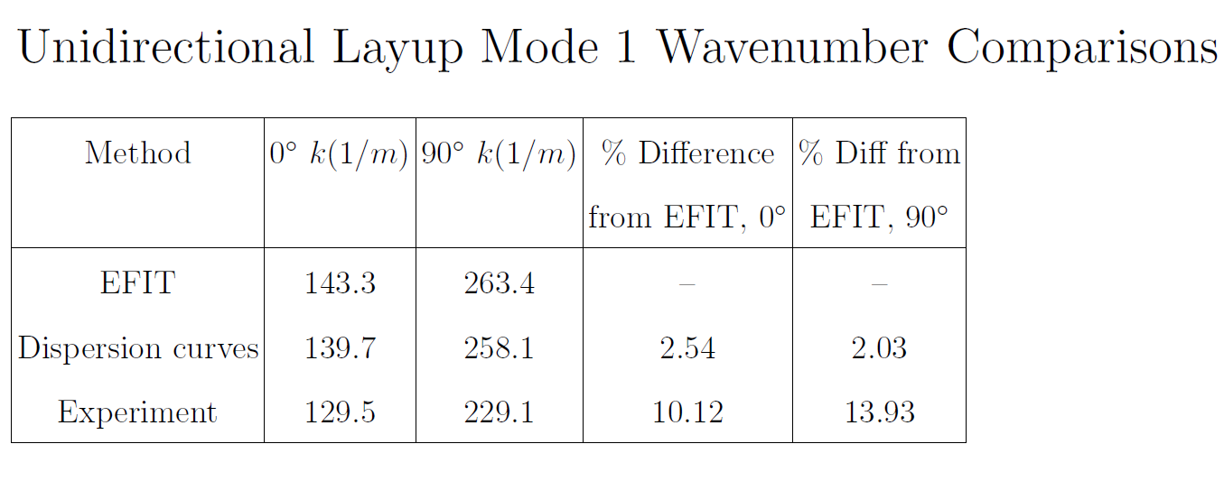
Guided Wave Metrics for Validation
Guided wave propagation across an IM7/8552 8-ply sample
  Laser Doppler vibrometry comparisons
  Two validation approaches:
    3D FFT to extract frequency-wavenumber data
    Tracking peak envelope travel for group velocity
A₀ group velocity comparisons
Approximate time=56 µs after initial excitation
A₀ wavenumber comparisons
LVD wavefield data 3D EFIT result
Leckey, Cara AC, Jeffrey P. Seebo, and Peter Juarez. "Challenges of NDE simulation tool validation, optimization, and utilization for composites." AIP Conference Proceedings. Vol. 1706. No. 1. AIP Publishing LLC, 2016.

Slide 22
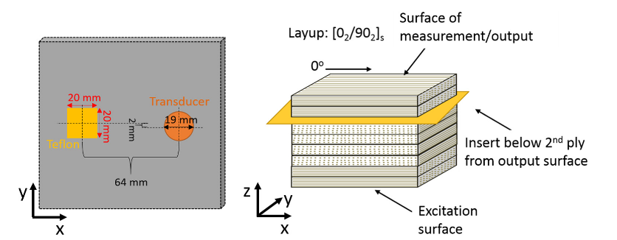
Benchmark Case Setup
IM7/8552 8-ply CFRP laminate containing delamination below 2nd ply
300 kHz excitation, resulting in S0 and A0 modes
3D simulation, each ply layer modeled
Benchmark case presented in: Leckey, Cara AC, et al. "Simulation of guided-wave ultrasound propagation in composite laminates: Benchmark comparisons of numerical codes and experiment." Ultrasonics 84 (2018): 187-200.

Slide 23
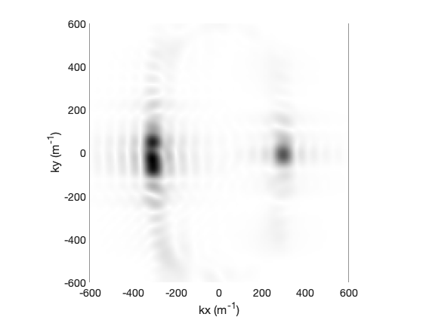
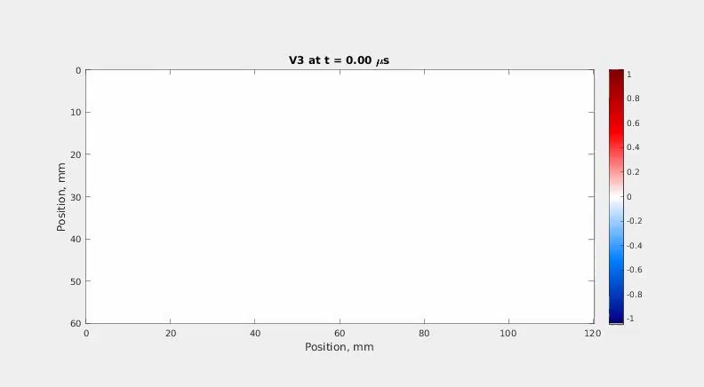
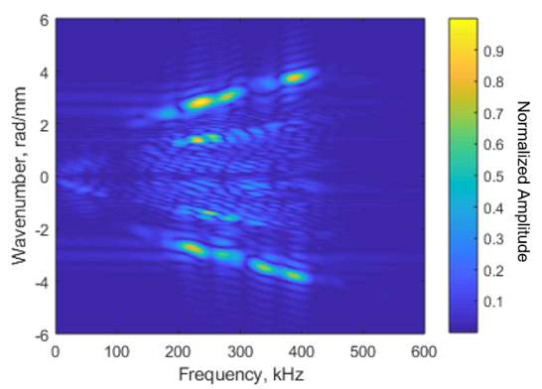
Benchmark Case Results
RSG k_{x} A₀ wavenumber:
3.6 % difference from theory
11.4 % difference from experiment
Leckey (2021)
Dispersion curve extracted from different simulation approach (Lebedev finite difference scheme)
Leckey (2021)
Rotated staggered grid (RSG) finite difference simulation
Frankforter (2019)
1. Leckey, Cara, et al. "Modeling of guided waves for aerospace applications." Health Monitoring of Structural and Biological Systems XV. Vol. 11593. International Society for Optics and Photonics, 2021.
2. Frankforter, Erik, et al. "Comparison of staggered grid finite difference schemes for ultrasound simulation in curving composites." AIP Conference Proceedings. Vol. 2102. No. 1. AIP Publishing LLC, 2019.

Slide 24
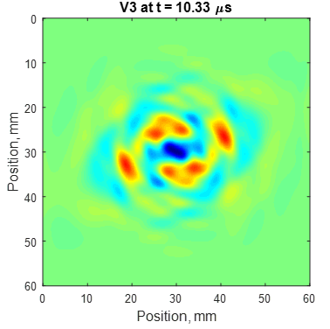
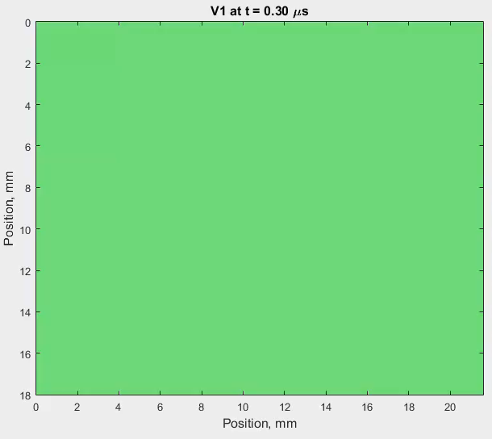
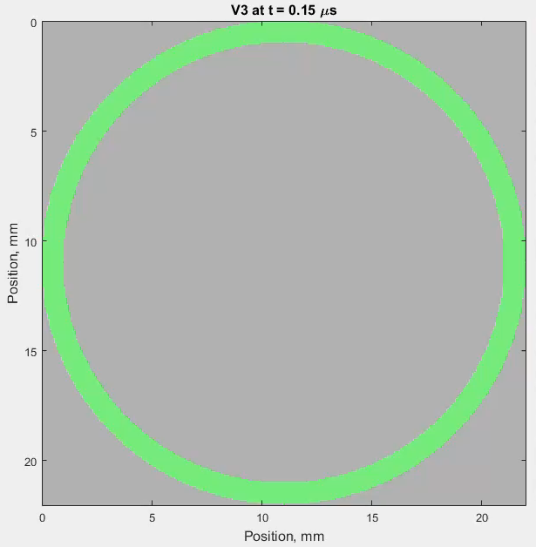
Numerical stability – Stress Testing Algorithms
Geometry/anisotropy/interface conditions and effect on numerical stability
Lacking quantitative validation. Although some first principles theories available for analytical assessment, complex & time-intensive to implement
Triclinic plate simulation with reflection off later traction free boundaries
(instabilities in EFIT)
Numerical instabilities in EFIT – lower than monoclinic symmetry with traction free boundaries
Bulk wave with lateral traction free boundaries, monoclinic-triclinic interface
(instabilities in EFIT. Unstable in Lebedev unless interface scheme with planar interface assumption is used)
Transversely isotropic cylinder (fibers wrapping circumferentially)
Instabilities in Lebedev following conversion to artifact modes at edges/corners
Simulation ‘stress’ test results from: Frankforter, Erik, et al. "Comparison of staggered grid finite difference schemes for ultrasound simulation in curving composites." AIP Conference Proceedings. Vol. 2102. No. 1. AIP Publishing LLC, 2018.

Slide 25
Conclusions
Need for gradual advancement of research software verification practices
  Leveraging culture and group efforts to overcome activation energy
  Behaviors that provide intra-group feedback & speed development after initial skill gap
V&V of simple 1D approach to inform V&V of more complex 3D approaches
Interspersing stress testing of algorithms with hierarchical V&V practices for lower TRL applications
Improving V&V practices – ongoing & future work
  Moving towards more 3D bulk wave assessments
  Expansions to guided wave metrics (wavenumbers sampled at various propagation angles)
  Addressing algorithm verification more directly (e.g. method of manufactured solutions)

Slide 26
Questions?

