Slide 1
UAM Noise Working Group Meeting
Subgroup 1: Tools & Technology
15 April 2021
Virtual Meeting
Group Leads:
Dr. D. Douglas Boyd Jr., Dr. Leonard V. Lopes (NASA Langley)
Jeremy Bain (Joby Aviation)

Slide 2
UNWG SG1 Actions on Recommendations
(1 of 2)
System noise prediction tools be further developed for application to UAM vehicles and made available to the research and industrial communities.
  Noise prediction framework updates, new capabilities and tools.
Research be performed to develop conventions on how to handle control redundancies to obtain preferred low-noise trim conditions and to further develop the acoustic tools to handle aperiodic sources.
  Noise prediction framework updates, new capabilities and tools.
Prediction models for the highest amplitude noise sources be validated with experimental data for isolated and installed configurations, and that flight test data be acquired to better understand variations under realistic operating conditions, particularly unsteady conditions (e.g., maneuvers and transition).
  Dissemination of geometry and acoustic measurement of nominal rotor design for participants to validate their tools, potential workshop.
Continued development of auralization tools be performed to allow realization of flight operations (including takeoff, forward flight, landing, and transition) for a representative range of vehicle configurations.
  Broadband noise prediction coupled into auralization framework

Slide 3
UNWG SG1 Actions on Recommendations
(2 of 2)
A dedicated technology maturation effort be performed on the most promising noise mitigation technologies and that opportunities be sought to evaluate their efficacy in flight.
Surrogate or other reduced order model methods be developed so that designers can quickly determine the effects of design changes on noise early in the design process, and that sensitivities be fully implemented to enable optimization of low-noise vehicle designs and operations.
  Additional tool development underway to evolve existing computational techniques and measurement data into reduced order model
Research be conducted to more fully explore limitations in methods for assessing community noise impact of UAM vehicles in their operational environments, and to generate a software development plan that addresses the limitations of current models over time.
  Noise power distance (NPD) curve generation for UAM vehicles into integrated environment design tool (AEDT)
  Advanced Acoustic Model (AAM) recent release with UAM vehicle updates to acoustic assessment evaluation
Manufacturers work with appropriate organizations to develop low noise guidance for piloted operations and automated low-noise procedures for autonomous operations that are specific to their products.

Slide 4
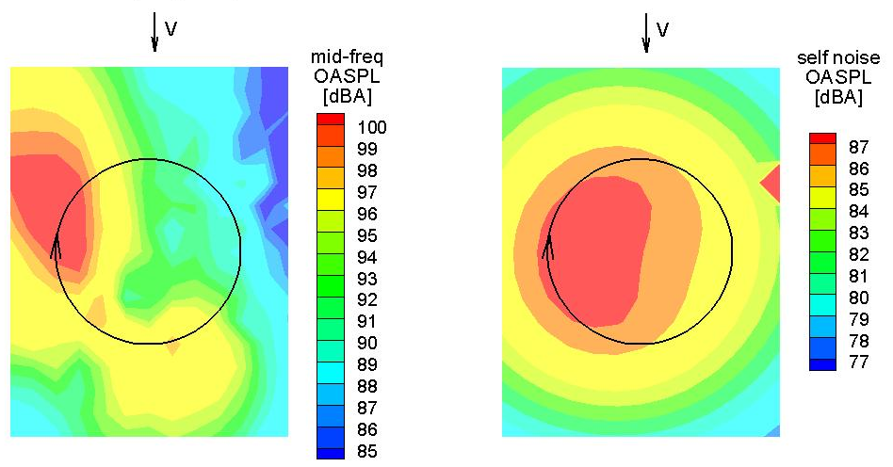
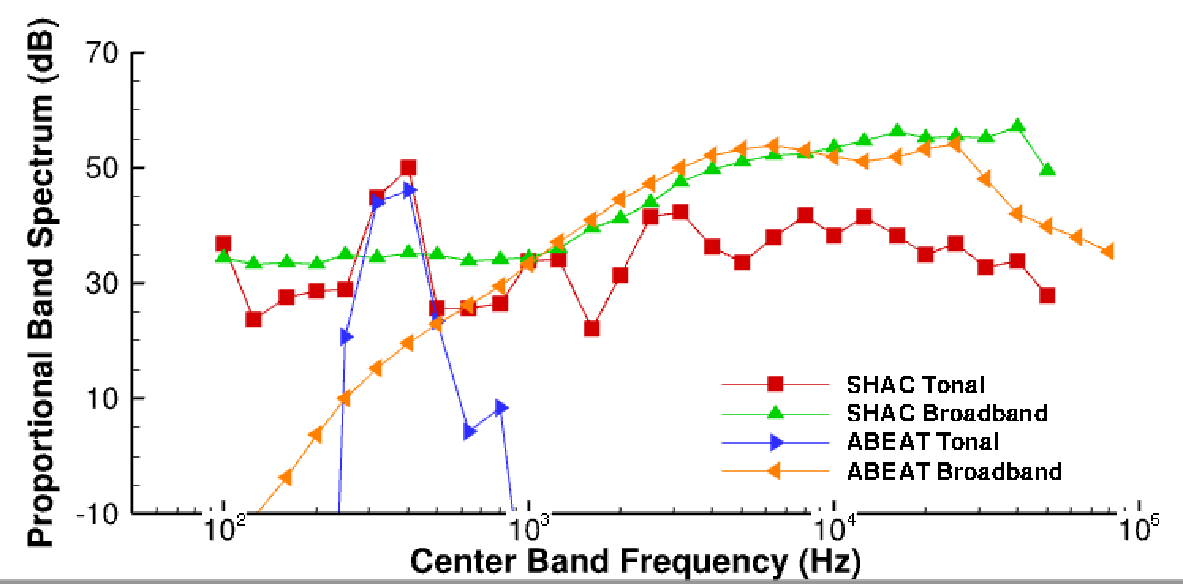
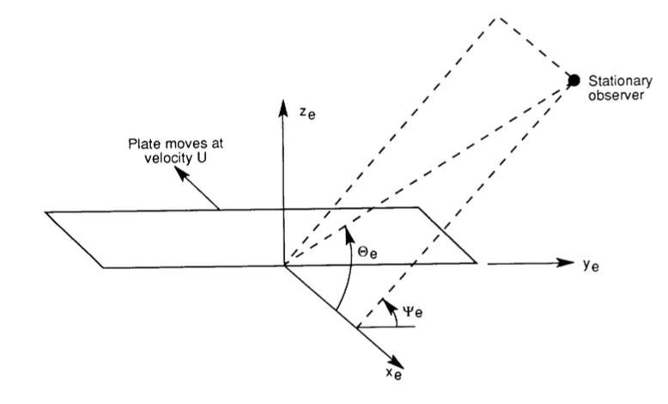
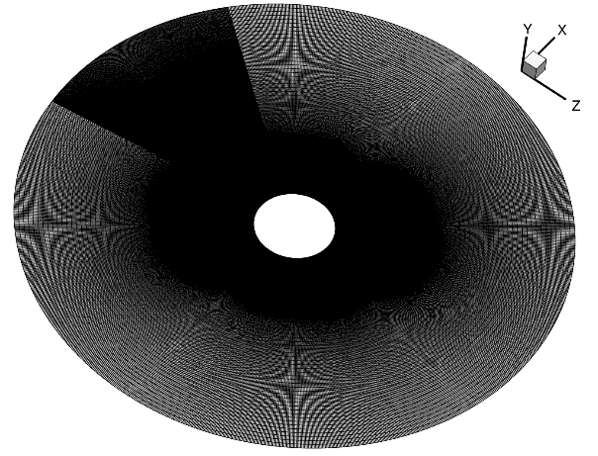
Aircraft Noise Prediction
Available tools incorporating self noise
Ongoing tool development and distribution
  ANOPP2 framework provides prediction platform
  Component prediction and propagation capability
  Tools for user interfaces and applications
Comprehensive tools (AARON)
Broadband self noise component prediction capability
Single broadband noise element
Discretization of rotor into elements
Fast blade element tools (ABEAT)

Slide 5
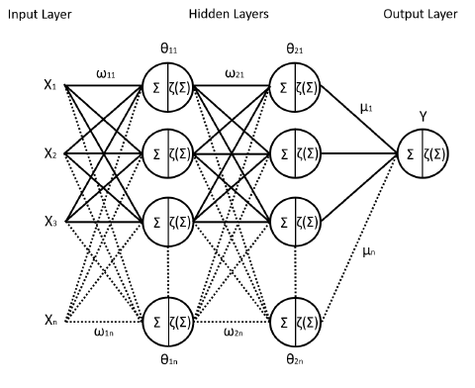
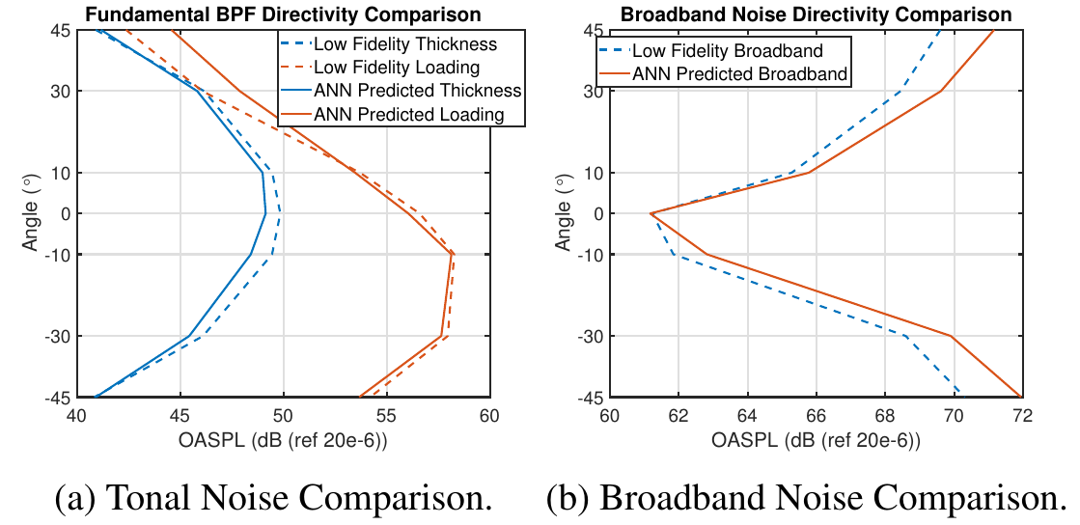
Reduced Order Models
Computationally intensive predictions are prohibitive
  Very prohibitive where several iterations are needed
Neural nets allow ‘training’ a system of neurons to interpolate within a complex database
  Training data can be measurement or prediction
  Predictions can be low or high order
ANOPP2’s Neural Network (ANNs) capability is under development
  Training and applying neural networks
  Coupled with array of prediction modules within ANOPP2
Applied ANOPP PAS to train model using tapered rotor
  148 PAS computations were used to train neural network
  Comparisons of neural network prediction to PAS computation show good agreement

Slide 6
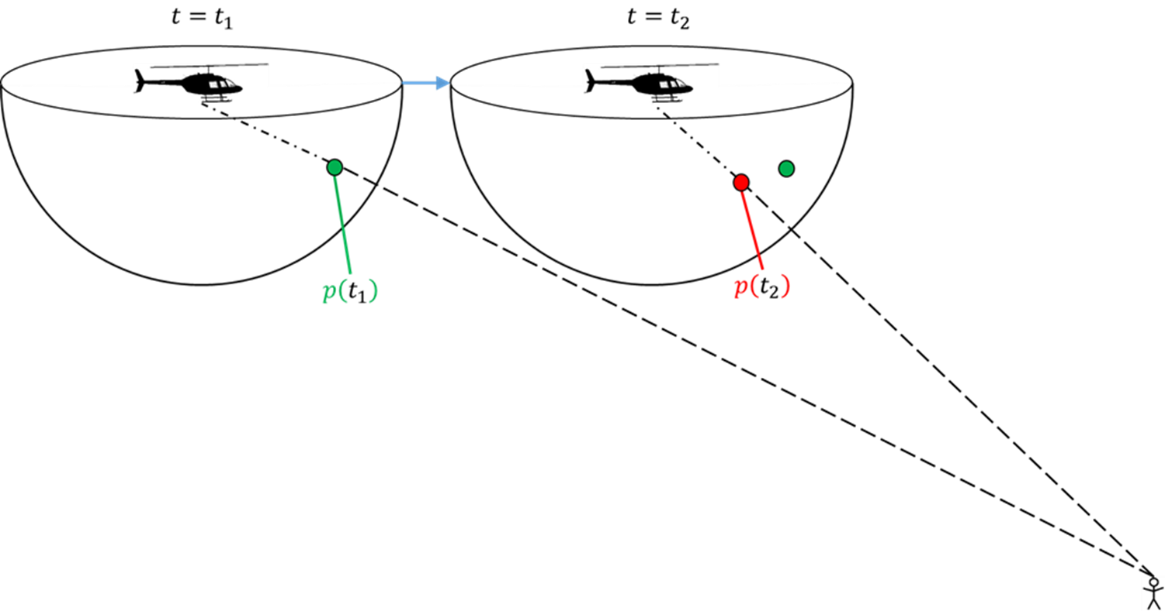
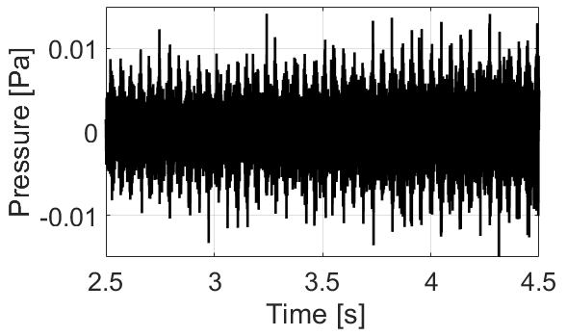
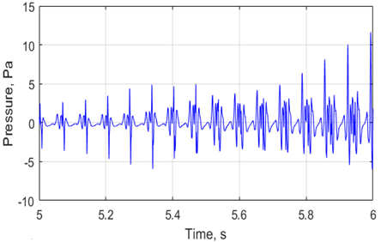
NAF Auralization Developments
High fidelity loading and thickness (tonal) noise auralization for arbitrary vehicle maneuvers
Modulated broadband synthesis for auralization with self noise
F1A computation of sound pressures at each time step in simulated flyover
Simulated Bell 206B Pitch-Up Maneuver Tonal Noise at Ground Observer

Slide 7
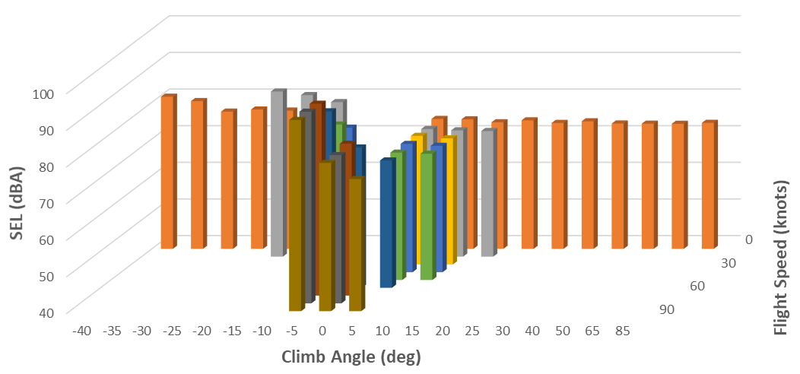
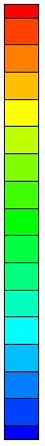
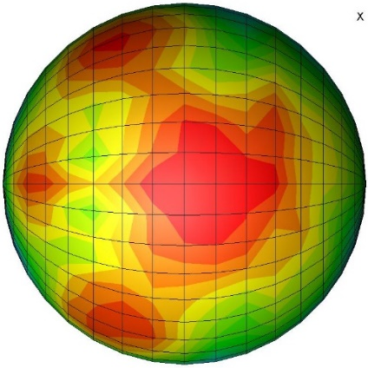
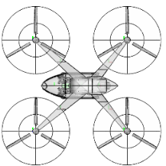
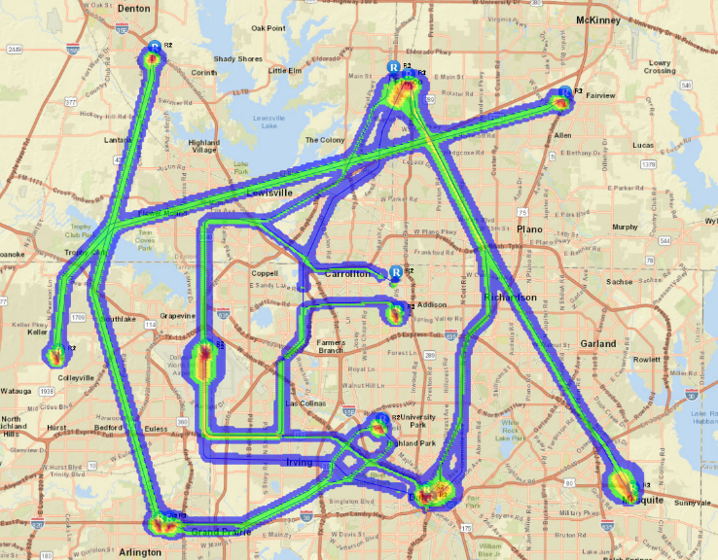
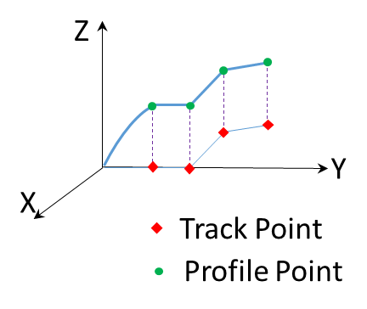
UAM Community Noise Assessment Using the FAA Aviation Environmental Design Tool
Source Noise Prediction
Gen 2 SEL Data for Quadrotor
SPL [dB]
NPD Database Generation
for Quadrotor and Lift+Cruise
Gen 1: Loading & Thickness Noise
Gen 2: Gen 1 + Broadband Selfnoise
Gen 1 Assessment of ATM-X Routes
Construction of AEDT Study
Using Fixed-Point Flight Profiles
600 Operations/Route of Quadrotor

Slide 8
Workshop Dataset
Government, industry, and academia all have their tools
  Lack consistent set of validation data
Dissemination challenges (including blade geometries)
  Previously NASA used commercial blades because:
    They were cost effective
    They could be acquired quickly
    They did not require design efforts
  NASA promised efforts to create sharable database of nominal rotor design
    Easy to define rotor properties
    NASA fabricated several sets of blades with different materials

Slide 9
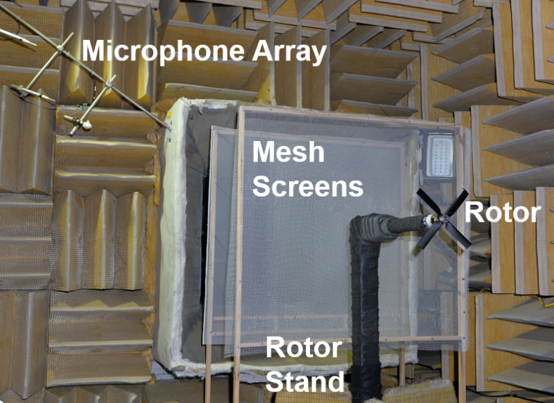
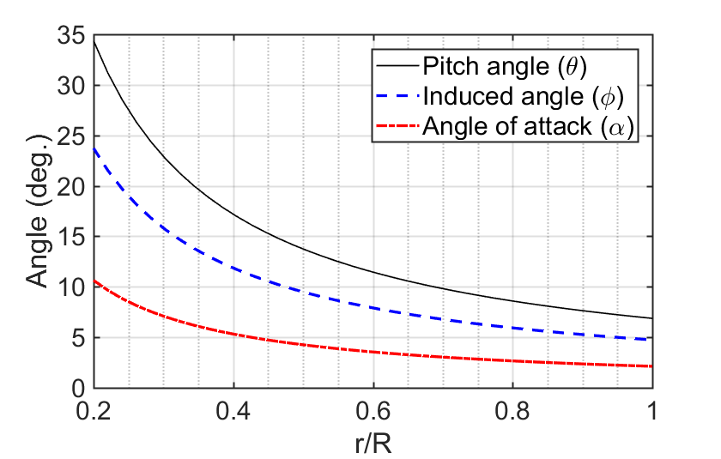
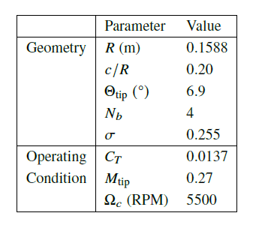
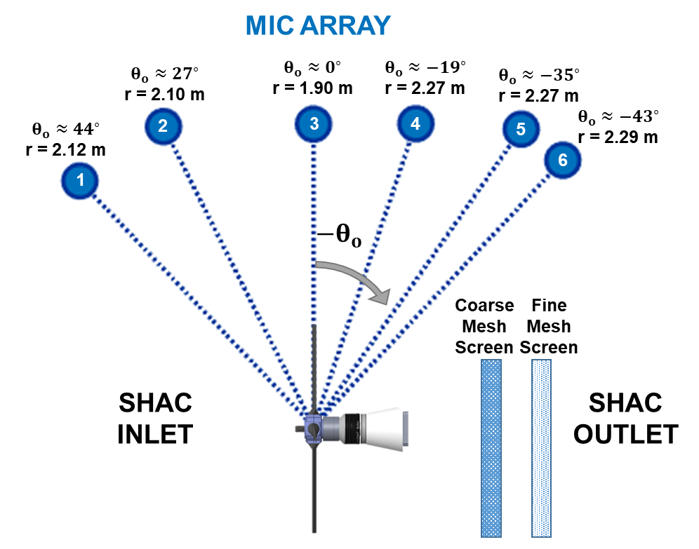

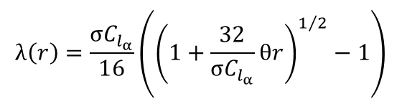
Ideally Twisted Rotor (ITR) Geometry
  Ideally, radially constant induced inflow to minimize induced power.
  From blade element momentum theory (BEMT) in hover:
$$λ\left(r\right)=\frac{σC_{l_{α}}}{16}\left({\left(1+\frac{32}{σC_{l_{α}}}θr\right)}^{1/2}−1\right)$$
$$θ= \frac{Constant}{r}$$
  Uniform inflow constraint

Slide 10
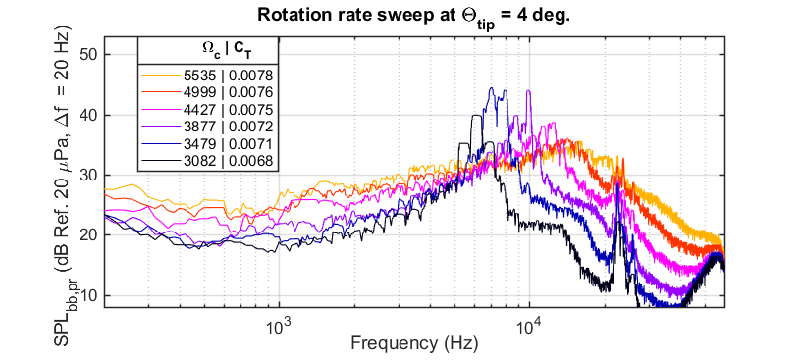
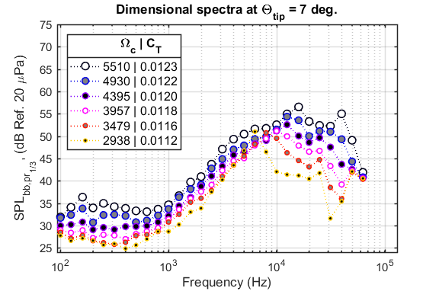
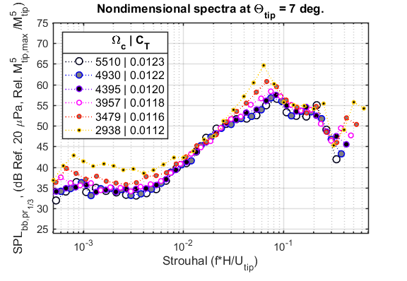
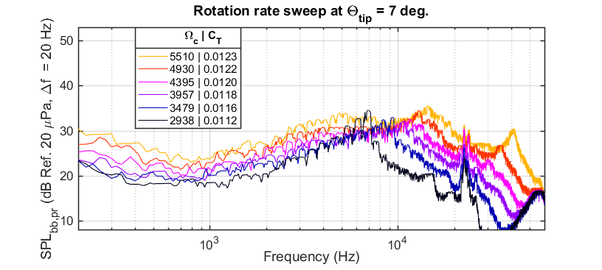
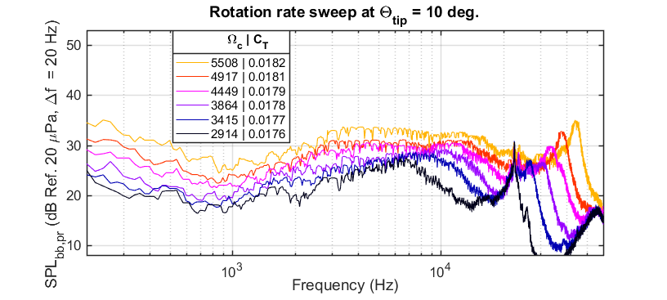
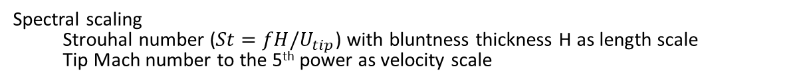
ITR Example Data: Noise Trends
Acoustic spectra for smooth blade experiments at microphone 5 (-35 deg. below the plane of the rotor)
Increasing rotation rate
Increasing blade tip pitch
Spectral scaling
  Strouhal number ($St=fH/U_{tip}$) with bluntness thickness H as length scale
  Tip Mach number to the 5th power as velocity scale

Slide 11
This represents work going on at NASA
There are, of course, other activities in government, industry, and academia
More details and discussions will occur during SG1 breakout session.
Any Questions?

Slide 12
UAM Noise Working Group Meeting
Subgroup 1: Tools & Technology (Breakout Session)
15 April 2021
Virtual Meeting
Group Leads:
Dr. D. Douglas Boyd Jr., Dr. Leonard V. Lopes (NASA Langley)
Dr. Jeremy Bain (Joby Aviation)

Slide 13
Breakout topics
Current dataset dissemination
Tool development and needs
Potential validation datasets
Recommended potential wind tunnel tests

Slide 14
ITR Papers (Scitech 2021)
“Acoustic and Performance Characteristics of an Ideally Twisted Rotor in Hover” – Pettingill, Zawodny, Thurman, and Lopes
  Various collective pitch angles to identify noise trends
  Tonal and broadband noise characteristics
  Identification of success and challenges
“Physics-Informed Broadband Noise Source Identification and Prediction of an Ideally Twisted Rotor” – Thurman, Zawodny, Pettingill, Lopes, and Baeder
  CFD based tonal and broadband noise prediction
  Source localization to identify if predictions match source identification

Slide 15

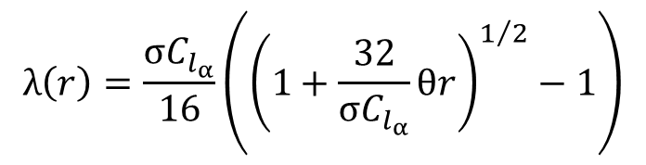
Ideally Twisted Rotor (ITR)
  Ideally, radially constant induced inflow to minimize induced power.
  From Blade Element Momentum Theory (BEMT) in hover:
$$λ\left(r\right)=\frac{σC_{l_{α}}}{16}\left({\left(1+\frac{32}{σC_{l_{α}}}θr\right)}^{1/2}−1\right)$$
  Uniform inflow constraint
$$θ= \frac{Constant}{r}$$

Slide 16
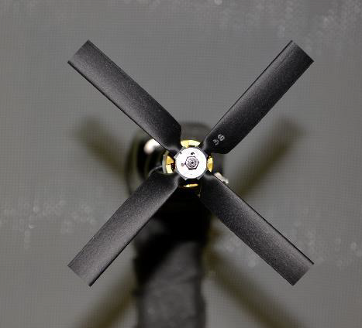
Ideally Twisted Rotor (ITR) Images
Rotor in Small Hover Anechoic Chamber (SHAC) at NASA Langley Research Center

Slide 17
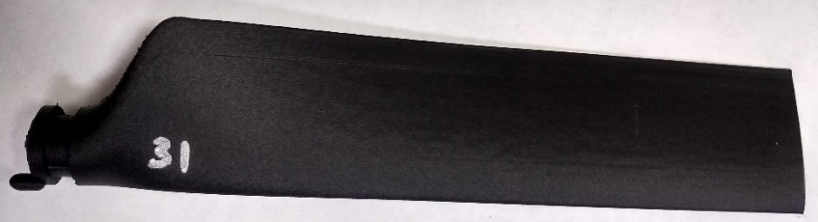
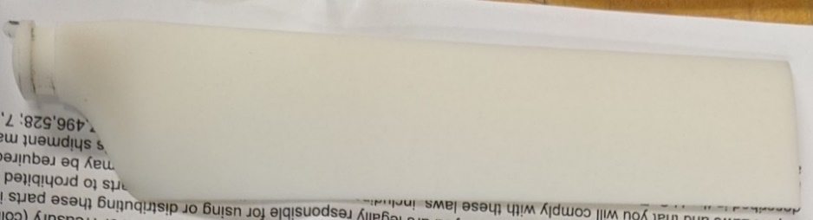
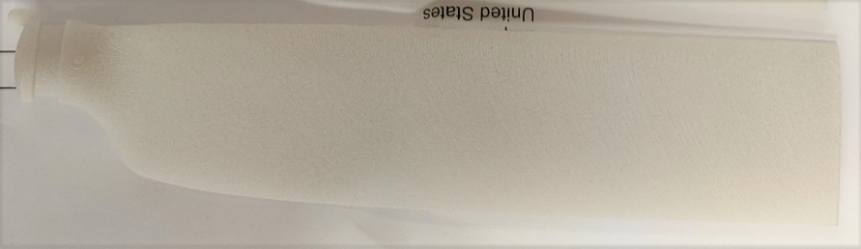
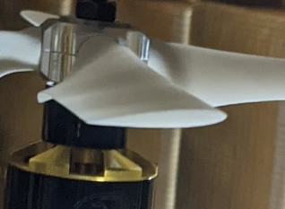
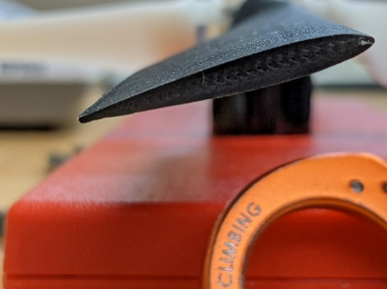
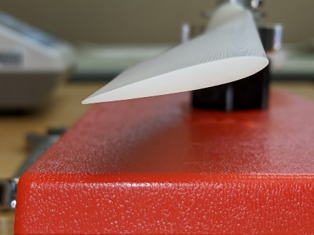
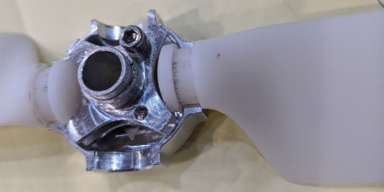
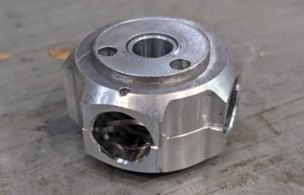
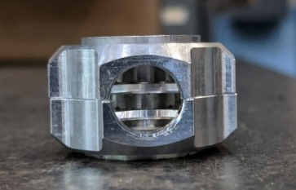
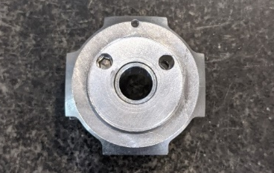
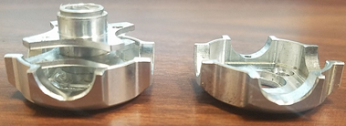
Experiment: Facility and Setup
In-house Markforged blades
Protolabs SLA “smooth” blades
Protolabs SLS “rough” blades
Onyx material: micro carbon fiber filled nylon plastic
Aluminum ejector pin inserted span-wise to improve stiffness
Accura Xtreme White 200 material: like injection molded resin (“ABS-like”)
Manufactured via stereolithography (SLA)
PA 12 material: 25% mineral-filled nylon
Manufactured via selective laser sintering (SLS)
COTS varioPROP hub

Slide 18
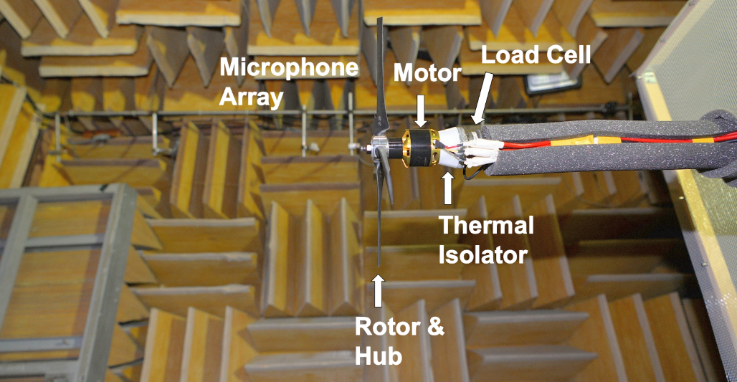
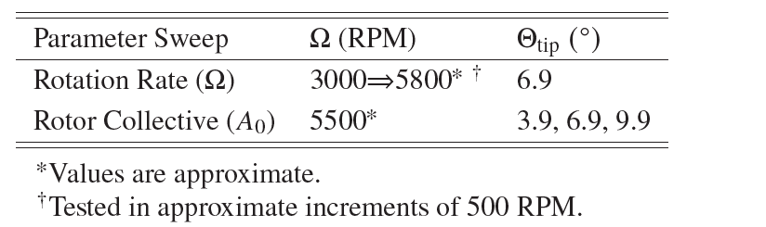
Experiment: Facility and Setup
Small Hover Anechoic Chamber (SHAC)*
Room dimensions = [3.87 x 2.56 x 3.26] m
Acoustically treated (cutoff down to 250 Hz)
DAS: Brüel & Kjær (BK) LAN-XI DAQ and BK Connect Software
  6 B&K Type 4939 Free-Field microphones
  Laser sensor tachometer
  6-Component AI-IA mini40 multiaxis load cell
Scorpion Motor
Experiment Target Conditions

Slide 19
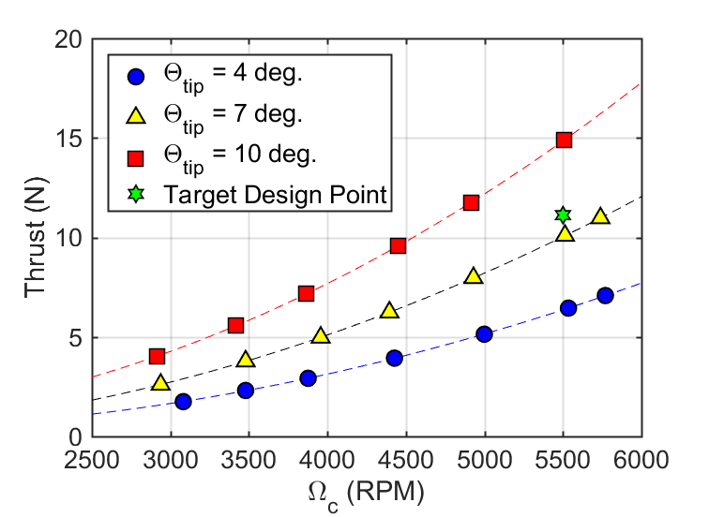
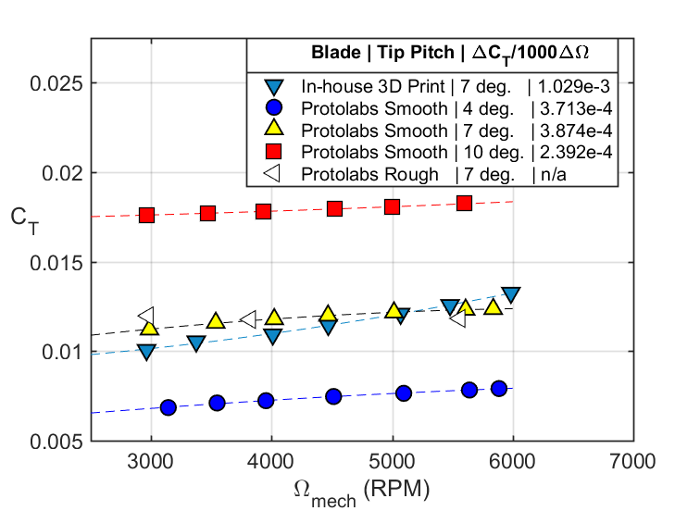

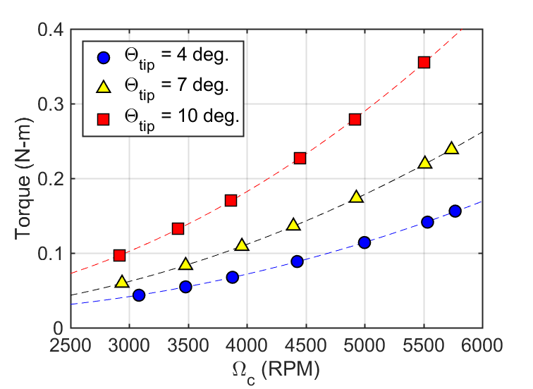



Performance Results
Performance data for three blade sets compared
  Thrust coefficient ($C_{T}$) expected to be constant if only rotation rate is varied
  In-house blades showed high variance in $C_{T}$
Protolabs smooth blades chosen to be tested for additional tip pitch conditions
  Produced 9.26% less thrust than design thrust of 11.12 N
In-house Markforged blades
Protolabs SLA “smooth” blades
Protolabs SLS “rough” blades

Slide 20
ITR Example Data: Noise Trends
Acoustic spectra for smooth blade experiments at microphone 5 (-35 deg. below the plane of the rotor)
Increasing rotation rate
Increasing blade tip pitch
Spectral scaling
  Strouhal number ($St=fH/U_{tip}$) with bluntness thickness H as length scale
  Tip Mach number to the 5th power as velocity scale

Slide 21
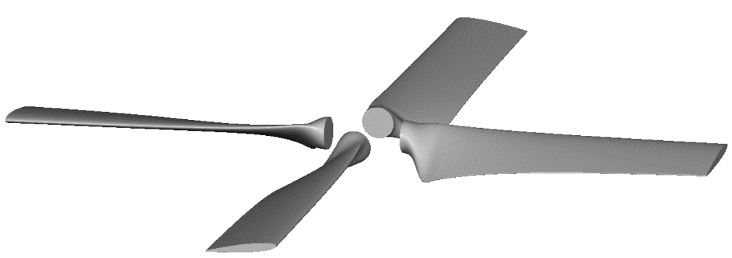
What NASA is Providing to Participants
CAD Drawing and Raw Measurement Data
CAD Drawing
Raw measurement data from all microphones all entries
Raw data from figures in publications (measurement and predictions)
  Approximately 1.8 GB of raw data

Slide 22
What NASA is Providing to Participants
Test Matrix
Blade Set Name | Theta_tip (Deg.) | Omega_mech (RPM) | Omega_c (RPM) | T (N) | Q (N-m) | M_tip | CT | CP | CA (m/s) | PRESS (Pa) | TEMP (K) | RHO (kg/m^3)
In-house Markforged Onyx Blades | 7 | 5985 | 5919 | 13.40882117 | -0.29060279 | 0.293444301 | 0.013255852 | -0.001783287 | 344.0825391 | 102911.1878 | 294.5944444 | 1.216929328
In-house Markforged Onyx Blades | 7 | 5480 | 5418 | 10.6547454 | -0.229733696 | 0.26858289 | 0.01257346 | -0.001682833 | 344.212291 | 102911.1878 | 294.8166667 | 1.21601205
In-house Markforged Onyx Blades | 7 | 5070 | 5013 | 8.770033121 | -0.187838944 | 0.248535024 | 0.01208633 | -0.00160688 | 344.1474212 | 102911.1878 | 294.7055556 | 1.216470516
In-house Markforged Onyx Blades | 7 | 4470 | 4419 | 6.460282881 | -0.138282857 | 0.21906066 | 0.011460941 | -0.001522795 | 344.2447213 | 102904.293 | 294.8722222 | 1.215701493
In-house Markforged Onyx Blades | 7 | 4010 | 3963 | 4.956033652 | -0.106396539 | 0.19648049 | 0.010929314 | -0.001456433 | 344.3095728 | 102904.293 | 294.9833333 | 1.215243576
In-house Markforged Onyx Blades | 7 | 3375 | 3337 | 3.387606007 | -0.07393918 | 0.165413733 | 0.010540162 | -0.001428017 | 344.212291 | 102904.293 | 294.8166667 | 1.215930581
In-house Markforged Onyx Blades | 7 | 2963 | 2929 | 2.492724639 | -0.055636726 | 0.145221004 | 0.010062664 | -0.001394134 | 344.212291 | 102904.293 | 294.8166667 | 1.215930581
Protolabs SLA ABS-like Smooth Blades | 4 | 5886 | 5770 | 7.08076072 | -0.151924755 | 0.281893048 | 0.007909695 | -0.001069042 | 347.1188864 | 101635.6572 | 299.8166667 | 1.180912305
Protolabs SLA ABS-like Smooth Blades | 4 | 5641 | 5535 | 6.448214682 | -0.137590186 | 0.270410127 | 0.007827843 | -0.001052147 | 346.7971343 | 101635.6572 | 299.2611111 | 1.183104579
Protolabs SLA ABS-like Smooth Blades | 4 | 5096 | 4999 | 5.13613091 | -0.110966362 | 0.244216706 | 0.007644232 | -0.00104034 | 346.8936913 | 101635.6572 | 299.4277778 | 1.182446042
Protolabs SLA ABS-like Smooth Blades | 4 | 4514 | 4427 | 3.934186617 | -0.086226988 | 0.216285269 | 0.00746534 | -0.001030681 | 346.9580476 | 101635.6572 | 299.5388889 | 1.182007425
Protolabs SLA ABS-like Smooth Blades | 4 | 3953 | 3877 | 2.92195252 | -0.065687872 | 0.18938777 | 0.007231815 | -0.001024108 | 346.9902213 | 101628.7624 | 299.5944444 | 1.181708068
Protolabs SLA ABS-like Smooth Blades | 4 | 3548 | 3479 | 2.310894036 | -0.053229141 | 0.169937005 | 0.007104141 | -0.001030783 | 347.0867246 | 101621.8676 | 299.7611111 | 1.180970914
Protolabs SLA ABS-like Smooth Blades | 4 | 3143 | 3082 | 1.748134972 | -0.042283989 | 0.150552849 | 0.006847065 | -0.001043258 | 347.0545598 | 101621.8676 | 299.7055556 | 1.181189827
Protolabs SLA ABS-like Smooth Blades | 7 | 5838 | 5739 | 10.97087994 | -0.232060252 | 0.280374607 | 0.012356473 | -0.001646418 | 346.1527331 | 101897.658 | 298.15 | 1.190574861
Protolabs SLA ABS-like Smooth Blades | 7 | 5605 | 5510 | 10.08604081 | -0.213235766 | 0.26915952 | 0.012327103 | -0.001641673 | 346.1849816 | 101890.7633 | 298.2055556 | 1.190272514
Protolabs SLA ABS-like Smooth Blades | 7 | 5015 | 4930 | 7.966269283 | -0.168772199 | 0.240826939 | 0.01216199 | -0.001623069 | 346.1849816 | 101890.7633 | 298.2055556 | 1.190272514
Protolabs SLA ABS-like Smooth Blades | 7 | 4468 | 4395 | 6.239990097 | -0.132481977 | 0.214699315 | 0.011987035 | -0.001603138 | 345.9591786 | 101883.8685 | 297.8166667 | 1.191746123
Protolabs SLA ABS-like Smooth Blades | 7 | 4022 | 3957 | 4.974340477 | -0.106032852 | 0.193321928 | 0.01178669 | -0.001582643 | 345.8623608 | 101876.9738 | 297.65 | 1.192332738
Protolabs SLA ABS-like Smooth Blades | 7 | 3537 | 3479 | 3.779793324 | -0.081082174 | 0.169978137 | 0.011585119 | -0.001565468 | 345.926909 | 101876.9738 | 297.7611111 | 1.191887813
Protolabs SLA ABS-like Smooth Blades | 7 | 2987 | 2938 | 2.608565759 | -0.058028197 | 0.143546705 | 0.011210731 | -0.001570932 | 345.926909 | 101876.9738 | 297.7611111 | 1.191887813
Protolabs SLA ABS-like Smooth Blades | 10 | 5601 | 5508 | 14.90249164 | -0.34593362 | 0.269067708 | 0.018244694 | -0.002667821 | 346.0559694 | 101787.3419 | 297.9833333 | 1.189951111
Protolabs SLA ABS-like Smooth Blades | 10 | 4999 | 4917 | 11.7524564 | -0.271731804 | 0.240215281 | 0.018053344 | -0.002629394 | 345.9591786 | 101780.4471 | 297.8166667 | 1.190536392
Protolabs SLA ABS-like Smooth Blades | 10 | 4527 | 4449 | 9.560316757 | -0.220997181 | 0.217372286 | 0.017933489 | -0.002611353 | 346.2172272 | 101787.3419 | 298.2611111 | 1.188842881
Protolabs SLA ABS-like Smooth Blades | 10 | 3932 | 3864 | 7.163291036 | -0.165630846 | 0.188767102 | 0.017819284 | -0.002595405 | 346.2817092 | 101780.4471 | 298.3722222 | 1.188319667
Protolabs SLA ABS-like Smooth Blades | 10 | 3473 | 3415 | 5.566484289 | -0.128811005 | 0.166855789 | 0.017722652 | -0.002583372 | 346.0237088 | 101780.4471 | 297.9277778 | 1.190092386
Protolabs SLA ABS-like Smooth Blades | 10 | 2962 | 2914 | 4.021002232 | -0.093793146 | 0.142358557 | 0.017588421 | -0.002584341 | 345.8946364 | 101773.5524 | 297.7055556 | 1.190900051
Protolabs SLS PA-12 Rough Blades | 7 | 5561 | 5465 | 9.512681179 | -0.242266435 | 0.266971987 | 0.01182726 | -0.001897408 | 346.2817092 | 101808.0262 | 298.3722222 | 1.188641662
Protolabs SLS PA-12 Rough Blades | 7 | 3823 | 3757 | 4.473498534 | -0.106950441 | 0.18353424 | 0.011768625 | -0.001772341 | 346.2817092 | 101808.0262 | 298.3722222 | 1.188641662
Protolabs SLS PA-12 Rough Blades | 7 | 2975 | 2923 | 2.755445826 | -0.064901621 | 0.142810237 | 0.011972526 | -0.001776379 | 346.3139458 | 101808.0262 | 298.4277778 | 1.188420384

Slide 23
What NASA is Providing to Participants
Figure Data (Dozens)
Frequency (Hz) | Total SPL (dB) | Frequency (Hz) | SPL_bb (dB) | Frequency (Hz) | SPL_bb,pr (dB) | Frequency (Hz) | Motor Noise (dB) | Frequency (Hz) | Facility Noise (dB)
0 | 49.32127913 | 0 | -4.717195637 | 0 | -4.717195637 | 0 | 41.6850737 | 0 | 42.27486367
19.99877937 | 55.46961043 | 19.99877937 | 4.656267405 | 19.99877937 | 4.656267405 | 19.99877937 | 48.13936905 | 19.99877937 | 48.0765236
39.99755874 | 52.60162959 | 39.99755874 | 23.06346841 | 39.99755874 | 23.06346841 | 39.99755874 | 46.44588642 | 39.99755874 | 46.15031763
59.99633811 | 40.75929831 | 59.99633811 | 30.40715814 | 59.99633811 | 30.40715814 | 59.99633811 | 37.28609458 | 59.99633811 | 37.6151822
79.99511749 | 39.25697272 | 79.99511749 | 32.0624142 | 79.99511749 | 32.0624142 | 79.99511749 | 31.74658308 | 79.99511749 | 32.42129357
99.99389686 | 40.31993288 | 99.99389686 | 31.35698781 | 99.99389686 | 31.35698781 | 99.99389686 | 28.77509913 | 99.99389686 | 28.60058111
119.9926762 | 33.39744242 | 119.9926762 | 31.56030091 | 119.9926762 | 31.56030091 | 119.9926762 | 25.76851548 | 119.9926762 | 26.29872392
139.9914556 | 33.41748232 | 139.9914556 | 33.36226352 | 139.9914556 | 33.36226352 | 139.9914556 | 24.85844216 | 139.9914556 | 24.63004171
159.990235 | 33.38189587 | 159.990235 | 33.28470786 | 159.990235 | 33.28470786 | 159.990235 | 23.86883498 | 159.990235 | 23.7711275
179.9890143 | 35.42527833 | 179.9890143 | 32.04408198 | 179.9890143 | 32.04408198 | 179.9890143 | 23.55043212 | 179.9890143 | 22.54751288
199.9877937 | 33.72555348 | 199.9877937 | 30.34459252 | 199.9877937 | 30.34459252 | 199.9877937 | 22.84289898 | 199.9877937 | 21.85271616
219.9865731 | 29.09703989 | 219.9865731 | 28.96038059 | 219.9865731 | 28.96038059 | 219.9865731 | 21.32962521 | 219.9865731 | 21.16254116
239.9853525 | 30.4824622 | 239.9853525 | 30.3879933 | 239.9853525 | 29.16046469 | 239.9853525 | 20.92794745 | 239.9853525 | 20.743546
259.9841318 | 31.3083955 | 259.9841318 | 31.2106894 | 259.9841318 | 29.16046469 | 259.9841318 | 20.63991555 | 259.9841318 | 19.53463806
279.9829112 | 31.44078746 | 279.9829112 | 30.78128191 | 279.9829112 | 29.16046469 | 279.9829112 | 22.65902596 | 279.9829112 | 18.55555263
299.9816906 | 29.66088321 | 299.9816906 | 29.36054879 | 299.9816906 | 29.36054879 | 299.9816906 | 20.59934705 | 299.9816906 | 18.75924262
319.9804699 | 27.07970582 | 319.9804699 | 26.94834439 | 319.9804699 | 26.94834439 | 319.9804699 | 19.20498014 | 319.9804699 | 18.5175903
339.9792493 | 32.52505965 | 339.9792493 | 25.77046308 | 339.9792493 | 27.12075032 | 339.9792493 | 18.67496872 | 339.9792493 | 17.76099127
359.9780287 | 49.87176786 | 359.9780287 | 28.08591458 | 359.9780287 | 27.12075032 | 359.9780287 | 17.91434945 | 359.9780287 | 17.29042252
379.9768081 | 51.99702137 | 379.9768081 | 29.74581657 | 379.9768081 | 27.12075032 | 379.9768081 | 16.73872252 | 379.9768081 | 16.59515617
399.9755874 | 41.69086066 | 399.9755874 | 31.07332541 | 399.9755874 | 27.29315626 | 399.9755874 | 16.96097422 | 399.9755874 | 16.46433257
419.9743668 | 29.91522354 | 419.9743668 | 29.30886146 | 419.9743668 | 27.29315626 | 419.9743668 | 15.75793848 | 419.9743668 | 16.11283739
439.9731462 | 27.02277604 | 439.9731462 | 26.50039794 | 439.9731462 | 26.50039794 | 439.9731462 | 16.43154483 | 439.9731462 | 16.14634102
459.9719255 | 29.65872703 | 459.9719255 | 25.29160079 | 459.9719255 | 25.29160079 | 459.9719255 | 16.23609927 | 459.9719255 | 15.85418599
479.9707049 | 28.98930303 | 479.9707049 | 25.51709503 | 479.9707049 | 25.51709503 | 479.9707049 | 16.54564105 | 479.9707049 | 15.43090919
499.9694843 | 26.14236745 | 499.9694843 | 25.8956362 | 499.9694843 | 25.8956362 | 499.9694843 | 16.77692383 | 499.9694843 | 14.89141029
519.9682637 | 26.05580256 | 519.9682637 | 26.10703753 | 519.9682637 | 26.10703753 | 519.9682637 | 17.40676985 | 519.9682637 | 14.60057456
539.967043 | 30.34150271 | 539.967043 | 27.13928746 | 539.967043 | 25.13003957 | 539.967043 | 18.9115037 | 539.967043 | 14.58420178
559.9658224 | 34.77196012 | 559.9658224 | 27.72001604 | 559.9658224 | 25.13003957 | 559.9658224 | 17.37314841 | 559.9658224 | 14.73616835

Slide 24
Expectations of Participants
Download dataset from NASA server, including CAD and measurements
Perform predictions of various flight conditions with your tools
  NASA tools also available for download (US and International Distributions)
Compare performance and noise metrics with measurement data
Communicate on discoveries (positive and negative)
Suggestion for future experiments

Slide 25
Future Datasets That May Be Possible
Ideally Twisted Rotor:
  Place rotor in Low Speed Aeroacoustic Wind Tunnel (LSAWT) (Date: TBD)
  Forward flight configurations
  Rotor angles of attack
  Installation effects
Other Rotors/Propellers
  Suggestions?

Slide 26
Open Floor Discussion

