Slide 1
Plan and Progress on Experimental Validation of Computational Small Rotor Design Optimization Tools
Leonard V. Lopes
NASA Langley Research Center leonard.v.lopes@nasa.gov
Acoustics Technical Working Group
April 13-14, 2021

Slide 2

Advanced Air Mobility (AAM) Challenge
Opportunities of AAM vehicles are numerous
  Large sized vehicles for intraregional transportation
  Medium sized vehicles for urban and rural applications (UAM)
  Small sized vehicles for package deliveries and surveillance (sUAS)
AAM challenges aeronautics community with unique challenges in performance and community impact
  Safety
  Reliability
  Automation
  Community impact (noise)

Slide 3
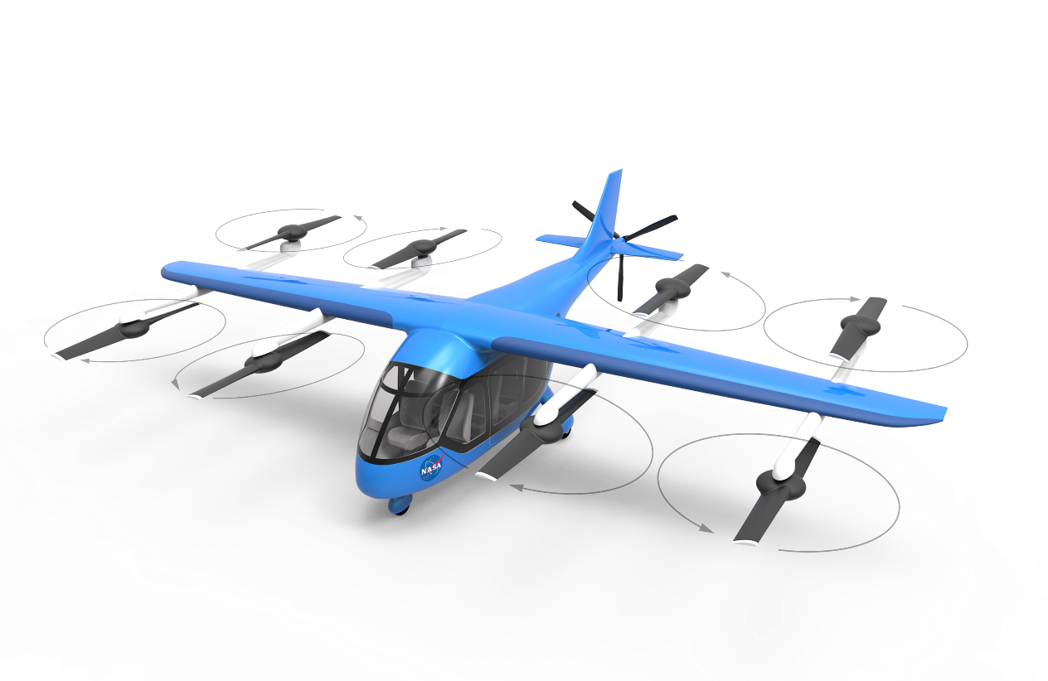
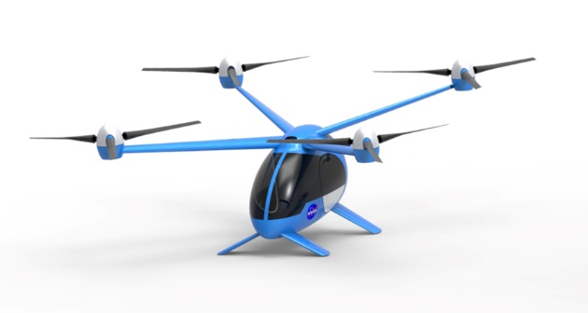
AAM Challenge
Traditional large transport vehicles limit design opportunities
  Tube and wing
Large helicopters and multirotor vehicles do have design opportunities but are limited also
  Traditional main/tail configurations
  X-rotors, tandem, etc.
AAM vehicles offer significantly more design opportunities
  Rotor count, placement, blade count, rotation direction
  Wing design and placement, installation effects
  Blade shape and rotor sizing
AAM vehicles also have significantly different flight mission requirements
Offers opportunity to design from the ground up
What can our design tools predict, what do our design tools miss?
  Do validation data exist?

Slide 4
Design Optimization
Many ways to optimize design for increased performance and/or reduced community impact
  Genetic algorithms, neural nets, gradient based, etc.
Adjoint based design optimization and backwards differentiation allow for much finer grain
  Perfect for small number of objectives (noise metric) with many design variables
    Design variables: blade shape, installation parameters, mission performance requirements, mission flight paths, etc.
  Can incorporate constraints (performance)
  Challenging to do integer optimizations (such as rotor count)
  Can (with adequate computational effort) do installation effects
Design optimization procedure:
Update Design
With Gradient
Design and Mission Parameters
(e.g. Blade Shape)
Vehicle Geometry
(e.g. Mesh)
Vehicle Dynamics, Performance, Loads
(e.g. CFD)
Acoustic Source Generation
(e.g. F1A)
Objective Function (F)
(e.g. Sum of OASPL)
No
Optimized Design
Yes
Converged?
How F Changes with Vehicle’s Design and Mission Parameters
(e.g. dF/dBlade Shape)
How F Changes with Vehicle Geometry
(e.g. dF/dMesh)
How F Changes with Vehicle Dynamics, Performance, Loads
(e.g. dF/dCFD)
How F Changes with Acoustic Source Generation
(e.g. dF/dF1A)
Seed Objective Function
(dF/dF = 1)
Tools said it is but is it?

Slide 5
Objective
Validate computational optimization design tools
  Noise measurement and computation (multiple rotors, installation, etc.)
  Mission from takeoff to landing (community impact objective)
  Must have measurement data set of baseline configuration (starting point)
Process of validation
  Select baseline configuration geometry and measurement data
  Validate our tools against baseline configuration data
  Run design tools to get optimized designs with performance constraints
  Fabricate optimized designs
  Test optimized designs under same conditions to see predicted improvement
What available data can be used as starting point
  Limited full-scale data, restricted to isolated rotor at this time
  Noisy rotor in a repeatable environment
  More than one flight condition
  Array of microphones for multiple emission angles (long duration flight)

Slide 6
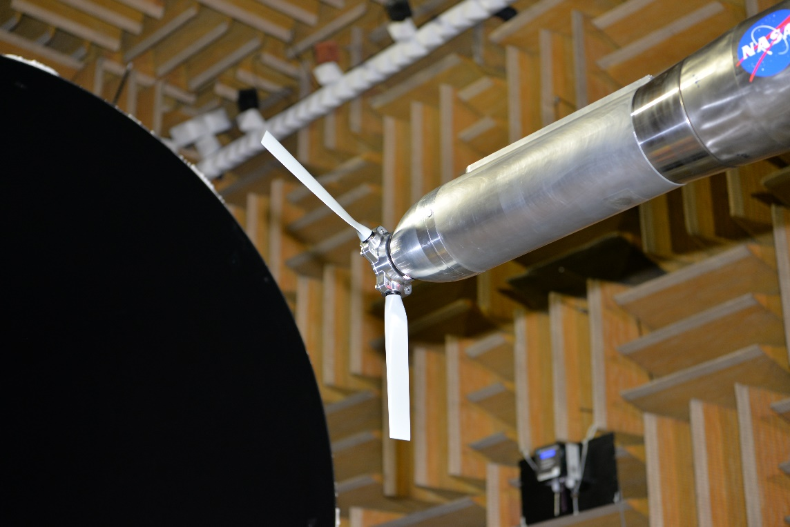
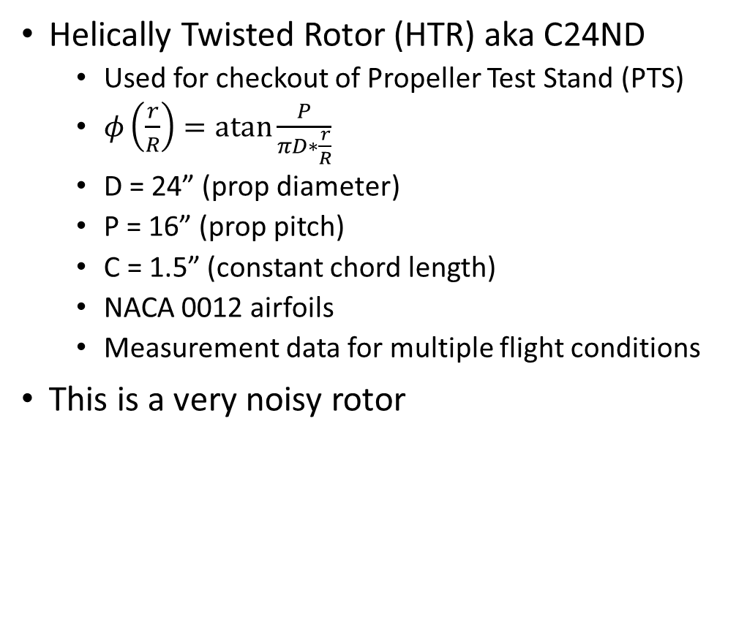
Available LSAWT Data
Helically Twisted Rotor (HTR) aka C24ND
  Used for checkout of Propeller Test Stand (PTS)
  $φ\left(\frac{r}{R}\right)=\operatorname{atan}{\frac{P}{πD∗\frac{r}{R}}}$
  D = 24” (prop diameter)
  P = 16” (prop pitch)
  C = 1.5” (constant chord length)
  NACA 0012 airfoils
  Measurement data for multiple flight conditions
This is a very noisy rotor

Slide 7
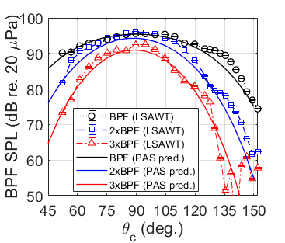
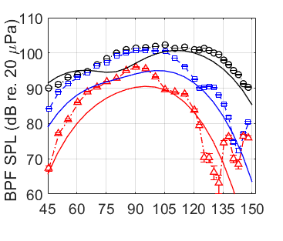
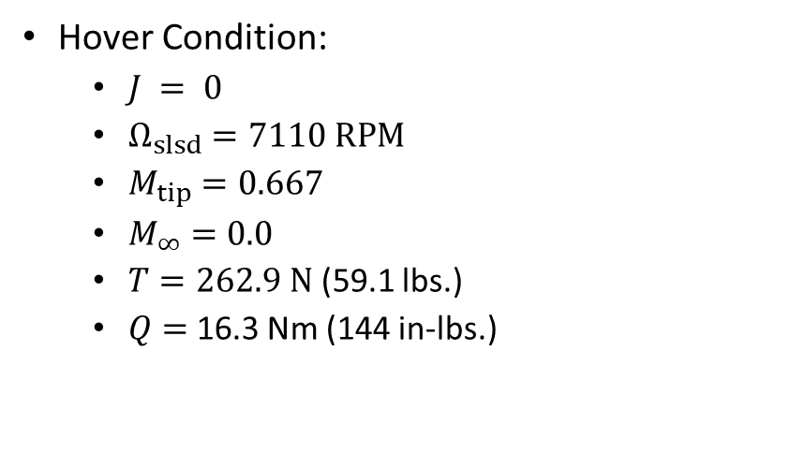
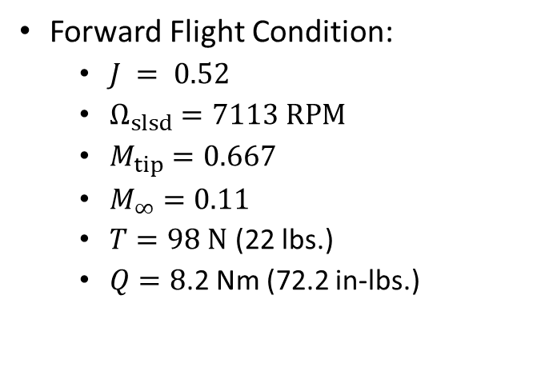
Helically Twisted Rotor (HTR) Data
Forward Flight Condition:
  $J = 0.52$
  $Ω_{slsd}=7113 RPM$
  $M_{tip}=0.667$
  $M_{∞}=0.11$
  $T=98 N$ (22 lbs.)
  $Q=8$.2 Nm (72.2 in-lbs.)
Preliminary Data and Predictions:
  Some thermal drift in thrust measurement may be present
  Recent improvements to PTS improves thermal drift resulting in more accurate load measurements
  ANOPP PAS has some difficulty predicting separation for hover condition
Credit Nikolas Zawodny
Hover Condition:
  $J = 0$
  $Ω_{slsd}=7110 RPM$
  $M_{tip}=0.667$
  $M_{∞}=0.0$
  $T=262.9 N$ (59.1 lbs.)
  $Q=$16.3 Nm (144 in-lbs.)

Slide 8
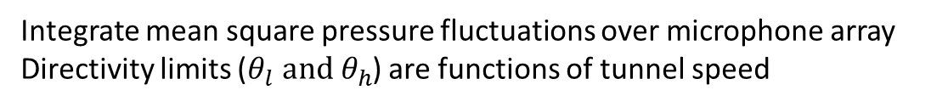
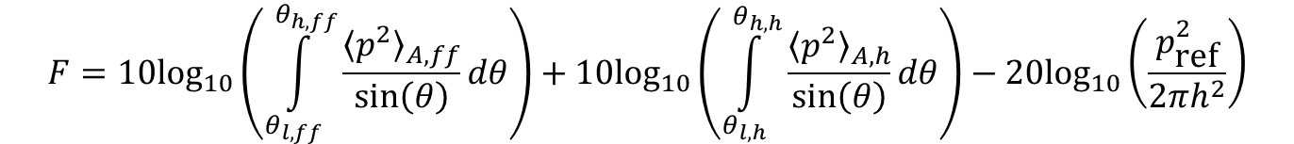


Objective Function
Incorporate as much as possible into objective function
  Only have isolated rotor data
  More than one flight condition to simulate maneuver
  Directivity to simulate flyover and multiple observers
  Frequency weighting to simulate human response
  Performance constraints (not shown)
    Optimized design must generate same thrust
    Optimized design torque cannot increase
LSAWT (not to scale)
Tunnel
Inlet
$$θ$$
Prop
Microphone Array
Tunnel Flow
Integrate mean square pressure fluctuations over microphone array
Directivity limits ($θ_{l} and θ_{h}$) are functions of tunnel speed
$$h$$
Tunnel
Collector
$$F=10{\text{log}}_{10}\left(\int_{θ_{l,ff}}^{θ_{h,ff}}{\frac{{\left\langle p^{2}\right\rangle }_{A,ff}}{\text{sin}\left(θ\right)}dθ}\right)+10{\text{log}}_{10}\left(\int_{θ_{l,h}}^{θ_{h,h}}{\frac{{\left\langle p^{2}\right\rangle }_{A,h}}{\text{sin}\left(θ\right)}dθ}\right)−20{\text{log}}_{10}\left(\frac{p_{\text{ref}}^{2}}{2πh^{2}}\right)$$
Forward Flight
Hover

Slide 9
Optimization Tools
Two tool fidelities
  Low granularity / fast computation (BEMT)
  High granularity / computationally intensive (CFD)
Four optimization tool approaches
  CCBlade.jl - BEMT code with compact acoustic sources
  ABEAT - BEMT code with compact/noncompact acoustic sources
  FUN3D - Unstructured CFD code
  SU2 - Unstructured CFD code

Slide 10
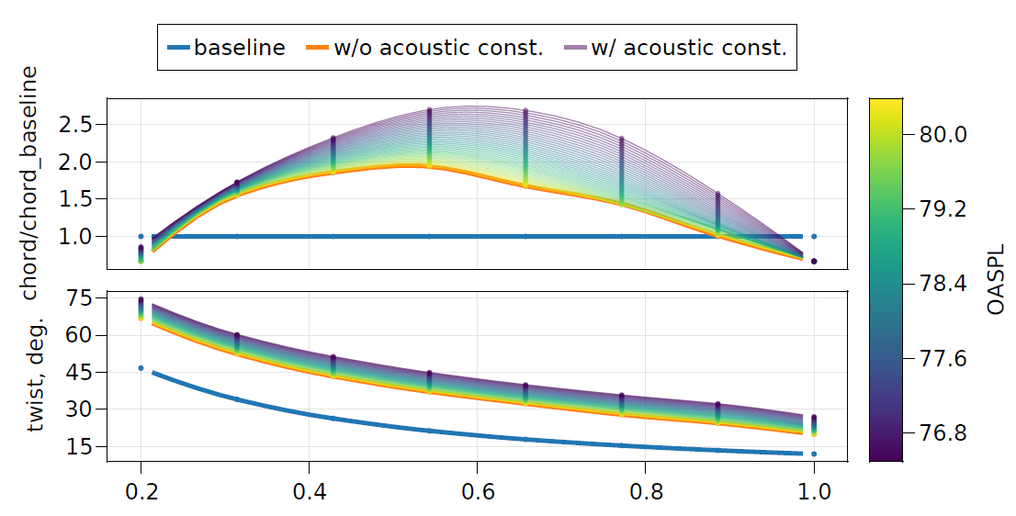
CCBlade.jl
Blade element momentum theory (BEMT)
  Compact formulation of F1A
  Very fast approximation of the noise
  Simple approximation of blade shape influence on airfoil section lift and drag
Much more detail and preliminary results in Dan Ingraham’s talk following this talk

Slide 11
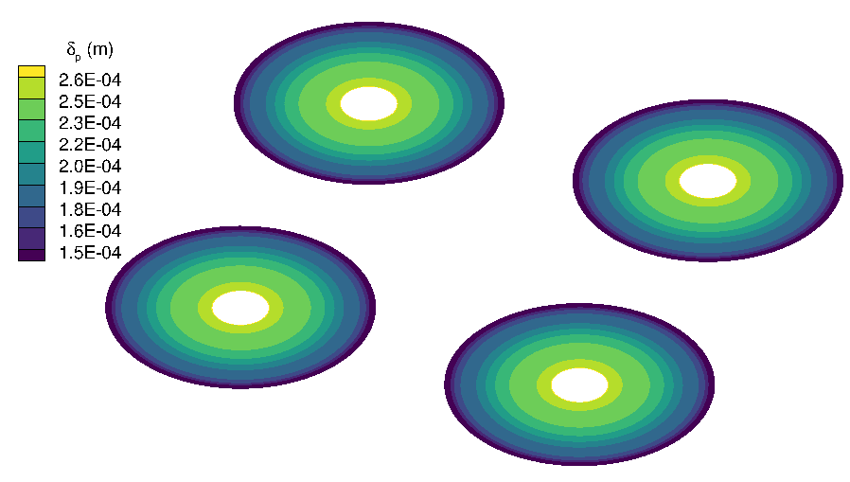
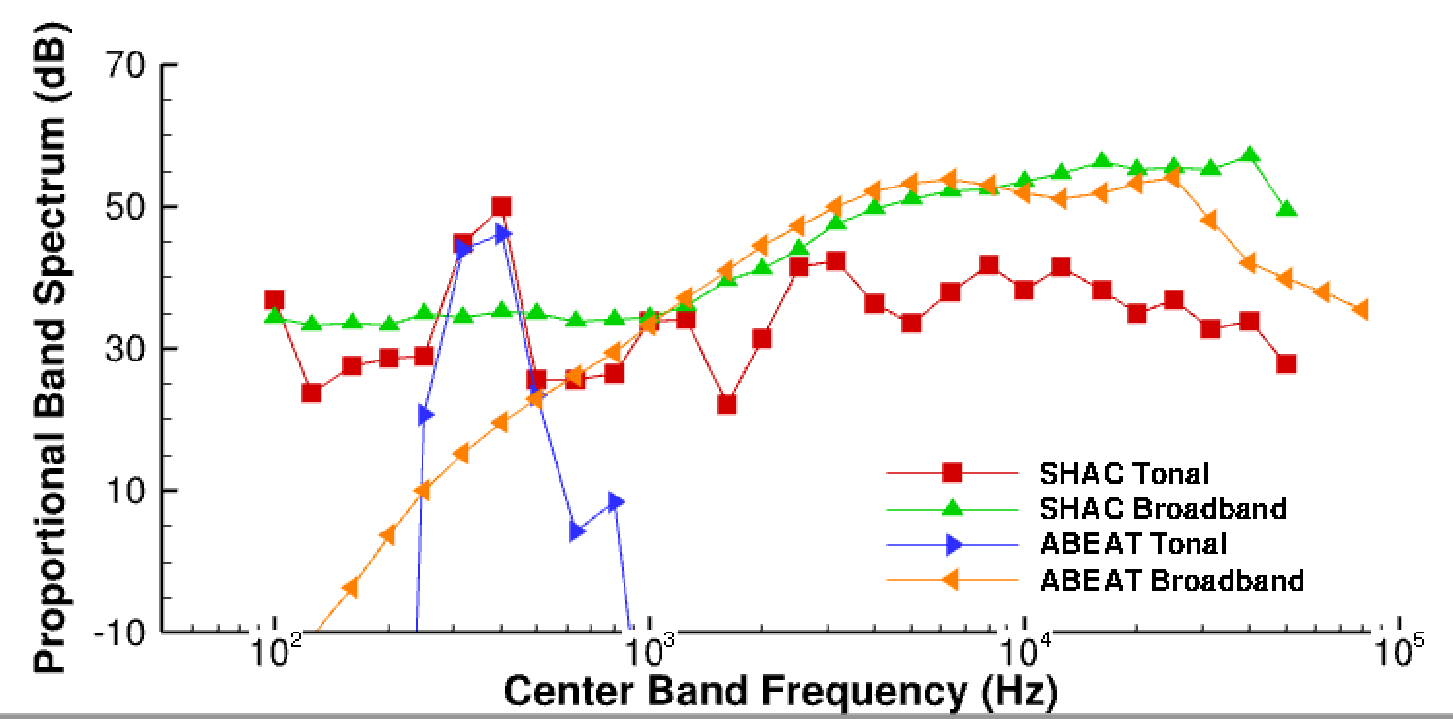
ANOPP2’s Blade Element Acoustic Tool (ABEAT)
Capability
  Fast computation of noise from vehicle with single (helicopter) or multirotor (GL-10)
  Each rotor may have similar airfoil geometry but may differ in RPM, phase offset, inflow, rotor angle of attack
  Use linear inflow models (such as uniform, Pitt-Peters, etc.) but may also couple with user specified inflow
  Include empirical broadband noise prediction (define boundary layer conditions and noise predictions)
  No trimming, kinematics of propeller/rotor blades are fixed pitch (currently)
  Only compact sources for tonal noise (currently, will be updated with next iteration)
  Motor noise when ready
Available in ANOPP2v1.3

Slide 12
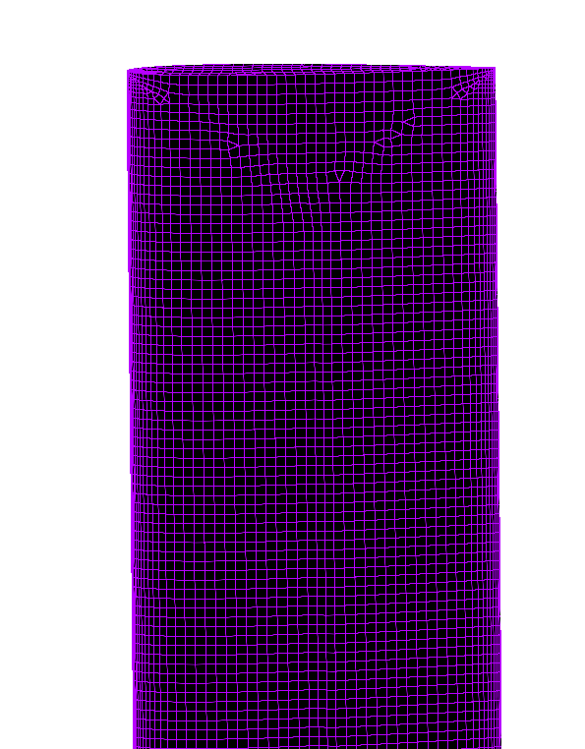
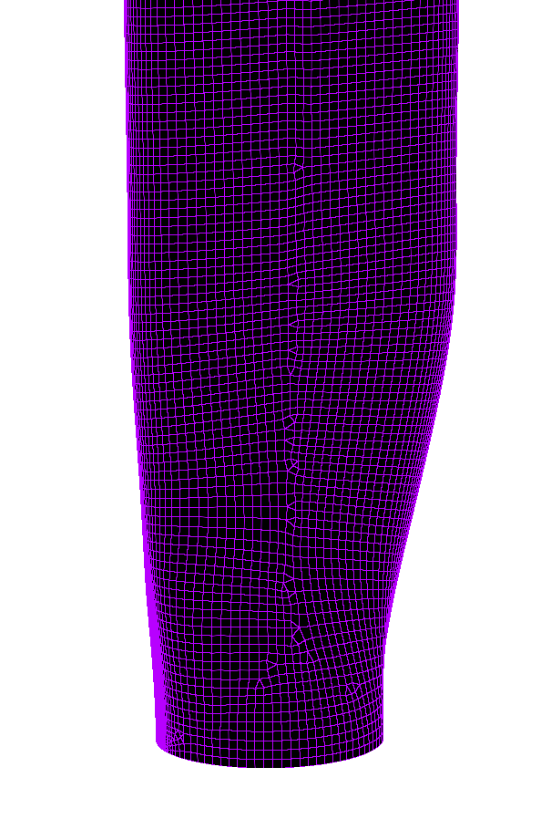
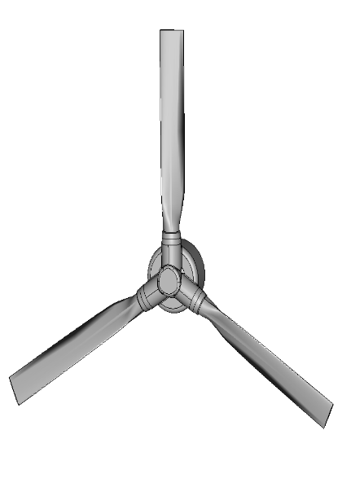
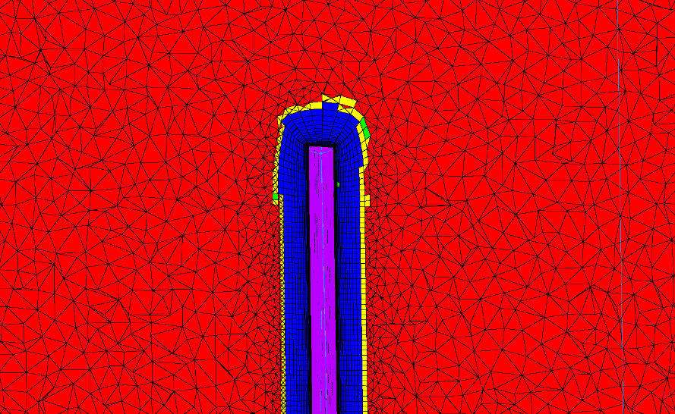
FUN3D CFD Solver
Physical time stepping:
  2nd order in time (BDF2OPT)
Spatial differencing
  2nd order row upwind for inviscid terms
  2nd order central differencing for viscous terms
Turbulence model
  Spalart-Allmaras one-equation model
Unstructured overset grids
Steady and unsteady Predictions
Adjoint capable

Slide 13

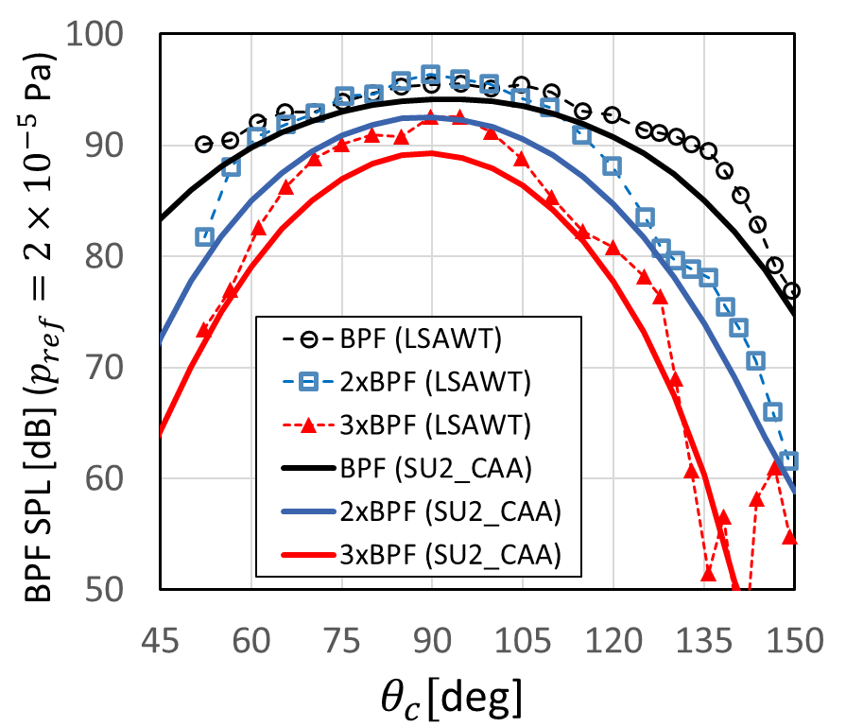
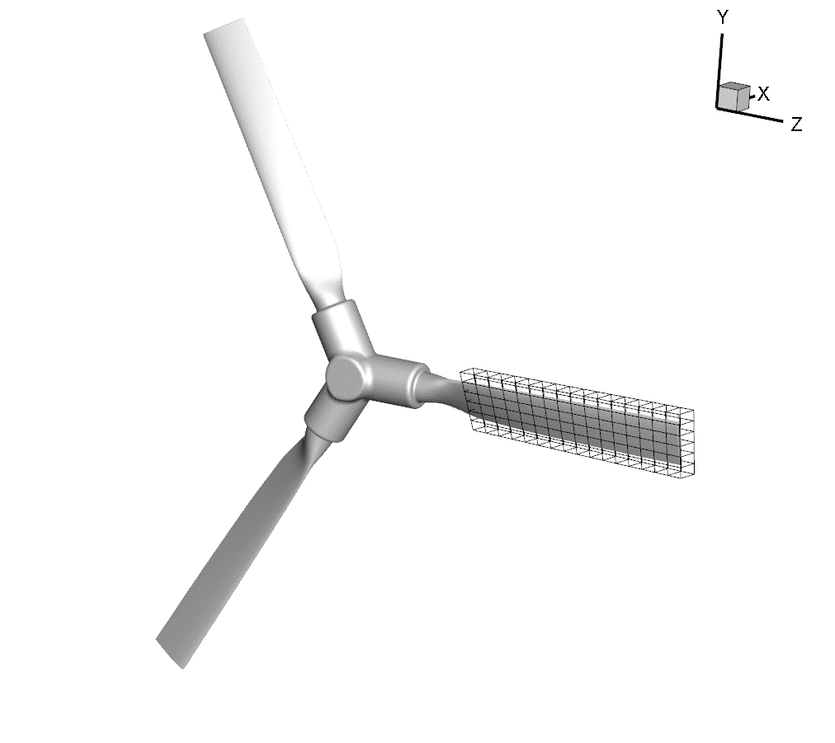
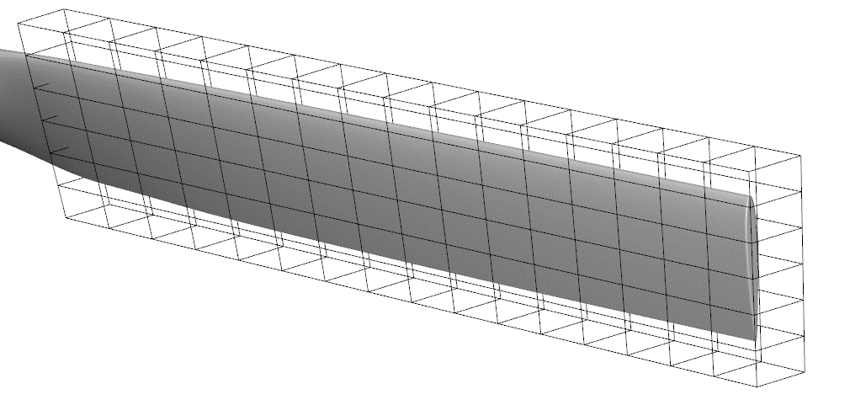
SU2 CFD Solver
“Stanford University Unstructured (SU2)” is an open source PDE solver
Active developer base around the world with many applications
Adjoint-based capable for design
Vertex-based, unsteady Reynolds-Averaged Navient-Stokes (URANS)

Slide 14
Current Status and Plan Moving Forward
Currently validating acoustic prediction of baseline design
  Each of four methods at different stages of validation
  Some methods have produced optimized designs with some success
  Have not incorporated full objective function
  Some code development still underway
Hope to have several optimized candidates by early summer
  Currently have a few designs that can be fabricated but not final
  New designs ready to fabricate by early summer
  Placed in LSAWT in late summer / early fall
  Maybe present preliminary comparisons at fall ATWG

Slide 15
Personnel
Justin Gray (NASA Glenn)
  Leading Multidisciplinary Design Optimization (MDAO) effort
Daniel Ingraham (NASA Glenn)
  Acoustic optimization using CCBlade.jl (following presentation)
Douglas Nark (NASA Langley)
  FUN3D design optimization
Oktay Basal and Omur Icke (ODU) with Boris Diskin (NIA)
  SU2 design optimization
  Special thanks to Beckett Zhou of TU Kaiserslautern
Joshua Blake and ANOPP2 development team (NASA Langley)
  ABEAT development and design optimization
Nikolas Zawodny (NASA Langley)
  LSAWT experiments and validation database generation

Slide 16
Conclusions
Reviewed benefits of UAM vehicles to airspace
Presented a gradient based design optimizations approach for UAM
Outlined a methodology for validating optimization tools
Showed selection of helically twisted rotor test in LSAWT as baseline
Presented four optimization tools of differing fidelity and capability
Outlined plan for future measurements in LSAWT of optimized designs

Slide 17
Acknowledgments
Support
Transformational Tools & Technologies (TTT) Project in the Transformative Aeronautics Concepts Program (TACP)

