Slide 1

NASA Auralization Framework 1.2 Upcoming Release
Aric Aumann, Analytical Services and Materials
Brian Tuttle, Analytical Mechanics Associates, Inc.
Acoustics Technical Working Group Meeting
April 14, 2021

Slide 2
Outline
NASA Auralization Framework (NAF)
  Overview
Recent Capability Enhancements – Research Driven Requirements
  Multiple pure tones (buzzsaw tones)
  Narrowband synthesis
  Rotor self-noise (modulated broadband)
  Unsteady blade loading and thickness noise (F1A synthesis)
  SAE 866a atmosphere
Documentation
Summary

Slide 3
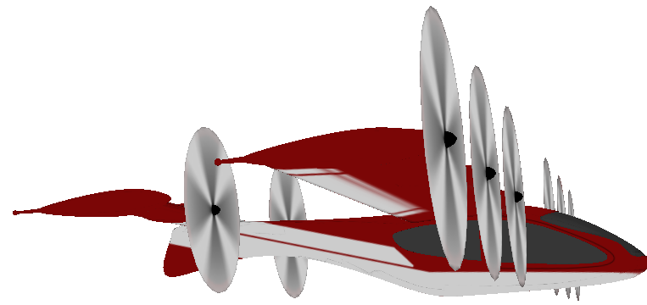
NAF Overview - Standard Use Case
Update Scene
Find Paths
Per Path
Emission Angle
Path
Synthesize Source Noise
Path: Gain, Time Delay, Filters (GTF)
Direct Path
Sample Buffer
GTF Series
Propagate
Reflected Path
Output Buffer
Ground Observer
Output
Loop
Notes:
Input includes source noise definition – Wind Tunnel, Predictions (ANOPP2), Flight Test

Slide 4
NAF and Advanced Plugin Library 1.2 Contents
Programs
NAFSNAP: Source Noise and Propagation
NAFExample
ANOPP2 Interface Examples
  Quickstart-modified
  F1A Synthesis
Path Finder / Traverser
Straight Line
Receiver-based
Atmosphere
Parameter definitions
  Uniform
  Isothermal
  Lapse
  Balloon File
Absorption Standard
  ANSI
  SAE
  SAE ARP 866A
Synth / Component
Directivity Loader
Restart Component
1/3 Octave Band
Narrowband
Modulated 1/3 OB
Pure Tone
Periodic
Multiple Pure Tone
F1A Synthesis
Wave File
Random
Ground Reflection
Infinitely Hard Ground
Delany-Bazley Impedance model
Directivity Loaders
NetCDF
TXT (ASCII)
Plot3D
Other
Postprocessors
  ANOPP2 Metrics
  Normalization
Preprocessor
  F1A Synth
Trajectory
  CSV file - track
  Higher order motion file
Notes:
An auralization in the NAF can be built from the pieces shown here, by putting the pieces together in a custom user code, or by running NAFSNAP.
The listing pictured is meant to give an idea of the scope of capabilities present in the NAF, with the red text indicating those newer capabilities to be highlighted today.

Slide 5
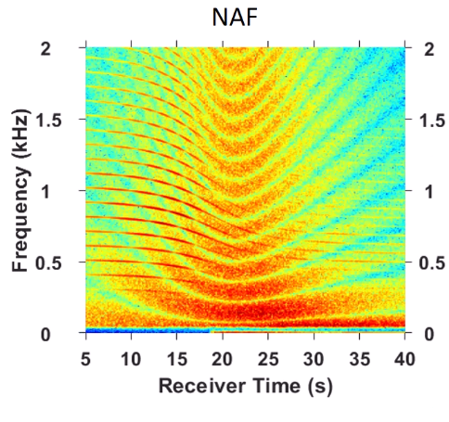

Multiple Pure Tone Synthesis
AKA Buzzsaw or Combination Tones
Prediction is 1/3 octave band as predicted by ANOPP’s modified Heidmann fan
Generate shaft order harmonic series, matching band energies
Was part of pre-NAF Synthesis code, now available in NAF
“A Comparison of Aircraft Flyover Auralizations by the Aircraft Noise Simulation Working Group”, Stephen A. Rizzi, Ingrid LeGriffon, Reto Pieren, and Lothar Bertsch, AIAA AVIATION 2020, AIAA-2020-2582, Virtual Event, 15-19 June 2020. https://doi.org/10.2514/6.2020-2582
Notes:
Spectrogram is zoomed on lower 2 kHz to capture the Buzzsaw harmonic series.
Comb filtering from ground reflection.

Slide 6
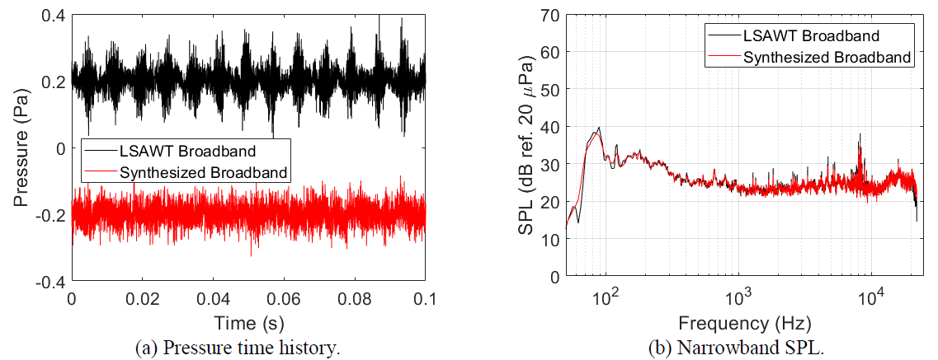
Narrowband Synthesis
Empirical data with magnitude and phase
Could also have prediction in narrowband
Was part of pre-NAF Synthesis code, now available in NAF
LSAWT
Synthesized
Audio sample levels
adjusted for playback
“On the use of Acoustic Wind Tunnel Data for the Simulation of sUAS Flyover Noise”, Stephen A. Rizzi, Nikolas S. Zawodny, and Nicole A. Pettingill, 25th AIAA/CEAS Aeroacoustics Conference, AIAA-2019-2630, Delft, NL, 20-23 May 2019. https://doi.org/10.2514/6.2019-2630
Notes:
Link to ModBB

Slide 7
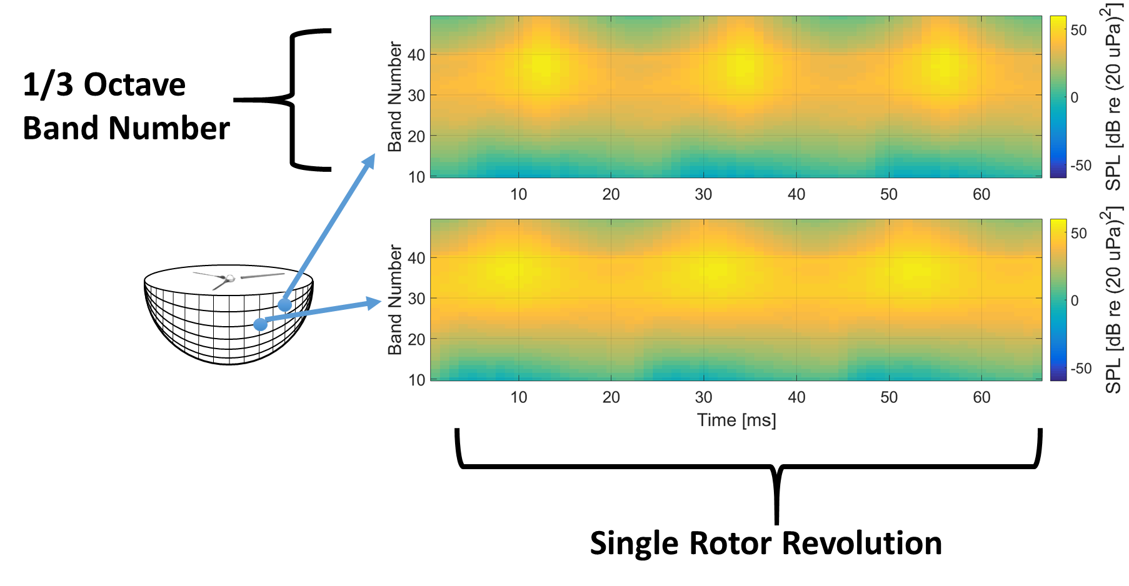
Broadband Self Noise Sound Pressure Predictions
Self noise sound pressure predictions from ANOPP2 Self Noise Internal Functional Module (ASNIFM) are sound pressure levels in each 1/3 octave band as a function of time over a single rotor revolution.

Slide 8
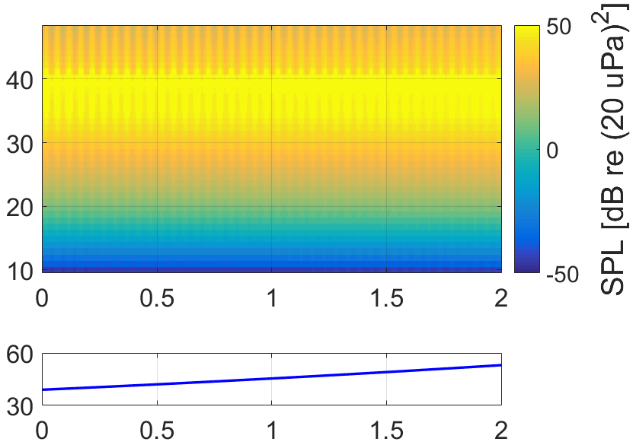
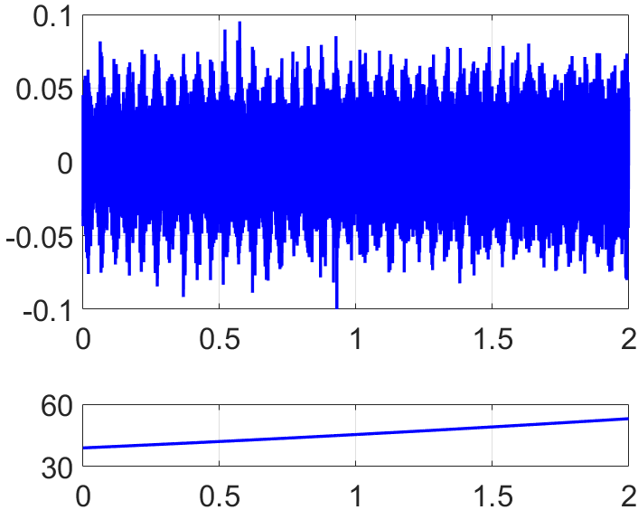
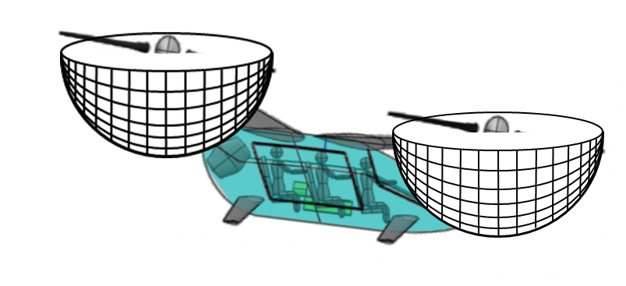



Self Noise Flyover Sound Synthesis
Details to be provided in plugin paper.
Primary Steps:
  Interpolate over emission angles to get 1 revolution of self noise.
  Extend or trim self noise to duration of current buffer.
  Modulate stochastic signal by self noise data.
Synthesized Sound Near Rotor to Propagate to Ground Observer
Sound Pressure Level Prediction Data
Band Number
Pressure [Pa]
$$θ$$
Ground
$θ$[deg]
$θ$[deg]
Ground Observer
Flyover Duration [s]
Flyover Duration [s]
“A Synthesis Plugin for Auralization of Rotor Self Noise”, Siddhartha Krishnamurthy, Aric Aumann, Stephen Rizzi, AIAA Aviation Forum 2021, Virtual Event, 2-6 August, 2021
Rotor 1 Self Noise
(25 sec)
Notes:
Maybe mention restart loader as part of this plugin development.
Reference LSAWT data.

Slide 9
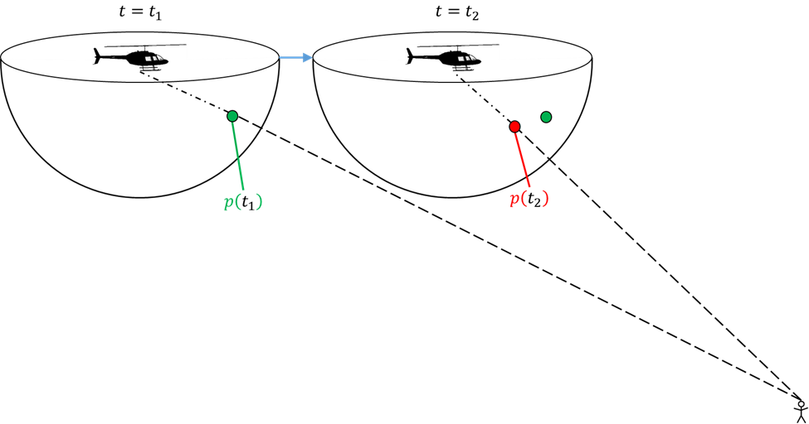
F1A Synthesis
Sound pressures generated using F1A from ANOPP2 Farassat’s Formulations Internal Functional Module (AFFIFM)
Improved method avoids need for additional interpolation
Can be applied to steady and unsteady periodic and
unsteady aperiodic sound synthesis

Slide 10
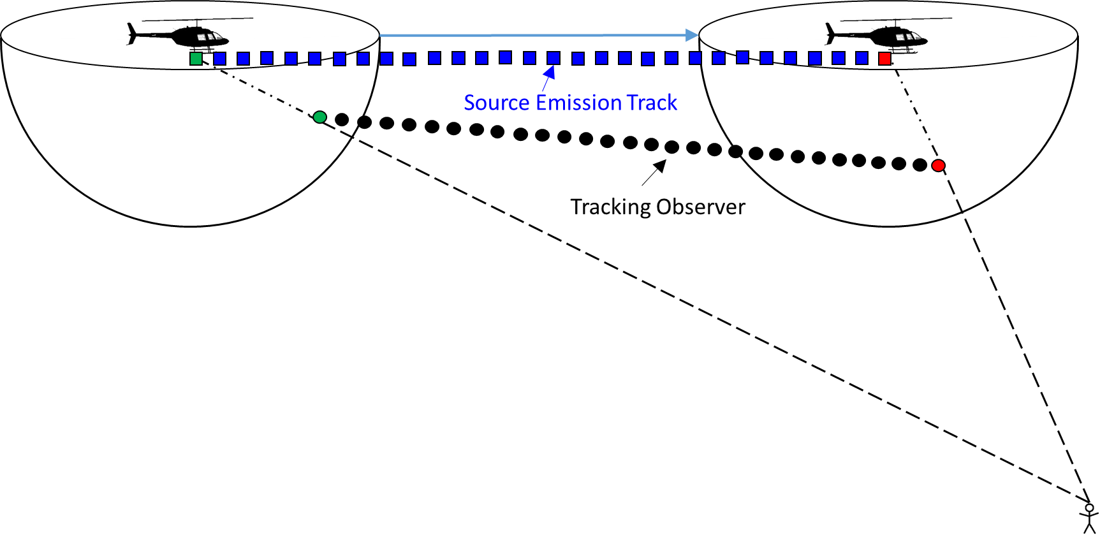
F1A Synthesis Tracking Observer
Constant distance r maintained between source emission track and tracking observer
r
r
“A Synthesis Plug-in for Steady and Unsteady Loading and Thickness Noise Auralization”, Siddhartha Krishnamurthy, Brian C. Tuttle, and Stephen A. Rizzi, AIAA Aviation 2020 Forum, AIAA-2020-2597, Virtual Event, 15-19 June 2020. https://doi.org/10.2514/6.2020-2597
NASA Auralization Framework (NAF) synthesizes and propagates sound to ground observer
The NAF F1A Synthesis Plugin synthesizes sound pressures at the tracking observer
Each vehicle noise source and each propagation path requires separate tracking observer

Slide 11
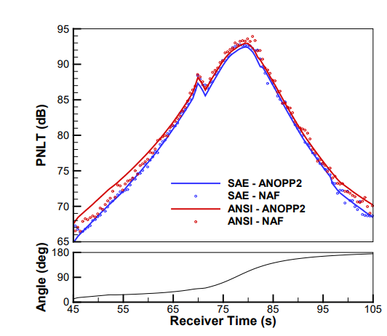
SAE ARP 866A Absorption
Added model for calculating absorption according to SAE ARP 866 Revision A
Consistent with prediction tool chain
NAF Advanced Plugin Library now includes ANSI as well as SAE ARP 866A absorption models
“Auralization of a Supersonic Business Jet Using Advanced Takeoff Procedures”, Stephen A. Rizzi, Jeffrey J. Berton, and Brian C. Tuttle, AIAA SciTech 2020, AIAA-2020-0266, Orlando, FL, USA, 6-10 January 2020. https://doi.org/10.2514/6.2020-0266

Slide 12
Documentation
User manuals
  NAF API Reference
  F1A Synthesis Plugin
  Modulated Broadband Plugin
Example codes for the plugins

Slide 13
Summary
NASA Auralization Framework 1.2 available soon
Research driven development
  Available soon after developed
  Community benefit from NASA research
Documentation
Software Request Links (when available) – or search software.nasa.gov
  NAF: https://software.nasa.gov/software/LAR-18541-1
  NAF-APL: https://software.nasa.gov/software/LAR-19278-1
  ANOPP2: https://software.nasa.gov/software/LAR-19861-1

Slide 14
Acknowledgements
Transformational Tools and Technologies Project
- NAF development
Revolutionary Vertical Lift Technology Project
- research driven prototype developments

Slide 15
Graveyard - Hidden Slides

Slide 16
Modulated Broadband Synthesis
Context: quadrotor flyover auralization to include sounds from both periodic noise and broadband self-noise predictions.
Input Blade Data
ANOPP2
NAF
Sound Pressure Prediction
CAMRAD II (for this effort)
Blade Inflow Velocity & Eff. Angle of Attack
Broadband Self Noise
Flyover Self Noise Synthesis
Propagate Synthesized Self Noise
Modulated Broadband Plugin
Propagation in NAF
ANOPP2 Self Noise Internal Functional Module (ASNIFM)
“Prediction-Based Auralization of a Multirotor Urban Air Mobility Vehicle,” Siddhartha Krishnamurthy, Stephen A. Rizzi, Rui Cheng, D. Douglas Boyd, Jr., and Andrew Christian, AIAA SciTech 2021, AIAA-2021-0587, Virtual Event, 11-15 & 19-21 January 2021. https://doi.org/10.2514/6.2021-0587
Sum with sounds from other rotors to complete auralization
Notes:
Can be cut

Slide 17
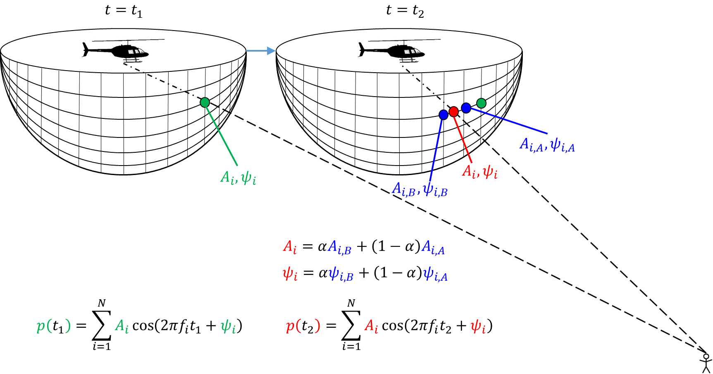
Current method: Additive Synthesis
Auralizations start with synthesizing sound near source and then propagating to ground
Interpolation of magnitude and phase over discrete set of source
noise predictions may introduce audible artifacts for additive synthesis
Formulation 1A (F1A) used to predict one blade passage or one revolution of sound pressures at discrete set of points on hemisphere
Notes:
Move to Graveyard

