Slide 1
Porosity Quantification During Composite Cure in an Autoclave Utilizing an Ultrasonic Inspection System and Machine Learning
Tyler B. Hudson^{1*}, Joseph J. Pinakidis², Patrick J. Follis², and Frank L. Palmieri¹
¹ NASA Langley Research Center, Hampton, VA 23681, USA
² NASA Internships and Fellowships, NASA Langley Research Center, Hampton, VA 23666, USA
*Corresponding author: tyler.b.hudson@nasa.gov
ASNT Research Symposium 2021
April 27-29, 2021
All uncredited figures and images generated at NASA
Notes:
This summer my project focused on

Slide 2
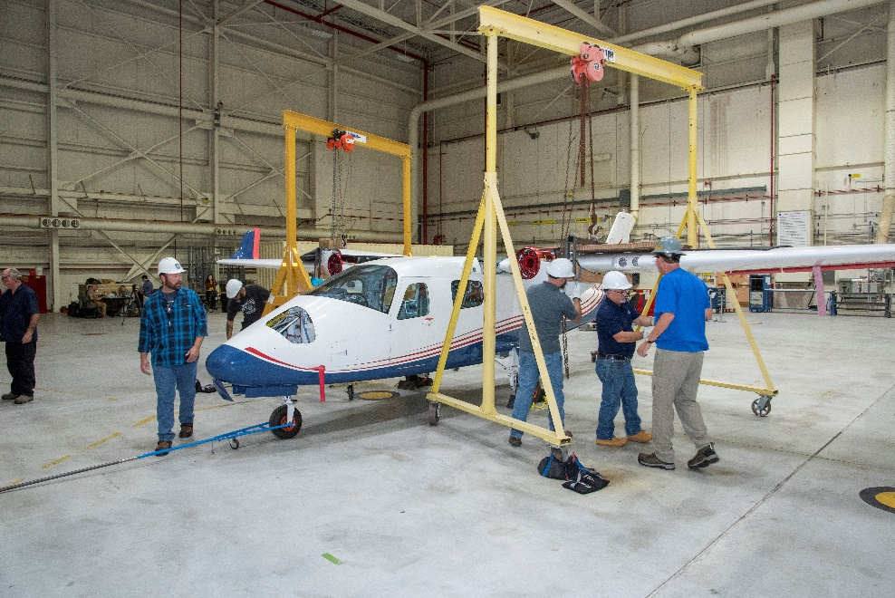
Challenge
Composite materials offer many advantages to aerospace applications
Defects (e.g., porosity) occur during the manufacture of composites, including cure
In-situ inspection system developed
  Measures ultrasonic wave amplitude, which is correlated to panel porosity
Seeking quantitative function that can connect these two variables
Can a Machine Learning model capture this relationship accurately?
Image Credit: NASA/AFRC/Ken Ulbrich
(https://images.nasa.gov/details-AFRC2019-0260-53)
Image Credit: NASA
Notes:
High strength to weight ratio
Image shows all-electric x-57 Maxwell developed by NASA. Uses composite wings
Images show Optical micrographs of carbon fiber laminate
Defects during cure result from uneven pressures, temperature gradients across the part, varying degree of cure and fiber volume fraction
Only post-cure validation of model has been possible thus far
The challenge this time around comes from developing a quantitative function that can relate measured amplitude to porosity
more value to this than just validating model... potential use throughout the industry, value to reduce scrap and reduce manufacturing time. will hopefully have large ramifications in the aerospace realm

Slide 3
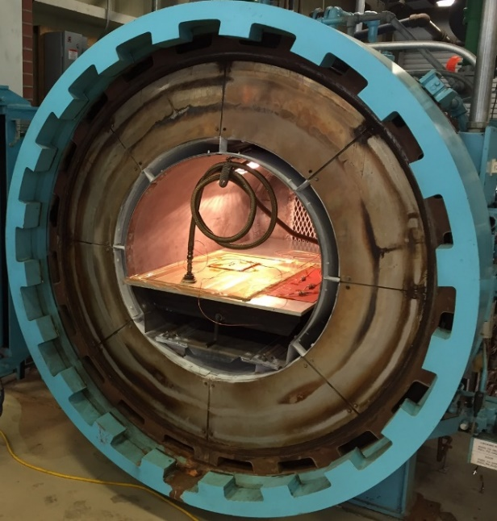
Objective
Utilize Machine Learning (ML) techniques to quantify porosity in real time from measured amplitude
  Amplitude depends on many variables (Porosity, number of plies, slope of panel surface, temperature, viscosity, Tg, and pressure)
Compare predicted porosities from ML against simulated porosities from process model
Determine preferred
regression method for this data
Advance understanding of
ML and its applications to
composite process monitoring
Image Credit: NASA
Notes:
To attack the challenge of quantifying porosity in real time from measured amplitude was to utilize machine learning
Each machine learning method has its pros and cons such as training time, prediction time, accuracy, trends
this image is not to scale and greatly distorted to see the taper, in reality its very thin and the caul plate bends around it during cure

Slide 4
System Design
Began with testing in oven, then transitioned to autoclave
Scanner mounted inside insulated, unsealed cooling enclosure
  Liquid nitrogen (LN₂) delivered from outside of autoclave maintains the temperature inside enclosure
  Autoclave controls maintain temperature and pressure for curing
Flexible bellow on side of container allows for
±X-Y movement of cantilever arm with transducer
High-temperature transducer (2.25 MHz) inspects composite part through the tool plate
  Composite part vacuum bagged underneath
  tool plate (Other orientations possible)
Ultrasonic waves reveal internal
structure of composite panel
Modular design allows for modifications
Image Credit: NASA
Contact UT
Transducer
Couplant
Tool Plate
Composite
Notes:
This meant an LN2 cooling system was needed to deliver LN2 in bursts to the insulated box. The pressure was okay
Ultrasonic pulse echo inspection
Carbon fiber panel bagged to underside of tool plate to be inspected through the tool plate
Key reflection was the composite and caul plate interface. Amplitude correlated to porosity - Ultrasonic waves dissipate in air (porosity)
Caul plate was varied to create expected low pressure points which allows porosity to form

Slide 5
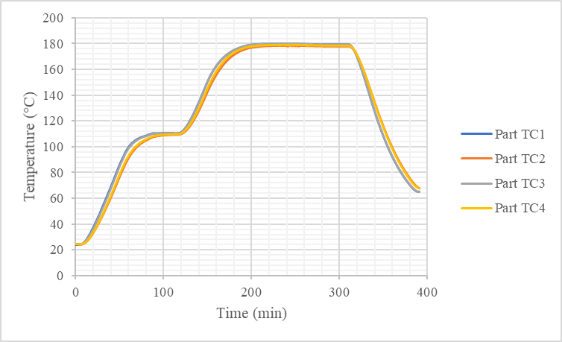
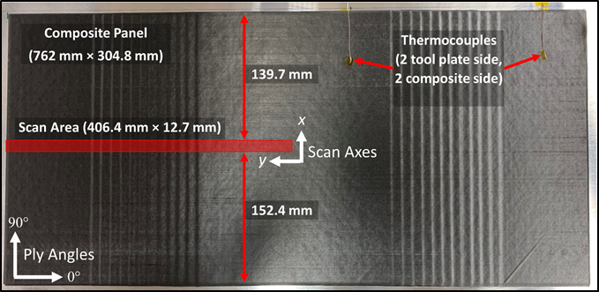
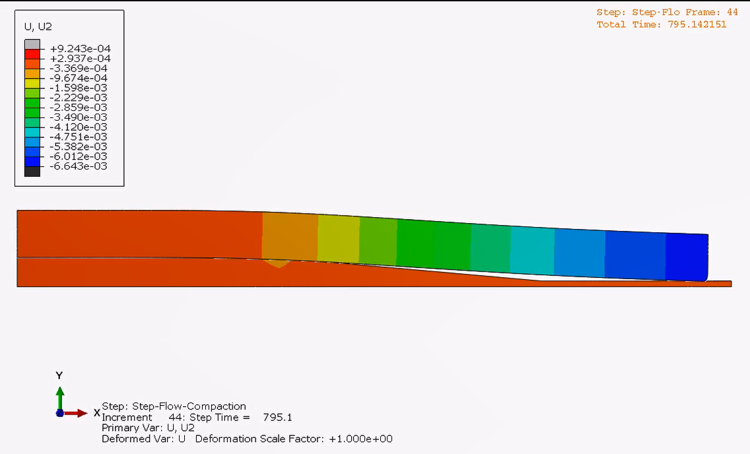
Autoclave Testing
Composite panel prior to cure with in-situ scan area highlighted in red
Part temperatures from four thermocouples (TCs) in contact with composite
Tool plate
Caul plate bending during cure
(color indicates displacement)
In-situ inspection setup for ply-drop panel with caul plate
5

Slide 6
Machine Learning Approach
1
2
3
4
Choose Regression Model (Generate Function Code)
Pre-Process Data
Use Model for Prediction
Train Model
Notes:
Unwrap consolidated experimental data
Document pros and cons of various ML Regression Models
Trained the model on a larger data set to make it more robust and capture a larger range
Relate the amplitude response signal received to predict porosity in real time
Most creativity used in step 4 with building scripts and how I would use the model for predictions
Iterative scripting – would have to go back to step 2 if the generated images were not satisfactory

Slide 7
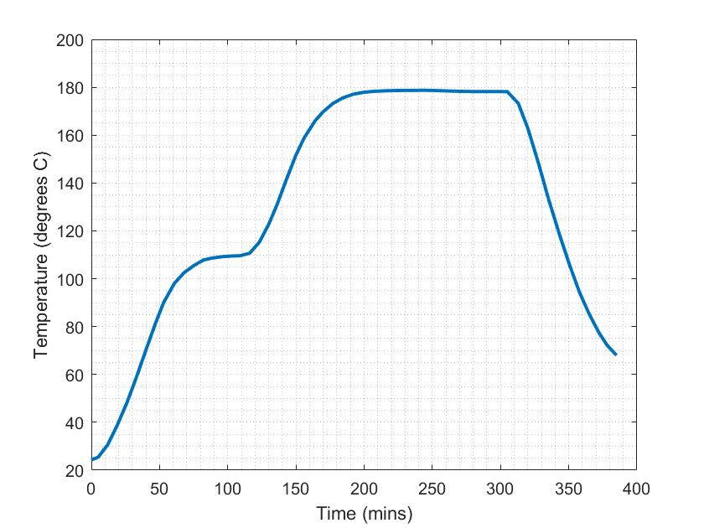
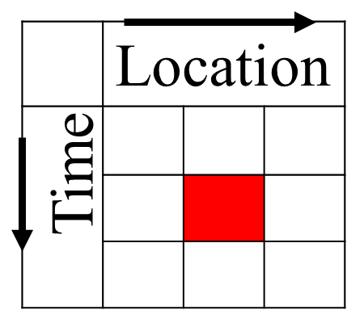
Step 1: Pre-Process Data Collection
At each pixel:
  Ultrasonic Amplitude
  Temperature
  Pressure
  Resin Viscosity
  Degree of Cure (DoC)
  Glass Transition Temperature (T_{g})
    Viscosity, DoC, and Tg predicted using process model and measured time vs. temperature
  Panel Thickness
  …
Input data for each pixel into machine learning algorithms
Notes:
This black and white image is what the ultrasonic sensor receives, analogous to an ultrasound just like you use at a doctor’s office
Using the same technology that you use to look at babies to look at defects in a panel

Slide 8
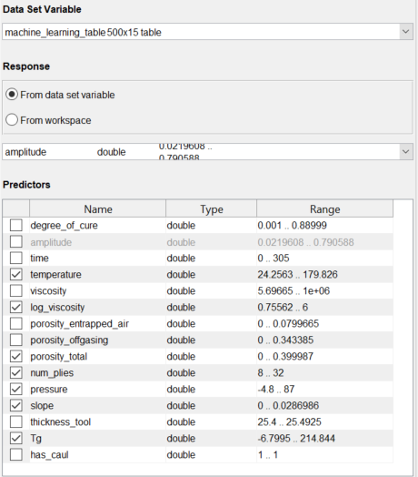
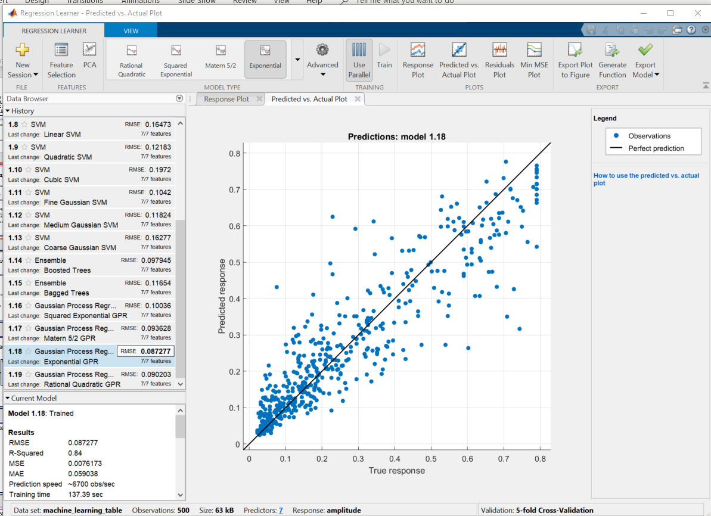
Step 2: Choose ML Model
Notes:
Feed in a smaller subset of data to reduce training time
Simulated porosity as a predictor, we would like to take micrographs post-cure but we cannot due to COVID-19
Number of plies is a substitute for thickness of panel
Cross validation versus holdout validation to prevent overfitting
Various regression algorithms
Perfect fit along black line
GPR is pretty good because it does follow this trendline well

Slide 9
Step 3: Train Model
Input Data
Train Model
Save Model
Number of Data Points in Training Data Set | Training Time (s)* | RMSE | Prediction Time for 500,000 Data Points/Pixels (s)*
500 | 1.0 | 0.079 | 8.3
1,000 | 12 | 0.064 | 14
5,000 | 45 | 0.059 | 59
10,000 | 71 | 0.054 | 118
25,000 | 4,518 | 0.049 | 291
50,000 | 16,854 | 0.049 | 583
75,000 | 35,473 | 0.047 | 876
*Training and prediction times using single core of laptop computer.
Notes:
Once we select the preferred model, we want to train it on a larger data set
more robust ML model
Wider range
Save various trained models for convenient usage in later scripts, makes it easier for comparison

Slide 10
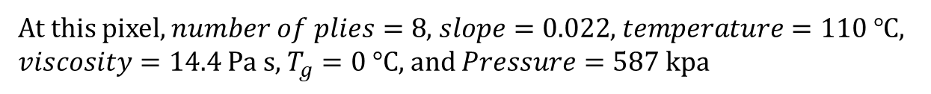
Step 4: Use Model for Prediction
$$Amplitude=f(porosity, number of plies,slope,temperature, viscosity, T_{g},pressure)$$
At this pixel, $number of plies=8$, $slope=0.022$, $temperature=110 ℃$, $viscosity=14.4$ Pa s, $T_{g}=0 °C$, and $Pressure=587$ kpa
Measured Amplitude = 11.3%
Predicted Porosity = 7.6%
Notes:
Graph is for Experiment 1, Scan 13, y = 279 mm
The generated ML model is a function that predicts porosity based on these predictors
For example, at one pixel there is a value for each variable
But I held them all constant and varied porosity as I fed it into the prediction model
The scripts automatically scans the plot to find the entry where the measured amplitude (known) is closest to the predicted amplitude
Follow this over to the point, then go downwards to see what porosity was fed in
This is the predicted porosity for that pixel, using a “back-door approach” and it assigns it to a structure so that the image can then be generated at each scan
Mention why we need to use amplitude empirical relationship to predict porosity

Slide 11
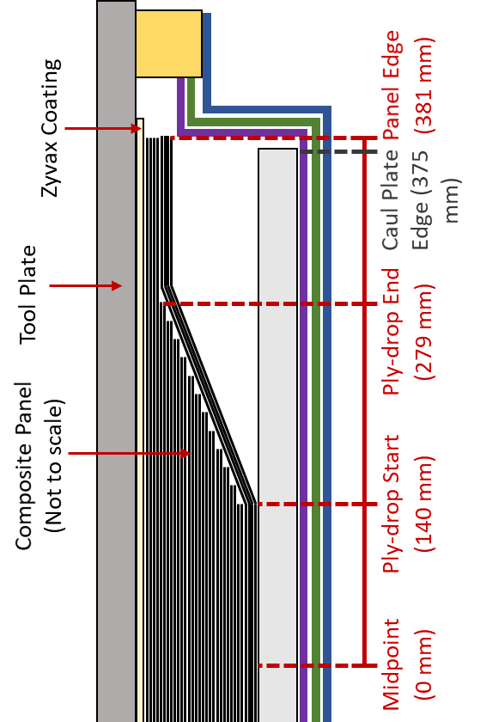
Results
Tool plate
Caul plate
(Cross-section view)
(Top view)
Notes:
These are some generated images of the panel
Measured amplitude, predicted porosity, and simulated porosity
It’s important to consider them collectively to get the whole picture
In image a, there are similar porosity levels near the end of the ply drop region, which is really good
This is a small taste of the many panel images I generated this summer
The rigid porosity near y = 40 mm is most likely due to a step in “slope” variable
In image b, it does well at y = 300, and the prediction actually does a good job from y = 150 to 200.
We have observed porosity exists here in post-cure micrographs, so we actually think the problem is with the process model and not with ML

Slide 12
Analysis Summary
ML demonstrates advancement in defect detection, localization, and quantification for composites
  Quantified porosity value from measured amplitude
Limited to range of data set
The ML tool is effective for predicting porosity in panel
  Compared against simulated porosity
Notes:
Quantified porosity based on a conglomeration of variables, not just amplitude
Meaningful results from the model
Shows a lot of promise compared to simulated porosity, and it would be even more interesting/valuable to see how it compares to post-cure data
Porosity detection in real-time in an autoclave is possible, which was the ultimate goal:
Remember, only post-cure porosity detection has been done, not yet in real-time so this is cutting edge!

Slide 13
Impact
System Features:
  System developed that performs defect detection, localization, and quantification during cure in oven and autoclave
  High spatial resolution cure monitoring of resin state and material properties (in addition to defect detection)
  Scalable from research and development to existing production lines
  No change required to current part design and limited changes to processing equipment
Impact:
  Real-time knowledge of porosity (or other defect) location and quantity during cure
  Validation of process models and/or processing parameters during certification
  Control of processing parameters during cure based on real-time measurements
  More efficient process development, shortened certification time, reduction in off-spec parts, and increased production throughput
Applications:
  Aircraft, launch vehicles, satellite buses, automotive, wind turbine blades marine, etc.
  Users: OEMs, Tier I/II suppliers, inspection equipment manufacturers, inspection service companies, processing equipment (e.g., autoclaves) manufacturers, government agencies, universities, research labs

Slide 14
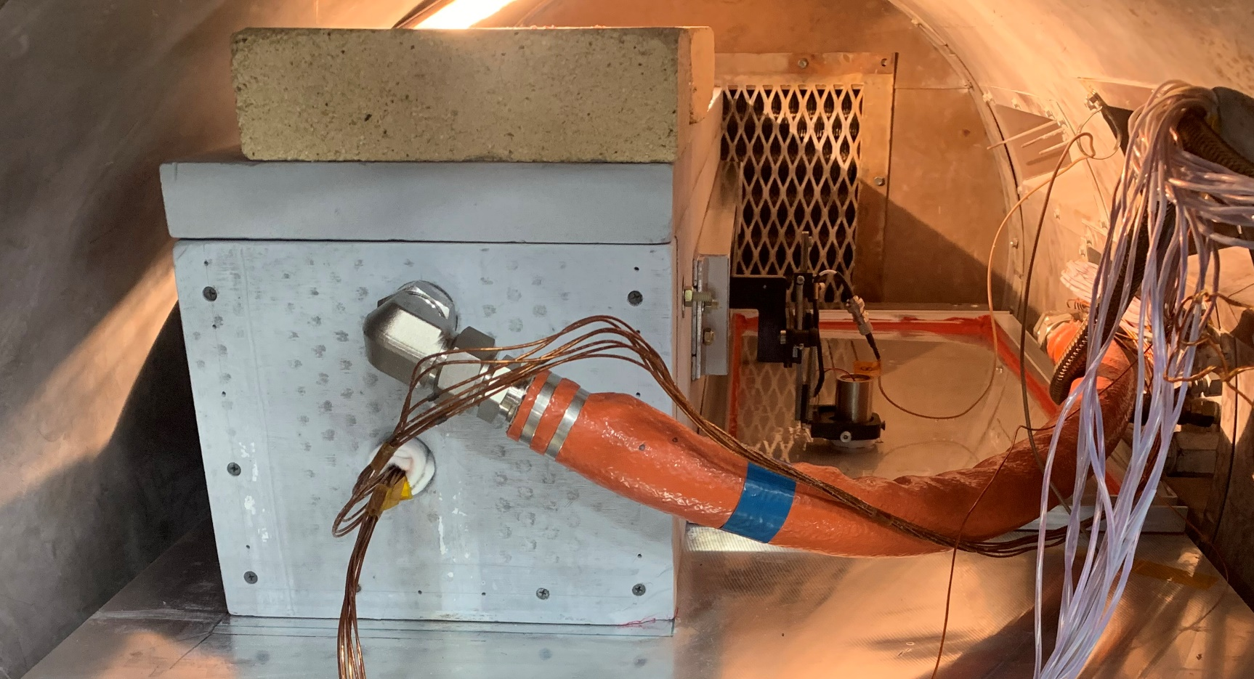
Next Steps/Future Work
Validation with post-cure experimental porosity data (optical micrographs and/or acid digestion)
Investigate methods to make ML algorithms more efficient
Further experimentation on industry-relevant composite structures
Transition technology to other NASA projects and industry partners
Image Credit: NASA
Notes:
using x-ray CT (computed thermography), microscopy, or acid digestion
Limited right now due to COVID-19
Grander impact on the aerospace realm

Slide 15
Acknowledgements
Composite Fabrication: Hoa Luong and Sean Britton
System Design: Eric Burke, Jeff Seebo, and Jamie Shiflett
Composite Processing Simulation: Thammaia Sreekantamurthy
Notes:
Having an opportunity to learn, grow and sense of stability this summer was critical during a time of flux
continue my personal development
Thank Gabrielle for her patience

Slide 16
Questions?
Tyler B. Hudson, Ph.D.
Materials Research Engineer
Advanced Materials and Processing Branch (AMPB)
NASA Langley Research Center tyler.b.hudson@nasa.gov
757-864-3342

