Slide 1
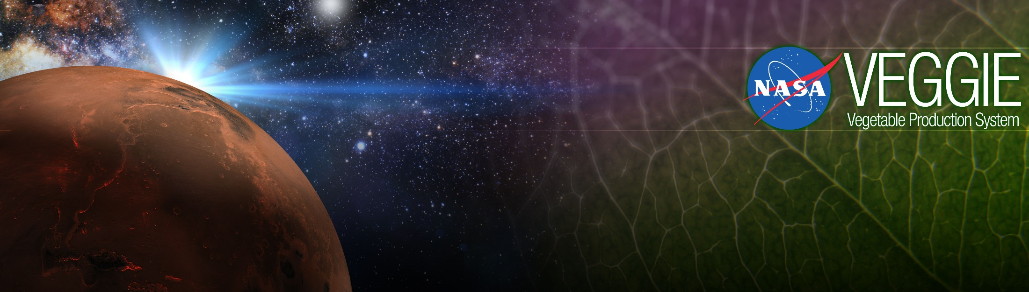
Growing Plants in Space
Gioia Massa
Exploration Research and Technology Programs
NASA, Kennedy Space Center, FL, USA

Slide 2


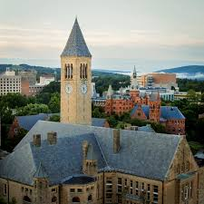
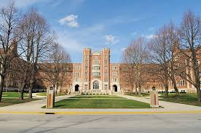
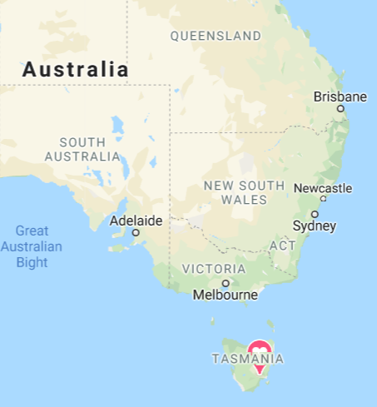
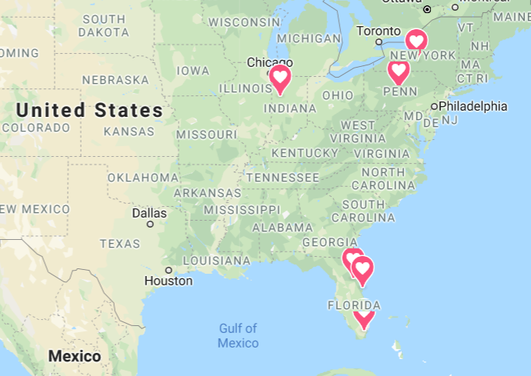
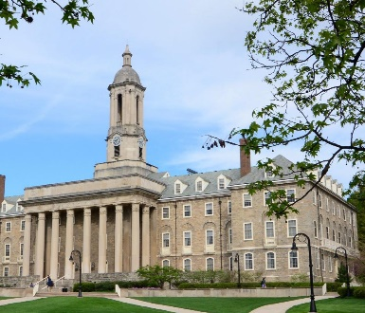

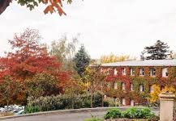

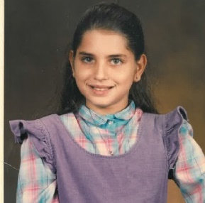
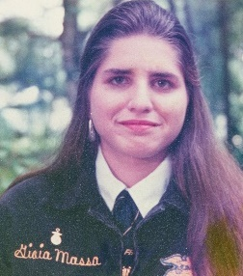

My Journey

Slide 3
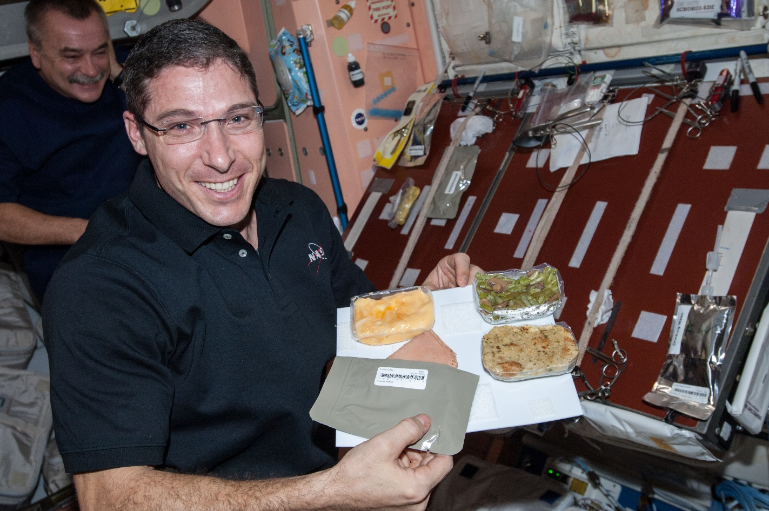
Why grow plants in space?
Food
Psychological well being
Atmosphere
Water

Slide 4
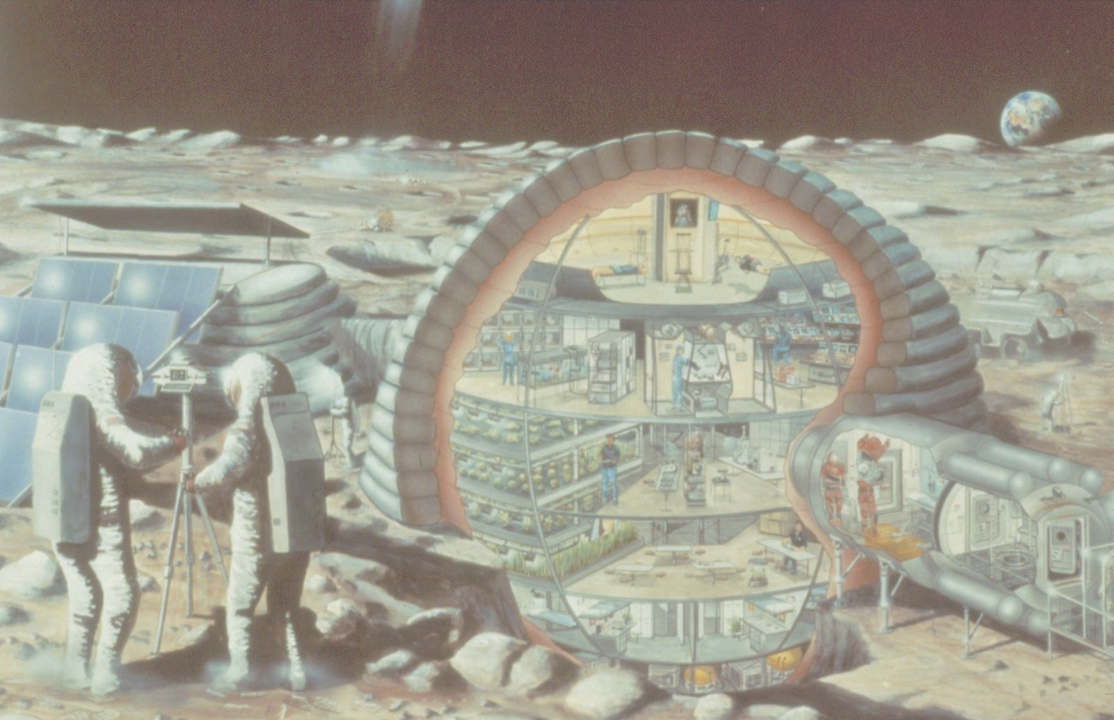

Slide 5
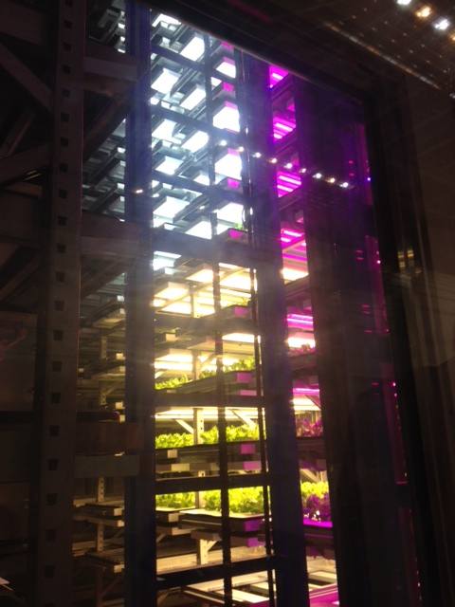
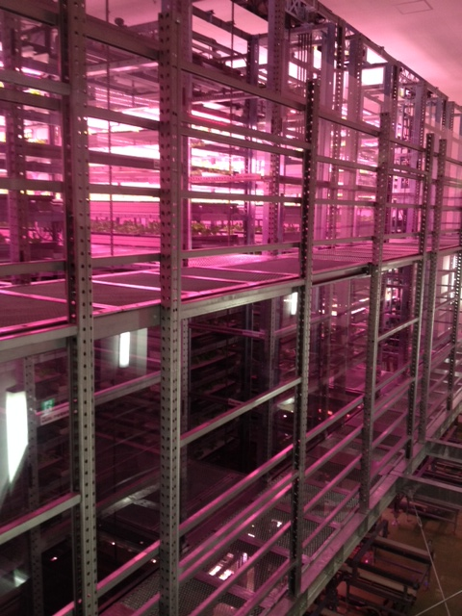
Plant Factories
Photos of Osaka Prefecture University training facility courtesy of Ray Wheeler

Slide 6
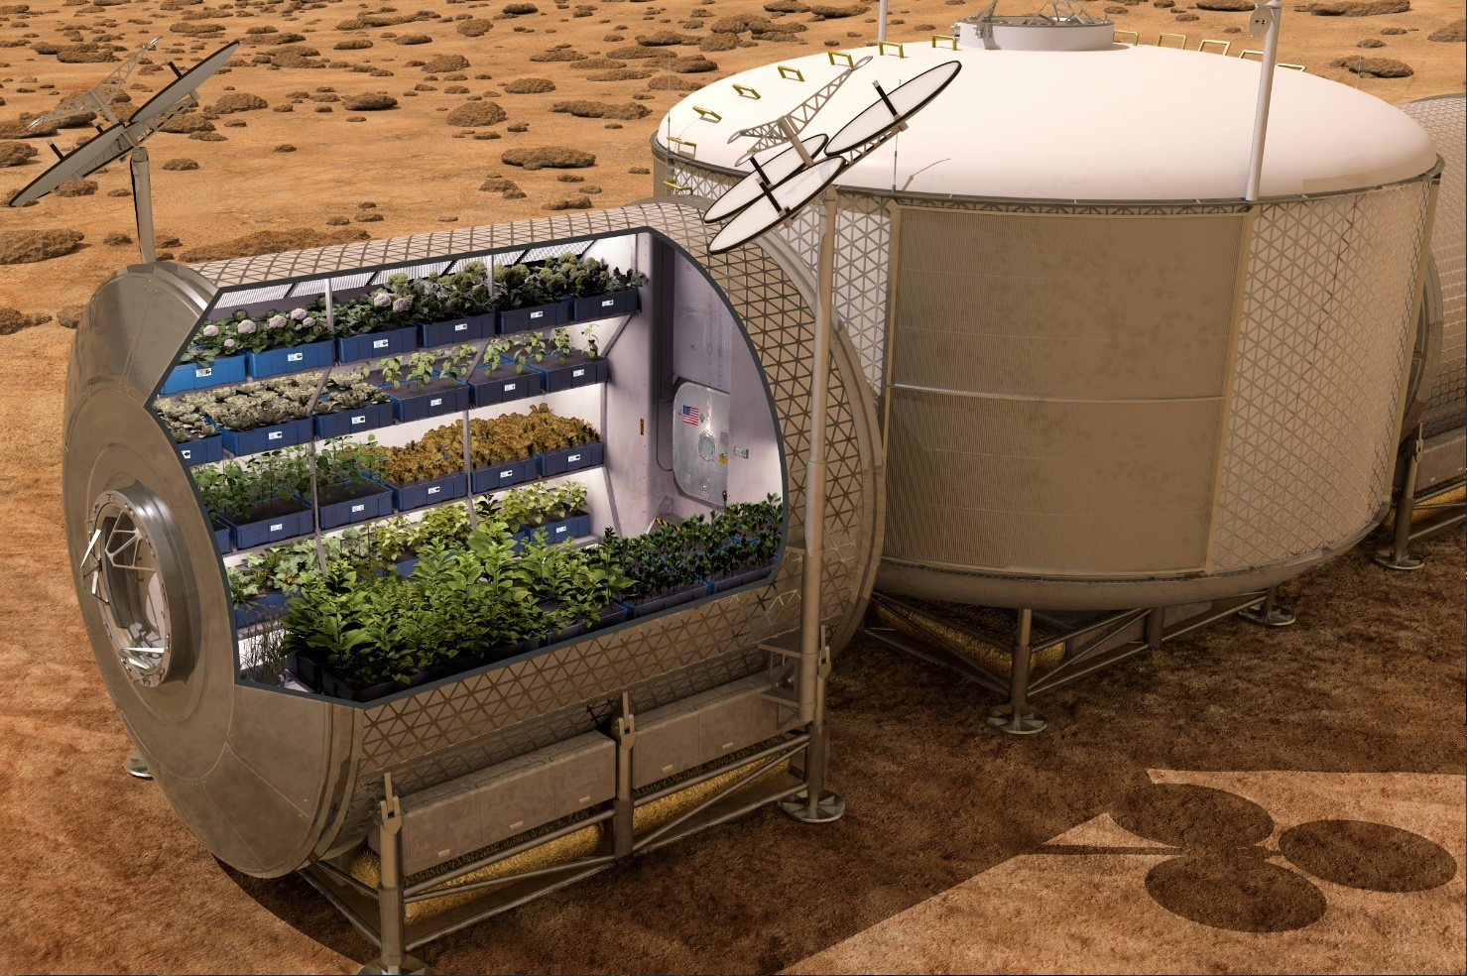

Slide 7
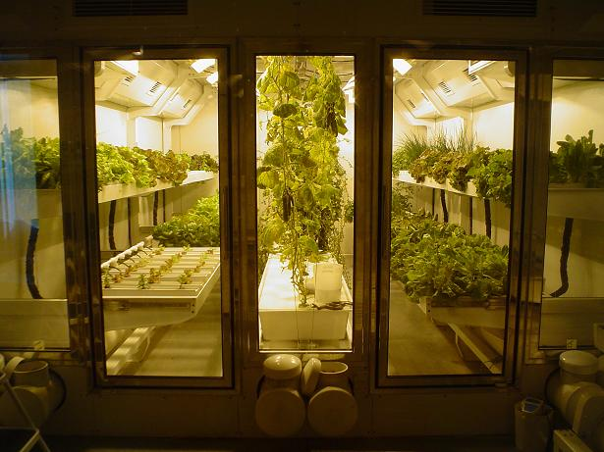
South Pole Greenhouse
Photo from “On the Ice” Blog of Russ Durkee

Slide 8
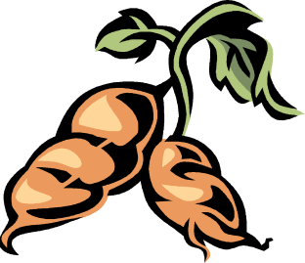

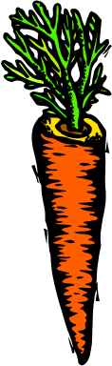
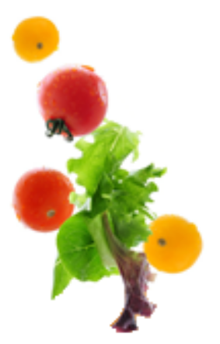


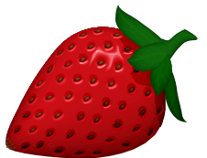
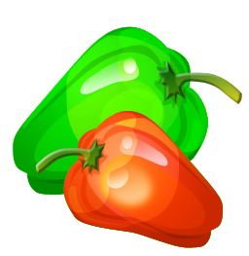

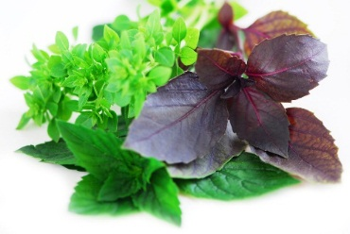
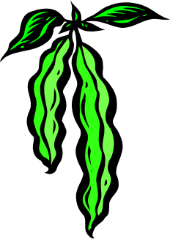

Space Crop Production Candidates
Salad
Leafy Greens
Tomato
Pepper
Radish
Strawberry
Green Onion
Pea
Carrot
Lettuce, Chinese cabbage, Swiss chard, Mizuna, Spinach
Staple Crops
White Potato
Sweet Potato
Rice
Wheat
Dried Bean
Soybean
Peanut
MINIMAL PREPARATION / COOKING
SIGNIFICANT PREPARATION / COOKING
CONSUMED FRESH WITHOUT PROCESSING
Herbs
Basil
Mint
Chives
Dill

Slide 9

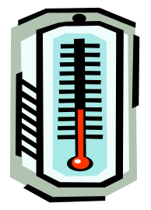
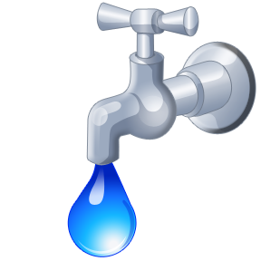
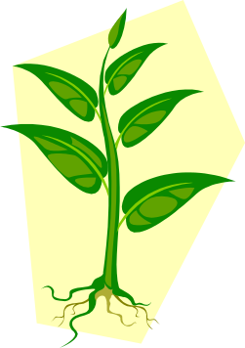
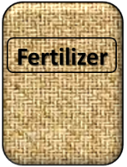

Plant Growth and the Environment
5 Cardinal Factors of Plant Growth…..
O₂

Slide 10

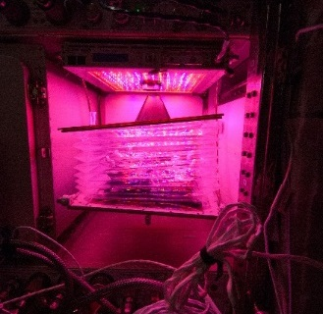
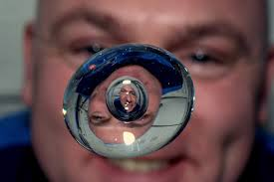

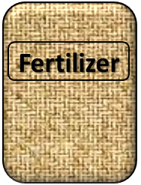
The Space Environment
….and how these work with and without Gravity!
Humans like white light, but plants may grow well with other wavelengths
No convection in space so need to mix the air
O₂
Water forms a ball, and water and air don’t mix well, and roots need both!
Fertilizer is heavy to launch so we need to learn how to recycle plant waste

Slide 11
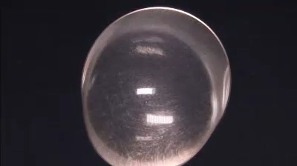
The Space Environment
….and how these work with and without Gravity!

Slide 12
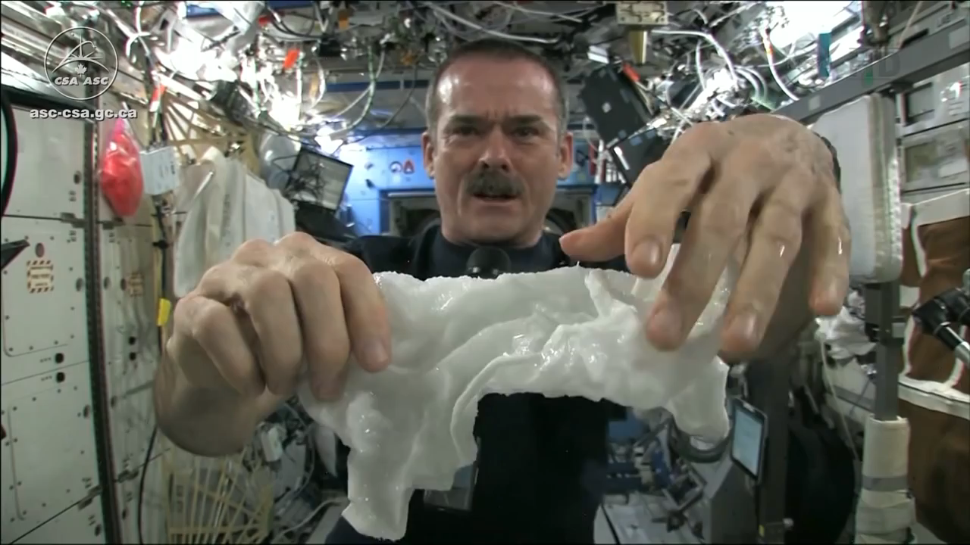
The Space Environment
….and how these work with and without Gravity!
Please Play Video 2

Slide 13
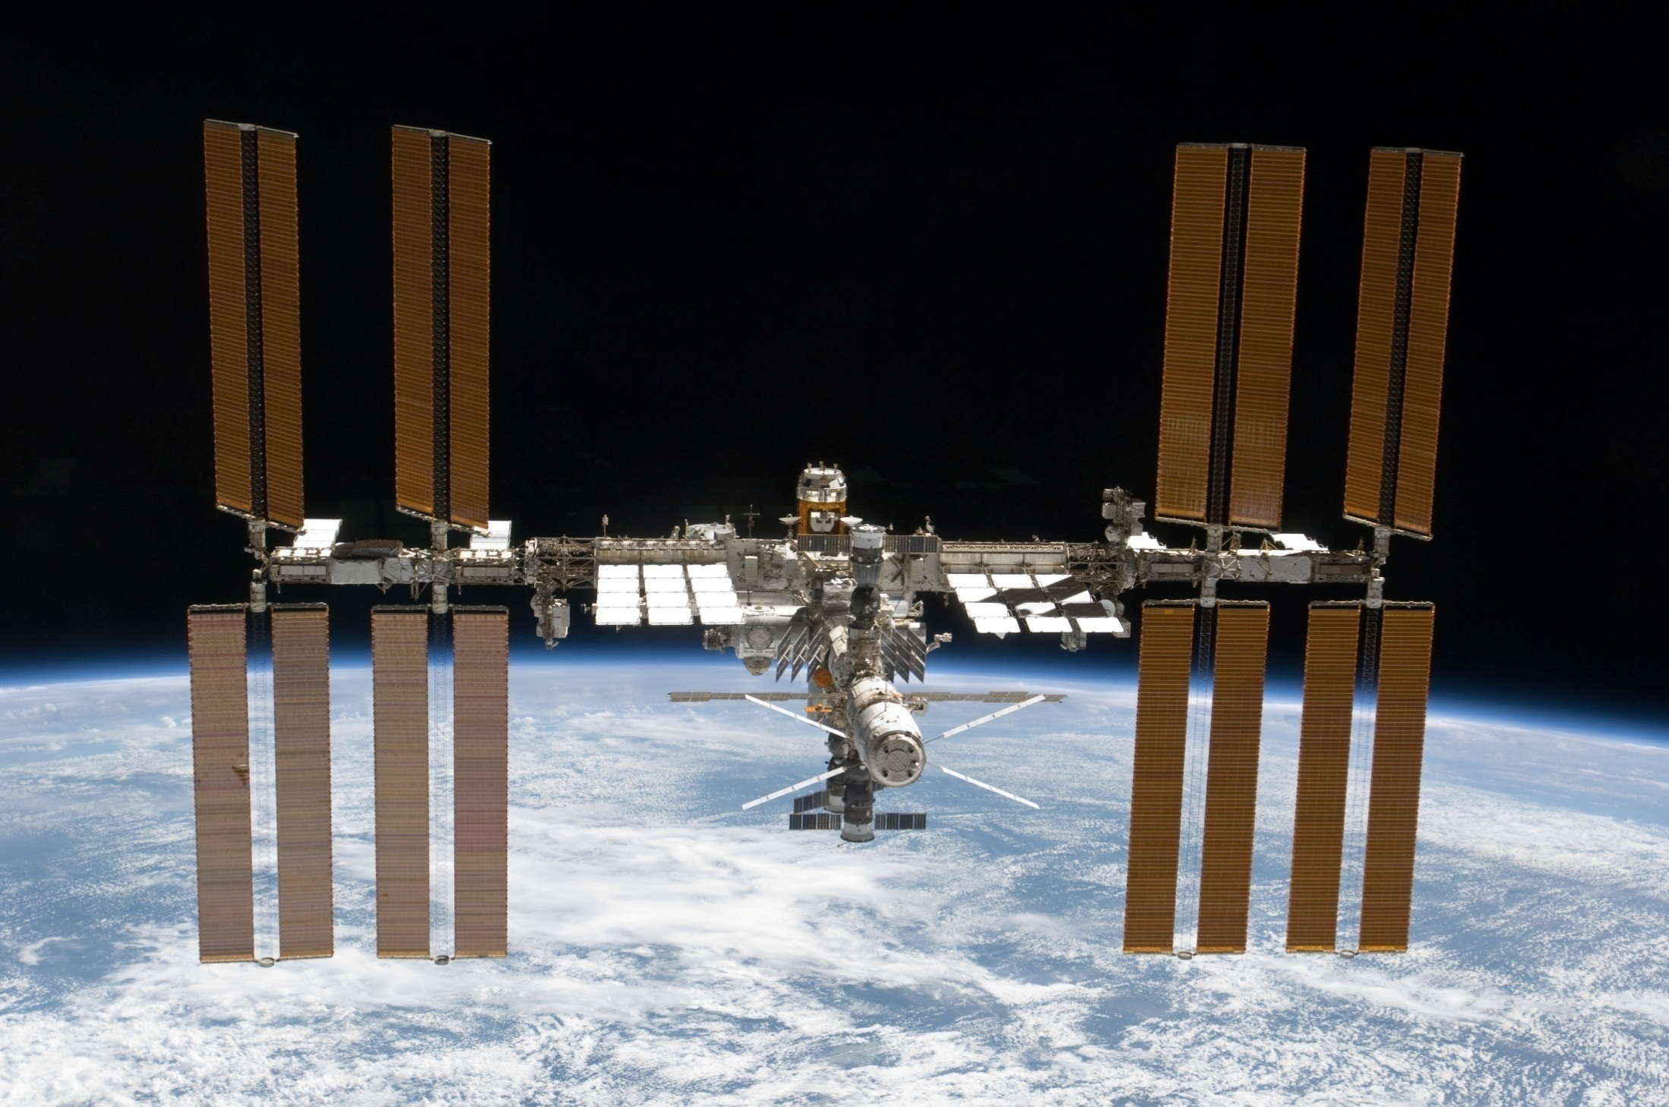
The International Space Station

Slide 14
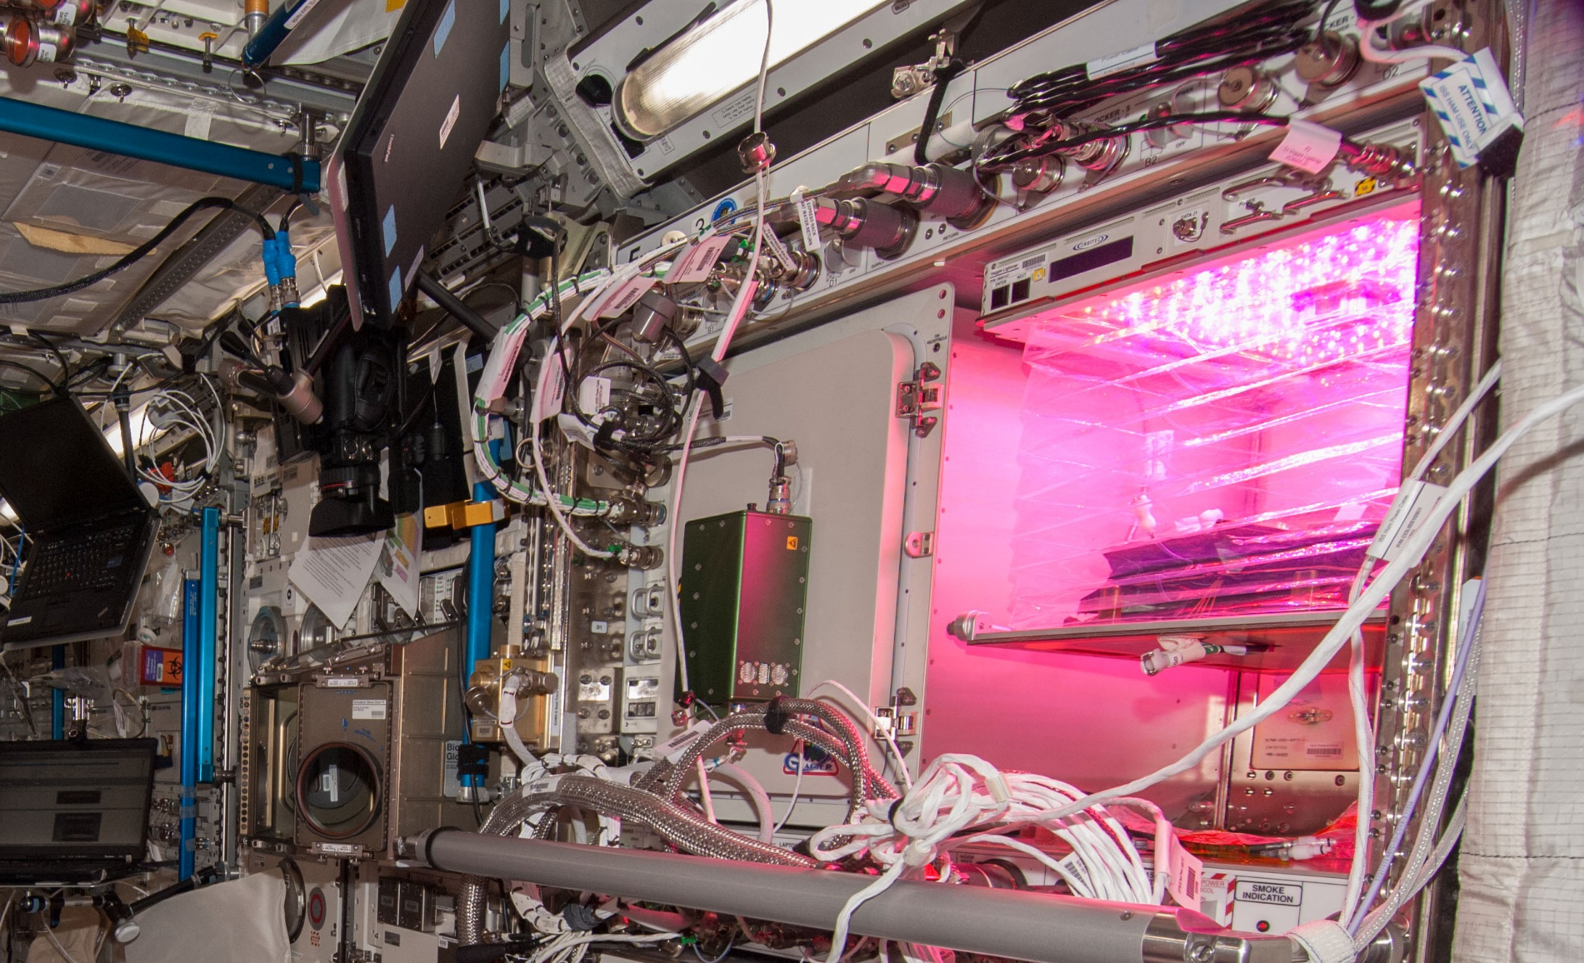
Veggie on ISS

Slide 15

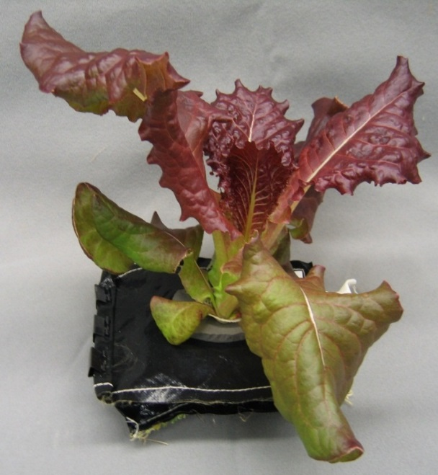
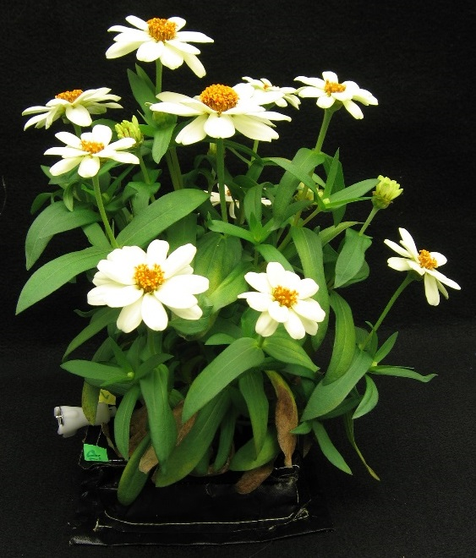
Crop Selection for VEG-01
Reliable germination
Rapid growth
Attractiveness
Low native microbial levels
Palatability / acceptability
Antioxidants and Nutrients
‘Outredgeous’
red romaine lettuce
‘Profusion’ Zinnia
VEG-01 consisted of two sets of ‘Outredgeous’ lettuce and one set of ‘Profusion’ zinnia pillows

Slide 16
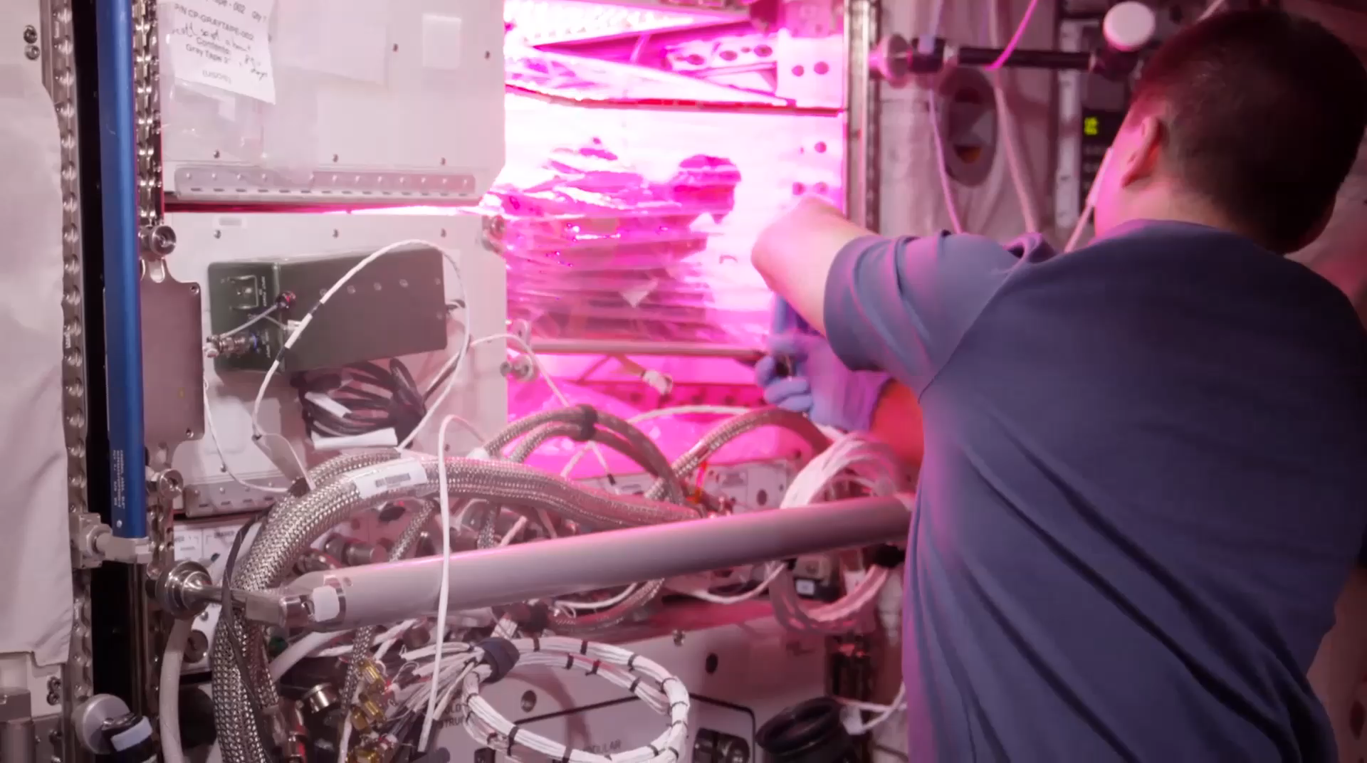
VEG-01B Harvest (August 2015)
Notes:
Veg-01 second crop, first consumption

Slide 17
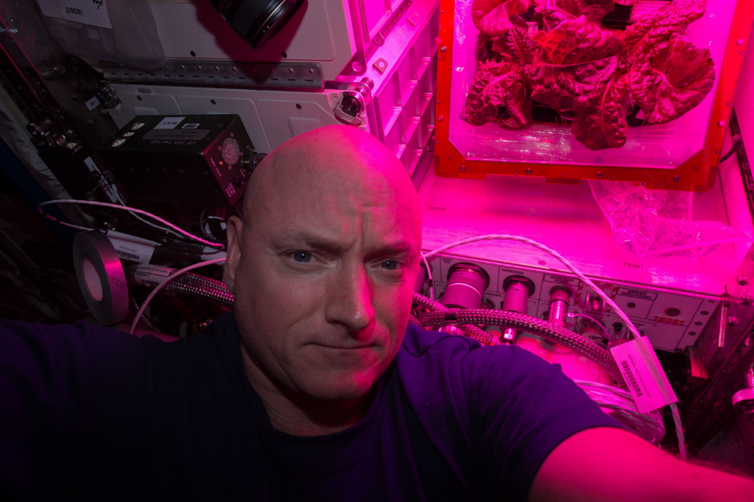
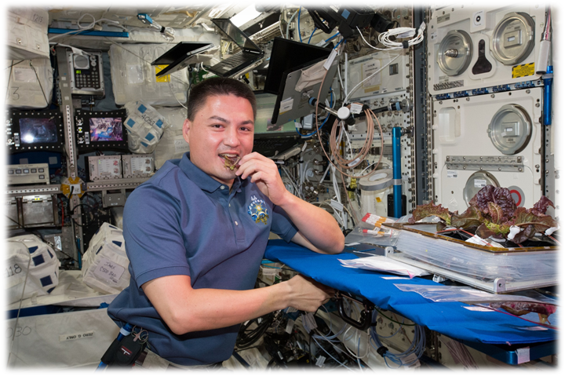
Astronaut Comments
Scott Kelly
  the logistical complexity of having people live and work in space for long periods
  the supply chain that is required
  For Mars, need a space craft that is more self-sustainable with regards to its food supply
Kjell Lindgren
  benefit of eating the fresh food
  contribution that plants have to the ISS ecosystem
  psychological benefit - it’s really fun to see green growing things in the sterile environment of the ISS

Slide 18
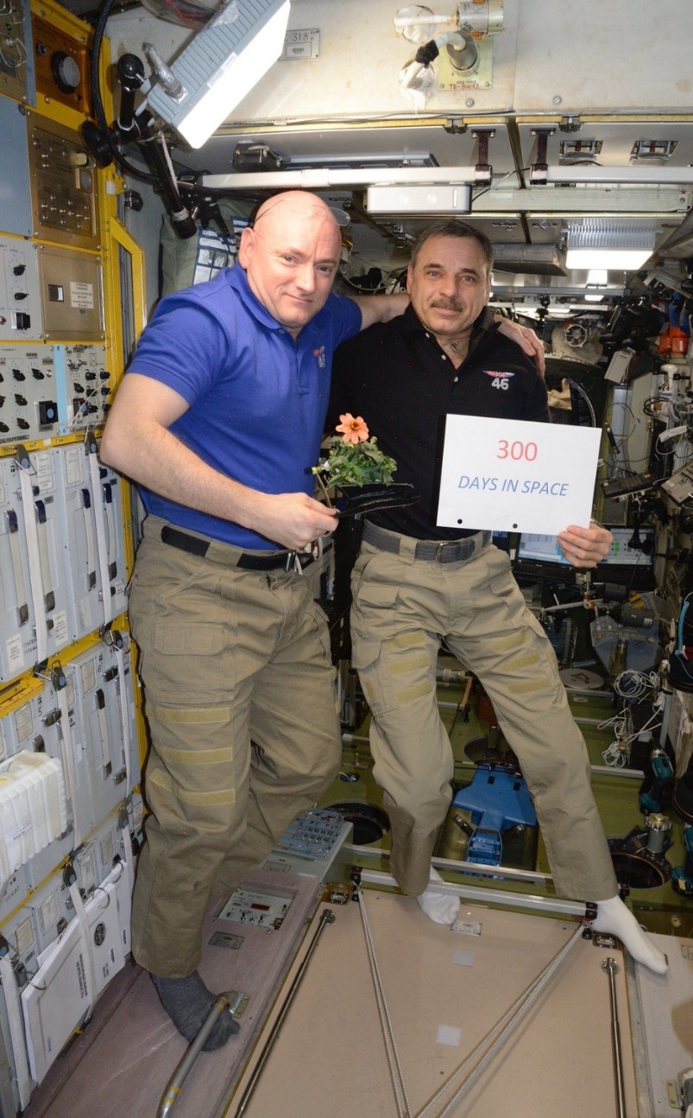
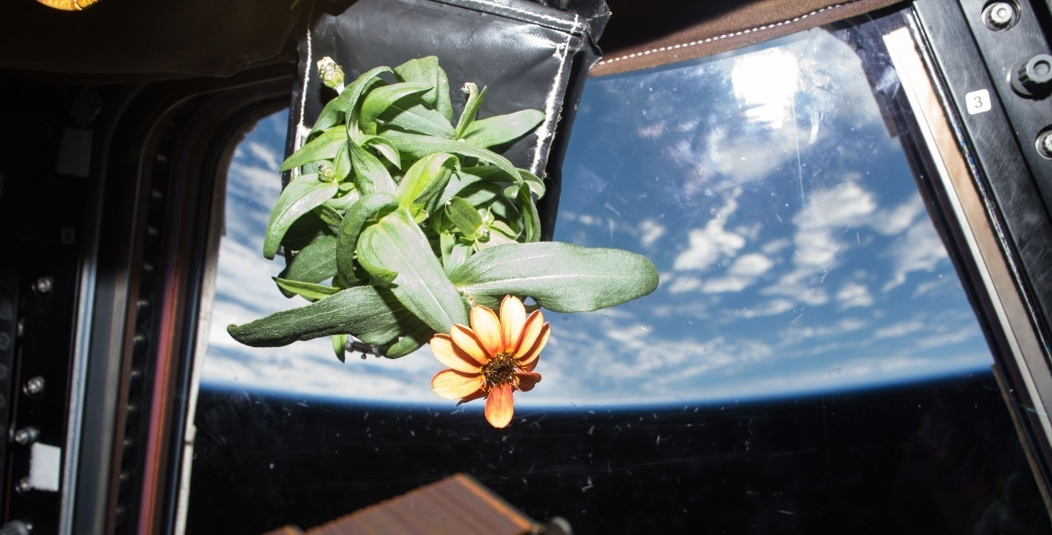
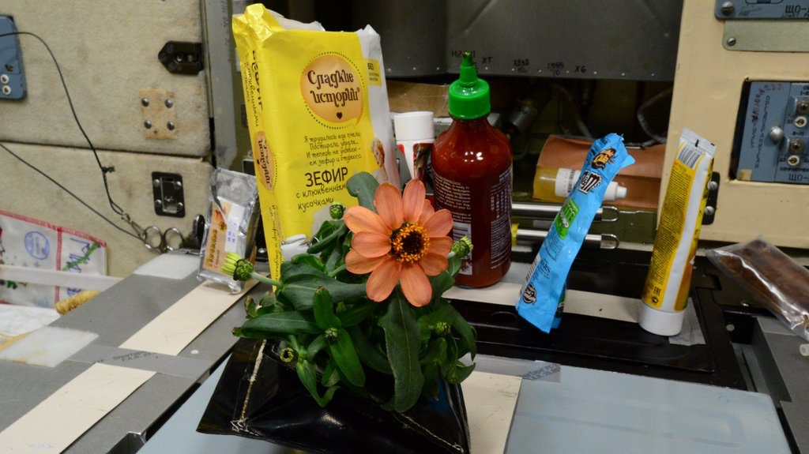
Zinnia Action Shots

Slide 19
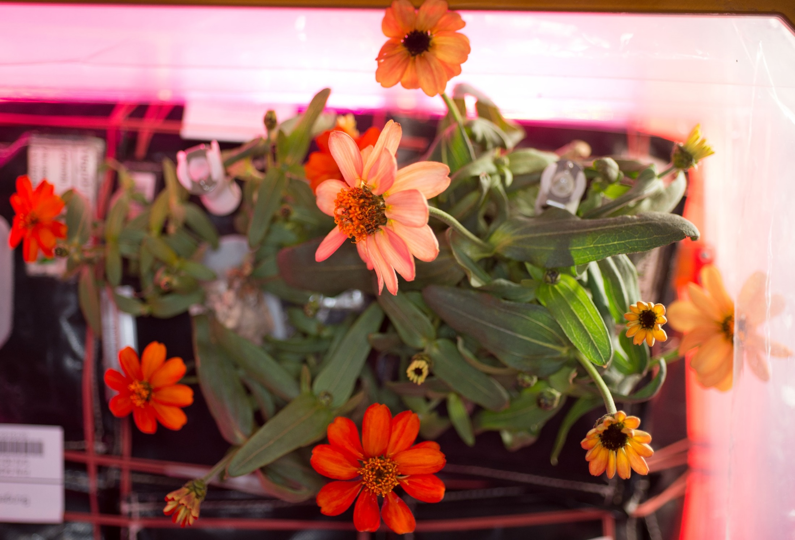
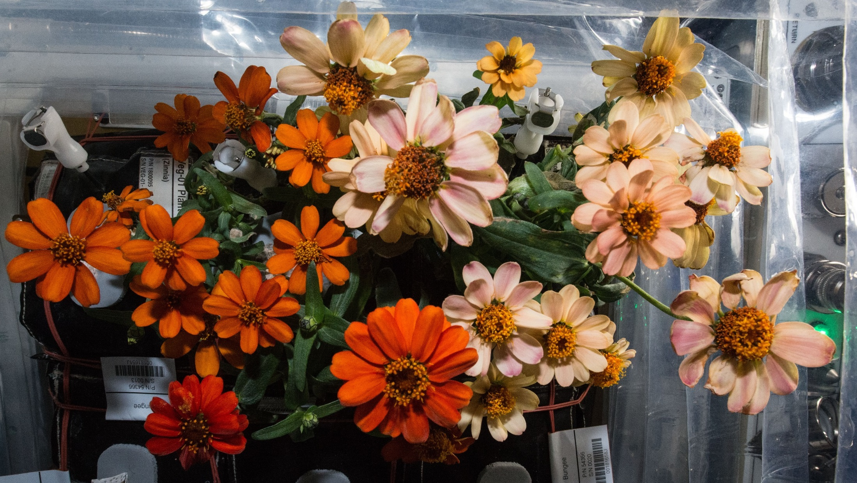
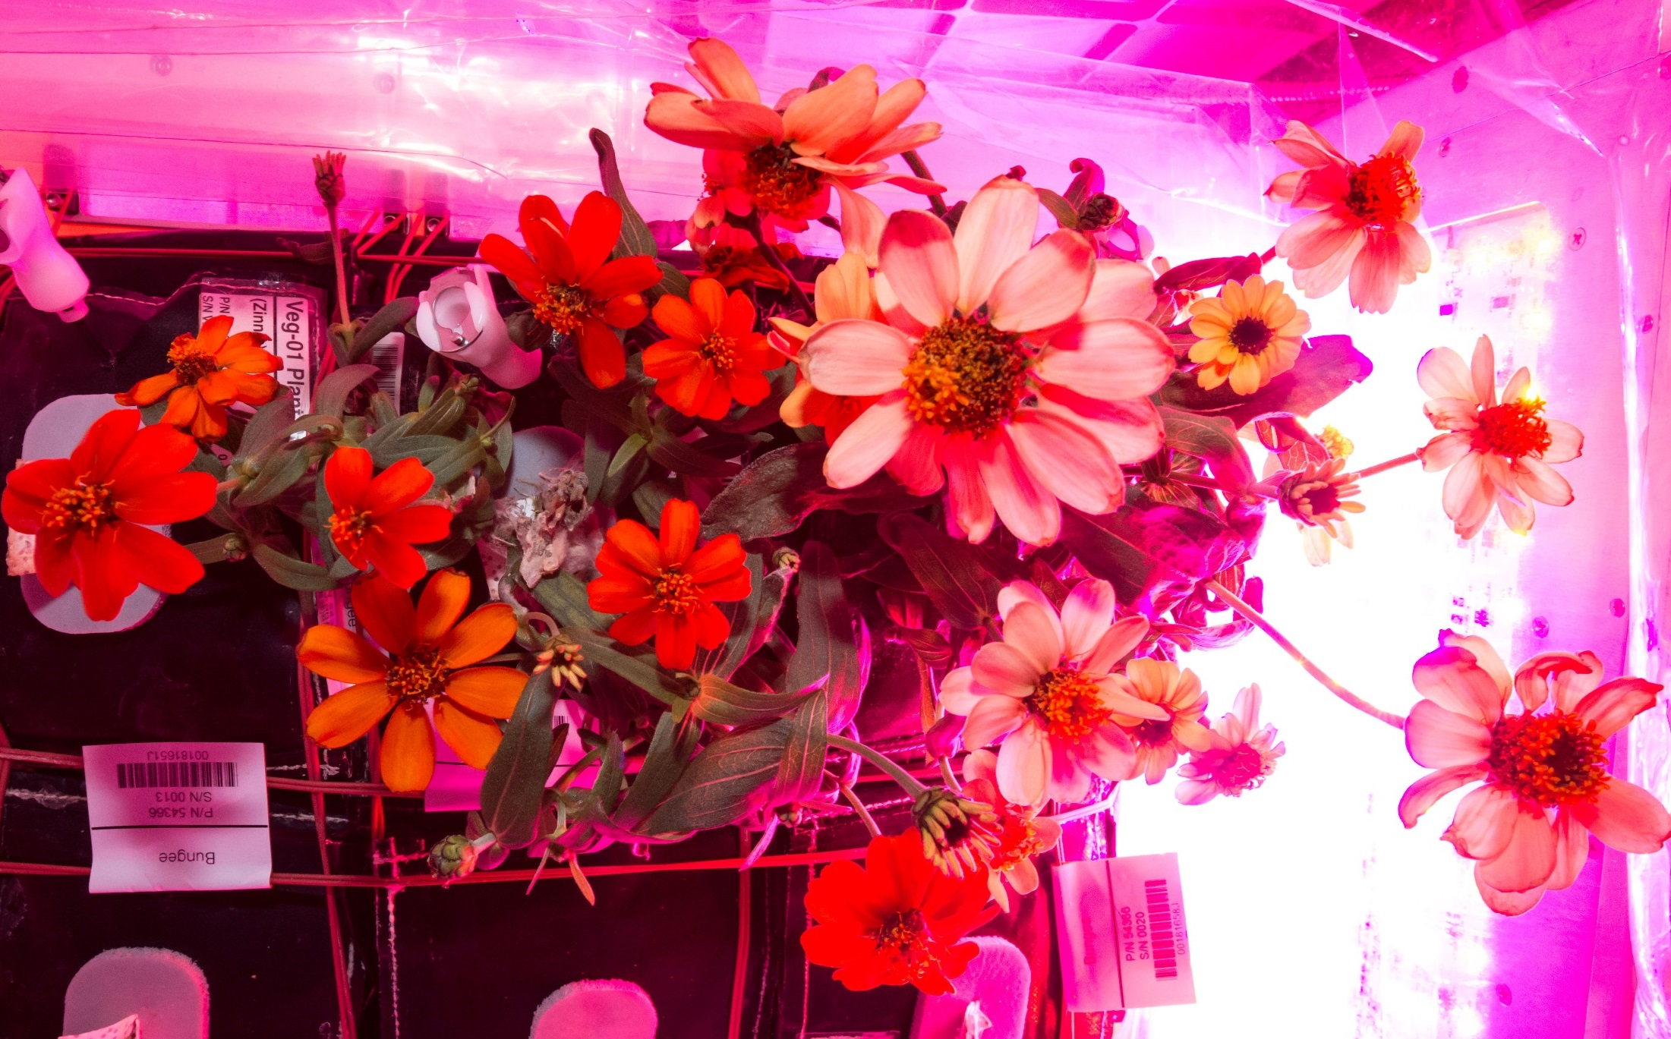
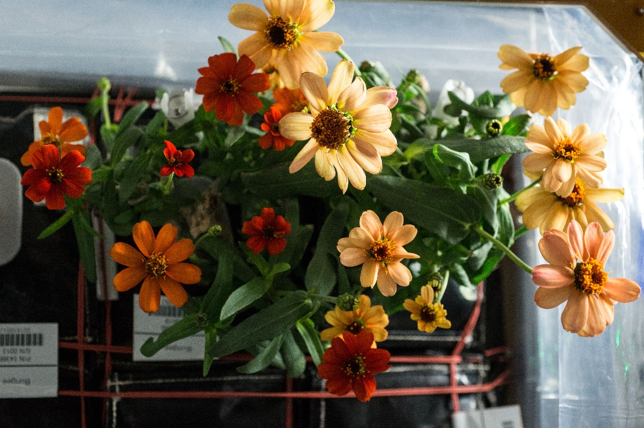
And they bloomed, and bloomed...
77 DAI
80 DAI
71 DAI
87 DAI

Slide 20
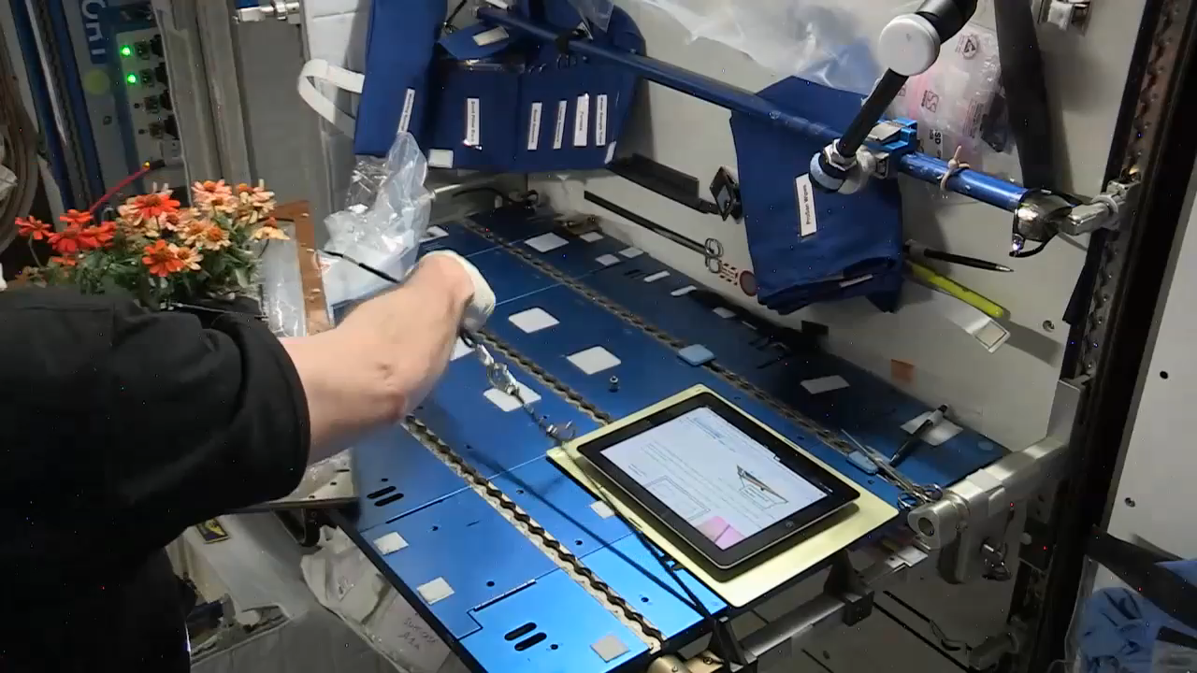
Zinnia Harvest on February 14, 2016
Notes:
Video by Rachel Hobson

Slide 21
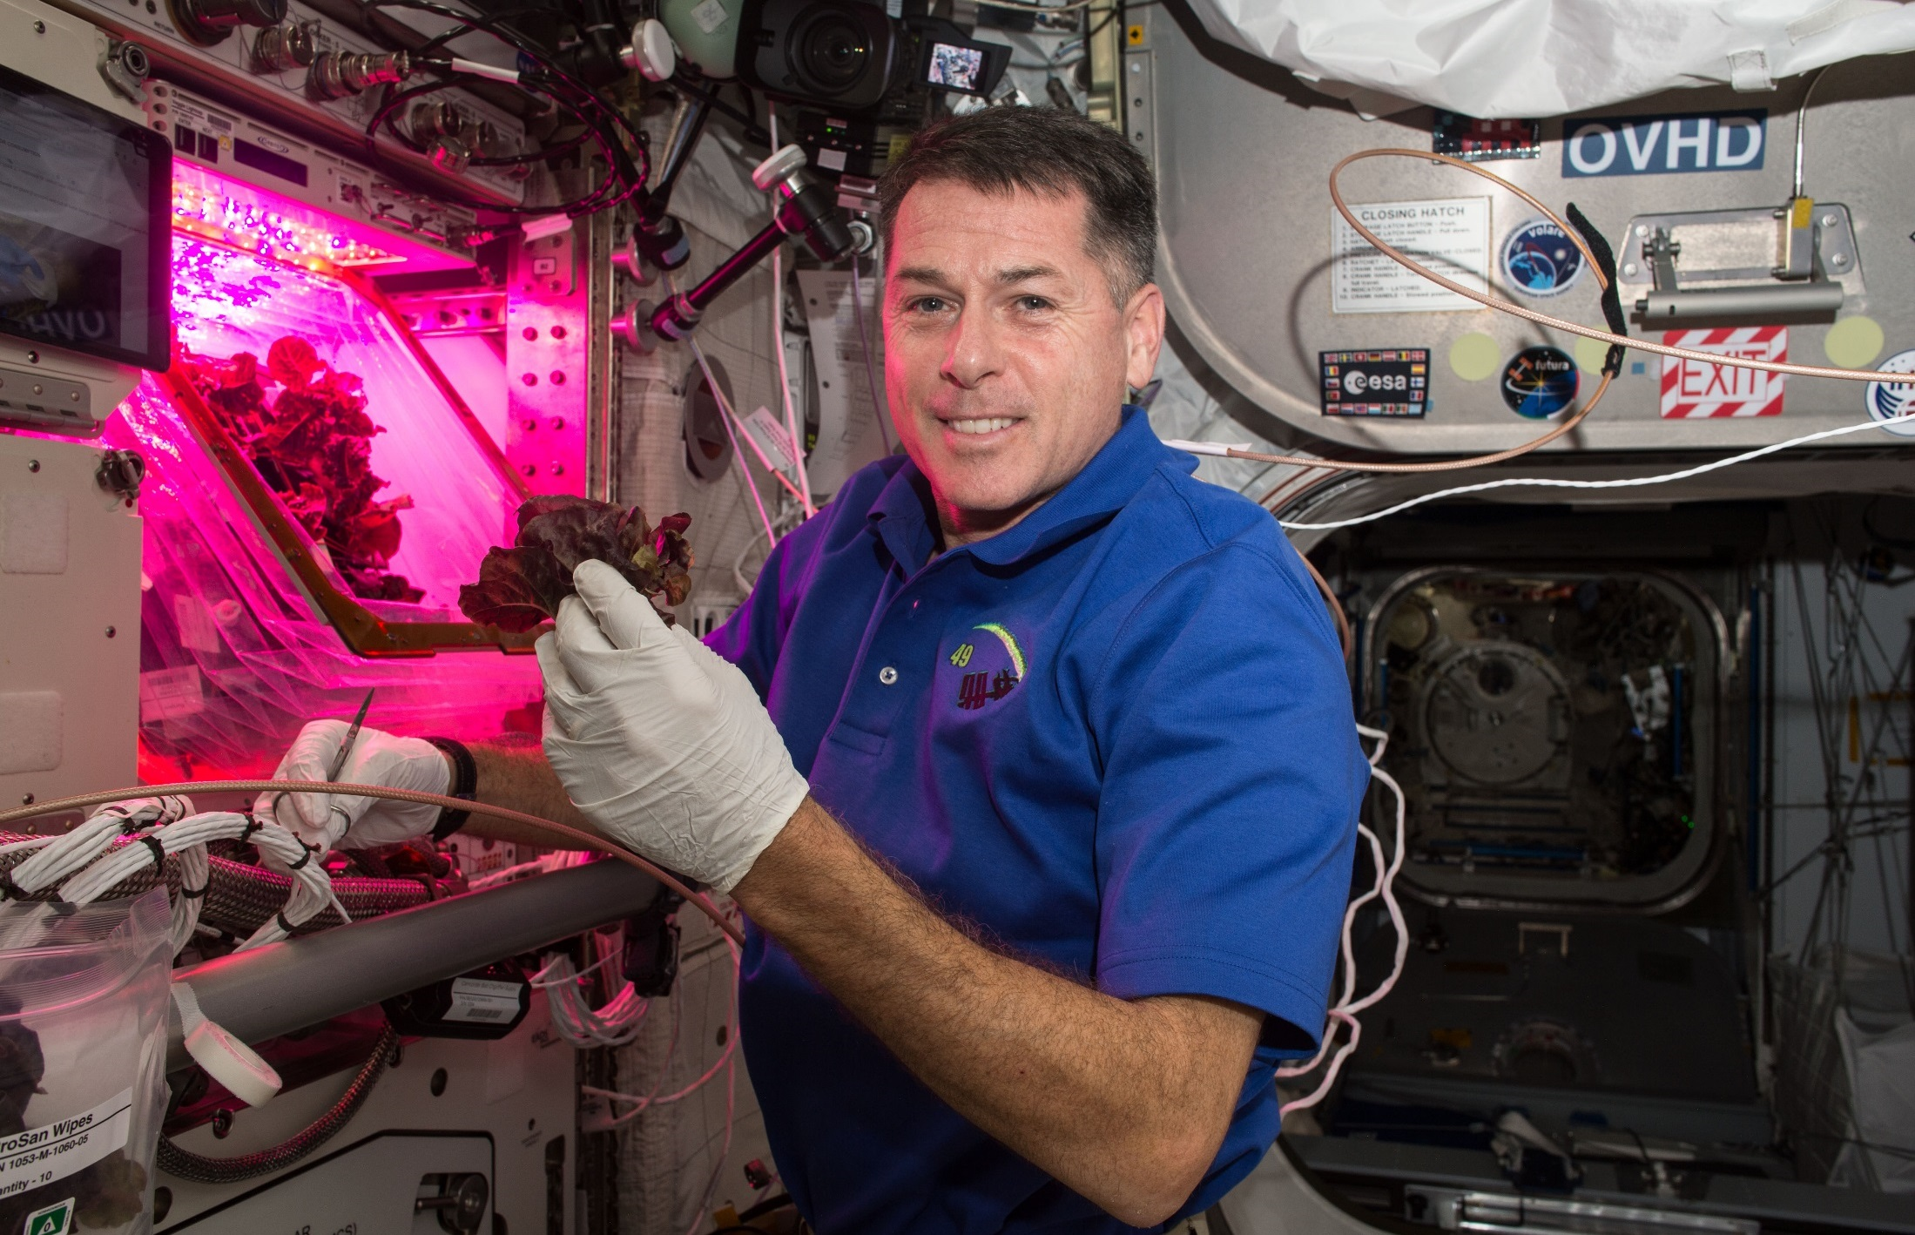
Red Lettuce Cut-and-Come-Again

Slide 22
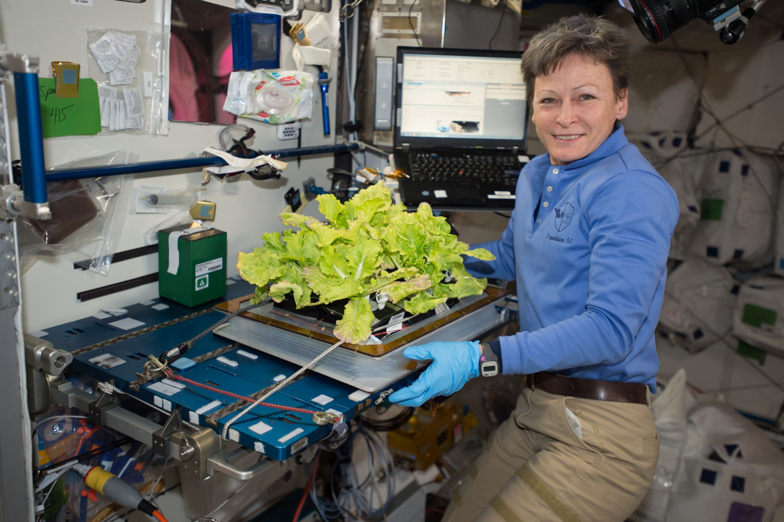
VEG-03C Cut-and-Come-Again

Slide 23
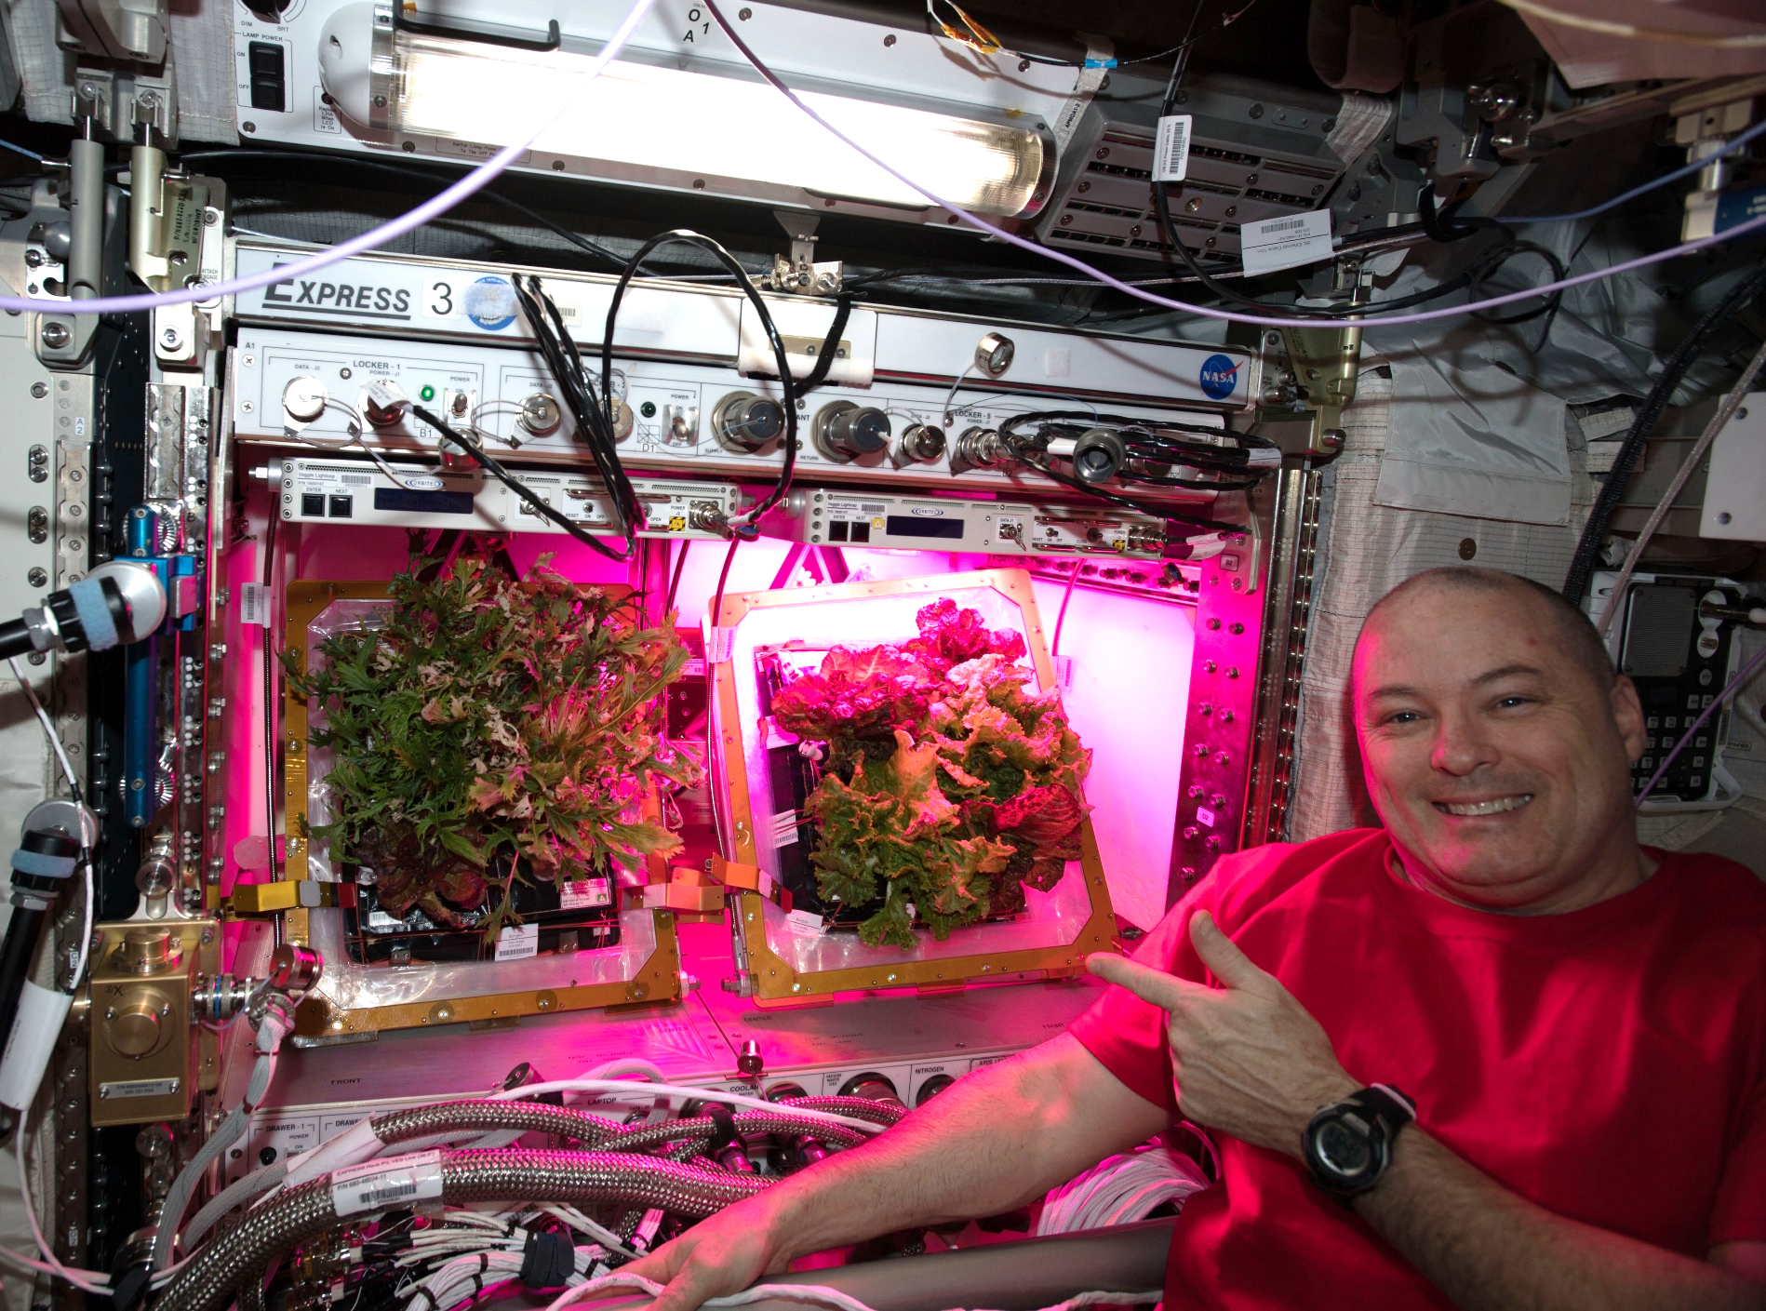
A Tale of Two Veggies

Slide 24
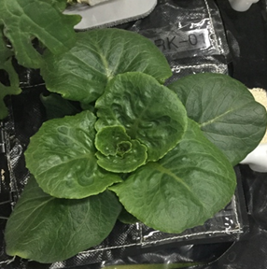




VEG-03 New Crops on Orbit
Red Russian Kale
*Dragoon Lettuce
Wasabi Mustard
*Extra Dwarf Pak Choy
Amara Mustard
Grown in different combinations with Amara Mustard and Extra Dwarf Pak Choi growing now on ISS!
*= Student Selected Crops!

Slide 25




Crew Engagement

Slide 26















Slide 27

Thank you!

