Slide 1
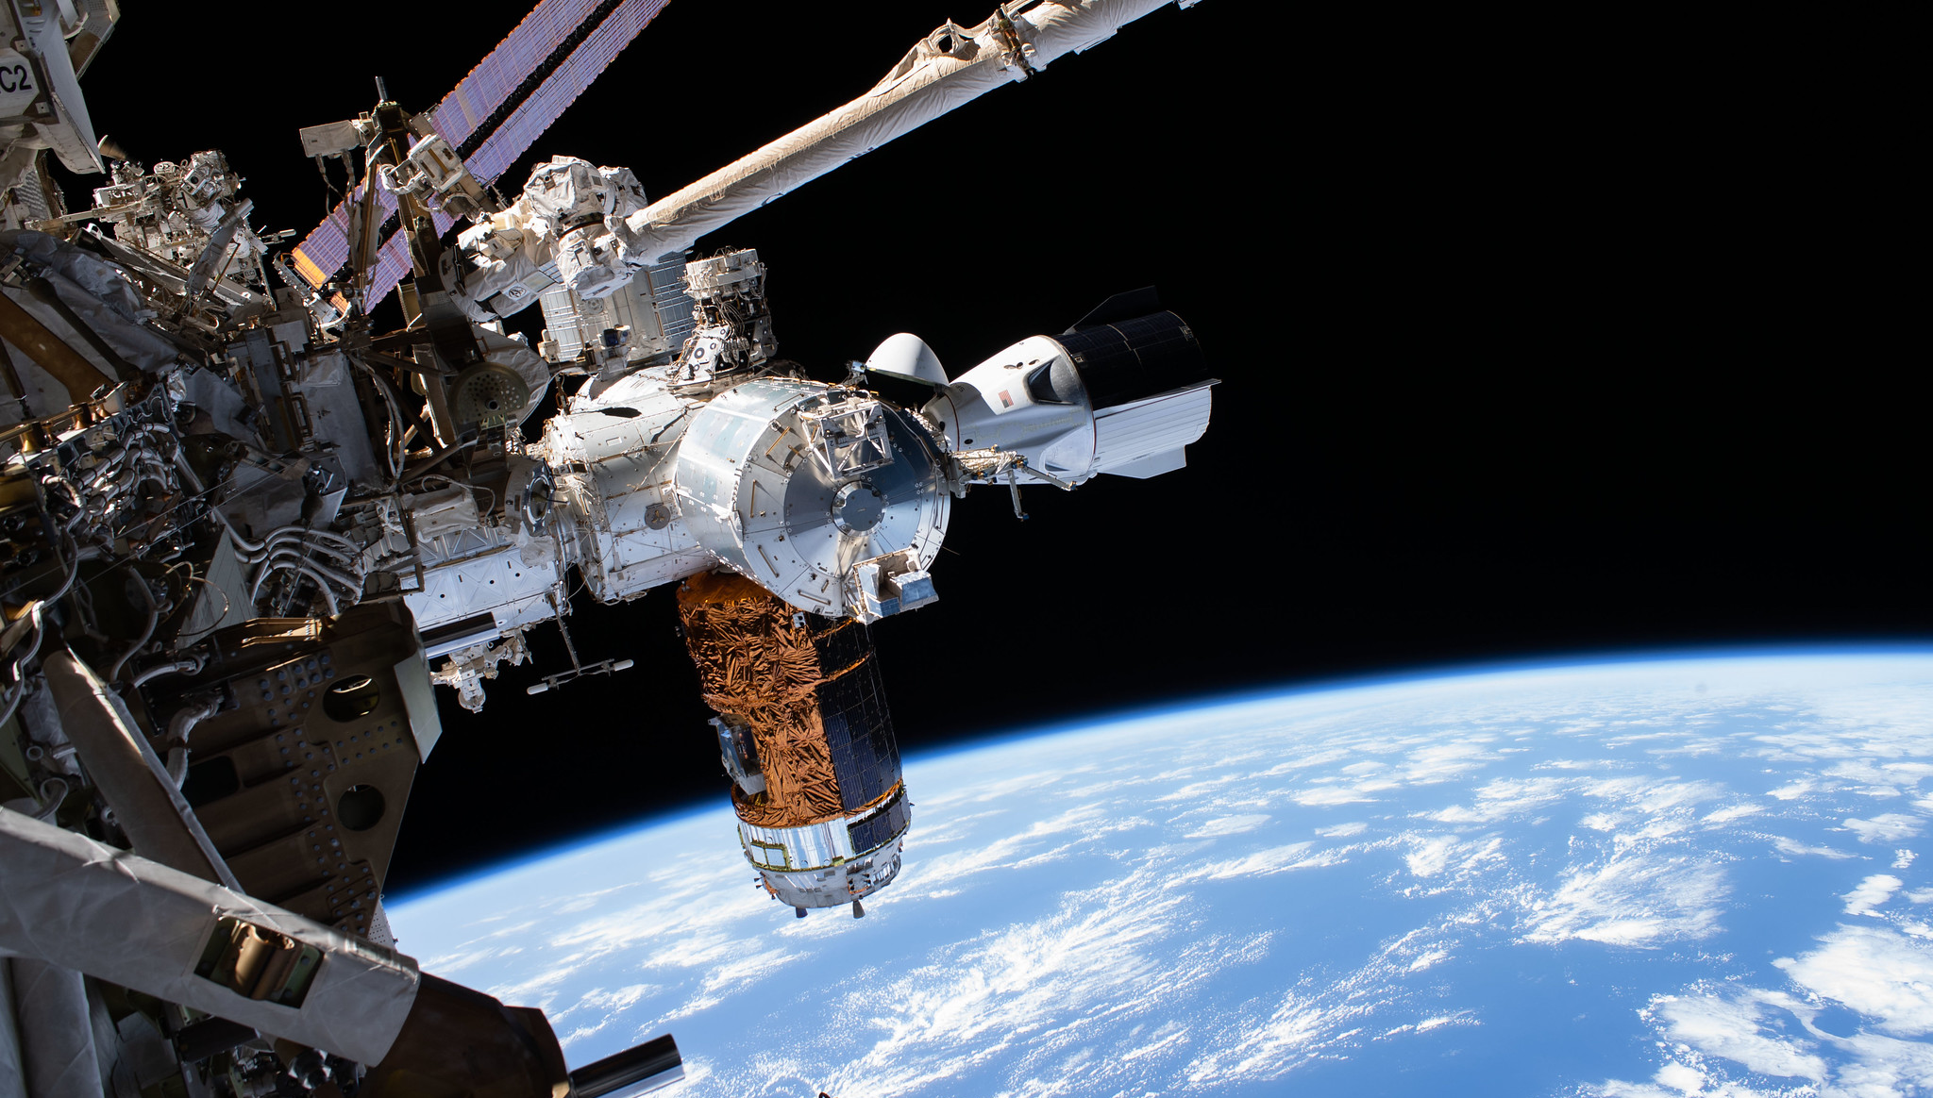
Designing Autonomy into Interfaces for Long-Duration Missions
Brooke Allen
Haifa Moses
NASA
SpaceOps 2021

Slide 2
Long-Duration Missions
Long-durations missions with added communication delays will require a paradigm shift in how ground control teams manage crew activities and flight systems
More systems will need to be managed on-board
Crew will need to be enabled to make critical decisions
System autonomy and crew autonomy can potentially reduce crew workload and improve task performance forging a path for a successful new dynamic for crew and ground control teams working under long-duration mission limitations

Slide 3
Design Focus
The design of these autonomous systems should be human-centered enabling the human to successfully interact with autonomy
The interface between the autonomous system and the crew must be designed so that the human and system are able to efficiently exchange the information needed for the system’s operational success
Utilizing human factors practices throughout the design process will result in an interface focused on the user and target the information that the crew will need from the system
Testing autonomous systems on current spacecraft helps determine what information successfully enables astronaut crews

Slide 4
Utilizing EXPRESS Racks
Autonomous Systems and Operations (ASO) is utilizing EXPRESS racks on the International Space Station (ISS) to demonstrate autonomy and to develop a better understanding of what is necessary for astronauts to interface with systems in an autonomous state
The EXpedite the PRocessing of Experiments for Space Station (EXPRESS) rack is a system that accommodates payloads on-board the ISS
Activation of the EXPRESS rack is currently a ~40-page procedure requiring well-choreographed and synchronized steps between ground control teams and various procedures for changing the state of the rack

Slide 5
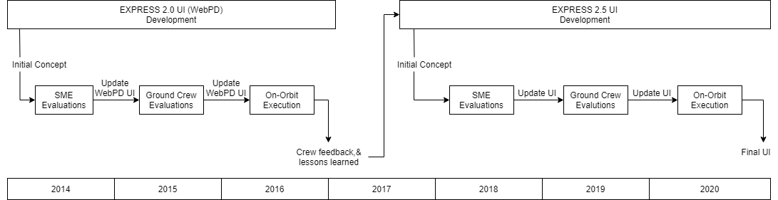
AMO EXPRESS Timeline
The ASO team executed an initial experiment, Autonomous Mission Operations (AMO) EXPRESS, which demonstrated that the EXPRESS rack can be configured to activate and deactivate with a single command from the ground reducing the need for considerable ground-system interaction. Utilizing the foundation of AMO EXPRESS, EXPRESS 2.0 and EXPRESS 2.5 were developed for furthering the research by incorporating crew interactions.
AMO EXPRESS 2.0
Transferred the single command capability from the ground to the crew on-board ISS
Developed custom user interface (UI) called WebPD to support the commanding capability for the crew
WebPD allowed crew to initiate the command to the EXPRESS rack and follow through the steps as they were executed
If the EXPRESS rack showed off-nominal behavior, the embedded fault detection, isolation, and recovery (FDIR) software logic provided the crew with information and recovery steps
AMO EXPRESS 2.5
On-going demonstration that adds additional complexities to AMO EXPRESS 2.0 by including induced failures with autonomous system fault recovery, constraint-driven planning, crew-managed activity scheduling, and recommended troubleshooting actions
Seeks to enable more crew autonomy through these added functionalities
Crew on-board will be given tasks to schedule an activation or deactivation of an EXPRESS rack; they will then have to find available time within their current schedule to complete the activity
Once the crew begins the activity, the UI will show activity progress and feedback or instruction depending on the end result of the EXPRESS procedure

Slide 6
Goals for the User Interface
Goals that drove the development of the UI ensuring a human-centered and usable design.
Learnability and memorability - no required training prior to use
Efficiency - does not increase time to complete task
Error tolerance - allows for easy error recovery and errors do not lead to a state that would result in harm to the system
Satisfaction - system is enjoyable to use and crew will want to use the system for future tasks
Situational awareness - Provides status on the state of the system and future tasks needed to be performed

Slide 7
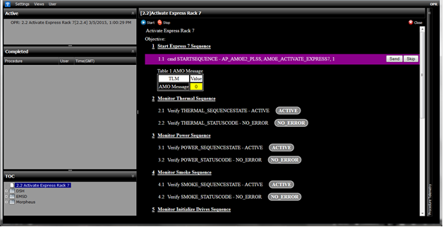
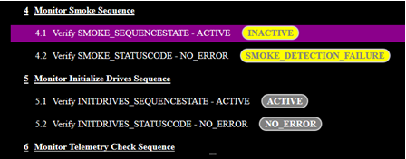
EXPRESS 2.0 WebPD
Initial “WebPD” Design
Single-button activation and deactivation of EXPRESS rack autonomous procedures

Slide 8
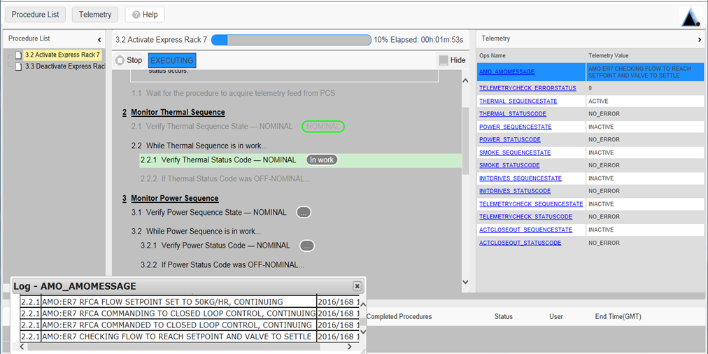
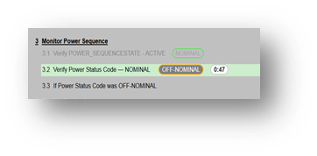
SME & Ground Crew Evaluations
Overall appearance was modified to meet ISS display standards (interface colors, buttons, nomenclature)
Improved use of color for status change indications
Added progress bar to reflect overall procedure status

Slide 9
On-Orbit Execution & Crew Feedback
Overall:
Easy to use
No difficulty in completing tasks
Comfortable using the tool
Areas for Improvement:
Difficulty deciphering different features used for in-work and completed statuses
Use of technical terms that weren’t well understood, would prefer more common terminology
Titles of procedures should be clearly distinct from other procedures
Telemetry should display a status and only appear if crew is waiting on a process

Slide 10
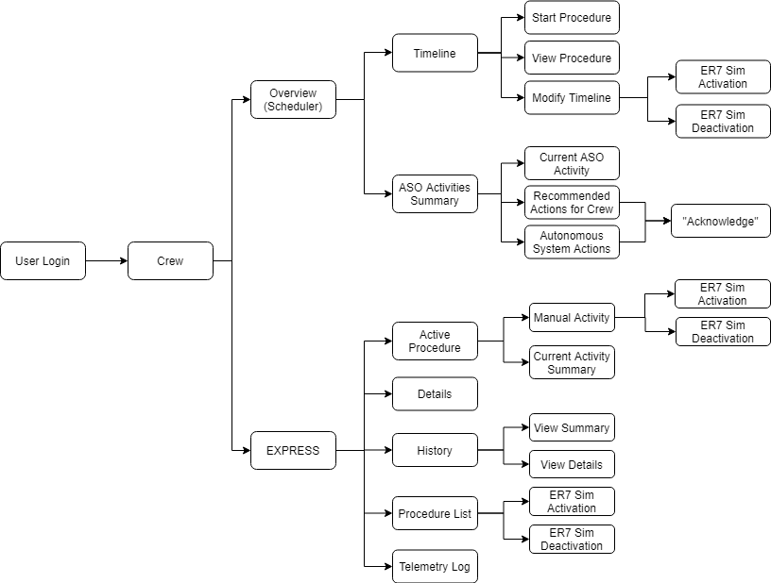
EXPRESS 2.5
Continued utilizing EXPRESS single command of autonomous procedures but added capabilities to allow crew self-scheduling.
Developed six scenarios for EXPRESS 2.5, including nominal and off-nominal, to assess different functions of the UI.

Slide 11
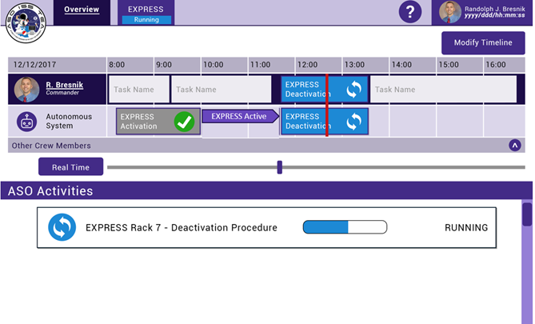
EXPRESS 2.5
Scheduling
Autonomous Activities
Overview page

Slide 12
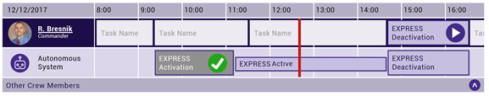
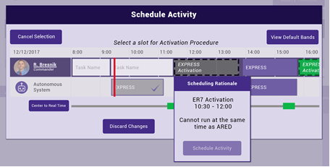
EXPRESS 2.5 Scheduling
Timeline with bands for crew members and autonomous system
Schedule activities with insight into scheduling constraints
Constraints through color-coding to determine “best fit”
green for activities with no conflicts
yellow for activities with a non-critical conflict
grey for activities with critical conflicts or unavailable time

Slide 13
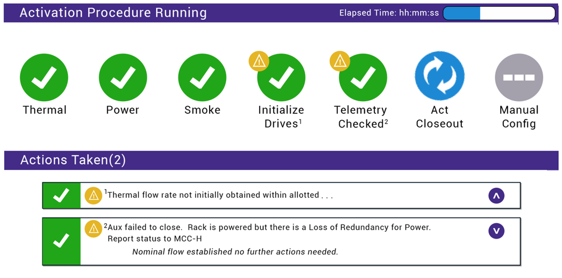
EXPRESS 2.5 Procedure
Status for overall procedure progress and high-level steps
Feedback regarding autonomous procedure recovery for crew situational awareness
Used more common terminology rather than unique technical terms related to EXPRESS

Slide 14
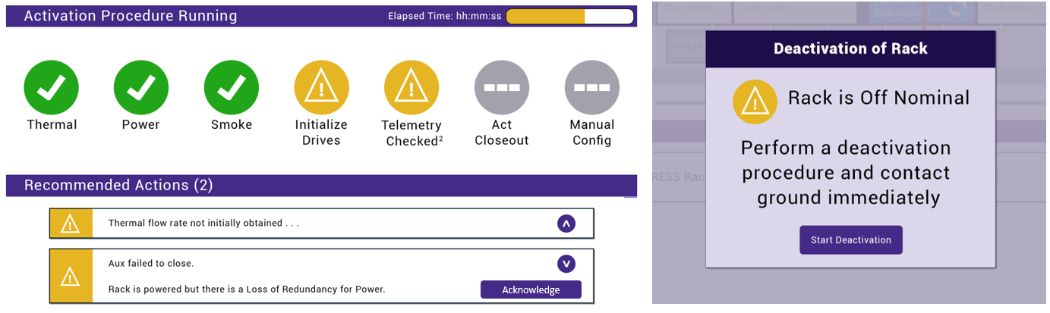
EXPRESS 2.5 Procedure
UI provides prompts with recommend actions for crew
If crew action is required, prompt appears guiding crew to complete the action

Slide 15
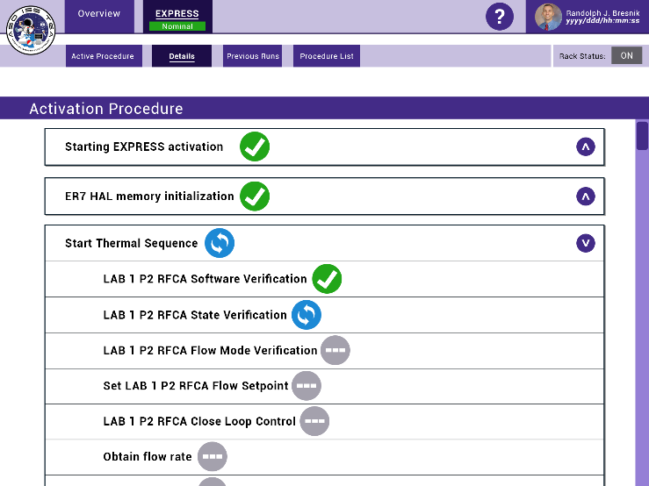
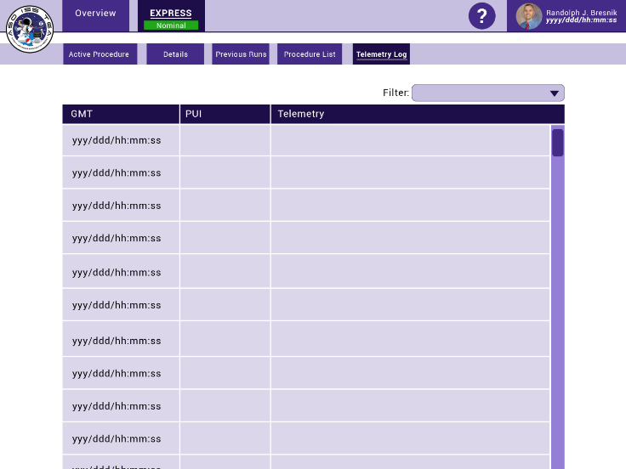
EXPRESS 2.5 Procedure
Details
Telemetry Log

Slide 16
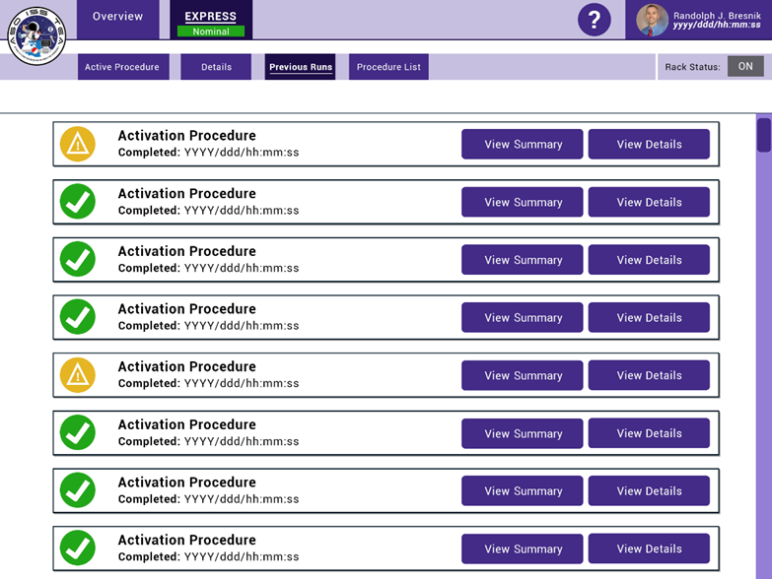
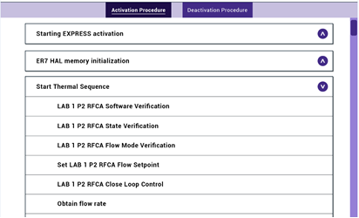
EXPRESS 2.5 Procedure
Procedure List
History

Slide 17
SME & Ground Crew Evaluations
Overall:
Dynamic feedback when in-work or active
Visible green checkmarks to validate success
Simple login with no passwords
Extensive “Help” section
Areas for Improvement:
Overall color scheme
Relocation of certain buttons/features to increase visual saliency and situational awareness

Slide 18
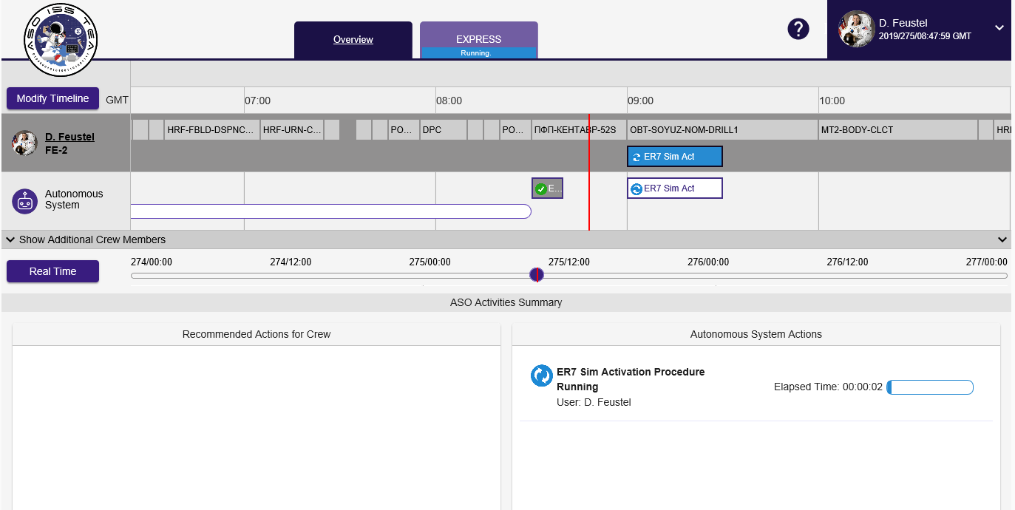
EXPRESS 2.5 Updates
Overall color scheme change
Relocation of “Modify Timeline” button
Added elapsed time to progress of activity

Slide 19

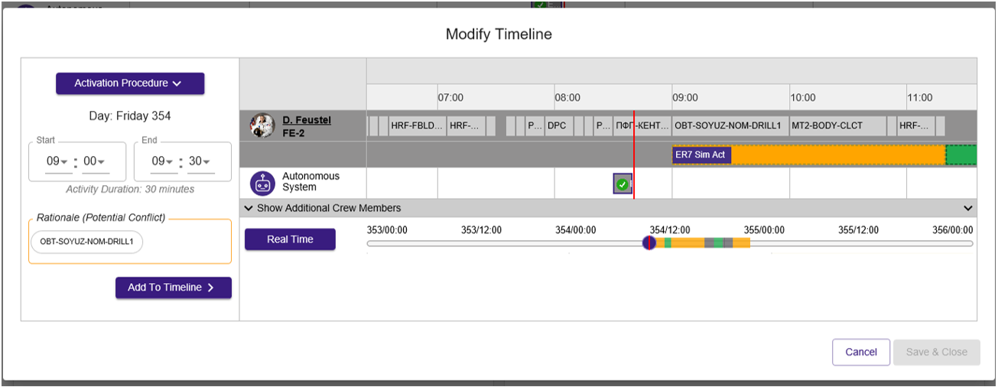
EXPRESS 2.5 Updates
Changed activity scheduling to allow for both dragging and tapping to move activity on timeline to accommodate use on both iPad and laptop
Added new scheduling panel on left side of pop-up

Slide 20
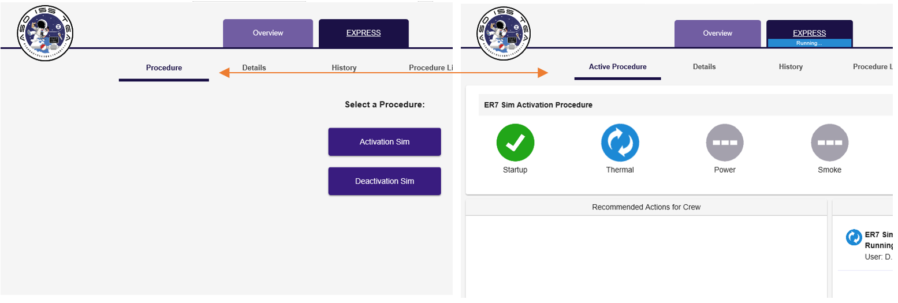
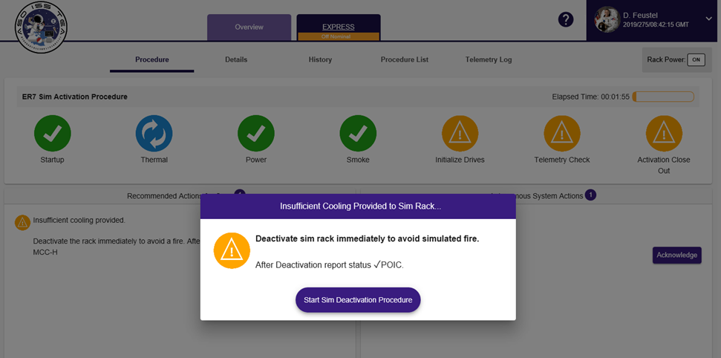
EXPRESS 2.5 Updates
Incorporated dynamic page titles
Feedback was provided to ensure task information remains visible until task is completed, particularly with any pop-ups

Slide 21
EXPRESS 2.5 Forward Work
On-orbit execution planned for late 2021
Expected crew feedback via on-orbit surveys and post-mission crew debriefs

Slide 22
UI Development Takeaways
Crew won’t be able to be closely familiar with details of every system on-board, need to use common terminology as much as possible
Too much detail will require interpretation that could become a task on it’s own potentially increasing crew workload
Status information should be concise and consistent across the interface
Utilize interface features similar to common commercially available tools where possible

Slide 23
Summary
New ways to manage the complex systems used for human spaceflight must be established for astronauts to successfully accomplish long-duration mission goals.
Systems must provide appropriate situational awareness so that the crew can make decisions regarding the system and their mission.
Incorporating human factors design principles and evaluation techniques into the design process keeps the human-centered focus that’s needed. As seen throughout all phases of the design, significant improvements were made to the preliminary concepts following the SME and ground crew evaluations.
The most critical steps in designing UIs for autonomy is the focus on the information that needs to be provided to the crew. Many of our findings revealed how information should be presented so that crewmembers could have full awareness of system actions. Reducing crew workload will be critical for these future missions. The design should enable the crew to quickly process the visual information and allow them to take action and make decisions.

