Slide 1
NASA/EOSDIS Persistent Identifiers
Status Update
Presented to CEOS WGISS 51
22 April 2021
Dawn R. Lowe ¹ ²
Nate James ¹
¹ ESDIS Project, NASA/Goddard Space Flight Center
² The Aerospace Corporation

Slide 2
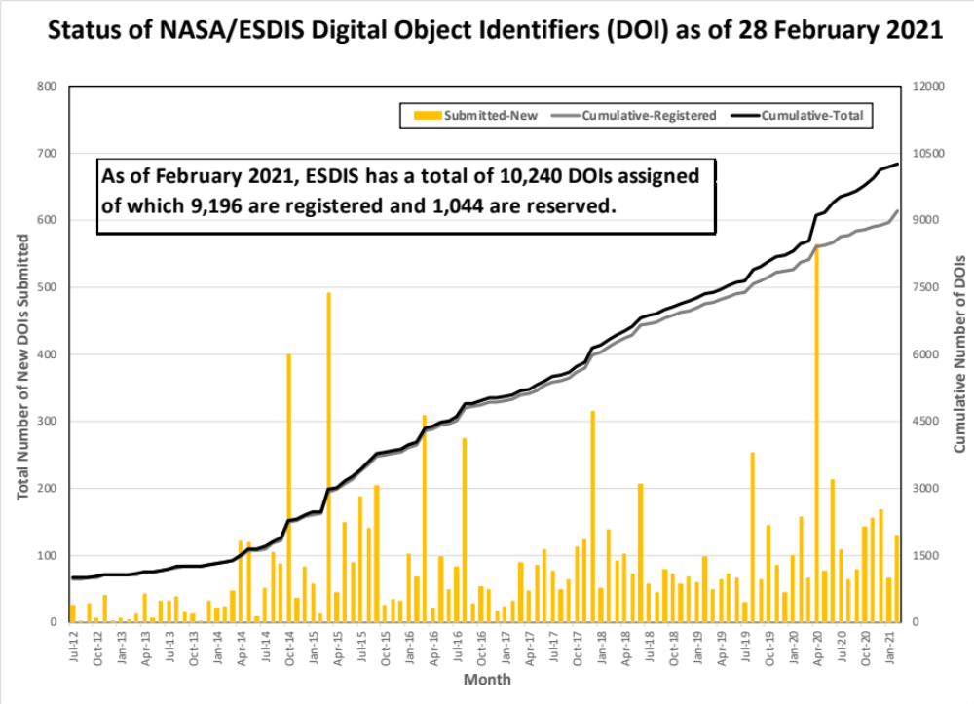

Slide 3
What’s Coming
Data Product Group DOIs – special DOIs that reference a group of data products often referenced together in publications. Each of these products would have their own DOI. Grouping is determined by the NASA archive center and the science community interested in these types of DOIs to address their unique publishing needs.

Slide 4
Back-up
For Reference:
Previous Report to
WGISS-49

Slide 5
NASA/EOSDIS Persistent Identifier
Implementation
Presented to CEOS WGISS 49
23 April 2020
Dawn R. Lowe
Nate James
ESDIS Project, NASA/Goddard Space Flight Center

Slide 6
Adherence to CEOS WGISS Best Practices
  Policies:
  DOIs are assigned to NASA Earth science products that have long term usability, are likely to be cited, and are archived/distributed by EOS data providers.
  DOIs are assigned at the Collection level
  Each data product version is assigned a new DOI
  DOIs are assigned to documents relating to EOSDIS data products that may be cited in scientific publications – e.g., Algorithm Theoretical Basis Documents (ATBDs)
  DOI requests are processed by the EOSDIS DAAC responsible for archiving and distributing the digital objects
  Wherever applicable, the DOI is embedded within the digital object metadata
  Digital objects from non-U.S. parties retain the DOI assigned by the non-U.S. partner
  ESDIS DOI Policy Document: https://wiki.earthdata.nasa.gov/display/DOIsforEOSDIS/DOI+Documents

Slide 7
Implementation
  The ESDIS Project is the official Registration Service Provider with DataCite (transitioned from EZID in Sept. 2018)
    Responsible for registering, updating and managing DOI information, including ensuring uniqueness of DOIs upon creation
    All DOIs assigned by ESDIS begin with prefix 10.5067
    ESDIS maintains a database of all project DOIs
  Process is largely automated
  DOIs are initially “reserved” to allow the DAAC to embed and test the DOIs in the product metadata before formal registration. Anything can be changed or deleted while reserved.

Slide 8
Implementation (continued)
Recommended Suffix Model:
    [mission]/[instrument]/data[m][n]
    [campaign]/[platform group]/data[m][n]
    [program]/[measurement group]/data[n]
    [measurement group]/data[n]
    [instrument]/[shortname.version]
      where [m] depicts the processing level of the product, and [n] depicts a version sequence number.
    or
    Opaque ID
    Examples:
    Aura HIRDLS level 2 data product:
    10.5067/Aura/HIRDLS/DATA201
    Operation IceBridge data product:
    10.5067/IGNSHKO4RRUC (opaque string)
Link to ESDIS DOI Registration Process:
https://wiki.earthdata.nasa.gov/display/DOIsforEOSDIS/ESDIS+DOI+Process

Slide 9
Implementation (continued)
Landing Pages
The DOI resolves to a Landing Page, which in turn provides a link to the actual data represented by the DOI.
EOSDIS Landing Pages are required to include:
  DOI
  Data Set Long Name
  Version Number
  Data Set Description
  Data Access (link to access files)
  Data Citation
Recommended:
  Associated Landing Pages (links to other versions of the data set)
If a data collection is transferred to a different data center, the URL can be updated, without effecting the validity of previous references.
Link to access EOSDIS Landing Page Recommendations:
https://wiki.earthdata.nasa.gov/display/ESDSWG/DOI+Landing+Pages

Slide 10
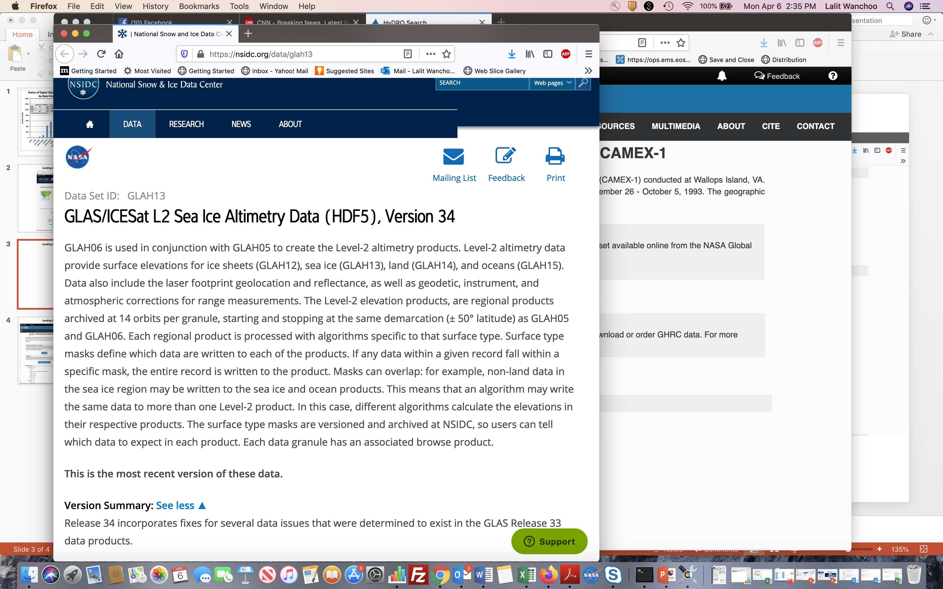
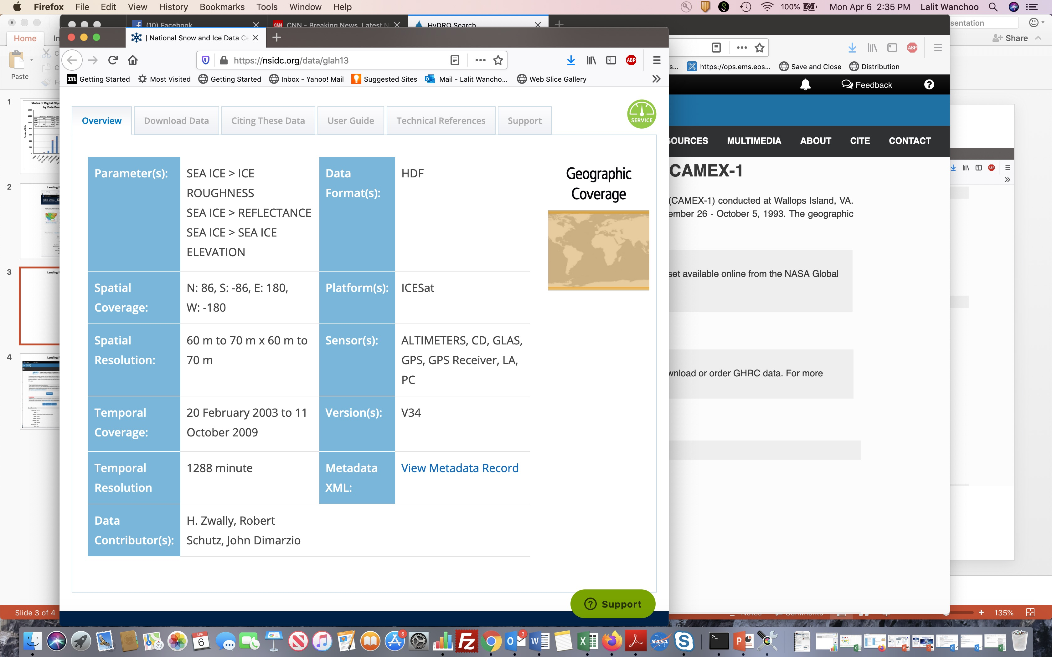
Landing Page for DOI 10.5067/ICESAT/GLAS/DATA206

